Slide 1
Computer Networks
Shyam Gollakota
Notes:
Chapter 1

Slide 2
Protocols and Layers
Protocols and layering is the main structuring method used to divide up network functionality
  Each instance of a protocol talks virtually to its peer using the protocol
  Each instance of a protocol uses only the services of the lower layer

Slide 3
Protocols and Layers (3)
Protocols are horizontal, layers are vertical
Instance of protocol X
Peer instance
Protocol X
X
X
Service provided by Protocol Y
Lower layer instance (of protocol Y)
Y
Y
Node 1
Node 2

Slide 4
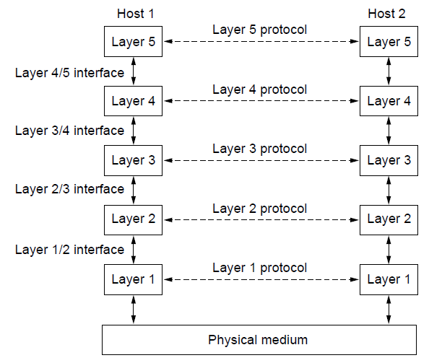
Protocols and Layers (4)
Set of protocols in use is called a protocol stack
Notes:
Circle protocol stack. Figure from CN5E figures 1-14

Slide 5
Protocols and Layers (6)
Protocols you’ve probably heard of:
  TCP, IP, 802.11, Ethernet, HTTP, SSL, DNS, … and many more
An example protocol stack
  Used by a web browser on a host that is wirelessly connected to the Internet
Browser
HTTP
TCP
IP
802.11

Slide 6
Encapsulation
Encapsulation is the mechanism used to effect protocol layering
  Lower layer wraps higher layer content, adding its own information to make a new message for delivery
  Like sending a letter in an envelope; postal service doesn’t look inside

Slide 7
Encapsulation (3)
Message “on the wire” begins to look like an onion
  Lower layers are outermost
HTTP
HTTP
TCP
HTTP
TCP
IP
TCP
HTTP
IP
802.11
IP
TCP
HTTP
802.11

Slide 8
Encapsulation (4)
HTTP
HTTP
HTTP
HTTP
TCP
HTTP
TCP
TCP
TCP
HTTP
IP
TCP
HTTP
IP
IP
IP
TCP
HTTP
IP
TCP
HTTP
802.11
802.11
802.11
IP
TCP
HTTP
802.11
(wire)
802.11
IP
TCP
HTTP

Slide 9
Advantage of Layering
Information hiding and reuse
Browser
Server
Browser
Server
HTTP
HTTP
HTTP
HTTP
or

Slide 10
Advantage of Layering (2)
Information hiding and reuse
Browser
Server
Browser
Server
HTTP
HTTP
HTTP
HTTP
TCP
TCP
TCP
TCP
or
IP
IP
IP
IP
802.11
802.11
Ethernet
Ethernet

Slide 11
Advantage of Layering (3)
Using information hiding to connect different systems
Browser
Server
HTTP
HTTP
TCP
TCP
IP
IP
802.11
Ethernet

Slide 12
Advantage of Layering (4)
Using information hiding to connect different systems
Browser
Server
HTTP
HTTP
IP
TCP
HTTP
TCP
TCP
IP
IP
IP
IP
802.11
802.11
Ethernet
Ethernet
802.11
IP
TCP
HTTP
Ethernet
IP
TCP
HTTP

Slide 13
Disadvantage of Layering
??

Slide 14
Internet Reference Model
A four layer model based on experience; omits some OSI layers and uses IP as the network layer.
4 Application – Programs that use network service
3 Transport – Provides end-to-end data delivery
2 Internet – Send packets over multiple networks
1 Link – Send frames over a link

Slide 15
Internet Reference Model (3)
IP is the “narrow waist” of the Internet
  Supports many different links below and apps above
4 Application
SMTP
HTTP
RTP
DNS
3 Transport
TCP
UDP
2 Internet
IP
Ethernet
3G
1 Link
Cable
DSL
802.11

Slide 16
Layer-based Names (2)
For devices in the network:
Repeater (or hub)
Physical
Physical
Switch (or bridge)
Link
Link
Router
Network
Network
Link
Link
Notes:
Underline new terms switch, router

Slide 17
Layer-based Names (3)
For devices in the network:
App
App
Proxy or middlebox or gateway
Transport
Transport
Network
Network
Link
Link
But they all look like this!
Notes:
Icons from Cisco icon library

Slide 18


Scope of the Physical Layer
Concerns how signals are used to transfer message bits over a link
  Wires etc. carry analog signals
  We want to send digital bits
10110…
…10110
Signal

Slide 19
Simple Link Model
We’ll end with an abstraction of a physical channel
  Rate (or bandwidth, capacity, speed) in bits/second
  Delay in seconds, related to length
Other important properties:
  Whether the channel is broadcast, and its error rate
Message
Delay D, Rate R

Slide 20
Message Latency
Latency is the delay to send a message over a link
  Transmission delay: time to put M-bit message “on the wire”
  Propagation delay: time for bits to propagate across the wire
  Combining the two terms we have:

Slide 21
Message Latency (2)
Latency is the delay to send a message over a link
  Transmission delay: time to put M-bit message “on the wire”
    T-delay = M (bits) / Rate (bits/sec) = M/R seconds
  Propagation delay: time for bits to propagate across the wire
    P-delay = Length / speed of signals = Length / ⅔c = D seconds
  Combining the two terms we have: L = M/R + D

Slide 22
Metric Units
The main prefixes we use:
Use powers of 10 for rates, 2 for storage
  1 Mbps = 1,000,000 bps, 1 KB = 2¹⁰ bytes
“B” is for bytes, “b” is for bits
Prefix | Exp. | prefix | exp.
K(ilo) | 10³ | m(illi) | 10⁻³
M(ega) | 10⁶ | μ(micro) | 10⁻⁶
G(iga) | 10⁹ | n(ano) | 10⁻⁹
Notes:
From CN5E Slides #1-42

Slide 23
Latency Examples (2)
“Dialup” with a telephone modem:
  D = 5 ms, R = 56 kbps, M = 1250 bytes
  L = 5 ms + (1250x8)/(56 x 10³) sec = 184 ms!
Broadband cross-country link:
  D = 50 ms, R = 10 Mbps, M = 1250 bytes
  L = 50 ms + (1250x8) / (10 x 10⁶) sec = 51 ms
A long link or a slow rate means high latency
  Often, one delay component dominates

Slide 24
Bandwidth-Delay Product
Messages take space on the wire!
The amount of data in flight is the bandwidth-delay (BD) product
  BD = R x D
  Measure in bits, or in messages
  Small for LANs, big for “long fat” pipes

Slide 25


Bandwidth-Delay Example (2)
Fiber at home, cross-country
  R=40 Mbps, D=50 ms
  BD = 40 x 10⁶ x 50 x 10⁻³ bits
  = 2000 Kbit
  = 250 KB
That’s quite a lot of data “in the network”!
110101000010111010101001011
Notes:
AU outline, book from openclipart.org

Slide 26
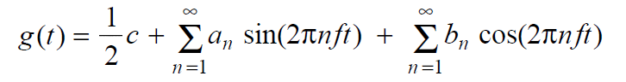
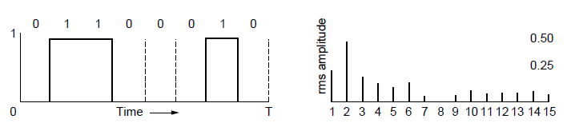
Frequency Representation
A signal over time can be represented by its frequency components (called Fourier analysis)
=
amplitude
Signal over time
weights of harmonic frequencies
Notes:
Figures from CN5e slides #2-4

Slide 27
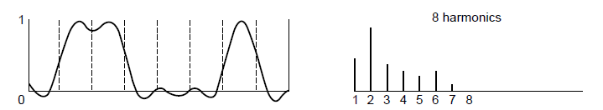
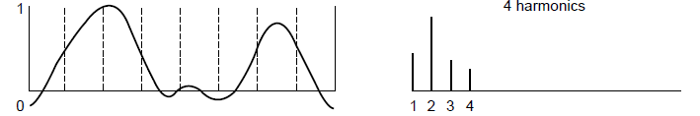
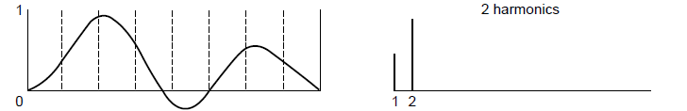
Effect of Less Bandwidth
Fewer frequencies (=less bandwidth) degrades signal
Lost!
Bandwidth
Lost!
Lost!
27
Notes:
Ask which signal we’d like to get out? (middle) Figures from CN5e slides #2-4

Slide 28
Signals over a Wire (2)
Example:
2: Attenuation:
Sent signal
3: Bandwidth:
4: Noise:

Slide 29
Signals over Wireless
Signals transmitted on a carrier frequency, like fiber
Travel at speed of light, spread out and attenuate faster than 1/dist²
Multiple signals on the same frequency interfere at a receiver

Slide 30
Signals over Wireless (5)
Various other effects too!
  Wireless propagation is complex, depends on environment
Some key effects are highly frequency dependent,
  E.g., multipath at microwave frequencies

Slide 31
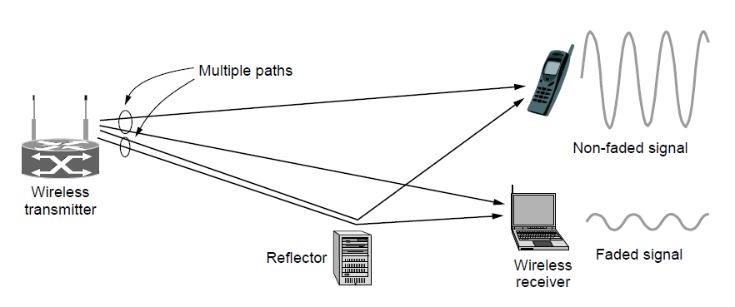
Wireless Multipath
Signals bounce off objects and take multiple paths
  Some frequencies attenuated at receiver, varies with location
  Messes up signal; handled with sophisticated methods (§2.5.3)
Notes:
CN5E slides #2-23. Show constructive / destructive interference

Slide 32

Wireless
Sender radiates signal over a region
  In many directions, unlike a wire, to potentially many receivers
  Nearby signals (same freq.) interfere at a receiver; need to coordinate use
Notes:
Radio icon from openclipart.org, laptop icon from Cisco icon library

Slide 33
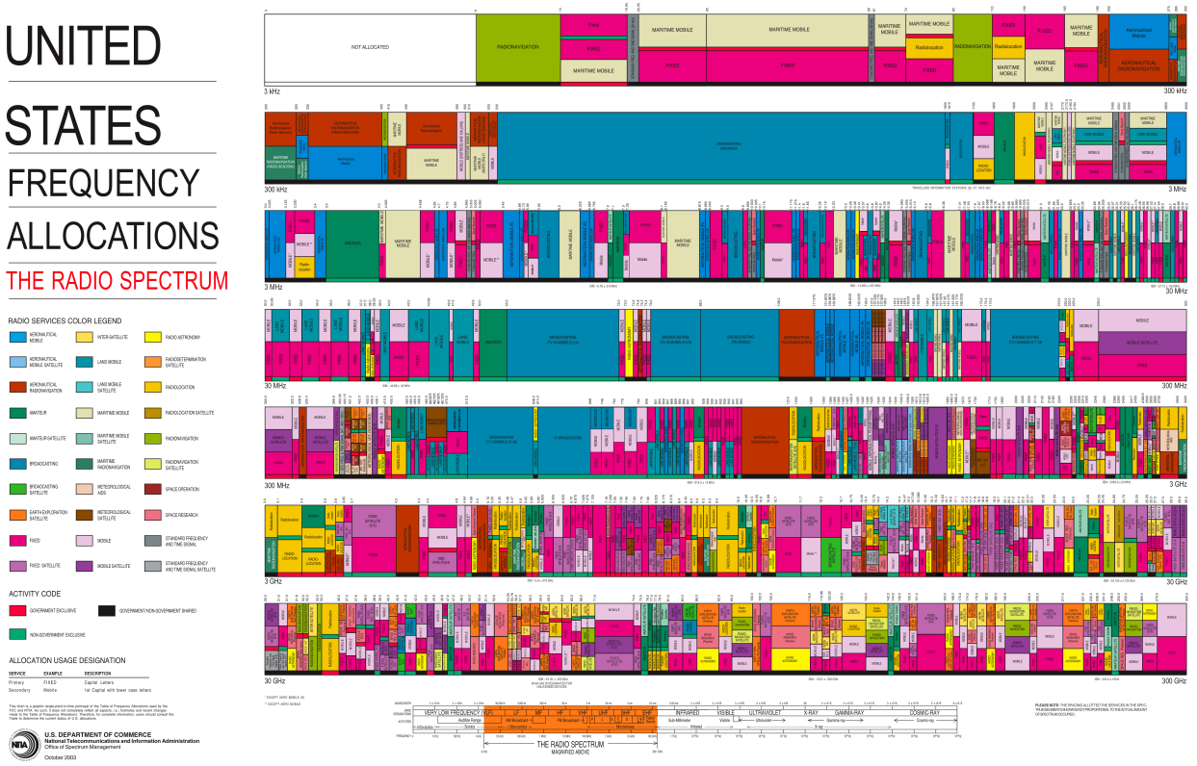
WiFi
WiFi
Notes:
Chart from http://www.ntia.doc.gov/page/2011/united-states-frequency-allocation-chart, public domain

Slide 34
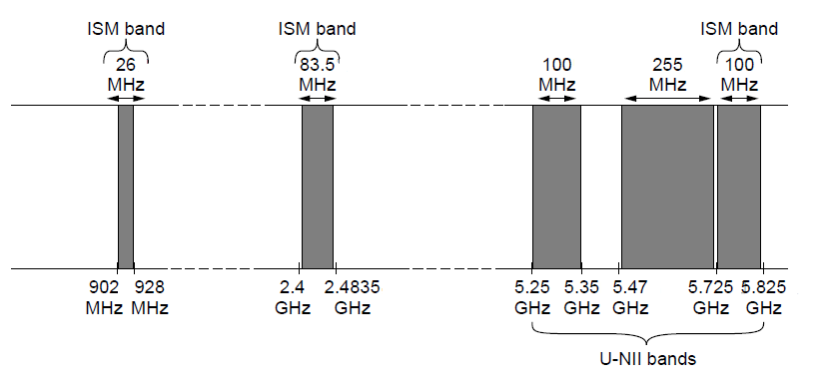
Wireless (2)
Microwave, e.g., 3G, and unlicensed (ISM) frequencies, e.g., WiFi, are widely used for computer networking
802.11
b/g/n
802.11a/g/n
Notes:
Figure from CN5E slide #2-20

Slide 35
Topic
We’ve talked about signals representing bits. How, exactly?
  This is the topic of modulation
Signal
10110…
…10110
Notes:
Laptop from Cisco Icon library

Slide 36
A Simple Modulation
Let a high voltage (+V) represent a 1, and low voltage (-V) represent a 0
  This is called NRZ (Non-Return to Zero)
Bits
0
0
1
0
1
1
1
1
0
1
0
0
0
0
1
0
+V
NRZ
-V

Slide 37
A Simple Modulation (2)
Let a high voltage (+V) represent a 1, and low voltage (-V) represent a 0
  This is called NRZ (Non-Return to Zero)
Bits
0
0
1
0
1
1
1
1
0
1
0
0
0
0
1
0
+V
NRZ
-V

Slide 38
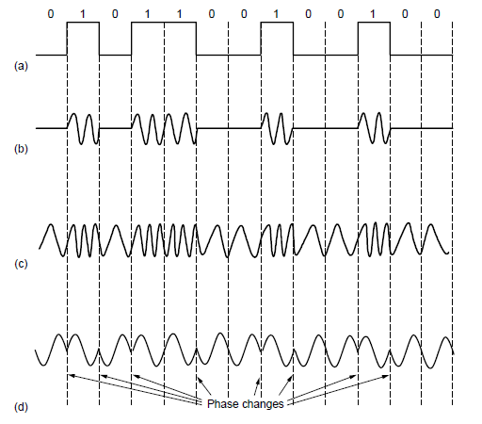
Modulation
NRZ signal of bits
Amplitude shift keying
Frequency shift keying
Phase shift keying
Notes:
Figure derived from CN5E figures #2-23. Write “baseband” under NRZ.

Slide 39
Topic
How rapidly can we send information over a link?
  Nyquist limit (~1924) »
  Shannon capacity (1948) »
Practical systems are devised to approach these limits

Slide 40
Key Channel Properties
The bandwidth (B), signal strength (S), and noise strength (N)
  B limits the rate of transitions
  S and N limit how many signal levels we can distinguish
Bandwidth B
Signal S,
Noise N

Slide 41
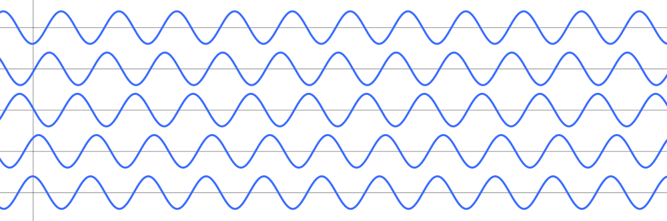
Nyquist Limit
The maximum symbol rate is 2B
Thus if there are V signal levels, ignoring noise, the maximum bit rate is:
1 0 1 0 1 0 1 0 1 0 1 0 1 0 1 0 1 0 1
R = 2B log₂V bits/sec

Slide 42
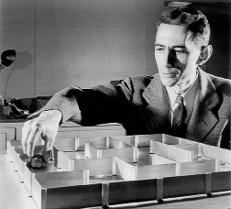
Claude Shannon (1916-2001)
Father of information theory
  “A Mathematical Theory of Communication”, 1948
Fundamental contributions to digital computers, security, and communications
Electromechanical mouse that “solves” mazes!
Credit: Courtesy MIT Museum
Notes:
Hi,
This photo is negative number CES 7 in our collection. We allow free use of our images at 72dpi and under 730px/side for educational purposes, as long as proper credit is given; if the image below is suitable for your needs, please use it with the credit line "Courtesy MIT Museum".
http://webmuseum.mit.edu/images/DIAmed/C/CES_7.jpg
Additional photos of Claude Shannon in our collection may be viewed here:
http://webmuseum.mit.edu/detail.php?t=people&type=all&f=&s=shannon&record=2
and more information on the maze being demonstrated in the photo is available here:
http://museum.mit.edu/150/20
Please let me know if there's anything else I can do to help!
Best regards,
Ariel Weinberg
Curatorial Associate, Science & Technology Collections
MIT Museum, Building N52
265 Massachusetts Avenue
Cambridge MA 02139-4307
tel: 617-253-3378 fax: 617-253-8994
http://web.mit.edu/museum
On Jan 10, 2013, at 12:21 PM, Mary Anne Hansen wrote:
> Hello Professor,
>
> The image in question does not belong to the News Office.
>
> By way of this email, I am forwarding your request to my colleague Ariel Weinberg,
> Curatorial Associate at the MIT Museum who may be able to assist you.
>
> Best regards,
> Mary Anne Hansen
> Senior Administrative Assistant
> MIT News Office, 11-400
> 617-253-8608
>
> From: David Wetherall <djw@cs.washington.edu>
> Date: Thursday, January 10, 2013 11:48 AM
> To: "newsoffice@MIT.EDU" <newsoffice@MIT.EDU>
> Subject: permissions request
>
> Hi,
>
> I am a professor teaching a massive free online course on Coursera (https://www.coursera.org/course/comnetworks). I came across your article on the Shannon limit:
>
> http://web.mit.edu/newsoffice/2010/explained-shannon-0115.html
>
> I'm asking for permission to reuse the photo in my videos and slides, which will be posted online.
>
> Please let me know how to proceed.
>
> Thank you,
>
> David

Slide 43
Shannon Capacity
How many levels we can distinguish depends on S/N
  Or SNR, the Signal-to-Noise Ratio
  Note noise is random, hence some errors
SNR given on a log-scale in deciBels:
  SNR_{dB} = 10log₁₀(S/N)
S+N
0
N
1
2
3
Notes:
Go over examples

Slide 44
Shannon Capacity (2)
Shannon limit is for capacity (C), the maximum information carrying rate of the channel:
C = B log₂(1 + S/(BN)) bits/sec

Slide 45
Wired/Wireless Perspective
Wires, and Fiber
  Engineer link to have requisite SNR and B
  Can fix data rate
Wireless
  Given B, but SNR varies greatly, e.g., up to 60 dB!
  Can’t design for worst case, must adapt data rate

Slide 46
Wired/Wireless Perspective (2)
Wires, and Fiber
  Engineer link to have requisite SNR and B
  Can fix data rate
Wireless
  Given B, but SNR varies greatly, e.g., up to 60 dB!
  Can’t design for worst case, must adapt data rate
Engineer SNR for data rate
Adapt data rate to SNR

Slide 47

Putting it all together – DSL
DSL (Digital Subscriber Line) is widely used for broadband; many variants offer 10s of Mbps
  Reuses twisted pair telephone line to the home; it has up to ~2 MHz of bandwidth but uses only the lowest ~4 kHz
Notes:
Draw lines to home, say rate depends on dist/quality
Home from openclipart.org, building from cisco icon library.

Slide 48
DSL (2)
DSL uses passband modulation (called OFDM)
  Separate bands for upstream and downstream (larger)
  Modulation varies both amplitude and phase (called QAM)
  High SNR, up to 15 bits/symbol, low SNR only 1 bit/symbol
Voice
Up to 1 Mbps
Up to 12 Mbps
ADSL2:
0-4
kHz
Freq.
26 – 138
kHz
143 kHz to 1.1 MHz
Telephone
Upstream
Downstream

