Slide 1
Computer Networks
Shyam Gollakota

Slide 2
Administrative
TA: Rajalakshmi Nandakumar
(rajaln@cs.washington.edu)
Course website:
cs.washington.edu/561

Slide 3
Course Details
Course material
  Mainly research papers with some background
Prerequisites
  Basic math: probability, Fourier, Shortest path alg.

Slide 4
Course Details (2)
Grading
  Research Project 50%
    Proposal, status report, presentation, final report
    OK to combine with other classes, e.g., NLP, Vision
  1-2 Class Projects 20-30%
  One final 20-30%

Slide 5
Class Topics
Wireless Networks
  New perspectives that transcend traditional network stack
  Combines signal processing with protocol design
Mobile Systems
  Localization, gesture recognition, RFID, acoustic networking
Wired Networks
  New topics like Data Centers
  Traditional Topics: Routing, Resource management

Slide 6
Protocols and Layers
Protocols and layering is the main structuring method used to divide up network functionality
  Each instance of a protocol talks virtually to its peer using the protocol
  Each instance of a protocol uses only the services of the lower layer

Slide 7
Protocols and Layers (3)
Protocols are horizontal, layers are vertical
Instance of protocol X
Peer instance
Protocol X
X
X
Service provided by Protocol Y
Lower layer instance (of protocol Y)
Y
Y
Node 1
Node 2

Slide 8
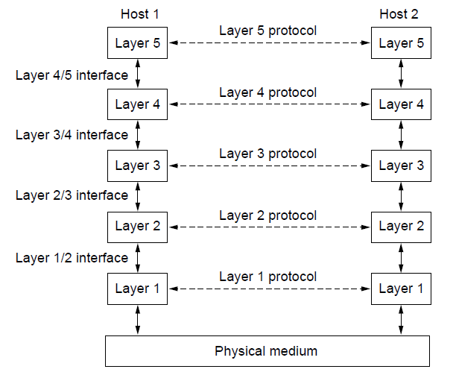
Protocols and Layers (4)
Set of protocols in use is called a protocol stack
Notes:
Circle protocol stack. Figure from CN5E figures 1-14

Slide 9
Protocols and Layers (6)
Protocols you’ve probably heard of:
  TCP, IP, 802.11, Ethernet, HTTP, SSL, DNS, … and many more
An example protocol stack
  Used by a web browser on a host that is wirelessly connected to the Internet
Browser
HTTP
TCP
IP
802.11

Slide 10
Encapsulation
Encapsulation is the mechanism used to effect protocol layering
  Lower layer wraps higher layer content, adding its own information to make a new message for delivery
  Like sending a letter in an envelope; postal service doesn’t look inside

Slide 11
Encapsulation (3)
Message “on the wire” begins to look like an onion
  Lower layers are outermost
HTTP
HTTP
TCP
HTTP
TCP
IP
TCP
HTTP
IP
802.11
IP
TCP
HTTP
802.11

Slide 12
Encapsulation (4)
HTTP
HTTP
HTTP
HTTP
TCP
HTTP
TCP
TCP
TCP
HTTP
IP
TCP
HTTP
IP
IP
IP
TCP
HTTP
IP
TCP
HTTP
802.11
802.11
802.11
IP
TCP
HTTP
802.11
(wire)
802.11
IP
TCP
HTTP

Slide 13
Advantage of Layering
Information hiding and reuse
Browser
Server
Browser
Server
HTTP
HTTP
HTTP
HTTP
or

Slide 14
Advantage of Layering (2)
Information hiding and reuse
Browser
Server
Browser
Server
HTTP
HTTP
HTTP
HTTP
TCP
TCP
TCP
TCP
or
IP
IP
IP
IP
802.11
802.11
Ethernet
Ethernet

Slide 15
Advantage of Layering (3)
Using information hiding to connect different systems
Browser
Server
HTTP
HTTP
TCP
TCP
IP
IP
802.11
Ethernet

Slide 16
Advantage of Layering (4)
Using information hiding to connect different systems
Browser
Server
HTTP
HTTP
IP
TCP
HTTP
TCP
TCP
IP
IP
IP
IP
802.11
802.11
Ethernet
Ethernet
802.11
IP
TCP
HTTP
Ethernet
IP
TCP
HTTP

Slide 17
Disadvantage of Layering
??

Slide 18
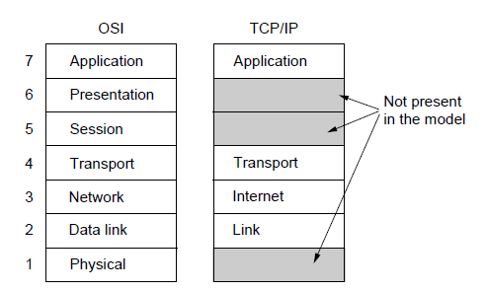
OSI “7 layer” Reference Model
A principled, international standard, to connect systems
  Influential, but not used in practice. (Woops)
– Provides functions needed by users
– Converts different representations
– Manages task dialogs
– Provides end-to-end delivery
– Sends packets over multiple links
– Sends frames of information
– Sends bits as signals
Notes:
CN5E Slides 1-23

Slide 19
Internet Reference Model
A four layer model based on experience; omits some OSI layers and uses IP as the network layer.
4 Application – Programs that use network service
3 Transport – Provides end-to-end data delivery
2 Internet – Send packets over multiple networks
1 Link – Send frames over a link

Slide 20
Internet Reference Model (2)
With examples of common protocols in each layer
4 Application
3 Transport
2 Internet
1 Link

Slide 21
Internet Reference Model (3)
IP is the “narrow waist” of the Internet
  Supports many different links below and apps above
4 Application
SMTP
HTTP
RTP
DNS
3 Transport
TCP
UDP
2 Internet
IP
Ethernet
3G
1 Link
Cable
DSL
802.11

Slide 22
Layer-based Names (2)
For devices in the network:
Repeater (or hub)
Physical
Physical
Switch (or bridge)
Link
Link
Router
Network
Network
Link
Link
Notes:
Underline new terms switch, router

Slide 23
Layer-based Names (3)
For devices in the network:
App
App
Proxy or middlebox or gateway
Transport
Transport
Network
Network
Link
Link
But they all look like this!
Notes:
Icons from Cisco icon library

Slide 24
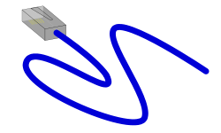

Scope of the Physical Layer
Concerns how signals are used to transfer message bits over a link
  Wires etc. carry analog signals
  We want to send digital bits
10110…
…10110
Signal

Slide 25
Simple Link Model
We’ll end with an abstraction of a physical channel
  Rate (or bandwidth, capacity, speed) in bits/second
  Delay in seconds, related to length
Other important properties:
  Whether the channel is broadcast, and its error rate
Message
Delay D, Rate R

Slide 26
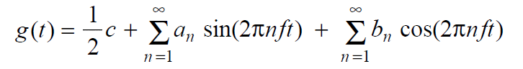
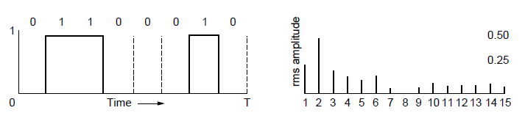
Frequency Representation
A signal over time can be represented by its frequency components (called Fourier analysis)
=
amplitude
Signal over time
weights of harmonic frequencies
Notes:
Figures from CN5e slides #2-4

Slide 27
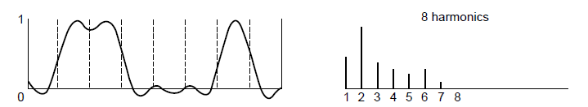
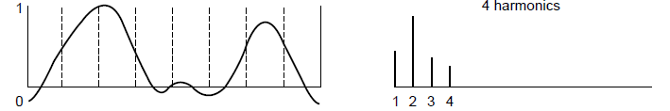
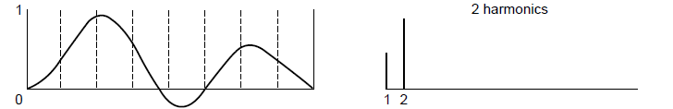
Effect of Less Bandwidth
Fewer frequencies (=less bandwidth) degrades signal
Lost!
Bandwidth
Lost!
Lost!
27
Notes:
Ask which signal we’d like to get out? (middle) Figures from CN5e slides #2-4

Slide 28
Signals over a Wire
What happens to a signal as it passes over a wire?
  The signal is delayed (propagates at ⅔c)
  The signal is attenuated (goes for m to km)
  Frequencies above a cutoff are highly attenuated
  Noise is added to the signal (later, causes errors)
EE: Bandwidth = width of frequency band, measured in Hz
CS: Bandwidth = information carrying capacity, in bits/sec
Notes:
Write c = speed of light

Slide 29
Signals over a Wire (2)
Example:
2: Attenuation:
Sent signal
3: Bandwidth:
4: Noise:

Slide 30
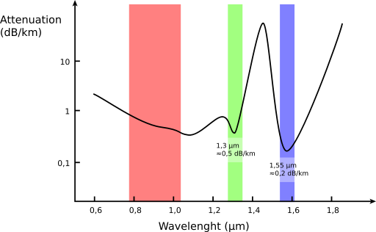
Signals over Fiber
Light propagates with very low loss in three very wide frequency bands
  Use a carrier to send information
Attenuation
(dB/km
By SVG: Sassospicco Raster: Alexwind, CC-BY-SA-3.0, via Wikimedia Commons
Wavelength (μm)

Slide 31
Signals over Wireless
Signals transmitted on a carrier frequency, like fiber
Travel at speed of light, spread out and attenuate faster than 1/dist²
Multiple signals on the same frequency interfere at a receiver

Slide 32
Signals over Wireless (5)
Various other effects too!
  Wireless propagation is complex, depends on environment
Some key effects are highly frequency dependent,
  E.g., multipath at microwave frequencies

Slide 33
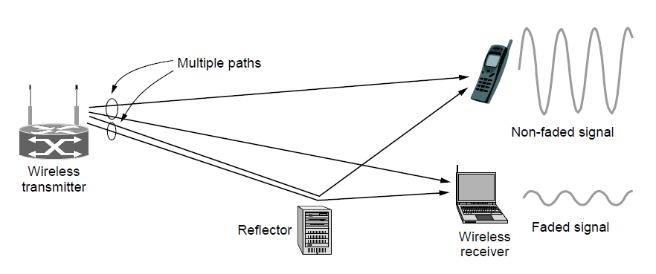
Wireless Multipath
Signals bounce off objects and take multiple paths
  Some frequencies attenuated at receiver, varies with location
  Messes up signal; handled with sophisticated methods (§2.5.3)
Notes:
CN5E slides #2-23. Show constructive / destructive interference

Slide 34

Wireless
Sender radiates signal over a region
  In many directions, unlike a wire, to potentially many receivers
  Nearby signals (same freq.) interfere at a receiver; need to coordinate use
Notes:
Radio icon from openclipart.org, laptop icon from Cisco icon library

Slide 35
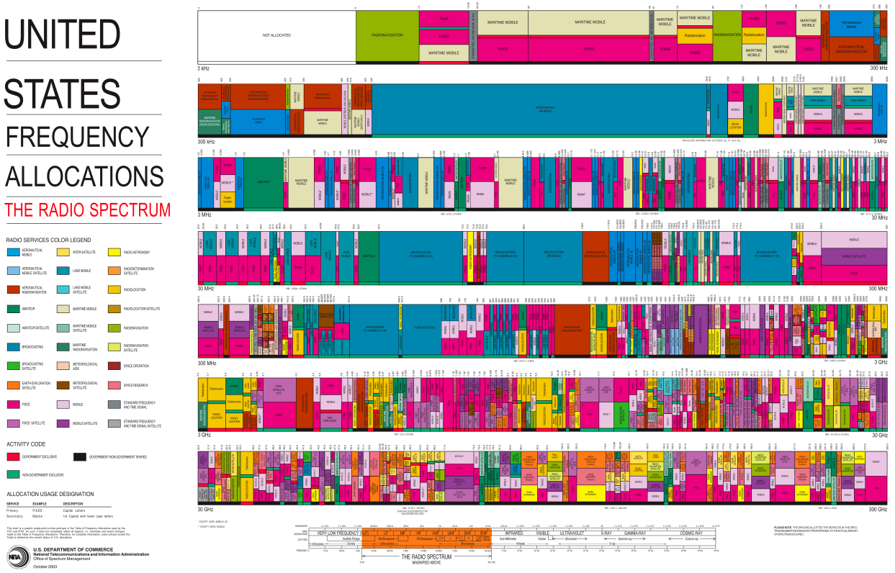
WiFi
WiFi
Notes:
Chart from http://www.ntia.doc.gov/page/2011/united-states-frequency-allocation-chart, public domain

Slide 36
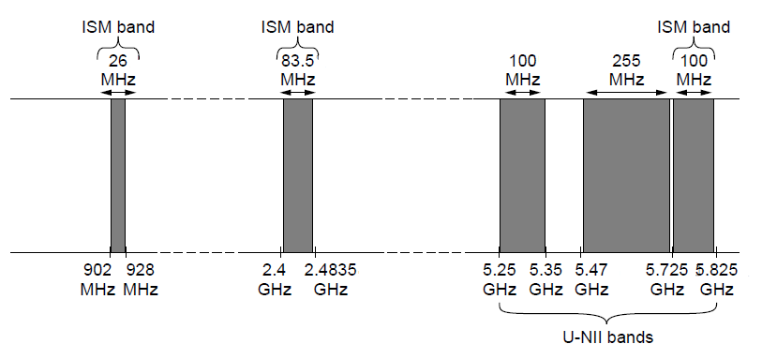
Wireless (2)
Microwave, e.g., 3G, and unlicensed (ISM) frequencies, e.g., WiFi, are widely used for computer networking
802.11
b/g/n
802.11a/g/n
Notes:
Figure from CN5E slide #2-20

Slide 37
Topic
We’ve talked about signals representing bits. How, exactly?
  This is the topic of modulation
Signal
10110…
…10110
Notes:
Laptop from Cisco Icon library

Slide 38
A Simple Modulation
Let a high voltage (+V) represent a 1, and low voltage (-V) represent a 0
  This is called NRZ (Non-Return to Zero)
Bits
0
0
1
0
1
1
1
1
0
1
0
0
0
0
1
0
+V
NRZ
-V

Slide 39
A Simple Modulation (2)
Let a high voltage (+V) represent a 1, and low voltage (-V) represent a 0
  This is called NRZ (Non-Return to Zero)
Bits
0
0
1
0
1
1
1
1
0
1
0
0
0
0
1
0
+V
NRZ
-V

Slide 40
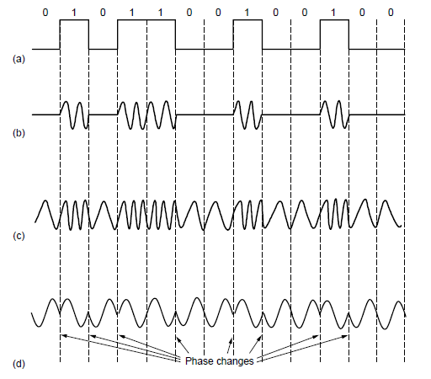
Modulation
NRZ signal of bits
Amplitude shift keying
Frequency shift keying
Phase shift keying
Notes:
Figure derived from CN5E figures #2-23. Write “baseband” under NRZ.

Slide 41
Topic
How rapidly can we send information over a link?
  Nyquist limit (~1924) »
  Shannon capacity (1948) »
Practical systems are devised to approach these limits

Slide 42
Key Channel Properties
The bandwidth (B), signal strength (S), and noise strength (N)
  B limits the rate of transitions
  S and N limit how many signal levels we can distinguish
Bandwidth B
Signal S,
Noise N

Slide 43
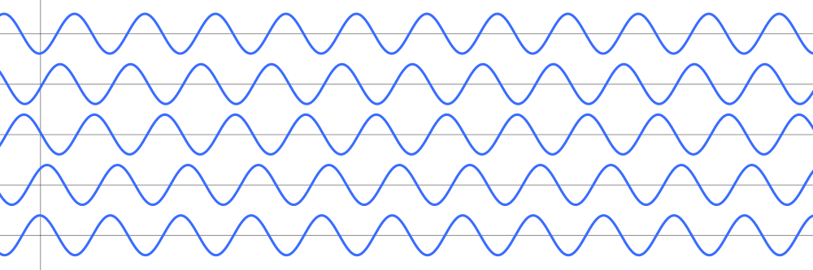
Nyquist Limit
The maximum symbol rate is 2B
Thus if there are V signal levels, ignoring noise, the maximum bit rate is:
1 0 1 0 1 0 1 0 1 0 1 0 1 0 1 0 1 0 1
R = 2B log₂V bits/sec

Slide 44
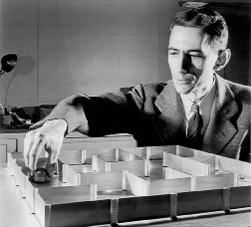
Claude Shannon (1916-2001)
Father of information theory
  “A Mathematical Theory of Communication”, 1948
Fundamental contributions to digital computers, security, and communications
Electromechanical mouse that “solves” mazes!
Credit: Courtesy MIT Museum
Notes:
Hi,
This photo is negative number CES 7 in our collection. We allow free use of our images at 72dpi and under 730px/side for educational purposes, as long as proper credit is given; if the image below is suitable for your needs, please use it with the credit line "Courtesy MIT Museum".
http://webmuseum.mit.edu/images/DIAmed/C/CES_7.jpg
Additional photos of Claude Shannon in our collection may be viewed here:
http://webmuseum.mit.edu/detail.php?t=people&type=all&f=&s=shannon&record=2
and more information on the maze being demonstrated in the photo is available here:
http://museum.mit.edu/150/20
Please let me know if there's anything else I can do to help!
Best regards,
Ariel Weinberg
Curatorial Associate, Science & Technology Collections
MIT Museum, Building N52
265 Massachusetts Avenue
Cambridge MA 02139-4307
tel: 617-253-3378 fax: 617-253-8994
http://web.mit.edu/museum
On Jan 10, 2013, at 12:21 PM, Mary Anne Hansen wrote:
> Hello Professor,
>
> The image in question does not belong to the News Office.
>
> By way of this email, I am forwarding your request to my colleague Ariel Weinberg,
> Curatorial Associate at the MIT Museum who may be able to assist you.
>
> Best regards,
> Mary Anne Hansen
> Senior Administrative Assistant
> MIT News Office, 11-400
> 617-253-8608
>
> From: David Wetherall <djw@cs.washington.edu>
> Date: Thursday, January 10, 2013 11:48 AM
> To: "newsoffice@MIT.EDU" <newsoffice@MIT.EDU>
> Subject: permissions request
>
> Hi,
>
> I am a professor teaching a massive free online course on Coursera (https://www.coursera.org/course/comnetworks). I came across your article on the Shannon limit:
>
> http://web.mit.edu/newsoffice/2010/explained-shannon-0115.html
>
> I'm asking for permission to reuse the photo in my videos and slides, which will be posted online.
>
> Please let me know how to proceed.
>
> Thank you,
>
> David

Slide 45
Shannon Capacity
How many levels we can distinguish depends on S/N
  Or SNR, the Signal-to-Noise Ratio
  Note noise is random, hence some errors
SNR given on a log-scale in deciBels:
  SNR_{dB} = 10log₁₀(S/N)
S+N
0
N
1
2
3
Notes:
Go over examples

Slide 46
Shannon Capacity (2)
Shannon limit is for capacity (C), the maximum information carrying rate of the channel:
C = B log₂(1 + S/N) bits/sec

Slide 47
Wired/Wireless Perspective
Wires, and Fiber
  Engineer link to have requisite SNR and B
  Can fix data rate
Wireless
  Given B, but SNR varies greatly, e.g., up to 60 dB!
  Can’t design for worst case, must adapt data rate

Slide 48
Wired/Wireless Perspective (2)
Wires, and Fiber
  Engineer link to have requisite SNR and B
  Can fix data rate
Wireless
  Given B, but SNR varies greatly, e.g., up to 60 dB!
  Can’t design for worst case, must adapt data rate
Engineer SNR for data rate
Adapt data rate to SNR

Slide 49

Putting it all together – DSL
DSL (Digital Subscriber Line, see §2.6.3) is widely used for broadband; many variants offer 10s of Mbps
  Reuses twisted pair telephone line to the home; it has up to ~2 MHz of bandwidth but uses only the lowest ~4 kHz
Notes:
Draw lines to home, say rate depends on dist/quality
Home from openclipart.org, building from cisco icon library.

Slide 50
DSL (2)
DSL uses passband modulation (called OFDM §2.5.1)
  Separate bands for upstream and downstream (larger)
  Modulation varies both amplitude and phase (called QAM)
  High SNR, up to 15 bits/symbol, low SNR only 1 bit/symbol
Voice
Up to 1 Mbps
Up to 12 Mbps
ADSL2:
0-4
kHz
Freq.
26 – 138
kHz
143 kHz to 1.1 MHz
Telephone
Upstream
Downstream

