Slide 1
Resilient Networks
CSE561

Slide 2
The Internet Has Issues
Avoidable outages and poor performance due to:
Pathological routing policies
Route convergence delays
Misconfigured ISPs
Prefix hijacking
Malicious route injection
Router software and firmware bugs
Distributed denial of service
NaaS @HotInterconnects 2013
Notes:
Had problems for decades
Goal - build a reliable robust network - commercial, medical
Research community - solved most of these, little adoption
requires all ISPs to adopt them to have any effect

Slide 3
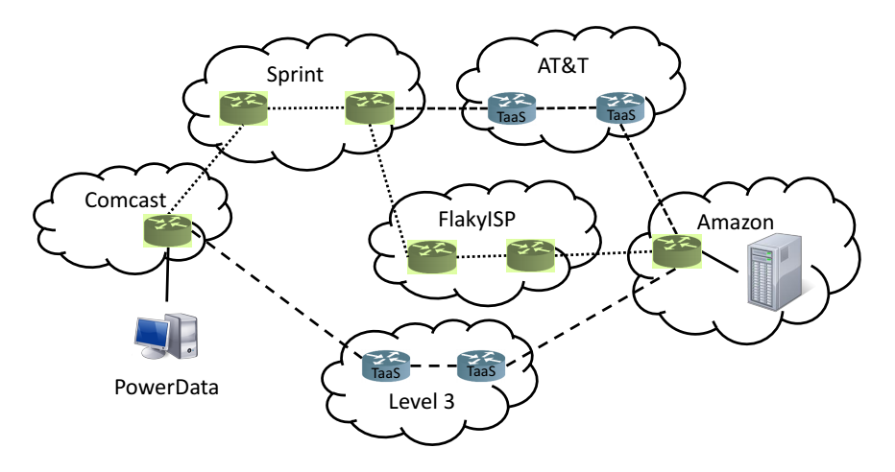
NaaS @HotInterconnects 2013
Notes:
When I send data from point A-B, traverses a number of AS’s - traceroute
No control over the route you take
ISP (Comcast) has no way of guaranteeing any level of end-to-end service

Slide 4
So Now What?
Measure failures on the Internet
Feamster et al. (2003), Hubble (2008), iSpy (2008)
Try to route around failures
Detour (1998), RON (2001), Tor (2006), uProxy
Try to repair failures on the Internet
Miro (2006), LIFEGUARD (2012)

Slide 5
How Do We Route Around Failures?
NaaS @HotInterconnects 2013
Notes:
Source routing of reliable hops
NaaS - allows incremental deployment
Multipath routing
Miro, multi-homing
Detour routing
Detour, RON

Slide 6
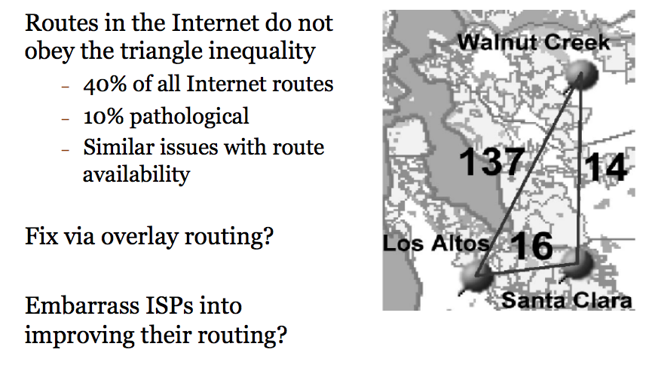
A Case for Detour Routing (1998)
NaaS @HotInterconnects 2013

Slide 7
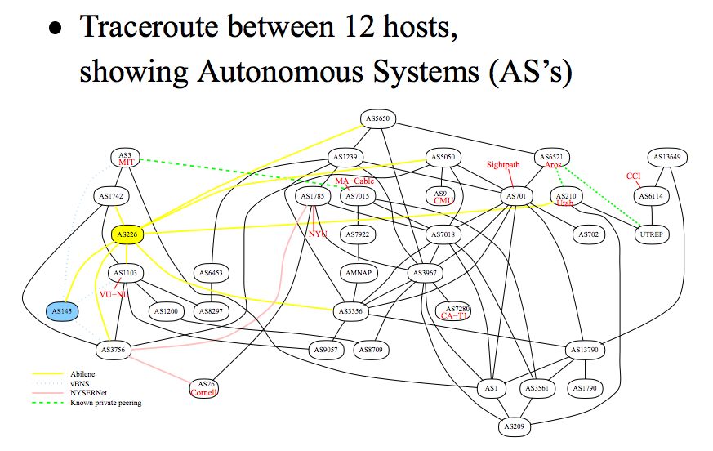
Resilient Overlay Networks (2001)
RON @SOSP 2001

Slide 8
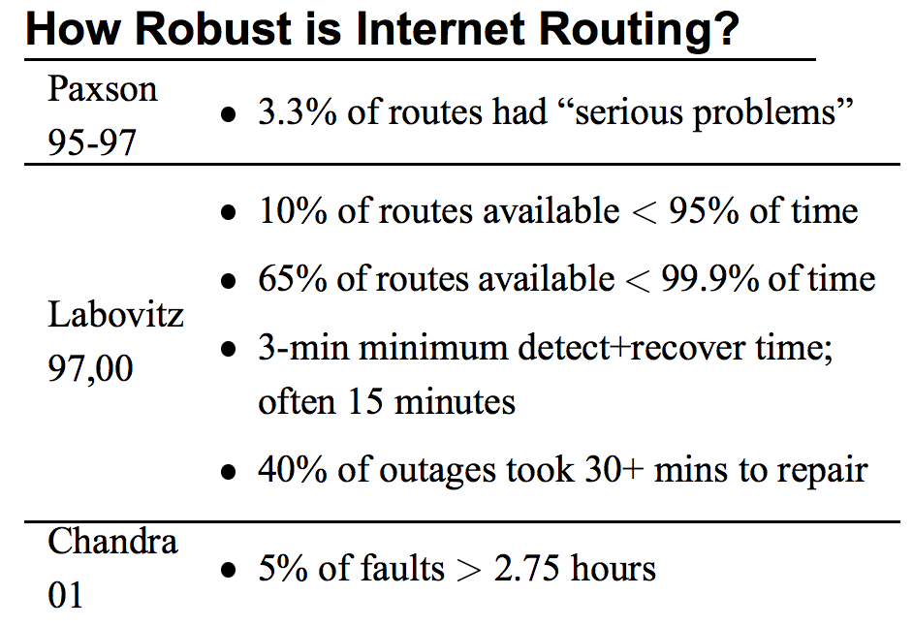

Slide 9
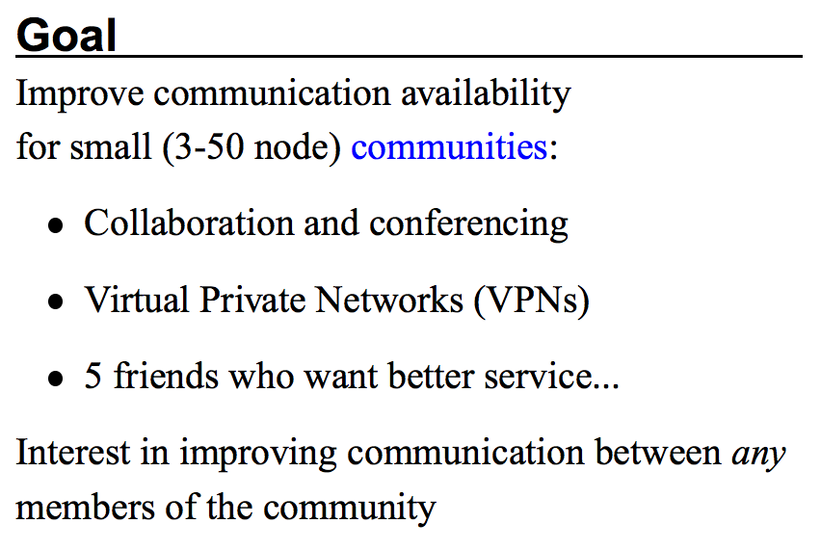

Slide 11
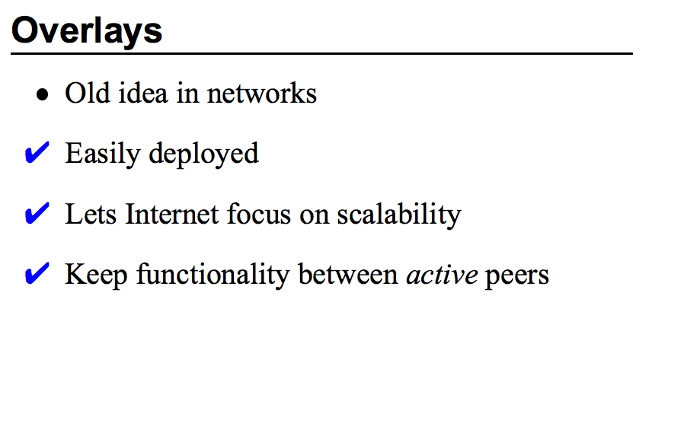

Slide 13
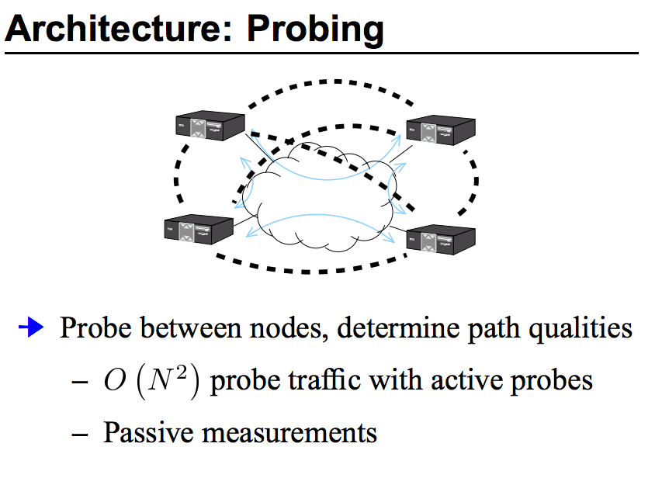

Slide 18
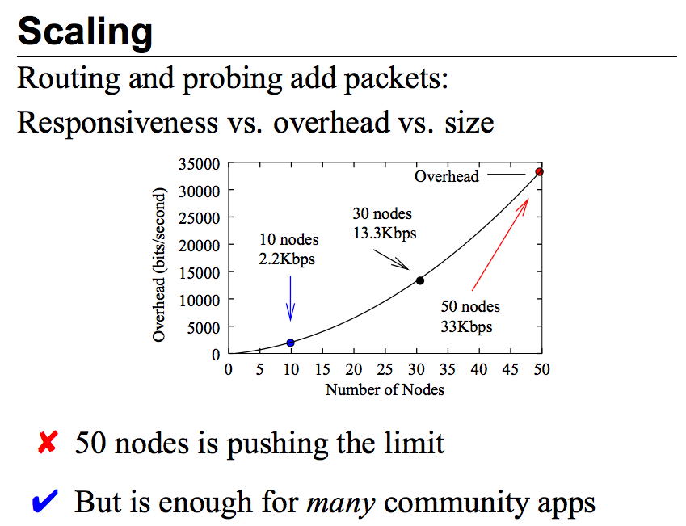

Slide 20
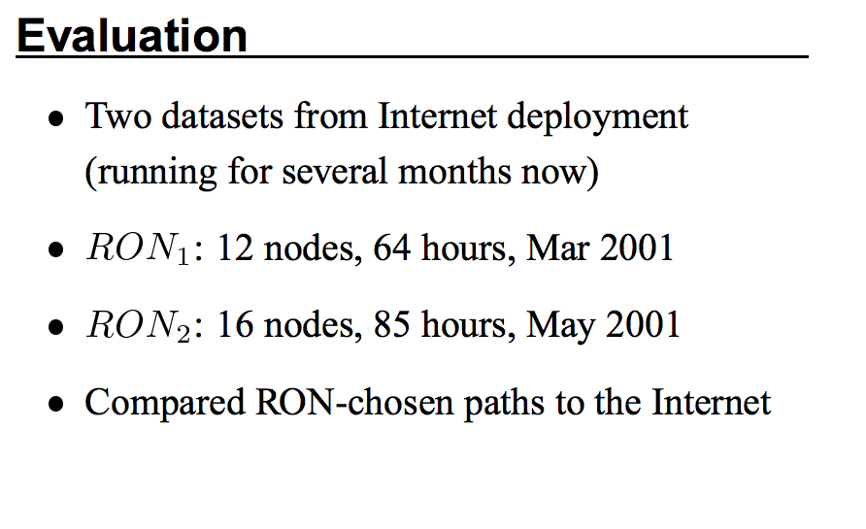

Slide 21
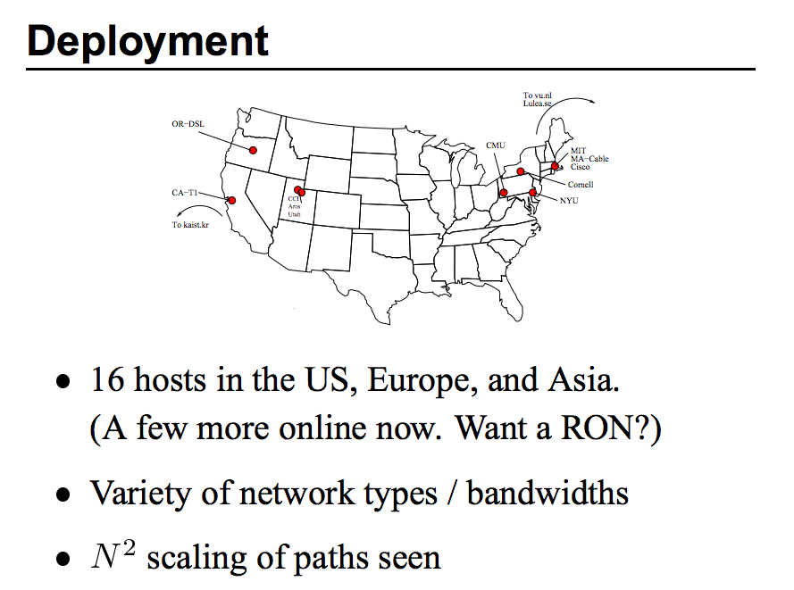

Slide 22
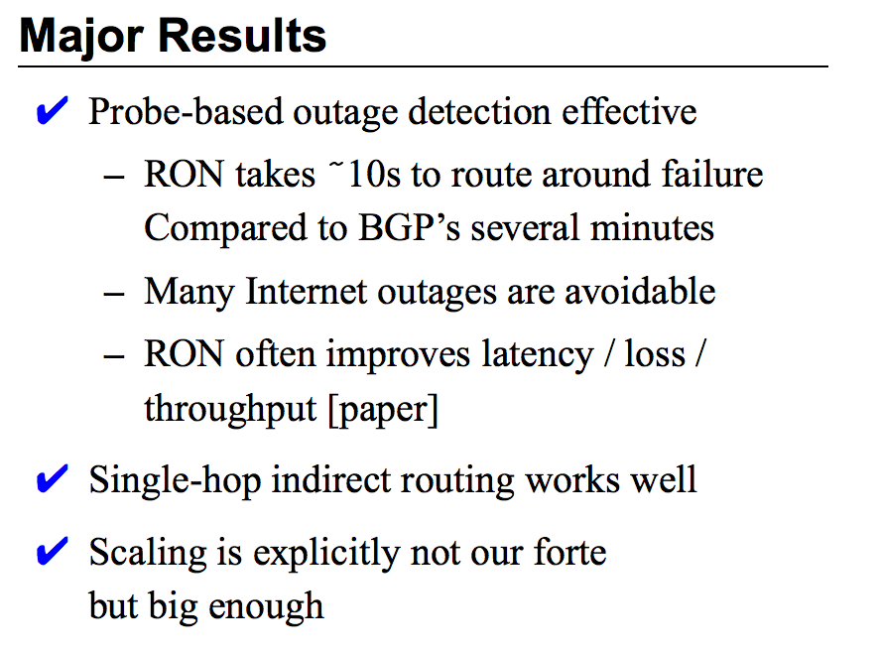

Slide 23
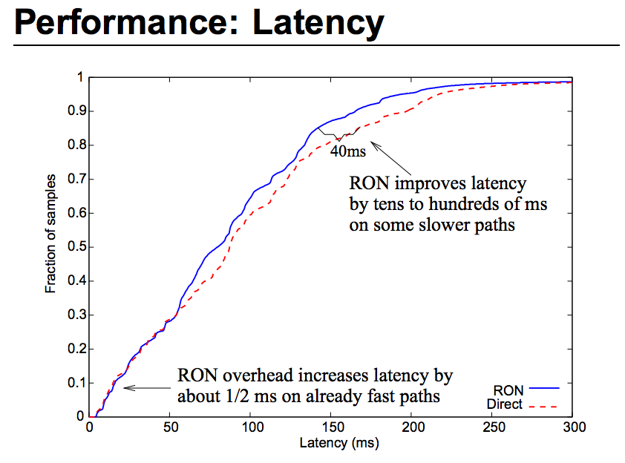

Slide 25
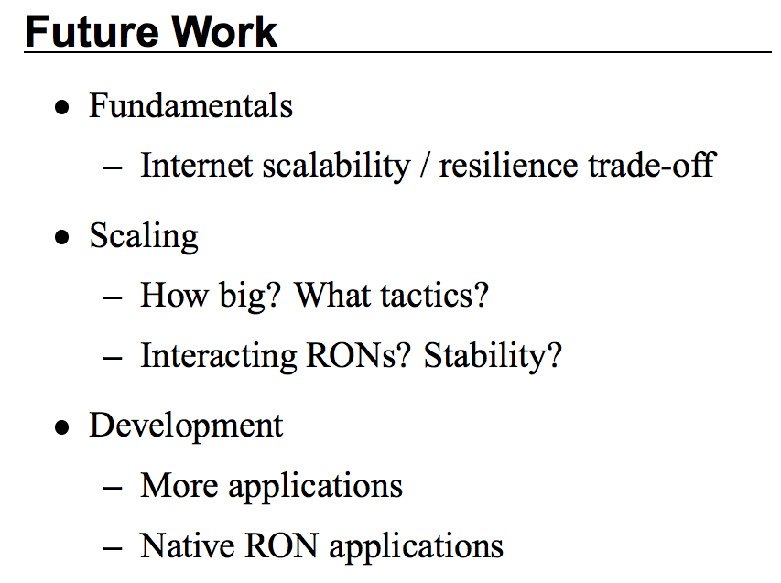

Slide 26
So What’s Different Now?
Notes:
3000 Transit AS’s - Internet more dense ISPs know how to make reliable internal networks Software (computers) can process packets at line-rate PC era is over - mobile, wearables, home devices Datacenters - cloud computing The Web

Slide 27
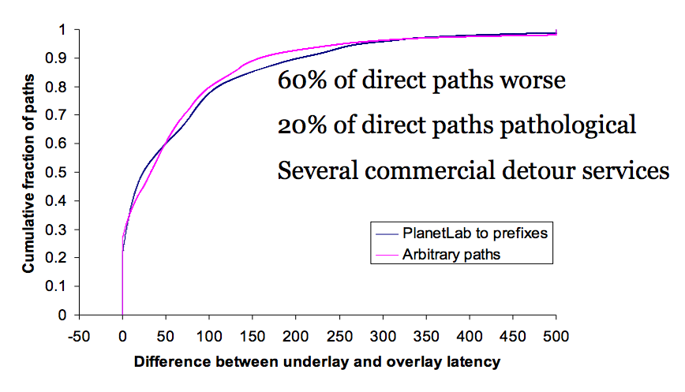
The Internet Today
NaaS @HotInterconnects 2013

Slide 28
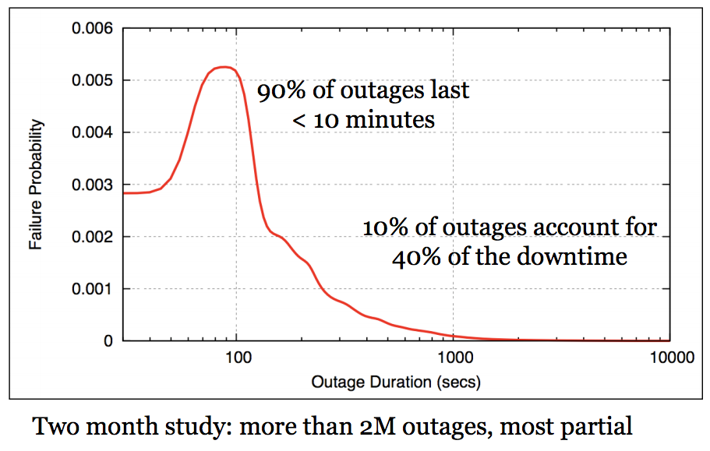
Modern Internet Failures
NaaS @HotInterconnects 2013
Notes:
Datacenter at Amazon - how many times were there outages to portions of the Internet?
Data from LIFEGUARD
Probability density function
First hump is route convergence - what BGP does to you - even if there’s a physical link, all ISPs working
Route tables are still in flux
30% of packet loss on Internet

Slide 29
CoDeeN (2003)

Slide 30
CoralCDN (2004)
Coral @NSDI 2004

Slide 32
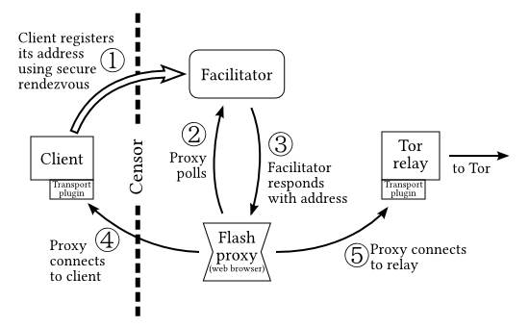
Flash Proxies (2012)

Slide 33
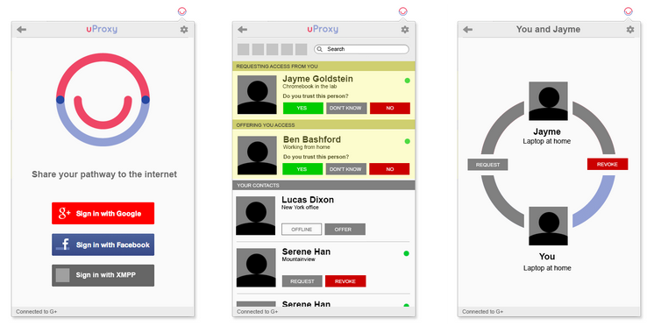
uProxy - Social Proxies

Slide 34
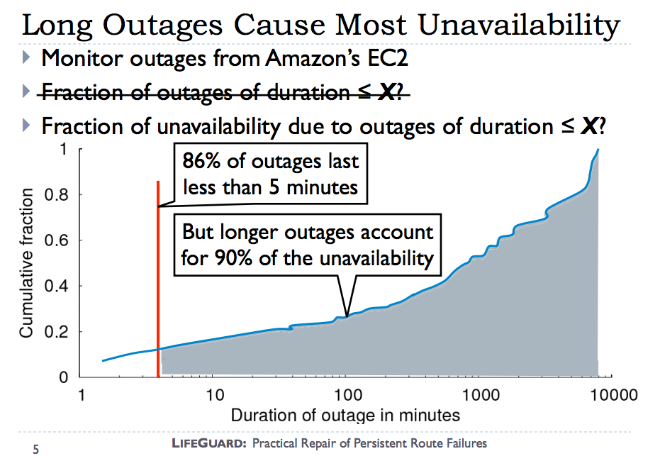
LIFEGUARD
LIFEGUARD @SIGCOMM 2012

Slide 39
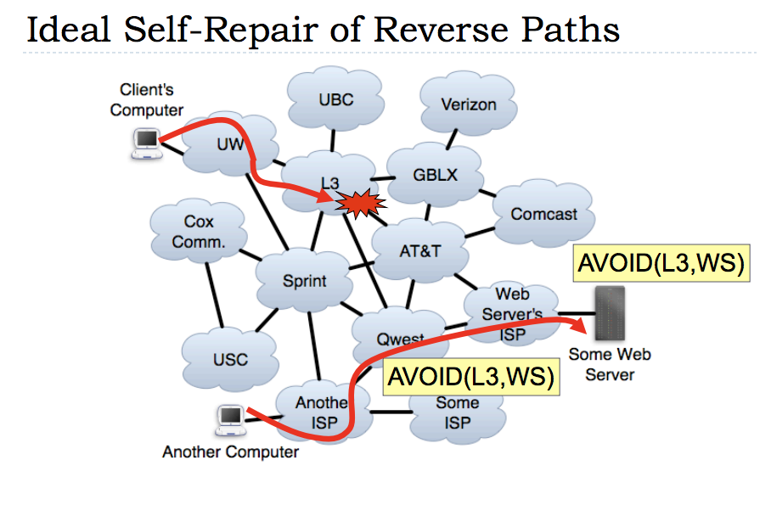

Slide 42
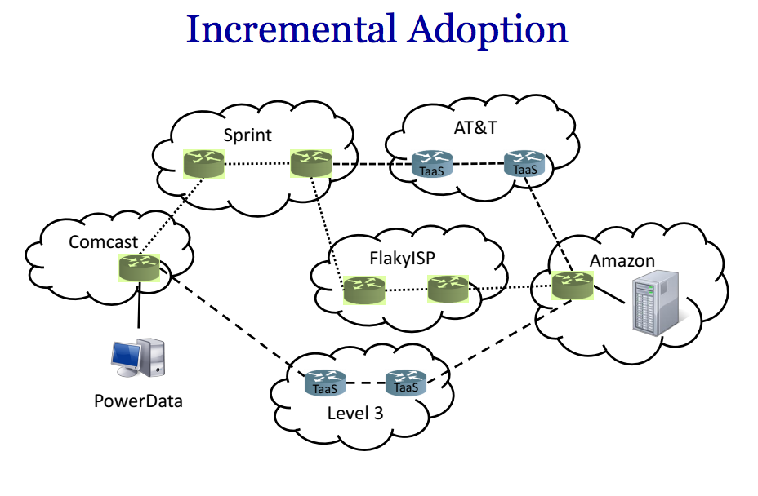
Arrow (2014)
Construct a network where ISPs only promise what they can directly deliver through their own network

