Slide 1
Data Centers

Slide 2
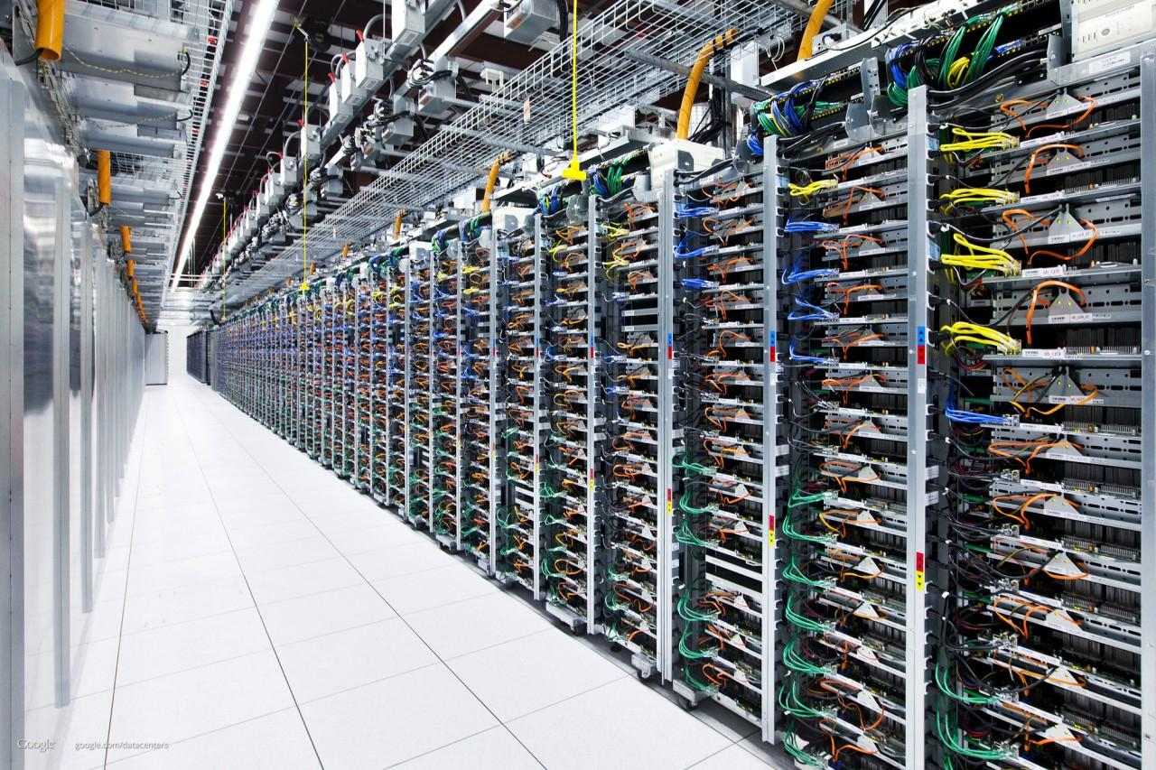
A data center is a centralized facility that houses computers and related systems.

Slide 3
Cloud Computing
Elastic resources
Expand and contract resources
Pay-per-use
Infrastructure on demand
Multi-tenancy
Multiple independent users
Security and resource isolation
amortize the cost of the (shared) infrastructure
Flexible service management
Resiliency: isolate failure of servers and storage
Workload movement: move work to other locations

Slide 4
Cloud Service Models
Software as a Service
Provider licensed applications to users as a service
E.g., customer relationship management, e-mail, …
Avoid costs of installation, maintenance, patches, …
Platform as a Service
Provider offers software platform for building applications
E.g., Google’s App-Engine
Avoid worrying about scability of platform
Infrastructure as a Service
Provider offers raw computing, storage, and network
E.g, Amazon’s Elastic Computing Cloud (EC2)
Avoid buying servers and estimating resource needs

Slide 5
How Might We Build a Cloud Data Center?
Commodity computers
Many general-purpose computers, not one big mainframe
Easier scaling
Much cheaper
Virtualization
Migration
Sharing
Design for any use
Many different applications
Programmers shouldn’t worry about the network
Unknown/changing workloads

Slide 6
What About Facebook/Twitter?
Applications consist of tasks
Many separate components
Running on different machines
Many different types of traffic
Web requests, analytics, search, backups, migration, etc.

Slide 7
How Might We Build Facebook?
Commodity computers
Many general-purpose computers, not one big mainframe
Easier scaling
Much cheaper
Virtualization
Migration
Sharing
Design for any use
Many different applications
Programmers shouldn’t worry about the network
Unknown/changing workloads

Slide 8
What Do They Actually Look Like?

Slide 9
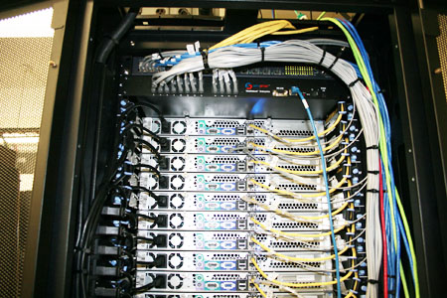
Top-of-Rack Architecture
Rack of servers
Commodity servers
And top-of-rack switch
Modular design
Preconfigured racks
Power, network, and storage cabling

Slide 10
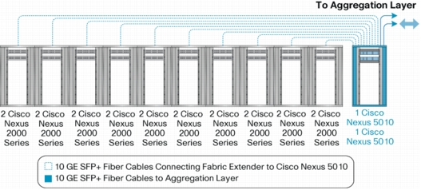
Aggregate to the Next Level

Slide 12
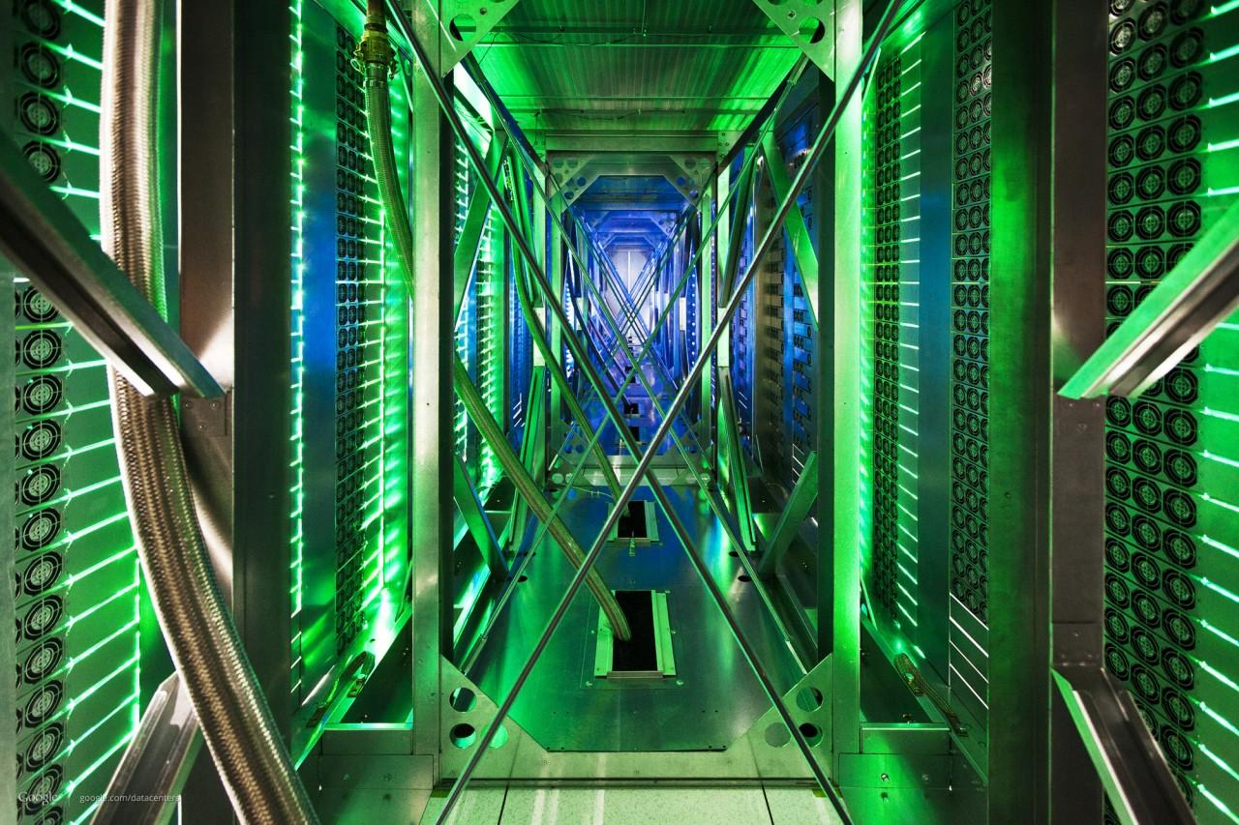

Slide 13
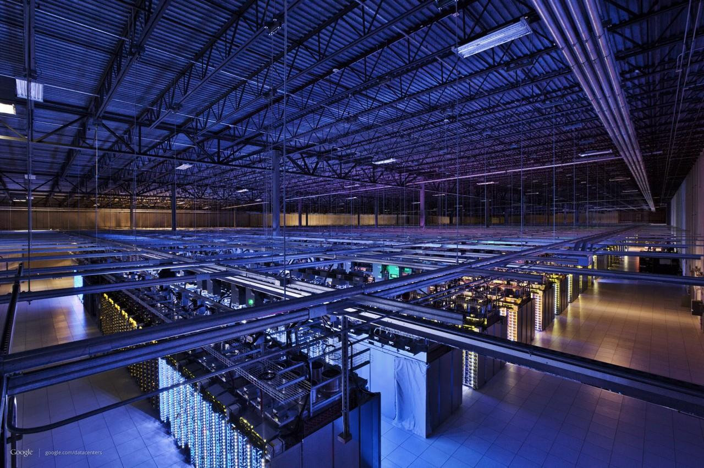

Slide 14
The Data Center Network
Goals:
Low cost
High bisection bandwidth (performance)
Fault tolerance

Slide 15
Traditional Data Center Topology
Internet
CR
CR
. . .
AR
AR
AR
AR
S
S
S
S
S
S
. . .
Key
CR = Core Router
AR = Access Router
S = Ethernet Switch
A = Rack of app. servers
A
A
…
A
A
A
…
A
~ 1,000 servers/pod
Expensive routers in the core
Scalability through hierarchical addressing/shortest-path routing
Notes:
Shortest path, ECMP

Slide 16
Capacity Mismatch
~ 200:1
CR
CR
AR
AR
AR
AR
S
S
S
S
~ 40:1
S
S
S
S
. . .
S
S
S
S
~ 5:1
A
A
…
A
A
A
…
A
A
A
…
A
A
A
…
A

Slide 17
Facebook’s Topology
Side links for redundancy
FC and CSW are still expensive
No oversubscription!
Except at the rack level

Slide 18
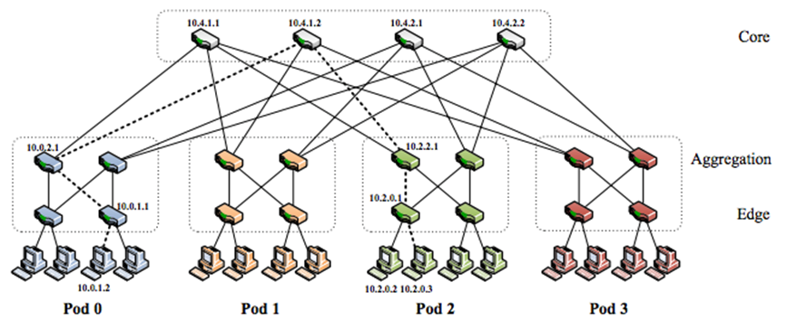
FatTree Topology (Google)
Clos network of commodity switches
More redundancy
Some oversubscription

Slide 19
PortLand/Hedera
Use a centralized controller
OpenFlow
Take the opportunity to do traffic engineering
Specialized topology
Flexible movement of workload

Slide 20
VL2 (Microsoft)
1. L2 semantics
2. Uniform high capacity
3. Performance isolation
A
A
A
A
A
A
A
A
A
A
A
A
A
A
A
A
A
A
A
A
A
A
…
A
A
…
A
A
A
A
A
A
A
A
A
A
…
…
A

Slide 21
VL2 Goals and Solutions
Objective
Approach
Solution
1. Layer-2 semantics
Employ flat addressing
Name-location separation & resolution service
2. Uniform high capacity between servers
Guarantee bandwidth for hose-model traffic
Flow-based random traffic indirection (Valiant LB)
3. Performance Isolation
Enforce hose model using existing mechanisms only
TCP
“Hose”: each node has ingress/egress bandwidth constraints

Slide 22
The Wide Area Network

Slide 23
Wide Area Network: Client-Server
. . .
. . .
Data Centers
Servers
Servers
Router
Router
DNS Server
Internet
Clients
DNS-based
site selection

Slide 24
Wide Area Network: Inter-DC
Full control
Small number of sites
Stable demand
Elastic bandwidth demands

Slide 25
Recent Research

Slide 26
Recent DC Network Research
Goals
Fault tolerance
Low cost
High performance
Why its interesting
Massive scale
Full control down to the hardware
Importance of the tail

Slide 27
Fault Tolerance and Data Center Topologies

Slide 28
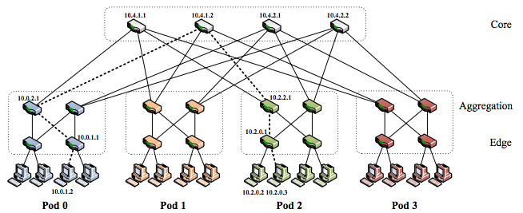
Failure Example: PortLand
Heartbeats to detect failures
Centralized controller installs updated routes
Exploits path redundancy

Slide 29
Unsolved Issues with FatTrees
Slow Detection
Commodity switches fail often
Not always sure they failed (gray/partial failures)
Slow Recovery
Failure recovery is not local
Topology does not support local reroutes
Suboptimal Flow Assignment
Failures result in an unbalanced tree
Loses load balancing properties

Slide 30
F10
Co-design of topology, routing protocols and failure detector
Novel topology that enables local, fast recovery
Cascading protocols for optimal recovery
Fine-grained failure detector for fast detection
Same # of switches/links as FatTrees

Slide 31
Outline
Motivation & Approach
Topology: AB FatTree
Cascaded Failover Protocols
Evaluation
Conclusion

Slide 32
Why is FatTree Recovery Slow?
dst
src
Lots of redundancy on the upward path
Immediately restore connectivity at the point of failure

Slide 33
Why is FatTree Recovery Slow?
dst
src
src
No redundancy on the way down
Alternatives are many hops away
No direct path
Has alternate path

Slide 34
Type A Subtree
Consecutive Parents
1
2
3
4
x
y

Slide 35
Type B Subtree
Strided Parents
1
2
3
4
x
y

Slide 36
AB FatTree

Slide 37
Alternatives in AB FatTrees
dst
src
src
More nodes have alternative, direct paths
One hop away from node with an alternative
No direct path
Has alternate path

Slide 38
Cascaded Failover Protocols
A local rerouting mechanism
Immediate restoration
A pushback notification scheme
Restore direct paths
An epoch-based centralized scheduler
globally re-optimizes traffic
μs
ms
s

Slide 39
Local Rerouting
u
dst
Route to a sibling in an opposite-type subtree
Immediate, local rerouting around the failure

Slide 40
Local Rerouting – Multiple Failures
u
dst
Resilient to multiple failures, refer to paper
Increased load and path dilation

Slide 41
Pushback Notification
u
u
Detecting switch broadcasts notification
Restores direct paths, but not finished yet
No direct path
Has alternate path

Slide 42
Centralized Scheduler
Related to existing work (Hedera, MicroTE)
Gather traffic matrices
Place long-lived flows based on their size
Place shorter flows with weighted ECMP

Slide 43
Outline
Motivation & Approach
Topology: AB FatTree
Cascaded Failover Protocols
Evaluation
Conclusion

Slide 44
Evaluation
Can F10 reroute quickly?
Can F10 avoid congestion loss that results from failures?
How much does this effect application performance?

Slide 45
Methodology
Testbed
Emulab w/ Click implementation
Used smaller packets to account for slower speed
Packet-level simulator
24-port 10GbE switches, 3 levels
Traffic model from Benson et al. IMC 2010
Failure model from Gill et al. SIGCOMM 2011
Validated using testbed

Slide 46
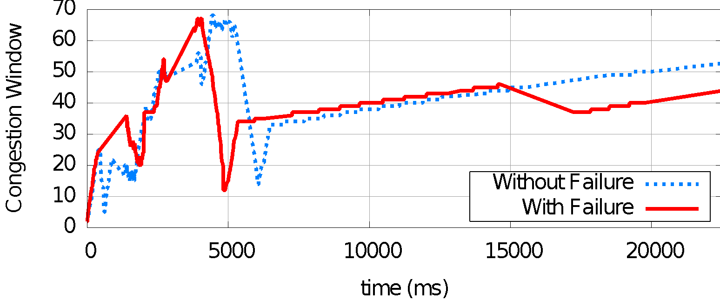
F10 Can Reroute Quickly
F10 can recover from failures in under a millisecond
Much less time than a TCP timeout

Slide 47
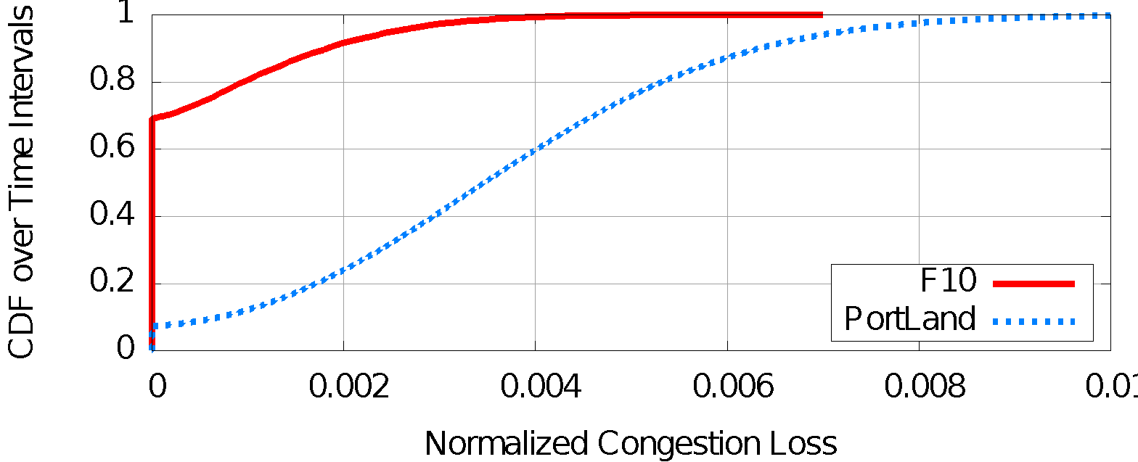
F10 Can Avoid Congestion Loss
PortLand has 7.6x the congestion loss of F10 under realistic traffic and failure conditions

Slide 48
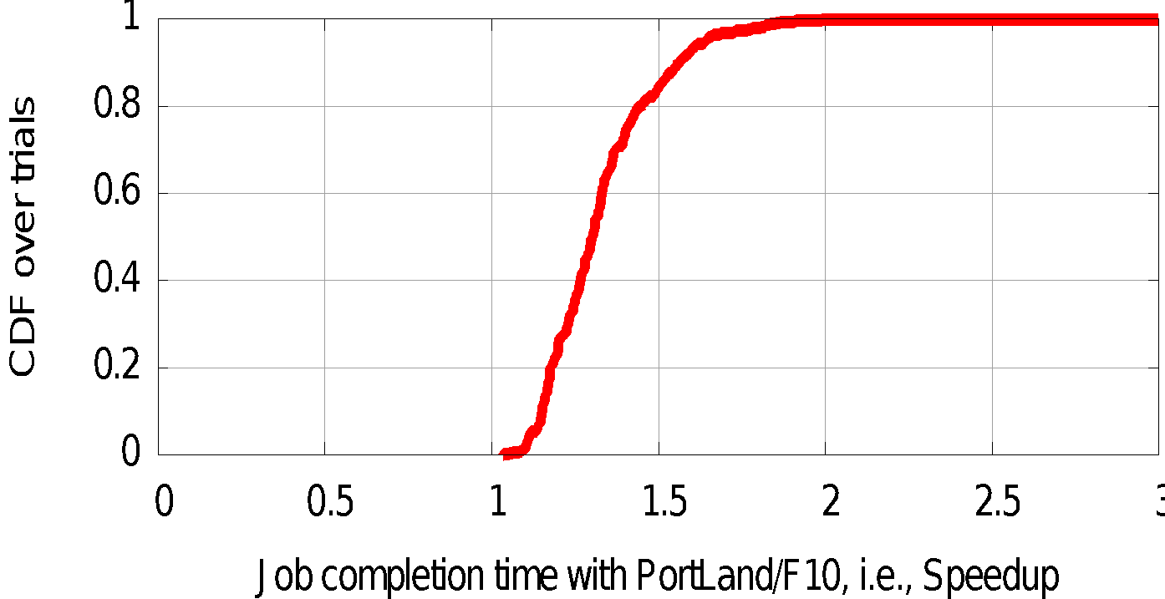
F10 Improves App Performance
Speedup of a MapReduce computation
Median speedup is 1.3x

Slide 49
Decreasing Cost with Flyways

Slide 50
Data Center Traffic is Bursty
Today’s data centers are oversubscribed by a factor of 3 or more

Slide 51
How Do We Do Better?
We Can’t Just Decrease Capacity
The network must be over-provisioned to handle the offered traffic.
We Can’t Just Move Jobs Around
Bursty rack-level traffic is a result of good job placement, not bad (e.g., colocation)

Slide 52
Our Goal: Flyways
To enable a network with
an oversubscribed core to act like
a non-oversubscribed network
by dynamically injecting
high-bandwidth links.

Slide 53
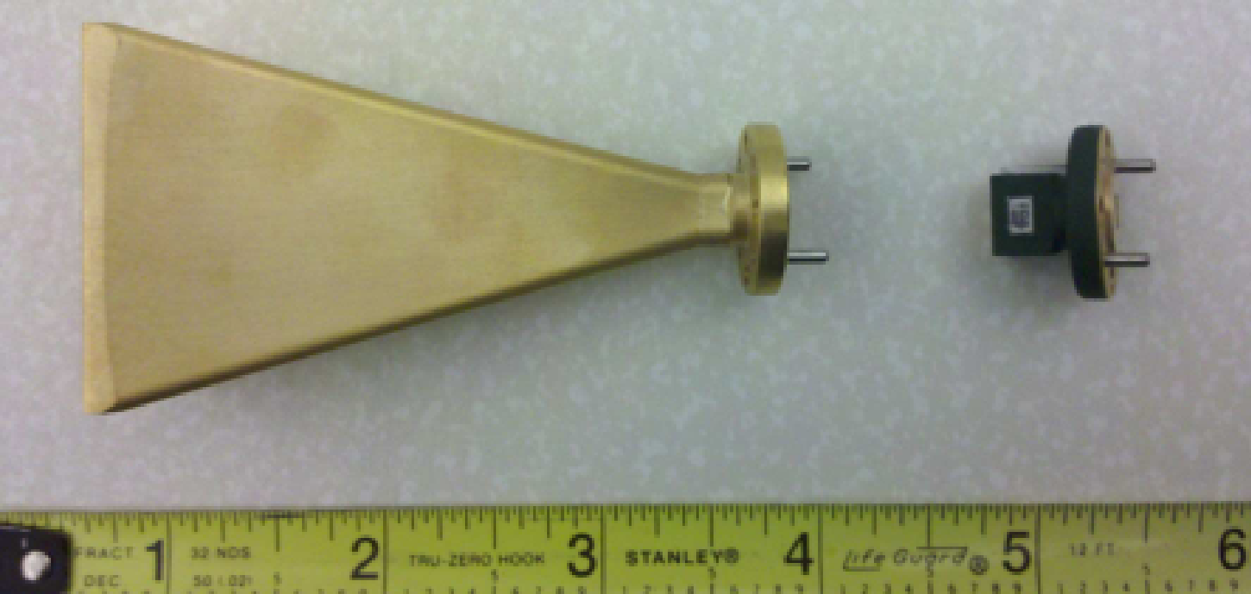
Our Approach: 60 GHz Wireless
Oversubscribed Core
…

Slide 54
Design Overview
Data placement
Jobs
DC Scheduler
Demands
Flyway Controller

Slide 55
Coordinating devices
✘
Leverage the wired backbone to sidestep issues of coordination

Slide 56
Orienting antennas
Traditional algorithms search, e.g. sector sweep
Data center topology is known and stable

Slide 57
Predicting bitrate
This is hard in multi-path environments
Directionality alleviates
multi-path: SNR lookup table
[DIRC, SIGCOMM’09]
Use SINR for interference

Slide 58
Using 3 Dimensions

Slide 59
Increasing Performance With DCTCP

Slide 60
TCP in the Data Center
We’ll see TCP does not meet demands of apps.
Suffers from bursty packet drops, Incast [SIGCOMM ‘09], ...
Builds up large queues:
Adds significant latency.
Wastes precious buffers, esp. bad with shallow-buffered switches.
Operators work around TCP problems.
Ad-hoc, inefficient, often expensive solutions
No solid understanding of consequences, tradeoffs

Slide 61
Impairments
Incast
Queue Buildup
Buffer Pressure

Slide 62
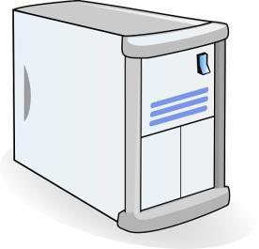
Incast
Worker 1
Synchronized mice collide.
Caused by Partition/Aggregate.
Aggregator
Worker 2
Worker 3
RTO_{min} = 300 ms
Worker 4
TCP timeout

Slide 63
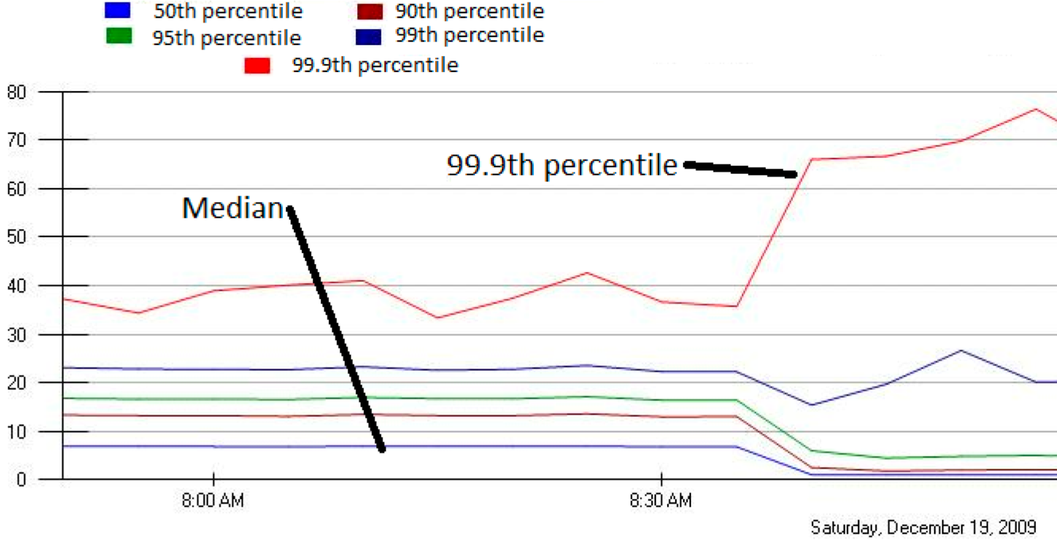
Incast Really Happens
MLA Query Completion Time (ms)
Requests are jittered over 10ms window.
Jittering switched off around 8:30 am.
99.9th percentile is being tracked.
Jittering trades off median against high percentiles.
Notes:
1. Incast really happens – see this actual screenshot from production tool
2. People care, they’ve solved it at application by jittering.
3. They care about the 99.9th percentile, 1-1000 customers

Slide 64
Queue Buildup
Sender 1
Big flows buildup queues.
Increased latency for short flows.
Receiver
Sender 2
Measurements in Bing cluster
For 90% packets: RTT < 1ms
For 10% packets: 1ms < RTT < 15ms

Slide 65
Data Center Transport Requirements
High Burst Tolerance
Incast due to Partition/Aggregate is common.
Low Latency
Short flows, queries
3. High Throughput
Continuous data updates, large file transfers
The challenge is to achieve these three together.

Slide 66
The DCTCP Algorithm

Slide 67
Review: The TCP/ECN Control Loop
Sender 1
ECN = Explicit Congestion Notification
ECN Mark (1 bit)
Receiver
Sender 2
Notes:
DCTCP is based on the existing Explicit Congestion Notification framework in TCP.

Slide 68
Small Queues & TCP Throughput:The Buffer Sizing Story
Bandwidth-delay product rule of thumb:
A single flow needs buffers for 100% Throughput.
Cwnd
Buffer Size
B
Throughput
100%
Notes:
In the first part of the talk, we established that what we need from DCTCP is to maintain small queues, without loss of throughput
Now in the case of TCP, the question of how much buffering is needed for high throughput has been studied and is known in the literature as the buffer sizing problem.
… and I’ll show you how to get low var…

Slide 69
Small Queues & TCP Throughput:The Buffer Sizing Story
Bandwidth-delay product rule of thumb:
A single flow needs buffers for 100% Throughput.
Appenzeller rule of thumb (SIGCOMM ‘04):
Large # of flows: is enough.
Cwnd
Buffer Size
B
Throughput
100%
Notes:
In the first part of the talk, we established that what we need from DCTCP is to maintain small queues, without loss of throughput
Now in the case of TCP, the question of how much buffering is needed for high throughput has been studied and is known in the literature as the buffer sizing problem.
… and I’ll show you how to get low var…

Slide 70
Small Queues & TCP Throughput:The Buffer Sizing Story
Bandwidth-delay product rule of thumb:
A single flow needs buffers for 100% Throughput.
Appenzeller rule of thumb (SIGCOMM ‘04):
Large # of flows: is enough.
Can’t rely on stat-mux benefit in the DC.
Measurements show typically 1-2 big flows at each server, at most 4.
Notes:
In the first part of the talk, we established that what we need from DCTCP is to maintain small queues, without loss of throughput
Now in the case of TCP, the question of how much buffering is needed for high throughput has been studied and is known in the literature as the buffer sizing problem.
… and I’ll show you how to get low var…

Slide 71
Small Queues & TCP Throughput:The Buffer Sizing Story
Bandwidth-delay product rule of thumb:
A single flow needs buffers for 100% Throughput.
Appenzeller rule of thumb (SIGCOMM ‘04):
Large # of flows: is enough.
Can’t rely on stat-mux benefit in the DC.
Measurements show typically 1-2 big flows at each server, at most 4.
Real Rule of Thumb:
Low Variance in Sending Rate → Small Buffers Suffice
B
Notes:
In the first part of the talk, we established that what we need from DCTCP is to maintain small queues, without loss of throughput
Now in the case of TCP, the question of how much buffering is needed for high throughput has been studied and is known in the literature as the buffer sizing problem.
… and I’ll show you how to get low var…

Slide 72
Two Key Ideas
React in proportion to the extent of congestion, not its presence.
Reduces variance in sending rates, lowering queuing requirements.
Mark based on instantaneous queue length.
Fast feedback to better deal with bursts.
ECN Marks | TCP | DCTCP
1 0 1 1 1 1 0 1 1 1 | Cut window by 50% | Cut window by 40%
0 0 0 0 0 0 0 0 0 1 | Cut window by 50% | Cut window by 5%

Slide 73
Data Center TCP Algorithm
B
K
Don’t
Mark
Switch side:
Mark packets when Queue Length > K.
Mark
Sender side:
Maintain running average of fraction of packets marked (α).
In each RTT:
Adaptive window decreases:
Note: decrease factor between 1 and 2.
Notes:
very simple marking mechanism
not all the tunings other aqms have
on the source side, the source is tryign to estimate the fraction of packets getting marked
using the obs that there is a stream of ecn marks coming back – more info in the stream than in any single bit
trying to maintain smooth rate variations to operate well even when using shallow buffers, and only a few flows (no stat mux)
F over the last RTT. In TCP there is always a way to get the next RTT from the window size. Comes from the self-clocking of TCP.
Only changing the decrease. Simplest version – makes a lot of sense. So generic could apply it to any algorithm – CTCP, CUBIC – how to cut its window leaving increase part to what it already does. Have to be careful here.

Slide 74
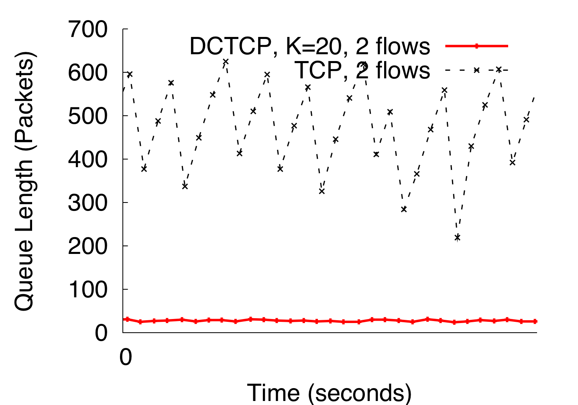
DCTCP in Action
(Kbytes)
Setup: Win 7, Broadcom 1Gbps Switch
Scenario: 2 long-lived flows, K = 30KB
Notes:
Not ns2.

Slide 75
Why it Works
High Burst Tolerance
Large buffer headroom → bursts fit.
Aggressive marking → sources react before packets are dropped.
Low Latency
Small buffer occupancies → low queuing delay.
3. High Throughput
ECN averaging → smooth rate adjustments, low variance.

