Slide 1
Problem Solving Strategies
CSE 417 Winter 21
Lecture 18

Slide 2
Updates
Most of you already used three or all of your late days, and we’ve still got almost half of the course left.
We’re going to give everyone 2 extra late days.
I’m still getting some feedback that homeworks are taking many of you a long time.
And I’ve gotten requests to talk about approaching problems in interviews.
We’re going to spend today talking about how to approach problems in general so that you can use the time you’re spending more effectively.

Slide 3
More Updates
We have to rearrange the schedule as a result
HW6 will be 1.5 times the length of the last few homeworks with twice as long to do it, due on March 5th We’ll release it on Friday, but much of it will only make sense partway through next week.
We’ll only have seven homeworks instead of eight.

Slide 4
An analogy
When you were first programming, debugging took a long time.
Even for “just” off-by-one errors.
Because you didn’t have a lot of practice debugging.
And if you got frustrated it was easy to start randomly changing < to <= one at a time in all combinations until one of them worked.
  Or until you realized the bug was in some other part of the code.
  You might have gotten the answer at the end of three hours of changing < to <=. But if you stopped and tried a different strategy

Slide 5
Pandemic-Specific Advice
It’s hard to focus on work right now.
Designing algorithms needs focus.
If you’re feeling frustrated, take a break.
Spread out the work you’re doing to give yourself time to digest new ideas.
It really helps to bounce ideas off of others – come to office hours!

Slide 6
General Advice
Spend extra time making sure you understand the problem statement at the start.
Make examples and solve them yourself early on.
Start with a baseline/brute force solution, even if it’s hopelessly inefficient.

Slide 7
General Advice
Find a homework buddy – human, or [stuffed] animal.
When you’re banging your head against a wall, explain to your buddy what you think is going wrong.
When you’re stuck, ask questions!
“Have I seen a similar problem before?” “Does this remind me of anything?”
“If I make the problem easier, Can I solve it?”

Slide 8
A Process
Technical interviews
Homework
Talk out the problem statement
Examples
Brute force
Optimize
Walk through
Implement
Test/Debug
Understand the statement
Do some examples
Is there a starting algorithm?
Common Questions
Can I simplify the problem? Have I seen this before?
Write pseudocode
Analyze and Justify

Slide 9

Example Problem
Let $G = (V, E)$ be an undirected graph. Let $e = \{u, v\}$ be an edge in G. Give an $O(n + m)$ time algorithm that finds the shortest cycle in $G$ which contains the edge $e$. Explain why your algorithm is correct.
Adapted from the Autumn 417 midterm.

Slide 10
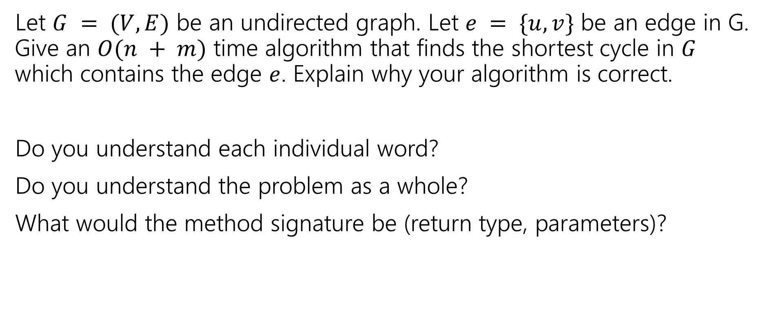
Talk
Let $G = (V, E)$ be an undirected graph. Let $e = \{u, v\}$ be an edge in G. Give an $O(n + m)$ time algorithm that finds the shortest cycle in $G$ which contains the edge $e$. Explain why your algorithm is correct.
Do you understand each individual word?
Do you understand the problem as a whole?
What would the method signature be (return type, parameters)?
Fill out the poll everywhere for Activity Credit!
Go to pollev.com/cse417 and login with your UW identity

Slide 11
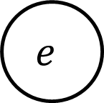
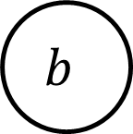
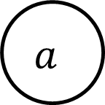

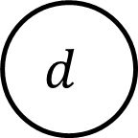
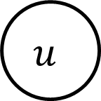
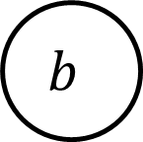
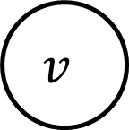
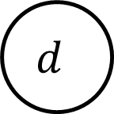
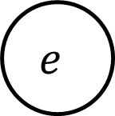
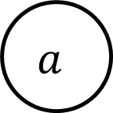
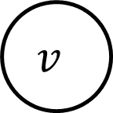
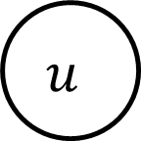

Examples
$$u$$
$$u$$
$$d$$
$$d$$
$$v$$
$$e$$
$$v$$
$$e$$
$$c$$
$$c$$
$$a$$
$$a$$
$$b$$
$$b$$

Slide 12
Examples
$$u$$
$$u$$
$$d$$
$$d$$
$$v$$
$$e$$
$$v$$
$$e$$
$$c$$
$$c$$
$$a$$
$$a$$
$$b$$
$$b$$

Slide 13
Brute Force/Baseline
Come up with an algorithm any algorithm that works.
Benefit 1: Sometimes you can improve the efficiency until you get a working algorithm (especially the case with DP!)
Benefit 2: Stress reduction.
You have something. Put it in your back pocket. Worst case, you’re writing something down.

Slide 14
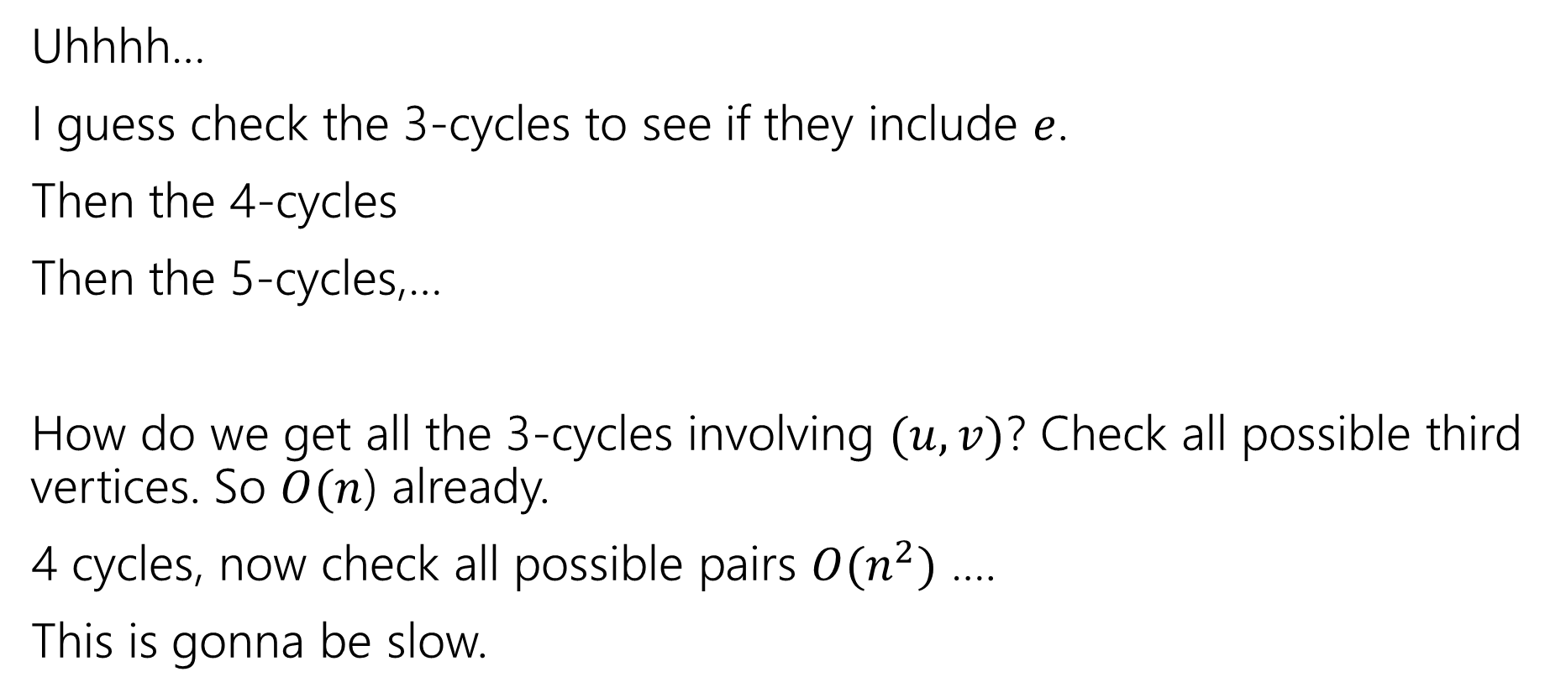
Brute Force/Baseline
Uhhhh…
I guess check the 3-cycles to see if they include $e$.
Then the 4-cycles
Then the 5-cycles,…
How do we get all the 3-cycles involving $(u,v)$? Check all possible third vertices. So $O(n$) already.
4 cycles, now check all possible pairs $O(n^{2})$ ….
This is gonna be slow.

Slide 15
Optimize
That brute force algorithm is bad
Hopelessly bad. We aren’t going to speed it up.
Let’s try to come up with something better…
Good questions to ask:
does this problem remind you of anything?
Is there a similar problem we’ve already studied?

Slide 16
Similar Problems
We detected cycles in directed graphs with depth-first-search.
In undirected graphs, we accidentally found odd-length cycles with BFS.
When we were 2-coloring, if the 2-coloring failed it was because of an intralayer edge that corresponded to an odd-cycle.
We found short paths in graphs.
Any of these might look like a reasonable starting point

Slide 17
Choose Your Own Adventure
Depth First Search

Slide 18















Depth First Search?
Probably want to start by processing $u,v$
Sometimes it’s the first back-edge we find!
But sometimes it’s not…
$$u$$
$$u$$
$$d$$
$$d$$
$$v$$
$$e$$
$$v$$
$$e$$
$$c$$
$$c$$
$$a$$
$$a$$
$$b$$
$$b$$

Slide 19
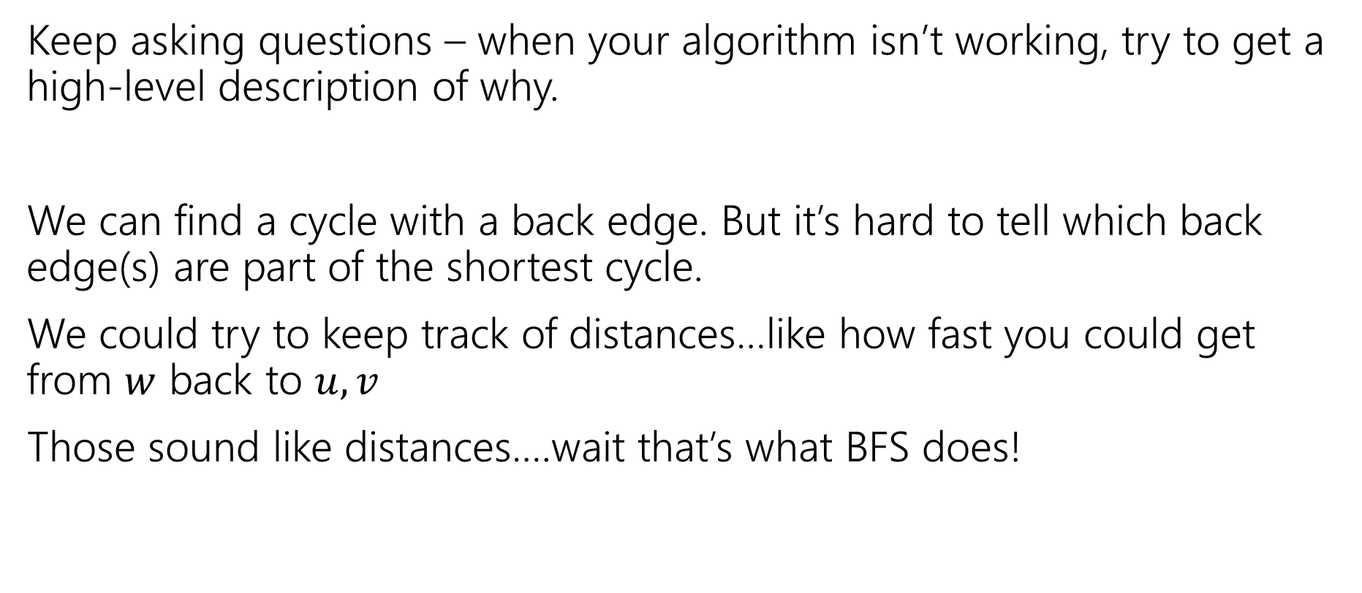
Why isn’t DFS working?
Keep asking questions – when your algorithm isn’t working, try to get a high-level description of why.
We can find a cycle with a back edge. But it’s hard to tell which back edge(s) are part of the shortest cycle.
We could try to keep track of distances…like how fast you could get from $w$ back to $u,v$
Those sound like distances….wait that’s what BFS does!

Slide 20
Choose Your Own Adventure
Modify BFS

Slide 21
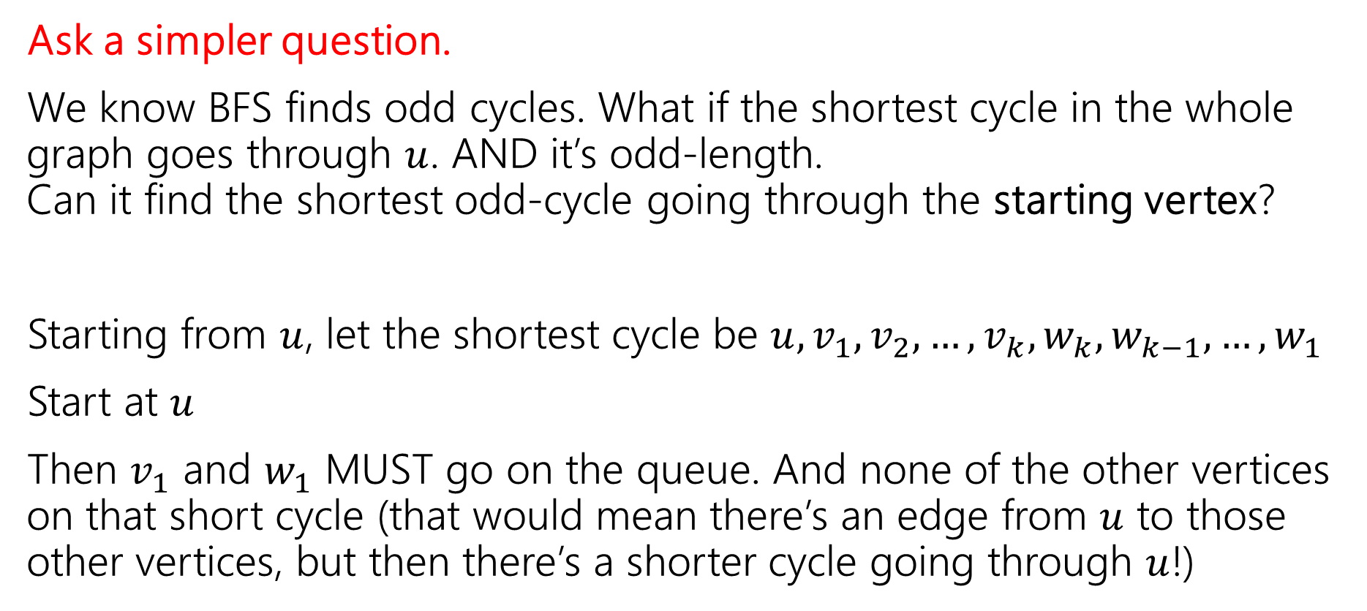
Let’s try BFS instead
Ask a simpler question.
We know BFS finds odd cycles. What if the shortest cycle in the whole graph goes through $u$. AND it’s odd-length.
Can it find the shortest odd-cycle going through the starting vertex?
Starting from $u$, let the shortest cycle be $u, v_{1},v_{2},…,v_{k},w_{k},w_{k−1},…,w_{1}$
Start at $u$
Then $v_{1}$ and $w_{1}$ MUST go on the queue. And none of the other vertices on that short cycle (that would mean there’s an edge from $u$ to those other vertices, but then there’s a shorter cycle going through $u$!)

Slide 22
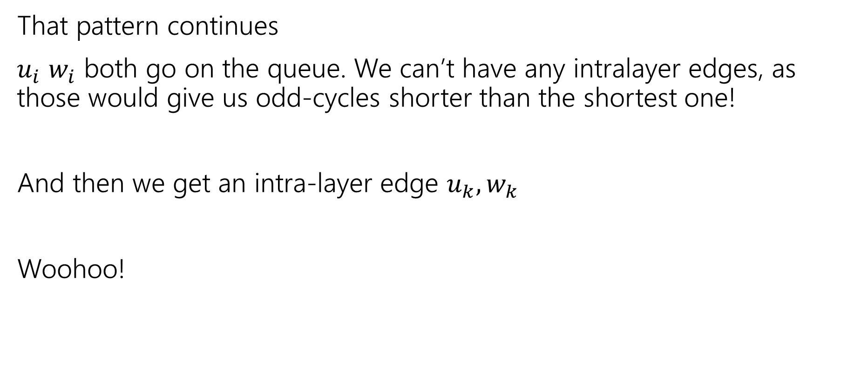
Let’s Try BFS Instead
That pattern continues
$u_{i}$ $w_{i}$ both go on the queue. We can’t have any intralayer edges, as those would give us odd-cycles shorter than the shortest one!
And then we get an intra-layer edge $u_{k},w_{k}$
Woohoo!

Slide 23
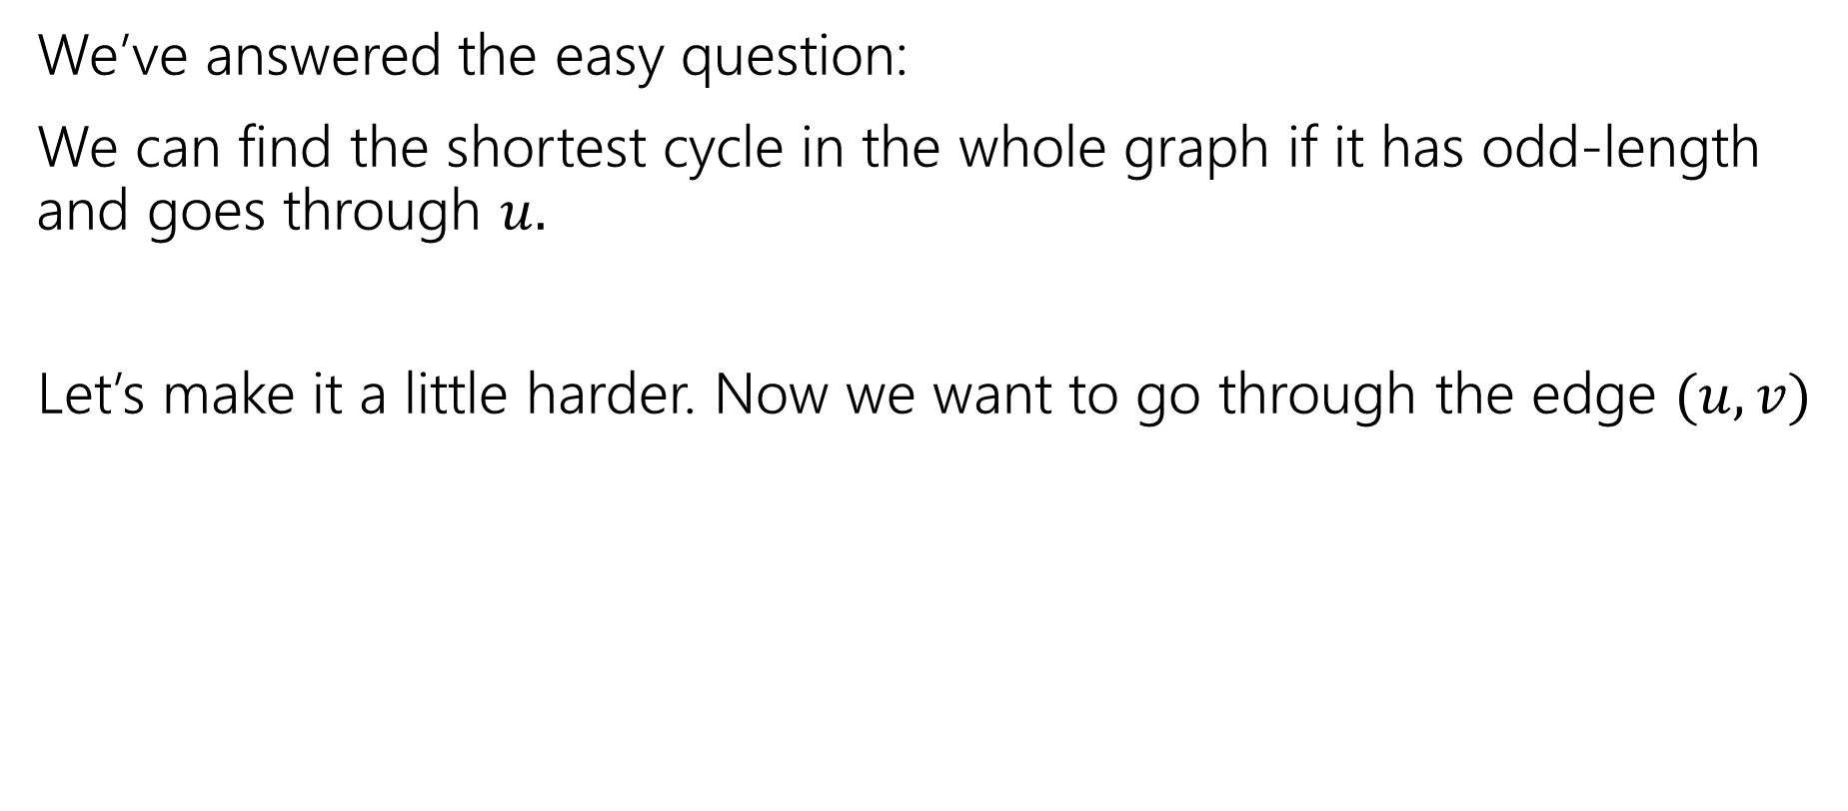
Making the question harder.
We’ve answered the easy question:
We can find the shortest cycle in the whole graph if it has odd-length and goes through $u.$
Let’s make it a little harder. Now we want to go through the edge $(u,v)$

Slide 24
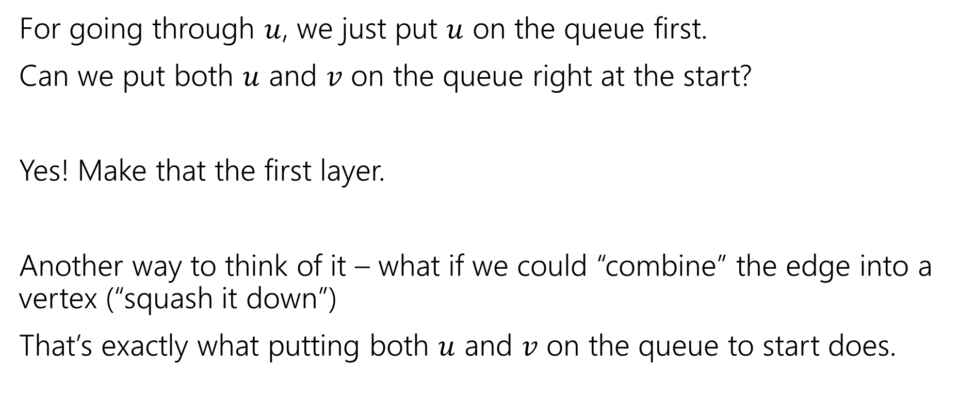
Making it an edge
For going through $u$, we just put $u$ on the queue first.
Can we put both $u$ and $v$ on the queue right at the start?
Yes! Make that the first layer.
Another way to think of it – what if we could “combine” the edge into a vertex (“squash it down”)
That’s exactly what putting both $u$ and $v$ on the queue to start does.

Slide 25








Almost There…
What if the cycle isn’t the shortest one overall?
0
$$u$$
1
$(d,e)$ will be an intralayer edge, but it’s associated with a useless cycle…
What’s the problem?
$$d$$
$$v$$
$$e$$
1
$$c$$
$$a$$
$$b$$

Slide 26

Almost There…
What if the cycle isn’t the shortest one overall?
0
$$u$$
1
$(d,e)$ will be an intralayer edge, but it’s associated with a useless cycle…
What’s the problem?
Both $d$ and $e$ come from $u,$we need one to trace back to $v$. Keep track of who we trace back to!
$$d$$
$$v$$
$$e$$
1
$$c$$
$$a$$
$$b$$

Slide 27

Almost There…
What happens in the length is odd?
Instead of an intralayer edge, we’ll have a single vertex discovered twice…
Once from $u$ and once from $v$. We can check for that too!

Slide 28
Modified BFS
  CycleFinder(G,u,v)
  u.side=u, v.side=v, u.layer=0, v.layer=0
  delete edge (u,v)
  Place u and v on queue
  Place divider on queue
  while(queue is not empty)
  curr = queue.dequeue()
  if(curr==divider)
  layer++
  for(each edge (curr,w))
  if(w is not seen)
  w.layer=curr.layer+1
  queue.enqueue(w)
  w.seen=true
  w.pred=curr
  w.side=curr.side
  else
  if(w.side!=curr.side) //a real cycle
  findCycle(u,v,curr,w)
  //otherwise do nothing. Not a real cycle and w already on queue.

Slide 29
Helper
  //finds cycle by backtracking from x,y until reaching u,v
  findCycle(u,v,x,y)
  list cycle
  cycle.insertFront(x)
  cycle.insertFront(y)
  while(x != u && x != v)
  cycle.insertFront(x)
  x=x.pred
  cycle.insertFront(x)
  while(y != 6 && y != v)
  cycle.insertBack(y)
  y=y.pred
  cycle.insertBack(y)
  return cycle

Slide 30
Choose Your own Adventure
Shortest Paths

Slide 31
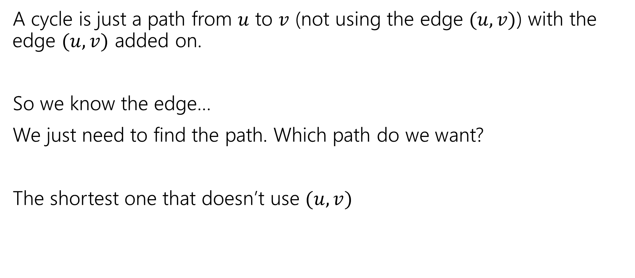
What is a cycle
A cycle is just a path from $u$ to $v$ (not using the edge $(u,v)$) with the edge $(u,v)$ added on.
So we know the edge…
We just need to find the path. Which path do we want?
The shortest one that doesn’t use $(u,v)$

Slide 32
Algorithm
FindCycle(G,u,v)
Delete (u,v) from G
Run BFS-Shortest-Path(G, u) //i.e. shortest paths starting from u.
List cycle
curr = v
while(curr != u)
cycle.insertBack(curr)
curr=curr.pred
cycle.insertBack(curr) // i.e. insert u
return cycle

Slide 33
Summary
Talk/Read carefully – understand individual words of question, then question as a whole.
Do Examples – confirms you understand the problem, get more intuition.
Brute Force Solution – sometimes can be optimized to a final answer, sometimes not…but a backup plan can take the pressure off.
Optimize – find a better algorithm. Ask yourself questions:
Have I seen a similar problem before?
Can I make the problem easier? Can I handle a special case?

Slide 34
Summary
Walk Through your idea on an example. Just to see that it’s not way off.
Implement – write the pseudocode (or real code)
Test – you already wrote some examples – do they work? Did you think of other edge cases when you were implementing? Check those too.

Slide 35
An Extra Example

Slide 36
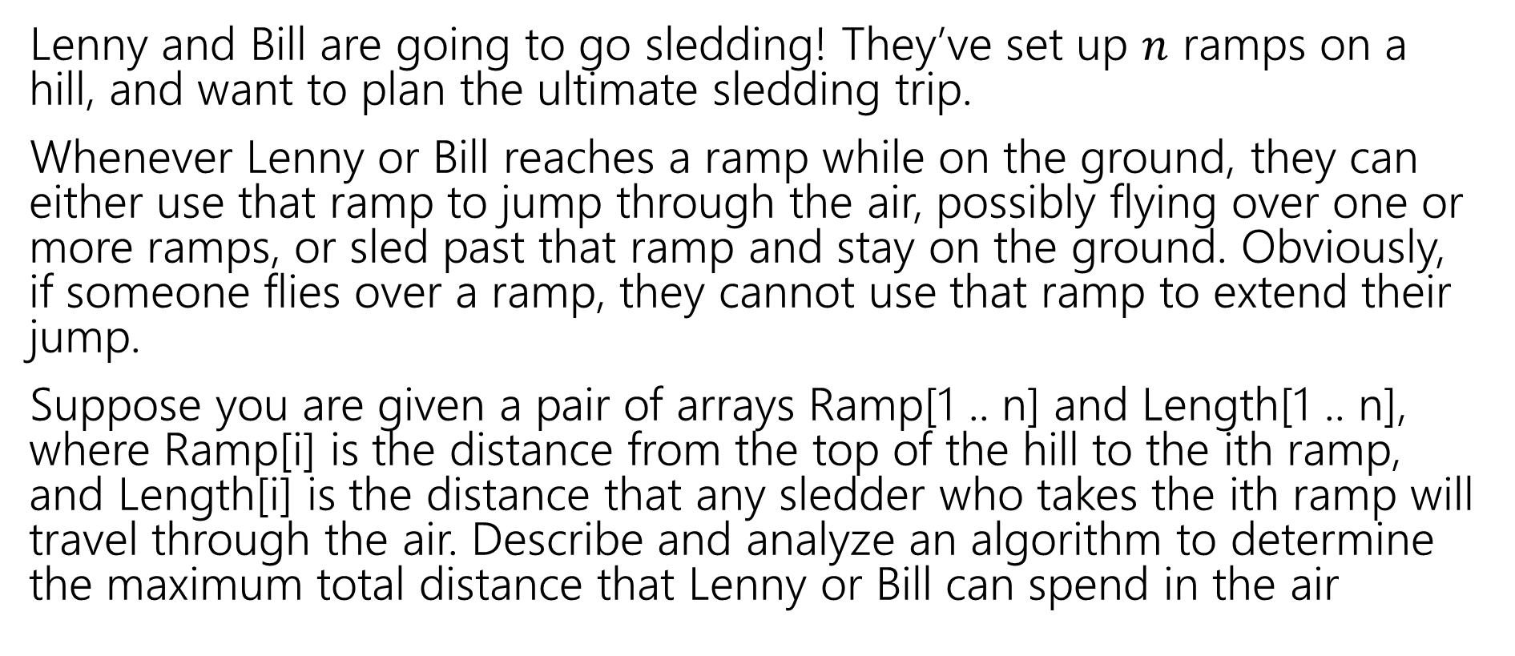
Sledding
Lenny and Bill are going to go sledding! They’ve set up $n$ ramps on a hill, and want to plan the ultimate sledding trip.
Whenever Lenny or Bill reaches a ramp while on the ground, they can either use that ramp to jump through the air, possibly flying over one or more ramps, or sled past that ramp and stay on the ground. Obviously, if someone flies over a ramp, they cannot use that ramp to extend their jump.
Suppose you are given a pair of arrays Ramp[1 .. n] and Length[1 .. n], where Ramp[i] is the distance from the top of the hill to the ith ramp, and Length[i] is the distance that any sledder who takes the ith ramp will travel through the air. Describe and analyze an algorithm to determine the maximum total distance that Lenny or Bill can spend in the air
Adapted from http://jeffe.cs.illinois.edu/teaching/algorithms/book/03-dynprog.pdf, problem 15

Slide 37
Step 1: Talk – Ask Questions
The goal of this step is to make sure you understand the problem statement.
In technical interviews, interviewers (at least in the past…) would sometimes leave questions somewhat ambiguous intentionally to see how you ask questions.
Robbie’s usual self-checks:
Do you understand all the words in the problem individually?
Do you understand the statement as a whole?
What’s our return type?
Are there any edge cases that immediately stick out?

Slide 38

Edge Case
If we take a ramp at $5$ and we’re in the air for $3,$ can we take the ramp at $8?$
Not totally clear in the problem – we’ll say yes!

Slide 39
Step 2: Examples
Good way to ensure you’ve understood the question
And to get started on solving it.
If we give you examples on a homework, use those. Cover up the “answers” and try to find them yourself.
If you aren’t given them, just generate you own instances and solve them.

Slide 40
Step 2: Examples
Ramp[]
Length[]
1 | 2 | 3 | 4 | 5
0 | 15 | 16 | 20 | 25
1 | 2 | 3 | 4 | 5
10 | 2 | 4 | 6 | 1
We can take ramp 1 (flying through the air from 0 to 10) 10 units so far
Take ramp 2 (flying through the air from 15 to 17) 12 units so far
We are not allowed to take 3 (in the air) 12 units so far
We choose to skip ramp 4. 12 units so far
Take ramp 5 (in the air from 25 to 26) 13 units total.

Slide 41
Step 2: Examples
Ramp[]
Length[]
1 | 2 | 3 | 4 | 5
0 | 15 | 16 | 20 | 25
1 | 2 | 3 | 4 | 5
10 | 2 | 4 | 6 | 1
We can take ramp 1 (flying through the air from 0 to 10) 10 units so far
Skip ramp 2 10 units so far
Take ramp 3 (flying through the air from 16 to 20) 14 units so far
Take ramp 4 (flying through the air from 20 to 26) 20 units so far
We cannot take ramp 5 (in the air) 20 units total.

Slide 42
Step 2: More Examples
Ramp[]
Length[]
1 | 2 | 3 | 4 | 5
0 | 5 | 10 | 15 | 20
1 | 2 | 3 | 4 | 5
6 | 4 | 3 | 6 | 1

Slide 43
Step 2: More Examples
Ramp[]
Length[]
1 | 2 | 3 | 4 | 5
0 | 5 | 10 | 15 | 20
1 | 2 | 3 | 4 | 5
6 | 4 | 3 | 6 | 1
We can skip ramp 1 0 units so far
Take ramp 2 (flying through the air from 5 to 9) 4 units so far
Take ramp 3 (flying through the air from 10 to 13) 7 units so far
Take ramp 4 (flying through the air from 15 to 21) 13 units so far
We cannot take ramp 5 (in the air) 13 units total.

Slide 44
Step 3: Brute Force (or just any algorithm)
In a technical interview: it’s a good idea to just state the first algorithm idea you think of. Even if it’s slow.
In our context: sometimes skippable, but often a good idea.
It takes pressure off. Worst case scenario you write that one up.
You’ll also often see more about the problem/see the optimization to get to a better solution.

Slide 45
Step 3: Brute Force
Just try every possible plan.
Spin off a method to be take this ramp and another skip this ramp.
(Need a check to make sure ramp is valid)

Slide 46
Step 3: Brute Force
BruteForceRamp(int score, int index, ramps, length)
//base case
//skip
//take ramp

Slide 47
Step 3: Brute Force
BruteForceRamp(int score, int index, ramps, length)
//base case
if(index > n) return 0
//skip ramp
int s=(score, index+1, ramps,length)
//take ramp
int newInd=findInd(ramps[index]+length[index])
int t=(score+length[index],newInd,ramps,length)
return max(s,t)

Slide 48
Step 4: Optimize
Turn that code into a more efficient version. Can we use DP instead?
What parameters do we really need?
int s=(score, index+1, ramps,length)
int t=(score+length[index],newInd,ramps,length)
Score made things easier when we weren’t sure what order to evaluate the recurrence. But we don’t need it.

Slide 49
Step 4: Optimize
Turn that code into a more efficient version. Can we use DP instead?
What parameters do we really need?
int s=(score, index+1, ramps,length)
int t=(score+length[index],newInd,ramps,length)
Ramps, length would be needed in java code, but aren’t changing.

Slide 50
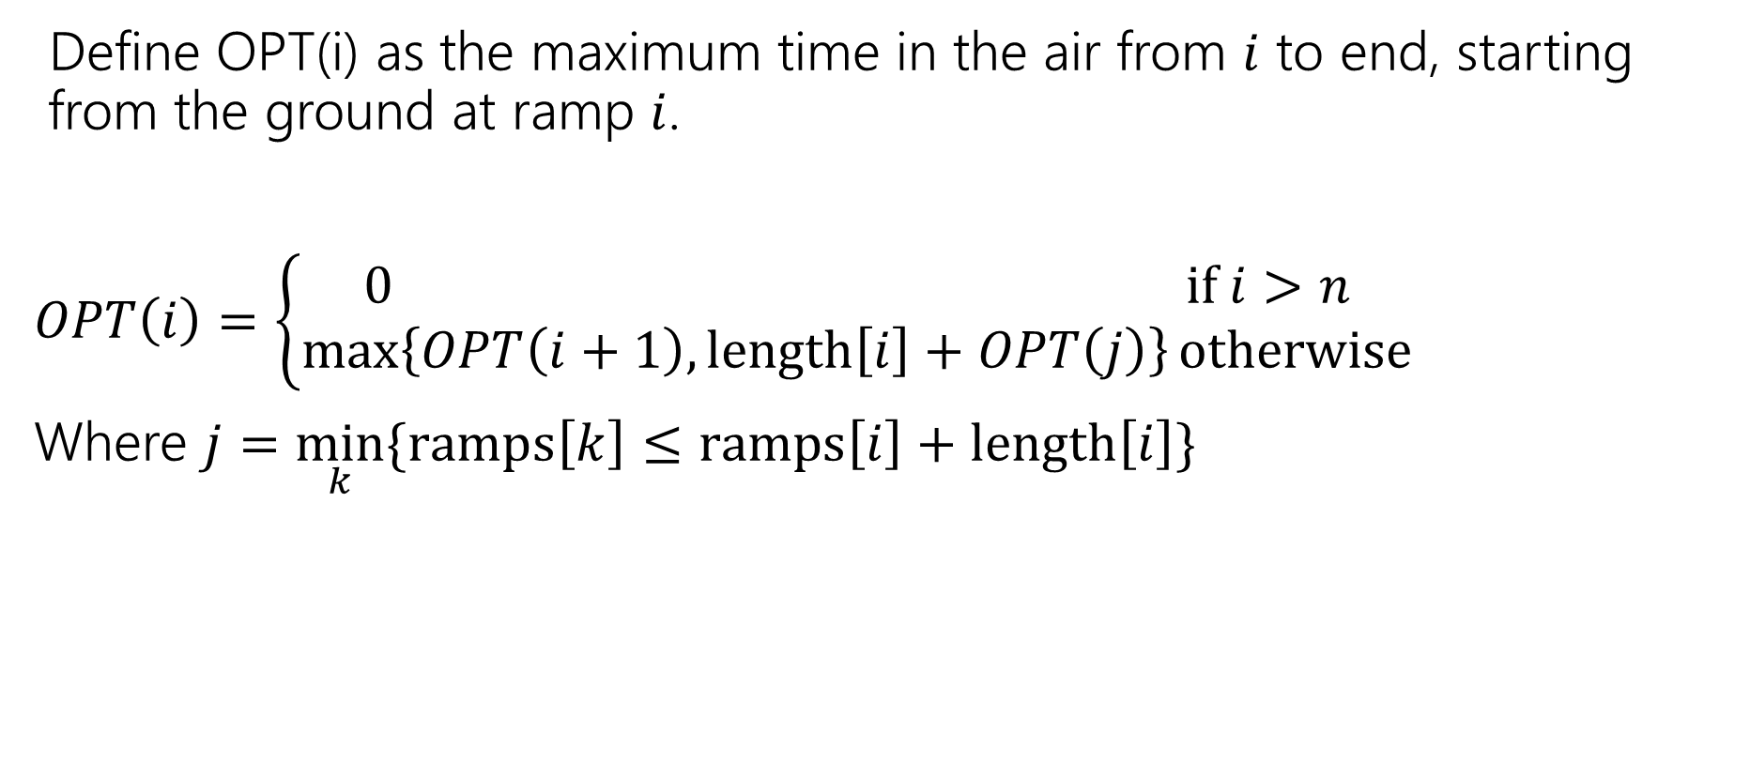
Optimized
Define OPT(i) as the maximum time in the air from $i$ to end, starting from the ground at ramp $i$.
$OPT\left(i\right)=\left\{\begin{aligned}0 if i>n \\ \max\left\{OPT\left(i+1\right), length\left[i\right]+OPT\left(j\right)\right\}otherwise\end{aligned}\right.$
Where $j=\min_{k}⁡\{ramps\left[k\right]≤ramps\left[i\right]+length\left[i\right]\}$

Slide 51
Try This one on your own
The university lawyers heard about Lenny and Bill’s little bet and immediately objected. To protect the university from either lawsuits or sky-rocketing insurance rates, they impose an upper bound on the number of jumps that either sledder can take. Describe and analyze an algorithm to determine the maximum total distance that Lenny or Bill can spend in the air with at most k jumps, given the original arrays Ramp[1 .. n] and Length[1 .. n] and the integer k as input.
Do all the steps – Start by altering the examples and making sure you understand the change!

