Slide 1
Dynamic Programming on Trees

Slide 2
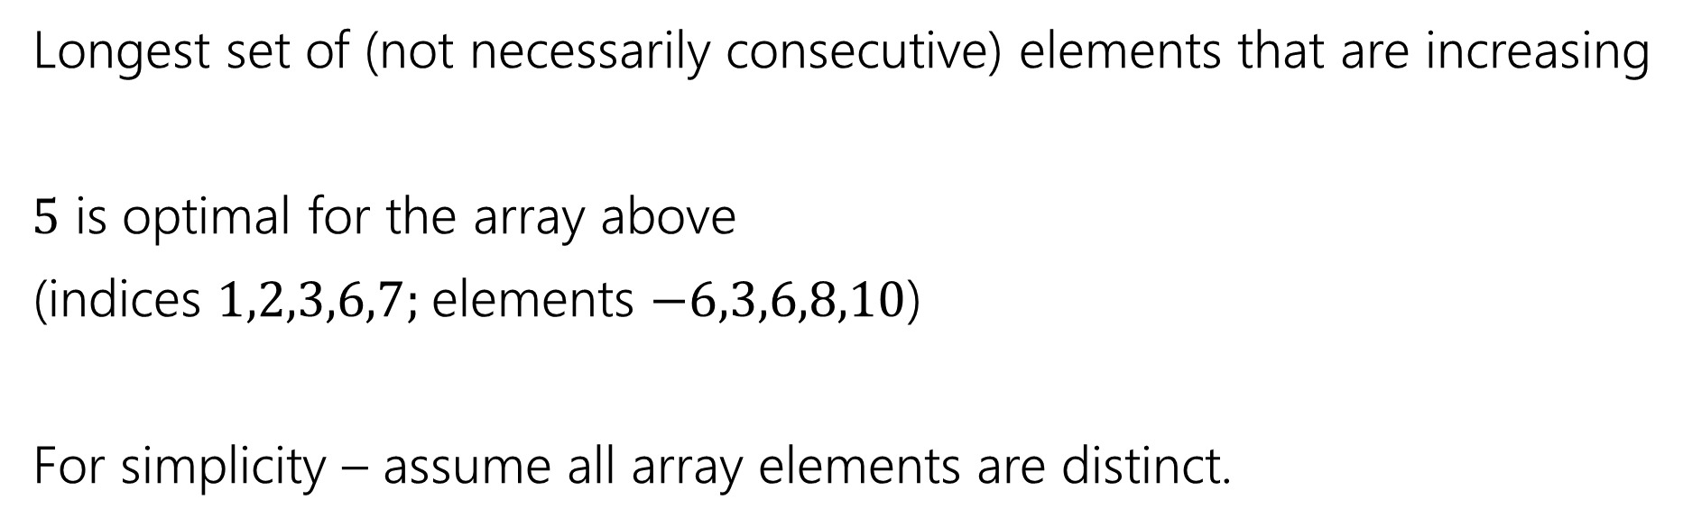
Longest Increasing Subsequence
0 | 1 | 2 | 3 | 4 | 5 | 6 | 7
5 | -6 | 3 | 6 | -5 | 2 | 8 | 10
Longest set of (not necessarily consecutive) elements that are increasing
$5$ is optimal for the array above
(indices $1,2,3,6,7;$elements $−6,3,6,8,10$)
For simplicity – assume all array elements are distinct.

Slide 3
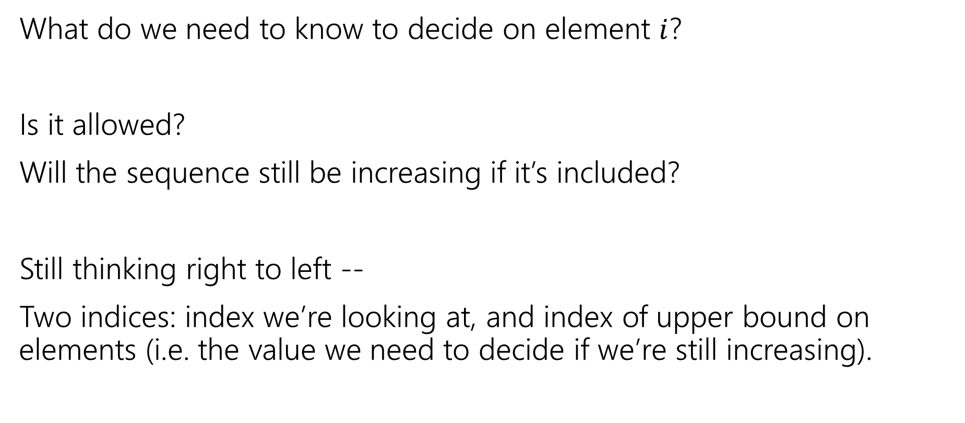
Longest Increasing Subsequence
What do we need to know to decide on element $i$?
Is it allowed?
Will the sequence still be increasing if it’s included?
Still thinking right to left --
Two indices: index we’re looking at, and index of upper bound on elements (i.e. the value we need to decide if we’re still increasing).

Slide 4

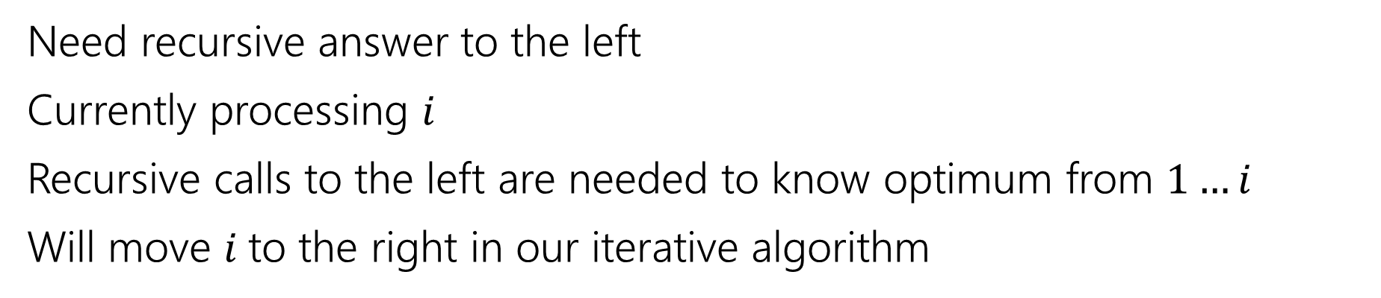
Recurrence
0 | 1 | 2 | 3 | 4 | 5 | 6 | 7
5 | -6 | 3 | 6 | -5 | 2 | 8 | 10
Recursive call is best value in this area
Current $i$
Not yet processed.
Need recursive answer to the left
Currently processing $i$
Recursive calls to the left are needed to know optimum from $1…i$
Will move $i$to the right in our iterative algorithm

Slide 5
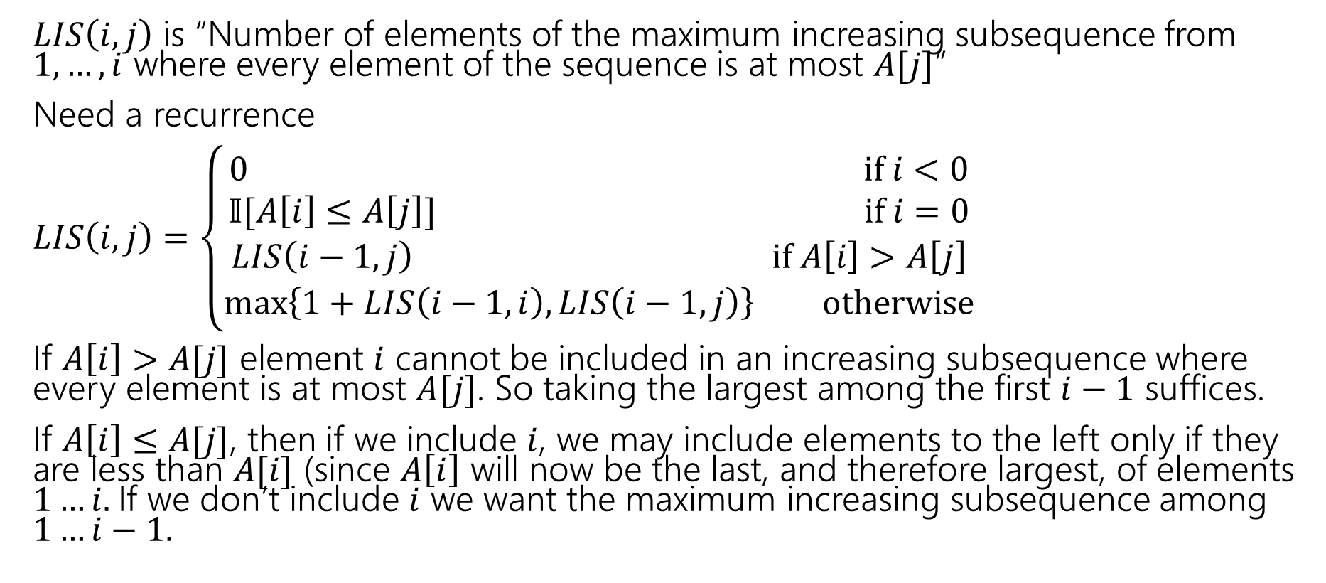
Longest Increasing Subsequence
$LIS\left(i,j\right)$ is “Number of elements of the maximum increasing subsequence from $1,…,i$ where every element of the sequence is at most $A[j]$”
Need a recurrence
$LIS\left(i,j\right)=\left\{\begin{aligned}0 if i<0 \\ 𝕀[A\left[i\right]≤A\left[j\right]] if i=0 \\ LIS\left(i−1,j\right) if A\left[i\right]>A\left[j\right] \\ \max\left\{1+LIS\left(i−1,i\right), LIS\left(i−1,j\right)\right\} otherwise\end{aligned}\right.$
If $A\left[i\right]>A[j]$ element $i$ cannot be included in an increasing subsequence where every element is at most $A[j]$. So taking the largest among the first $i−1$ suffices.
If $A\left[i\right]≤A[j]$, then if we include $i$, we may include elements to the left only if they are less than $A[i]$ (since $A\left[i\right]$ will now be the last, and therefore largest, of elements $1…i.$If we don’t include $i$ we want the maximum increasing subsequence among $1…i−1.$

Slide 6

Longest Increasing Subsequence
$LIS\left(i,j\right)=\left\{\begin{aligned}0 if i<0 \\ 𝕀[A\left[i\right]≤A\left[j\right]] if i=0 \\ LIS\left(i−1,j\right) if A\left[i\right]>A\left[j\right] \\ \max\left\{1+LIS\left(i−1,i\right), LIS\left(i−1,j\right)\right\} otherwise\end{aligned}\right.$
Memoization structure? $n×n$ array.
Filling order?

Slide 7


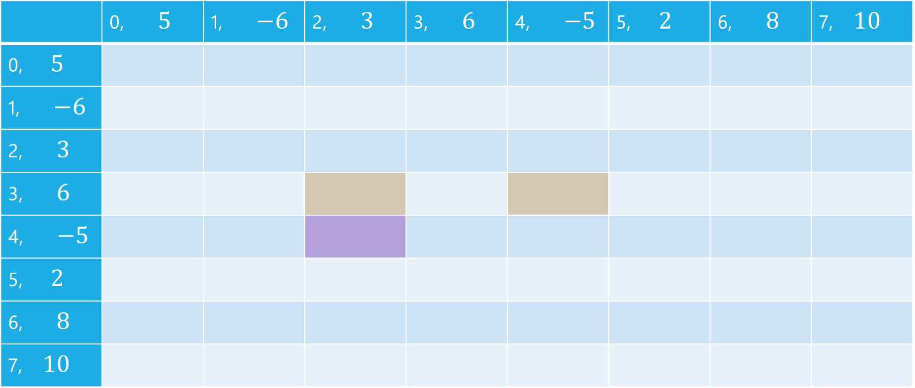


LIS
$$j$$
 | 0, $5$ | 1, $−6$ | 2, $3$ | 3, $6$ | 4, $−5$ | 5, $2$ | 6, $8$ | 7, $10$
0, $5$
1, $−6$
2, $3$
3, $6$
4, $−5$
5, $2$
6, $8$
7, $10$
$$i$$

Slide 8
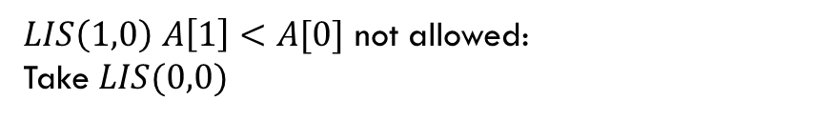
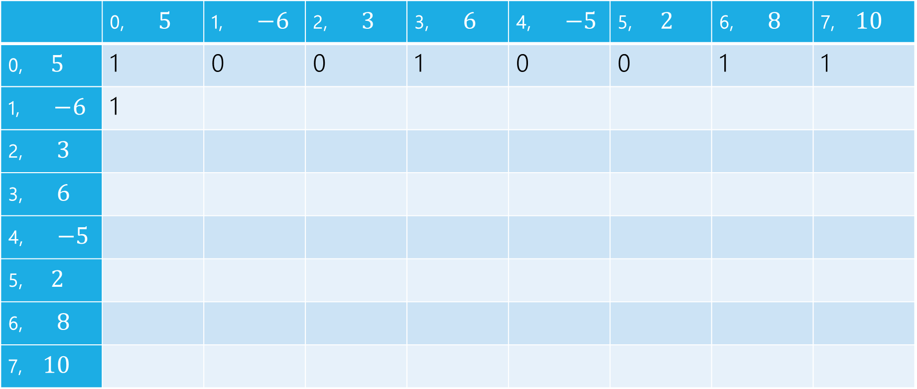
LIS
$LIS\left(1,0\right)$ $A\left[1\right]<A[0]$ not allowed:
Take $LIS(0,0)$
$$j$$
 | 0, $5$ | 1, $−6$ | 2, $3$ | 3, $6$ | 4, $−5$ | 5, $2$ | 6, $8$ | 7, $10$
0, $5$ | 1 | 0 | 0 | 1 | 0 | 0 | 1 | 1
1, $−6$ | 1
2, $3$
3, $6$
4, $−5$
5, $2$
6, $8$
7, $10$
$$i$$

Slide 9

LIS
$LIS\left(1,1\right)$ $A\left[1\right]≥A[1]$ can add, $1+LIS(0,1)$ or $LIS(0,1)$
$$j$$
 | 0, $5$ | 1, $−6$ | 2, $3$ | 3, $6$ | 4, $−5$ | 5, $2$ | 6, $8$ | 7, $10$
0, $5$ | 1 | 0 | 0 | 1 | 0 | 0 | 1 | 1
1, $−6$ | 1 | 1
2, $3$
3, $6$
4, $−5$
5, $2$
6, $8$
7, $10$
$$i$$

Slide 10

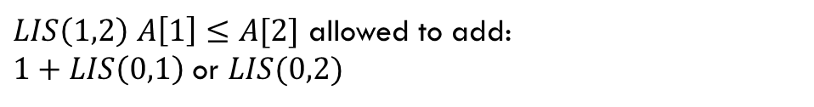
LIS
$LIS\left(1,2\right)$ $A\left[1\right]≤A[2]$ allowed to add:
$1+LIS\left(0,1\right)$ or $LIS(0,2)$
$$j$$
 | 0, $5$ | 1, $−6$ | 2, $3$ | 3, $6$ | 4, $−5$ | 5, $2$ | 6, $8$ | 7, $10$
0, $5$ | 1 | 0 | 0 | 1 | 0 | 0 | 1 | 1
1, $−6$ | 1 | 1 | 1
2, $3$
3, $6$
4, $−5$
5, $2$
6, $8$
7, $10$
$$i$$

Slide 11
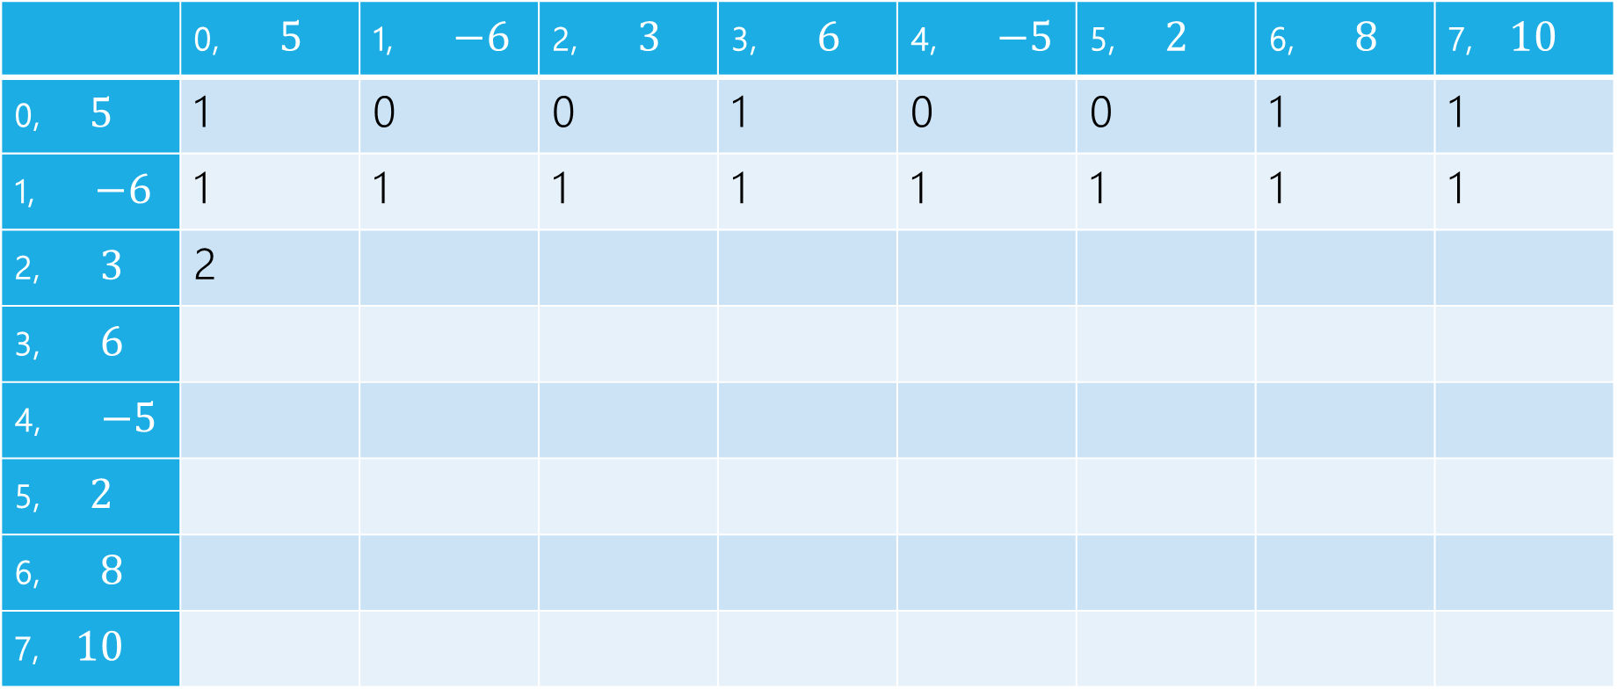
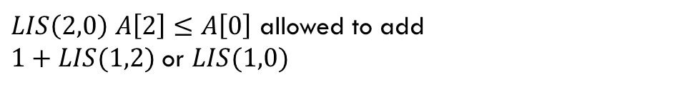
LIS
$LIS\left(2,0\right)$ $A\left[2\right]≤A\left[0\right]$ allowed to add
$1+LIS(1,2)$ or $LIS(1,0)$
$$j$$
 | 0, $5$ | 1, $−6$ | 2, $3$ | 3, $6$ | 4, $−5$ | 5, $2$ | 6, $8$ | 7, $10$
0, $5$ | 1 | 0 | 0 | 1 | 0 | 0 | 1 | 1
1, $−6$ | 1 | 1 | 1 | 1 | 1 | 1 | 1 | 1
2, $3$ | 2
3, $6$
4, $−5$
5, $2$
6, $8$
7, $10$
$$i$$

Slide 12
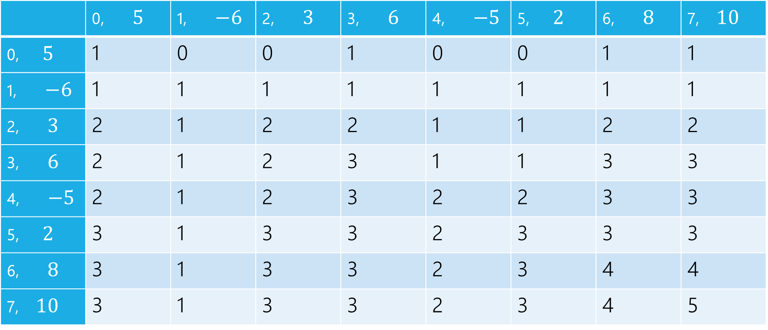
LIS
$$j$$
 | 0, $5$ | 1, $−6$ | 2, $3$ | 3, $6$ | 4, $−5$ | 5, $2$ | 6, $8$ | 7, $10$
0, $5$ | 1 | 0 | 0 | 1 | 0 | 0 | 1 | 1
1, $−6$ | 1 | 1 | 1 | 1 | 1 | 1 | 1 | 1
2, $3$ | 2 | 1 | 2 | 2 | 1 | 1 | 2 | 2
3, $6$ | 2 | 1 | 2 | 3 | 1 | 1 | 3 | 3
4, $−5$ | 2 | 1 | 2 | 3 | 2 | 2 | 3 | 3
5, $2$ | 3 | 1 | 3 | 3 | 2 | 3 | 3 | 3
6, $8$ | 3 | 1 | 3 | 3 | 2 | 3 | 4 | 4
7, $10$ | 3 | 1 | 3 | 3 | 2 | 3 | 4 | 5
$$i$$

Slide 13
pseudocode
//real code snippet that actually generated the table on the last slide
for(int j=0; j < n; j++){
vals[0][j] = (A[0] <= A[j]) ? 1 : 0;
}
for(int i = 1; i < 8; i++){
for(int j = 0; j < n; j++){
if(A[i] > A[j])
vals[i][j] = vals[i-1][j];
else{
vals[i][j] = Math.max(1+vals[i-1][i], vals[i-1][j]);
}
}
}

Slide 14
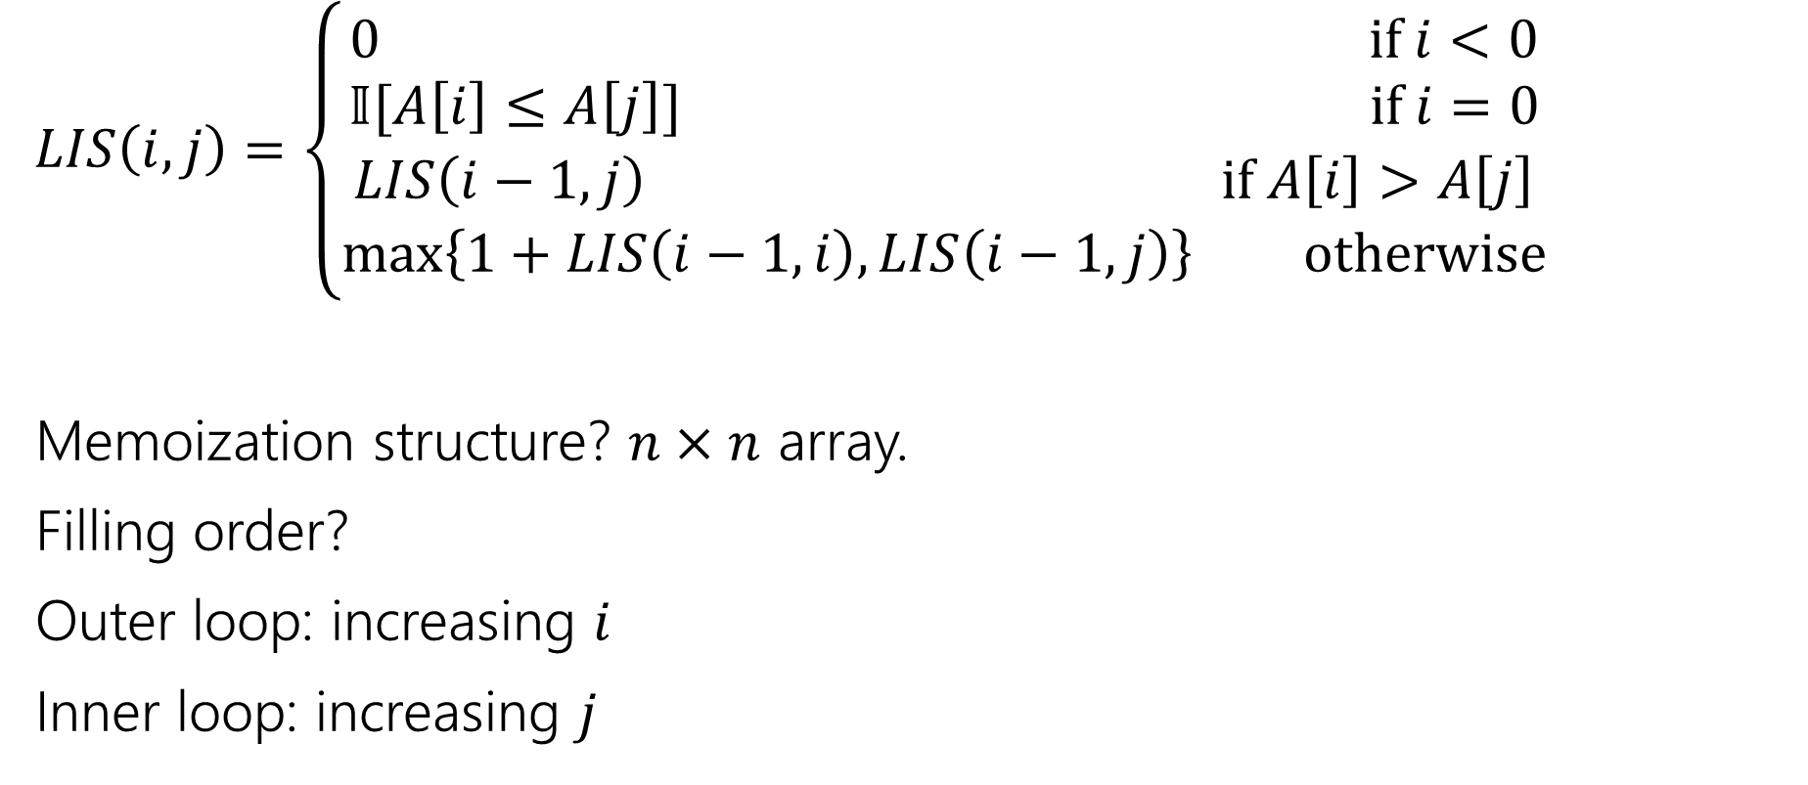
Longest Increasing Subsequence
$LIS\left(i,j\right)=\left\{\begin{aligned}0 if i<0 \\ 𝕀[A\left[i\right]≤A\left[j\right]] if i=0 \\ LIS\left(i−1,j\right) if A\left[i\right]>A\left[j\right] \\ \max\left\{1+LIS\left(i−1,i\right), LIS\left(i−1,j\right)\right\} otherwise\end{aligned}\right.$
Memoization structure? $n×n$ array.
Filling order?
Outer loop: increasing $i$
Inner loop: increasing $j$

Slide 15

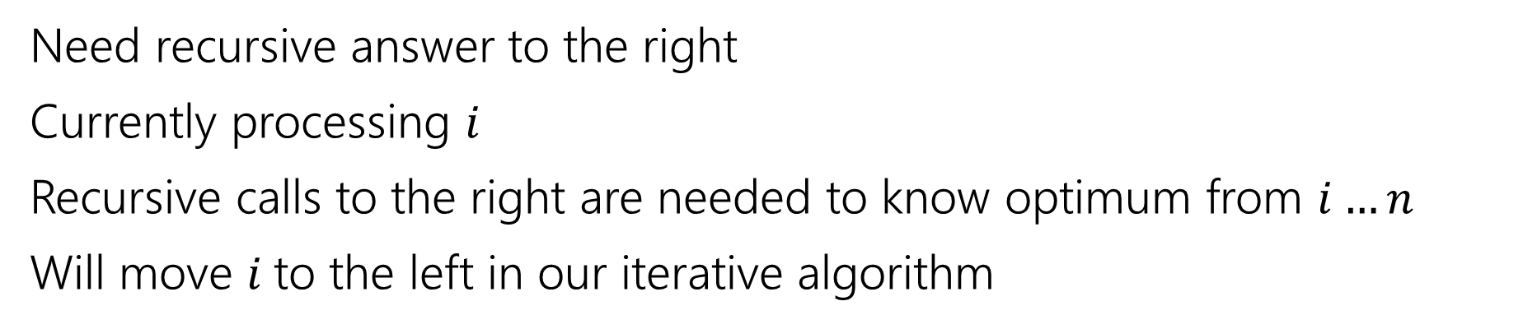
Recurrence
0 | 1 | 2 | 3 | 4 | 5 | 6 | 7
5 | -6 | 3 | 6 | -5 | 2 | 8 | 10
Not yet processed.
Current $i$
Recursive call is best value in this area
Need recursive answer to the right
Currently processing $i$
Recursive calls to the right are needed to know optimum from $i…n$
Will move $i$to the left in our iterative algorithm

Slide 16
Recurrence
0 | 1 | 2 | 3 | 4 | 5 | 6 | 7
5 | -6 | 3 | 6 | -5 | 2 | 8 | 10
Not yet processed.
Current $i$
Recursive call is best value in this area
Fill out the poll everywhere for Activity Credit!
Go to pollev.com/cse417 and login with your UW identity
Try to write a different recurrence for longest increasing subsequence.

Slide 17
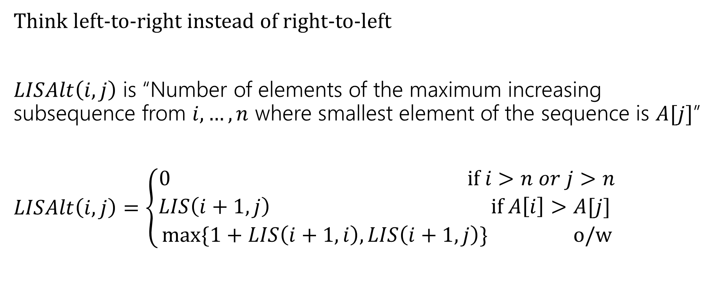
Longest Increasing Subsequence
Think left-to-right instead of right-to-left
$LISAlt\left(i,j\right)$ is “Number of elements of the maximum increasing subsequence from $i,…,n$ where smallest element of the sequence is $A[j]$”
$LISAlt\left(i,j\right)=\left\{\begin{aligned}0 if i>n or j>n \\ LIS\left(i+1,j\right) if A\left[i\right]>A[j] \\ \max{\{1+LIS\left(i+1,i\right), LIS\left(i+1,j\right)\}} o/w\end{aligned}\right.$

Slide 18
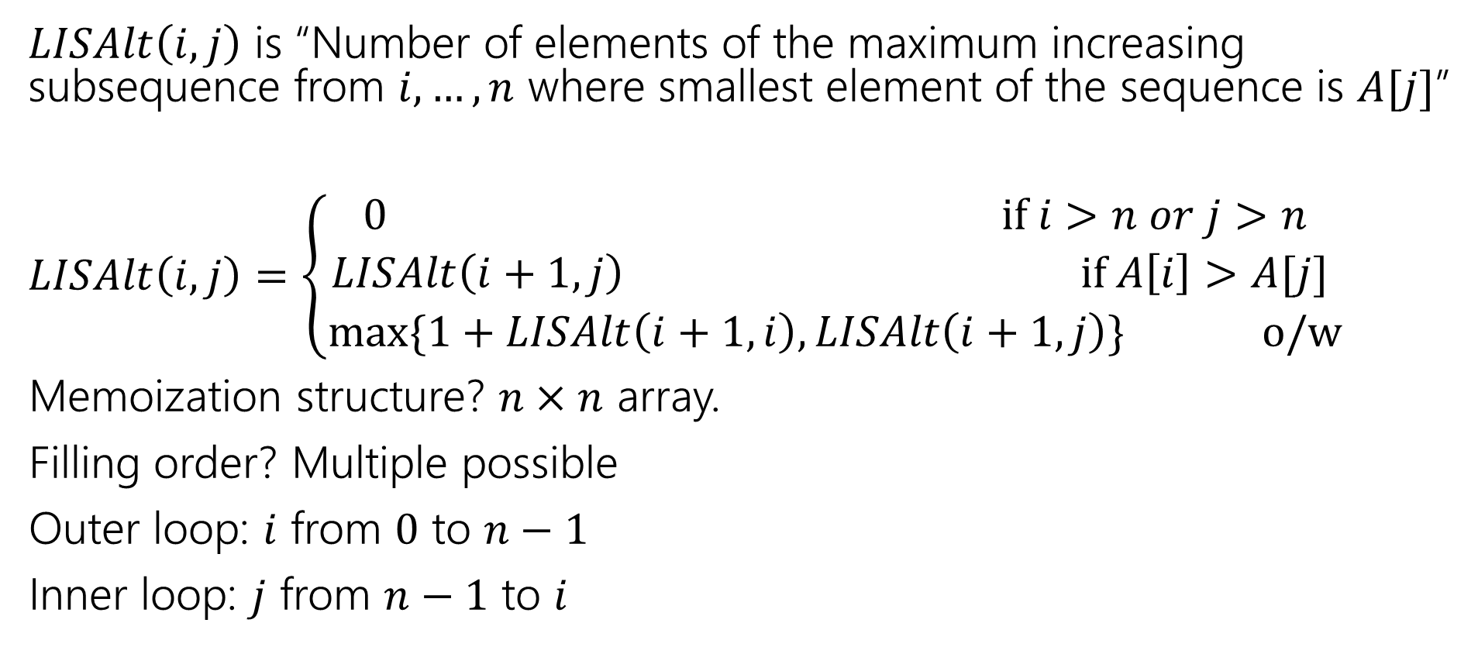
Longest Increasing Subsequence
$LISAlt\left(i,j\right)$ is “Number of elements of the maximum increasing subsequence from $i,…,n$ where smallest element of the sequence is $A[j]$”
$LISAlt\left(i,j\right)=\left\{\begin{aligned}0 if i>n or j>n \\ LISAlt\left(i+1,j\right) if A\left[i\right]>A[j] \\ \max{\{1+LISAlt\left(i+1,i\right), LISAlt\left(i+1,j\right)\}} o/w\end{aligned}\right.$
Memoization structure? $n×n$ array.
Filling order? Multiple possible
Outer loop: $i$ from $0$ to $n−1$
Inner loop: $j$ from $n−1$ to $i$

Slide 19
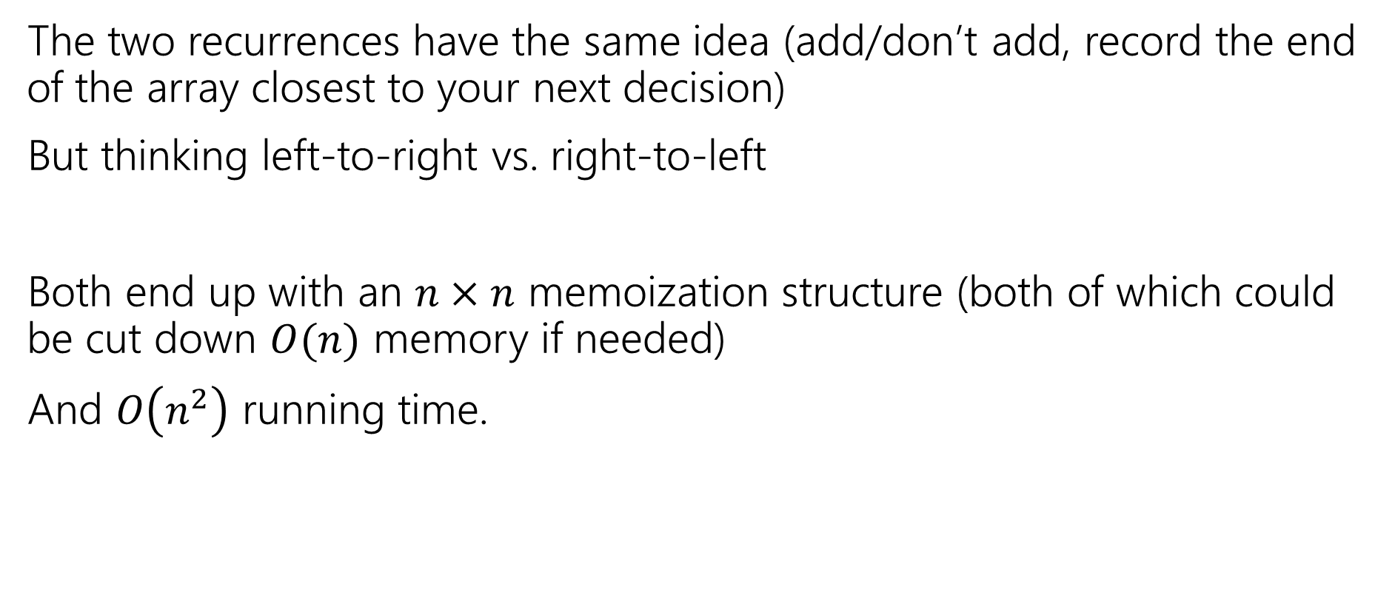
Summing Up
The two recurrences have the same idea (add/don’t add, record the end of the array closest to your next decision)
But thinking left-to-right vs. right-to-left
Both end up with an $n×n$ memoization structure (both of which could be cut down $O(n)$ memory if needed)
And $O\left(n^{2}\right)$ running time.

Slide 20
But Wait! There’s more
Another recurrence at the end of these slides for more practice.
Instead of thinking “do I include this element or not?” for each element,
Ask “what’s the next element” or equivalently “what’s the longest subsequence starting from me”
Get a different recurrence, but not a better running time.

Slide 21
Takeaways
When designing a dynamic program, we sometimes need to introduce a second variable, that doesn’t appear in the program
Or a second recurrence that mixes with the first if other decisions affect what’s optimal (beyond which problem you look at)
There might be more than one program available.

Slide 22
Extra Practice

Slide 23
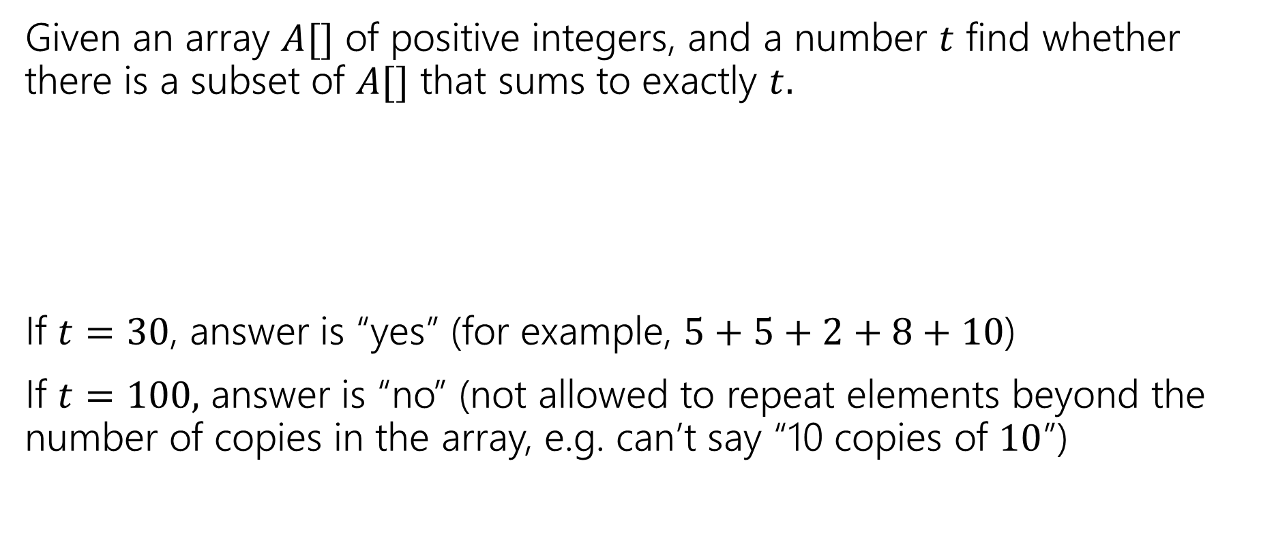
Subset Sum
Given an array $A[]$ of positive integers, and a number $t$ find whether there is a subset of $A[]$ that sums to exactly $t.$
If $t=30$, answer is “yes” (for example, $5+5+2+8+10$)
If $t=100,$ answer is “no” (not allowed to repeat elements beyond the number of copies in the array, e.g. can’t say “10 copies of $10$”)
0 | 1 | 2 | 3 | 4 | 5 | 6 | 7
5 | 6 | 3 | 6 | 5 | 2 | 8 | 10

Slide 24
Subset Sum
Write an English description of what you want to calculate
Write a recurrence
Give a sentence or two (in English) of why your recurrence should work.

Slide 25

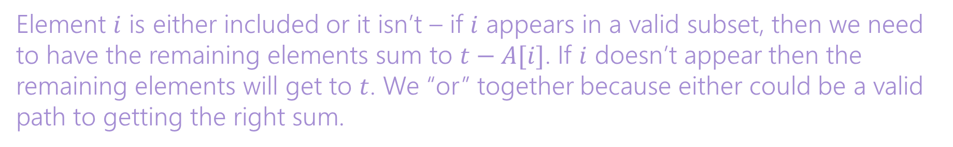
Subset Sum
Write an English description of what you want to calculate
Write a recurrence
Give a sentence or two (in English) of why your recurrence should work.
Let $SUBSUM(i,t)$ be true if and only if a subset of $A\left[0\right],…,A[i]$ can sum to $t$.
$$SUBSUM\left(i,t\right)=\left\{\begin{aligned}True if t=0 \\ False if i<0 and t≠0 \\ SUBSUM\left(i−1,t\right)||SUBSUM\left(i−1,t−A[i]\right) o/w\end{aligned}\right.$$
Element $i$ is either included or it isn’t – if $i$ appears in a valid subset, then we need to have the remaining elements sum to $t−A[i]$. If $i$ doesn’t appear then the remaining elements will get to $t$. We “or” together because either could be a valid path to getting the right sum.

Slide 26
Subset Sum
What memorization structure will you use?
Write the pseudocode to fill up the structure iteratively.
A 2D Boolean array SUBSUM($i,j$). Array will be $n×T$
SubSum(int[] A, int T)
Bool[][] SubSum = new Bool[n][T+1]
for(int j=0;j<T+1;j++){ SubSum[0][j]=False;}
SubSum[0][A[0]]=True;
for(int i=1; i<n;i++){
for(int j=0; j<T+1; j++){
if(SubSum[i-1][j]){
SubSum[i][j]=True;
SubSum[i][j+A[i]]=True;//need to catch Array index errors. Don’t do
//this in real code.
}
}
}
return SubSum[n][T-1];

Slide 27
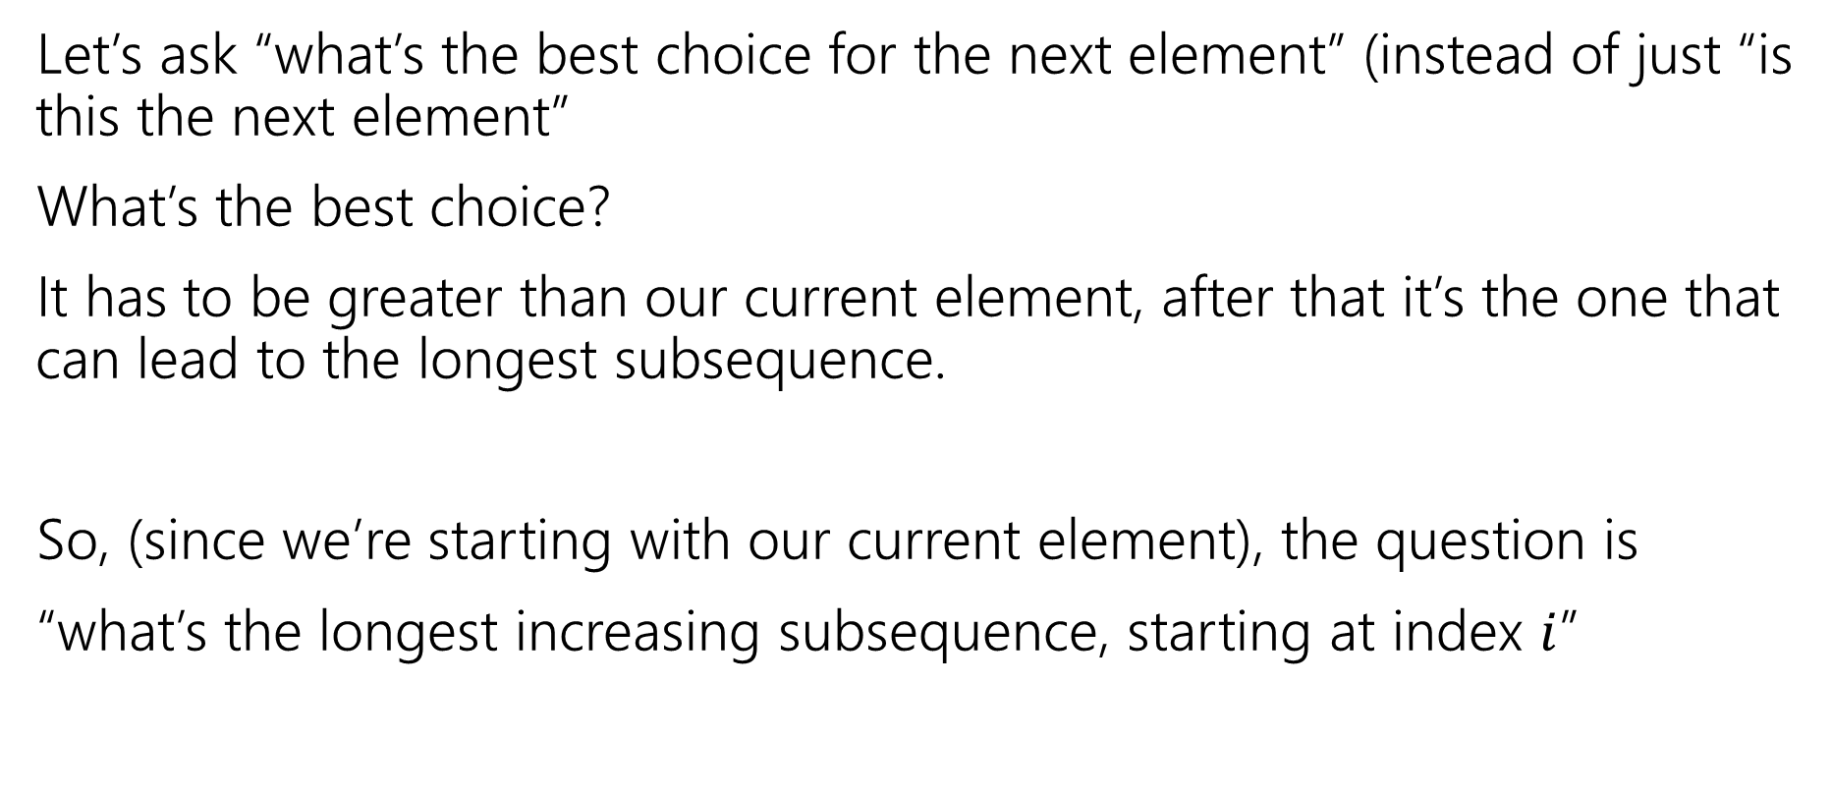
Longest Increasing Subsequence, Round 3
Let’s ask “what’s the best choice for the next element” (instead of just “is this the next element”
What’s the best choice?
It has to be greater than our current element, after that it’s the one that can lead to the longest subsequence.
So, (since we’re starting with our current element), the question is
“what’s the longest increasing subsequence, starting at index $i$”

Slide 28
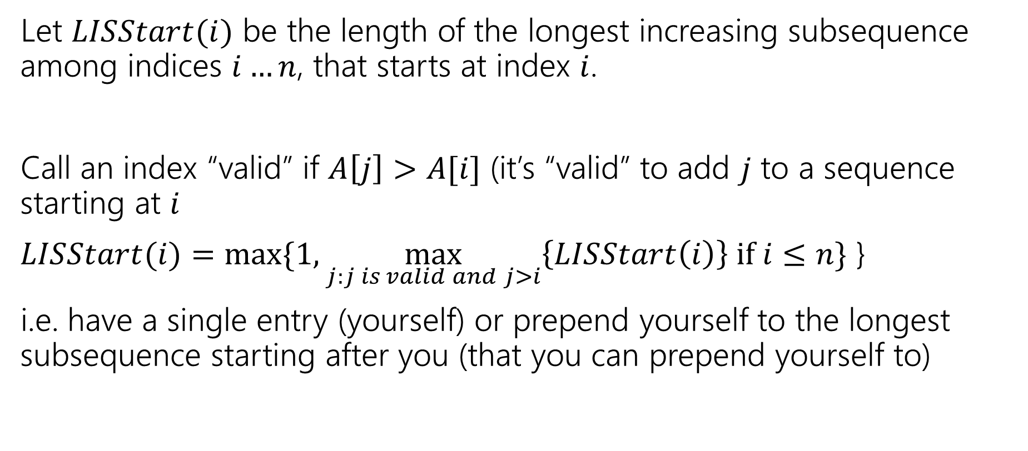
Longest Increasing Subsequence, Round 3
Let $LISStart(i)$ be the length of the longest increasing subsequence among indices $i…n$, that starts at index $i$.
Call an index “valid” if $A\left[j\right]>A[i]$ (it’s “valid” to add $j$ to a sequence starting at $i$
$LISStart(i)=max⁡\{1,\max_{j:j is valid and j>i}\left\{LISStart\left(i\right)\right\} if i≤n\}$ }
i.e. have a single entry (yourself) or prepend yourself to the longest subsequence starting after you (that you can prepend yourself to)

Slide 29
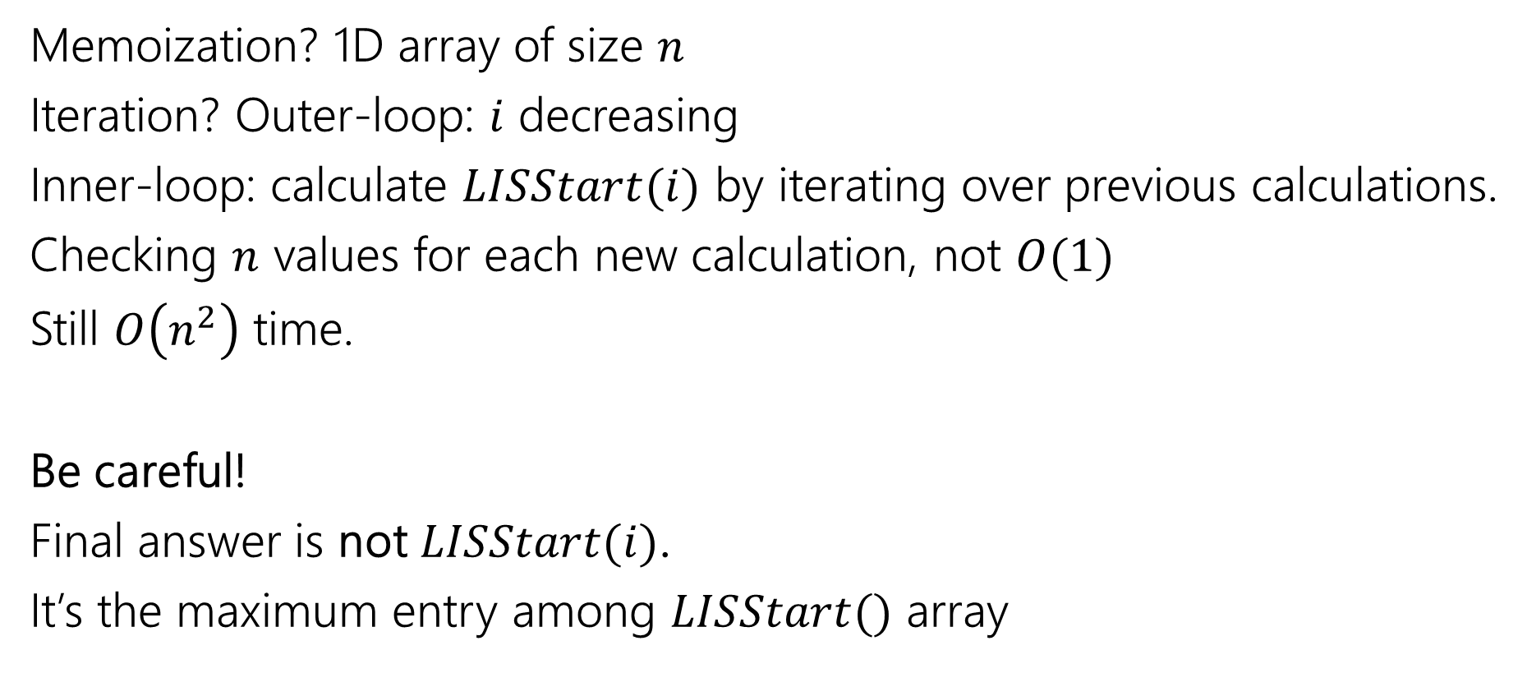
Longest Increasing Subsequence, Round 3
Memoization? 1D array of size $n$
Iteration? Outer-loop: $i$ decreasing
Inner-loop: calculate $LISStart(i)$ by iterating over previous calculations.
Checking $n$ values for each new calculation, not $O(1)$
Still $O\left(n^{2}\right)$ time.
Be careful!
Final answer is not $LISStart(i)$.
It’s the maximum entry among $LISStart()$ array

Slide 30
DP on Trees

Slide 31
DP on Trees
Trees are recursive structures
A tree is a root node, with zero or more children
Each of which are roots of trees
Since DP is “smart recursion” (recursion where we save values)
Recursive functions/calculations are really common.

Slide 32
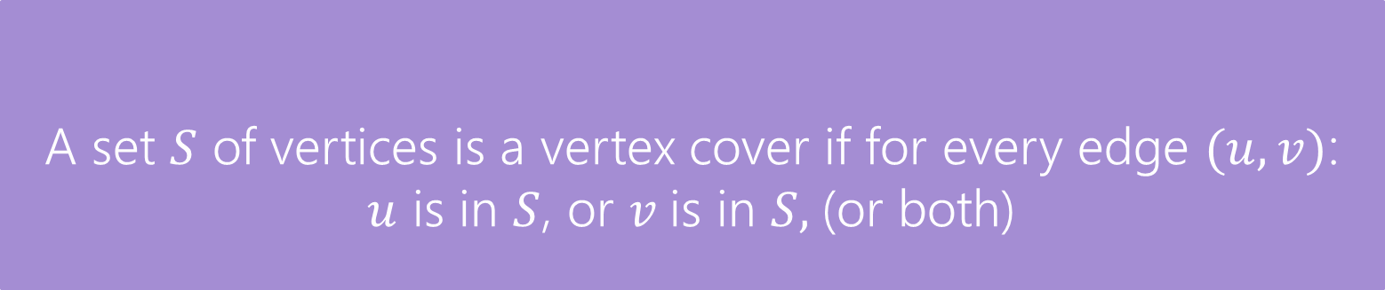
DP on Trees
Find the minimum vertex cover in a tree.
Give every vertex a weight, find the minimum weight vertex cover
Vertex Cover
A set $S$ of vertices is a vertex cover if for every edge $(u,v)$:
$u$ is in $S$, or $v$is in $S,$(or both)
The weight of a vertex cover is just the sum of the weights of the vertices in the set.
We want to find the minimum weight vertex cover.

Slide 33
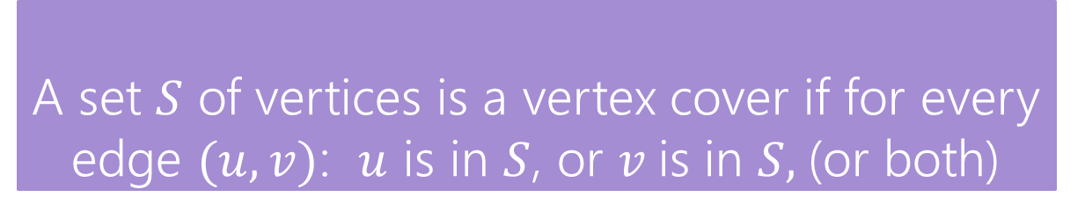
Vertex Cover
Vertex Cover
A set $S$ of vertices is a vertex cover if for every edge $(u,v)$: $u$ is in $S$, or $v$is in $S,$(or both)
Find the minimum vertex cover in a tree.
Give every vertex a weight, find the minimum weight vertex cover
1
10
8
5
3
20

Slide 34
Vertex Cover
Vertex Cover
A set $S$ of vertices is a vertex cover if for every edge $(u,v)$: $u$ is in $S$, or $v$is in $S,$(or both)
Find the minimum vertex cover in a tree.
Give every vertex a weight, find the minimum weight vertex cover
1
10
8
A valid vertex cover! (just take everything)
Definitely not the minimum though.
5
3
20

Slide 35
Vertex Cover
Vertex Cover
A set $S$ of vertices is a vertex cover if for every edge $(u,v)$: $u$ is in $S$, or $v$is in $S,$(or both)
Find the minimum vertex cover in a tree.
Give every vertex a weight, find the minimum weight vertex cover
1
10
8
A better vertex cover – weight 18
5
3
20

Slide 36
Vertex Cover
Vertex Cover
A set $S$ of vertices is a vertex cover if for every edge $(u,v)$: $u$ is in $S$, or $v$is in $S,$(or both)
Find the minimum vertex cover in a tree.
Give every vertex a weight, find the minimum weight vertex cover
1
10
8
The minimum vertex cover: weight 17
5
3
20

Slide 37
Vertex Cover
Vertex Cover
A set $S$ of vertices is a vertex cover if for every edge $(u,v)$: $u$ is in $S$, or $v$is in $S,$(or both)
Notice, the minimum weight vertex cover might have both endpoints of some edges
Even though only one of 1, 8 is required on the edge between them, they are both required for other edges.
Also an indication that greedy probably won’t work!
1
10
8
5
3
20

Slide 38
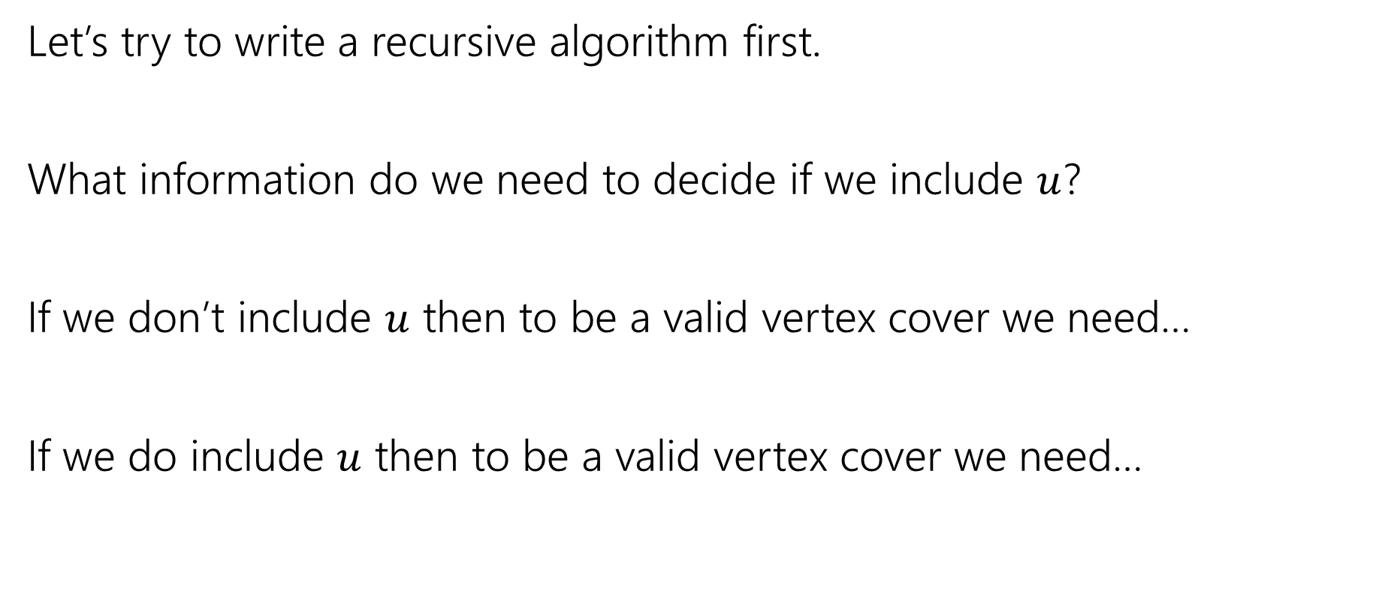
Vertex Cover – Recursively
Let’s try to write a recursive algorithm first.
What information do we need to decide if we include $u$?
If we don’t include $u$ then to be a valid vertex cover we need…
If we do include $u$ then to be a valid vertex cover we need…

Slide 39
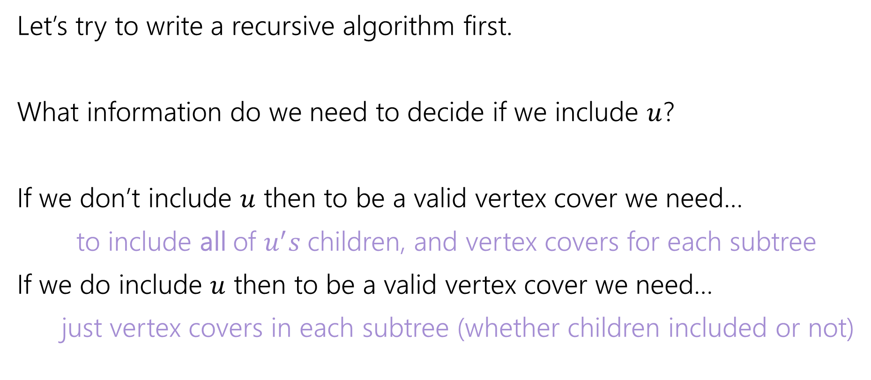
Vertex Cover – Recursively
Let’s try to write a recursive algorithm first.
What information do we need to decide if we include $u$?
If we don’t include $u$ then to be a valid vertex cover we need…
to include all of $u^{′}s$children, and vertex covers for each subtree
If we do include $u$ then to be a valid vertex cover we need…
just vertex covers in each subtree (whether children included or not)

Slide 40

Recurrence
Let $OPT(v)$ be the weight of a minimum weight vertex cover for the subtree rooted at $v$.
Write a recurrence for $OPT()$
Then figure out how to calculate it

Slide 41
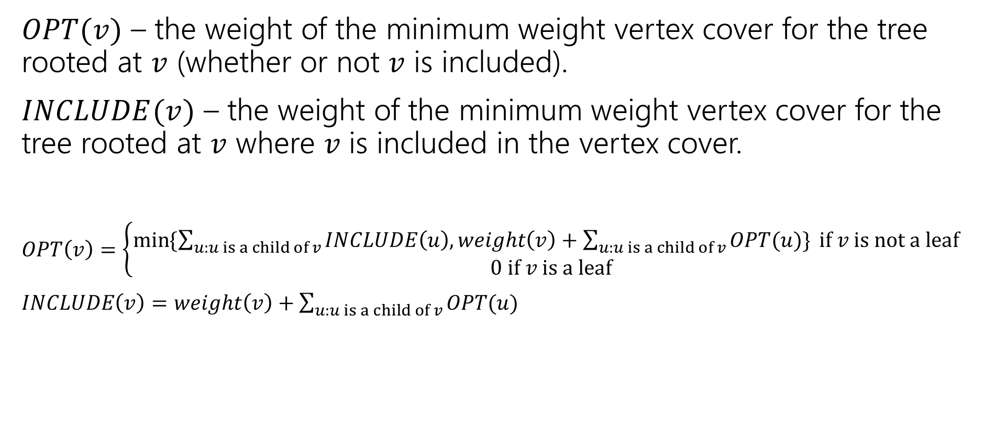
Recurrence
$OPT(v)$ – the weight of the minimum weight vertex cover for the tree rooted at $v$ (whether or not $v$ is included).
$INCLUDE(v)$ – the weight of the minimum weight vertex cover for the tree rooted at $v$ where $v$ is included in the vertex cover.
$OPT\left(v\right)=\left\{\begin{aligned}\min{⁡\{\sum_{u:u is a child of v}{INCLUDE\left(u\right), weight\left(v\right)+\sum_{u:u is a child of v}{OPT(u)\}} if v is not a leaf} } \\ 0 if v is a leaf\end{aligned}\right.$
$INCLUDE\left(v\right)=weight\left(v\right)+\sum_{u:u is a child of v}{OPT(u)}$

Slide 42
Vertex Cover Dynamic Program
What memoization structure should we use?
What code should we write?
What’s the running time?

Slide 43
Vertex Cover Dynamic Program
What memoization structure should we use?
the tree itself!
What code should we write?
What’s the running time?

Slide 44
Vertex Cover
What order do we do the calculation?
1
10
8
5
3
20

Slide 45
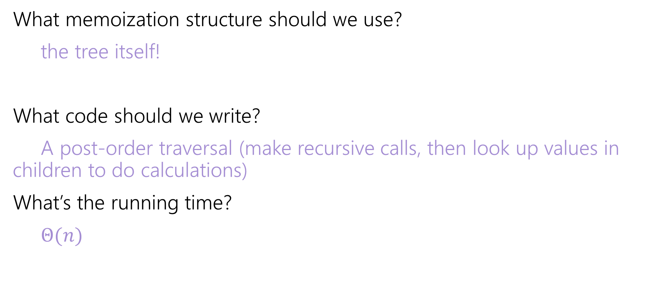
Vertex Cover Dynamic Program
What memoization structure should we use?
the tree itself!
What code should we write?
A post-order traversal (make recursive calls, then look up values in children to do calculations)
What’s the running time?
$Θ(n)$

Slide 46
DP Context

Slide 47
DP Design Notes
We haven’t done a single proof for DP…
We won’t ask you to do one.
DP proofs are almost always just “the code does the recurrence”
But that just moves the correctness question – why is the recurrence correct?
And the proof of the recurrence being correct is almost always “I included all the cases”
I’d rather you focus on checking it than trying to explain it.

Slide 48
DP history
So…why is it called “dynamic programming?”
“programming” is an old-timey meaning of the word.
It means “scheduling”
Like a conference has a “program” of who speaks where when.
Or a television executive decides on the nightly programming (what show airs when).

Slide 49
DP history
So…dynamic?
The phrase “dynamic programming” was popularized by Richard Bellman (we’ll see one of his algorithms on Monday)
He was a researcher, funded by the U.S. military….
But the Secretary of Defense [as Bellman tells it] hated research. And hated math even more.
So Bellman needed a description of his research that everyone

Slide 50
DP history
Dynamic
Is actually an accurate adjective – what we think is the best option (include/exclude) can change over time.
Even better
“It’s impossible to use the word ‘dynamic’ in a pejorative sense”
“It was something not even a Congressman could object to.”

Slide 51
Next week
Dynamic Programming on General graphs
Linear Programming

