Slide 1
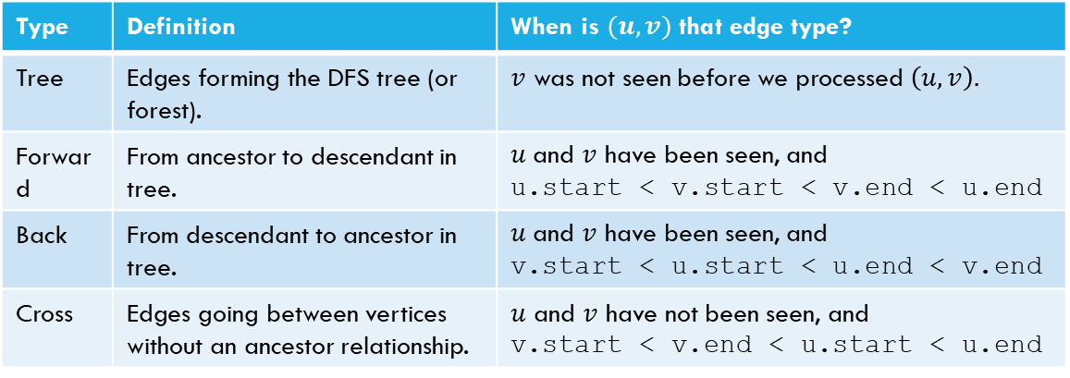
Try it Yourselves!
Type | Definition | When is $(u,v)$ that edge type?
Tree | Edges forming the DFS tree (or forest). | $v$ was not seen before we processed $\left(u,v\right).$
Forward | From ancestor to descendant in tree. | $u$and $v$ have been seen, and u.start < v.start < v.end < u.end
Back | From descendant to ancestor in tree. | $u$and $v$ have been seen, and v.start < u.start < u.end < v.end
Cross | Edges going between vertices without an ancestor relationship. | $u$ and $v$ have not been seen, and v.start < v.end < u.start < u.end
DFSWrapper(G)
counter = 0
For each vertex u of G
If u is not “seen”
DFS(u)
End If
End For
A
DFS(u)
Mark u as “seen”
u.start = counter++
For each edge (u,v) //leaving u
If v is not “seen”
DFS(v)
End If
End For
u.end = counter++
B
C
D
F
E

Slide 2
DFS, Graph Modeling
CSE 417 Winter 21
Lecture 6

Slide 3
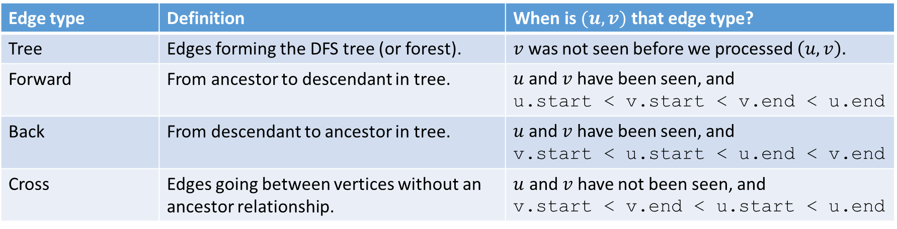
Edge Classification (for DFS on directed graphs)
Edge type | Definition | When is $(u,v)$ that edge type?
Tree | Edges forming the DFS tree (or forest). | $v$ was not seen before we processed $\left(u,v\right).$
Forward | From ancestor to descendant in tree. | $u$and $v$ have been seen, and u.start < v.start < v.end < u.end
Back | From descendant to ancestor in tree. | $u$and $v$ have been seen, and v.start < u.start < u.end < v.end
Cross | Edges going between vertices without an ancestor relationship. | $u$ and $v$ have not been seen, and v.start < v.end < u.start < u.end
The third column doesn’t look like it encompasses all possibilities.
It does – the fact that we’re using a stack limits the possibilities:
e.g. u.start < v.start < u.end < v.end is impossible.
And the rules of the algorithm eliminate some other possibilities.

Slide 4
Try it Yourselves!
DFSWrapper(G)
counter = 0
For each vertex u of G
If u is not “seen”
DFS(u)
End If
End For
1
12
A
back
2
B
C
7
8
11
forward
4
5
3
10
D
cross
DFS(u)
Mark u as “seen”
u.start = counter++
For each edge (u,v) //leaving u
If v is not “seen”
DFS(v)
End If
End For
u.end = counter++
F
E
6
9

Slide 5
Actually Using DFS
Here’s a claim that will let us use DFS for something!
DFS run on a directed graph has a back edge if and only if it has a cycle.
Back Edge Characterization

Slide 6
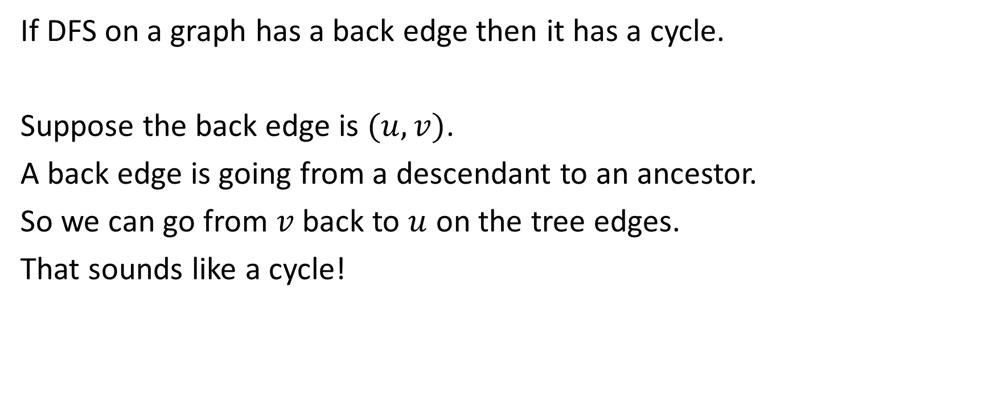
Forward Direction
If DFS on a graph has a back edge then it has a cycle.
Suppose the back edge is $(u,v)$.
A back edge is going from a descendant to an ancestor.
So we can go from $v$ back to $u$ on the tree edges.
That sounds like a cycle!

Slide 7
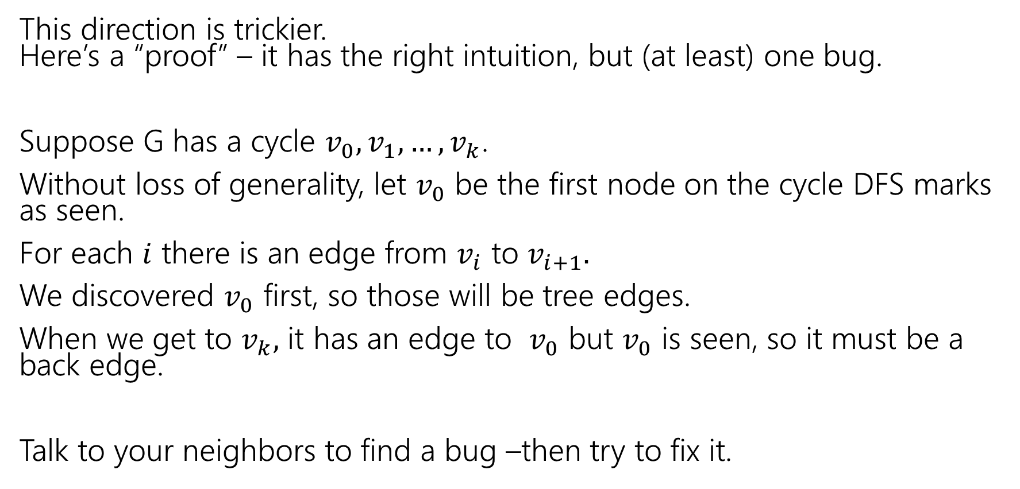
Backward direction
This direction is trickier.
Here’s a “proof” – it has the right intuition, but (at least) one bug.
Suppose G has a cycle $v_{0},v_{1},…,v_{k}$.
Without loss of generality, let $v_{0}$ be the first node on the cycle DFS marks as seen.
For each $i$ there is an edge from $v_{i}$ to $v_{i+1}.$
We discovered $v_{0}$ first, so those will be tree edges.
When we get to $v_{k},$ it has an edge to $v_{0}$ but $v_{0}$ is seen, so it must be a back edge.
Talk to your neighbors to find a bug –then try to fix it.

Slide 8
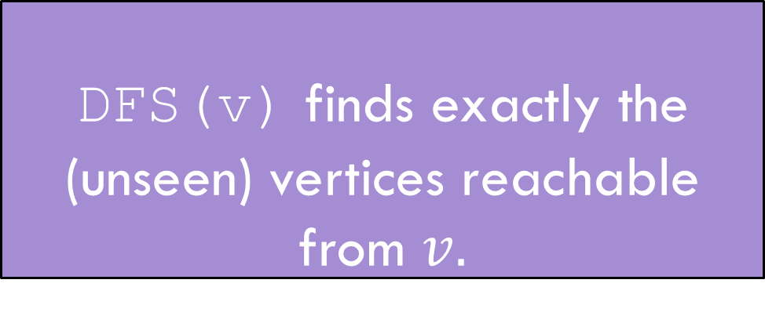
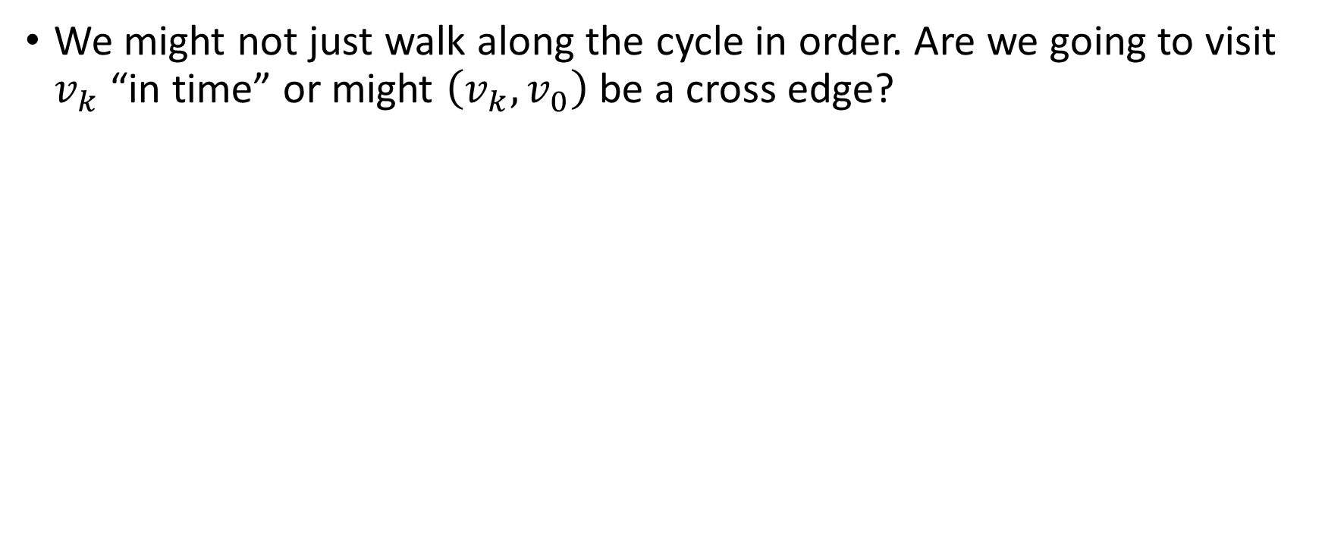
Fixing the Backward Direction
We might not just walk along the cycle in order. Are we going to visit $v_{k}$ “in time” or might $\left(v_{k}, v_{0}\right)$ be a cross edge?
DFS(v) finds exactly the (unseen) vertices reachable from $v.$
DFS discovery

Slide 9
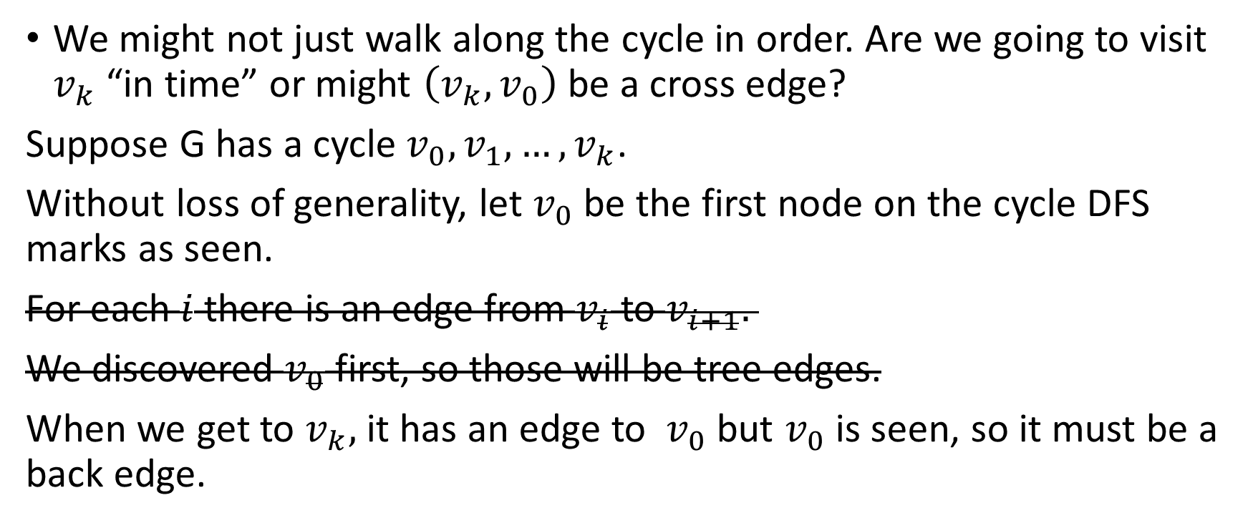
Fixing the Backward Direction
We might not just walk along the cycle in order. Are we going to visit $v_{k}$ “in time” or might $\left(v_{k}, v_{0}\right)$ be a cross edge?
Suppose G has a cycle $v_{0},v_{1},…,v_{k}$.
Without loss of generality, let $v_{0}$ be the first node on the cycle DFS marks as seen.
For each $i$ there is an edge from $v_{i}$ to $v_{i+1}.$
We discovered $v_{0}$ first, so those will be tree edges.
When we get to $v_{k},$ it has an edge to $v_{0}$ but $v_{0}$ is seen, so it must be a back edge.
$v_{k}$ is reachable from $v_{0}$ so we must reach $v_{k}$ before $v_{0}$ comes off the stack.

Slide 10
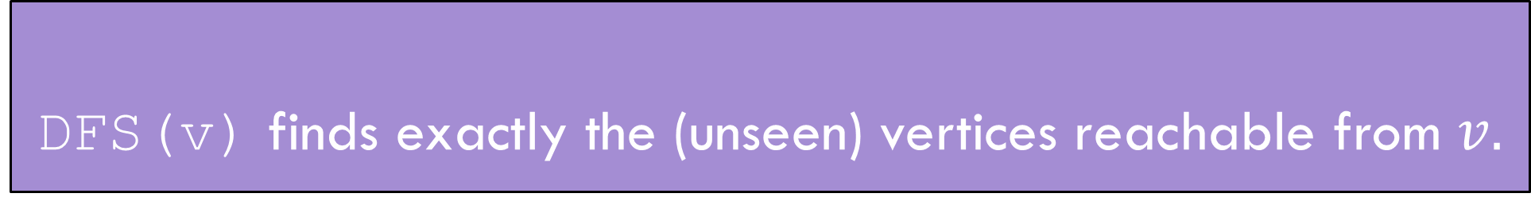
Summary
DFS(v) finds exactly the (unseen) vertices reachable from $v.$
DFS discovery
A directed graph has a back edge if and only if it has a cycle.
Back Edge Characterization

Slide 11
BFS/DFS caveats and cautions
Edge classifications are different for directed graphs and undirected graphs.
DFS in undirected graphs don’t have cross edges.
BFS in directed graphs can have edges skipping levels (only as back edges, skipping levels up though!)

Slide 12
Summary – Graph Search Applications
BFS
dfs
Shortest Paths (unweighted) graphs)
Cycle detection (directed graphs)
Topological sort
Strongly connected components
Cut edges (on homework)
EITHER
2-coloring
Connected components (undirected)
Usually use BFS – easier to understand.

Slide 13
Designing New Algorithms on Directed Graphs
In 373 you learned some applications of depth first search:
Finding Strongly Connected Components
Finding a Topological Sort of a DAG
We’ll briefly review what these do, but won’t go into details.

Slide 14
Your turn: Find Strongly Connected Components
A
B
D
E
K
C
F
J
A subgraph C such that every pair of vertices in C is connected via some path in both directions, and there is no other vertex which is connected to every vertex of C in both directions.
Strongly Connected Component
{A}, {B}, {C,D,E,F}, {J,K}

Slide 15
Problem 1: Ordering Dependencies
Given a directed graph G, where we have an edge from u to v if u must happen before v.
We can only do things one at a time, can we find an order that respects dependencies?
Given: a directed graph G
Find: an ordering of the vertices so all edges go from left to right.
Topological Sort (aka Topological Ordering)
Uses:
Compiling multiple files
Graduating

Slide 16
Topological Ordering
A course prerequisite chart and a possible topological ordering.
Math 126
CSE 374
CSE 143
CSE 142
CSE 373
CSE 417
Math 126
CSE 142
CSE 143
CSE 373
CSE 374
CSE 417

Slide 17
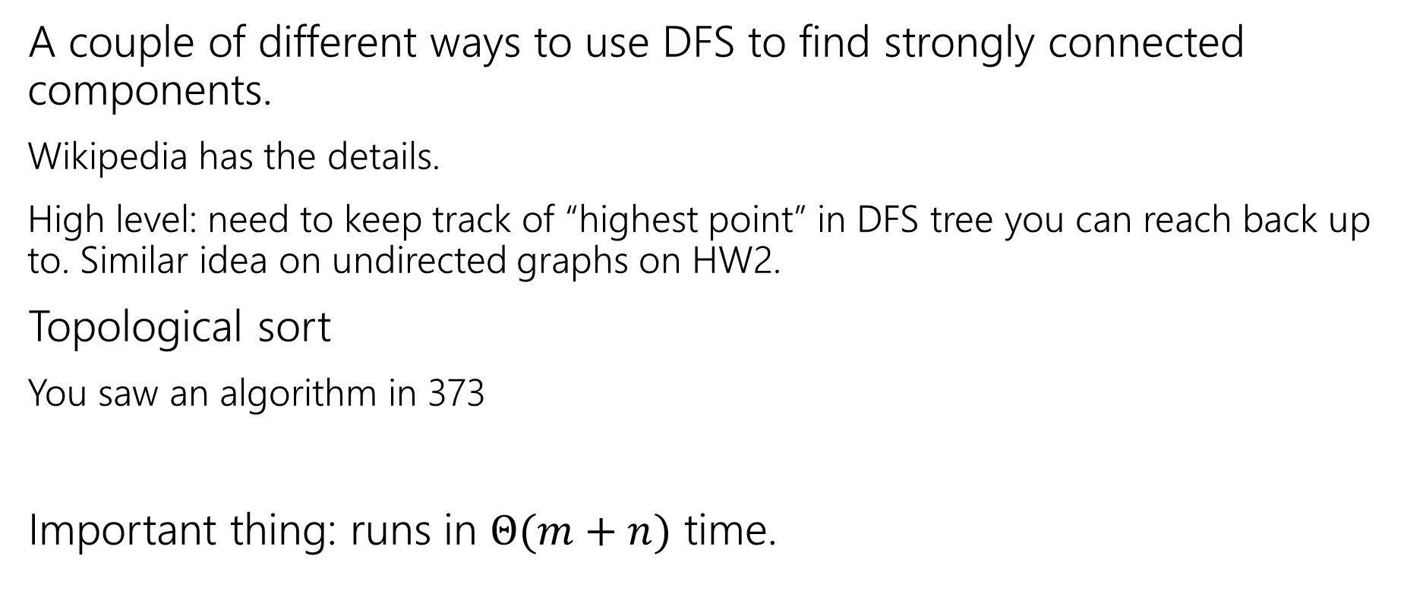
How do these work?
A couple of different ways to use DFS to find strongly connected components.
Wikipedia has the details.
High level: need to keep track of “highest point” in DFS tree you can reach back up to. Similar idea on undirected graphs on HW2.
Topological sort
You saw an algorithm in 373
Important thing: runs in $Θ(m+n)$ time.

Slide 18
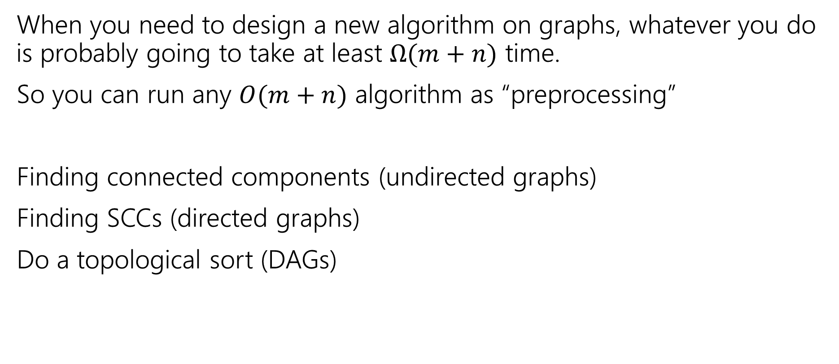
Designing new algorithms
When you need to design a new algorithm on graphs, whatever you do is probably going to take at least $Ω(m+n)$ time.
So you can run any $O(m+n)$ algorithm as “preprocessing”
Finding connected components (undirected graphs)
Finding SCCs (directed graphs)
Do a topological sort (DAGs)

Slide 19
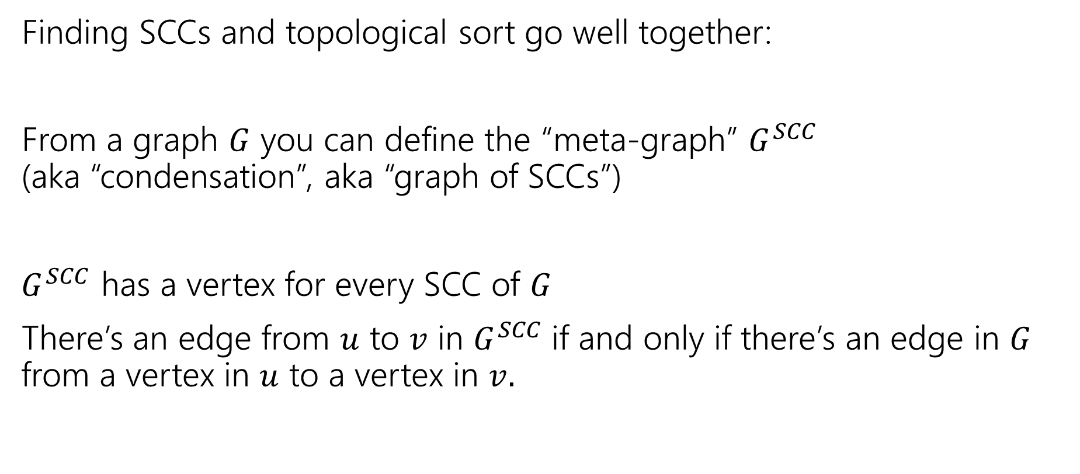
Designing New Algorithms
Finding SCCs and topological sort go well together:
From a graph $G$ you can define the “meta-graph” $G^{SCC}$
(aka “condensation”, aka “graph of SCCs”)
$G^{SCC}$ has a vertex for every SCC of $G$
There’s an edge from $u$ to $v$ in $G^{SCC}$if and only if there’s an edge in $G$ from a vertex in $u$ to a vertex in $v.$

Slide 20
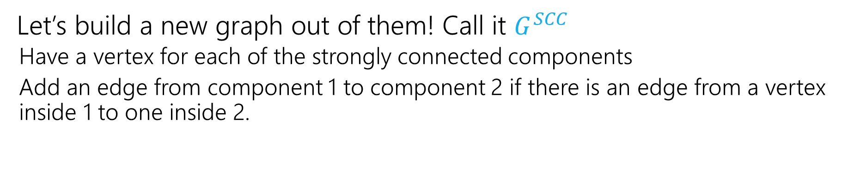
Why Find SCCs?
Let’s build a new graph out of them! Call it $G^{SCC}$
  Have a vertex for each of the strongly connected components
  Add an edge from component 1 to component 2 if there is an edge from a vertex inside 1 to one inside 2.
A
B
D
E
K
1
2
C
F
J
3
4

Slide 21
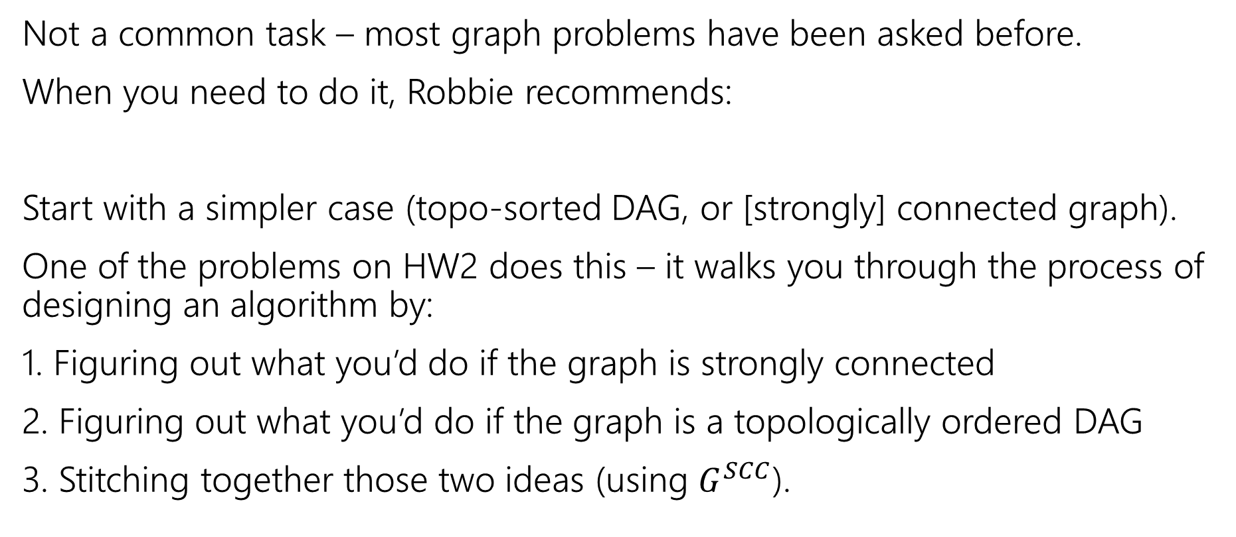
Designing New Graph Algorithms
Not a common task – most graph problems have been asked before.
When you need to do it, Robbie recommends:
Start with a simpler case (topo-sorted DAG, or [strongly] connected graph).
One of the problems on HW2 does this – it walks you through the process of designing an algorithm by:
1. Figuring out what you’d do if the graph is strongly connected
2. Figuring out what you’d do if the graph is a topologically ordered DAG
3. Stitching together those two ideas (using $G^{SCC}$).

Slide 22
Graph Modeling
But…Most of the time you don’t need a new graph algorithm.
What you need is to figure out what graph to make and which graph algorithm to run.
“Graph modeling”
Going from word problem to graph algorithm.
Often finding a clever way to turn your requirements into graph features.
Mix of “standard bag of tricks” and new creativity.

Slide 23
Graph Modeling Process
1. What are your fundamental objects?
  Those will probably become your vertices.
2. How are those objects related?
  Represent those relationships with edges.
3. How is what I’m looking for encoded in the graph?
  Do I need a path from s to t? The shortest path from s to t? A minimum spanning tree? Something else?
4. Do I know how to find what I’m looking for?
  Then run that algorithm/combination of algorithms
  Otherwise go back to step 1 and try again.

Slide 24
Scenario #1
You’ve made a new social networking app, Convrs. Users on Convrs can have “asymmetric” following (I can follow you, without you following me). You decide to allow people to form multi-user direct messages, but only if people are probably in similar social circles (to avoid spamming).
You’ll allow a messaging channel to form only if for every pair of users a,b in the channel: a must follow b or follow someone who follows b or follow someone who follows someone who follows b, or …
And the same for b to a.
You’d like to be able to quickly check for any new proposed channel whether it meets this condition.
What are the vertices?
What are the edges?
What are we looking for?
What do we run?

Slide 25
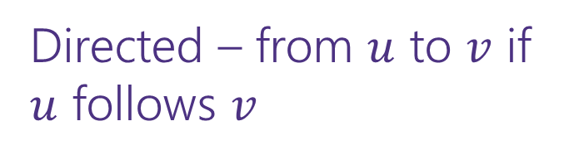
Scenario #1
You’ve made a new social networking app, Convrs. Users on Convrs can have “asymmetric” following (I can follow you, without you following me). You decide to allow people to form multi-user direct messages, but only if people are probably in similar social circles (to avoid spamming).
You’ll allow a messaging channel to form only if for every pair of users a,b in the channel: a must follow b or follow someone who follows b or follow someone who follows someone who follows b, or …
And the same for b to a.
You’d like to be able to quickly check for any new proposed channel whether it meets this condition.
What are the vertices?
What are the edges?
What are we looking for?
What do we run?
Users
Directed – from $u$ to $v$ if $u$ follows $v$
If everyone in the channel is in the same SCC.
Find SCCs, to test a new channel, make sure all are in same component.

Slide 26
Scenario #2
Sports fans often use the “transitive law” to predict sports outcomes -- .
In general, if you think A is better than B, and B is also better than C, then you expect that A is better than C.
Teams don’t all play each other – from data of games that have been played, determine if the “transitive law” is realistic, or misleading about at least one outcome.
What are the vertices?
What are the edges?
What are we looking for?
What do we run?

Slide 27
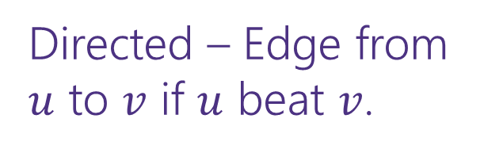
Scenario #2
What are the vertices?
What are the edges?
What are we looking for?
What do we run?
Sports fans often use the “transitive law” to predict sports outcomes -- .
In general, if you think A is better than B, and B is also better than C, then you expect that A is better than C.
Teams don’t all play each other – from data of games that have been played, determine if the “transitive law” is realistic, or misleading about at least one outcome.
Teams
Directed – Edge from $u$ to $v$ if $u$ beat $v$.
A cycle would say it’s not realistic.
OR a topological sort would say it is.
Cycle-detection DFS.
a topological sort algorithm (with error detection)

Slide 28
Scenario #3
19
It’s a
small
world
15
6
4
7
You are at Splash Mountain. Your best friend is at Space Mountain. You have to tell each other about your experiences in person as soon as possible. Where do you meet and how quickly can you get there?
What are the vertices?
  Rides
What are the edges?
  Walkways with how long it would take to walk
What are we looking for?
  The “midpoint”
What do we run?
  Run Dijkstra’s from Splash Mountain, store distances
  Run Dijkstra’s from Space Mountain, store distances
  Iterate over vertices, for each vertex remember max of two
  Iterate over vertices, find minimum of remembered numbers
Dumbo
33
29
6
16
12
10
8
9
5
22
Matter-
horn
14
Thunder
Mtn
14
32
4
5
1
17
13
Splash
Mtn
Castle
36
19
9
0
7
15
17
0
11
9
3
29
Space
Mtn
Indiana
Jones
8
10
1
15
0
Star
Tours
Flag
Pole
28
1
36
2
2
31
Jungle
Cruise
20
3
37
17

Slide 29
Scenario #4
You’re a Disneyland employee, working the front of the Splash Mountain line. Suddenly, the crowd-control gates fall over and the line degrades into an unordered mass of people.
Sometimes you can tell who was in line before who; for other groups you aren’t quite sure.
You need to restore the line, while ensuring if you knew A came before B before the incident, they will still be in the right order afterward.
What are the vertices?
  People
What are the edges?
  Edges are directed, have an edge from X to Y if you know X came before Y.
What are we looking for?
  A total ordering consistent with all the ordering we do know.
What do we run?
  Topological Sort!

