Slide 1
CSE 332 Winter 2024 Lecture 7: Dictionaries, BSTs
Nathan Brunelle
http://www.cs.uw.edu/332

Slide 2
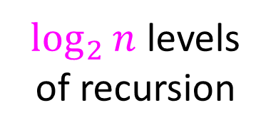
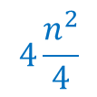
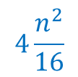
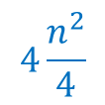
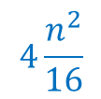
Warm Up: Tree Method
$$T\left(n\right)=2T\left(\frac{n}{2} \right)+4n^{2}$$
Red box represents a problem instance
$$n$$
$$4n^{2}$$
⇒ $4\frac{n^{2}}{4^{i}}$ work at level $i$
Blue value represents time spent at that level of recursion
$$n/2$$
$$4\frac{n^{2}}{4}$$
$$n/2$$
$$4\frac{n^{2}}{4}$$
$$n/4$$
$$4\frac{n^{2}}{16}$$
$$n/4$$
$$4\frac{n^{2}}{16}$$
$$n/4$$
$$4\frac{n^{2}}{16}$$
$$n/4$$
$$4\frac{n^{2}}{16}$$
$\log_{2}⁡n$ levels
of recursion
…
…
…
…
…
$$1$$
$$1$$
$$1$$
$$1$$
$$1$$
$$1$$
$$1$$
$$1$$
$$1$$
$$1$$
$$1$$
$$1$$
$$T\left(n\right)=\sum_{i=1}^{\log_{2}{n}}{4\frac{n^{2}}{4^{i}}}=4n^{2}\sum_{i=1}^{\log_{2}{n}}{\frac{1}{4^{i}}}=Θ(n^{2})$$

Slide 3
Warm Up: Which is better?
Both of the following build a binary heap within an unordered array. Which is better?
5
buildHeapDown(arr){
for(int i = arr.length; i>0; i--){
percolateDown(arr, i);
}
}
Parents where Heap Property is Violated
0
6
10
3
1
15
8
2
7
3
4
5
6
buildHeapUp(arr){
for(int i = 0; i<arr.length; i++){
percolateUp(arr, i);
}
}
14
2
1
7
8
9
5
6
10
3
15
8
7
14
2
1
0
1
2
3
4
5
6
7
8
9

Slide 4
Dictionary (Map) ADT
Contents:
Sets of key+value pairs
Keys must be comparable
Operations:
insert(key, value)
Adds the (key,value) pair into the dictionary
If the key already has a value, overwrite the old value
Consequence: Keys cannot be repeated
find(key)
Returns the value associated with the given key
delete(key)
Remove the key (and its associated value)

Slide 5
Naïve attempts
Data Structure | Time to insert | Time to find | Time to delete
Unsorted Array | $$Θ(n)$$ | $$Θ(n)$$ | $$Θ(n)$$
Unsorted Linked List | $$Θ(n)$$ | $$Θ(n)$$ | $$Θ(n)$$
Sorted Array | $$Θ\left(n\right)$$ | $$Θ(\log{n})$$ | $$Θ(n)$$
Sorted Linked List | $$Θ\left(n\right)$$ | $$Θ\left(n\right)$$ | $$Θ\left(n\right)$$

Slide 6
Less Naïve attempts
Binary Search Trees (today)
Tries (Project)
AVL Trees (next week)
B-Trees (next week)
HashTables (week after)
Red-Black Trees (not included in this course)
Splay Trees (not included in this course)

Slide 7
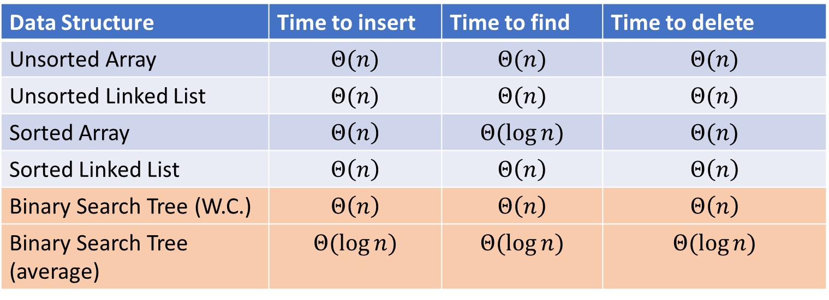
Naïve attempts
Data Structure | Time to insert | Time to find | Time to delete
Unsorted Array | $$Θ(n)$$ | $$Θ(n)$$ | $$Θ(n)$$
Unsorted Linked List | $$Θ(n)$$ | $$Θ(n)$$ | $$Θ(n)$$
Sorted Array | $$Θ\left(n\right)$$ | $$Θ(\log{n})$$ | $$Θ(n)$$
Sorted Linked List | $$Θ\left(n\right)$$ | $$Θ\left(n\right)$$ | $$Θ\left(n\right)$$
Binary Search Tree (W.C.) | $$Θ\left(n\right)$$ | $$Θ\left(n\right)$$ | $$Θ\left(n\right)$$
Binary Search Tree (average) | $$Θ(\log{n})$$ | $$Θ(\log{n})$$ | $$Θ(\log{n})$$

Slide 8
Tree Height
treeHeight(root){
height = 0;
if (root.left != Null){
height = max(height, treeHeight(root.left));
}
if (root.right != Null){
height = max(height, treeHeight(root.right));
}
return height;
}

Slide 9
More Tree “Vocab”
D
U
B
Traversal:
An algorithm for “visiting/processing” every node in a tree
Pre-Order Traversal:
Root, Left Subtree, Right Subtree
In-Order Traversal:
Left Subtree, Root, Right Subtree
Post-Order Traversal
Left Subtree, Right Subtree, Root
S
2

Slide 10
Name that Traversal!
AorderTraversal(root){
if (root.left != Null){
process(root.left);
}
if (root.right != Null){
process(root.right);
}
process(root);
}
BorderTraversal(root){
process(root);
if (root.left != Null){
process(root.left);
}
if (root.right != Null){
process(root.right);
}
}
CorderTraversal(root){
if (root.left != Null){
process(root.left);
}
process(root)
if (root.right != Null){
process(root.right);
}
}

Slide 11
Binary Search Tree
7
3
10
1
6
8
16
Binary Tree
Definition:
Order Property
All keys in the left subtree are smaller than the root
All keys in the right subtree are larger than the root
Why?
0
2

Slide 12
Are these BSTs?
7
3
10
7
7
16
1
3
10
0
1
16
16
10
0
7
7
3
10
3
1
8
16
1
0
0

Slide 13
Find Operation (recursive)
7
3
10
find(key, root){
if (root == Null){
return Null;
{
if (key == root.key){
return root.value;
}
if (key < root.key){
return find(key, root.left);
}
if (key > root.key){
return find(key, root.right);
}
return Null;
}
1
6
16
0

Slide 14
Find Operation (iterative)
7
3
10
find(key, root){
while (root != Null && key != root.key){
if (key < root.key){
root = root.left;
}
else if (key > root.key){
root = root.right;
}
}
if (root == Null){
return Null;
}
return root.value;
}
1
6
16
0

Slide 15
Insert Operation (iterative)
7
3
10
insert(key, value, root){
if (root == Null){ this.root = new Node(key, value); }
parent = Null;
while (root != Null && key != root.key){
parent = root;
if (key < root.key){ root = root.left; }
else if (key > root.key){ root = root.right; }
}
if (root != Null){ root.value = value; }
else if (key < parent.key){ parent.left = new Node(key, value); }
else{ parent.right = new Node (key, value); }
}
1
6
16
0
Note: Insert happens only at the leaves!

Slide 17
Delete Operation (iterative)
9
3
10
delete(key, root){
while (root != Null && key != root.key){
if (key < root.key){ root = root.left; }
else if (key > root.key){ root = root.right; }
}
if (root == Null){ return; }
// Now root is the node to delete, what happens next?
}
1
6
16
0
5
7

Slide 18
Delete – 3 Cases
9
3
10
1
6
16
0 Children (i.e. it’s a leaf)
1 Child
2 Children
0
5
7

Slide 19
Finding the Max and Min
9
3
10
maxNode(root){
if (root == Null){ return Null; }
while (root.right != Null){
root = root.right;
}
return root;
}
1
6
16
Max of a BST:
Right-most Thing
Min of a BST:
Left-most Thing
0
5
7
minNode(root){
if (root == Null){ return Null; }
while (root.left != Null){
root = root.left;
}
return root;
}

Slide 20
Delete Operation (iterative)
9
3
10
delete(key, root){
while (root != Null && key != root.key){
if (key < root.key){ root = root.left; }
else if (key > root.key){ root = root.right; }
}
if (root == Null){ return; }
if (root has no children){
make parent point to Null Instead;
}
if (root has one child){
make parent point to that child instead;
}
if (root has two children){
make parent point to either the max from the left or min from the right
}
}
1
6
16
0
5
7

Slide 21
Worst Case Analysis
For each of Find, insert, Delete:
Worst case running time matches height of the tree
What is the maximum height of a BST with $n$ nodes?

Slide 22
Improving the worst case
How can we get a better worst case running time?

Slide 23
“Balanced” Binary Search Trees
We get better running times by having “shorter” trees
Trees get tall due to them being “sparse” (many one-child nodes)
Idea: modify how we insert/delete to keep the tree more “full”

Slide 24
Idea 1: Both Subtrees of Root have same # Nodes

Slide 25
Idea 2: Both Subtrees of Root have same height

Slide 26
Idea 3: Both Subtrees of every Node have same # Nodes

Slide 27
Idea 4: Both Subtrees of every Node have same height

Slide 28
Teaser: AVL Tree
A Binary Search tree that maintains that the left and right subtrees of every node have heights that differ by at most one.
Not too weak (ensures trees are short)
Not too strong (works for any number of nodes)

