Slide 1
CSE 332 Autumn 2023
Lecture 26: Topological Sort and Minimum Spanning Trees
Nathan Brunelle
http://www.cs.uw.edu/332

Slide 2
Bank Account
Public static final Object BANK = new Object();
class BankAccount {
…
synchronized void withdraw(int amt) {…}
synchronized void deposit(int amt) {…}
synchronized void transferTo(int amt, BankAccount a) {
timer.start();
lk.lock();
other thread
}
}

Slide 3
The Deadlock
Expected Behavior:
Thread 2 items from a stack are popped in LIFO order
Thread 1:
Thread 2:
x.transferTo(1,y);
y.transferTo(1,x);
acquire lock for account x b/c transferTo is synchronized
acquire lock for account y b/c deposit is synchronized
release lock for account y after depost
release lock for account x at end of transferTo
acquire lock for account y b/c transferTo is synchronized
acquire lock for account x b/c deposit is synchronized
release lock for account x after deposit
release lock for account y at end of transferTo

Slide 4
The Deadlock
Expected Behavior:
Thread 2 items from a stack are popped in LIFO order
Thread 1:
Thread 2:
x.transferTo(1,y);
y.transferTo(1,x);
acquire lock for account x b/c transferTo is synchronized
acquire lock for account y b/c deposit is synchronized
release lock for account y after depost
release lock for account x at end of transferTo
acquire lock for account y b/c transferTo is synchronized
acquire lock for account x b/c deposit is synchronized
release lock for account x after deposit
release lock for account y at end of transferTo

Slide 5
Resolving Deadlocks
Deadlocks occur when there are multiple locks necessary to complete a task and different threads may obtain them in a different order
Option 1:
  Have a coarser lock granularity
  E.g. one lock for ALL bank accounts
Option 2:
  Have a finer critical section so that only one lock is needed at a time
  E.g. instead of a synchronized transferTo, have the withdraw and deposit steps locked separately
Option 3:
  Force the threads to always acquire the locks in the same order
  E.g. make transferTo acquire both locks before doing either the withdraw or deposit, make sure both threads agree on the order to aquire

Slide 6
Option 1: Coarser Locking
static final Object BANK = new Object();
class BankAccount {
…
synchronized void withdraw(int amt) {…}
synchronized void deposit(int amt) {…}
void transferTo(int amt, BankAccount a) {
synchronized(BANK){
this.withdraw(amt);
a.deposit(amt);
}
}
}

Slide 7
Option 2: Finer Critical Section
class BankAccount {
…
synchronized void withdraw(int amt) {…}
synchronized void deposit(int amt) {…}
void transferTo(int amt, BankAccount a) {
synchronized(this){
this.withdraw(amt);
}
synchronized(a){
a.deposit(amt);
}
}
}

Slide 8
Option 3: First Get All Locks In A Fixed Order
class BankAccount {
…
synchronized void withdraw(int amt) {…}
synchronized void deposit(int amt) {…}
void transferTo(int amt, BankAccount a) {
if (this.acctNum < a.acctNum){
synchronized(this){
synchronized(a){
this.withdraw(amt);
a.deposit(amt);
} } }
else {
synchronized(a){
synchronized(this){
this.withdraw(amt);
a.deposit(amt);
} } }
}
}

Slide 9
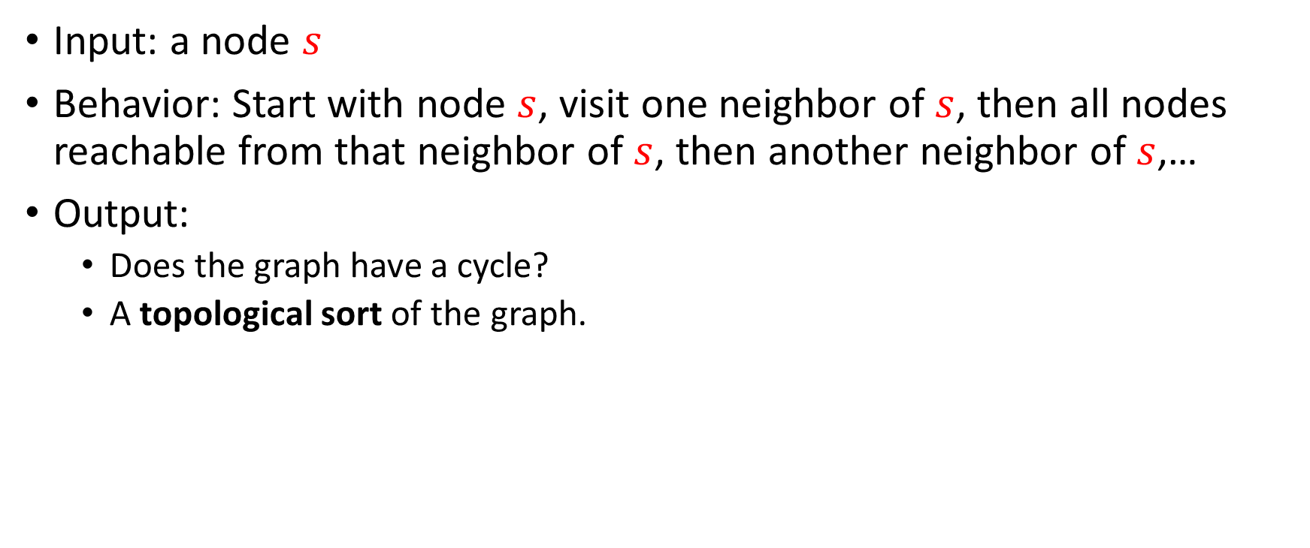
Depth-First Search
Input: a node $s$
Behavior: Start with node $s$, visit one neighbor of $s$, then all nodes reachable from that neighbor of $s$, then another neighbor of $s$,…
Output:
  Does the graph have a cycle?
  A topological sort of the graph.
1
2
2
5
3
0
8
1
6
4
9
5
3
7
6
4
7

Slide 10
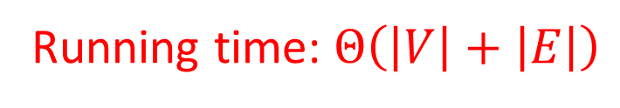
DFS (non-recursive)
void dfs(graph, s){
found = new Stack();
found.pop(s);
mark s as “visited”;
While (!found.isEmpty()){
current = found.pop();
for (v : neighbors(current)){
if (! v marked “visited”){
mark v as “visited”;
found.push(v);
}
}
}
}
2
5
8
1
4
9
3
7
6
Running time: $Θ\left(\left|V\right|+\left|E\right|\right)$

Slide 11
DFS Recursively (more common)
void dfs(graph, curr){
mark curr as “visited”;
for (v : neighbors(current)){
if (! v marked “visited”){
dfs(graph, v);
}
}
mark curr as “done”;
}
2
5
8
1
4
9
3
7
6

Slide 12
Cycle Detection
Idea: Look for a back edge!
boolean hasCycle(graph, curr){
mark curr as “visited”;
cycleFound = false;
for (v : neighbors(current)){
if (v marked “visited” && ! v marked “done”){
cycleFound=true;
}
if (! v marked “visited” && !cycleFound){
cycleFound = hasCycle(graph, v);
}
}
mark curr as “done”;
return cycleFound;
}
2
5
8
1
4
9
3
7
6

Slide 13

Topological Sort
A Topological Sort of a directed acyclic graph $G=(V,E)$ is a permutation of $V$ such that if $\left(u,v\right)∈E$ then $u$ is before $v$ in the permutation
2
5
8
1
1
3
4
6
2
5
9
8
7
4
9
3
7
6

Slide 14
DFS Recursively
void dfs(graph, curr){
mark curr as “visited”;
for (v : neighbors(current)){
if (! v marked “visited”){
dfs(graph, v);
}
}
mark curr as “done”;
}
2
5
8
1
4
9
3
7
6

Slide 15
DFS Recursively
Idea: List in reverse order by “done” time
void dfs(graph, curr){
mark curr as “visited”;
for (v : neighbors(current)){
if (! v marked “visited”){
dfs(graph, v);
}
}
mark curr as “done”;
}
2
5
8
1
4
9
3
7
6

Slide 16
DFS: Topological sort
List topSort(graph){
List<Nodes> done = new List<>();
for (Node v : graph.vertices){
if (!v.visited){
finishTime(graph, v, finished);
}
}
done.reverse();
return done;
}
void finishTime(graph, curr, finished){
curr.visited = true;
for (Node v : curr.neighbors){
if (!v.visited){
finishTime(graph, v, finished);
}
}
done.add(curr)
}
Idea: List in reverse order by “done” time
finished:
2
5
8
1
4
9
3
7
6

Slide 17
Definition: Tree
A connected graph with no cycles
10
B
E
7
H
A
Note: A tree does not need a root, but they often do!
D
5
9
I
12
3
C
3
11
G
F

Slide 18
Definition: Tree
A connected graph with no cycles
D
3
7
10
B
E
3
7
H
C
F
E
A
12
D
5
9
5
I
12
3
Pick some arbitrary root node and rearrange tree
3
A
G
C
11
11
G
10
9
F
B
H
I

Slide 19
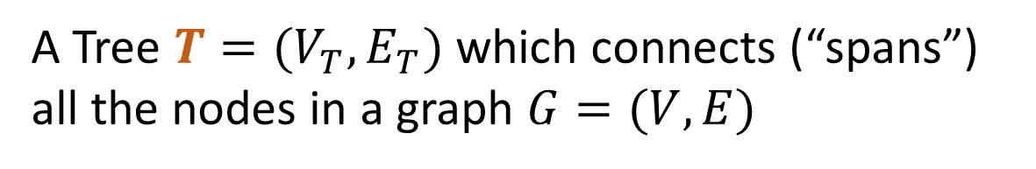

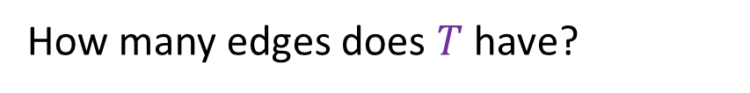
Definition: Spanning Tree
A Tree $T=(V_{T},E_{T})$ which connects (“spans”) all the nodes in a graph $G=(V,E)$
How many edges does $T$ have?
B
8
10
E
8
$$V−1$$
8
7
H
E
8
A
9
2
10
B
H
D
5
9
5
2
I
12
A
G
I
3
Pick some arbitrary root node and rearrange tree
C
3
6
11
1
F
G
3
1
F
6
C
D
Any set of V-1 edges in the graph that doesn’t have any cycles is guaranteed to be a spanning tree!
Any set of V-1 edges that connects all the nodes in the graph is guaranteed to be a spanning tree!
Notes:
Some set of edges from the graph, which forms a tree with all of the nodes in a graph. Subset of the edges, which has no cycles, and connects all the nodes.

Slide 20
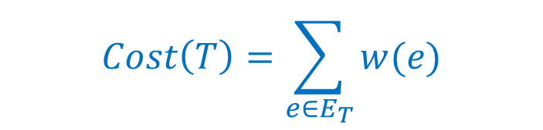
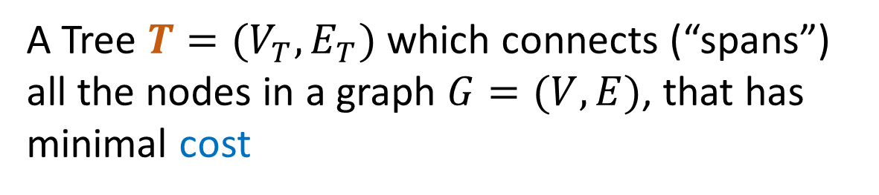
Definition: Minimum Spanning Tree
A Tree $T=(V_{T},E_{T})$ which connects (“spans”) all the nodes in a graph $G=(V,E)$, that has minimal cost
B
8
10
E
8
$$Cost\left(T\right)=\sum_{e∈E_{T}}{w(e)}$$
7
H
A
9
2
D
5
9
I
12
3
C
3
11
G
1
F
6

Slide 21
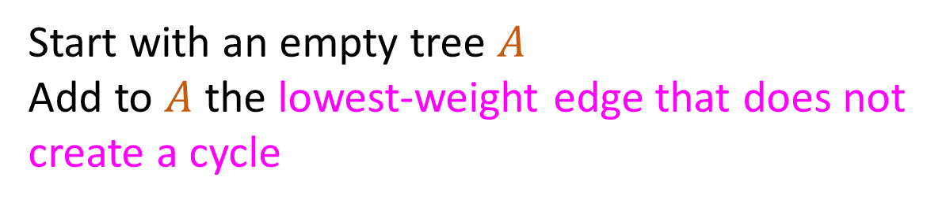
Kruskal’s Algorithm
Start with an empty tree $A$
Add to $A$ the lowest-weight edge that does not create a cycle
B
8
10
E
8
7
H
A
9
2
D
5
9
I
12
3
C
3
11
G
1
F
6

Slide 22
Kruskal’s Algorithm
Start with an empty tree $A$
Add to $A$ the lowest-weight edge that does not create a cycle
B
8
10
E
8
7
H
A
9
2
D
5
9
I
12
3
C
3
11
G
1
F
6

Slide 23
Kruskal’s Algorithm
Start with an empty tree $A$
Add to $A$ the lowest-weight edge that does not create a cycle
B
8
10
E
8
7
H
A
9
2
D
5
9
I
12
3
C
3
11
G
1
F
6

Slide 24
Kruskal’s Algorithm
Start with an empty tree $A$
Add to $A$ the lowest-weight edge that does not create a cycle
B
8
10
E
8
7
H
A
9
2
D
5
9
I
12
3
C
3
11
G
1
F
6

Slide 25
Kruskal’s Algorithm
Start with an empty tree $A$
Add to $A$ the lowest-weight edge that does not create a cycle
B
8
10
E
8
7
H
A
9
2
D
5
9
I
12
3
C
3
11
G
1
F
6

Slide 26
Kruskal’s Algorithm
Start with an empty tree $A$
Add to $A$ the lowest-weight edge that does not create a cycle
B
8
10
E
8
7
H
A
9
2
D
5
9
I
12
3
C
3
11
G
1
F
6

Slide 27
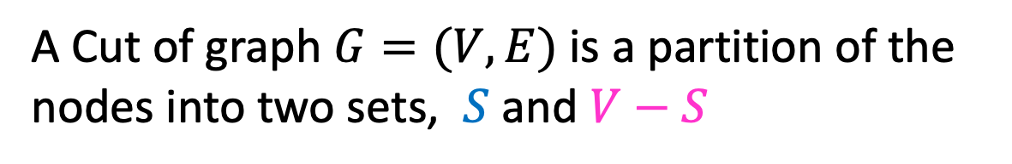
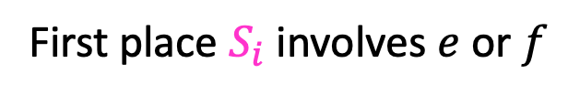


Definition: Cut
A Cut of graph $G=(V,E)$ is a partition of the nodes into two sets, $S$ and $V−S$
B
8
10
E
8
7
H
A
9
2
D
5
9
$$S$$
I
12
3
C
3
11
G
1
F
6
Edge $\left(v_{1},v_{2}\right)∈E$ crosses a cut if $v_{1}∈S$ and $v_{2}∈V−S$ (or opposite), e.g. $(A,C)$
A set of edges $R$ Respects a cut if no edges cross the cut
e.g. $R=\{\left(A,B\right),\left(E,G\right),\left(F,G\right)\}$
Notes:
Go over some examples of edges that cross the cut and edges that do not

Slide 28

Cut Theorem
If a set of edges $A$ is a subset of a minimum spanning tree $T$, let $(S, V−S)$ be any cut which $A$ respects. Let $e$ be the least-weight edge which crosses $(S, V−S)$. $A∪\{e\}$ is also a subset of a minimum spanning tree.
Notes:
If I take any cut at all in the graph, then the least weight edge across that cut is guaranteed to be part of some minimum spanning tree. The least weight edge that crosses any cut in .
We need a bit more mechanics to make this work for kruskals.
Suppose A is a subset of a minimum spanning tree, meaning, we are on our way to building. There is a minimum spanning tree T, where every edge in A is part of this minimum spanning tree T
Define some cut (S,V-S), which A respects. It is safe to add e to A and we will have made more progress
Repeat v-1 times. If we know we can start with some arbitrary subset, then we can add this edge e . There is some minimum spanning tree that has this edge f,g. If I used some other edge instead, an

Slide 29

Cut Theorem
If a set of edges $A$ is a subset of a minimum spanning tree $T$, let $(S, V−S)$ be any cut which $A$ respects. Let $e$ be the least-weight edge which crosses $(S, V−S)$. $A∪\{e\}$ is also a subset of a minimum spanning tree.
B
8
10
E
8
7
H
A
9
2
D
5
9
I
12
3
C
3
11
G
1
F
6
Notes:
If I take any cut at all in the graph, then the least weight edge across that cut is guaranteed to be part of some minimum spanning tree. The least weight edge that crosses any cut in .
We need a bit more mechanics to make this work for kruskals.
Suppose A is a subset of a minimum spanning tree, meaning, we are on our way to building. There is a minimum spanning tree T, where every edge in A is part of this minimum spanning tree T
Define some cut (S,V-S), which A respects. It is safe to add e to A and we will have made more progress
Repeat v-1 times. If we know we can start with some arbitrary subset, then we can add this edge e . There is some minimum spanning tree that has this edge f,g. If I used some other edge instead, an

Slide 30

Cut Theorem
If a set of edges $A$ is a subset of a minimum spanning tree $T$, let $(S, V−S)$ be any cut which $A$ respects. Let $e$ be the least-weight edge which crosses $(S, V−S)$. $A∪\{e\}$ is also a subset of a minimum spanning tree.
B
8
10
E
8
7
H
A
9
2
D
5
9
I
12
3
C
3
11
G
1
F
6
Notes:
If I take any cut at all in the graph, then the least weight edge across that cut is guaranteed to be part of some minimum spanning tree. The least weight edge that crosses any cut in .
We need a bit more mechanics to make this work for kruskals.
Suppose A is a subset of a minimum spanning tree, meaning, we are on our way to building. There is a minimum spanning tree T, where every edge in A is part of this minimum spanning tree T
Define some cut (S,V-S), which A respects. It is safe to add e to A and we will have made more progress
Repeat v-1 times. If we know we can start with some arbitrary subset, then we can add this edge e . There is some minimum spanning tree that has this edge f,g. If I used some other edge instead, an

Slide 31

Cut Theorem
If a set of edges $A$ is a subset of a minimum spanning tree $T$, let $(S, V−S)$ be any cut which $A$ respects. Let $e$ be the least-weight edge which crosses $(S, V−S)$. $A∪\{e\}$ is also a subset of a minimum spanning tree.
B
8
10
E
8
7
H
A
9
2
D
5
9
I
12
3
C
3
11
G
1
F
6
Notes:
If I take any cut at all in the graph, then the least weight edge across that cut is guaranteed to be part of some minimum spanning tree. The least weight edge that crosses any cut in .
We need a bit more mechanics to make this work for kruskals.
Suppose A is a subset of a minimum spanning tree, meaning, we are on our way to building. There is a minimum spanning tree T, where every edge in A is part of this minimum spanning tree T
Define some cut (S,V-S), which A respects. It is safe to add e to A and we will have made more progress
Repeat v-1 times. If we know we can start with some arbitrary subset, then we can add this edge e . There is some minimum spanning tree that has this edge f,g. If I used some other edge instead, an

Slide 32

Cut Theorem
If a set of edges $A$ is a subset of a minimum spanning tree $T$, let $(S, V−S)$ be any cut which $A$ respects. Let $e$ be the least-weight edge which crosses $(S, V−S)$. $A∪\{e\}$ is also a subset of a minimum spanning tree.
B
8
10
E
8
7
H
A
9
2
D
5
9
I
12
3
C
3
11
G
1
F
6
Notes:
If I take any cut at all in the graph, then the least weight edge across that cut is guaranteed to be part of some minimum spanning tree. The least weight edge that crosses any cut in .
We need a bit more mechanics to make this work for kruskals.
Suppose A is a subset of a minimum spanning tree, meaning, we are on our way to building. There is a minimum spanning tree T, where every edge in A is part of this minimum spanning tree T
Define some cut (S,V-S), which A respects. It is safe to add e to A and we will have made more progress
Repeat v-1 times. If we know we can start with some arbitrary subset, then we can add this edge e . There is some minimum spanning tree that has this edge f,g. If I used some other edge instead, an

Slide 33

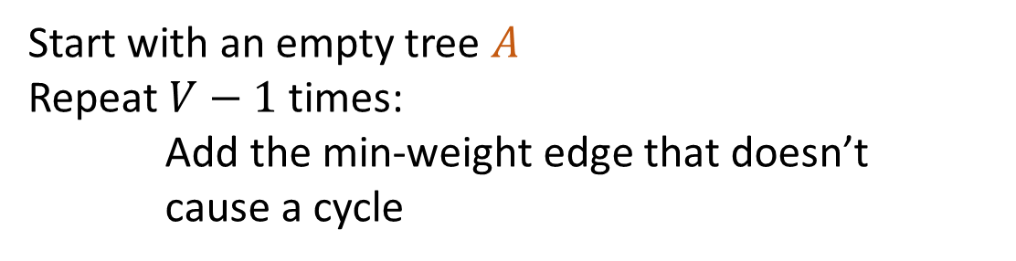
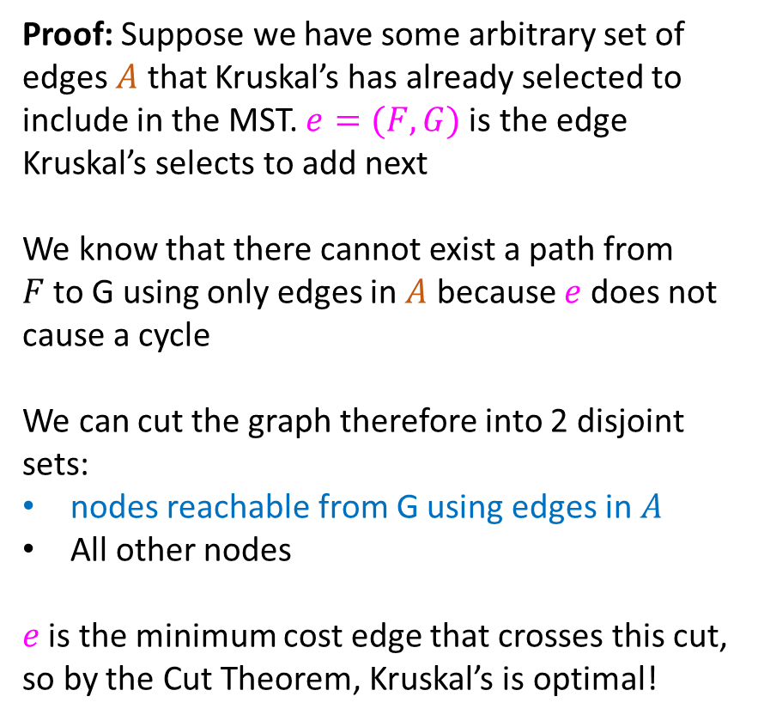

Proof of Kruskal’s Algorithm
Start with an empty tree $A$
Repeat $V−1$ times:
Add the min-weight edge that doesn’t cause a cycle
Proof: Suppose we have some arbitrary set of edges $A$ that Kruskal’s has already selected to include in the MST. $e=(F,G)$is the edge Kruskal’s selects to add next
We know that there cannot exist a path from $F$to G using only edges in $A$ because $e$ does not cause a cycle
We can cut the graph therefore into 2 disjoint sets:
nodes reachable from G using edges in $A$
All other nodes
$e$ is the minimum cost edge that crosses this cut, so by the Cut Theorem, Kruskal’s is optimal!
B
8
10
E
8
7
H
A
9
2
D
5
9
I
12
3
C
3
$$e$$
11
G
1
F
6
$$S$$

Slide 34
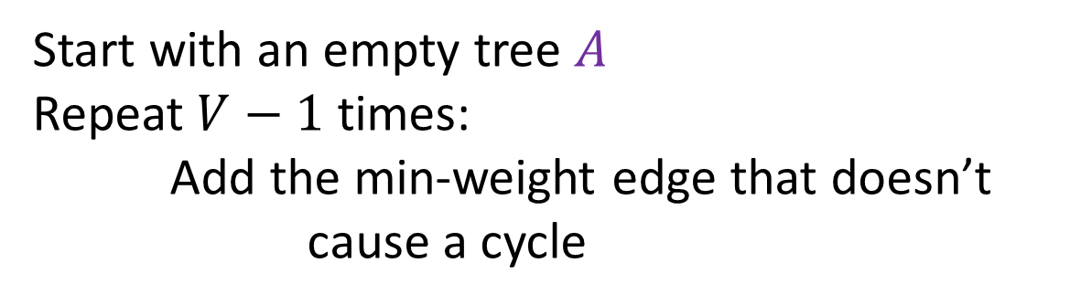
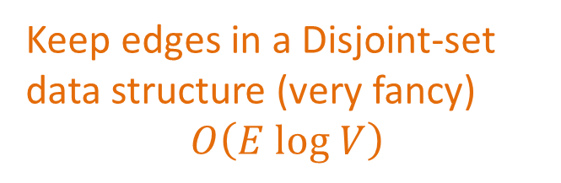


Kruskal’s Algorithm Runtime
Start with an empty tree $A$
Repeat $V−1$ times:
Add the min-weight edge that doesn’t cause a cycle
Keep edges in a Disjoint-set data structure (very fancy)
$$O\left(E log V\right)$$
B
8
10
E
8
7
H
A
9
2
D
5
9
I
12
3
C
3
$$e$$
11
G
1
F
6
$$S$$

Slide 35
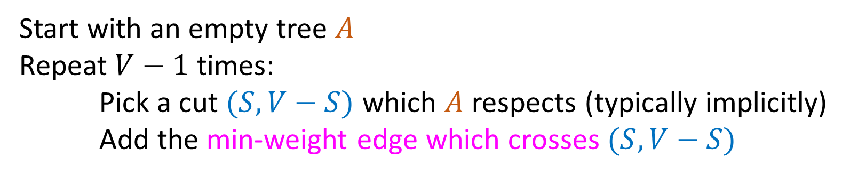
General MST Algorithm
Start with an empty tree $A$
Repeat $V−1$ times:
Pick a cut $(S,V−S)$ which $A$ respects (typically implicitly)
Add the min-weight edge which crosses $(S,V−S)$
B
8
10
E
8
7
H
A
9
2
D
5
9
I
12
3
C
3
11
G
1
F
6

Slide 36
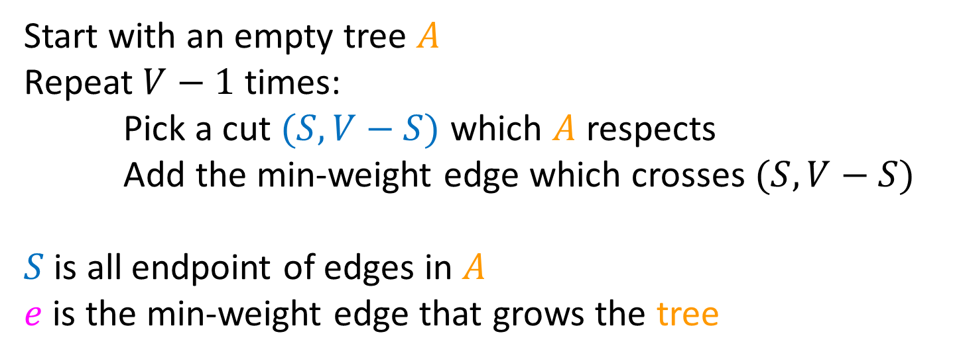
Prim’s Algorithm
Start with an empty tree $A$
Repeat $V−1$ times:
Pick a cut $(S,V−S)$ which $A$ respects
Add the min-weight edge which crosses $(S,V−S)$
$S$ is all endpoint of edges in $A$
$e$ is the min-weight edge that grows the tree
B
8
10
E
6
7
H
A
9
2
D
5
9
I
12
3
C
3
11
G
1
F
7

Slide 37
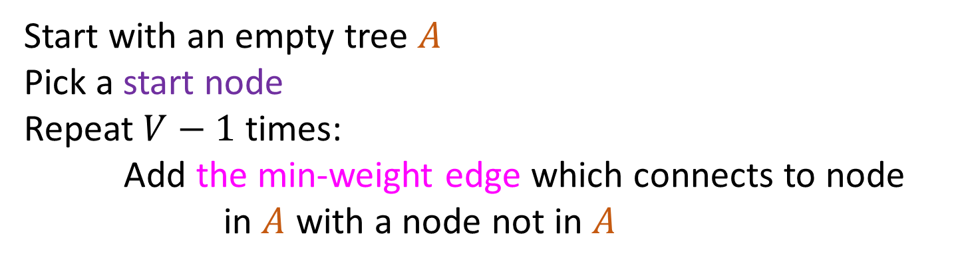
Prim’s Algorithm
Start with an empty tree $A$
Pick a start node
Repeat $V−1$ times:
Add the min-weight edge which connects to node in $A$ with a node not in $A$
B
8
10
E
6
7
H
A
9
2
D
5
9
I
12
3
C
3
11
G
1
F
7

Slide 38
Prim’s Algorithm
Start with an empty tree $A$
Pick a start node
Repeat $V−1$ times:
Add the min-weight edge which connects to node in $A$ with a node not in $A$
B
8
10
E
6
7
H
A
9
2
D
5
9
I
12
3
C
3
11
G
1
F
7

Slide 39
Prim’s Algorithm
Start with an empty tree $A$
Pick a start node
Repeat $V−1$ times:
Add the min-weight edge which connects to node in $A$ with a node not in $A$
B
8
10
E
6
7
H
A
9
2
D
5
9
I
12
3
C
3
11
G
1
F
7

Slide 40
Prim’s Algorithm
Start with an empty tree $A$
Pick a start node
Repeat $V−1$ times:
Add the min-weight edge which connects to node in $A$ with a node not in $A$
B
8
10
E
6
7
H
A
9
2
D
5
9
I
12
3
C
3
11
G
1
F
7

Slide 41
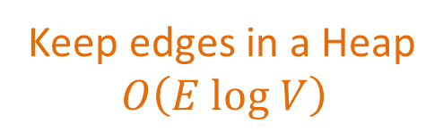
Prim’s Algorithm
Start with an empty tree $A$
Pick a start node
Repeat $V−1$ times:
Add the min-weight edge which connects to node in $A$ with a node not in $A$
Keep edges in a Heap
$$O\left(E log V\right)$$
B
8
10
E
6
7
H
A
9
2
D
5
9
I
12
3
C
3
11
G
1
F
7

Slide 42
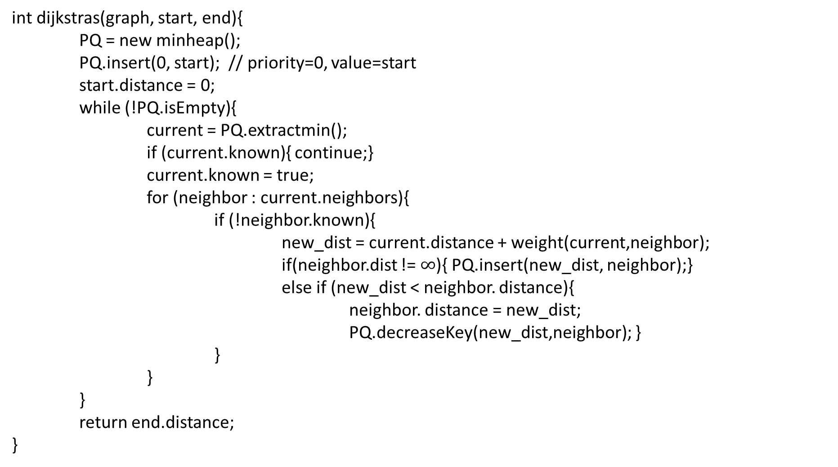
Dijkstra’s Algorithm
1
8
10
4
6
int dijkstras(graph, start, end){
PQ = new minheap();
PQ.insert(0, start); // priority=0, value=start
start.distance = 0;
while (!PQ.isEmpty){
current = PQ.extractmin();
if (current.known){ continue;}
current.known = true;
for (neighbor : current.neighbors){
if (!neighbor.known){
new_dist = current.distance + weight(current,neighbor);
if(neighbor.dist != $∞$){ PQ.insert(new_dist, neighbor);}
else if (new_dist < neighbor. distance){
neighbor. distance = new_dist;
PQ.decreaseKey(new_dist,neighbor); }
}
}
}
return end.distance;
}
7
7
0
9
2
3
5
9
8
12
3
2
3
11
6
1
5
7

Slide 43
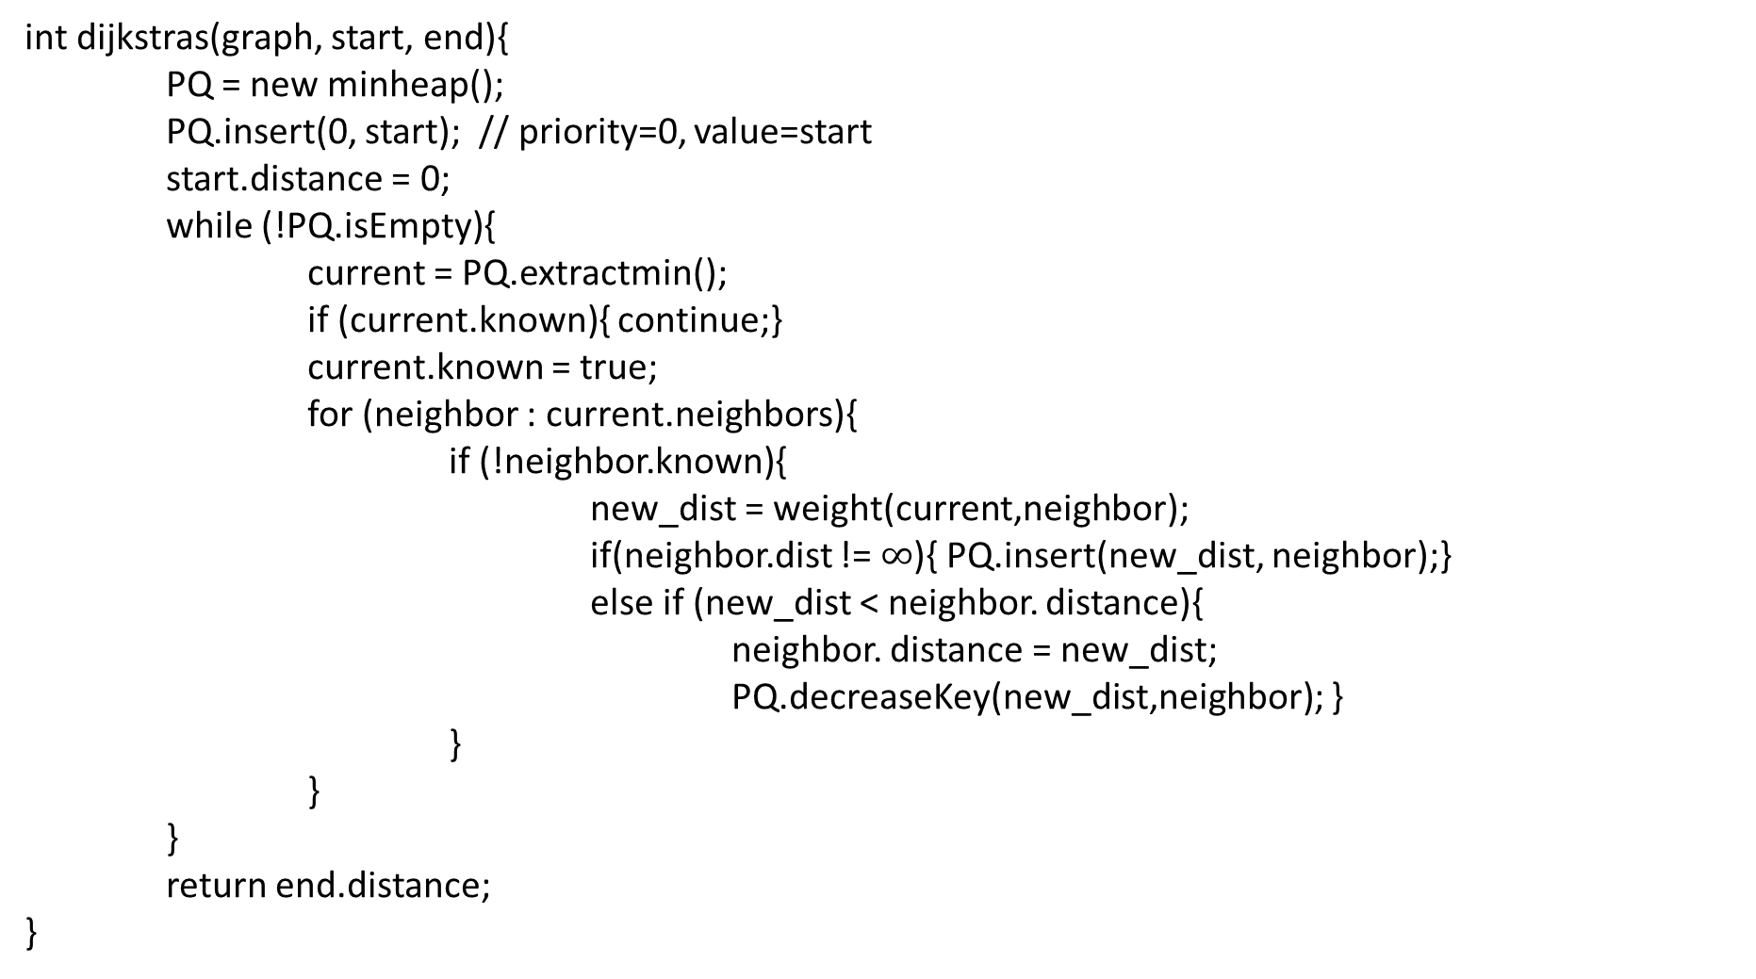
Prim’s Algorithm
1
8
10
4
6
int dijkstras(graph, start, end){
PQ = new minheap();
PQ.insert(0, start); // priority=0, value=start
start.distance = 0;
while (!PQ.isEmpty){
current = PQ.extractmin();
if (current.known){ continue;}
current.known = true;
for (neighbor : current.neighbors){
if (!neighbor.known){
new_dist = weight(current,neighbor);
if(neighbor.dist != $∞$){ PQ.insert(new_dist, neighbor);}
else if (new_dist < neighbor. distance){
neighbor. distance = new_dist;
PQ.decreaseKey(new_dist,neighbor); }
}
}
}
return end.distance;
}
7
7
0
9
2
3
5
9
8
12
3
2
3
11
6
1
5
7

Slide 44
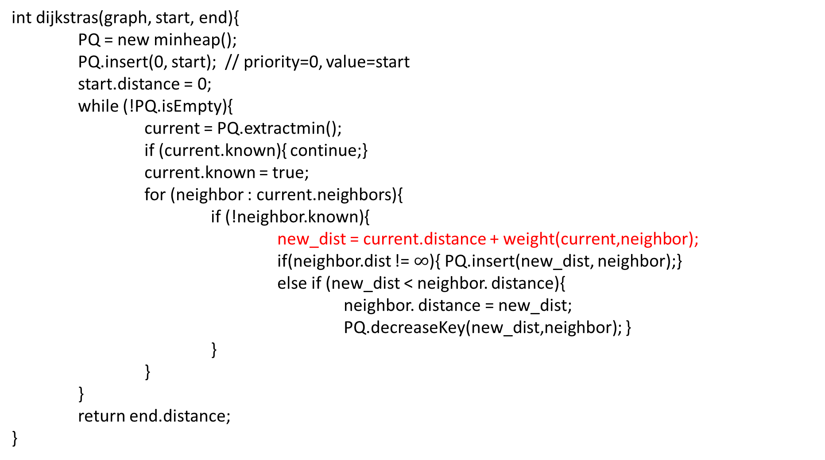
Dijkstra’s Algorithm
1
8
10
4
6
int dijkstras(graph, start, end){
PQ = new minheap();
PQ.insert(0, start); // priority=0, value=start
start.distance = 0;
while (!PQ.isEmpty){
current = PQ.extractmin();
if (current.known){ continue;}
current.known = true;
for (neighbor : current.neighbors){
if (!neighbor.known){
new_dist = current.distance + weight(current,neighbor);
if(neighbor.dist != $∞$){ PQ.insert(new_dist, neighbor);}
else if (new_dist < neighbor. distance){
neighbor. distance = new_dist;
PQ.decreaseKey(new_dist,neighbor); }
}
}
}
return end.distance;
}
7
7
0
9
2
3
5
9
8
12
3
2
3
11
6
1
5
7

Slide 45
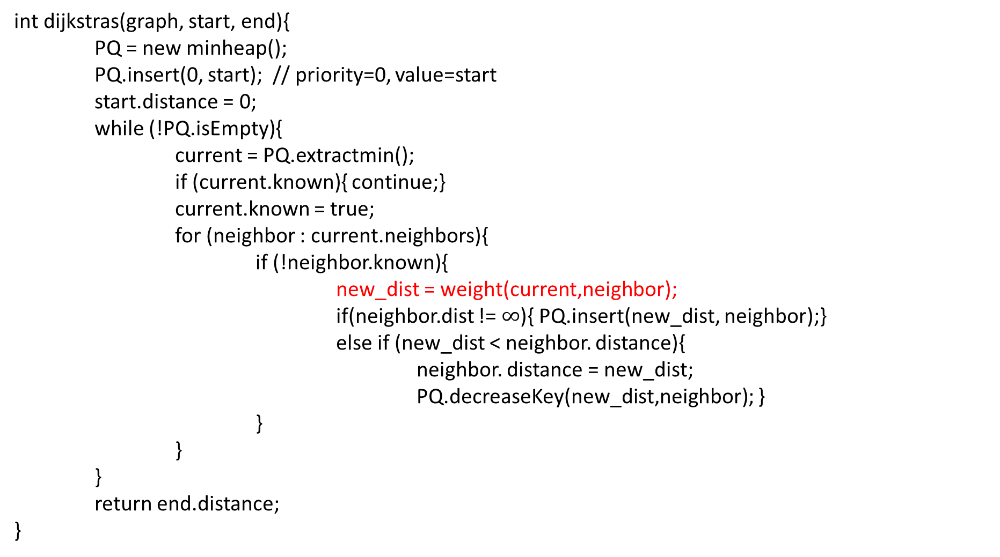
Prim’s Algorithm
1
8
10
4
6
int dijkstras(graph, start, end){
PQ = new minheap();
PQ.insert(0, start); // priority=0, value=start
start.distance = 0;
while (!PQ.isEmpty){
current = PQ.extractmin();
if (current.known){ continue;}
current.known = true;
for (neighbor : current.neighbors){
if (!neighbor.known){
new_dist = weight(current,neighbor);
if(neighbor.dist != $∞$){ PQ.insert(new_dist, neighbor);}
else if (new_dist < neighbor. distance){
neighbor. distance = new_dist;
PQ.decreaseKey(new_dist,neighbor); }
}
}
}
return end.distance;
}
7
7
0
9
2
3
5
9
8
12
3
2
3
11
6
1
5
7

