Slide 1
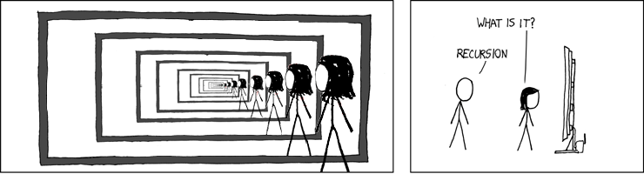
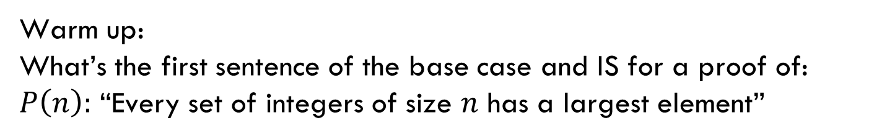
Structural Induction
Warm up:
What’s the first sentence of the base case and IS for a proof of:
$P\left(n\right):$ “Every set of integers of size $n$ has a largest element”
CSE 311 Spring 22
Lecture 19

Slide 2
Announcements
Homework 6 comes out tonight, due May 18th.
Normal number of problems, but a lot of them are induction, so those extra days may be necessary.
We’re wrapping up some logistics related to the midterm today.
  Once that’s all done, we’ll post solutions.
Late this week and next week, I’ll have slots for one-on-one meetings to discuss grade concerns.

Slide 3
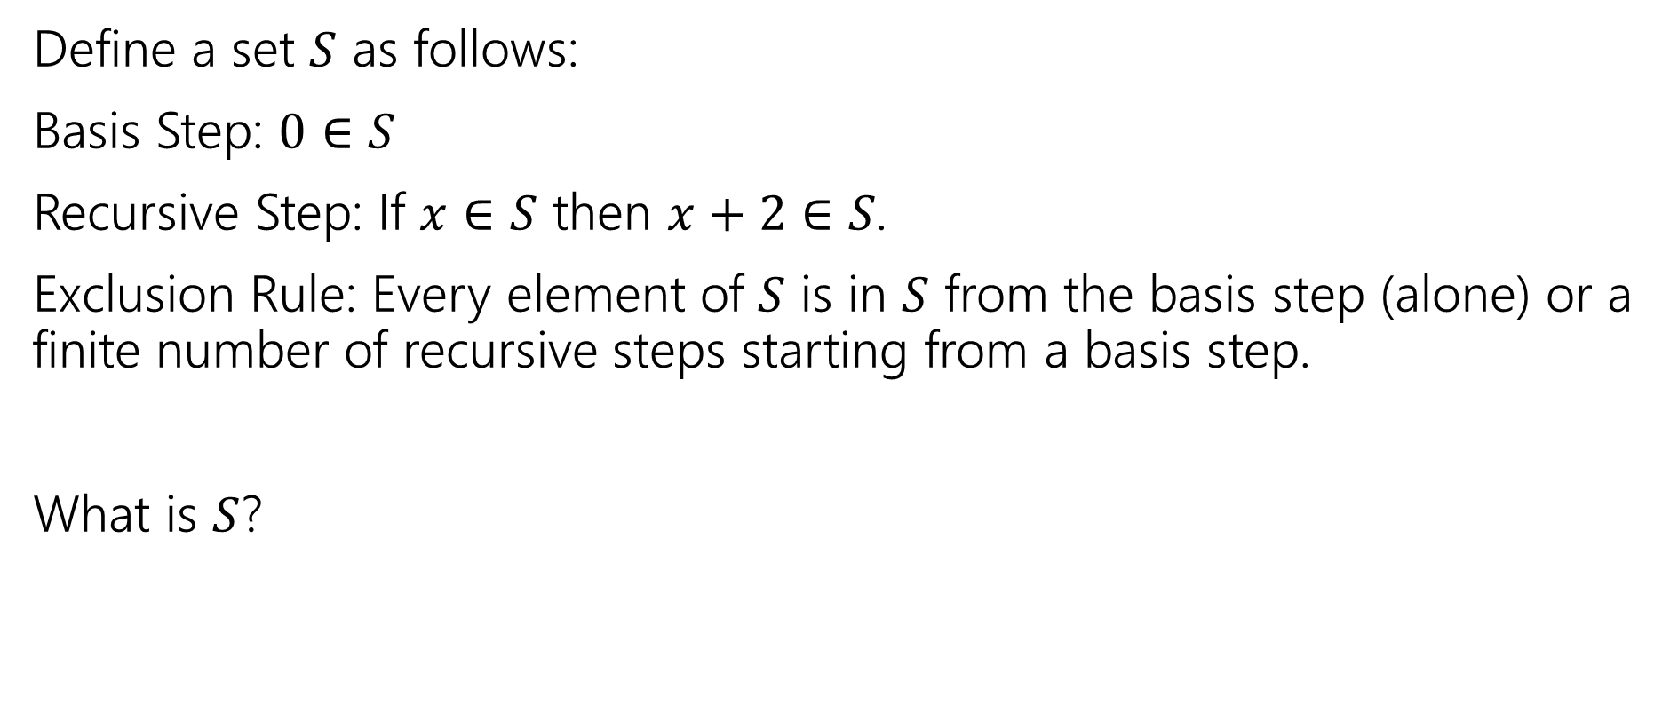
Recursive Definitions of Sets
Define a set $S$ as follows:
Basis Step: $0∈S$
Recursive Step: If $x∈S$ then $x+2∈S$.
Exclusion Rule: Every element of $S$ is in $S$ from the basis step (alone) or a finite number of recursive steps starting from a basis step.
What is $S$?

Slide 4
Recursive Definitions of Sets
We’ll always list the Basis and Recursive parts of the definition.
Starting…now…we’re going to be lazy and skip writing the “exclusion” rule. It’s still part of the definition.

Slide 5
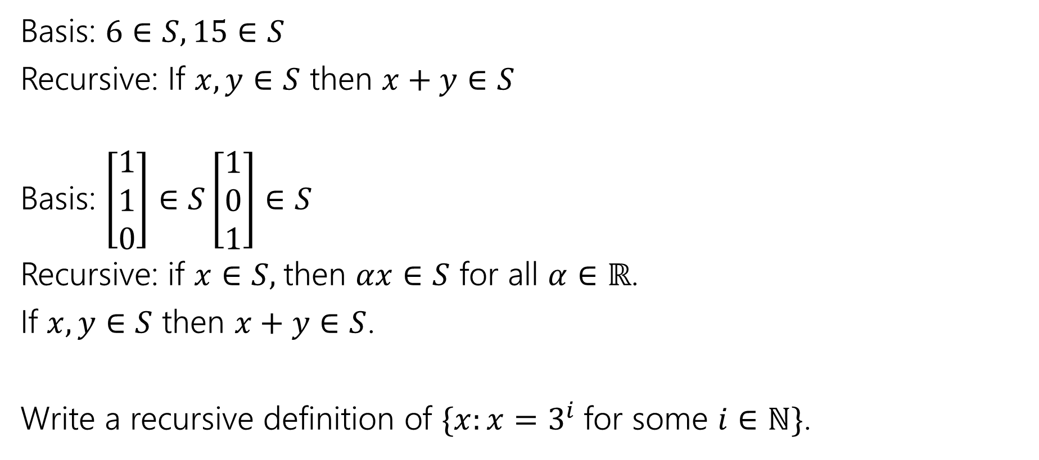
Recursive Definitions of Sets
Basis: $6∈S, 15∈S$
Recursive: If $x,y∈S$ then $x+y∈S$
Basis: $\left[\begin{matrix}1 \\ 1 \\ 0\end{matrix}\right]∈S\left[\begin{matrix}1 \\ 0 \\ 1\end{matrix}\right]∈S$
Recursive: if $x∈S,$then $αx∈S$ for all $α∈ℝ$.
If $x,y∈S$ then $x+y∈S$.
Write a recursive definition of $\{x:x=3^{i}$for some $i∈ℕ\}$.

Slide 6
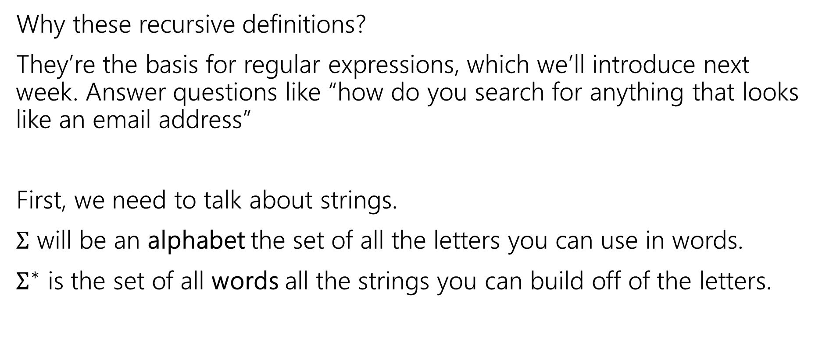
Strings
Why these recursive definitions?
They’re the basis for regular expressions, which we’ll introduce next week. Answer questions like “how do you search for anything that looks like an email address”
First, we need to talk about strings.
$Σ$ will be an alphabet the set of all the letters you can use in words.
$Σ^{∗}$ is the set of all words all the strings you can build off of the letters.

Slide 7
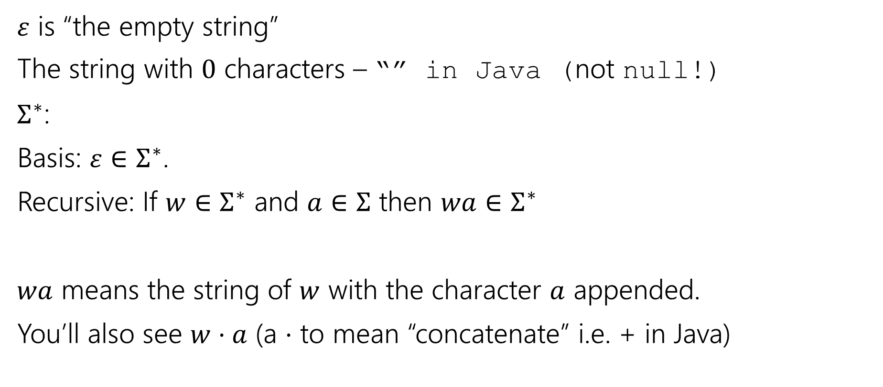
Strings
$ε$ is “the empty string”
The string with $0$ characters – “” in Java (not null!)
$Σ^{∗}$:
Basis: $ε∈Σ^{∗}$.
Recursive: If $w∈Σ^{∗}$ and $a∈Σ$ then $wa∈Σ^{∗}$
$wa$ means the string of $w$ with the character $a$ appended.
You’ll also see $w⋅a$ (a $⋅$ to mean “concatenate” i.e. + in Java)

Slide 8
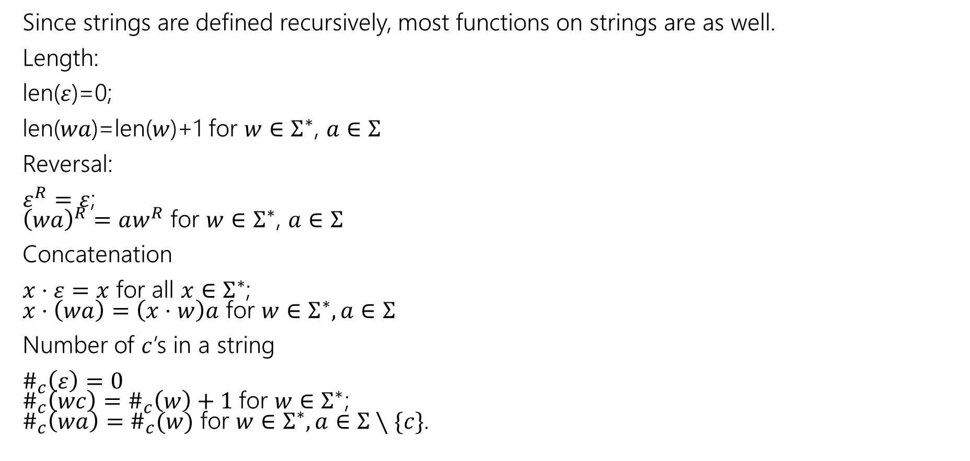
Functions on Strings
Since strings are defined recursively, most functions on strings are as well.
Length:
len($ε$)=0;
len($wa$)=len($w$)+1 for $w∈Σ^{∗}$, $a∈Σ$
Reversal:
$ε^{R}=ε$;
${\left(wa\right)}^{R}=aw^{R}$ for $w∈Σ^{∗}$, $a∈Σ$
Concatenation
$x⋅ε=x$ for all $x∈Σ^{∗}$;
$x⋅\left(wa\right)=\left(x⋅w\right)a$ for $w∈Σ^{∗},a∈Σ$
Number of $c$’s in a string
$\#_{c}\left(ε\right)=0$
$\#_{c}\left(wc\right)=\#_{c}\left(w\right)+1$for $w∈Σ^{∗}$;
$\#_{c}\left(wa\right)=\#_{c}(w)$ for $w∈Σ^{∗},a∈Σ∖\{c\}$.

Slide 9
Functions on Strings
Since strings are defined recursively, most functions on strings are as well.
Length:
len($ε$)=0;
len($wa$)=len($w$)+1 for $w∈Σ^{∗}$, $a∈Σ$
Reversal:
$ε^{R}=ε$;
${\left(wa\right)}^{R}=aw^{R}$ for $w∈Σ^{∗}$, $a∈Σ$
Concatenation
$x⋅ε=x$ for all $x∈Σ^{∗}$;
$x⋅\left(wa\right)=\left(x⋅w\right)a$ for $w∈Σ^{∗},a∈Σ$
Number of $c$’s in a string
$\#_{c}\left(ε\right)=0$
$\#_{c}\left(wc\right)=\#_{c}\left(w\right)+1$for $w∈Σ^{∗}$;
$\#_{c}\left(wa\right)=\#_{c}(w)$ for $w∈Σ^{∗},a∈Σ∖\{c\}$.

Slide 10
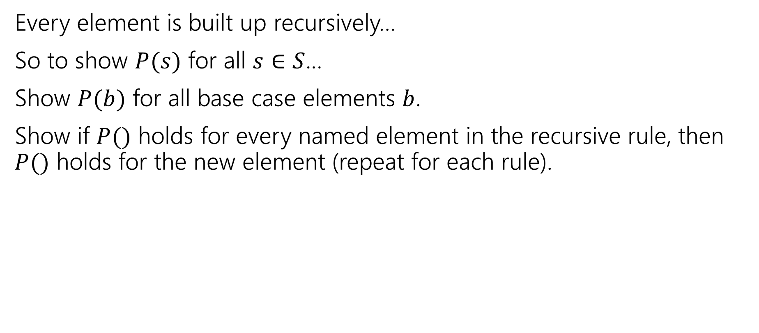
Structural Induction
Every element is built up recursively…
So to show $P(s)$ for all $s∈S$…
Show $P(b)$ for all base case elements $b$.
Show if $P()$ holds for every named element in the recursive rule, then $P()$ holds for the new element (repeat for each rule).

Slide 11

Structural Induction Example
Let $S$ be:
Basis: $6∈S, 15∈S$
Recursive: if $x,y∈S$ then $x+y∈S$.
Show that every element of $S$ is divisible by $3$.

Slide 12
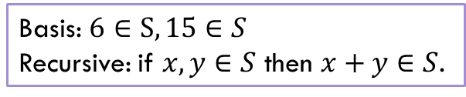
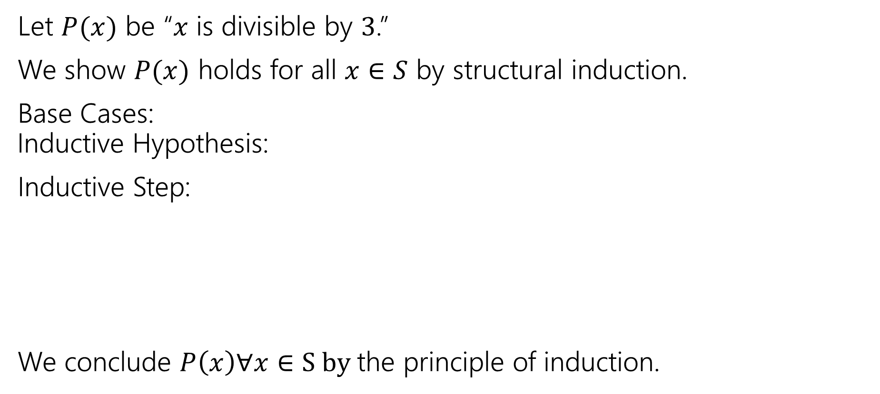
Structural Induction
Let $P(x)$ be “$x$ is divisible by $3$.”
We show $P(x)$ holds for all $x∈S$ by structural induction.
Base Cases:
Inductive Hypothesis:
Inductive Step:
We conclude $P\left(x\right)∀x∈S by$the principle of induction.
Basis: $6∈S, 15∈S$
Recursive: if $x,y∈S$ then $x+y∈S$.

Slide 13
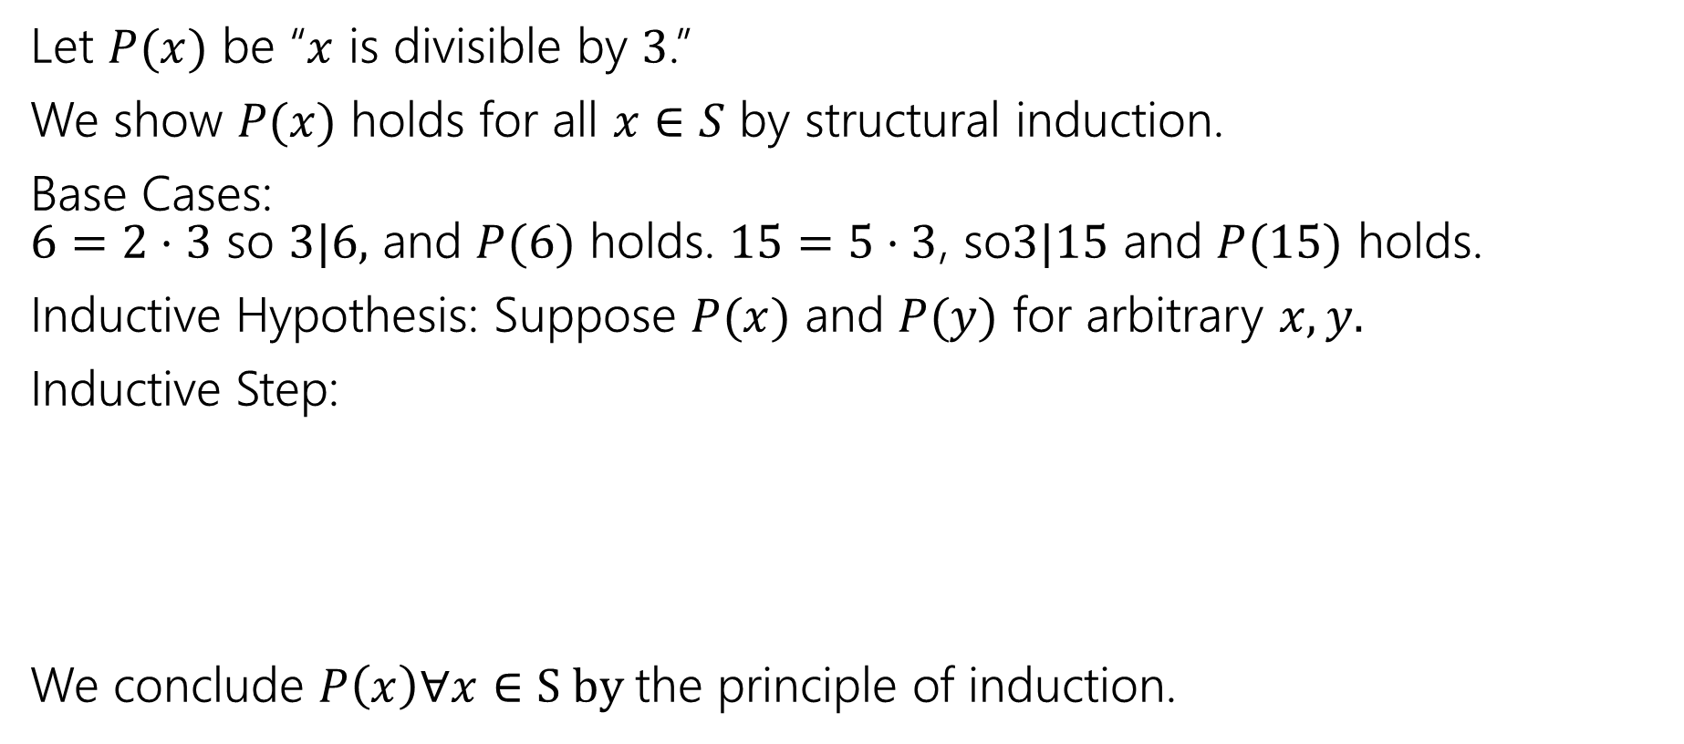
Structural Induction
Let $P(x)$ be “$x$ is divisible by $3$.”
We show $P(x)$ holds for all $x∈S$ by structural induction.
Base Cases:
$6=2⋅3$ so $3|6,$ and $P(6)$ holds. $15=5⋅3$, so$3|15$ and $P(15)$ holds.
Inductive Hypothesis: Suppose $P(x)$ and $P(y)$ for arbitrary $x,y.$
Inductive Step:
We conclude $P\left(x\right)∀x∈S by$the principle of induction.
Basis: $6∈S, 15∈S$
Recursive: if $x,y∈S$ then $x+y∈S$.

Slide 14
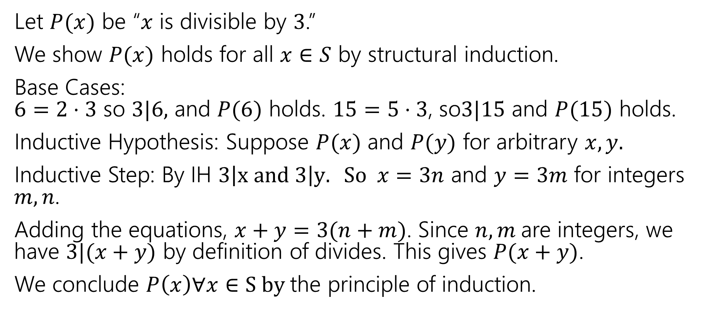
Structural Induction
Let $P(x)$ be “$x$ is divisible by $3$.”
We show $P(x)$ holds for all $x∈S$ by structural induction.
Base Cases:
$6=2⋅3$ so $3|6,$ and $P(6)$ holds. $15=5⋅3$, so$3|15$ and $P(15)$ holds.
Inductive Hypothesis: Suppose $P(x)$ and $P(y)$ for arbitrary $x,y.$
Inductive Step: By IH $3\left|x and 3\right|y. So x=3n$ and $y=3m$ for integers $m,n$.
Adding the equations, $x+y=3(n+m)$. Since $n,m$are integers, we have $3|(x+y)$ by definition of divides. This gives $P(x+y)$.
We conclude $P\left(x\right)∀x∈S by$the principle of induction.
Basis: $6∈S, 15∈S$
Recursive: if $x,y∈S$ then $x+y∈S$.

Slide 15
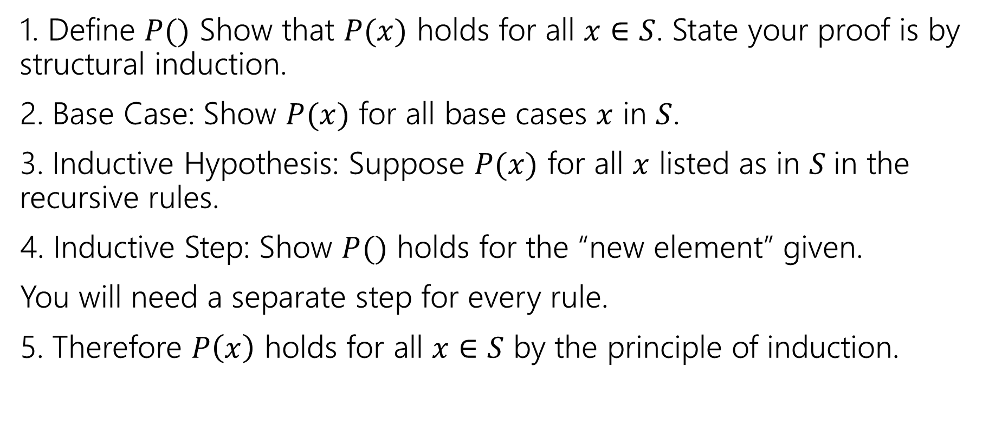
Structural Induction Template
1. Define $P()$ Show that $P(x)$ holds for all $x∈S$. State your proof is by structural induction.
2. Base Case: Show $P(x)$ for all base cases $x$ in $S$.
3. Inductive Hypothesis: Suppose $P(x)$ for all $x$ listed as in $S$in the recursive rules.
4. Inductive Step: Show $P()$ holds for the “new element” given.
You will need a separate step for every rule.
5. Therefore $P\left(x\right)$ holds for all $x∈S$ by the principle of induction.

Slide 16
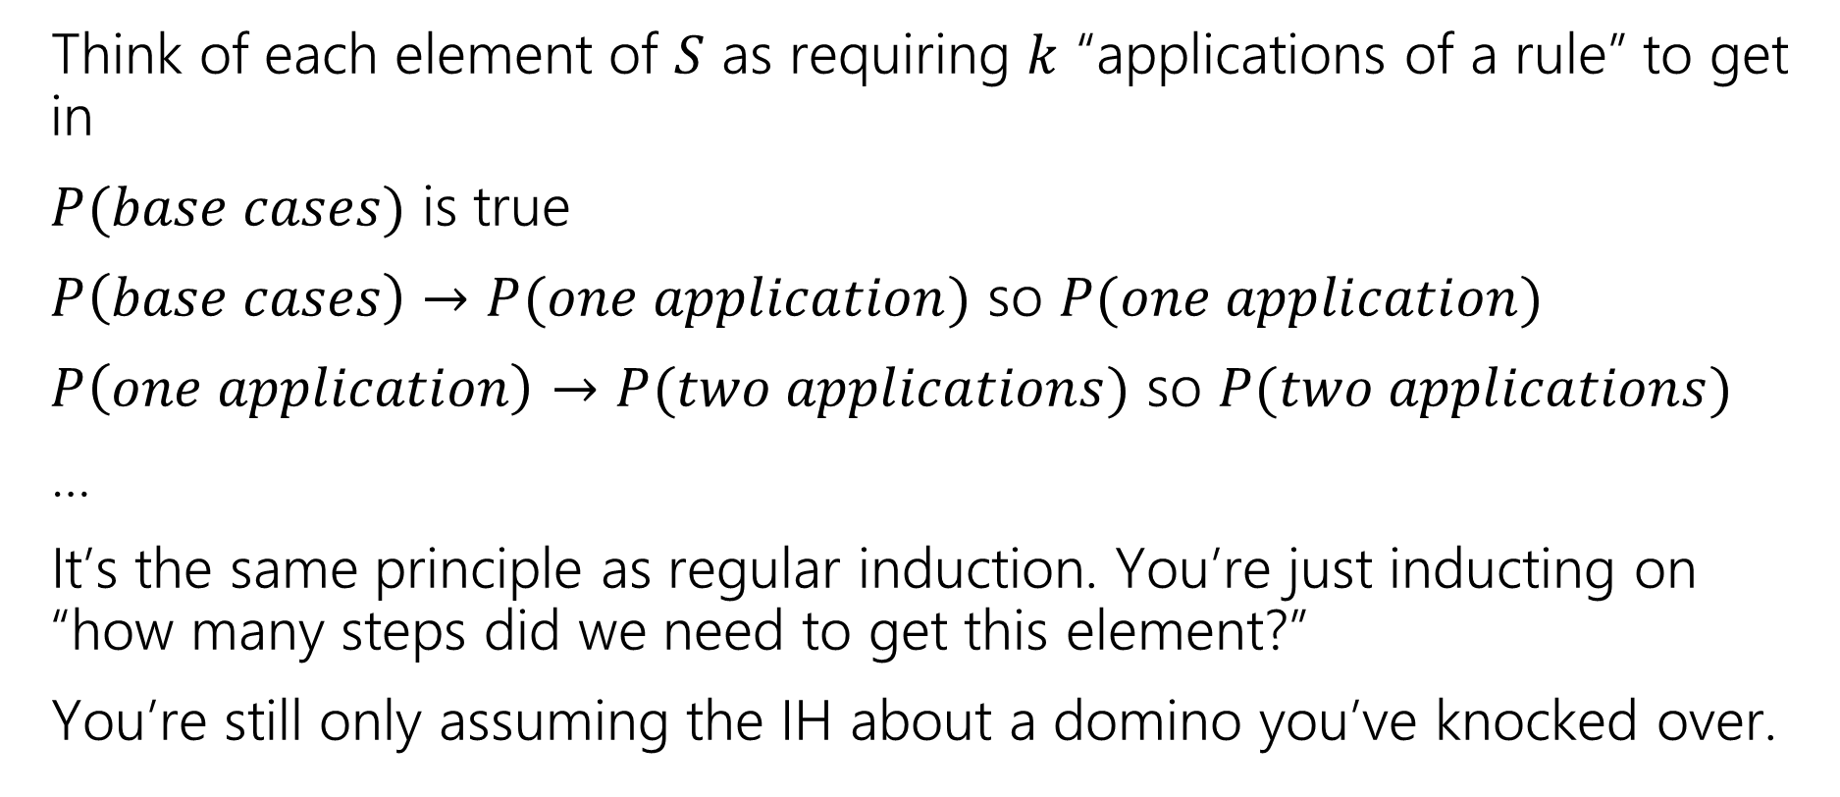
Wait a minute! Why can we do this?
Think of each element of $S$ as requiring $k$ “applications of a rule” to get in
$P(base cases)$ is true
$P\left(base cases\right)→P(one application)$ so $P(one application)$
$P\left(one application\right)→P(two applications)$ so $P(two applications)$
…
It’s the same principle as regular induction. You’re just inducting on “how many steps did we need to get this element?”
You’re still only assuming the IH about a domino you’ve knocked over.

Slide 17
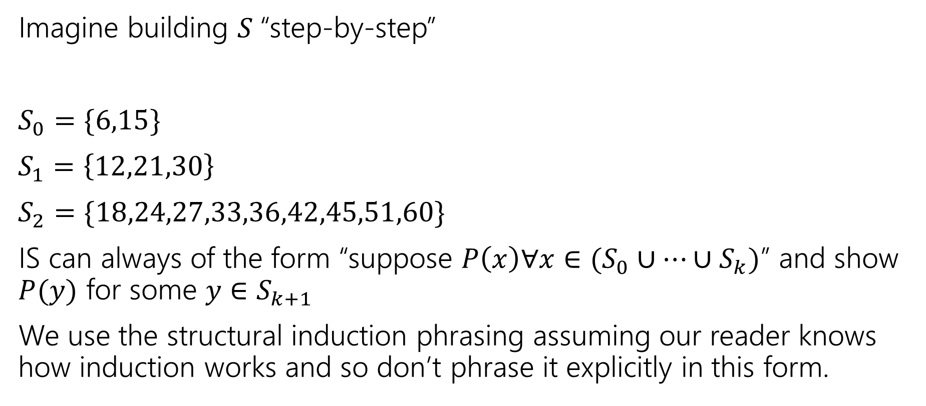
Wait a minute! Why can we do this?
Imagine building $S$“step-by-step”
$S_{0}=\{6,15\}$
$S_{1}=\left\{12,21,30\right\}$
$S_{2}=\{18,24,27,33,36,42,45,51,60\}$
IS can always of the form “suppose $P\left(x\right)∀x∈(S_{0}∪…∪S_{k})$” and show $P(y)$ for some $y∈S_{k+1}$
We use the structural induction phrasing assuming our reader knows how induction works and so don’t phrase it explicitly in this form.

Slide 18
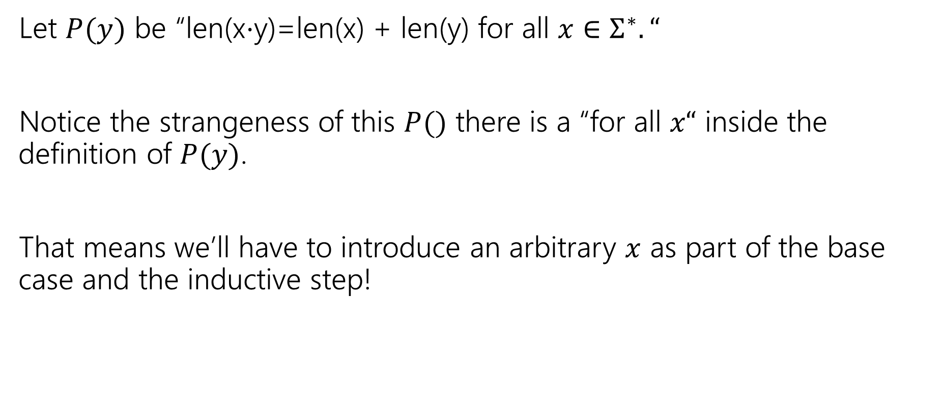
Claim len(x$⋅$y)=len(x) + len(y) for all $x,y∈Σ^{∗}$.
Let $P(y)$ be “len(x$⋅$y)=len(x) + len(y) for all $x∈Σ^{∗}.“$
Notice the strangeness of this $P()$ there is a “for all $x“$ inside the definition of $P(y)$.
That means we’ll have to introduce an arbitrary $x$ as part of the base case and the inductive step!

Slide 19

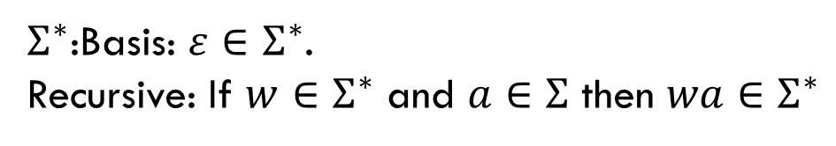
Claim len(x$⋅$y)=len(x) + len(y) for all $x,y∈Σ^{∗}$.
Define Let $P(y)$ be “len(x$⋅$y)=len(x) + len(y) for all $x∈Σ^{∗}.“$
We prove $P(y)$ for all $y∈Σ^{∗}$ by structural induction.
Base Case:
Inductive Hypothesis:
Inductive Step:
$Σ^{∗}$:Basis: $ε∈Σ^{∗}$.
Recursive: If $w∈Σ^{∗}$ and $a∈Σ$ then $wa∈Σ^{∗}$

Slide 20
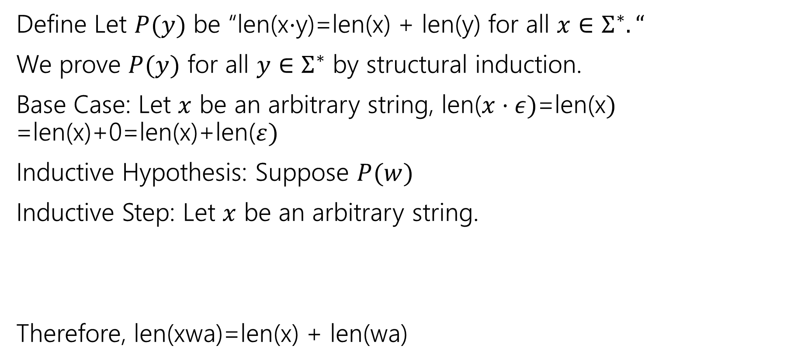
Claim len(x$⋅$y)=len(x) + len(y) for all $x,y∈Σ^{∗}$.
Define Let $P(y)$ be “len(x$⋅$y)=len(x) + len(y) for all $x∈Σ^{∗}.“$
We prove $P(y)$ for all $y∈Σ^{∗}$ by structural induction.
Base Case: Let $x$ be an arbitrary string, len($x⋅ε)$=len(x$)$
=len(x)+0=len(x)+len($ε)$
Inductive Hypothesis: Suppose $P(w)$
Inductive Step: Let $x$ be an arbitrary string.
Therefore, len(xwa)=len(x) + len(wa)
$Σ^{∗}$:Basis: $ε∈Σ^{∗}$.
Recursive: If $w∈Σ^{∗}$ and $a∈Σ$ then $wa∈Σ^{∗}$

Slide 21
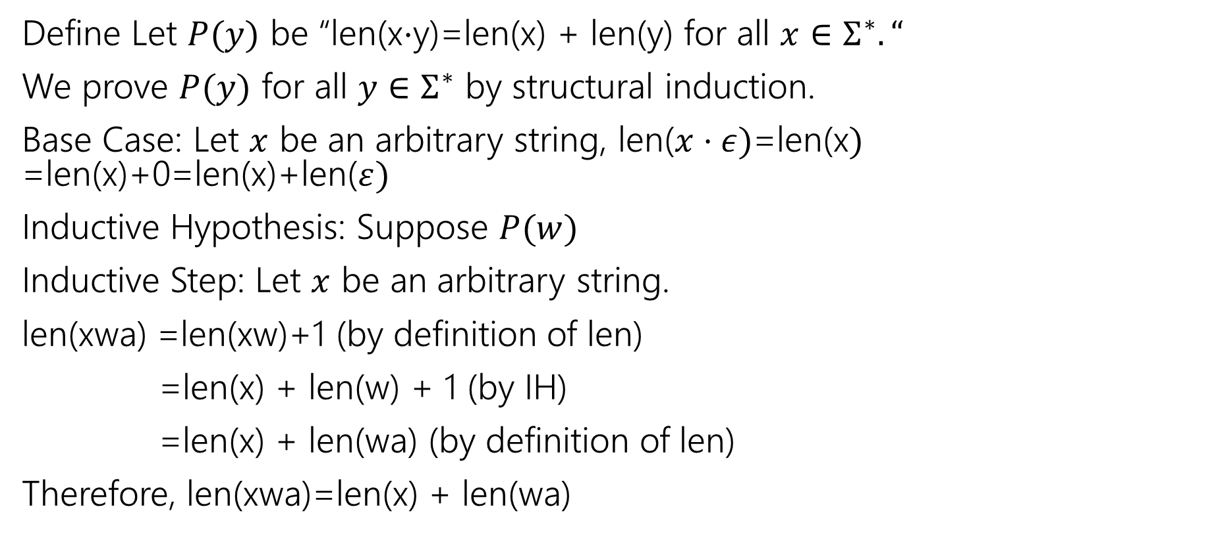
Claim len(x$⋅$y)=len(x) + len(y) for all $x,y∈Σ^{∗}$.
Define Let $P(y)$ be “len(x$⋅$y)=len(x) + len(y) for all $x∈Σ^{∗}.“$
We prove $P(y)$ for all $y∈Σ^{∗}$ by structural induction.
Base Case: Let $x$ be an arbitrary string, len($x⋅ε)$=len(x$)$
=len(x)+0=len(x)+len($ε)$
Inductive Hypothesis: Suppose $P(w)$
Inductive Step: Let $x$ be an arbitrary string.
len(xwa) =len(xw)+1 (by definition of len)
=len(x) + len(w) + 1 (by IH)
=len(x) + len(wa) (by definition of len)
Therefore, len(xwa)=len(x) + len(wa)
$Σ^{∗}$:Basis: $ε∈Σ^{∗}$.
Recursive: If $w∈Σ^{∗}$ and $a∈Σ$ then $wa∈Σ^{∗}$

Slide 22

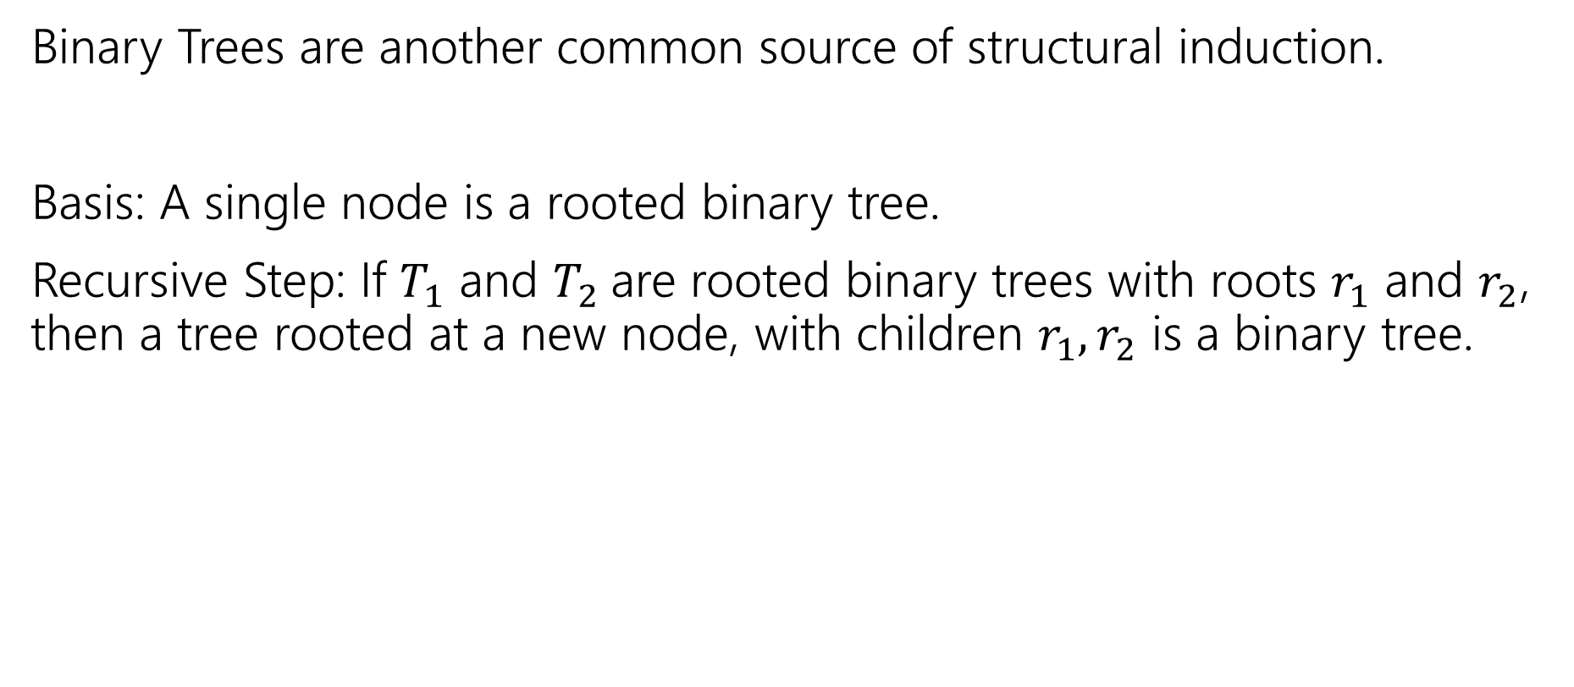

More Structural Sets
Binary Trees are another common source of structural induction.
Basis: A single node is a rooted binary tree.
Recursive Step: If $T_{1}$ and $T_{2}$are rooted binary trees with roots $r_{1}$ and $r_{2}$, then a tree rooted at a new node, with children $r_{1},r_{2}$ is a binary tree.
$$T_{1}$$
$$T_{2}$$

Slide 23





Functions on Binary Trees
size( )=1
size( ) = size($T_{1}$) + size($T_{2}$) + 1
height( ) = 0
height( ) = 1+$max⁡($height($T_{1}$),height($T_{2}$)$)$
$$T_{1}$$
$$T_{2}$$
$$T_{1}$$
$$T_{2}$$

Slide 24

Structural Induction on Binary Trees
For every rooted binary tree $T$, size($T$) $≤2^{height\left(T\right)+1}−1$
We’ll show this next time.

