Slide 1
Predicates and Quantifiers
CSE 311 Spring 22
Lecture 5

Slide 2
Announcements
HW1 is due tonight at 10PM
It takes a few minutes to upload to gradescope! You need to “select the pages” on your submission.
Check this afternoon to make sure you’re on gradescope if you haven’t done that yet.
If something goes wrong at 9:59, I will not see the email until tomorrow (neither will your TAs). If you have issues, send me your pdf via email and what happened and we’ll deal with it in the morning.

Slide 3
Announcements
Sections AA and AD meet in different locations starting this week.
That’s one of the 11:30 and 12:30 sections.
Correct locations on Ed (or on the time schedule)

Slide 4
Meet Boolean Algebra
Preferred by some mathematicians and circuit designers.
“or” is $+$
“and” is $⋅$ (i.e. “multiply”)
“not” is ‘ (an apostrophe after a variable)
Why?
Mathematicians like to study “operations that work kinda like ‘plus’ and ‘times’ on integers.”
Circuit designers have a lot of variables, and this notation is more compact.

Slide 5
Meet Boolean Algebra
Name | Variables | “True/False” | “And” | “Or” | “Not” | Implication
Java Code | boolean b | true,false | && | || | ! | No special symbol
Propositional Logic | $$"p,q,r"$$ | T, F | $$∧$$ | $$∨$$ | $$¬$$ | $$→$$
Circuits | Wires | 1, 0 |  |  |  | No special symbol
Boolean Algebra | $$a,b,c$$ | 1,0 | $$⋅$$ (“multiplication”) | $$+$$ (“addition”) | $$′$$ (apostrophe after variable) | No special symbol
Propositional logic
Boolean Algebra
$$\left(p∧q∧r\right)∨s∨¬t$$
$$pqr+s+t′$$

Slide 6
Comparison
Propositional logic
Boolean Algebra
$$\left(p∧q∧r\right)∨s∨¬t$$
$$pqr+s+t′$$
Remember this is just an alternate notation for the same underlying ideas.
So that big list of identities? Just change the notation and you get another big list of identities!
Sometimes names are different (“involution” instead of “double negation”), but the core ideas are the same.

Slide 7
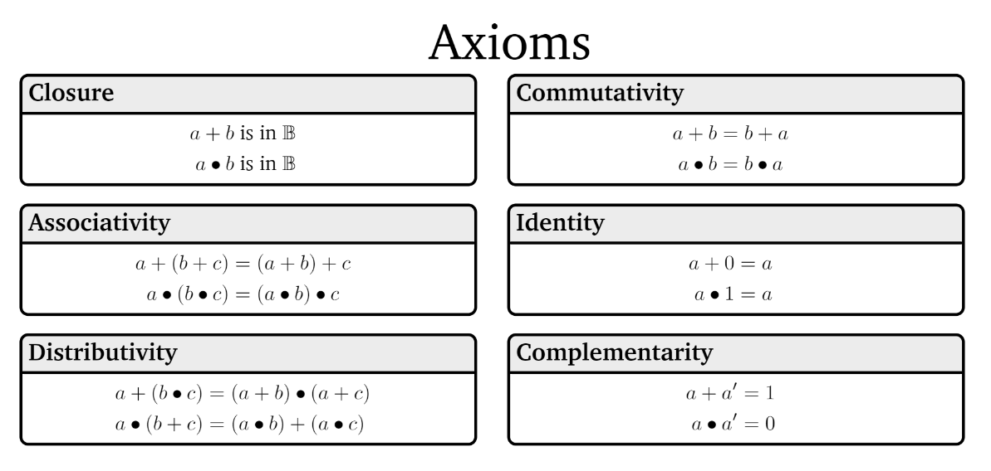
Boolean Algebra

Slide 8
Boolean Algebra

Slide 9
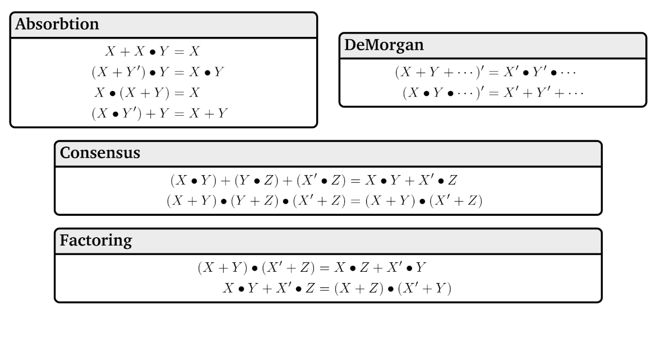
Boolean Algebra

Slide 10
A Few Fun Facts
That you’re not responsible for:
The identities are divided into “axioms” and “theorems”
Mathematicians (and some computer scientists, like me ☺ ) will sometimes study what minimum starting points (“the axioms”) will be enough to derive all the usual facts we rely on (“the theorems”)
That’s what I meant by “operations that work kinda like plus and times”
For our purposes, we won’t make a distinction here, but we will use similar thinking later in the course.
Boolean algebra makes things like commutativity axioms (starting points, things we assume) with propositional logic, we start from the truth tables and can derive that commutativity is true. For this class, though, it’s a fact you can use either way.

Slide 11
Why ANOTHER way of writing down logic?
This is the third one!?
Because, in your future courses, you’ll use any/all of them.
Remember there aren’t new concepts here, just new representations.
We mostly use propositional notation ($∧,∨,¬,$etc.) but we’ll use them all a bit so you’re ready for any of them in your future courses.
Practice in section and on homework.

Slide 12
Predicate Logic

Slide 13
Predicate Logic
So far our propositions have worked great for fixed objects.
What if we want to say “If $x>10$ then $x^{2}>100.$”
$x>10$ isn’t a proposition. Its truth value depends on $x$.
We need a function that can take in a value for $x$ and output True or False as appropriate.

Slide 14
Predicates
A function that outputs true or false.
Predicate
Cat(x):= “x is a cat”
Prime(x) := “x is prime”
LessThan(x,y):= “x$<$y”
Sum(x,y,z):= “x$+$y$=$z”
HasNChars(s,n):= “string s has length n”
Numbers and types of inputs can change. Only requirement is output is Boolean.

Slide 15
Analogy
Propositions were like Boolean variables.
What are predicates? Functions that return Booleans
public boolean predicate(…)

Slide 16
Translation
Translation works a lot like when we just had propositions.
Let’s try it…
$x$ is prime or $x^{2}$ is odd or $x=2$.
Prime$\left(x\right)∨$Odd$\left(x^{2}\right)∨$Equals$\left(x,2\right)$

Slide 17
Domain of Discourse
$x$ is prime or $x^{2}$ is odd or $x=2$.
Prime$\left(x\right)∨$Odd$\left(x^{2}\right)∨$Equals$\left(x,2\right)$
Can $x$ be 4.5? What about “abc” ?
I never intended you to plug 4.5 or “abc” into $x$.
When you read the sentence you probably didn’t imagine plugging those values in….

Slide 18
Domain of Discourse
$x$ is prime or $x^{2}$ is odd or $x=2$.
Prime$\left(x\right)∨$Odd$\left(x^{2}\right)∨$Equals$\left(x,2\right)$
To make sure we can’t plug in 4.5 for $x,$predicate logic requires deciding on the types we’ll allow
The types of inputs allowed in our predicates.
Domain of Discourse

Slide 19
Try it…
What’s a possible domain of discourse for these lists of predicates?
“$x$ is a cat”, “$x$ barks”, “$x$ likes to take walks”
“$x$ is prime”, “$x$=5” “$x<20“$ “$x$ is a power of two”
“$x$ is enrolled in course $y$”, “$y$ is a pre-req for $z"$

Slide 20
Try it…
What’s a possible domain of discourse for these lists of predicates?
“$x$ is a cat”, “$x$ barks”, “$x$ likes to take walks”
“$x$ is prime”, “$x$=5” “$x<20“$ “$x$ is a power of two”
“$x$ is enrolled in course $y$”, “$y$ is a pre-req for $z"$
“Mammals”, “pets”, “dogs and cats”, …
“positive integers”, “integers”, “numbers”, …
“objects in the university course enrollment system”, “university entities”, “students and courses”, …
More than one domain of discourse might be reasonable…if it might affect the meaning of the statement, we specify it.

Slide 21
Quantifiers
Now that we have variables, let’s really use them…
We tend to use variables for two reasons:
The statement is true for every $x$, we just want to put a name on it.
There’s some $x$ out there that works, (but I might not know which it is, so I’m using a variable).

Slide 22
Quantifiers
We have two extra symbols to indicate which way we’re using the variable.
The statement is true for every $x$, we just want to put a name on it.
$∀x (p\left(x\right)∧q\left(x\right))$ means “for every $x$ in our domain, $p(x)$ and $q(x)$ both evaluate to true.”
There’s some $x$ out there that works, (but I might not know which it is, so I’m using a variable).
$∃x(p\left(x\right)∧q\left(x\right))$ means “there is an $x$ in our domain, such that $p(x)$ and $q\left(x\right)$ are both true.

Slide 23
Quantifiers
We have two extra symbols to indicate which way we’re using the variable.
The statement is true for every $x$, we just want to put a name on it.
$∀x (p\left(x\right)∧q\left(x\right))$ means “for every $x$ in our domain, $p(x)$ and $q(x)$ both evaluate to true.”
There’s some $x$ out there that works, (but I might not know which it is, so I’m using a variable).
$∃x(p\left(x\right)∧q\left(x\right))$ means “there is an $x$ in our domain, $p(x)$ and $q\left(x\right)$ are both true.
“$∀x“$
“for each $x$”, “for every $x$”, “for all $x$” are common translations
Remember: upside-down-A for All.
Universal Quantifier

Slide 24
Quantifiers
“$∃x“$
“there is an $x$”, “there exists an $x$”, “for some $x$” are common translations
Remember: backwards-E for Exists.
Existential Quantifier
We have two extra symbols to indicate which way we’re using the variable.
The statement is true for every $x$, we just want to put a name on it.
$∀x (p\left(x\right)∧q\left(x\right))$ means “for every $x$ in our domain, $p(x)$ and $q(x)$ both evaluate to true.”
There’s some $x$ out there that works, (but I might not know which it is, so I’m using a variable).
$∃x(p\left(x\right)∧q\left(x\right))$ means “there is an $x$ in our domain, for which $p(x)$ and $q\left(x\right)$ are both true.

Slide 25
Translations
“For every $x$, if $x$ is even, then $x=2$.”
“There are $x,y$ such that $x<y$.”
$∃x ($Odd$\left(x\right)∧$LessThan$\left(x,5\right))$
$∀y ($Even$\left(y\right)∧$Odd$\left(y\right))$
pollev.com/uwcse311
Help me adjust my explanation!

Slide 26
Translations
“For every $x$, if $x$ is even, then $x=2$.”
“There are $x,y$ such that $x<y$.”
$∃x ($Odd$\left(x\right)∧$LessThan$\left(x,5\right))$
$∀y ($Even$\left(y\right)∧$Odd$\left(y\right))$
$∀x($Even$\left(x\right)→$Equal$\left(x,2\right))$
$∃x∃y($LessThan$\left(x,y\right))$
There is an odd number that is less than 5.
All numbers are both even and odd.

Slide 27
Translations
More practice in section and on homework.
Also a reading on the webpage –
An explanation of why “for any” is not a great way to translate $∀$(even though it looks like a good option on the surface)
More information on what happens with multiple quantifiers (we’ll discuss more on Friday or Monday).

Slide 28
Evaluating Predicate Logic
“For every $x$, if $x$ is even, then $x=2$.” / $∀x($Even$\left(x\right)→$Equal$\left(x,2\right))$
Is this true?

Slide 29
Evaluating Predicate Logic
“For every $x$, if $x$ is even, then $x=2$.” / $∀x($Even$\left(x\right)→$Equal$\left(x,2\right))$
Is this true?
TRICK QUESTION! It depends on the domain.
Prime Numbers | Positive Integers | Odd integers
True | False | True (vacuously)

Slide 30
One Technical Matter
How do we parse sentences with quantifiers?
What’s the “order of operations?”
We will usually put parentheses right after the quantifier and variable to make it clear what’s included. If we don’t, it’s the rest of the expression.
Be careful with repeated variables…they don’t always mean what you think they mean.
$∀x\left(P\left(x\right)\right)∧∀x(Q\left(x\right))$ are different $x$’s.

Slide 31
Bound Variables
What happens if we repeat a variable?
Whenever you introduce a new quantifier with an already existing variable, it “takes over” that name until its expression ends.
$$∀x(P\left(x\right)∧ ∀x\left[Q\left(x\right)\right]∧R\left(x\right))$$
It’s common (albeit somewhat confusing) practice to reuse a variables when it “wouldn’t matter”.
Never do something like the above: where a single name switches from gold to purple back to gold. Switching from gold to purple only is usually fine…but names are cheap.

Slide 32
More Practice
Let your domain of discourse be fruits. Translate these
There is a fruit that is tasty and ripe.
For every fruit, if it is not ripe then it is not tasty.
There is a fruit that is sliced and diced.

Slide 33
More Practice
Let your domain of discourse be fruits. Translate these
There is a fruit that is tasty and ripe.
For every fruit, if it is not ripe then it is not tasty.
There is a fruit that is sliced and diced.
$∃x($Tasty$\left(x\right)∧$Ripe$\left(x\right))$
$∀x(¬$Ripe$\left(x\right)→¬\text{Tasty}\left(x\right))$
$∃x($Sliced$\left(x\right)∧\text{Diced}\left(x\right))$

Slide 34
Inference Proofs

Slide 35
Inference Proofs
A new way of thinking of proofs:
Here’s one way to get an iron-clad guarantee:
1. Write down all the facts we know.
2. Combine the things we know to derive new facts.
3. Continue until what we want to show is a fact.

Slide 36
Drawing Conclusions
You know “If it is raining, then I have my umbrella”
And “It is raining”
You should conclude….
For whatever you conclude, convert the statement to propositional logic – will your statement hold for any propositions, or is it specific to raining and umbrellas?
I have my umbrella!
I know $(p→q)$ and $p$, I can conclude $q$
Or said another way: $\left[\left(p→q\right)∧p\right]→q$

Slide 37
Modus Ponens
The inference from the last slide is always valid. I.e.
$$\left[\left(p→q\right)∧p\right]→q≡T$$

Slide 38
Modus Ponens – a formal proof
$$\left[\left(p→q\right)∧p\right]→q$$
$≡[\left(¬p∨q\right)∧p]→q$
$≡\left[p∧\left(¬p∨q\right)\right]→q$
$≡\left[\left(p∧¬p\right)∨\left(p∧q\right)\right]→q$
$≡\left[F∨\left(p∧q\right)\right]→q$
$≡\left[\left(p∧q\right)∨F\right]→q$
$≡\left[\left(p∧q\right)\right]→q$
$≡\left[¬\left(p∧q\right)\right]∨q$
$≡\left[¬p∨¬q\right]∨q$
$≡¬p∨[¬q∨q]$
$≡¬p∨[q∨¬q]$
$≡¬p∨T$
$≡T$
Law of Implication
Commutativity
Distributivity
Negation
Commutativity
Identity
Law of Implication
DeMorgan’s Law
Associativity
Commutativity
Negation
Domination

Slide 39
Modus Ponens
The inference from the last slide is always valid. I.e.
$$\left[\left(p→q\right)∧p\right]→q≡T$$
We use that inference A LOT
So often people gave it a name (“Modus Ponens”)
So often…we don’t have time to repeat that 12 line proof EVERY TIME.
Let’s make this another law we can apply in a single step.
Just like refactoring a method in code.

Slide 40
Notation – Laws of Inference
We’re using the “$→“$ symbol A LOT.
Too much
Some new notation to make our lives easier.
If we know both $A$and$B$
$$A,B$$
$$∴$$
We can conclude any (or all) of $C,D$
$$∴$$
$$C,D$$
“$∴$” means “therefore” – I knew $A,B$ therefore I can conclude $C,D$.
$$p→q,p$$
Modus Ponens, i.e. $\left[\left(p→q\right)∧p\right]→q$), in our new notation.
$$∴$$
$$q$$

Slide 41
Another Proof
Let’s keep going.
I know “If it is raining then I have my umbrella” and “I do not have my umbrella”
I can conclude…
What’s the general form?
How do you think the proof will go?
If you had to convince a friend of this claim in English, how would you do it?
It is not raining!
$$[(p→q)∧¬q]→¬p$$

Slide 42
A proof!
We know $p→q$ and $¬q$; we want to conclude $¬p.$
Let’s try to prove it. Our goal is to list facts until our goal becomes a fact.
We’ll number our facts, and put a justification for each new one.

Slide 43
A proof!
We know $p→q$ and $¬q$; we want to conclude $¬p.$
Let’s try to prove it. Our goal is to list facts until our goal becomes a fact.
We’ll number our facts, and put a justification for each new one.
$p→ q$
$¬q$
$¬q→¬p$
$¬p$
Given
Given
Contrapositive of 1.
Modus Ponens on 3,2.

Slide 44
Try it yourselves
Suppose you know $p→q,¬s→¬q,$and$p.$ Give an argument to conclude $s.$
Pollev.com/uwcse311
Help me adjust my explanation!

Slide 45
Try it yourselves
Suppose you know $p→q,¬s→¬q,$and$p.$ Give an argument to conclude $s.$
$p→q$
$¬s→¬q$
$p$
$q$
$q→s$
$s$
Given
Given
Given
Modus Ponens 1,3
Contrapositive of 2
Modus Ponens 5,4

Slide 46
More Inference Rules
We need a couple more inference rules.
These rules set us up to get facts in exactly the right form to apply the really useful rules.
A lot like commutativity and associativity in the propositional logic rules.
$$A∧B$$
I know the fact $A∧B$
Eliminate ∧
$$∴$$
$$A, B$$
$$∴$$
I can conclude $A$is a fact and $B$is a fact separately.

Slide 47
More Inference Rules
In total, we have two for $∧$ and two for $∨$, one to create the connector, and one to remove it.
None of these rules are surprising, but they are useful.
$$A∧B$$
$$A,B$$
Eliminate ∧
Intro ∧
$$∴$$
$$∴$$
$$A∧B$$
$$A, B$$
$$A∨B, ¬A$$
$$A$$
Eliminate $∨$
Intro $∨$
$$∴$$
$$∴$$
$$A∨B, B∨A$$
$$B$$

Slide 48
The Direct Proof Rule
We’ve been implicitly using another “rule” today, the direct proof rule
Write a proof “given $A$ conclude $B$”
$$A⇒B$$
Direct Proof rule
$$A→B$$
$$A→B$$
This rule is different from the others – $A⇒B$ is not a “single fact.”
It’s an observation that we’ve done a proof. (i.e. that we showed fact $B$ starting from $A$.)
We will get a lot of mileage out of this rule…starting next time.

Slide 49
Caution
Be careful! Logical inference rules can only be applied to entire facts. They cannot be applied to portions of a statement (the way our propositional rules could). Why not?
Suppose we know $p→q$, $r.$ Can we conclude $q$?
$p→q$
$r$
$\left(p∨r\right)→q$
$p∨r$
$q$
Given
Given
Introduce $∨$ (1)
Introduce $∨$ (2)
Modus Ponens 3,4.
$$A$$
Intro $∨$
$$∴$$
$$A∨B, B∨A$$

Slide 50
One more Proof
Show if we know: $p, q, \left[\left(p∧q\right)→\left(r∧s\right)\right], r→t$ we can conclude $t$.

Slide 51
One more Proof
Show if we know: $p, q, \left[\left(p∧q\right)→\left(r∧s\right)\right], r→t$ we can conclude $t$.
$p$
$q$
$[\left(p∧q\right)→\left(r∧s\right)]$
$r→t$
$p∧q$
$r∧s$
$r$
$t$
Given
Given
Given
Given
Intro $∧$ (1,2)
Modus Ponens (3,5)
Eliminate $∧$ (6)
Modus Ponens (4,7)

Slide 52
Inference Rules
$$A∧B$$
Eliminate ∧
$$A⇒B$$
Direct Proof rule
$$∴$$
$$A, B$$
$$A→B$$
$$A∨B, ¬A$$
$$P→Q,P$$
Eliminate $∨$
Modus Ponens
$$∴$$
$$B$$
$$∴$$
$$Q$$
$$A,B$$
Intro ∧
$$∴$$
$$A∧B$$
You can still use all the propositional logic equivalences too!
$$A$$
Intro $∨$
$$∴$$
$$A∨B, B∨A$$

