Slide 1
Practical Aspects of Modern Cryptography
Autumn 2016
Guest Lecturer: Michael Naehrig
Tolga Acar
Josh Benaloh

Slide 2
A large-scale quantum computer
Can break most public-key schemes used in practice today:
RSA public-key encryption and digital signatures,
Diffie-Hellman key exchange (DH(E)),
Digital Signature Algorithm (DSA),
Elliptic curve key exchange (ECDH(E)),
digital signatures (ECDSA).

Slide 3
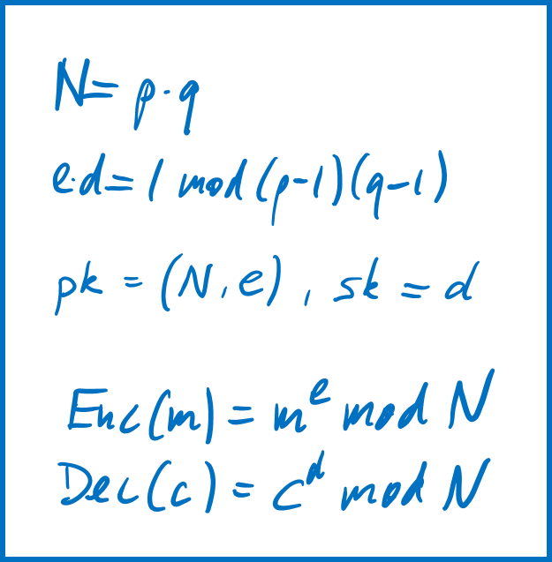

Public-key cryptography
RSA (Rivest, Shamir, Adleman, 1978)
Public-key encryption
Digital signatures
…relies on the difficulty of factoring large integers.

Slide 4
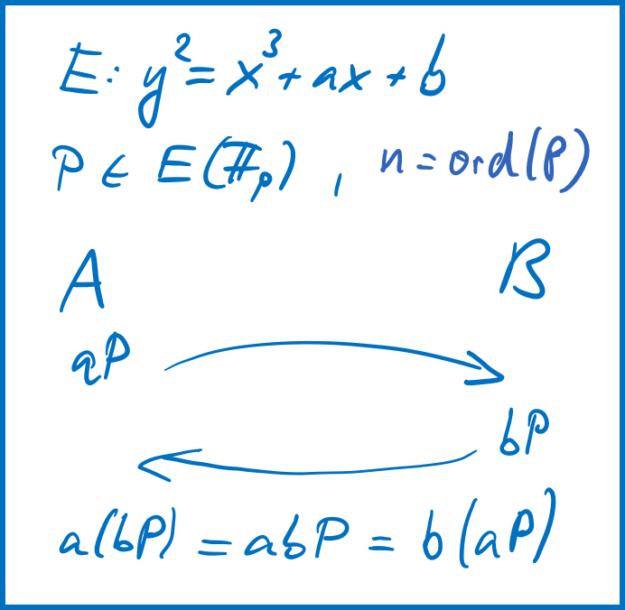
Public-key cryptography
DH (Diffie, Hellman, 1977)
ECDH (Miller, Koblitz, 1985)
Key exchange
…relies on the difficulty of computing discrete logarithms in a finite field or on an elliptic curve.

Slide 5
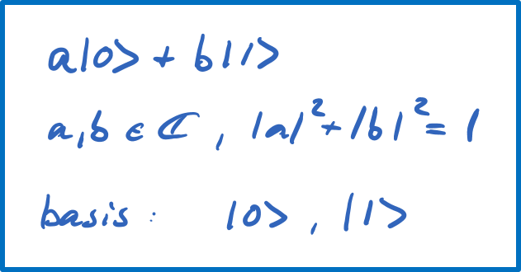
Quantum computing
Qubit: unit of quantum information
Unit vector in a two-dimensional complex vector space
Linear superposition of basis states

Slide 6
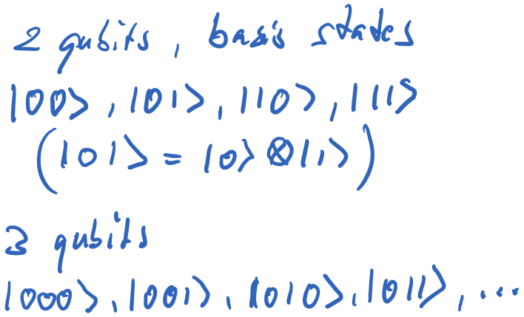
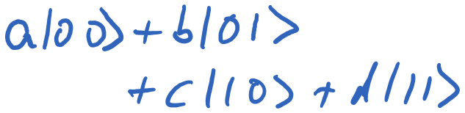

Quantum computing
Multiple qubits correspond to tensor product
$n$ qubit system: $2^{n}$-dimensional state space

Slide 7
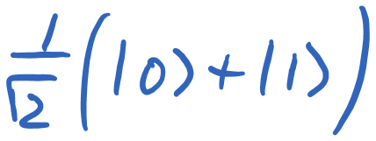
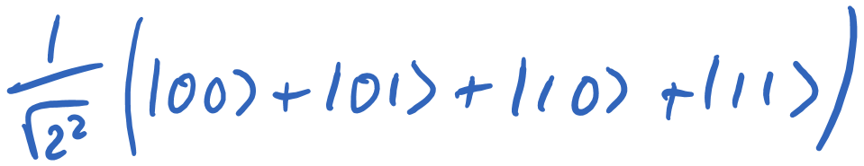
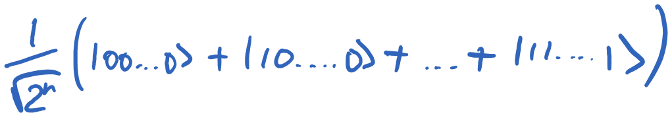
Quantum computing
Quantum parallelism: e.g. work on a (uniform) superposition of all possible values (bit strings)

Slide 8
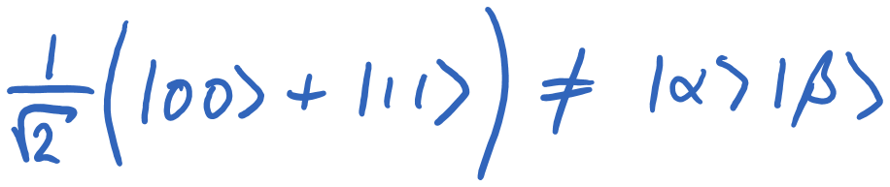
Quantum computing
Entanglement: state of a composite system that cannot be written as a product of component states
Two-qubit state that cannot be written as a product of single qubit states

Slide 9
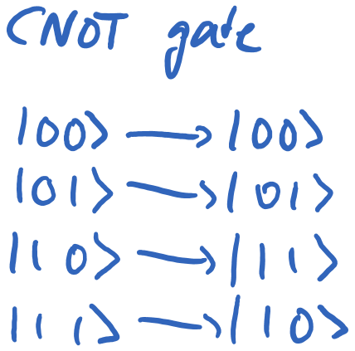
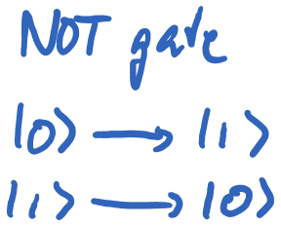
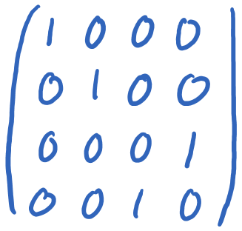
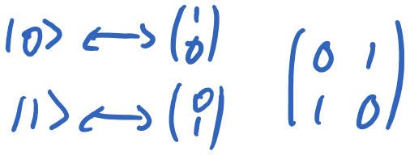
Quantum computing
Quantum gates: unitary operations on the vector space, i.e. only reversible operations allowed

Slide 10
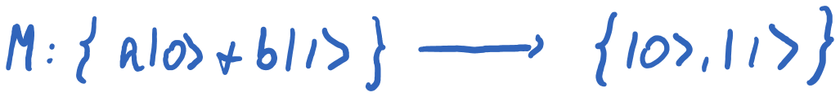
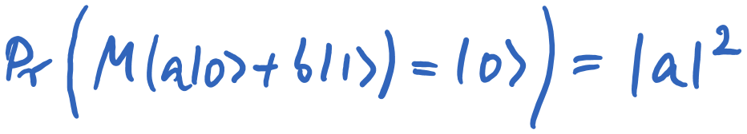
Quantum computing
Measurement: per qubit can only obtain one single classical bit of information

Slide 11
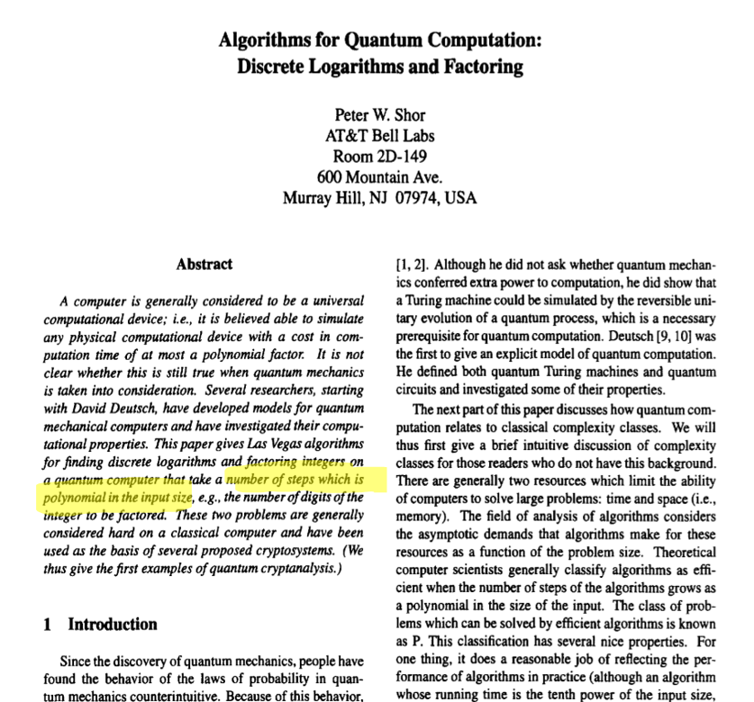
Quantum cryptanalysis
Shor (1994)
Polynomial-time quantum algorithm for factoring and DL
Uses quantum parallelism and quantum Fourier transform

Slide 12
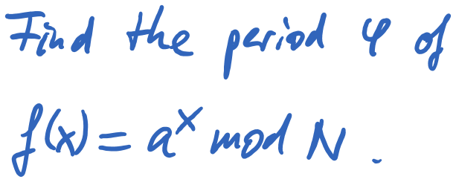
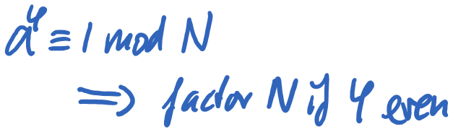
Quantum cryptanalysis

Slide 13
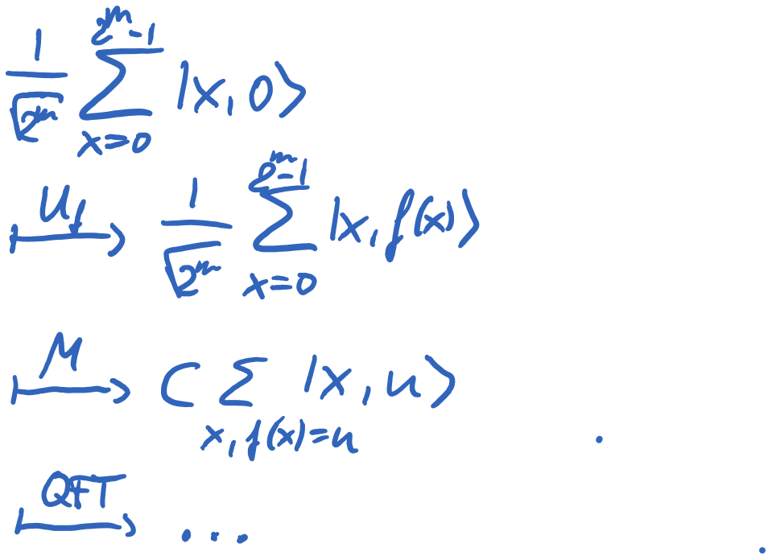
Quantum cryptanalysis

Slide 14
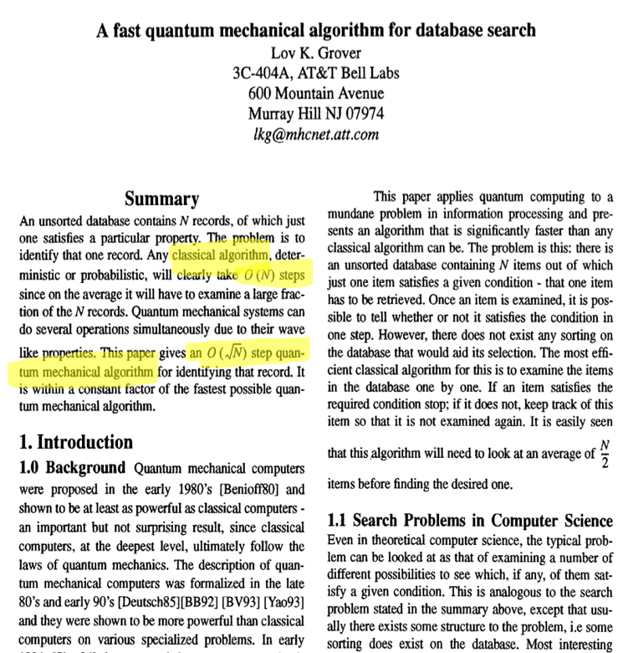
Quantum cryptanalysis
Grover (1996)
Quadratic speedup for unstructured search
(only quadratic)
Invert one-way function
Find (2nd) preimage of a hash function

Slide 15
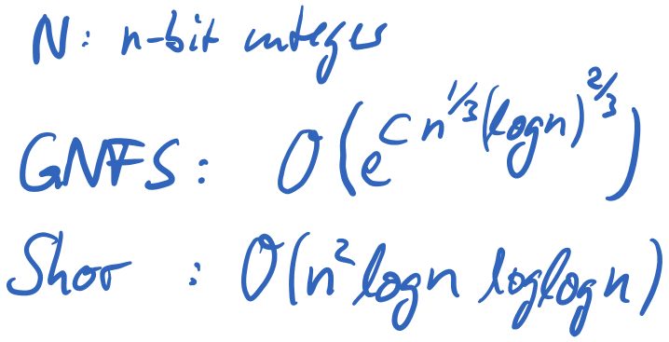
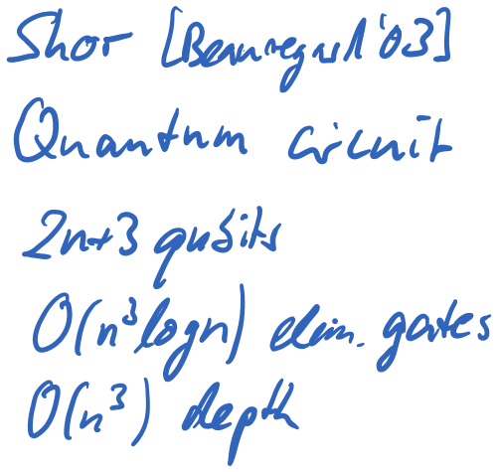
Is cryptography dead?
RSA:
Classical algorithm
GNFS: sub-exponential time
Quantum algorithm
Shor: polynomial time
For factoring 2048-bit RSA modulus, Shor’s algorithm needs 4099 logical qubits

Slide 16
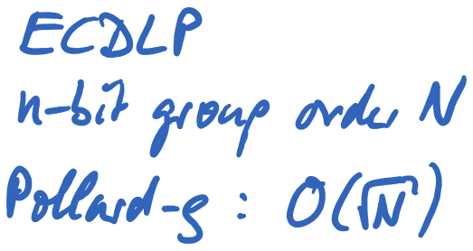
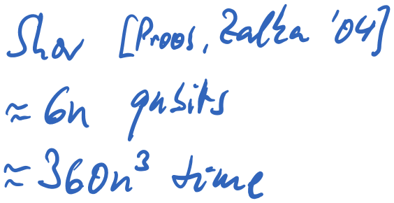
Is cryptography dead?
Similar picture for ECDH/ECDSA:
Classical algorithm
Pollard rho: exponential
Quantum algorithm
Shor: polynomial time
ECDLP-Shor likely to need less qubits than factoring at comparable classical security level

Slide 17
Is cryptography dead?
If it is possible to build a large-scale quantum computer with thousands of logical qubits,
then likely RSA and ECC are dead.
Increasing parameters to make quantum attacks infeasible will be intolerable.
But there are survivors and alternatives…

Slide 18
What is post-quantum crypto?
Cryptographic schemes that are believed to be secure even if there exists a large quantum computer.
Also referred to as “quantum-safe”, “quantum-resistant”.
Efficient classical schemes which resist the best known classical and quantum attacks.
Different from quantum cryptography, e.g. quantum key distribution.

Slide 19
Why not quantum crypto?
Bruce Schneier
Blog post “Quantum Cryptography: As Awesome As It Is Pointless” (10/2008)
“I don't see any commercial value in it. I don't believe it solves any security problem that needs solving. […] There are far more serious security problems to worry about, and it makes much more sense to spend effort securing those.”

Slide 20
Why not quantum crypto?
CESG: the information security arm of GCHQ
White paper “Quantum Key Distribution” (02/2016)
“QKD has fundamental practical limitations, does not address large parts of the security problem, and is poorly understood in terms of potential attacks. By contrast, post-quantum public key cryptography appears to offer much more effective mitigations for real-world communications systems from the threat of future quantum computers.”

Slide 21
Why should we care now?
We don’t have a large-scale quantum computer yet.
But we might have one in 15 years.
How long does it take to migrate the whole internet (or the whole world) to post-quantum crypto?
Some of today’s data and communications still need to be secure in 20 years.
How long does it take to migrate encryption systems to (re-)encrypt this data with post-quantum schemes?

Slide 22
Why should we care now?
We don’t have a large-scale quantum computer yet.
Does the NSA have one already? Or some other well-funded organization?
Even if quantum computers cannot be built: Have alternatives and increase cryptographic agility!

Slide 23
Hypothetical 15-year view

Slide 24
NIST timeline

Slide 25
Post-quantum candidates
Symmetric algorithms
Hash-based digital signatures
Code-based cryptography
Lattice-based cryptography
Based on multivariate quadratic equations
Based on supersingular elliptic curve isogenies

Slide 26
Post-quantum candidates
Symmetric algorithms
Hash-based digital signatures
Code-based cryptography
Lattice-based cryptography
Based on multivariate quadratic equations
Based on supersingular elliptic curve isogenies

Slide 27
Symmetric algorithms
Current block ciphers, stream ciphers, hash functions remain efficient and secure.
Grover’s algorithm only provides up to a quadratic speedup for the attacker.
E.g. double the key sizes for AES.
But not post-quantum if used with keys negotiated through finite field or elliptic curve DH.

Slide 28
Post-quantum candidates
Symmetric algorithms
Hash-based digital signatures
Code-based cryptography
Lattice-based cryptography
Based on multivariate quadratic equations
Based on supersingular elliptic curve isogenies

Slide 29
Hash-based digital signatures
Merkle hash trees (1979)
Use hash-based one-time signatures
such as Lamport-Diffie (1979), Winternitz (1979)
And hash trees to authenticate many one-time signature verification keys by a single public key
…relies on standard properties of hash functions.

Slide 30
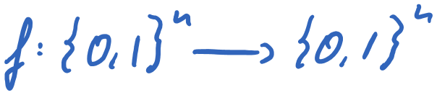
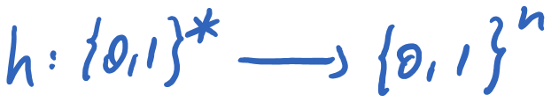
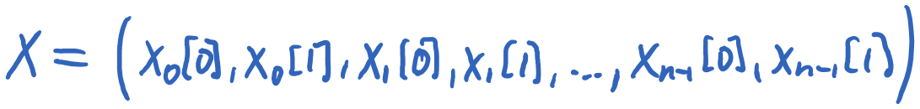
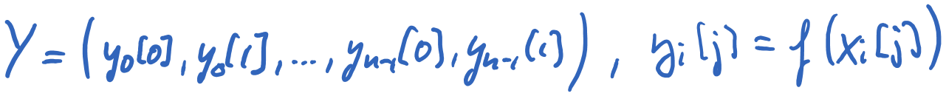
Lamport-Diffie one-time signatures
Use a one-way function
And a cryptographic hash function
Signature key: 2𝑛 random 𝑛-bit strings
Verification key: their values under the one-way funct.

Slide 31
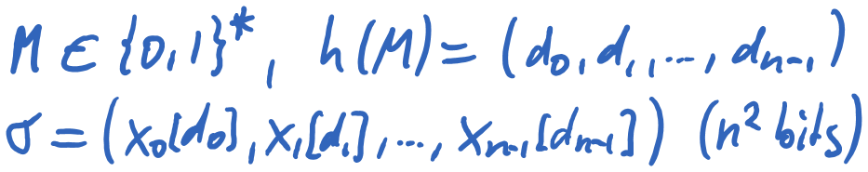
Lamport-Diffie one-time signatures
Signature key: 2𝑛 random 𝑛-bit strings
Signature

Slide 32
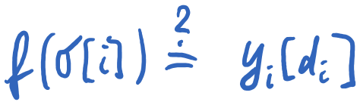
Lamport-Diffie one-time signatures
Signature
Verification: Hash message, check whether values of signature strings under the one-way function are equal to values in verification key

Slide 33
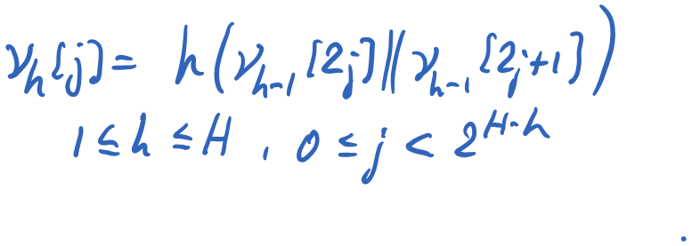
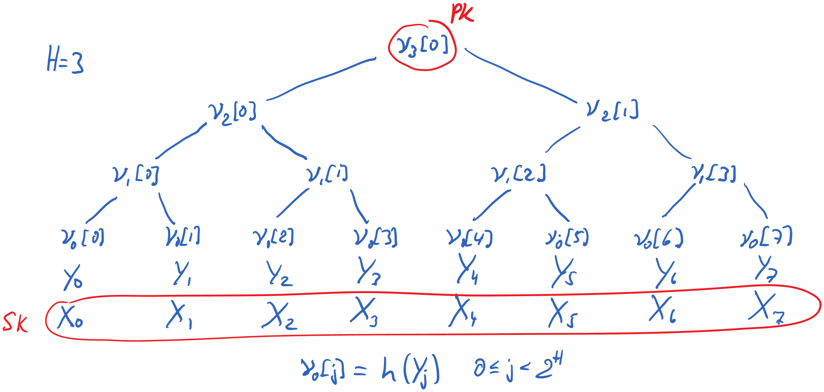
Merkle hash trees

Slide 34
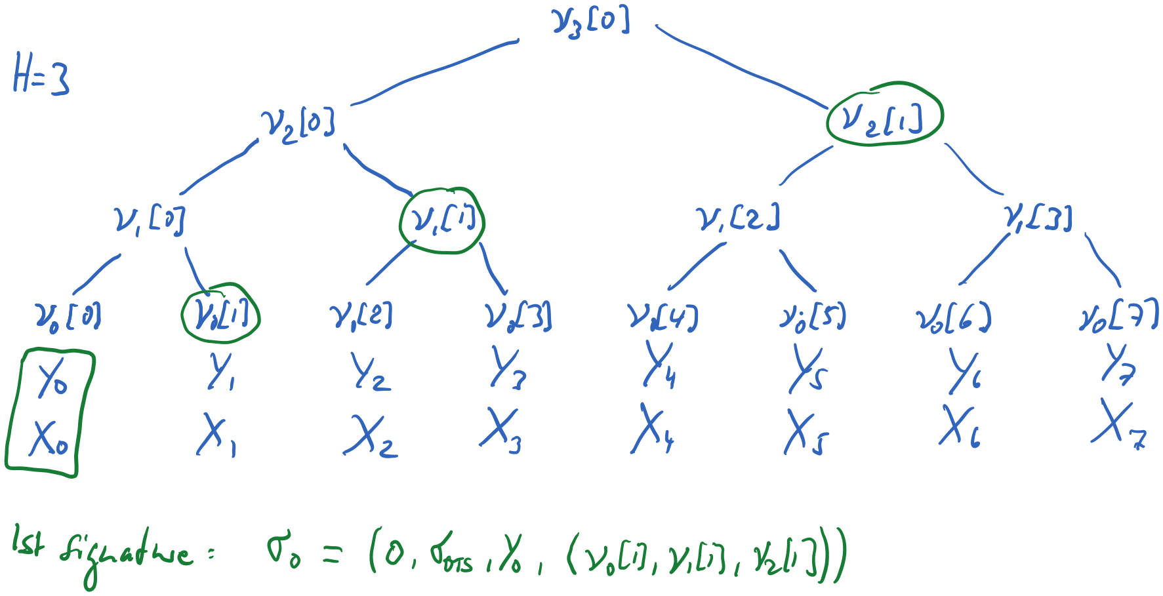
Merkle hash trees

Slide 35
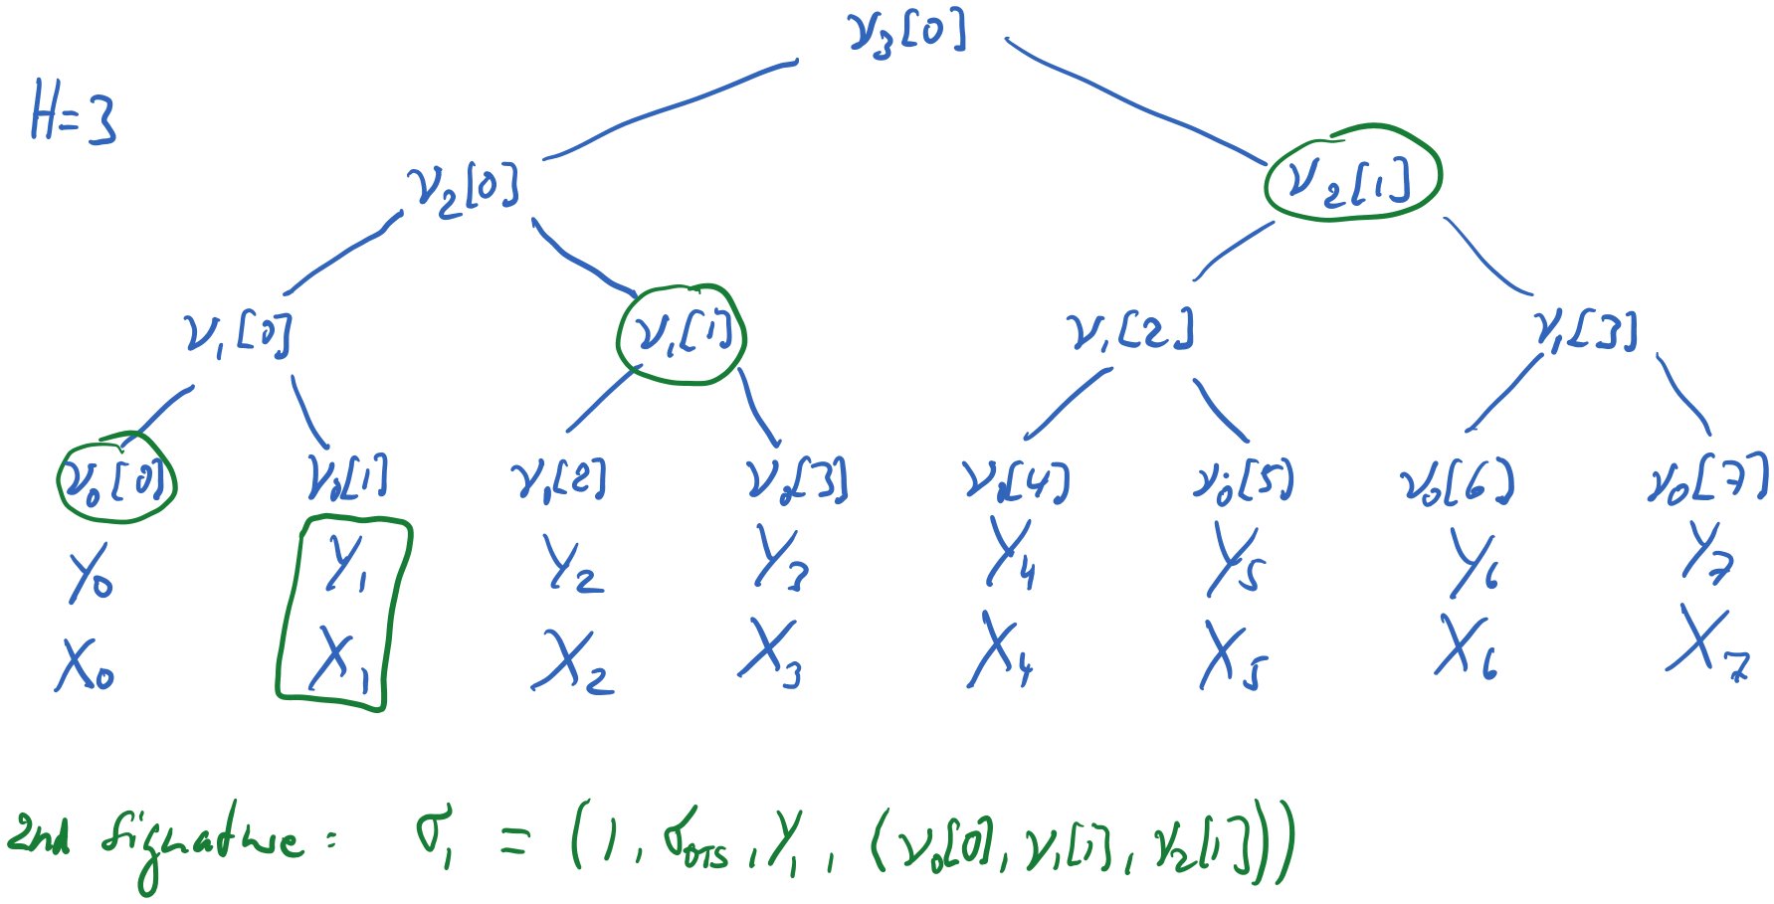
Merkle hash trees

Slide 36
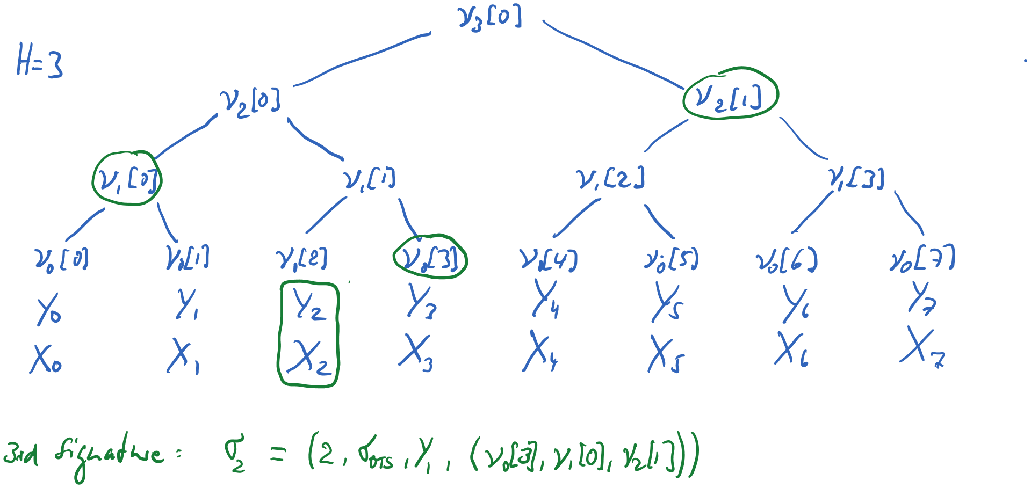
Merkle hash trees

Slide 37
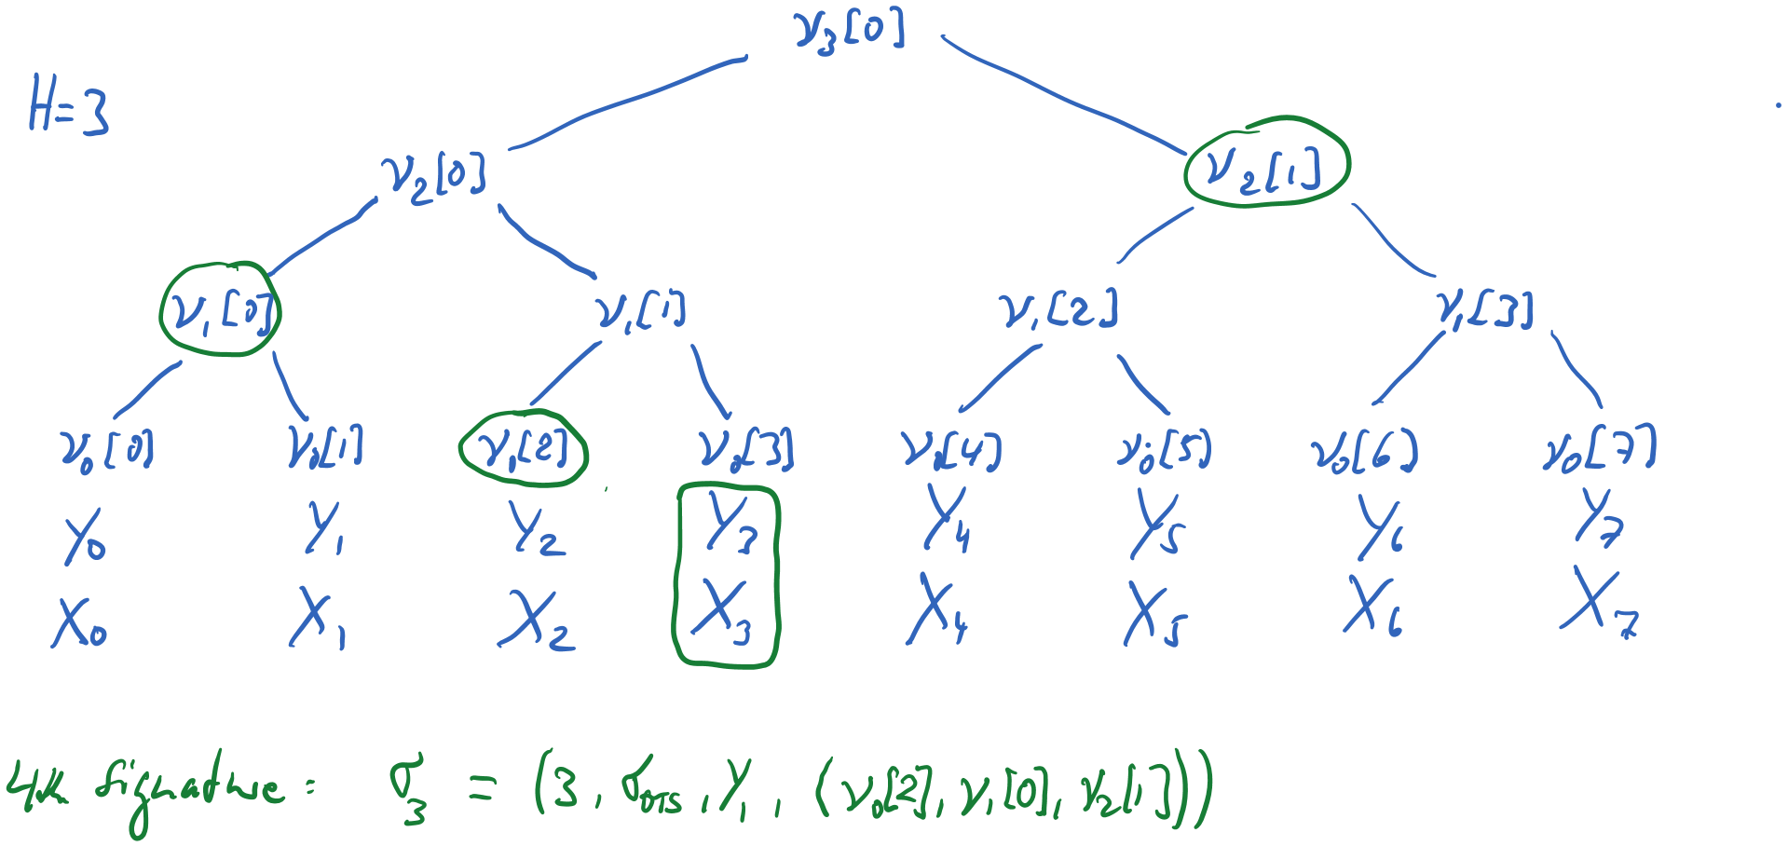
Merkle hash trees

Slide 38
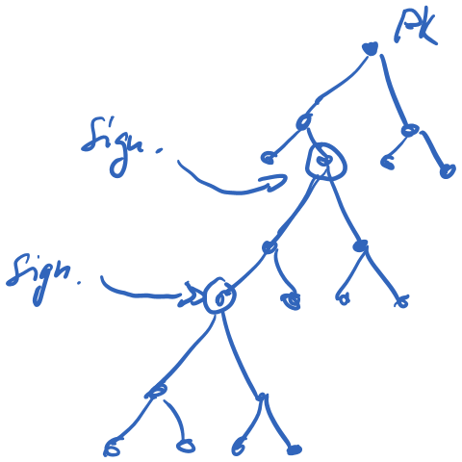
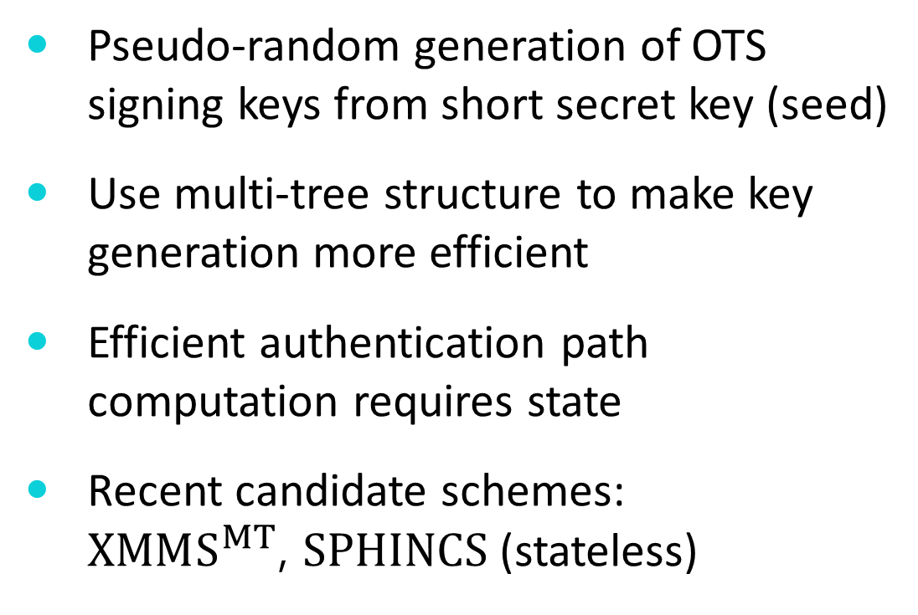
Hash-based digital signatures
Pseudo-random generation of OTS signing keys from short secret key (seed)
Use multi-tree structure to make key generation more efficient
Efficient authentication path computation requires state
Recent candidate schemes:
$XMMS^{MT}$, $SPHINCS$ (stateless)

Slide 39
Post-quantum candidates
Symmetric algorithms
Hash-based digital signatures
Code-based cryptography
Lattice-based cryptography
Based on multivariate quadratic equations
Based on supersingular elliptic curve isogenies

Slide 40
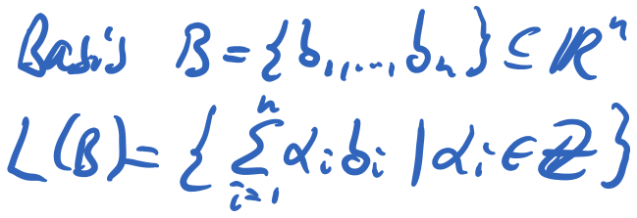
Lattice-based cryptography
Early schemes
Ajtai (1996): one-way function family
Ajtai, Dwork (1997): public-key encryption

Slide 41
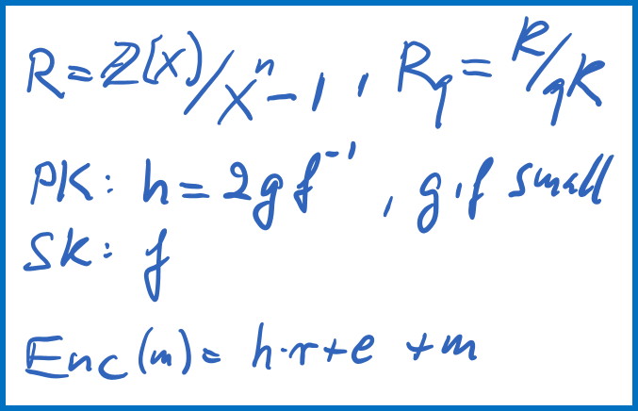
Lattice-based cryptography
NTRU (1996): encryption, signatures
ring-based scheme with additional structure

Slide 42
Learning with errors (LWE)
Regev (2005)
More efficient than previous works with proofs of security
LWE problem at least as hard as solving worst-case lattice problems (quantum reduction)
…relies on the difficulty the LWE problem

Slide 43







Learning with errors (LWE)
$$Z_{q}^{m×n}$$
$$Z_{q}^{n×1}$$
$$Z_{q}^{m×1}$$
$$Z_{q}^{m×1}$$
$$×$$
$$+$$
$$=$$
LWE problem: given blue, find red

Slide 44
Learning with errors (LWE)
random
secret
small noise
looks random
4 | 1 | 11 | 10
5 | 5 | 9 | 5
3 | 9 | 0 | 10
1 | 3 | 3 | 2
12 | 7 | 3 | 4
6 | 5 | 11 | 4
3 | 3 | 5 | 0
4
7
2
11
5
12
8
×
+
=

Slide 45
Learning with errors (LWE)
random
secret
small noise
looks random
4 | 1 | 11 | 10
5 | 5 | 9 | 5
3 | 9 | 0 | 10
1 | 3 | 3 | 2
12 | 7 | 3 | 4
6 | 5 | 11 | 4
3 | 3 | 5 | 0
6
9
11
11
0
-1
1
1
1
0
-1
4
7
2
11
5
12
8
×
+
=

Slide 46
Toy vs. real-world example
256
4 | 1 | 11 | 10
5 | 5 | 9 | 5
3 | 9 | 0 | 10
1 | 3 | 3 | 2
12 | 7 | 3 | 4
6 | 5 | 11 | 4
3 | 3 | 5 | 0
2738 | 3842 | 3345 | 2979 | …
2896 | 595 | 3607
377 | 1575
2760
…
640
640 × 256 × 12 bits = 245 KiB

Slide 47
Ring-LWE
Lyubashevsky, Peikert, Regev (2010)
Additional ring structure
Most promising in terms of efficiency
There are already efficient implementations for key exchange (in OpenSSL), signatures
…relies on the difficulty the Ring-LWE problem

Slide 48
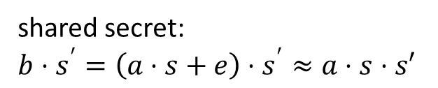
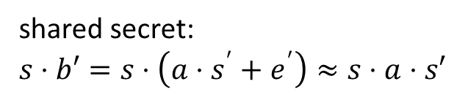


Basic R-LWE-DH key agreement
public: “big” a in R_{q} = Z_{q}[x]/(x^{n}+1)
Alice’s secret:
random “small” s, e in R_{q}
Bob’s secret:
random “small” s’, e’ in R_{q}
$$b=a⋅s+e$$
$$b′=a⋅s′+e′$$
shared secret:
$$s⋅b′=s⋅\left(a⋅s^{′}+e^{′}\right)≈s⋅a⋅s′$$
shared secret:
$$b⋅s^{′}=\left(a⋅s+e\right)⋅s^{′}≈a⋅s⋅s′$$
These are only approximately equal => need rounding

Slide 49


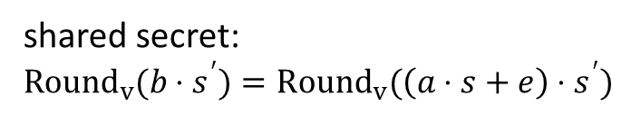
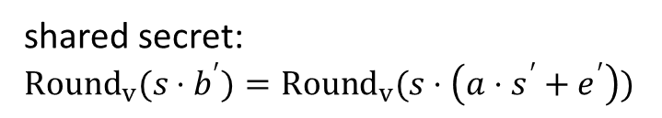

Exact R-LWE-DH key agreement
public: “big” a in R_{q} = Z_{q}[x]/(x^{n}+1)
Alice’s secret:
random “small” s, e in R_{q}
Bob’s secret:
random “small” s’, e’ in R_{q}
$$b=a⋅s+e$$
$b^{′}=a⋅s^{′}+e^{′}, v∈\{ , \}$
shared secret:
$${Round}_{v}(s⋅b^{′})={Round}_{v}(s⋅\left(a⋅s^{′}+e^{′}\right))$$
shared secret:
$${Round}_{v}(b⋅s^{′})={Round}_{v}(\left(a⋅s+e\right)⋅s^{′})$$

Slide 50
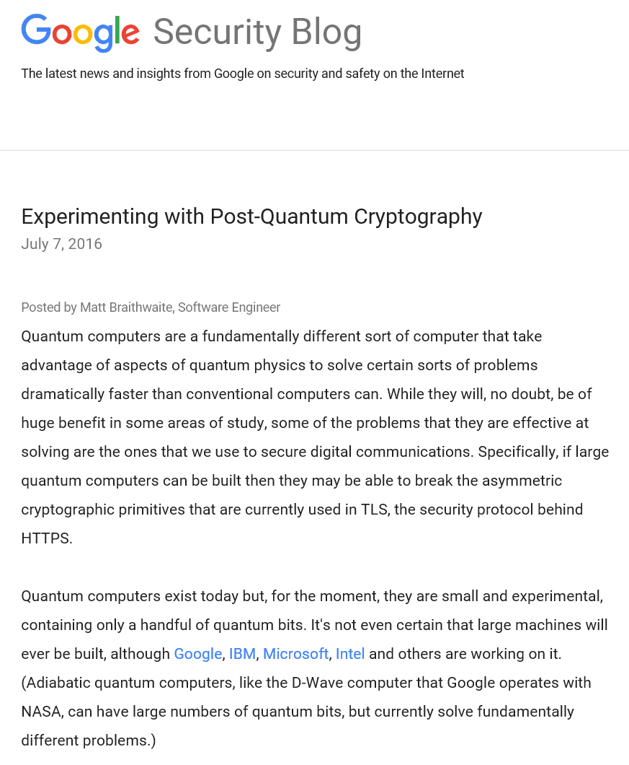
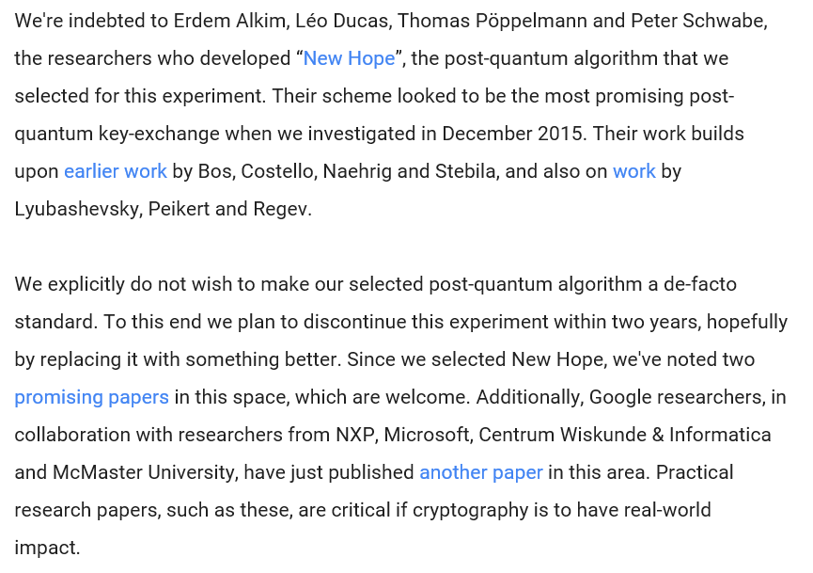
PQ key exchange in Chrome

Slide 51
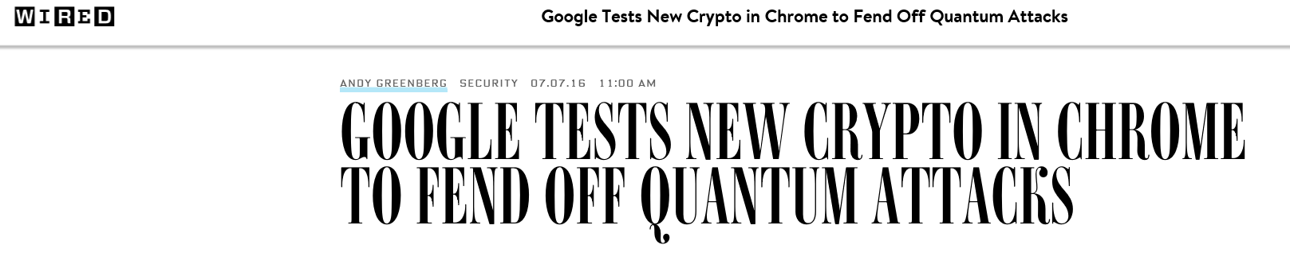
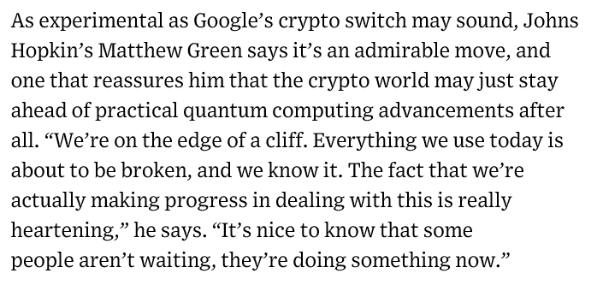
PQ key exchange in Chrome

Slide 52
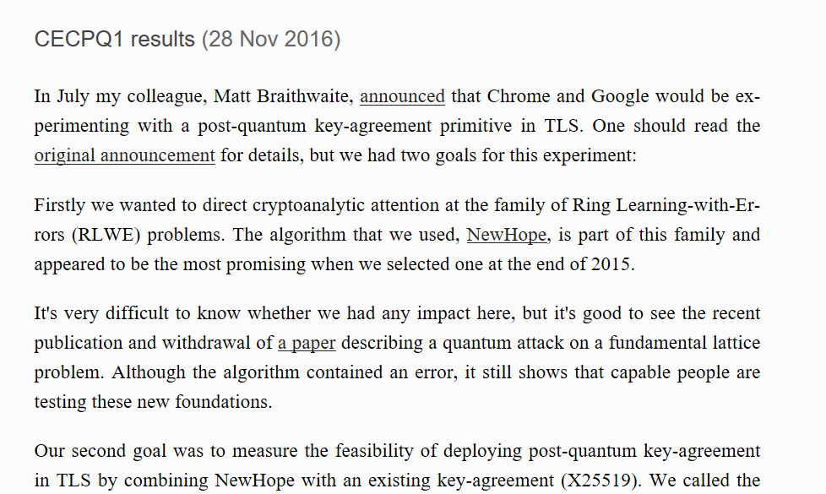

PQ key exchange in Chrome

Slide 53



PQ key exchange in Chrome

Slide 54
Post-quantum candidates
Symmetric algorithms
Hash-based digital signatures
Code-based cryptography
Lattice-based cryptography
Based on multivariate quadratic equations
Based on supersingular elliptic curve isogenies

Slide 55

Supersingular elliptic curve isogenies
Jao and DeFeo (2011)
DH-like key agreement (SIDH) and public-key encryption
Does not rely on difficulty of ECDLP
Moving around in a huge set of supersingular elliptic curves

Slide 56

Supersingular elliptic curve isogenies

Slide 57
Supersingular elliptic curve isogenies
Ephemeral SIDH key exchange
Slow, but relatively small key sizes
…relies on the difficulty of computing an isogeny of a certain degree between two elliptic curves.

Slide 58
Post-quantum candidates
Symmetric algorithms
Hash-based digital signatures
Code-based cryptography
Lattice-based cryptography
Based on multivariate quadratic equations
Based on supersingular elliptic curve isogenies

Slide 59

Code-based cryptography
McEliece (1978) public-key encryption
Uses error correcting codes
Secret key is a randomly chosen binary Goppa code (allows efficient decoding)
Hide the code structure by random transformations

Slide 60

Code-based cryptography
McEliece (1978) public-key encryption
Encryption: encode message and randomly flip a certain number of bits
Decryption: undo permutation, correct errors with the fast decoding algorithm

Slide 61
Code-based cryptography
McEliece (1978) public-key encryption
Fast, but keys are large
…relies on difficulty of decoding a random linear code.

