Slide 1
Teradata Database
Vantage
Douglas Brown
May 12, 2022

Slide 2
Agenda: Key Components/Concepts
MPP Architecture
Data Management
Query
Execution
Extensibility
Workload Management
Availability
Teradata
Vantage
Optimizer
MPP Shared-nothing Software-based Architecture
  Hash-based with partitioning (row and column)
Data Management
  Relational, semi-structured, unstructured
Cost-based Optimizer
Query Execution
  SQL Engine, Machine Learning Engines
Extensibility
  UDTs, UDFs, procedures, foreign servers
High-concurrency mixed workload management
Reliability and availability
Property of Teradata

Slide 3
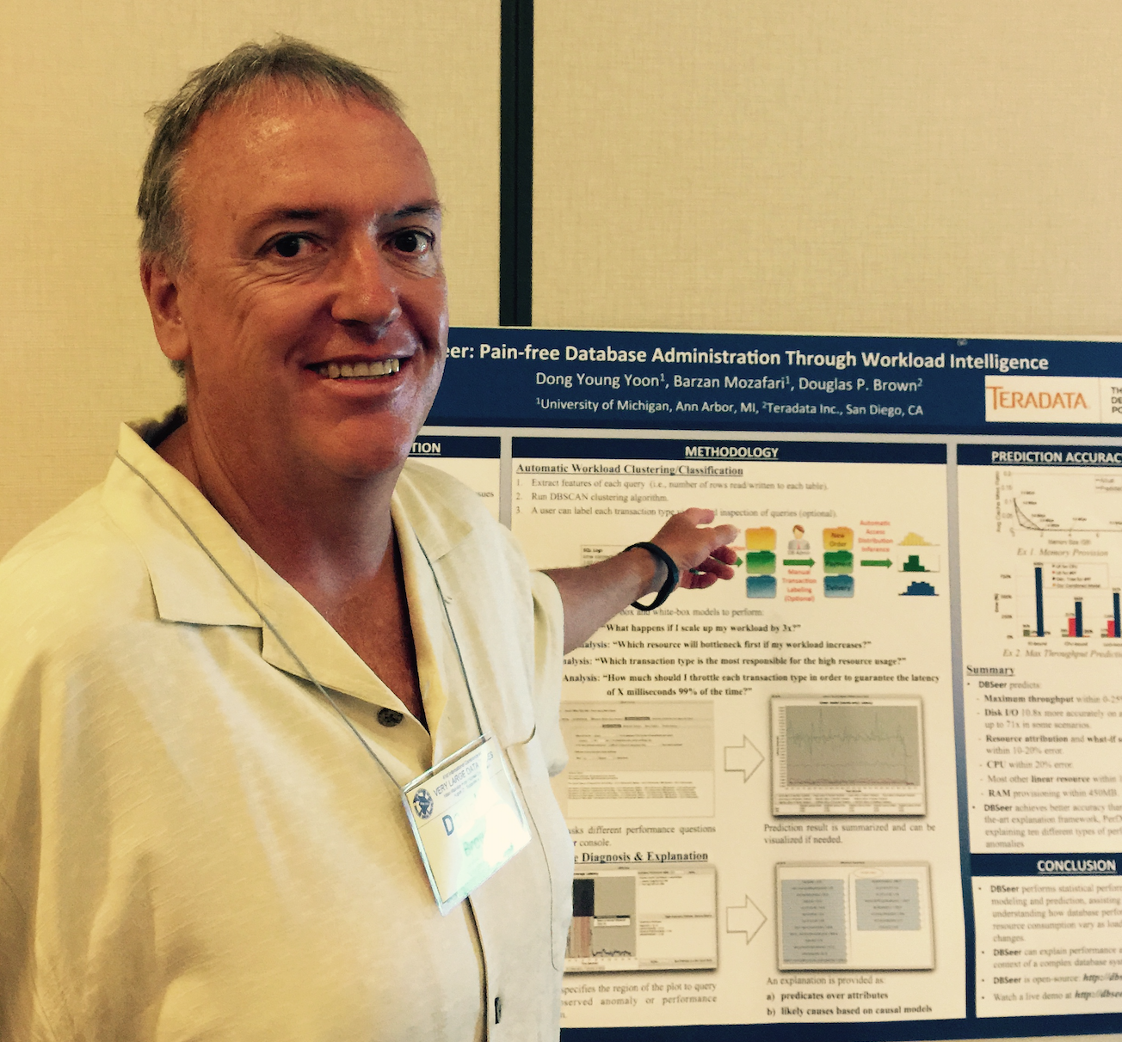
Doug Brown
Engineering Fellow - Technology Innovation Office (TIO)
Doug is currently a member of the Technology Innovation Office (TIO) in San Diego. He is presently the lead researcher and Product Owner (PO) for the workload management components of the Teradata database aka Teradata Active Systems Management (TASM).
Doug has been working in the Teradata database engineering team since 1989 and has contributed over 75 US Patents.
Property of Teradata

