Slide 1
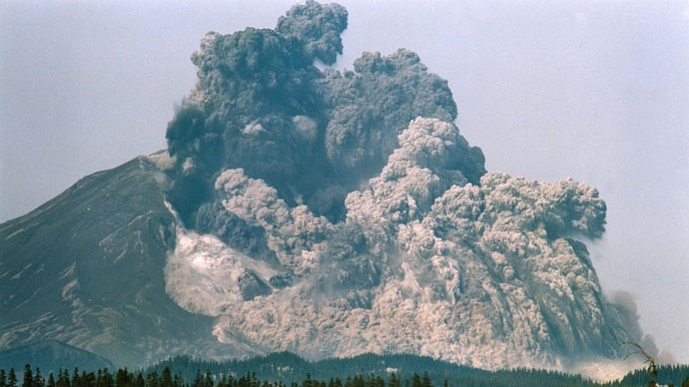
Development Engineering
CSEP 590 B
Open Data Kit
Waylon Brunette & Richard Anderson
May 18, 2020
Mount St. Helens, May 18, 1980

Slide 2
Today
Announcements
Waylon Brunette, University of Washington
Discussion with Waylon

Slide 3
Announcements
Discussion Sections – Zoom – Attend one
Wednesday: 3:00-4:00 pm
Wednesday: 5:00-6:00 pm
Homework 7, Due May 26.
Short paper based on Open Data Kit readings
Submit by email
Course grade based on 7 of 9 assignments
Next weeks lecture: Tuesday, May 26.

Slide 4
Course Schedule
Date | Topic | Lead
April 6 | Engineering the Vaccine Cold Chain
April 13 | Community Cellular Networks | Kurtis Heimerl
April 20 | Remote Temperature Monitoring | Martin Lukac, Nexleaf
April 27 | Election Monitoring | James Long
May 4 | Global Goods Software | Skye Gilbert
May 11 | Voice Based Social Networks | Aditya Vashistha
May 18 | Open Data Kit | Waylon Brunette
May 26 | Water Sanitation and Health | Ashok Gadgil
June 1 | Fintech for Rural Networks | Jenny Aker
June 8 | Development Engineering Discussion | Temina Madon and Anustubh Agnihotri

Slide 5
Development Engineering
Technological interventions to improve human and economic conditions in low-resource settings
Technical aspects of development engineering
Context for development engineering
How is development engineering practiced in different settings and domain

Slide 6
Global Goods Software
Software designed to support global development
Provided as a Global Good
Open source models predominate
Robust to infrastructure challenges
Poor network connectivity
Low cost devices
Limited technical capacity

Slide 7
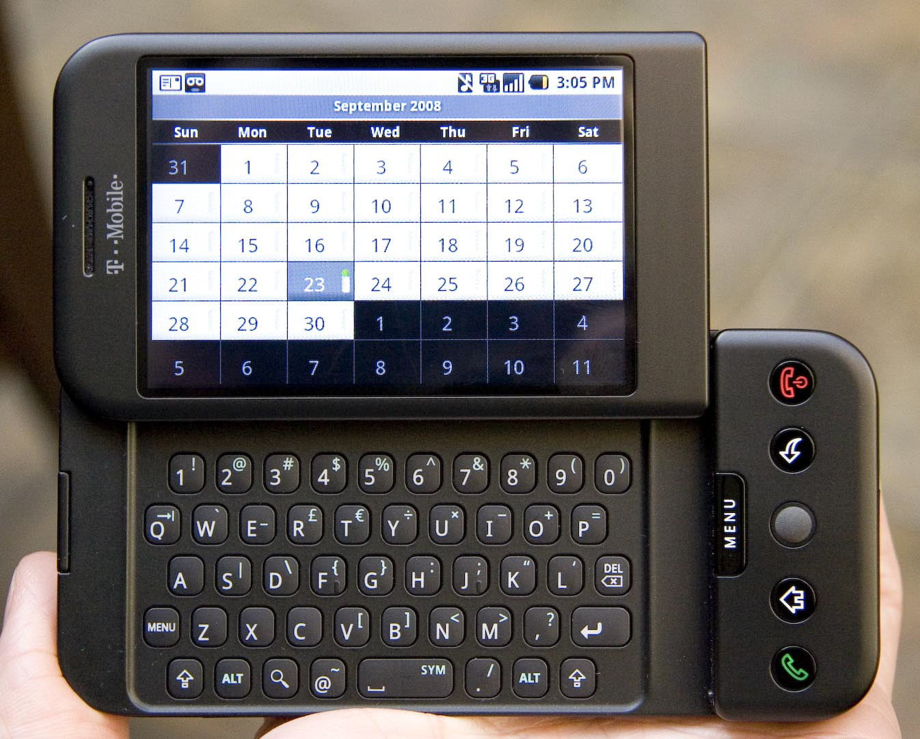
Open Data Kit
Mobile data management for development organizations
Platform for organizations to implement solutions
Project started in 2008, prior to public launch of Android
Mobile networks and available devices have evolved considerably since then

Slide 8
Academic Projects in Development Engineering
Academic incentive structure
Create projects that have impact
Mentor students
Publish research results
Open Data Kit
Started by Professor Gaetano Borriello
Research program on mobile applications
Need to focus on problems that require innovation
Scoping projects at “Phd Thesis” level
Challenge of spinning out academic projects in global goods setting

Slide 9
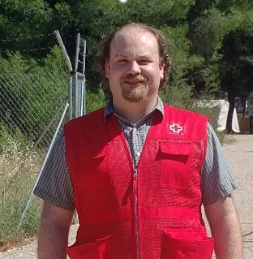
Today – Open Data Kit
Waylon Brunette
PhD student, University of Washington
Graduating June, 2020
Amazon and Intel Research Seattle experience
One of the original developers of Open Data Kit

Slide 10
Over to you Waylon. . .

