Slide 1
Development Engineering
CSEP 590 B
Voice based social networks
Aditya Vashistha & Richard Anderson
May 11, 2020

Slide 2
Today
Announcements
Aditya Vashisha, Cornell University
Discussion with Aditya

Slide 3
Announcements
Discussion Sections – Zoom – Attend one
Wednesday: 3:00-4:00 pm
Wednesday: 5:00-6:00 pm
Homework 6, Due May 18.
Review a technology innovation paper by Aditya
Submit by email
Course grade based on 7 of 9 assignments

Slide 4
Course Schedule
Date | Topic | Lead
April 6 | Engineering the Vaccine Cold Chain
April 13 | Community Cellular Networks | Kurtis Heimerl
April 20 | Remote Temperature Monitoring | Martin Lukac, Nexleaf
April 27 | Election Monitoring | James Long
May 4 | Global Goods Software | Skye Gilbert
May 11 | Voice Based Social Networks | Aditya Vashistha
May 18 | Fintech for Rural Networks | Jenny Aker
May 26 | Water Sanitation and Health | Ashok Gadgil
June 1 | Open Data Kit | Waylon Brunette
June 8 | Development Engineering Discussion | Temina Madon and Anustubh Agnihotri

Slide 5
Development Engineering
Technological interventions to improve human and economic conditions in low-resource settings
Technical aspects of development engineering
Context for development engineering
How is development engineering practiced in different settings and domain

Slide 6
The course so far . . .
Vaccine Cold Chain: System wide updates of cold chain status
Community Cellular: Last mile delivery of cellular communication
Remote Monitoring: Real time, automatic reporting
Election Monitoring: Verification of polling data through crowd sourcing
Global Goods: Information systems for public health
How do these fit together into an engineering domain: Development Engineering

Slide 7
Development Engineering Engineering process
Application of commercial grade technology
Common set of constraints: infrastructure, finance, technological capacity
Iterative development

Slide 8
Development Engineering Deployment context
Industry structure, governance, and finance have a dominant role in engineering practice
Civil Engineering
Military Systems
Commercial Aviation
Medical Systems
Software
Development Engineering
Governance and Funding
What is the source of innovation
What are opportunities for sustainable impact

Slide 9
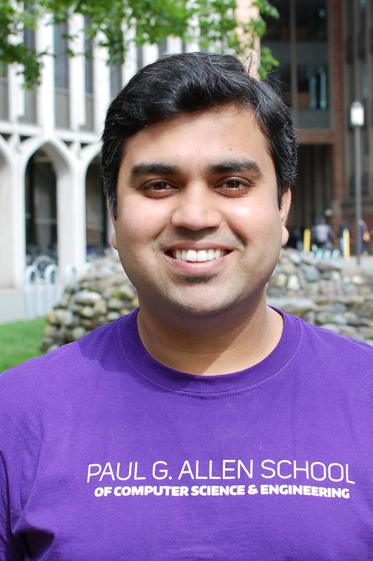
Today – Voice Based Social Networks
Aditya Vashistha
B. Tech, Jaypee Institute of Information Technology, Noida, India
Infosys Labs
Microsoft Research India, Technology for Emerging Markets, Assistant Researcher
PhD, Computer Science and Engineering, UW
Assistant Professor, Cornell University

Slide 10
Over to you Aditya. . .

