Slide 1
Development Engineering
CSEP 590 B
Community Cellular Networks
Richard Anderson
April 13, 2020

Slide 2
Today
Announcements
Kurtis Heimerl – Community Cellular Networks
Discussions with Kurtis
Cellular

Slide 3
Announcements
Discussion Sections – Zoom – Attend one
  Wednesday: 3:00-4:00 pm
  Wednesday: 5:00-6:00 pm
Homework 2, Due April 20.
  Submit by email
  Course grade based on 7 of 9 assignments
Readings:
  A Longitudinal Study of Local, Sustainable, Small-Scale Cellular Networks, Heimerl et al., Information Technologies & International Development, 11(1), 1–19, 2014.
  Scaling Community Cellular Networks with CommunityCellularManager, Heimerl et al., NSDI 2019.

Slide 4
Course Schedule
Date | Topic | Lead
April 6 | Engineering the Vaccine Cold Chain
April 13 | Community Cellular Networks | Kurtis Heimerl
April 20 | Remote Temperature Monitoring | Martin Lukac, Nexleaf
April 27 | Election Monitoring | James Long
May 4 | Voice Based Social Networks | Aditya Vashistha
May 11 | TBD
May 18 | Fintech for Rural Networks | Jenny Aker
May 26 | TBD
June 1 | Open Data Kit | Waylon Brunette

Slide 5
Development Engineering
Technological interventions to improve human and economic conditions in low-resource settings
Technical aspects of development engineering
Context for development engineering
How is development engineering practiced in different settings and domain

Slide 6








Development Engineering and Immunization
Top down environment
  Policy set from above
  Country level implementation
Where is development engineering going to take place:
  Big NGOs
  Technologists
  Corporate

Slide 7
Cell Phones
Impact on development

Slide 8
Development Engineering and Cellular Communication
Global Engineering –
Central players are going to be telecommunications companies and regulators
  Tremendous capital required
  Needed standardization
  Regulation of spectrum
Is there an opportunity for Development Engineering in this domain
Extend connectivity beyond where Telcos can be profitable

Slide 9
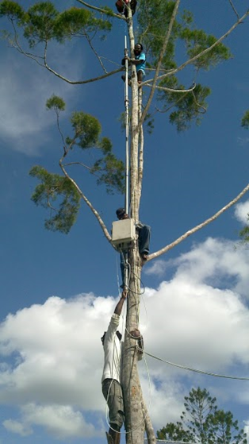
Today – Community Cellular Networks
Kurtis Heimerl
  Assistant Professor, UW CSE
  PhD, UC Berkeley (2013)
  BS, UW CSE (2007)
Research builds community based systems for rural areas
UW Early Career Diamond award, MIT TR-35, ISIF Asia Community Network Award, NSDI Community Award

Slide 10
Over to you Kurtis . . .

Slide 11
Additional slides if needed

Slide 12
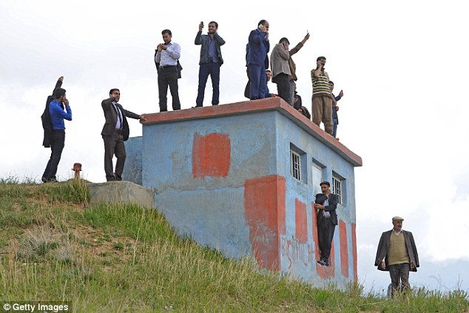
Communications Infrastructure

Slide 13
Mobile Phones and Development
Mobile phones have had a dramatic impact worldwide
Most adults have access to a mobile phone
Leap frog technology – did not replace land-lines
Biggest impact is making communication possible where it wasn’t previously
Primarily commercially driven – private or semi-private companies making oodles of money
Mobile phones have transformed many activities and industries
Adoption path across different groups has been uneven

Slide 14
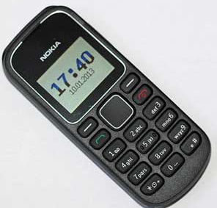
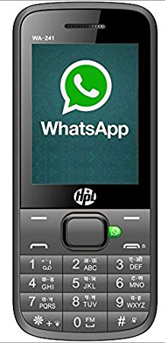
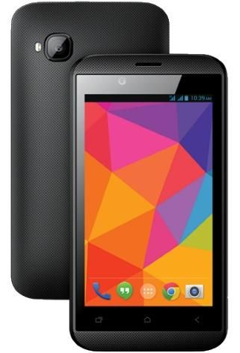
Handset Types
Basic Mobile Phones
Feature Phones
Smart Phones

Slide 15
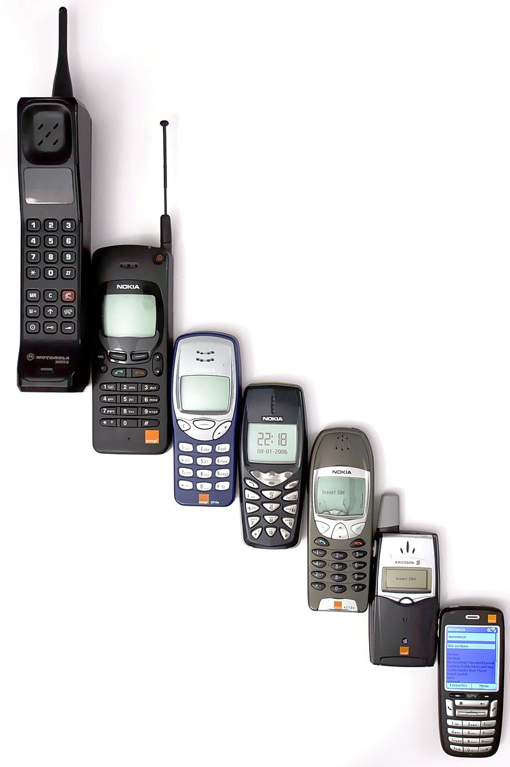
Cell Phone timeline
1G: Analog
  Demonstration 1973. Commercial Launch: Japan 1979 (fully covered in 1984), Nordic countries 1981, USA 1983
2G: Digital
  GSM (Global System for Mobiles)
    Commercially launched in Finland in 1991.
    Mandated by European Union in 1987
    In USA: ATT, T-Mobile
    Globally Dominant
  CDMA (Code Division Multiple Access)
    Commercially Introduced in USA in 1995.
    Dominated by Qualcomm.
    In USA: Sprint, Verizon, US Cellular.
2.5 G, 2.75 G: Enhanced Digital
  GPRS (General Packet Radio Service)
  Enhanced Data Rates for GSM Evolution (EDGE)

Slide 16
Cell Phone timeline
Marketing terms for multiple technologies
3G
  Faster data speeds
  Roll out: 2001 Japan, 2001 Isle of Man, 2003 USA
  Issue in release of new phones
  Different spectrum than 2G
  Widespread by 2007
4G
  Long Term Evolution (LTE) standard
  Even faster data speeds
  Internet Packet (IP) packet-switched technologies
  Introduced around 2009 / 2010
5G
  2018-2020
  Even faster data speeds

Slide 17
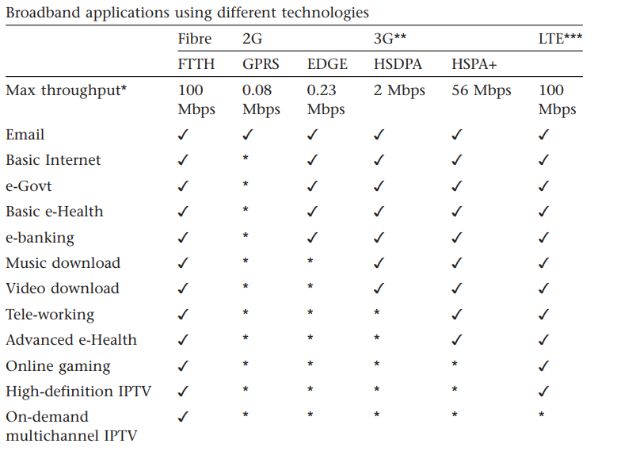
Broadband Applications

Slide 18
Cell Phone Worldwide Growth
Mobile Subscriptions per 100 inhabitants

Slide 19
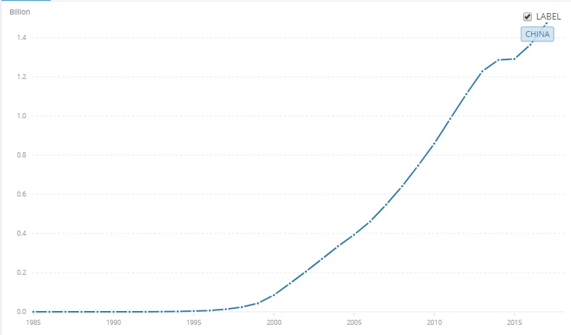
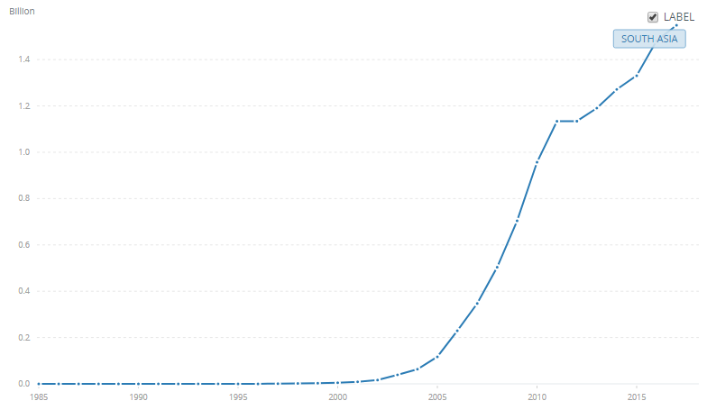
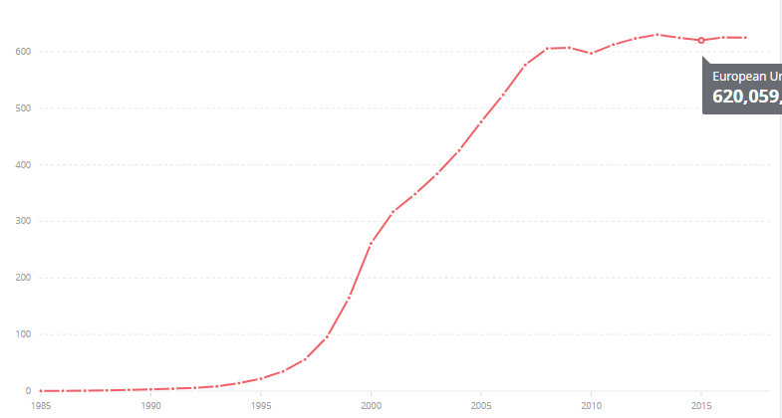
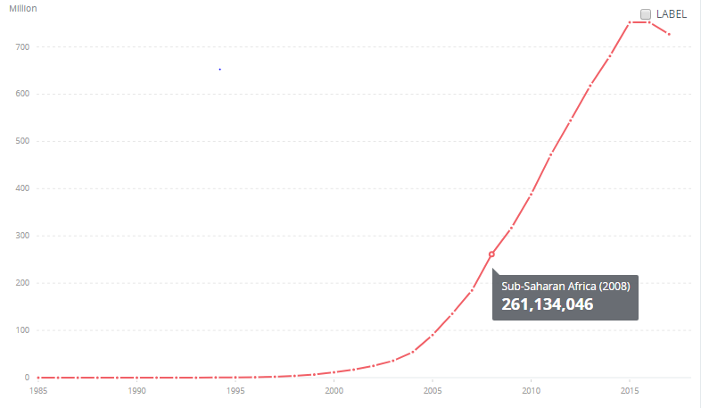
Cell phone subscriptions, 1985-2017
World
South Asia
Europe
Sub-Saharan Africa

Slide 20
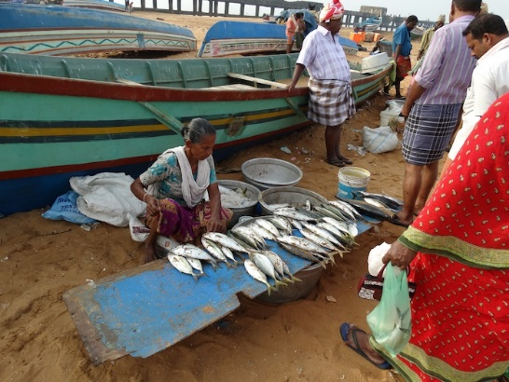
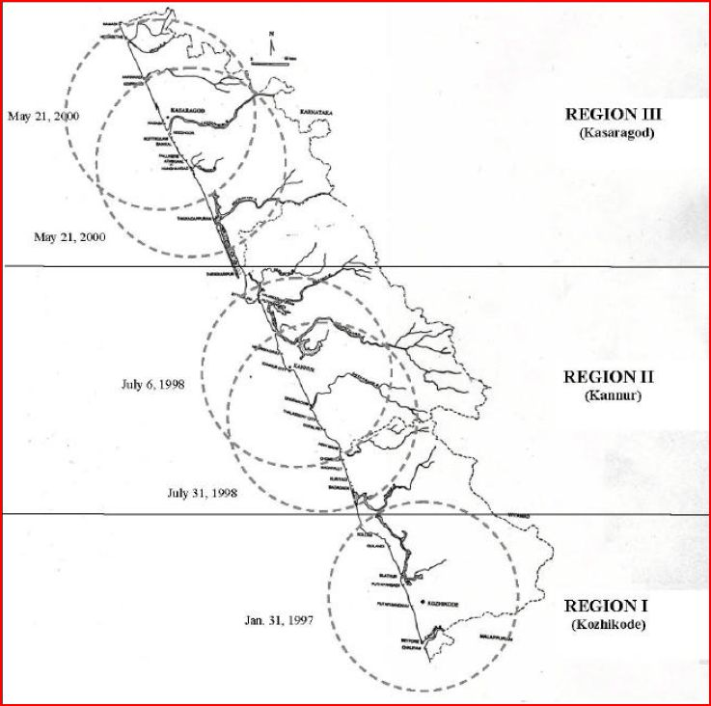
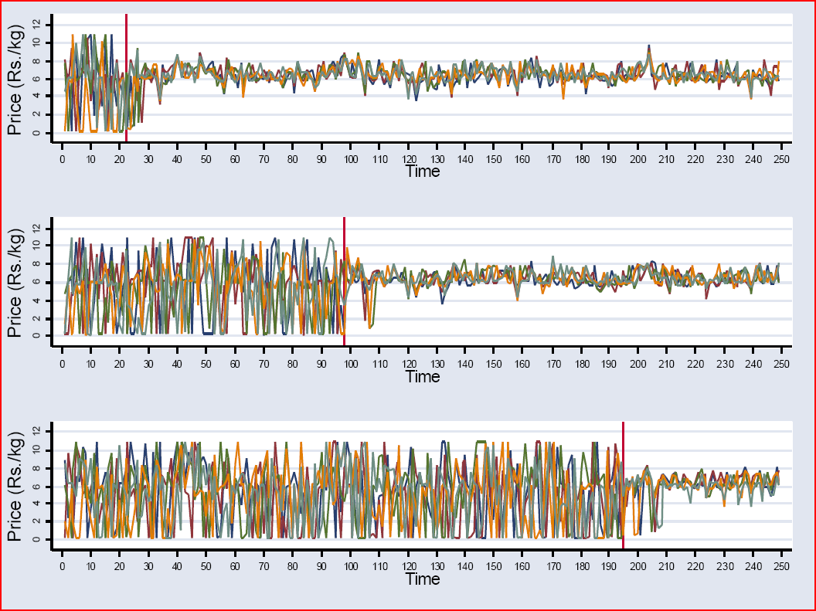
Fish prices in Kerala
Study by Robert Jensen of the wholesale price of fish at beach markets in Kerala, India
Studied prices as cell towers were build moving up the coast

Slide 21
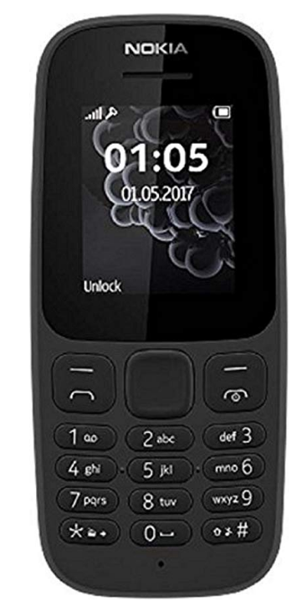
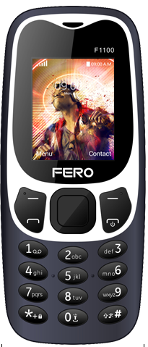
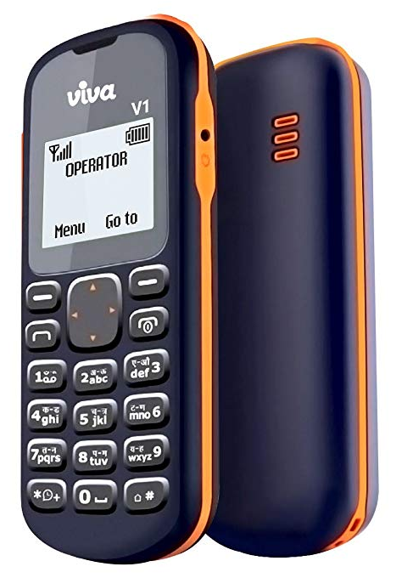
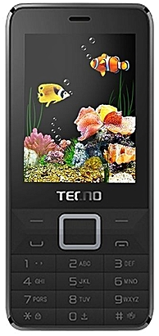
Basic Mobile Phones (October, 2018)
Nokia 105
Quad band, GSM, Dual Sim
999 rs
Fero F1100
1.2 MP Camera
900/1800Mhz
GPRS
BlueTooth
1050 Ksh
Viva V1
Single Sim, 2G
Flashlight, Snake
432 rs
Tecno T350
GSM 900 Mhz
Camera, Radio, Facebook, Palmchat
5100 Ngn

Slide 22
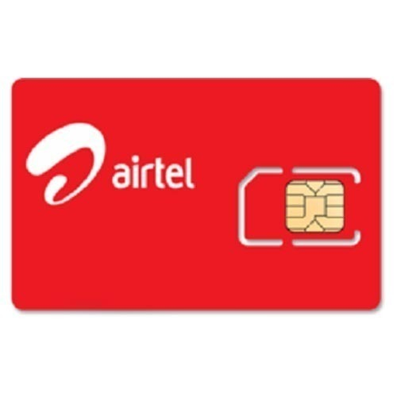
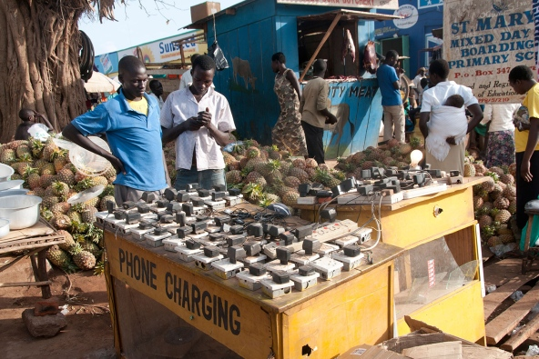
Handset Constraints
Connectivity
Simcard Ownership
Simcard Registration
Airtime Balance
Electrical charging
Handset Cost

Slide 23
Basic Mobile Phones (GSM Standard)
Voice
DTMF
  Dual Tone Multi-Frequency
SMS
  Short Message Service
USSD
  Unstructured Supplementary Service Data

Slide 24
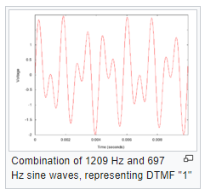
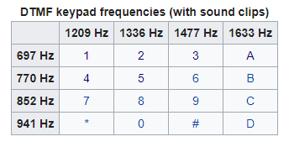
Voice + DTMF
Analog signal for sound waves
Converted by handset to digital data for transmission
Multiple codecs can be used for conversion
Voice Fundamental Frequency:
  Male (85 to 180 Hz), Female (165 to 255 Hz)
Speaking frequency 20Hz to 20000 Hz
Audible through 20000 Hz
Telephony: Frequency band 300Hz to 3400 Hz.
Sampling at 8000 Hz

Slide 25
SMS (Short Messaging Service)
Defined in 1985 as part of the GSM Standard
Protocol allows seeing of up to 160 character alpha-numeric messages
The hard thing in designing SMS was getting an agreed upon standard
  Deutsche Telekom + France Telecom
The first SMS was sent over Vodafone GSM Network on December 3, 1992 in the UK
Initial growth was very slow, significant growth around 2000
  Designed for Engineers
  Took off when European Teenagers started using it
SMS Gateway services are very important for building SMS applications – more later
Hack: You can send SMS from email – 2065551212@tmomail.net

Slide 26
Trivia
What was the content of the first voice call? (Alexander Graham Bell to Thomas Watson, March 10, 1876)
What was the content of the first text message? (Neil Papworth to Richard Jarvis, December 3, 1992)
Why are SMS messages limited to 160 Characters.

Slide 27
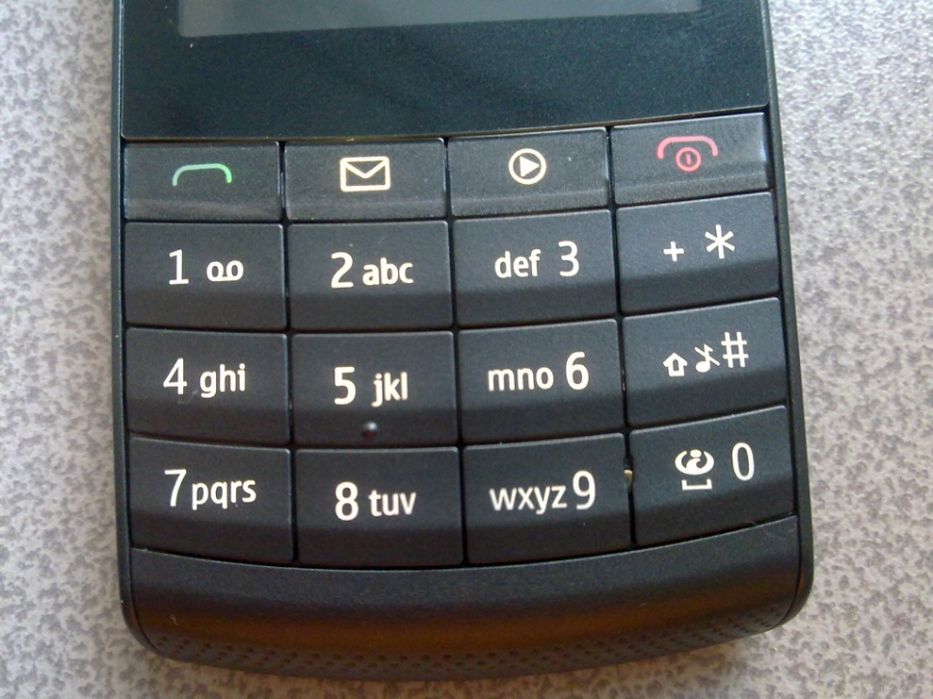
SMS Challenges
Character limitation
Expense
Character Set – restricted to basic Latin characters (7-bit characters)
  Unicode extensions require 16 bit – greatly reducing message length
Difficulty of entering letters on a keypad
Reliability

Slide 28
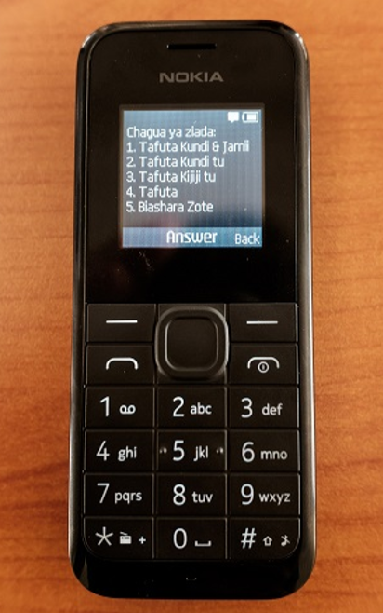
USSD Unstructured Supplementary
Service Data
Session based protocol for communicating by text between handset and service provider
Initiated with a short code, e.g., *144# to check Safaricom balance
160 character strings sent back and forth between handset and provider until session is terminated
Key differences from SMS
  Synchronized communication
  Direct with service provider: better security
  Does not leave messages on the phone
Applications
  Adding services to cell service
  Mobile Money
  Yellow Pages Directory

Slide 29
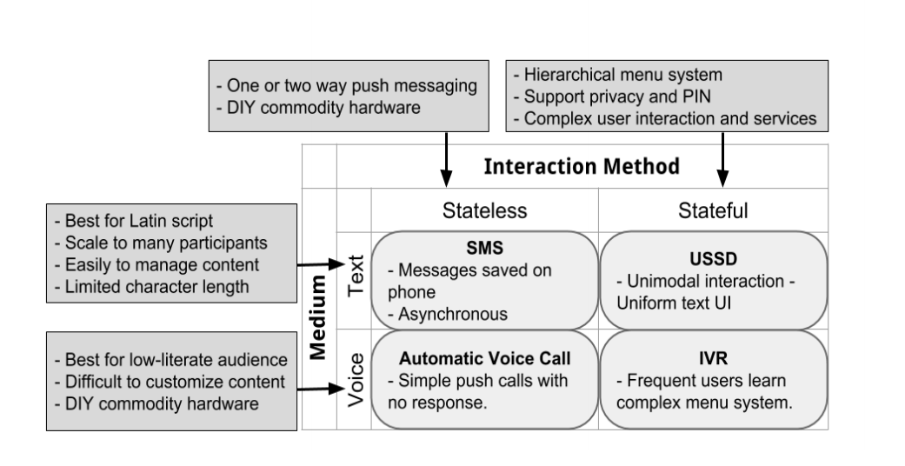
Universal Apps (Trevor Perrier)

Slide 30
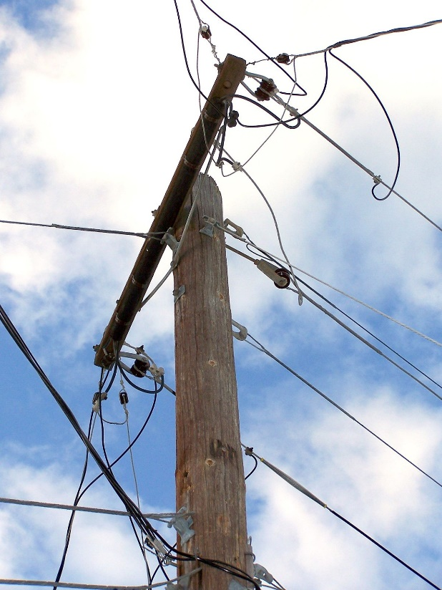
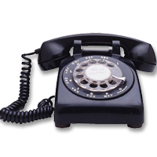
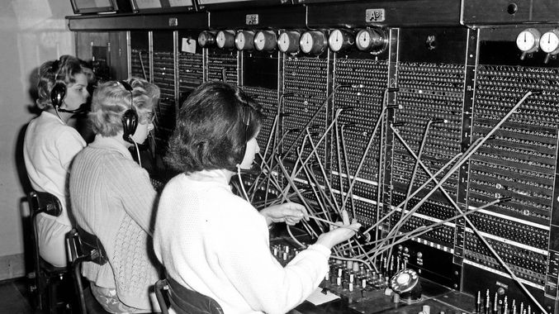
Phone Service
Copper wire to house
Phone connected to wire
Physical exchange to connect calls
Monopoly
Development of standards to allow international calls
  Technical
  Billing

Slide 31
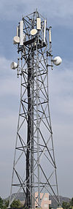
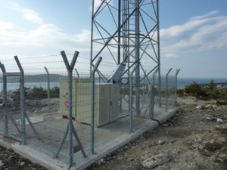

Cellular Service
Cell Tower
  Radio transceiver
  Power source
  Range: Up to 40 miles, limited by
    Terrain
    Technology
    Capacity
Aside
  OpenBTS

Slide 32
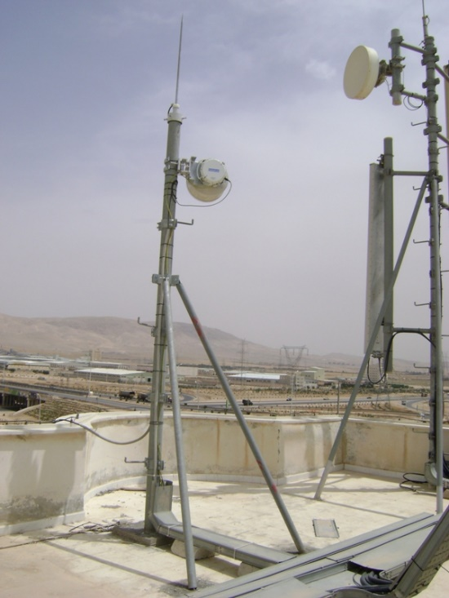
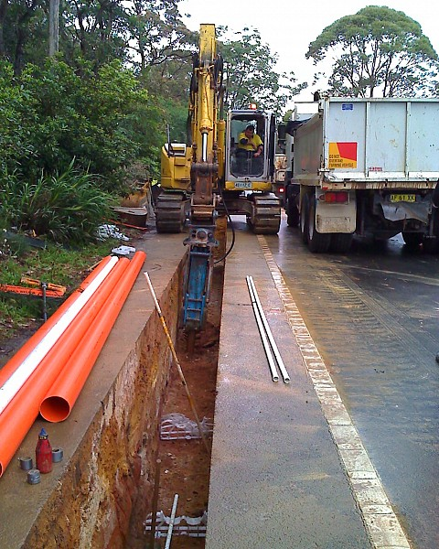
Cellular Technology
Backhaul
  Connecting base station to main network
  Wired backhaul
    Optical Fibre or Copper
  Wireless
    Microwave radio relay
    High capacity radio

Slide 33
Cellular Connections
Cell towers must connect to all phones in radius
  Protocol for identifying phones
  Needs to know to initiate action to a phone or from a phone
Cell tower handoff
  Mobile communication
Connectivity info
  Cell tower logs
  TAC – type allocation code
  Records all (turned on) phones
    Not just making calls or on the network
Call Data Records
  Data for individual calls
    Phone numbers, time, duration, cell tower ids

Slide 34
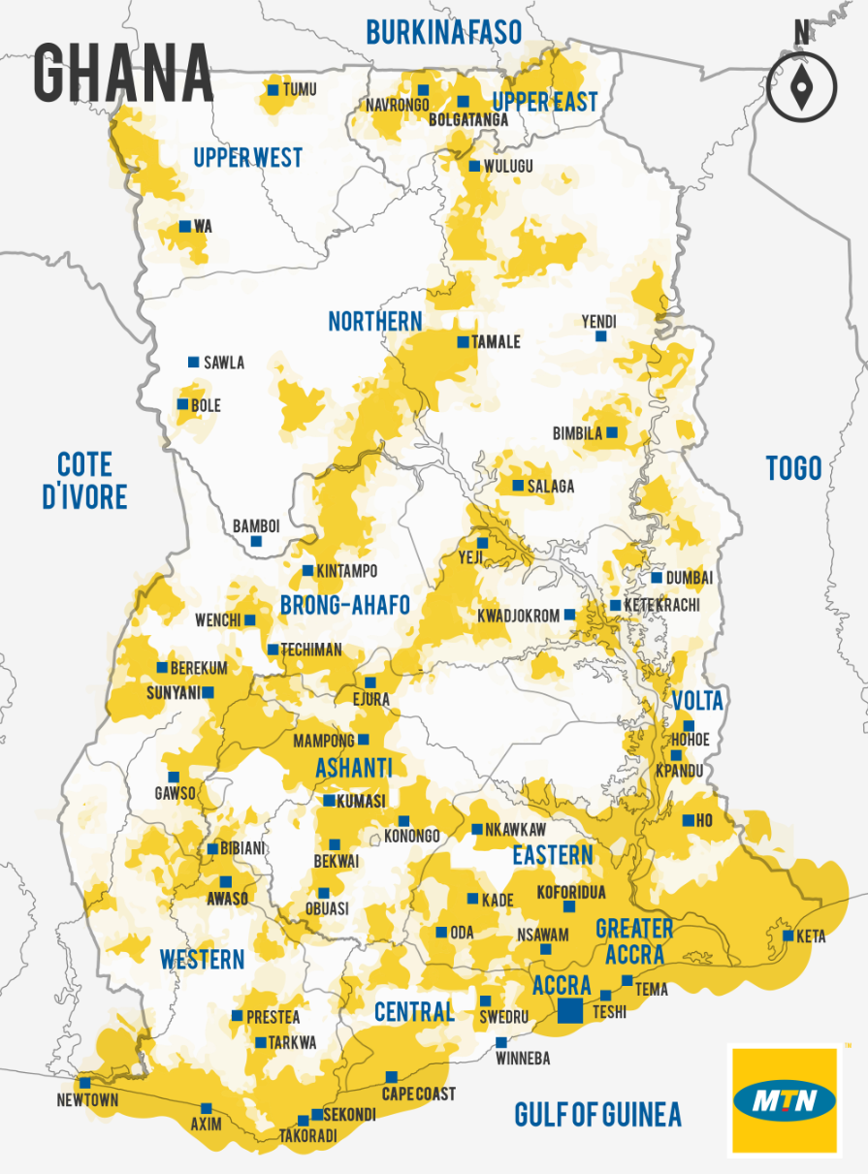
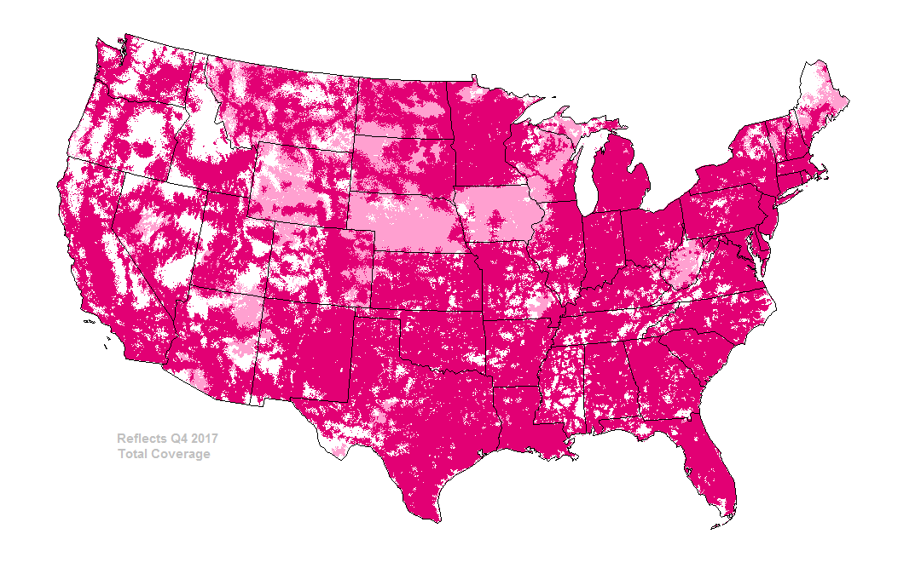
Global Cellular Coverage

Slide 35
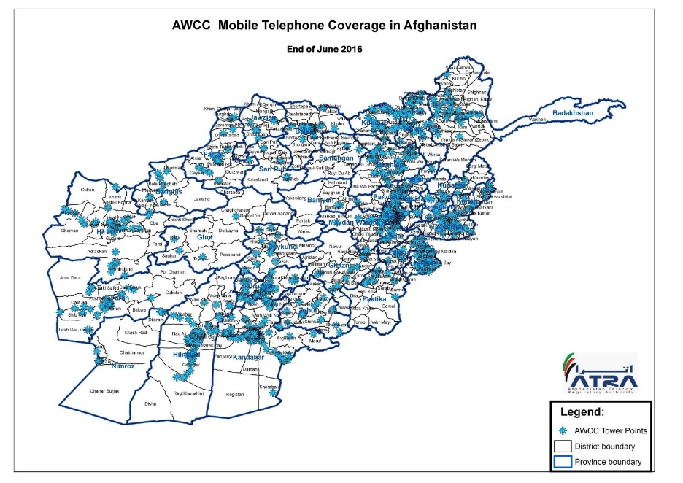
Global Cellular Coverage
Finding good cellular coverage maps is a challenge
Areas with high population will be covered
Low coverage in remote/mountainous areas
Coverage between carriers is highly variable
Often there are carriers focusing urban areas, and carriers with a rural focus
Crowd sourced cellular data not that useful – need telco data

Slide 36







Telcos
Big, global companies
Most countries seem to have about three to five competing mobile operators
  Possibly with some government ownership
  A few countries have government monopolies
List of top 15 mobile telecommunications company
  Companies either focus on one large market or serve many countries
  USA barely appears on this list
    T-Mobile (Deutsche Telekom)
    TracFone (America Movil)
  US Based Telcos do not have a global presence
Largest companies (by subscriptions)
  China Mobile
  Vodaphone Idea (India)
  Airtel (India) [20 countries]
  Vodaphone (UK) [26 countries]
  China Unacom
  China Telecom
  America Movil (Mex) [22 countries] Claro
  Telefonica (Sp) [20 countries] Movistar
  Veon (Neth)[14 countries]
  Reliance Jio (India)
  MTN (SA) [20 countries]
  Orange (France) [25 countries]
  Telkomsel (Indonesia)
  Telenor (Norway) [12 countries]
  Deutsche Telekom (Ger) [16 countries] T-Mobile

Slide 37
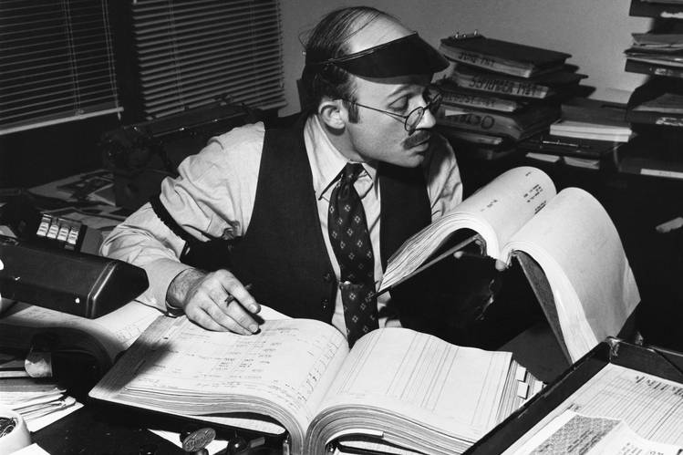
Charging for Calls and SMS
Telcos want to maximize ARPU
Charging for service
  Call cost
  SMS cost
Wide range of costs in different markets
  Costs may be very high relative to income
Charging for calls across networks
  In-network vs. out of network
  Charge incoming and out going
Bundling of handset and services

Slide 38
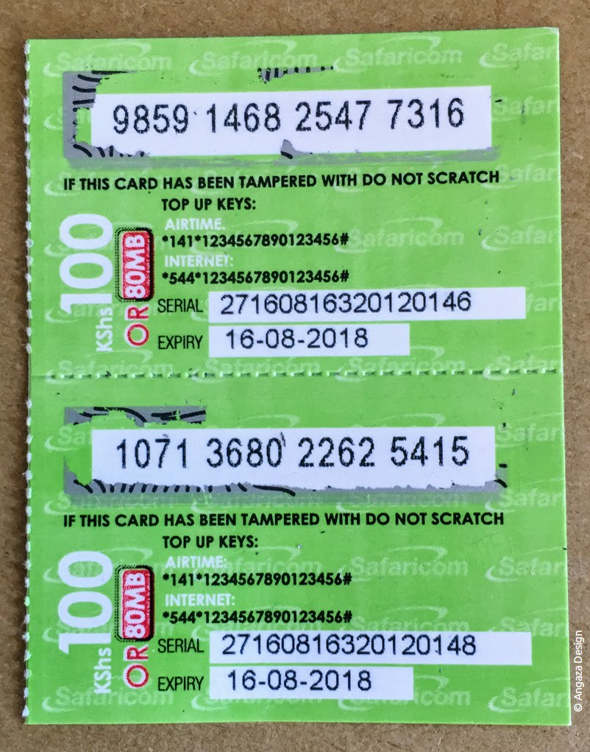
Paying for calls and SMS
Prepaid vs Postpaid
Utilities are often of poor quality in developing countries
Cell phones are different with pre-paid models
  Buy credit from vender
  Buy scratch card from vendor
Behavior when calls are very expensive (relative to income)

