Slide 1
Development Engineering
CSE 590 B
Course Overview
Richard Anderson

Slide 2
Today
Development Engineering Overview
My background
Course Mechanics
Development Engineering
Some background
Topics

Slide 3
Development Engineering
Technological interventions to improve human and economic conditions in low-resource settings
An engineering discipline aimed at addressing global inequity
Develop principles for design, introduction, scaling, and sustainability of Global Good technology

Slide 4
What are the challenges
Domain challenges: Health, Education, Agriculture, Markets, Livelihoods, Infrastructure, Sanitation, Energy, Environmental Degradation
Resource constraints: Finance, Infrastructure, Distance, Education and literacy, Governance
Shocks: Climate Change, Global Pandemics

Slide 5
Setting
Rapid, global economic and technological change
  Many technologies are globally accessible
Not just a split between “Developed” and “Developing Countries”, but within countries between “Urban-Affluent” and “Rural/Urban-Poor”
In many ways, the world is getting better
  Increasing literacy rates
  Decline in maternal mortality rates
  Near elimination of diseases such as polio

Slide 6
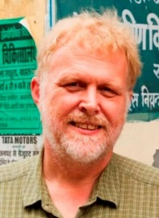



My background
PhD, Stanford (1985)
  Thesis: The Complexity of Parallel Algorithms
Post Doc (1985-86) Mathematical Science Research Institute, Berkeley
University of Washington (since 1986)
  Broad range of work: Algorithms, Software Engineering, Educational Technology, Computing for Development
Sabbatical 1993-1994
  Indian Institute of Science, Bangalore
  Parallel Algorithms
Sabbatical 2001-2002
  Microsoft Research, Redmond
  Learning Science and Technology
Sabbatical 2008-2009
  PATH, Seattle
  Digital Health

Slide 7
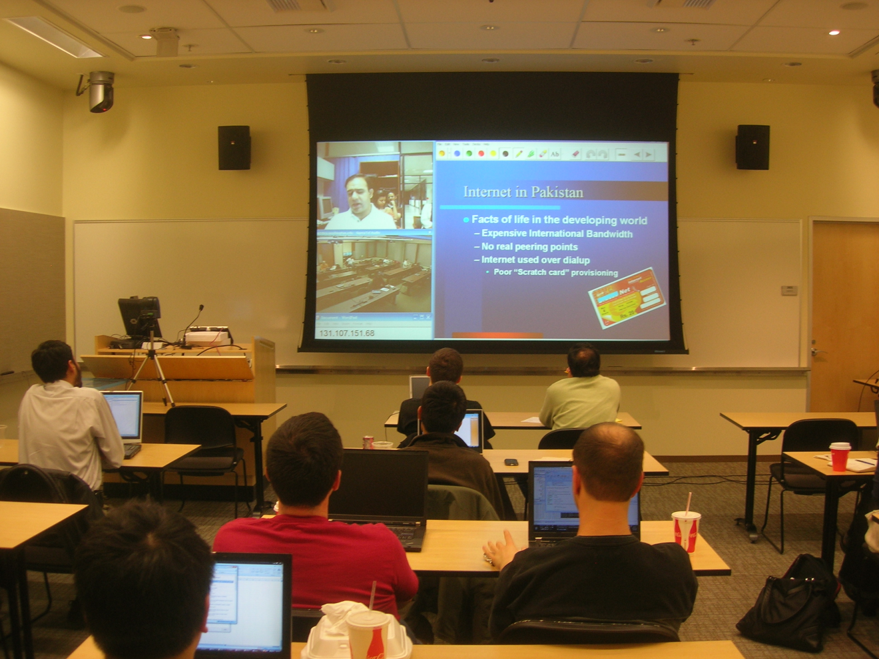
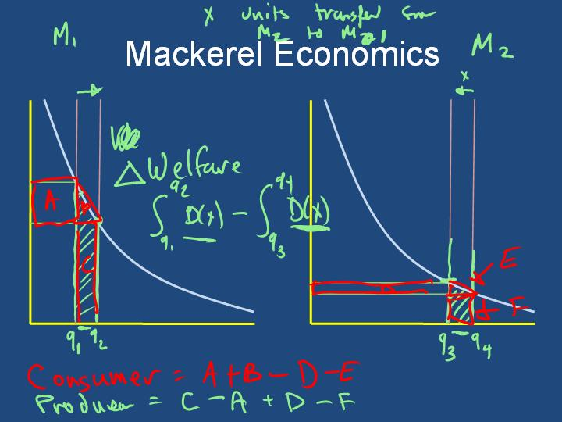
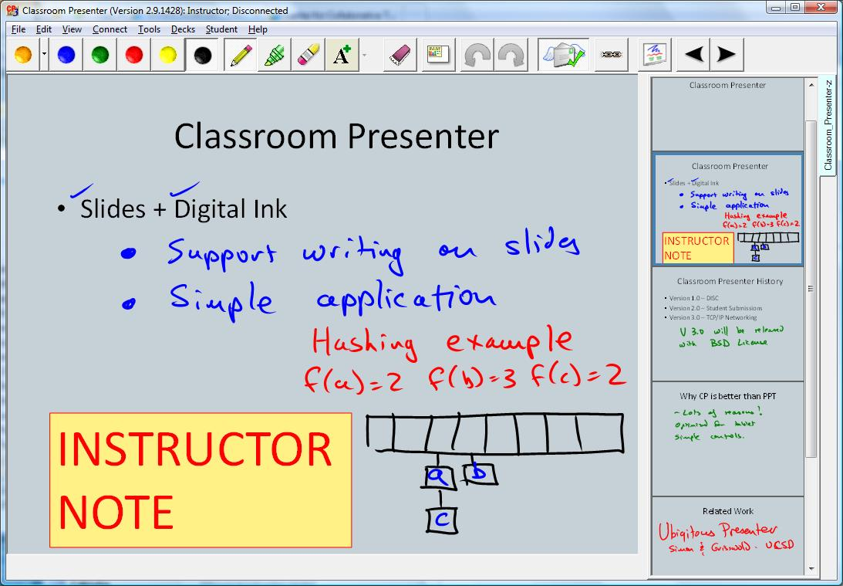
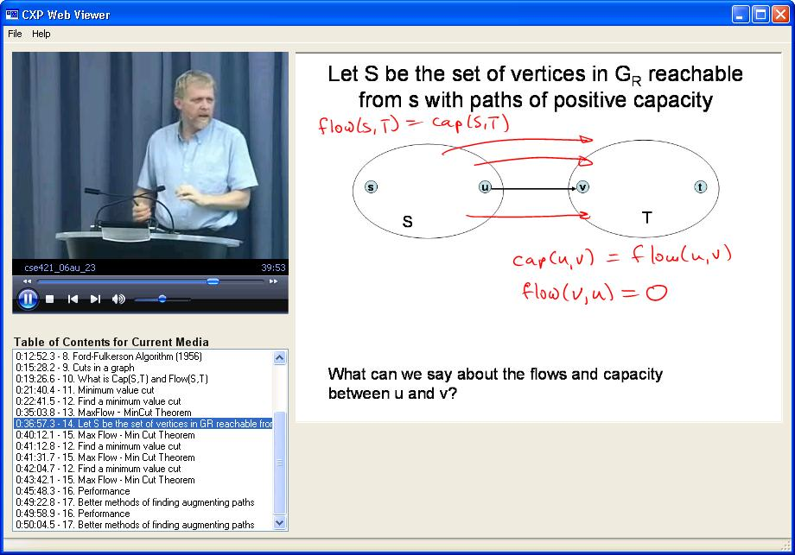
Distance Education (2001-2008)
Sabbatical at Microsoft to develop ConferenceXP technology
  Basis of UW PMP Distance Learning
  Multisite courses including UW-Redmond-Pakistan
Tablet PC Technology
  Classroom Presenter
  Interactive Classroom Activities

Slide 8
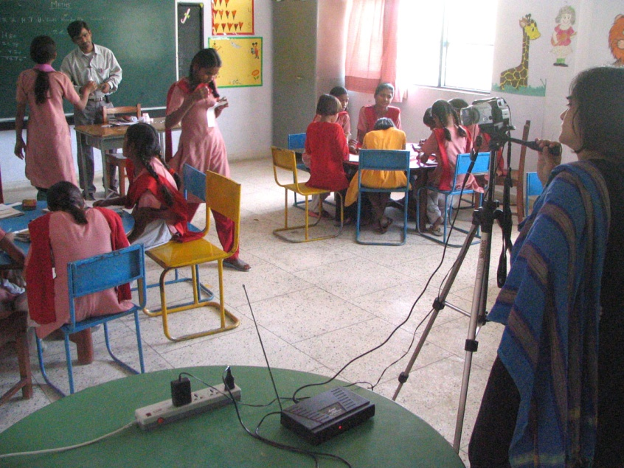
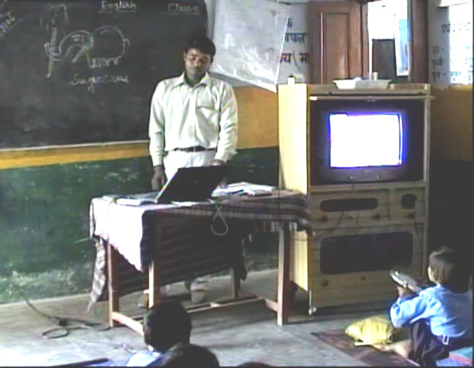
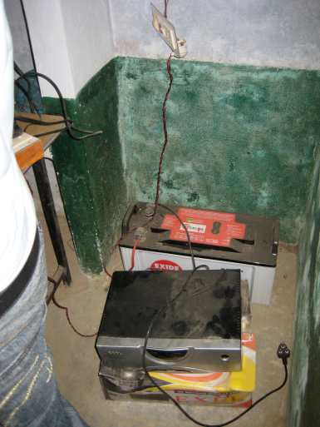
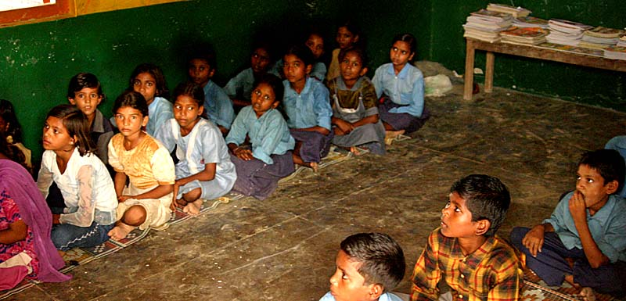
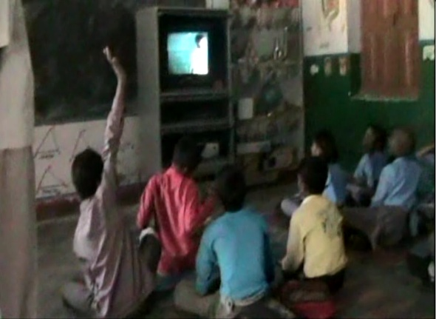
Digital StudyHall (Lucknow, India)
Tutored Video Instruction Pedagogy
Target: Rural schools in India
Model
  Lesson videos recorded at hub school
  Training of facilitators
  Facilitation model
  Cost realism in technology deployment

Slide 9

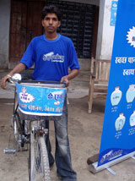

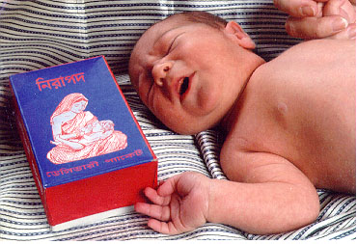


Digital Health at PATH
Global Health NGO Based in Seattle
  Development of health technologies
  Global advocacy
  Implementation of global programs
Increased emphasis on Digital Health
  Promotion of Global Good software
9

Slide 10
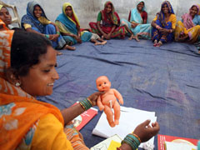

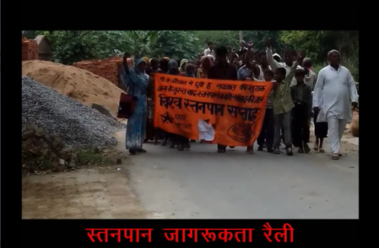
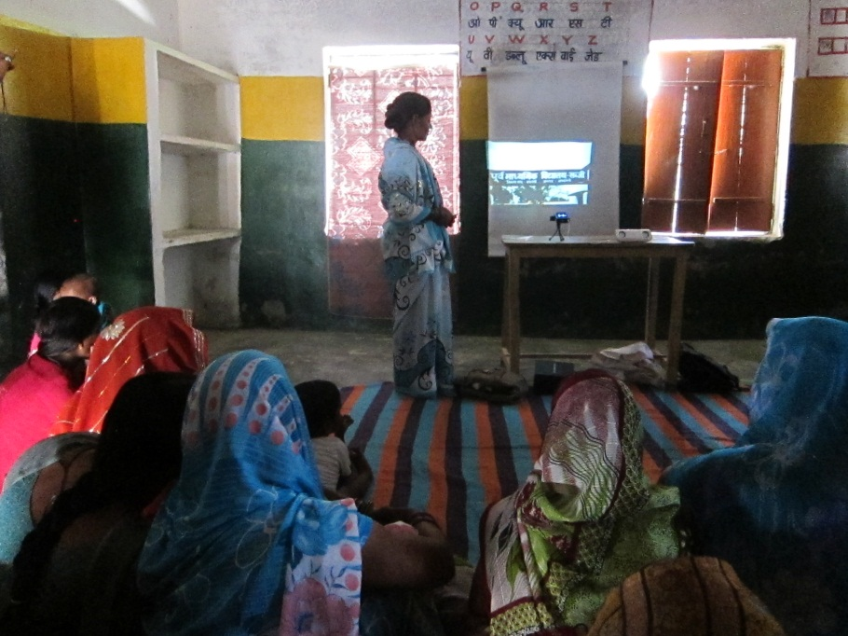
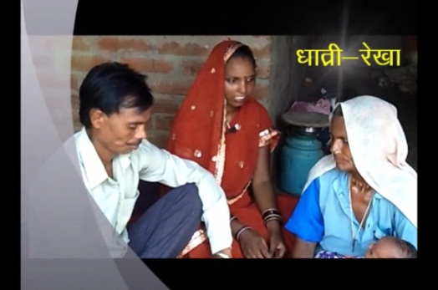
Projecting Health
Video based education in Health
Implementation with PATH
Community created video content
Facilitated showing in Mothers’ groups
Broad range of health messaging
  Maternal Health
  Immunization
  Family Planning
  Infectious diseases
  Sanitation

Slide 11
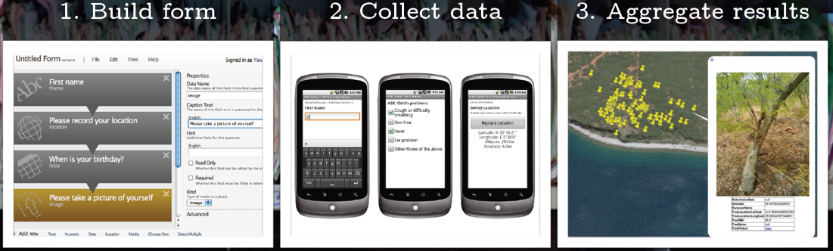
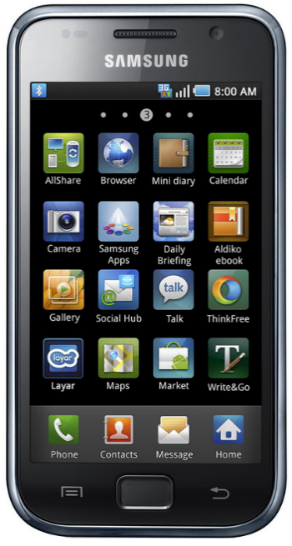
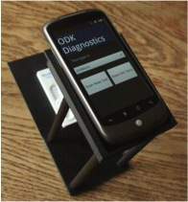
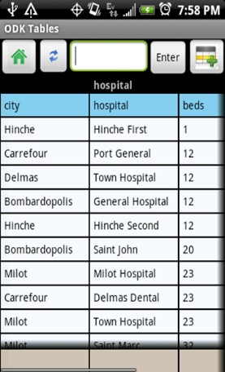
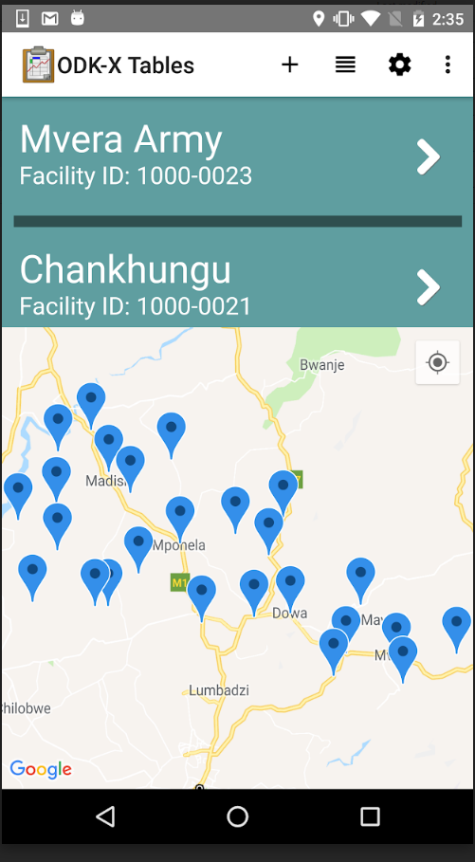
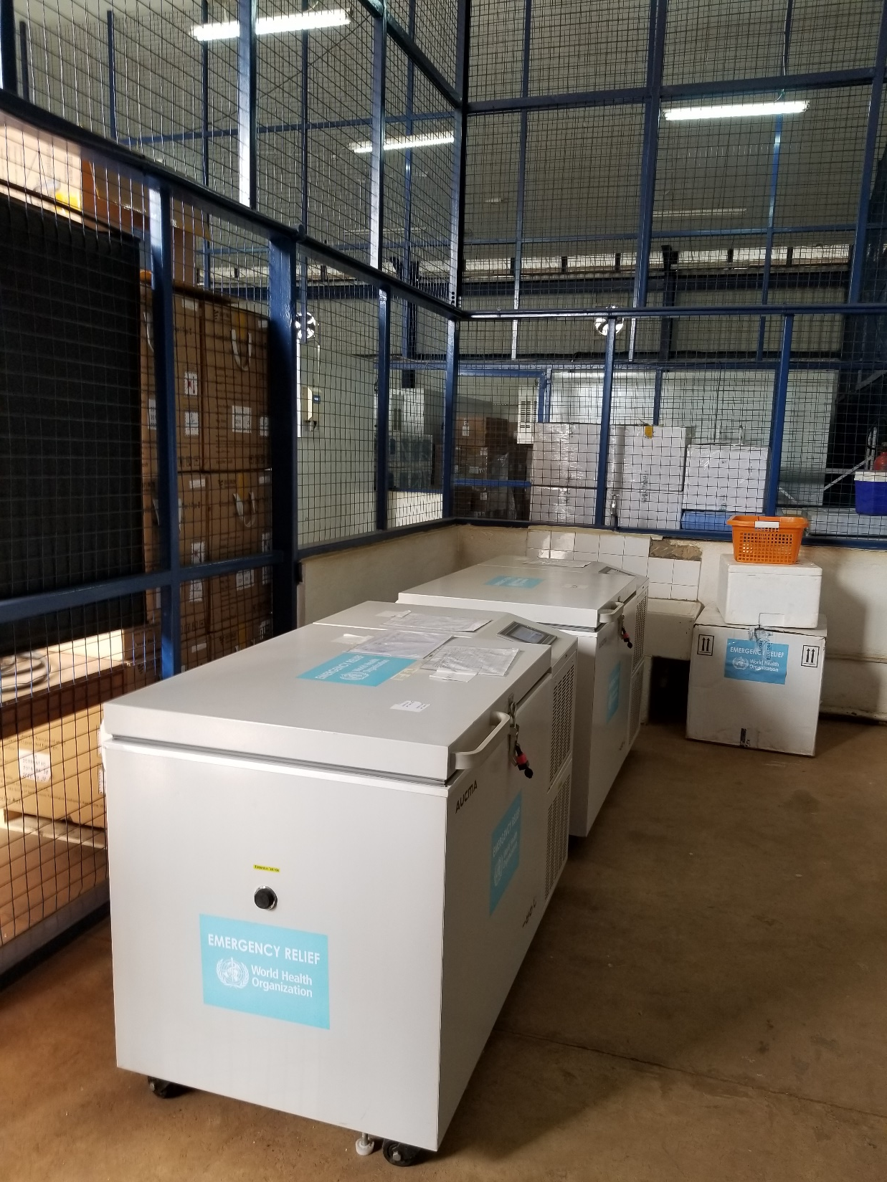
Open Data Kit
Digital Data Collection on Android Phones
Launched by Gaetano Borriello (2008)
Took over project in 2014
ODK 1.0 Forms based data collection
  Spun out as independent Open Source Project
ODK-X Mobile Data Management
Multiple current projects in immunization and with IRC

Slide 12
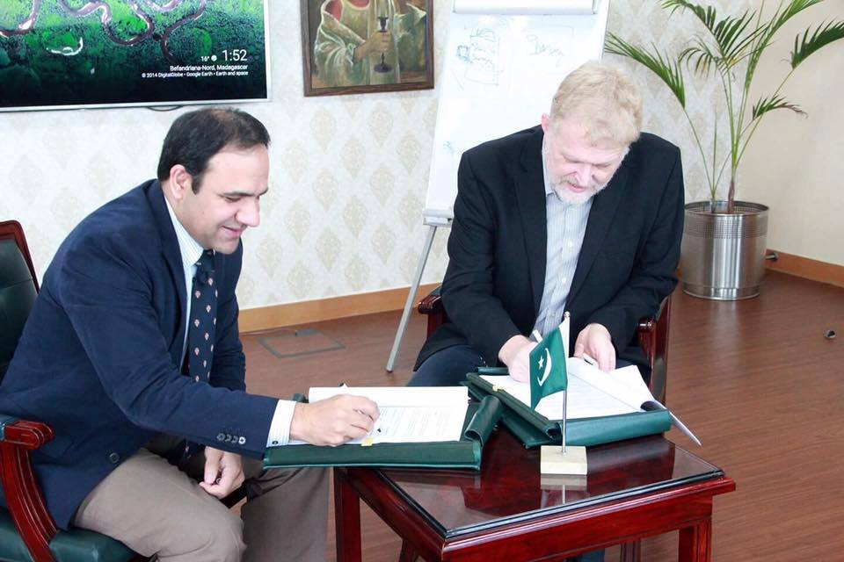
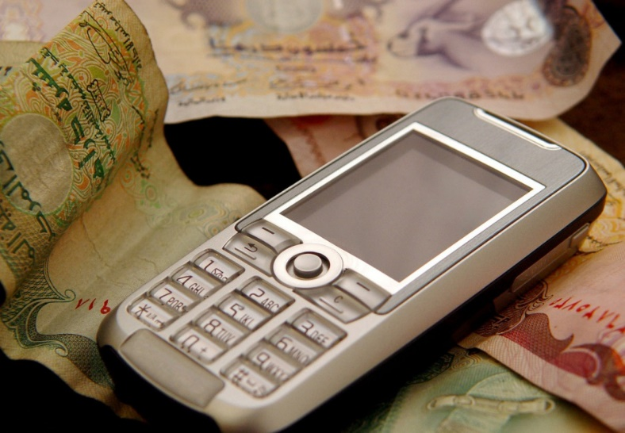
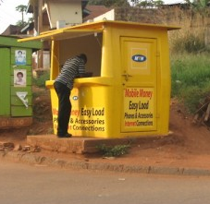
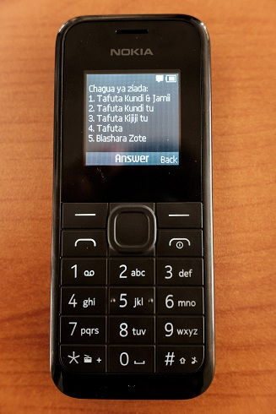
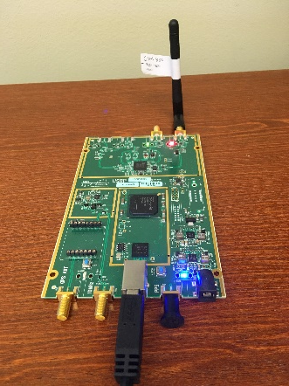

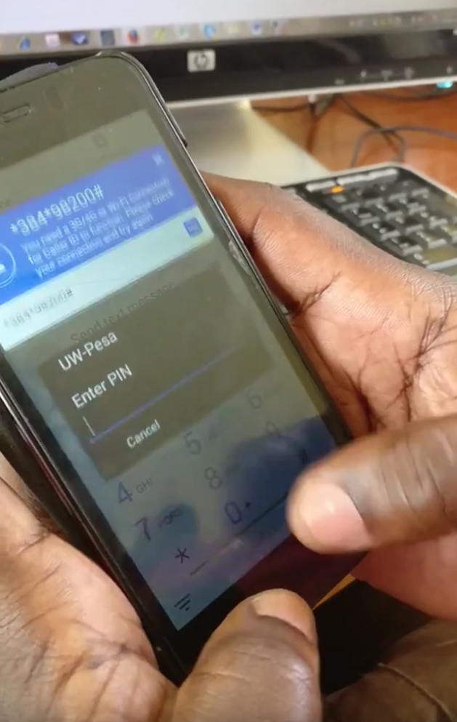
Digital Financial Services
Project with BMGF
Funded to investigate technological challenges to adoption of Digital Financial Services
Project Areas
  Security and Fraud
  USSD Technology
  Technological Inclusion
Established center in Lahore, Pakistan
Waseela-e-haq program ki taraf se apkay Rs.25200 rupay aya hain.apka ye number03314311169BISP mein register tha.ap is number per 03017073199 call karein
Improved access to financial services is critical for raising people out of poverty

Slide 13
Course objective
Prepare students to take on Development Engineering job assignments
  Work on a product with Development Engineering applications
  Take a job with an organization doing Development Engineering
Generals skills: Global engineering

Slide 14
Course mechanics
Weekly presentation / discussion (2 hours)
  This is not a format I am familiar with, so we will have to figure it out
Discussion sections (1 hour)
  Smaller group discussions
Weekly readings
Weekly assignments
Course grade will be based on 7 of 9 assignments.
  This is done to allow flexibility for travel and deadlines

Slide 15
Development Engineering
Post world war two development agenda
  Substantial resources to global economic development
  Establishment of global organizations: UN, WHO, WorldBank
  Tied to East-West conflict and decolonialization
  Development = Expertise + Resources
Global development has been uneven
  Many academic fields attempt to understand development
  Understanding of process
    Recognition of markets, local control, capacity development, partnerships
  Development has divided into domains
    With periodic pushes to break down silos and support cross-cutting programs

Slide 16
Engineering Focus
This course will focus on appropriate technology
Recognition that technology is only one component, and that there are challenges outside of the scope of technology
Recognition that there are risks with technology, and that technology can have negative consequences
However, there are many global problems that can be addressed by technological interventions
  Where, to the first order, it is a good thing to do

Slide 17
Constraints I
Financial:
  Targeting a radically different price point
  Different trade offs between labor and technology
Infrastructure:
  Network access and bandwidth
  Electricity access and quality
Technology:
  Different types of devices
  Different modes of device access
  Limitation on device access
Education
  Different levels of literacy
  Technological capacity

Slide 18
Constraints II
Language
  Multilingual
  Low-resource languages
Market Limitations

Slide 19
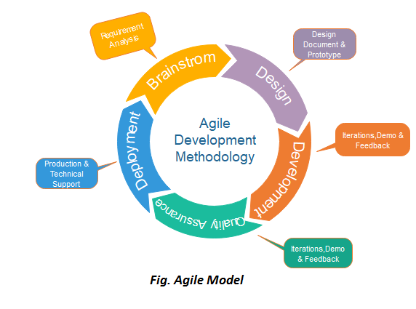
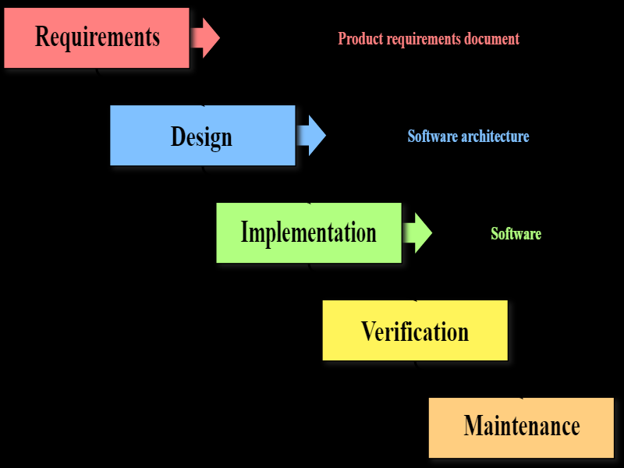
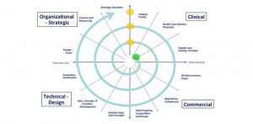
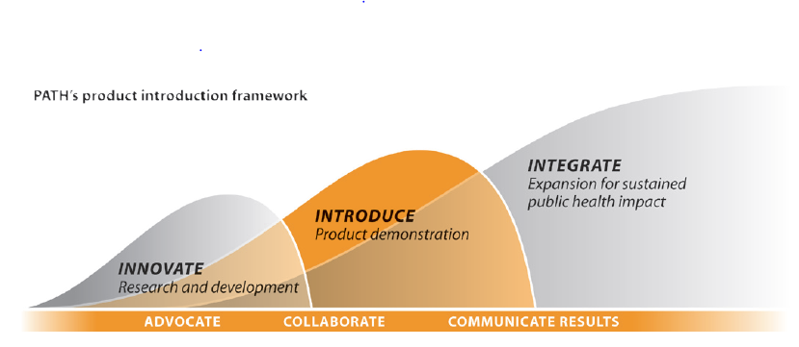
Design and Development Process
Many different models
  Come up with an idea
  Flesh out the idea
  Build a prototype
  Build a better prototype
  And another prototype
  Engineer the system
  Initial Deployment
  Fix the system
  Bigger deployment
  Production release
  Promote broad adoption
  Keep the product running

Slide 20
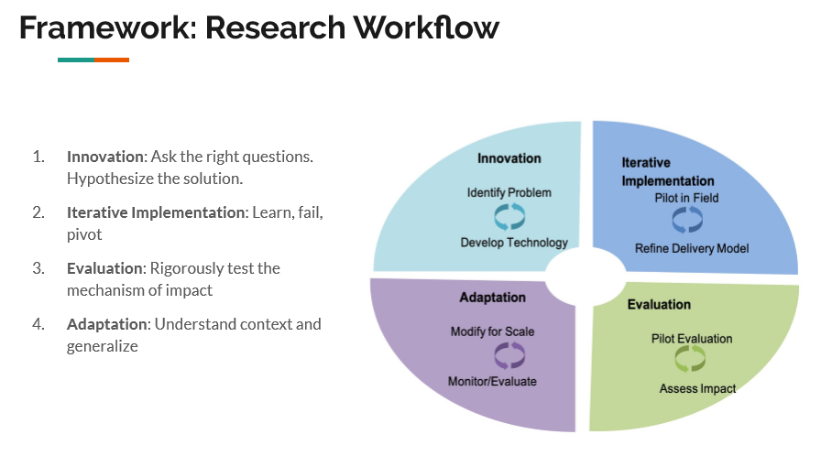

Slide 21
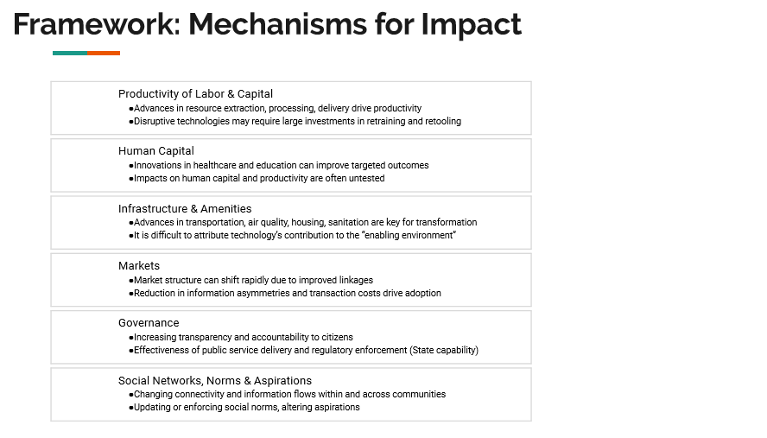

Slide 22
Sustainability
Critical issue is achieving long term impact
Field is criticized for too many pilots
Some projects should go no further than the pilot stage
  Not a good idea
  But identify learnings
Sustainability
  Requires a business case, or market, or some means of keeping things going
  Domain is not necessarily market driven
Product life cycle
  Requires consideration of the entire product life-cycle

Slide 23
Covid-19
How has the world changed since Jan 21, 2020?

Slide 24

Millennium development goals
International development goals established by United Nations in 2000
Targeted results by end of 2015

Slide 25
Millennium development goals
To eradicate extreme poverty and hunger
To achieve universal primary education
To promote gender equality and empower women
To reduce child mortality
To improve maternal health
To combat HIV/AIDS, malaria, and other diseases
To ensure environmental sustainability
To develop a global partnership for development

Slide 26
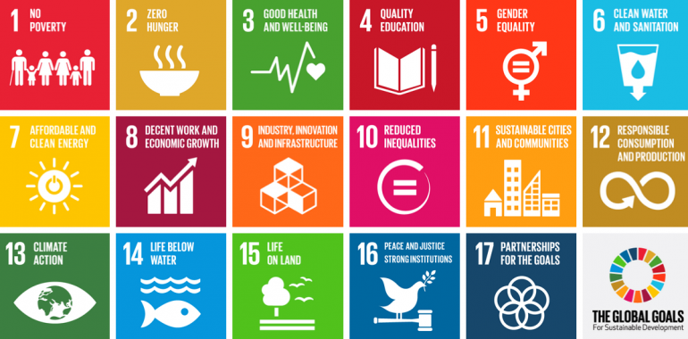
Sustainable Development Goals
New global goals through 2030
  17 Goals with 169 Targets

Slide 27
Sustainable Development Goals
End poverty in all its forms everywhere
End hunger, achieve food security and improved nutrition and promote sustainable agriculture
Ensure healthy lives and promote well-being for all at all ages
Ensure inclusive and equitable quality education and promote lifelong learning opportunities for all
Achieve gender equality and empower all women and girls
Ensure availability and sustainable management of water and sanitation for all
Ensure access to affordable, reliable, sustainable and modern energy for all
Promote sustained, inclusive and sustainable economic growth, full and productive employment and decent work for all
Build resilient infrastructure, promote inclusive and sustainable industrialization and foster innovation
Reduce inequality within and among countries
Make cities and human settlements inclusive, safe, resilient and sustainable
Ensure sustainable consumption and production patterns
Take urgent action to combat climate change and its impacts
Conserve and sustainably use the oceans, seas and marine resources for sustainable development
Protect, restore and promote sustainable use of terrestrial ecosystems, sustainably manage forests, combat desertification, and halt and reverse land degradation and halt biodiversity loss
Promote peaceful and inclusive societies for sustainable development, provide access to justice for all and build effective, accountable and inclusive institutions at all levels
Strengthen the means of implementation and revitalize the global partnership for sustainable development

Slide 28













Global Technology and Development Stakeholders
Global Organizations
Donors
Implementing NGOs
Research Establishment
Technology NGOs
Tech Industry
Government
Local NGOs and Civil Society

Slide 29



Global
World health organization
UNICEF
GAVI
FAO
World Bank

Slide 30



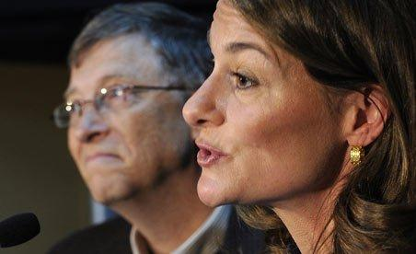
Donors
Bill & Melinda Gates Foundation
USAID
DFID
GDZ
NORAD

Slide 31





Implementing NGOs

Slide 32






Research establishment

Slide 33






Technology NGOs and Social Enterprises

