Slide 1
Assignment #4 – Solutions

Slide 2
Problem 1
Scenario: two companies, A & B, each running Kerberos-based systems. Key Distribution Centers KDC_{A} and KDC_{B}
A and B want to link their Kerberos networks together
  Have shared secret key K_{AB}
What modifications do we need to make to the standard Kerberos protocol?
The interesting case is when a client in one company wants to access a server in another company.
  No change needed for intra-company communications.

Slide 3
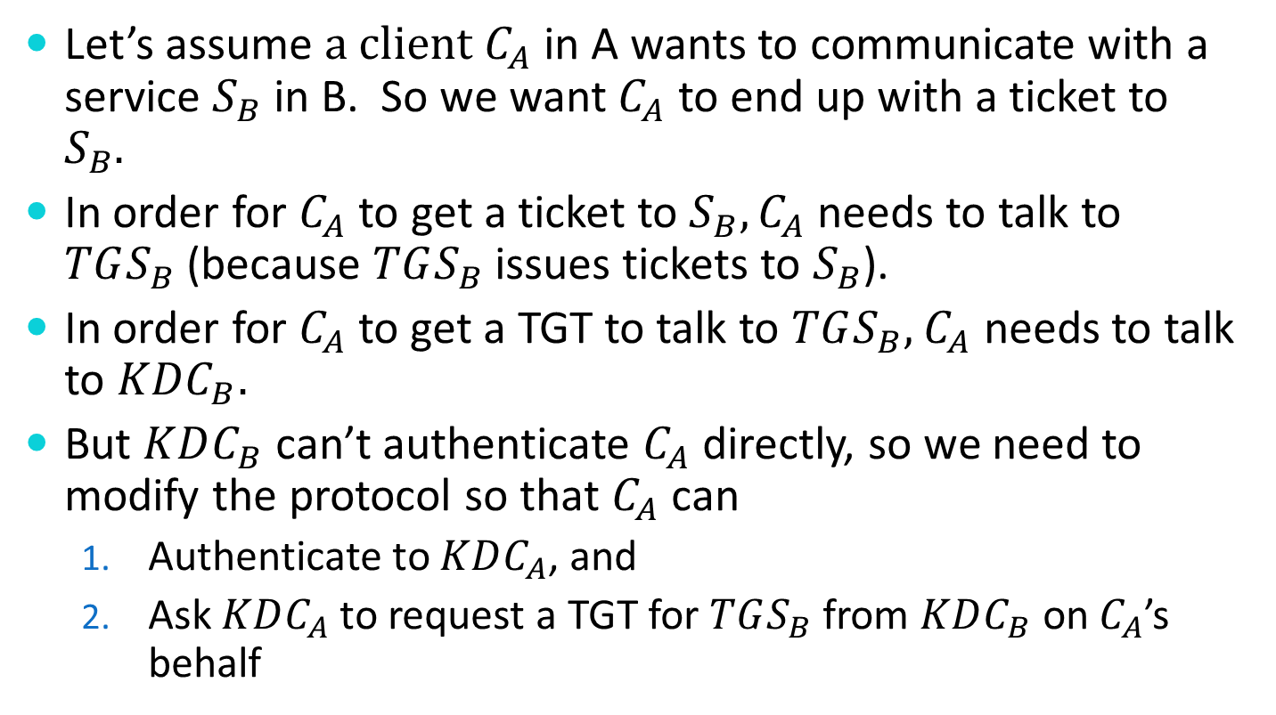
Problem 1
Let’s assume $a client C_{A}$ in A wants to communicate with a service $S_{B}$ in B. So we want $C_{A}$ to end up with a ticket to $S_{B}.$
In order for $C_{A}$ to get a ticket to $S_{B}, C_{A}$ needs to talk to $TGS_{B}$ (because $TGS_{B}$ issues tickets to $S_{B}$).
In order for $C_{A}$to get a TGT to talk to $TGS_{B},$ $C_{A}$ needs to talk to $KDC_{B}.$
But $KDC_{B}$ can’t authenticate $C_{A}$ directly, so we need to modify the protocol so that $C_{A}$ can
  Authenticate to $KDC_{A}$, and
  Ask $KDC_{A}$ to request a TGT for $TGS_{B}$ from $KDC_{B}$ on $C_{A}$’s behalf

Slide 4
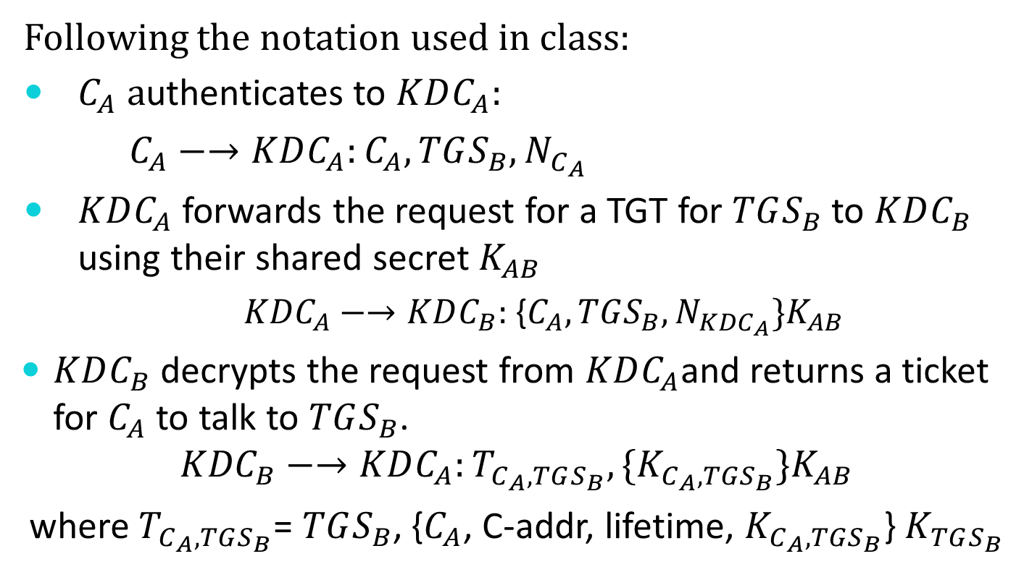
Problem 1
Following the notation used in class:
$C_{A} a$uthenticates to $KDC_{A}:$
$C_{A}−→KDC_{A}:C_{A}, TGS_{B}, N_{C_{A}}$
$KDC_{A}$ forwards the request for a TGT for $TGS_{B}$ to $KDC_{B}$ using their shared secret $K_{AB}$
  ${KDC}_{A}−→KDC_{B}:${$C_{A}, TGS_{B}, N_{KDC_{A}}\}K_{AB}$
$KDC_{B}$ decrypts the request from $KDC_{A}$and returns a ticket for $C_{A}$ to talk to $TGS_{B}$.
$${KDC}_{B}−→KDC_{A}:T_{C_{A},TGS_{B}},\{K_{C_{A}, {TGS}_{B}}\}K_{AB}$$
where $T_{C_{A},TGS_{B}}$= $TGS_{B}$, {$C_{A}$, C-addr, lifetime, $K_{C_{A}, {TGS}_{B}}$} $K_{TGS_{B}}$

Slide 5

Problem 1
$KDC_{A}$ can then decrypt and re-encrypt the session key$:$
$KDC_{A} −→C_{A}:T_{C_{A},TGS_{B}},\{K_{C_{A}, {TGS}_{B}}\}K_{C_{A}}$
$C_{A}$ now knows $K_{C_{A}, {TGS}_{B}}$and can use this session key along with $T_{C_{A},TGS_{B}}$to continue Phase 2 of Kerberos with $TGS_{B}$ directly.

Slide 6
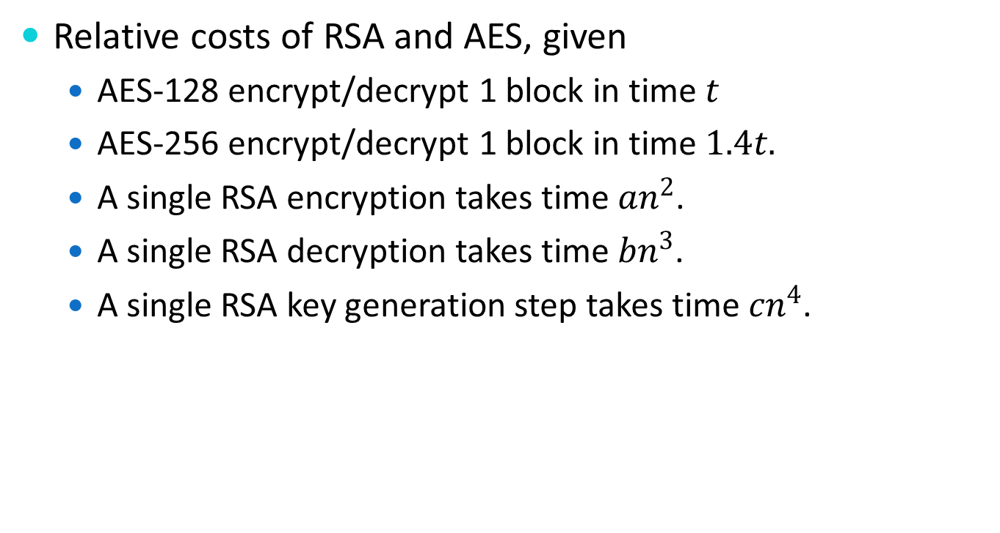
Problem 2
Relative costs of RSA and AES, given
  AES-128 encrypt/decrypt 1 block in time $t$
  AES-256 encrypt/decrypt 1 block in time $1.4t.$
  A single RSA encryption takes time $an^{2}$.
  A single RSA decryption takes time $bn^{3}$.
  A single RSA key generation step takes time $cn^{4}$.

Slide 7
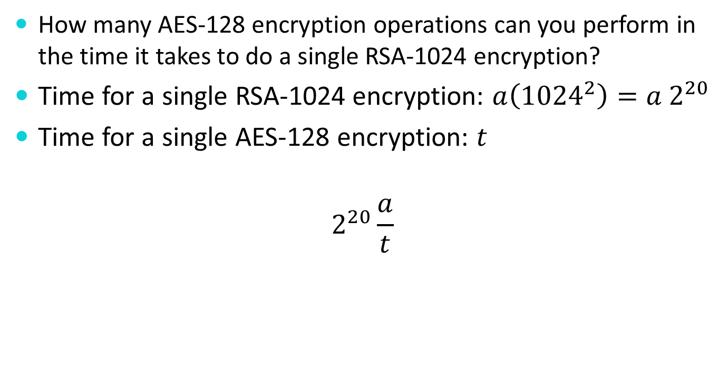
Problem 2a
  How many AES-128 encryption operations can you perform in the time it takes to do a single RSA-1024 encryption?
Time for a single RSA-1024 encryption: $a\left({1024}^{2}\right)=a 2^{20}$
Time for a single AES-128 encryption: $t$
$$2^{20}\frac{a}{t}$$

Slide 8

Problem 2b
  How many AES-128 decryption operations can you perform in the time it takes to do a single RSA-1024 decryption?
Time for a single RSA-1024 decryption: $b\left({1024}^{3}\right)=b 2^{30}$
Time for a single AES-128 decryption: $t$
$$2^{30}\frac{b}{t}$$

Slide 9

Problem 2c
  Moving from AES-128 to AES-256
  AES-256 encryptions per RSA-1024 encryption
  $2^{20}\frac{a}{\begin{aligned}1.4t\end{aligned}} =$748982.8571428… $\frac{a}{t}$

Slide 10
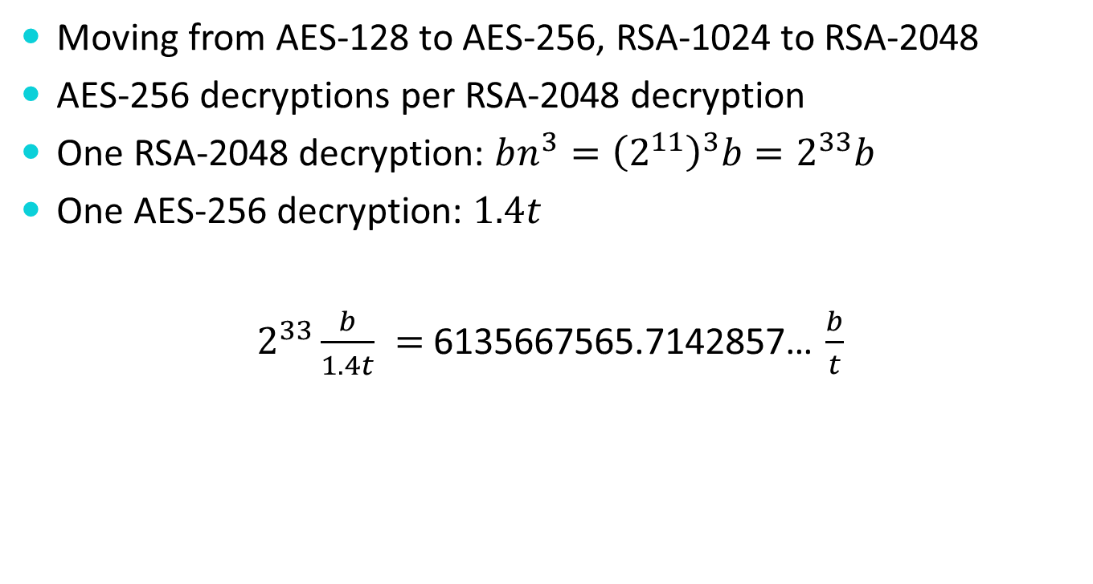
Problem 2d
  Moving from AES-128 to AES-256, RSA-1024 to RSA-2048
  AES-256 decryptions per RSA-2048 decryption
  One RSA-2048 decryption: $bn^{3}={\left(2^{11}\right)}^{3}b=2^{33}b$
  One AES-256 decryption: $1.4t$
  $2^{33}\frac{b}{\begin{aligned}1.4t\end{aligned}} =$6135667565.7142857… $\frac{b}{t}$

Slide 11
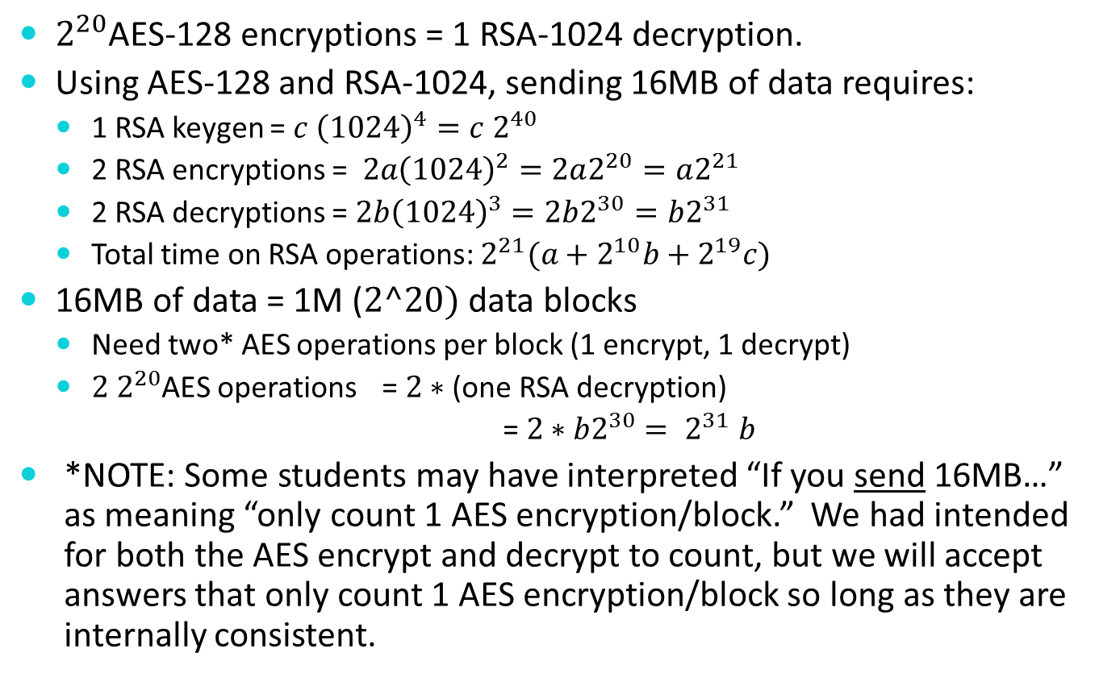
Problem 2e (for AES-128/RSA-1024)
  $2^{20}$AES-128 encryptions = 1 RSA-1024 decryption.
  Using AES-128 and RSA-1024, sending 16MB of data requires:
    1 RSA keygen = ${c \left(1024\right)}^{4}=c 2^{40}$
    2 RSA encryptions = $2a{\left(1024\right)}^{2}=2a2^{20}=a2^{21}$
    2 RSA decryptions = $2b{\left(1024\right)}^{3}=2b2^{30}=b2^{31}$
    Total time on RSA operations: $2^{21}(a+2^{10}b+2^{19}c)$
  16MB of data = 1M ($2^20)$ data blocks
    Need two* AES operations per block (1 encrypt, 1 decrypt)
    $2 2^{20}$AES operations = $2∗$ (one RSA decryption)
    = $2∗b2^{30}$ ${= 2}^{31}b$
  *NOTE: Some students may have interpreted “If you send 16MB…” as meaning “only count 1 AES encryption/block.” We had intended for both the AES encrypt and decrypt to count, but we will accept answers that only count 1 AES encryption/block so long as they are internally consistent.

Slide 12
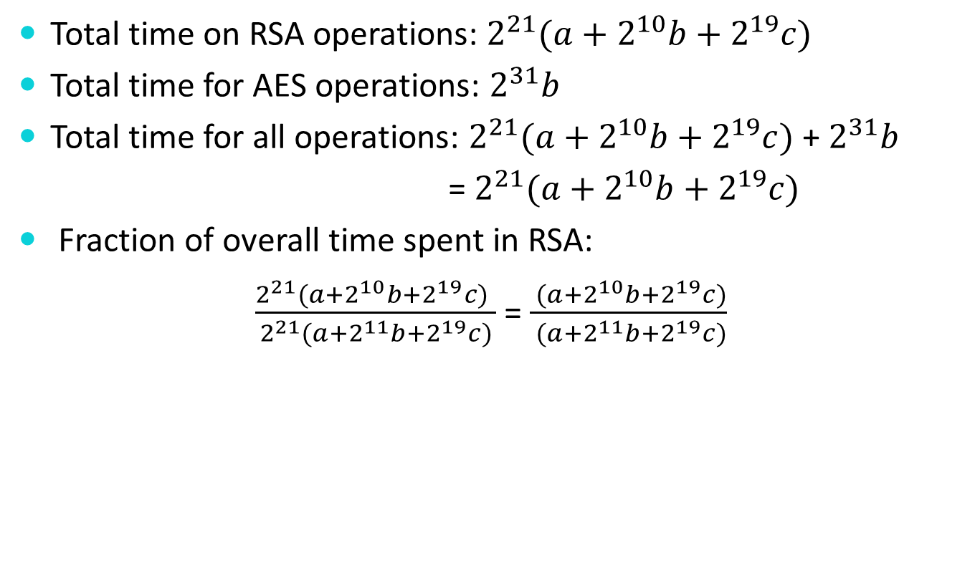
Problem 2e (AES-128/RSA-1024)
  Total time on RSA operations: $2^{21}(a+2^{10}b+2^{19}c)$
  Total time for AES operations: $2^{31}b$
  Total time for all operations: $2^{21}(a+2^{10}b+2^{19}c)$ + $2^{31}b$
  = $2^{21}(a+2^{10}b+2^{19}c)$
  Fraction of overall time spent in RSA:
  $\frac{2^{21}(a+2^{10}b+2^{19}c) }{2^{21}(a+2^{11}b+2^{19}c)}$ = $\frac{ (a+2^{10}b+2^{19}c)}{ (a+2^{11}b+2^{19}c)}$

Slide 13
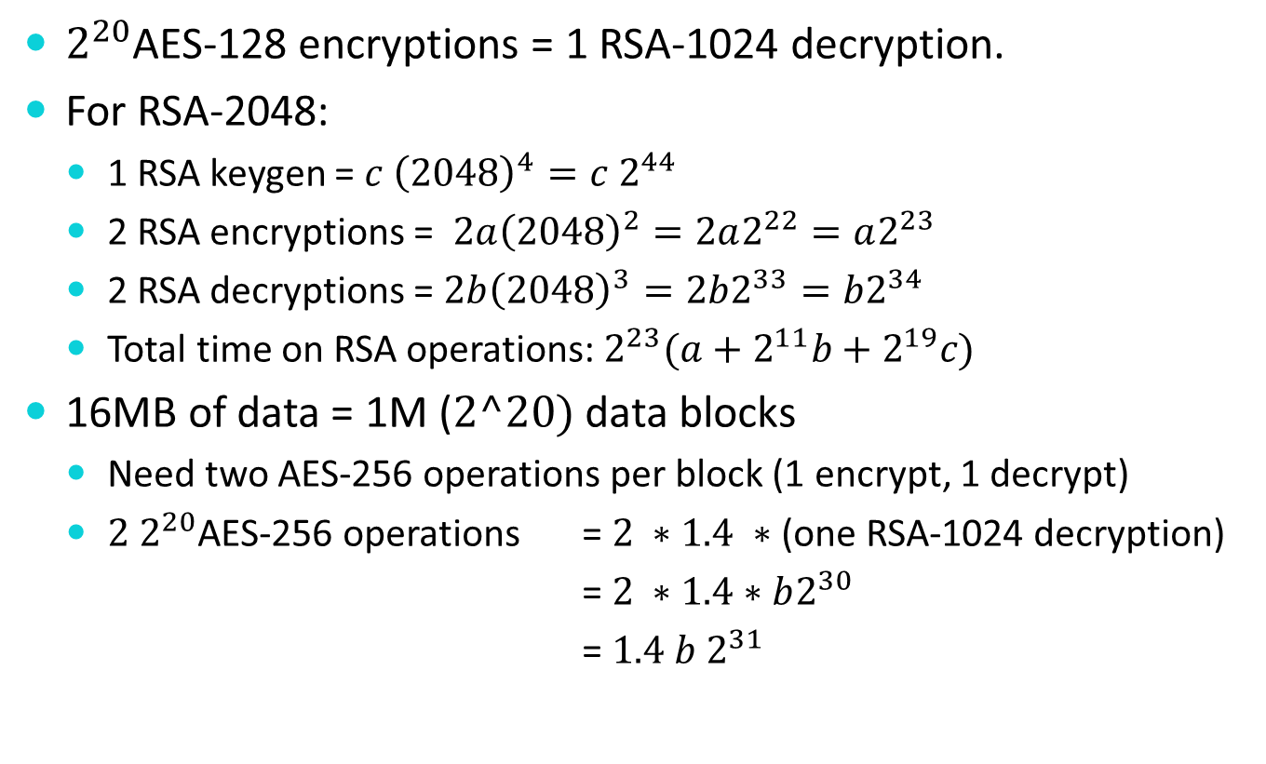
Problem 2e (for AES-256/RSA-2048)
  $2^{20}$AES-128 encryptions = 1 RSA-1024 decryption.
  For RSA-2048:
    1 RSA keygen = ${c \left(2048\right)}^{4}=c 2^{44}$
    2 RSA encryptions = $2a{\left(2048\right)}^{2}=2a2^{22}=a2^{23}$
    2 RSA decryptions = $2b{\left(2048\right)}^{3}=2b2^{33}=b2^{34}$
    Total time on RSA operations: $2^{23}(a+2^{11}b+2^{19}c)$
  16MB of data = 1M ($2^20)$ data blocks
    Need two AES-256 operations per block (1 encrypt, 1 decrypt)
    $2 2^{20}$AES-256 operations = $2 ∗1.4 ∗$ (one RSA-1024 decryption)
    = $2 ∗1.4∗b2^{30}$
    = $1.4 b 2^{31}$

Slide 14
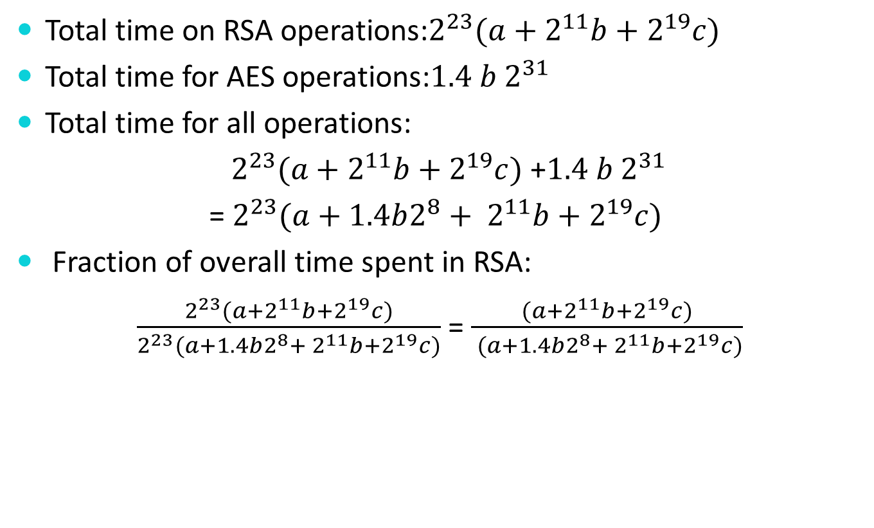
Problem 2e (AES-256/RSA-2048)
  Total time on RSA operations:$2^{23}(a+2^{11}b+2^{19}c)$
  Total time for AES operations:$1.4 b 2^{31}$
  Total time for all operations:
  $2^{23}(a+2^{11}b+2^{19}c)$ +$1.4 b 2^{31}$
  = $2^{23}(a+1.4b2^{8}+ 2^{11}b+2^{19}c)$
  Fraction of overall time spent in RSA:
  $\frac{2^{23}(a+2^{11}b+2^{19}c)}{2^{23}(a+1.4b2^{8}+ 2^{11}b+2^{19}c)}$ = $\frac{(a+2^{11}b+2^{19}c)}{ (a+1.4b2^{8}+ 2^{11}b+2^{19}c)}$

Slide 15
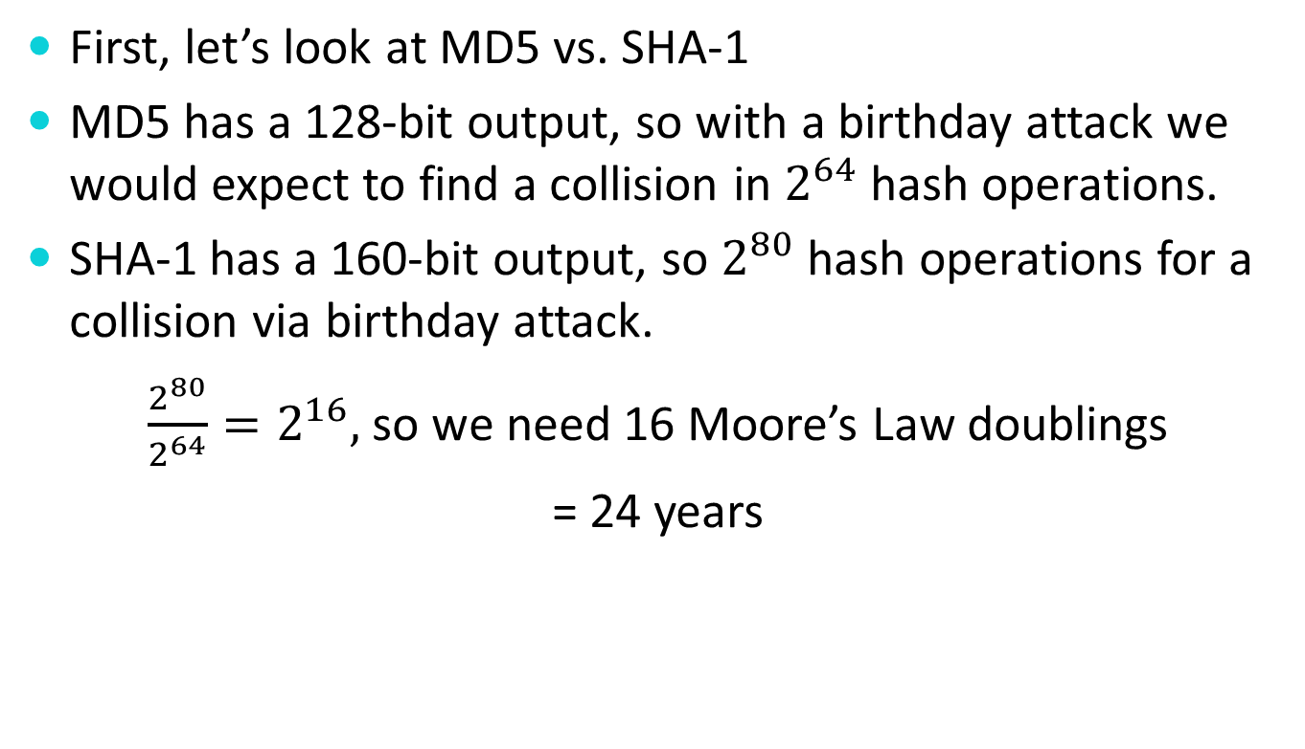
Problem 3
First, let’s look at MD5 vs. SHA-1
MD5 has a 128-bit output, so with a birthday attack we would expect to find a collision in $2^{64}$hash operations.
SHA-1 has a 160-bit output, so $2^{80}$hash operations for a collision via birthday attack.
$\frac{2^{80}}{2^{64}}=2^{16},$ so we need 16 Moore’s Law doublings
= 24 years

Slide 16
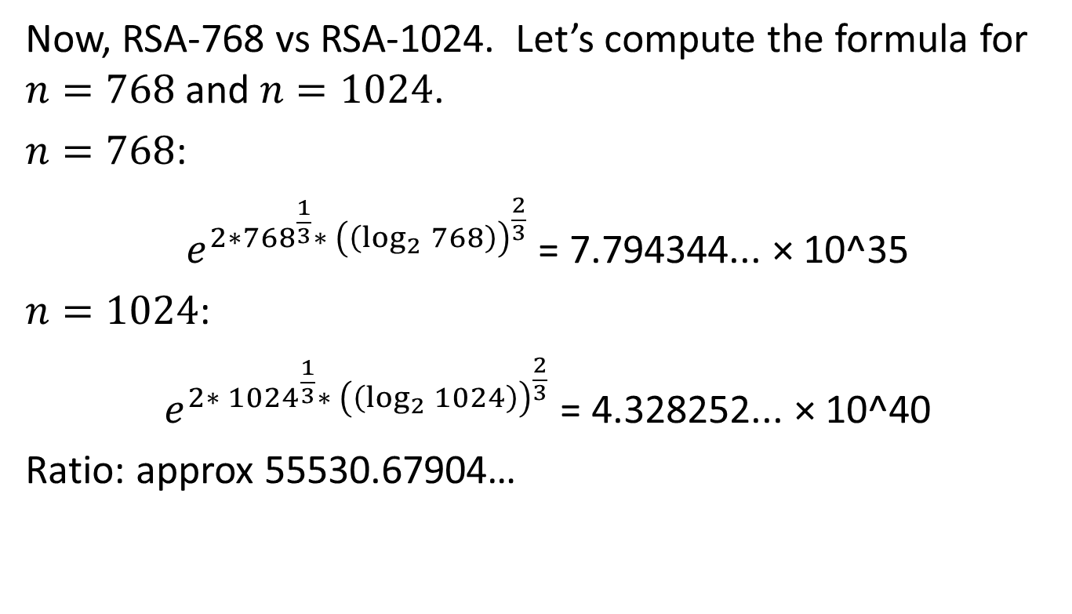
Problem 3
Now, RSA-768 vs RSA-1024. Let’s compute the formula for $n=768$ and $n=1024$.
$n=768$:
$e^{{2∗768}^{\frac{1}{3}}∗ {\left(\left(\log_{2}{768}\right)\right)}^{\frac{2}{3}}}$ = 7.794344... × 10^35
$n=1024$:
$e^{{2∗ 1024}^{\frac{1}{3}}∗ {\left(\left(\log_{2}{1024}\right)\right)}^{\frac{2}{3}}}$ = 4.328252... × 10^40
Ratio: approx 55530.67904…

Slide 17
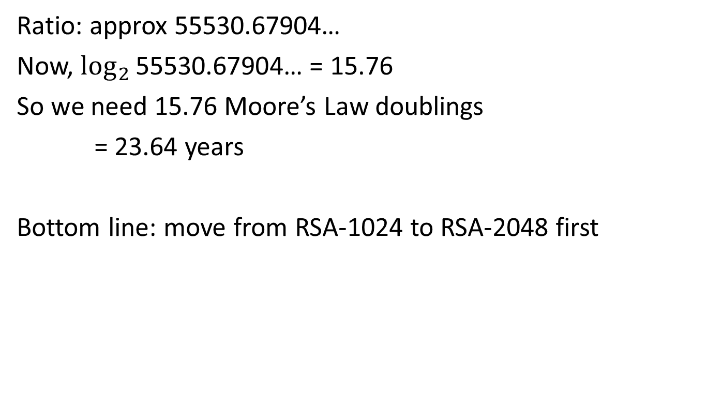
Problem 3
Ratio: approx 55530.67904…
Now, $\log_{2}{\text{55530.67904…}}$ = 15.76
So we need 15.76 Moore’s Law doublings
= 23.64 years
Bottom line: move from RSA-1024 to RSA-2048 first

Slide 18
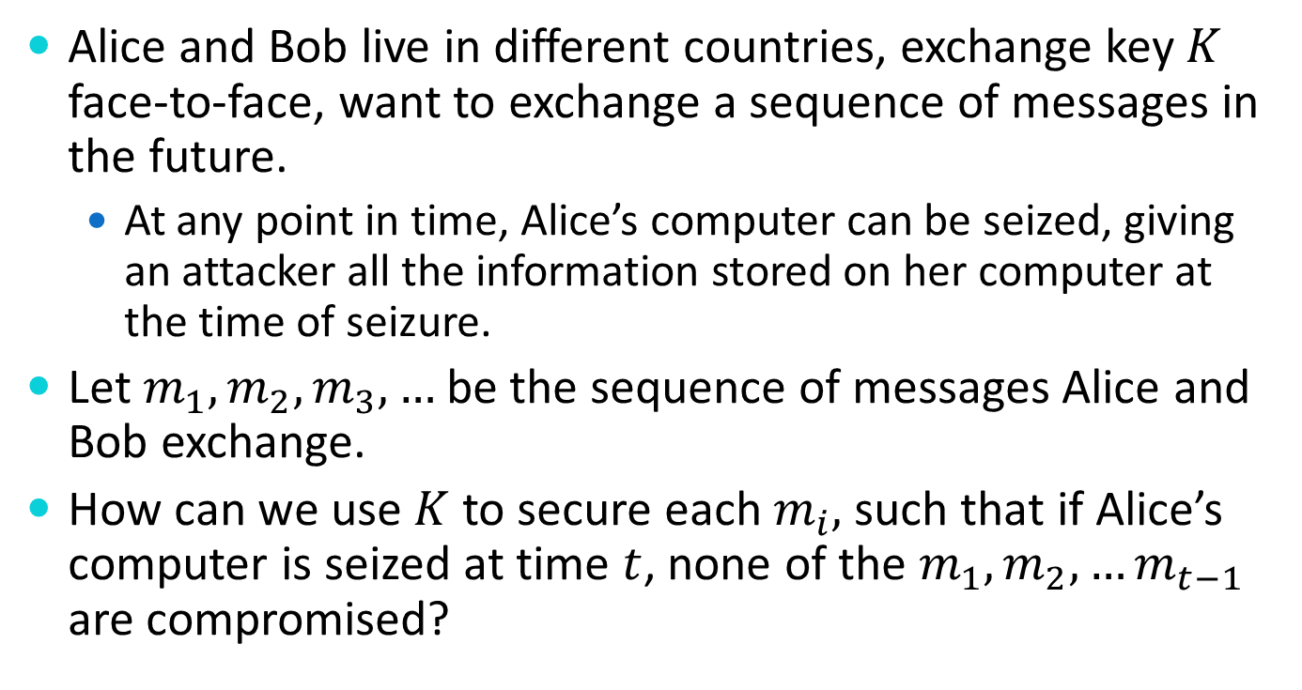
Problem 4
Alice and Bob live in different countries, exchange key $K$ face-to-face, want to exchange a sequence of messages in the future.
  At any point in time, Alice’s computer can be seized, giving an attacker all the information stored on her computer at the time of seizure.
Let $m_{1},m_{2},m_{3},…$be the sequence of messages Alice and Bob exchange.
How can we use $K$ to secure each $m_{i},$such that if Alice’s computer is seized at time $t$, none of the $m_{1},m_{2},…m_{t−1}$ are compromised?

Slide 19
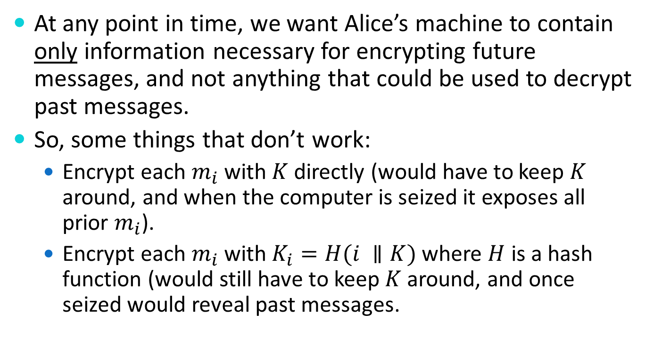
Problem 4
At any point in time, we want Alice’s machine to contain only information necessary for encrypting future messages, and not anything that could be used to decrypt past messages.
So, some things that don’t work:
  Encrypt each $m_{i}$ with $K$ directly (would have to keep $K$ around, and when the computer is seized it exposes all prior $m_{i}$).
  Encrypt each $m_{i}$ with $K_{i}=H(i ∥K)$ where $H$ is a hash function (would still have to keep $K$ around, and once seized would reveal past messages.

Slide 20
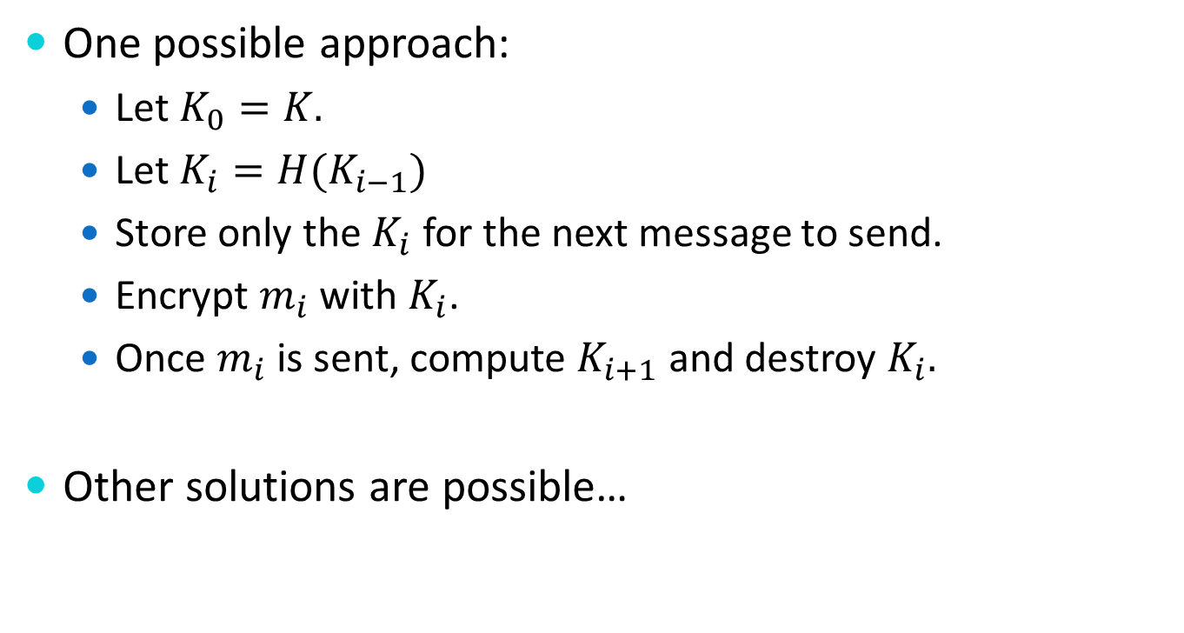
Problem 4
One possible approach:
  Let $K_{0}=K.$
  Let $K_{i}=H(K_{i−1})$
  Store only the $K_{i}$ for the next message to send.
  Encrypt $m_{i}$ with $K_{i}$.
  Once $m_{i}$ is sent, compute $K_{i+1}$ and destroy $K_{i}.$
Other solutions are possible…

Slide 21
Problem 5
Modifying SSL/TLS to support session restart
  Proposal: Whenever a session is established, the pre-master secret is used to derive a session identifier that can be retained by the client and server.
  This session identifier is then cached along w/ the original pre-master secret, and the client can request restart by sending the identifier along with the rest of the session details (including the ciphersuite).
How can an attacker exploit this protocol modification?

Slide 22
Problem 5
An attacker can play man-in-the-middle between a client requesting restart and the server
The attacker can’t change the pre-master secret, but because the client sends the session details to the server, the adversary can change any of those details.
  In particular, the adversary can change the ciphersuite, making it something easier
This is called a downgrade attack – it causes the client and server to use a ciphersuite that neither would negotiate to absent interference from the adversary

