Slide 1
Assignment #3 – Solutions

Slide 2
Problem 1
n bits
k zero bits
IV
Block
Cipher
Block
Cipher
Block
Cipher
Block
Cipher
removed

Slide 3
Problem 1
IV
Inverse
Cipher
Inverse
Cipher
Inverse
Cipher
Inverse
Cipher
Missing bits

Slide 4
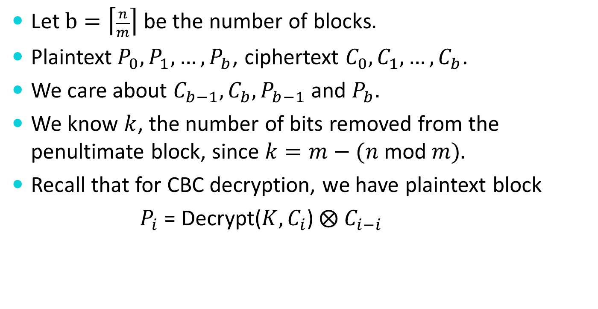
Problem 1
Let $b=\left\lceil \frac{n}{m}\right\rceil$ be the number of blocks$.$
Plaintext$P_{0}, P_{1},…, P_{b}$, ciphertext $C_{0},C_{1},…, C_{b}$.
We care about ${C_{b−1}, C_{b},P}_{b−1}$ and $P_{b}.$
We know $k$, the number of bits removed from the penultimate block, since $k=m−(n$mod$m).$
Recall that for CBC decryption, we have plaintext block
$P_{i}$ = Decrypt($K, C_{i}$)$⨂ C_{i−i}$

Slide 5
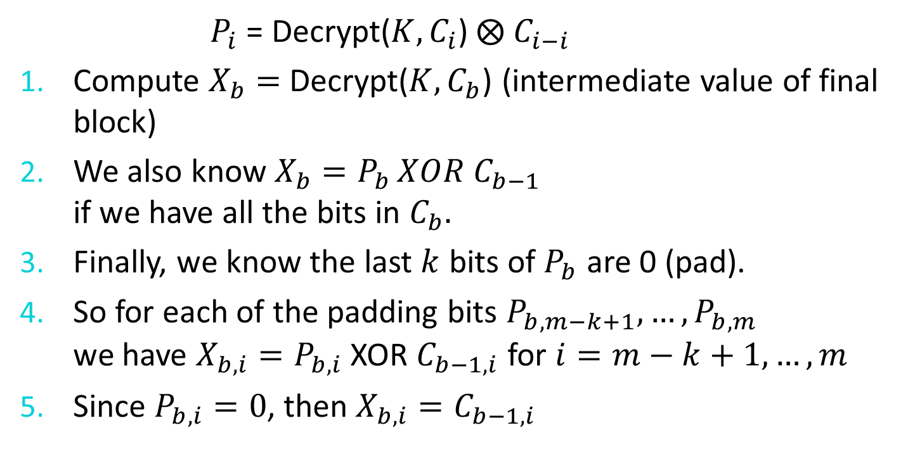
Problem 1
$P_{i}$ = Decrypt($K, C_{i}$)$⨂ C_{i−i}$
Compute $X_{b}=$ Decrypt($K,C_{b}$) (intermediate value of final block)
We also know $X_{b}=P_{b }XOR C_{b−1}$
if we have all the bits in $C_{b}.$
Finally, we know the last $k$ bits of $P_{b}$ are 0 (pad).
So for each of the padding bits $P_{b,m−k+1},…,P_{b,m}$
we have ${X_{b,i}=P}_{b,i}$ XOR $C_{b−1,i}$ for $i=m−k+1, …, m$
Since $P_{b,i}=0$, then $X_{b,i}=C_{b−1,i}$

Slide 6
Problem 1: Ciphertext Stealing
Plaintext
110101
00…0
IV
Inverse
Cipher
Inverse
Cipher
Inverse
Cipher
Inverse
Cipher
110101
Ciphertext

Slide 7
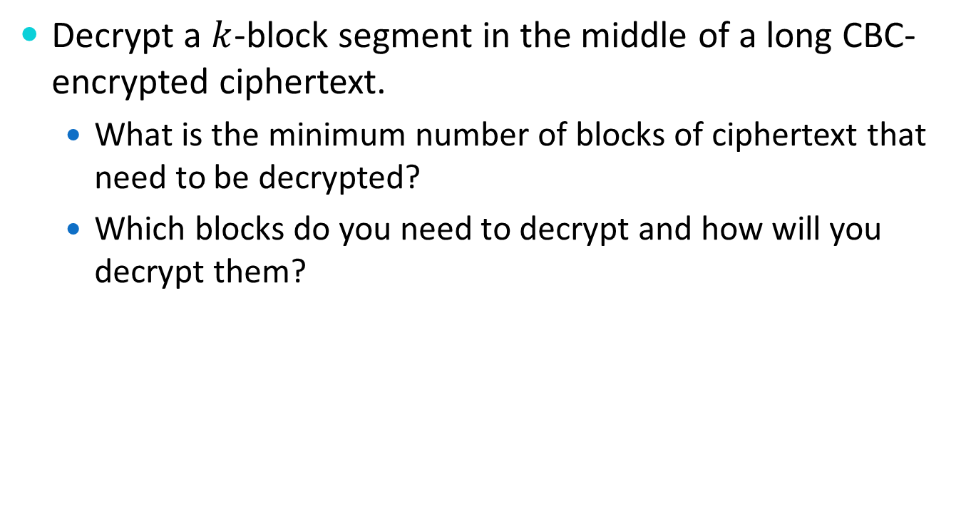
Problem 2
Decrypt a $k$-block segment in the middle of a long CBC-encrypted ciphertext.
  What is the minimum number of blocks of ciphertext that need to be decrypted?
  Which blocks do you need to decrypt and how will you decrypt them?

Slide 8
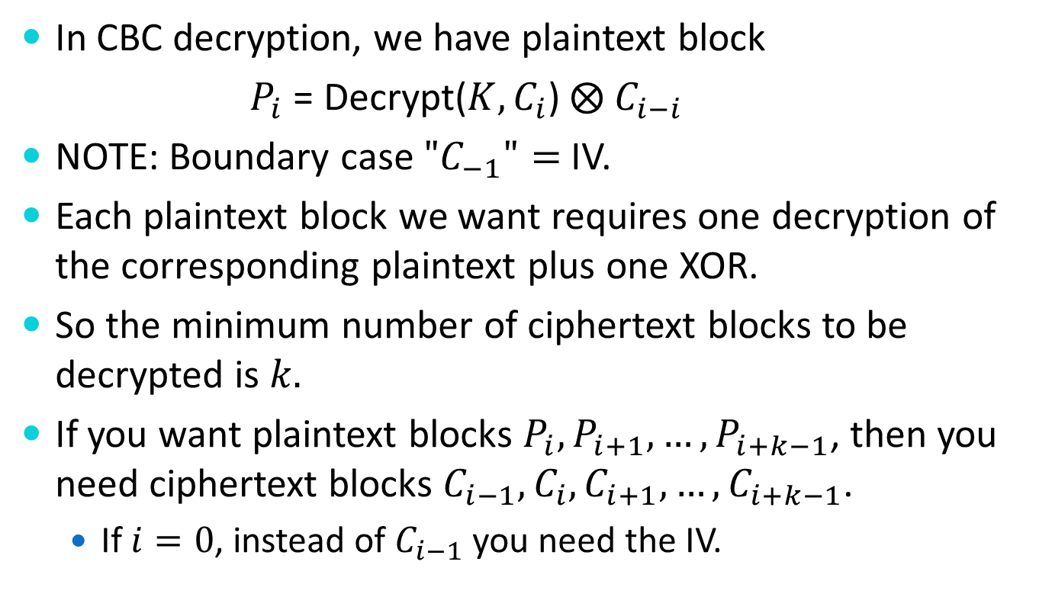
Problem 2
In CBC decryption, we have plaintext block
$P_{i}$ = Decrypt($K, C_{i}$)$⨂ C_{i−i}$
NOTE: Boundary case $"C_{−1}"=$ IV.
Each plaintext block we want requires one decryption of the corresponding plaintext plus one XOR.
So the minimum number of ciphertext blocks to be decrypted is $k.$
If you want plaintext blocks $P_{i}, P_{i+1}, …, P_{i+k−1}$, then you need ciphertext blocks $C_{i−1},C_{i}, C_{i+1}, …, C_{i+k−1}$.
  If $i=0$, instead of $C_{i−1}$ you need the IV.

Slide 9
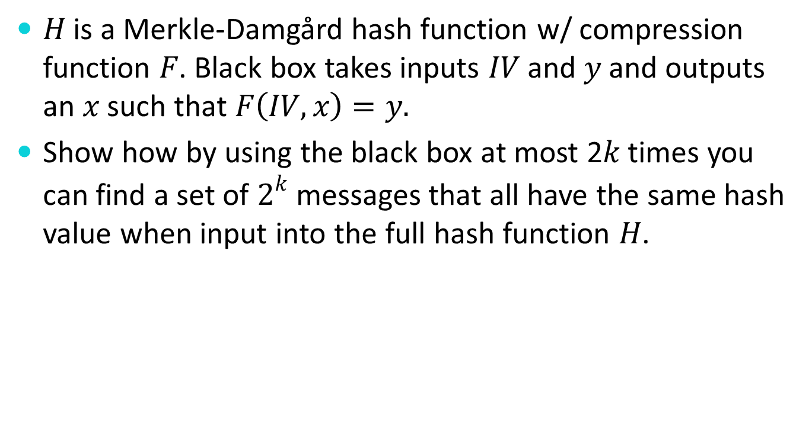
Problem 3
$H$ is a Merkle-Damgård hash function w/ compression function $F$. Black box takes inputs $IV$and $y$ and outputs an $x$ such that $F\left(IV,x\right)=y.$
Show how by using the black box at most 2$k$ times you can find a set of $2^{k}$ messages that all have the same hash value when input into the full hash function $H$.

Slide 10
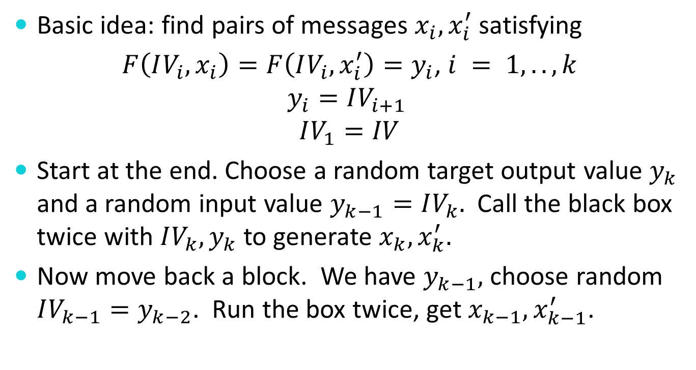
Problem 3 – Solution 1
Basic idea: find pairs of messages $x_{i}, x_{i}^{′}$ satisfying
$F\left(IV_{i}, x_{i}\right)=F\left(IV_{i}, x_{i}^{′}\right)=y_{i}$, $i = 1,..,k$
$$y_{i}=IV_{i+1}$$
$$IV_{1}=IV$$
Start at the end. Choose a random target output value $y_{k}$ and a random input value $y_{k−1}=IV_{k}.$ Call the black box twice with $IV_{k}, y_{k}$ to generate $x_{k}, x_{k}^{′}.$
Now move back a block. We have $y_{k−1},$ choose random $IV_{k−1}=y_{k−2}$. Run the box twice, get $x_{k−1}, x_{k−1}^{′}$.

Slide 11
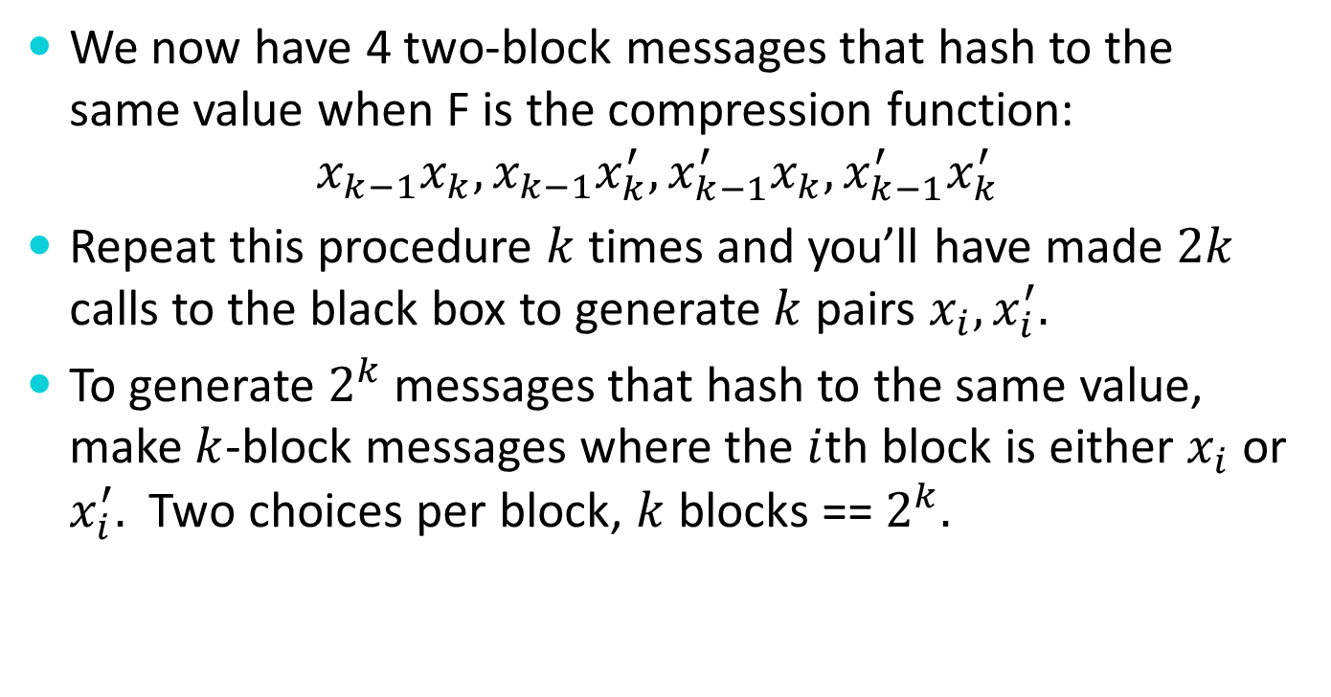
Problem 3 – Solution 1
We now have 4 two-block messages that hash to the same value when F is the compression function:
$$x_{k−1}x_{k}, x_{k−1}x_{k}^{′}, x_{k−1}^{′}x_{k}, x_{k−1}^{′}x_{k}^{′}$$
Repeat this procedure $k$times and you’ll have made $2k$ calls to the black box to generate $k$pairs $x_{i},x_{i}^{′}.$
To generate $2^{k}$ messages that hash to the same value, make $k$-block messages where the $i$th block is either $x_{i}$ or $x_{i}^{′}.$ Two choices per block, $k$ blocks == $2^{k}.$

Slide 12
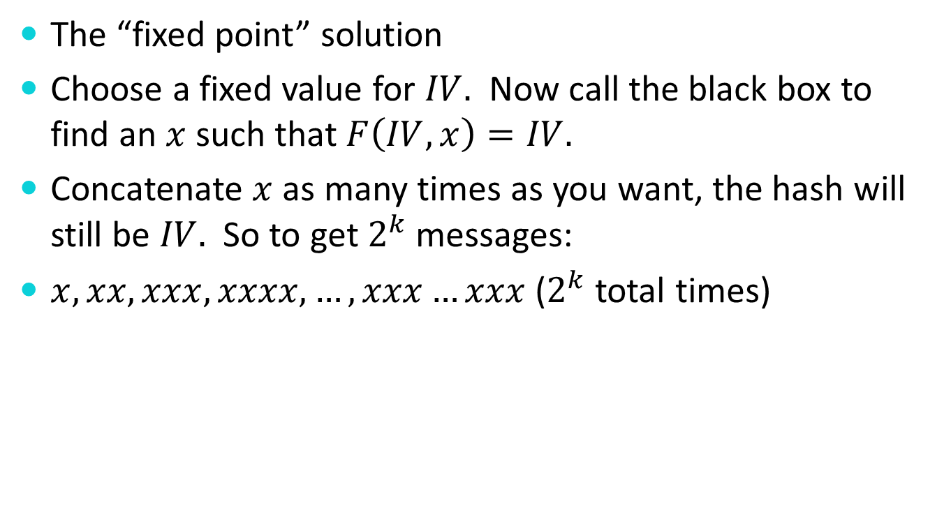
Problem 3 – Solution 2
The “fixed point” solution
Choose a fixed value for $IV.$ Now call the black box to find an $x$ such that $F\left(IV, x\right)=IV.$
Concatenate $x$ as many times as you want, the hash will still be $IV.$ So to get $2^{k}$ messages:
$x, xx, xxx, xxxx, …, xxx…xxx$ ($2^{k}$ total times)

Slide 13
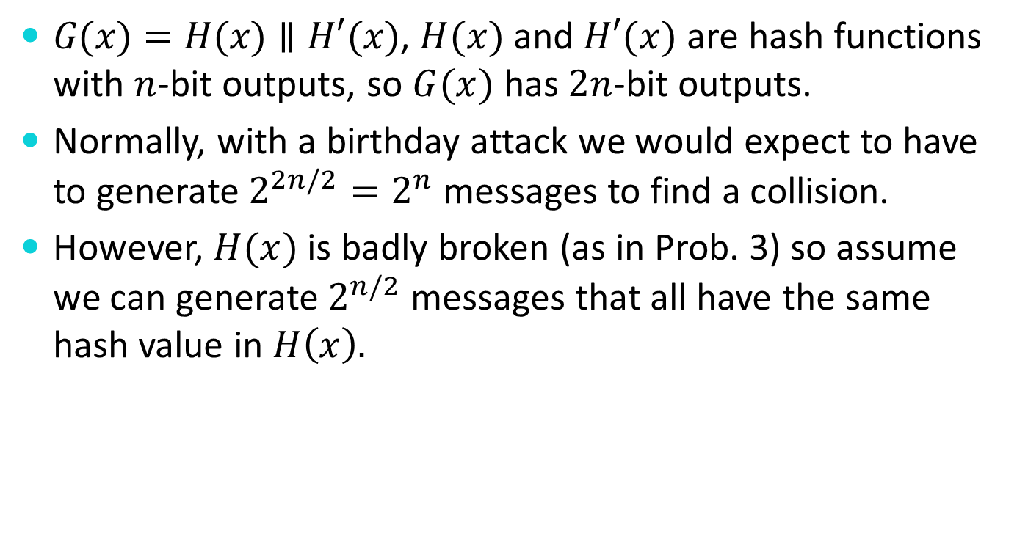
Problem 4
$G(x)=H(x)∥H′(x)$, $H(x)$ and $H′(x)$ are hash functions with $n$-bit outputs, so $G(x)$ has $2n$-bit outputs.
Normally, with a birthday attack we would expect to have to generate $2^{2n/2}=2^{n}$ messages to find a collision.
However, $H(x)$ is badly broken (as in Prob. 3) so assume we can generate $2^{n/2}$ messages that all have the same hash value in $H\left(x\right).$

Slide 14

Problem 4
Now compute $H′(x)$ for each of the $2^{n/2}$ that have the same hash value in $H(x)$.
By the birthday attack we expect to find a collision from those $2^{n/2}$ messages.

Slide 15

Problem 4
Was it a good idea to construct $G(x)=H(x)∥H′(x)$?

Slide 16

Problem 4
Was it a good idea to construct $G(x)=H(x)∥H′(x)$?
Well, it depends…

Slide 17
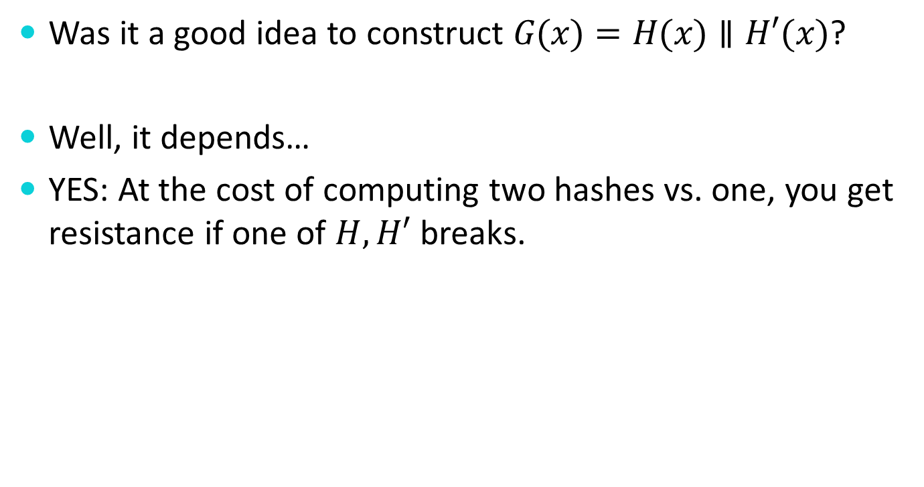
Problem 4
Was it a good idea to construct $G(x)=H(x)∥H′(x)$?
Well, it depends…
YES: At the cost of computing two hashes vs. one, you get resistance if one of $H, H′$ breaks.

Slide 18
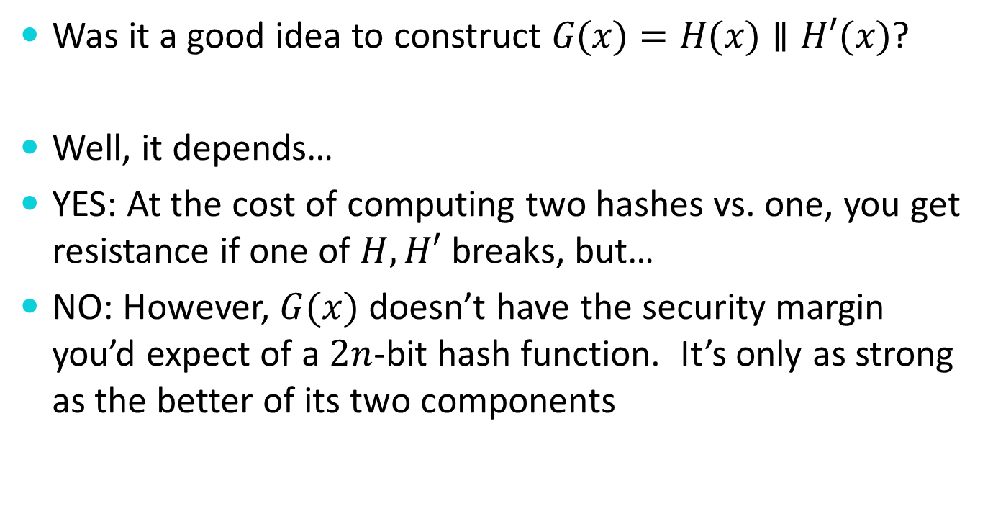
Problem 4
Was it a good idea to construct $G(x)=H(x)∥H′(x)$?
Well, it depends…
YES: At the cost of computing two hashes vs. one, you get resistance if one of $H, H′$ breaks, but…
NO: However, $G(x)$ doesn’t have the security margin you’d expect of a $2n$-bit hash function. It’s only as strong as the better of its two components

Slide 19
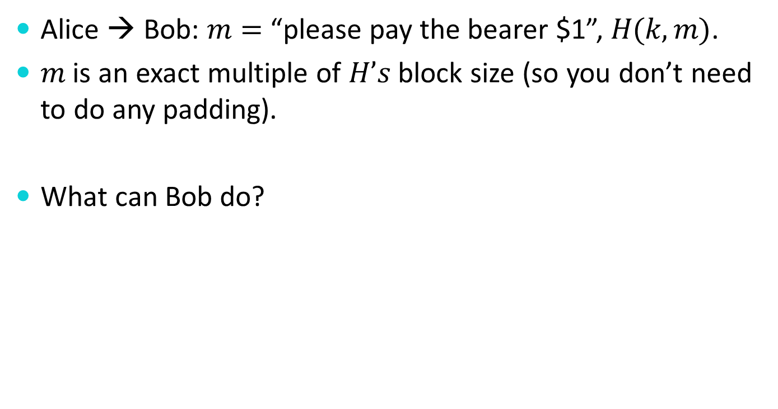
Problem 5
Alice → Bob: $m=$ “please pay the bearer $1”, $H(k,m)$.
$m$ is an exact multiple of $H’s$ block size (so you don’t need to do any padding).
What can Bob do?

Slide 20

Problem 5
Note that $k$ is only an input to the first application of $H^{′}s$ compression function (e.g. it’s the $IV$ to the hash of the first block of $m$)
Bob can append data to $m$, create $m^{′}=m∥$ “,000,000”, and compute $H\left(k,m^{′}\right)$ from $H(k,m)$.

