Slide 1
Assignment #2 – Solutions

Slide 2
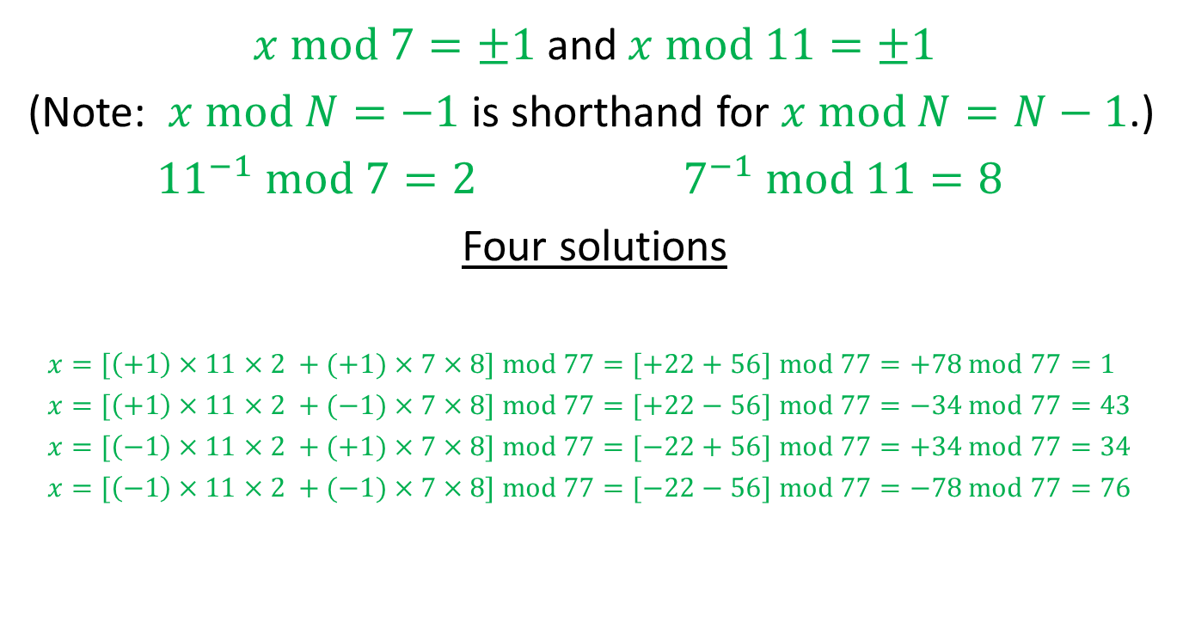
Problem 1
$x$ mod $7=±1$ and $x$ mod $11=±1$
(Note: $x$ mod $N=−1$ is shorthand for $x$ mod $N=N−1$.)
${11}^{−1}$ mod $7=2$ $7^{−1}$ mod $11=8$
Four solutions
$x=[\left(+1\right)×11×2 +(+1)×7×8]$ mod $77=[+22+56]$ mod $77=+78$ mod $77=1$
$x=[\left(+1\right)×11×2 +(−1)×7×8]$ mod $77=[+22−56]$ mod $77=−34$ mod $77=43$
$x=[\left(−1\right)×11×2 +(+1)×7×8]$ mod $77=[−22+56]$ mod $77=+34$ mod $77=34$
$x=[\left(−1\right)×11×2 +(−1)×7×8]$ mod $77=[−22−56]$ mod $77=−78$ mod $77=76$

Slide 3
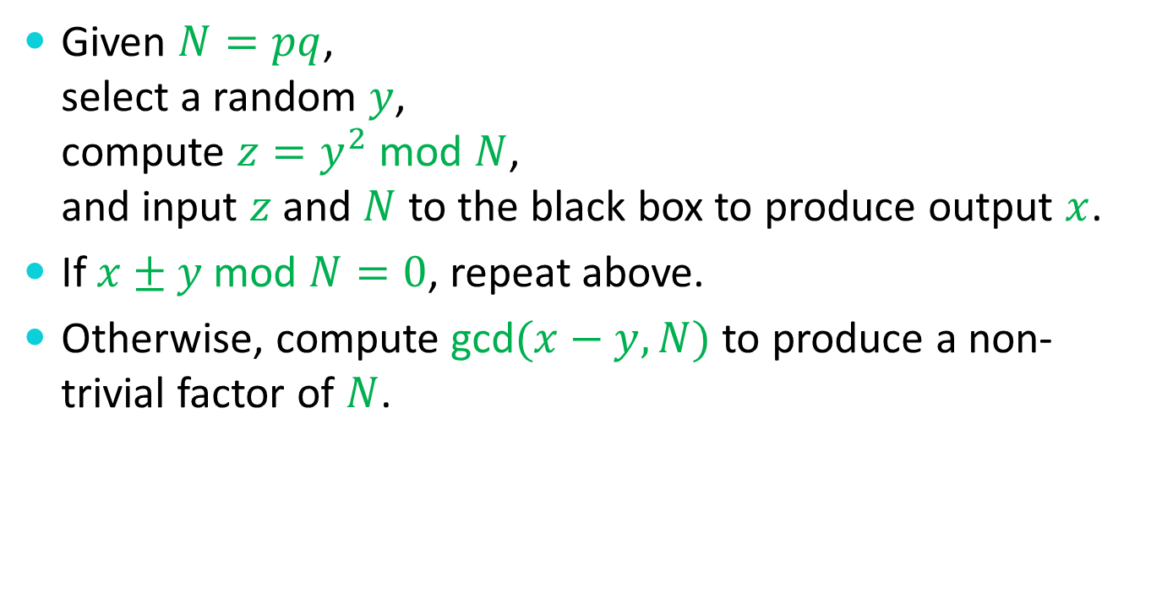
Problem 2
Given $N=pq$, select a random $y$, compute $z=y^{2}$ mod $N$, and input $z$ and $N$ to the black box to produce output $x$.
If $x±y$ mod $N=0$, repeat above.
Otherwise, compute gcd$(x−y,N)$ to produce a non-trivial factor of $N$.

Slide 4
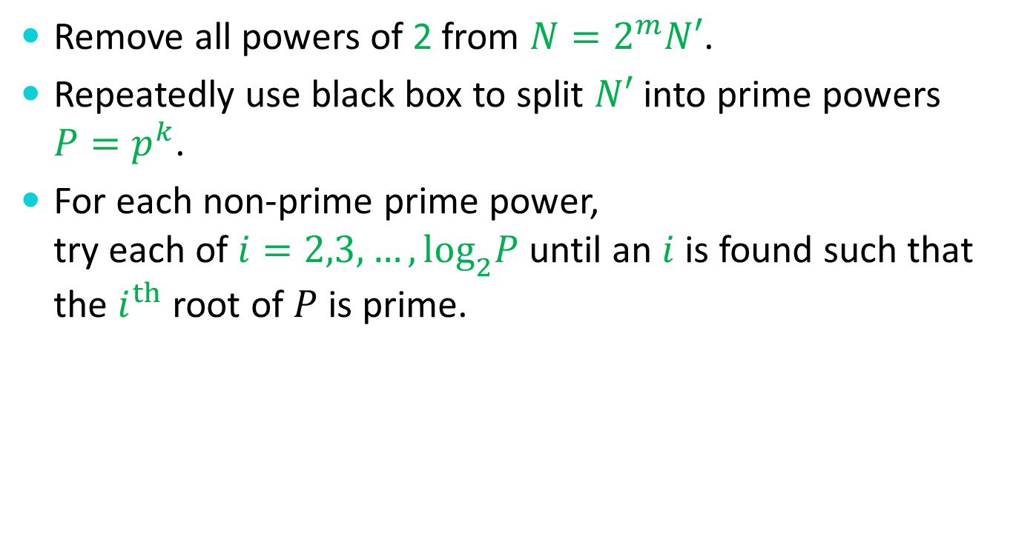
Problem 2 – Bonus
Remove all powers of 2 from $N=2^{m}N′$.
Repeatedly use black box to split $N′$ into prime powers ${P=p}^{k}$.
For each non-prime prime power, try each of $i=2,3,…,\log_{2}P$ until an $i$ is found such that the $i^{th}$ root of $P$ is prime.

Slide 5

Problem 3
Use Fermat’s Little Theorem and induction on k to prove that
$x^{k\left(p−1\right)+1}$mod $p=x$ mod $p$
for all primes $p$ and $k≥0$.

Slide 6
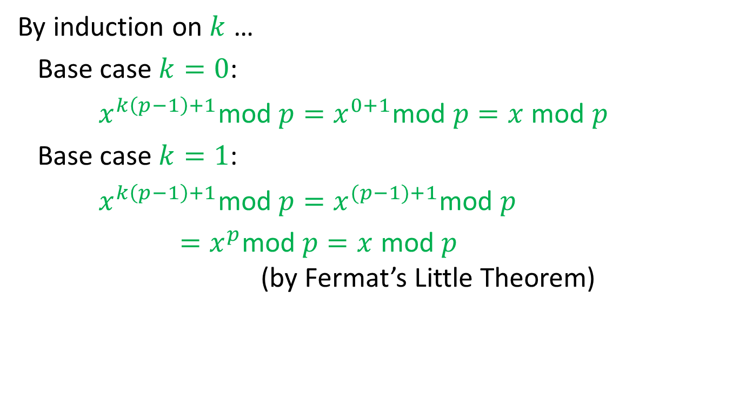
Problem 3 (cont.)
By induction on $k$ …
Base case $k=0$:
$x^{k\left(p−1\right)+1}$mod $p=x^{0+1}$mod $p=x$ mod $p$
Base case $k=1$:
$x^{k\left(p−1\right)+1}$mod $p=x^{(p−1)+1}$mod $p$
$=x^{p}$mod $p=x$ mod $p$ (by Fermat’s Little Theorem)

Slide 7

Problem 3 (cont.)
Inductive step:
Assume that $x^{k\left(p−1\right)+1}$mod $p=x$ mod $p$.
Prove that $x^{(k+1)\left(p−1\right)+1}$mod $p=x$ mod $p$.

Slide 8
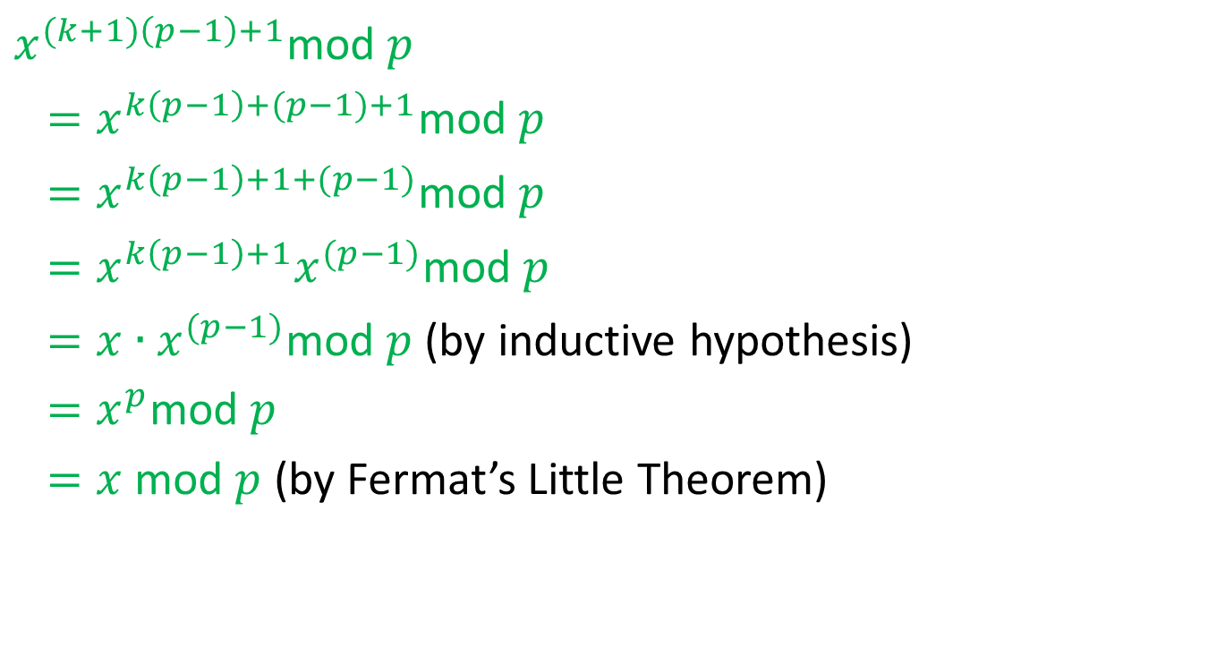
Problem 3 (cont.)
$x^{(k+1)\left(p−1\right)+1}$mod $p$
$=x^{k\left(p−1\right)+(p−1)+1}$mod $p$
$=x^{k\left(p−1\right)+1+(p−1)}$mod $p$
$=x^{k\left(p−1\right)+1}x^{(p−1)}$mod $p$
${=x∙x}^{(p−1)}$mod $p$ (by inductive hypothesis)
${=x}^{p}$mod $p$
$=x$ mod $p$ (by Fermat’s Little Theorem)

Slide 9

Problem 4
Show that for distinct primes $p$ and $q$,
$x$ mod $p=y$ mod $p$
$x$ mod $q=y$ mod $q$
together imply that
$x$ mod $pq=y$ mod $pq$.

Slide 10
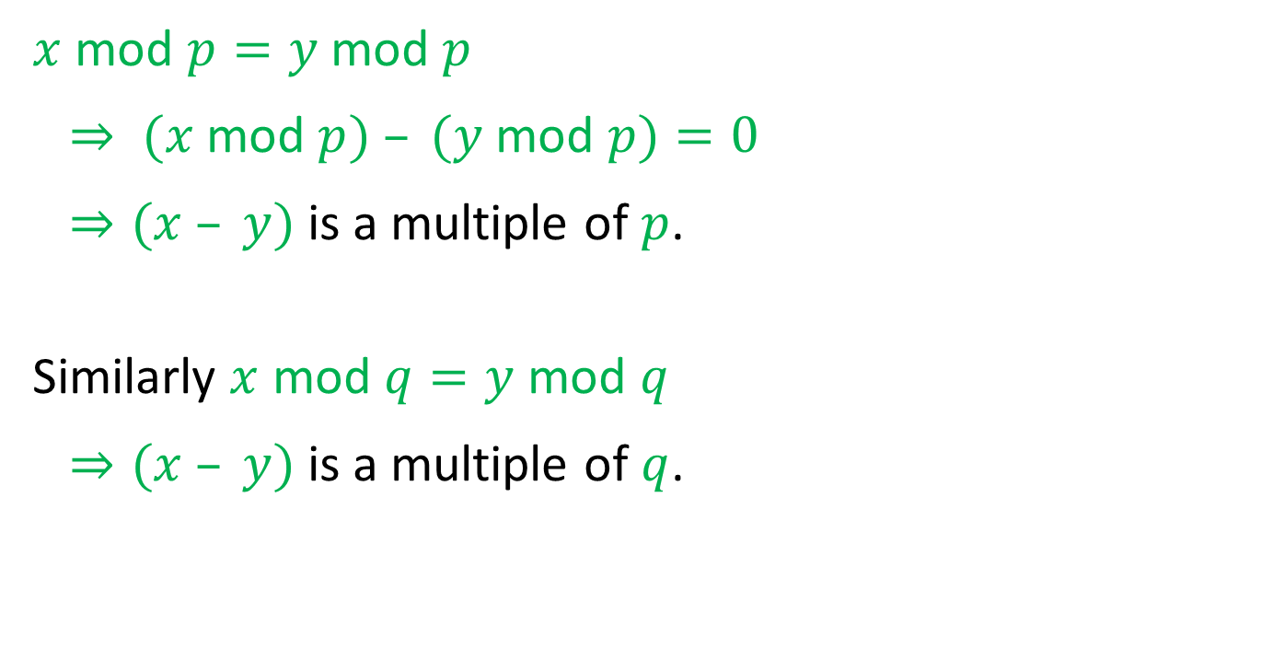
Problem 4
$x$ mod $p=y$ mod $p$
$⇒ (x$mod $p) – (y$ mod $p)=0$
$⇒(x – y)$is a multiple of $p$.
Similarly $x$ mod $q=y$ mod $q$
$⇒(x – y)$is a multiple of $q$.

Slide 11

Problem 4
Therefore, $(x – y)$ is a multiple of pq
$⇒(x – y)$mod $pq=0$
$⇒(x$ mod $pq) – (y$ mod $pq) = 0$
$⇒x$ mod $pq=y$ mod $pq$.

Slide 12

Problem 5
Put problems 3 and 4 together to prove that
$x^{K\left(p−1\right)\left(q−1\right)+1}$ mod $pq=x$ mod $pq$
For $K≥0$ and distinct primes $p$ and $q$.

Slide 13
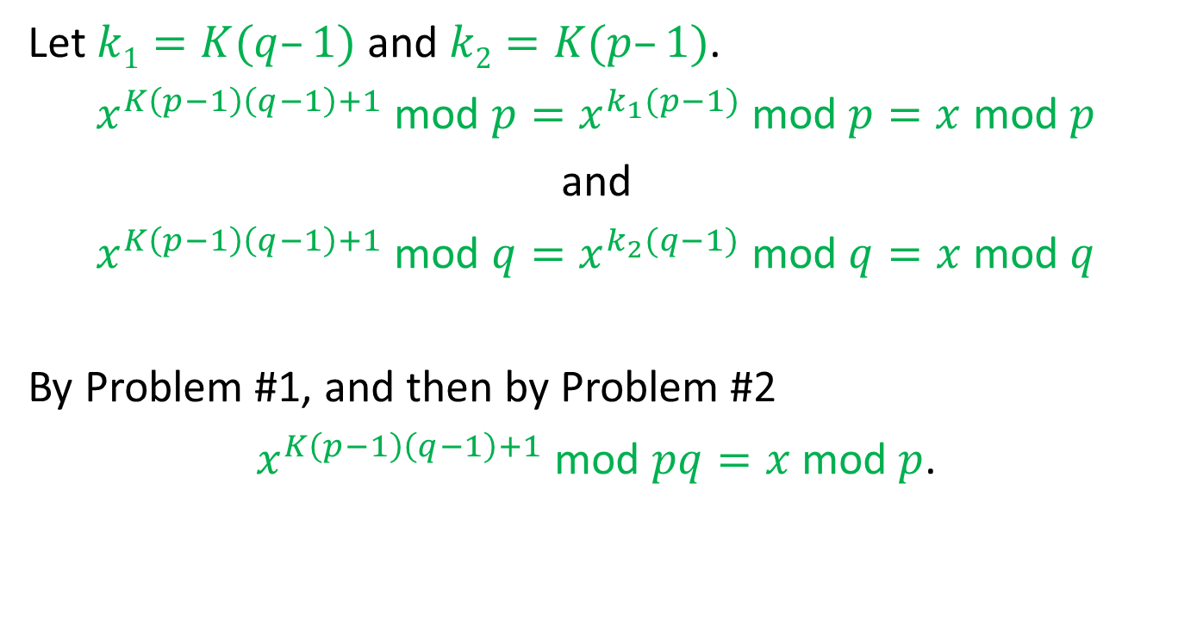
Problem 5 (cont.)
Let $k1=K(q–1)$ and $k2=K(p–1)$.
$x^{K\left(p−1\right)\left(q−1\right)+1}$ mod $p=x^{k_{1}(p−1)}$ mod $p=x$ mod $p$
and
$x^{K\left(p−1\right)\left(q−1\right)+1}$ mod $q=x^{k_{2}(q−1)}$ mod $q=x$ mod $q$
By Problem #1, and then by Problem #2
$x^{K\left(p−1\right)\left(q−1\right)+1}$ mod $pq=x$ mod $p$.

