Slide 1
Dynamic Searchable Symmetric Encryption
Tom Roeder
eXtreme Computing Group
Microsoft Research
Joint work with Seny Kamara

Slide 2
Encrypted Cloud Backup
Cloud backup
Users want to back up their data
The cloud provides storage
Privacy, integrity, and confidentiality
But servers learn much about users this way
Honest-but-curious server can read everything
Malicious server can make arbitrary changes
Naïve solution: store all data encrypted
User keeps key and decrypts locally
Problems: key management, search, cloud computation

Slide 3
Searchable Symmetric Encryption (SSE)
SSE solves the search problem
Encrypt an index
User keeps key and generates search tokens
Server can use tokens to search encrypted index
Practical implementations need update
Current impls do not have efficient update
Either no supported update operations
Or each word has size linear in all documents
We provide two schemes with efficient update
Update (add or delete) per word/doc pair
Update (add or delete) per doc

Slide 4
Overview
Introduction
Dynamic SSE Protocols
Security Proofs
Implementation

Slide 5
The Encrypted Search Problem
User has collection $d_{1},d_{2},…, d_{m}$ of documents
$d$ is a document identifier
Each document $d$has set of unique words $W_{d}$
Set of all unique words: $w_{1}, w_{2},…, w_{n}$
Goal: Produce an encrypted index with ops
Search($w$): returns encrypted doc ids
Add($d, W_{d}$): adds the doc id with word set
Delete($d$): deletes the doc id and all words
Expand(): expands the index
client
server
Notes:
- Note: this is the encrypted search problem for the doc-based case

Slide 6
The Encrypted Search Problem
User has collection $d_{1},d_{2},…, d_{m}$ of documents
$d$ is a document identifier
Each document $d$has set of unique words $W_{d}$
Set of all unique words: $w_{1}, w_{2},…, w_{n}$
Goal: Produce an encrypted index with ops
Search($w$): returns encrypted doc ids
Add($d, W_{d}$): adds the doc id with word set
Delete($d$): deletes the doc id and all words
Expand(): expands the index
enc
files
tokens
client
server
enc
index

Slide 7
The Encrypted Search Problem
User has collection $d_{1},d_{2},…, d_{m}$ of documents
$d$ is a document identifier
Each document $d$has set of unique words $W_{d}$
Set of all unique words: $w_{1}, w_{2},…, w_{n}$
Goal: Produce an encrypted index with ops
Search($w$): returns encrypted doc ids
Add($d, W_{d}$): adds the doc id with word set
Delete($d$): deletes the doc id and all words
Expand(): expands the index
enc
files
tokens
client
server
enc
index
response

Slide 8
CGKO
SSE scheme without update operations
Main idea:
Each word is mapped to a token (under PRF)
Tokens map to an initial position in encrypted array
Each position points to next element in list
The large encrypted, randomized array hides the document count for each word
In original form, only secure against non-adaptive adversaries
Assume honest-but-curious server

Slide 9
Modified CGKO
index $:$ $f_{k_{c}}\left(w\right)→〈start〉⊕f_{k_{b}^{}}(w)$
list entry $:Enc_{k_{w}}\left(next\right), Enc_{k_{e}}(d)$
index
list entries

Slide 10
Modified CGKO: Search
Given
w, $k_{c}$, $k_{b}^{}$, $k_{g}$. $k_{w}=KDF_{k_{g}}(w)$
construct token $f_{k_{c}}\left(w\right), f_{k_{b}^{}}\left(w\right), k_{w}$
index
list entries
Notes:
- Note: encrypted doc ids contain more than just identifiers

Slide 11
Modified CGKO: Search
Given
w, $k_{c}$, $k_{b}^{}$, $k_{g}$. $k_{w}=KDF_{k_{g}}(w)$
construct token $f_{k_{c}}\left(w\right), f_{k_{b}^{}}\left(w\right), k_{w}$
index
list entries
$$f_{k_{c}}\left(w\right)$$

Slide 12
Modified CGKO: Search
Given
w, $k_{c}$, $k_{b}^{}$, $k_{g}$. $k_{w}=KDF_{k_{g}}(w)$
construct token $f_{k_{c}}\left(w\right), f_{k_{b}^{}}\left(w\right), k_{w}$
index
list entries
$$f_{k_{c}}\left(w\right)$$
$$⊕$$
$$f_{k_{b}^{}}\left(w\right)$$

Slide 13
Modified CGKO: Search
Given
w, $k_{c}$, $k_{b}^{}$, $k_{g}$. $k_{w}=KDF_{k_{g}}(w)$
construct token $f_{k_{c}}\left(w\right), f_{k_{b}^{}}\left(w\right), k_{w}$
index
list entries
$$f_{k_{c}}\left(w\right)$$
$$⊕$$
$$Dec_{k_{w}}$$
$$f_{k_{b}^{}}\left(w\right)$$

Slide 14
Modified CGKO: Search
Given
w, $k_{c}$, $k_{b}^{}$, $k_{g}$. $k_{w}=KDF_{k_{g}}(w)$
construct token $f_{k_{c}}\left(w\right), f_{k_{b}^{}}\left(w\right), k_{w}$
index
list entries
$$f_{k_{c}}\left(w\right)$$
$$⊕$$
$$Dec_{k_{w}}$$
$$Dec_{k_{w}}$$
$$f_{k_{b}^{}}\left(w\right)$$

Slide 15
Modified CGKO: Search
Given
w, $k_{c}$, $k_{b}^{}$, $k_{g}$. $k_{w}=KDF_{k_{g}}(w)$
construct token $f_{k_{c}}\left(w\right), f_{k_{b}^{}}\left(w\right), k_{w}$
index
list entries
$$f_{k_{c}}\left(w\right)$$
$$⊕$$
$$Dec_{k_{w}}$$
$$Dec_{k_{w}}$$
$$Dec_{k_{w}}$$
$$f_{k_{b}^{}}\left(w\right)$$

Slide 16
List Patching
To delete an entry ($x$), need
Location of entry to delete
Location of next ($n$) and prev ($p$) entries (if any)
Use XOR encryption for list pointers
$$p$$
$$x$$
$$n$$
$$r, 〈u, x〉⊕f_{k_{w}}\left(r\right)$$
$$r′, 〈p, n〉⊕f_{k_{w}}\left(r′\right)$$
$$r′′, 〈x, v〉⊕f_{k_{w}}\left(r′′\right)$$

Slide 17
List Patching
To delete an entry ($x$), need
Location of entry to delete
Location of next ($n$) and prev ($p$) entries (if any)
Use XOR encryption for list pointers
$$p$$
$$x$$
$$n$$
$$r, 〈u, x〉⊕f_{k_{w}}\left(r\right)$$
$$r′, 〈p, n〉⊕f_{k_{w}}\left(r′\right)$$
$$r′′, 〈x, v〉⊕f_{k_{w}}\left(r′′\right)$$
$$⊕〈0, x⊕n〉$$
$$⊕〈x⊕p, 0〉$$

Slide 18
List Patching
To delete an entry ($x$), need
Location of entry to delete
Location of next ($n$) and prev ($p$) entries (if any)
Use XOR encryption for list pointers
$$p$$
$$x$$
$$n$$
$$r, 〈u, n〉⊕f_{k_{w}}\left(r\right)$$
$$r′, 〈p, n〉⊕f_{k_{w}}\left(r′\right)$$
$$r′′, 〈p, v〉⊕f_{k_{w}}\left(r′′\right)$$

Slide 19
Deletion index
To patch the data structure
E.g., pulling a document out of a list
And need a structure to index directly into the lists
Add deletion index
Index: $f_{k_{c}}\left(d\right)→〈start〉⊕f_{k_{b}}\left(d\right)$
$r, r^{′}, r^{′′}, 〈n_{d}, dn_{x}, dp_{x}〉⊕f_{k_{d}}\left(r\right), 〈x, p, n〉⊕f_{k_{d}}\left(r^{′}\right),$ $f_{k_{c}}\left(w\right)⊕f_{k_{d}}(r^{′′})$
list structure uses $n_{d}$ to point to next word for d
$dn_{x}$ and $dp_{x}$ point to del index entries for $n$ and $p$
1-1 correspondence between list entries

Slide 20
Doc-Based Index
index
list entries

Slide 21
Doc-Based Index
del list entries
index
list entries

Slide 22
Doc-Based Index
del list entries
index
list entries
$$x$$
$$p$$
$$n$$

Slide 23
Doc-Based Index
$$n_{d}$$
del list entries
index
list entries
$$x$$
$$p$$
$$n$$

Slide 24
Doc-Based Index
$$n_{d}$$
$$dn_{x}$$
$$dp_{x}$$
del list entries
index
list entries
$$x$$
$$p$$
$$n$$

Slide 25
Free List
Add and delete must track unused space
revealing unused would reveal word * doc
user must keep track of freelist count
main
del
main index

Slide 26
Free List
Add and delete must track unused space
revealing unused would reveal word * doc
user must keep track of freelist count
main
del
main index
$$f_{k_{c}}(freelist)$$

Slide 27
Free List
Add and delete must track unused space
revealing unused would reveal word * doc
user must keep track of freelist count
main
del
main index
$$f_{k_{c}}(freelist)$$

Slide 28
Free List
Add and delete must track unused space
revealing unused would reveal word * doc
user must keep track of freelist count
main
del
main index
$$f_{k_{c}}(freelist)$$

Slide 29
Free List
Add and delete must track unused space
revealing unused would reveal word * doc
user must keep track of freelist count
$$〈l_{i−1}, ld_{i}〉⊕f_{k_{f}}(i)$$
main
del
main index
$$f_{k_{c}}(freelist)$$
$$〈l_{i−2}, ld_{i−1}〉⊕f_{k_{f}}(i−1)$$

Slide 30
Add a Document
$〈$doc tokens$〉$, $〈$freelist tokens$〉$, word count
per word: $〈$word tokens$〉$, $〈$freelist mask$〉$, templates
main
del
main index
del index
Notes:
- note: if you don’t care about revealing the length of the free list, then you can use a single key, and this makes the key no longer stateful

Slide 31
Add a Document
$〈$doc tokens$〉$, $〈$freelist tokens$〉$, word count
per word: $〈$word tokens$〉$, $〈$freelist mask$〉$, templates
$$f_{k_{c}}(d)$$
main
del
main index
del index

Slide 32
Add a Document
$〈$doc tokens$〉$, $〈$freelist tokens$〉$, word count
per word: $〈$word tokens$〉$, $〈$freelist mask$〉$, templates
$$f_{k_{c}}(d)$$
main
del
main index
del index
$$f_{k_{c}}(freelist)$$

Slide 33
Add a Document
$〈$doc tokens$〉$, $〈$freelist tokens$〉$, word count
per word: $〈$word tokens$〉$, $〈$freelist mask$〉$, templates
$$f_{k_{c}}(d)$$
main
del
main index
del index
$$f_{k_{c}}(freelist)$$

Slide 34
Add a Document
$〈$doc tokens$〉$, $〈$freelist tokens$〉$, word count
per word: $〈$word tokens$〉$, $〈$freelist mask$〉$, templates
$$f_{k_{c}}(d)$$
main
del
main index
del index
$$f_{k_{c}}(freelist)$$

Slide 35
Add a Document
$〈$doc tokens$〉$, $〈$freelist tokens$〉$, word count
per word: $〈$word tokens$〉$, $〈$freelist mask$〉$, templates
$$f_{k_{c}}(d)$$
main
del
main index
del index
$$f_{k_{c}}(freelist)$$

Slide 36
Add a Document
$〈$doc tokens$〉$, $〈$freelist tokens$〉$, word count
per word: $〈$word tokens$〉$, $〈$freelist mask$〉$, templates
$$f_{k_{c}}(w_{1})$$
$$f_{k_{c}}(d)$$
main
del
main index
del index
$$f_{k_{c}}(freelist)$$

Slide 37
Add a Document
$〈$doc tokens$〉$, $〈$freelist tokens$〉$, word count
per word: $〈$word tokens$〉$, $〈$freelist mask$〉$, templates
$$f_{k_{c}}(w_{1})$$
$$f_{k_{c}}(d)$$
main
del
main index
del index
patch
$$f_{k_{c}}(freelist)$$
patch

Slide 38
Delete a Document
$〈$doc tokens$〉$, doc key, $〈$freelist tokens$〉$, count
per word: $〈$freelist mask$〉$
main
del
main index
del index

Slide 39
Delete a Document
$〈$doc tokens$〉$, doc key, $〈$freelist tokens$〉$, count
per word: $〈$freelist mask$〉$
$$f_{k_{c}}(d)$$
main
del
main index
del index

Slide 40
Delete a Document
$〈$doc tokens$〉$, doc key, $〈$freelist tokens$〉$, count
per word: $〈$freelist mask$〉$
$$f_{k_{c}}(w_{1})$$
$$f_{k_{c}}(d)$$
main
del
main index
del index

Slide 41
Delete a Document
$〈$doc tokens$〉$, doc key, $〈$freelist tokens$〉$, count
per word: $〈$freelist mask$〉$
$$f_{k_{c}}(w_{1})$$
$$f_{k_{c}}(d)$$
main
del
main index
del index

Slide 42
Delete a Document
$〈$doc tokens$〉$, doc key, $〈$freelist tokens$〉$, count
per word: $〈$freelist mask$〉$
$$f_{k_{c}}(w_{1})$$
patch
$$f_{k_{c}}(d)$$
patch
main
del
main index
del index
patch
patch

Slide 43
Delete a Document
$〈$doc tokens$〉$, doc key, $〈$freelist tokens$〉$, count
per word: $〈$freelist mask$〉$
$$f_{k_{c}}(w_{1})$$
$$f_{k_{c}}(d)$$
main
del
main index
del index
$$f_{k_{c}}(freelist)$$

Slide 44
Index Extension
Index size is fixed at generation time
So, add to free list for expansion
main
del
main index
$$f_{k_{c}}(freelist)$$

Slide 45
Index Extension
Index size is fixed at generation time
So, add to free list for expansion
main
del
main index
$$f_{k_{c}}(freelist)$$

Slide 46
Index Extension
Index size is fixed at generation time
So, add to free list for expansion
main
del
main index
$$f_{k_{c}}(freelist)$$

Slide 47
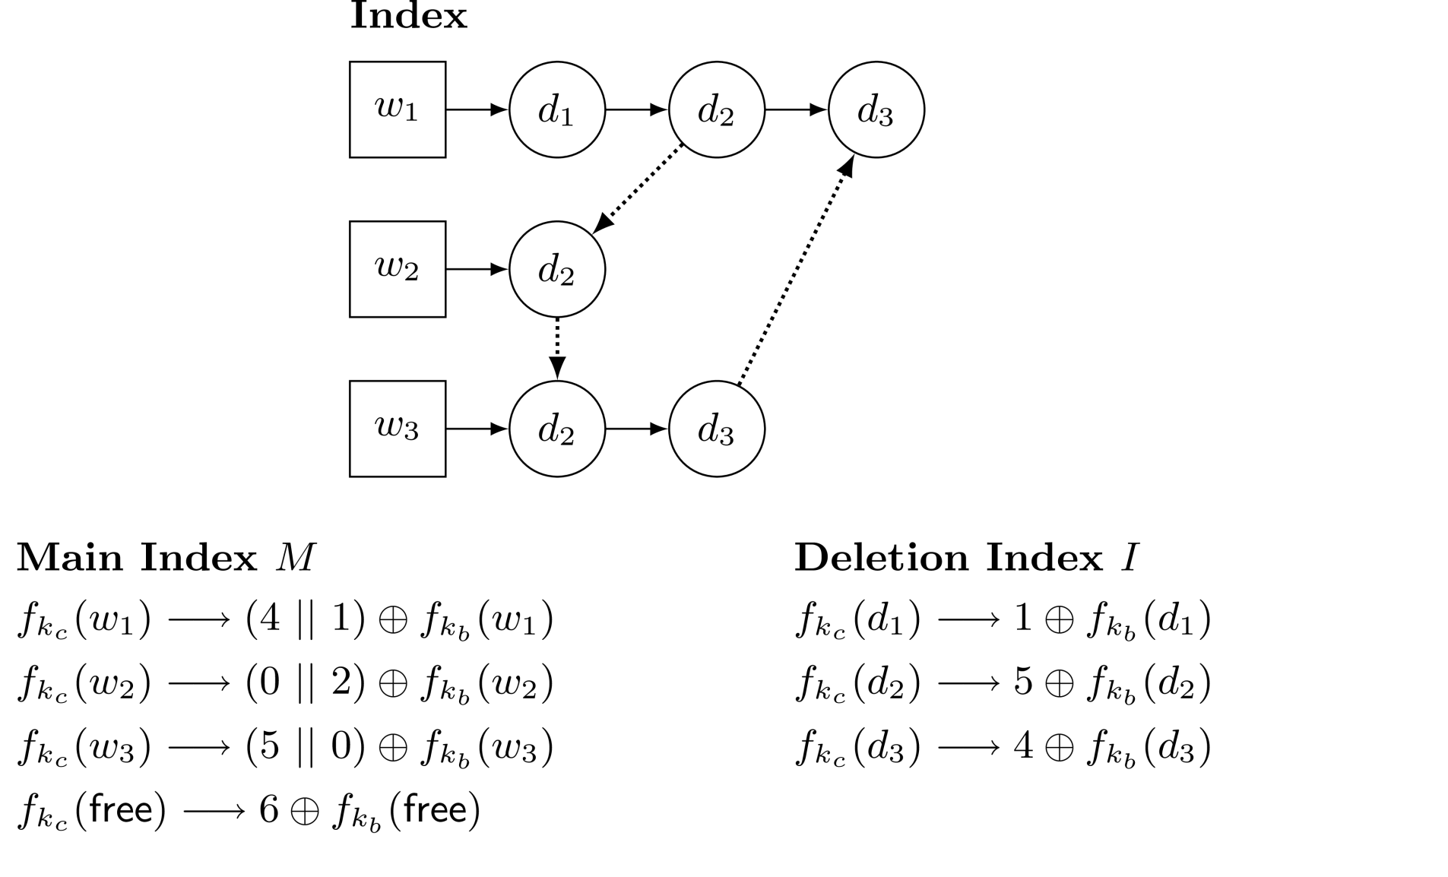
A Small Example: Indexes

Slide 48
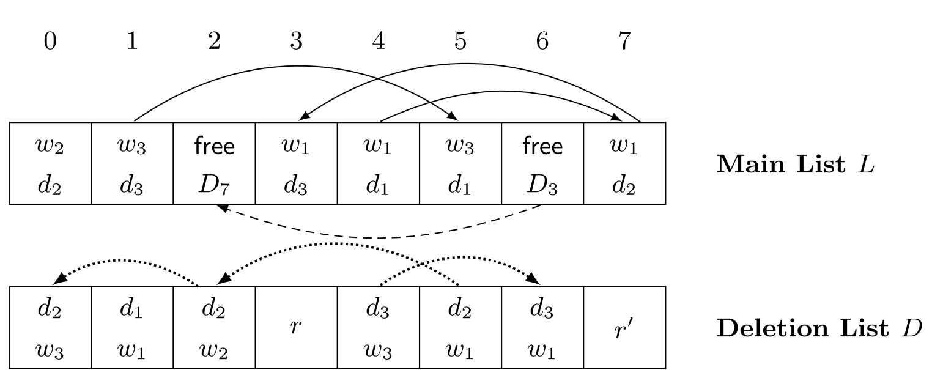
A Small Example: Arrays

Slide 49
Word-Based Deletion
Deletion index uses doc/word pairs:
No lists of words per doc
$f_{k_{c}}\left(d, w\right)→r,r^{′},r^{′′}, 〈x,p,n〉⊕f_{k_{d, w}}\left(r\right), f_{k_{c}}\left(d_{p}, w_{p}\right)⊕f_{k_{d, w}}\left(r^{′}\right),f_{k_{c}}\left(d_{n}, w_{n}\right)⊕f_{k_{d, w}}\left(r^{′}′\right)$
Algorithms similar
Search identical
Add puts new word on front of list
Delete patches to pull word out of list
Extension identical

Slide 50
Tradeoffs
Word-Based Update
Update token linear in number of word changes
Hides number of unique words in document
Uses less space for index
But requires keeping track of diffs on disk
Doc-Based Update
Stateless for client (except freelist count)
But reveals the unique words in old and new docs
We currently use Doc-Based Update
Cost of keeping diffs outweighs value of hiding

Slide 51
Overview
Introduction
Dynamic SSE Protocols
Security Proofs
Implementation

Slide 52
Security Proofs
Adaptive Simulatability
$Σ=($Gen, Index, TrapS, Search, Retrieve, TrapA, Add, TrapD, Delete, ExtendIndex$)$ is a dynamic SSE scheme
$$S$$
SSE
?
RO
$$A$$
Notes:
- note that we are only going to describe the argument for simulation and not for indistinguishability.

Slide 53
Leakage
Searchable Symmetric Encryption leaks info
Query pattern: unique terms and result counts
Access pattern: which documents are retrieved
Our algorithm leaks a little more
unique ID for words in added and deleted docs
Update pattern: add to existing, pos of delete
tail of the free list
amount of index expansion
when the index is full

Slide 54
Proof Outline
Index Generation and Expansion: random
Search: given number of results
If seen search (+ any updates), then repeat
Otherwise, choose a random index entry
Provide random unused location for first element
Choose unused locations for other elements
Program random oracle to “decrypt” list ($k_{w}$)
$$x$$
$$r, r^{′}, r′′$$

Slide 55
Proof Outline
Index Generation and Expansion: random
Search: given number of results
If seen search (+ any updates), then repeat
Otherwise, choose a random index entry
Provide random unused location for first element
Choose unused locations for other elements
Program random oracle to “decrypt” list ($k_{w}$)
$$x$$
$$f_{k_{w}}\left(r\right)=〈p,n〉⊕r′$$
$${r^{′}⊕f}_{k_{w}}\left(r\right)=r^{′}⊕〈p,n〉⊕r^{′}=〈p,n〉$$
$$r, r^{′}, r′′$$

Slide 56
Proof Outline: Add and Delete
Add: given unique IDs of added words
Find random locations and setup freelist tokens
Choose random index entry and get word tokens
Set masks to XOR to chosen pattern
Delete: given unique IDs of deleted words
Choose deletion locations (from prev or random)
Choose index entry to delete (from prev or random)
Program random oracle to decrypt chosen pattern ($k_{d}$)
Notes:
- NB: the adversary can query the random oracle at any time. So, it might seem like the adversary could go through and query all of the randomness in the provided index, forcing the simulator to commit to it. But recall that the random oracle takes two inputs: a key and randomness. And the probability of the adversary guessing the right key is negligible. So any queries the adversary makes that are to things we haven’t programmed we can just answer with a random response.

Slide 57
Overview
Introduction
Dynamic SSE Protocols
Security Proofs
Implementation

Slide 58
Performance
Prototype doc-based scheme in C++
Intel Xeon x64 2.26 GHz with Win 2008 R2
Zipf, Docs, Email datasets
500k to 1.5M doc/word pairs
Results
Generation (doc/word pair): 40 µs (c)
Search (doc): 8 µs (s)
Add (word): 35 µs (c), 2 µs (s)
Delete (word): 3 µs (c), 24 µs (s)
Notes:
- Note that this sort of Zipf distribution is probably a good approximation of a media-file workload: many documents with only a few terms.

Slide 59
Related SSE Schemes
[CGKO06]
Efficient search
Provides an adaptive scheme in plain model
Doesn’t provide any update properties
[SLDH09]
Efficient update via XOR encryption
Uses padded lists: linear in number of docs
Large storage cost: O(|w| |d|)
Notes:
CGKO = Curtmola, Garay, Kamara, and Ostrovsky
SLDH = Sedghi, van Liesdonk, Doumen, and Hartel

Slide 60
Conclusions
Dynamic SSE algorithms
Add and Delete use XOR encryption to modify index
Practical for real-world applications
Can trade off leakage for server operations

