Slide 1
Structure From Motion
Ali Farhadi
CSEP576
Several slides from Steve Seitz, Rick Szeliski, Martial Hebert, and Noha Snavely

Slide 2
Problem: Drift
(x₁,y₁)
(x_{n},y_{n})
copy of first image
Solution
  add another copy of first image at the end
  this gives a constraint: y_{n} = y₁
  there are a bunch of ways to solve this problem
    add displacement of (y₁ – y_{n})/(n -1) to each image after the first
    compute a global warp: y’ = y + ax
    run a big optimization problem, incorporating this constraint
      best solution, but more complicated
      known as “bundle adjustment”

Slide 3
Global optimization
p₁
p₂
p₃
Input
I₁
I₂
I₃
I₄
Output
t₁
t₂
t₃
t₄
(0,0)
We want to estimate ti . We know pi
  how do ti relate to pi?

Slide 4
Global optimization
s₁
p₁
p₂
r₃
r₄
s₄
p₃
q₃
q₄
q₂
I₁
I₂
I₃
I₄
Recipe
  Identify the variables you want to estimate
    in our case: ti
  Identify a set of objectives you want to satisfy
    in our case: pi - pj = ti - tj and similar for q, r, s
  Define an objective function F over these variables, whose minimum occurs at the “answer” for these variables
  Find the minimum of F

Slide 5
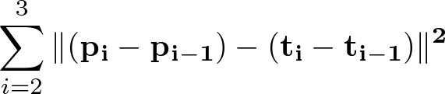
Objective function
s₁
p₁
p₂
r₃
r₄
s₄
p₃
q₃
q₄
q₂
I₁
I₂
I₃
I₄
Objective function
    + similar terms for q, r, s

Slide 6
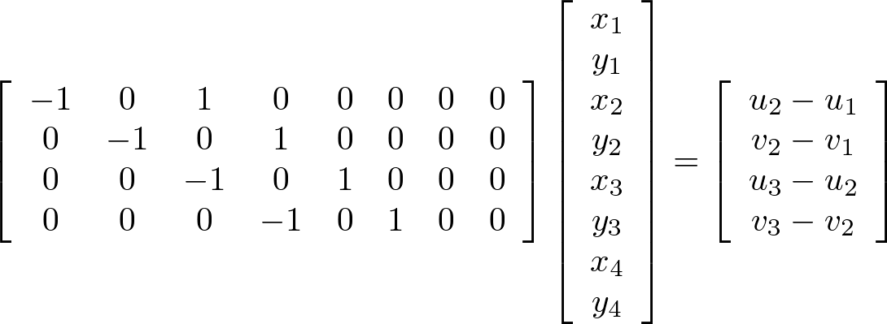
Objective function
p₁
p₂
p₃
Objective function
Matrix form
t_{i}= (x_{i}, y_{i})
p_{i}= (u_{i}, v_{i})

Slide 7
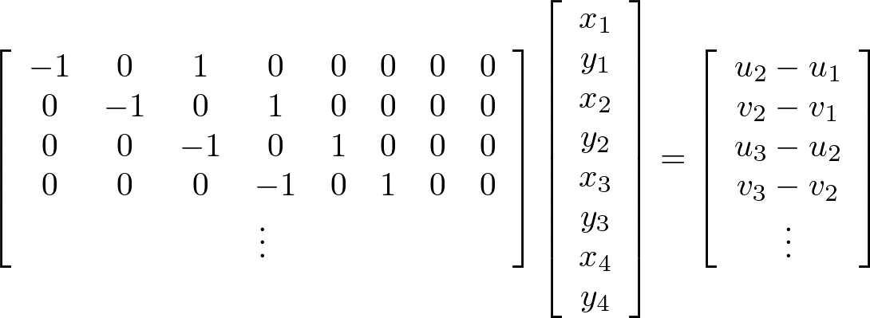


Objective Function
Adding in q, r, s give a larger matrix equation
A
x
b
Defines a least squares problem: minimize
Solution:

Slide 8
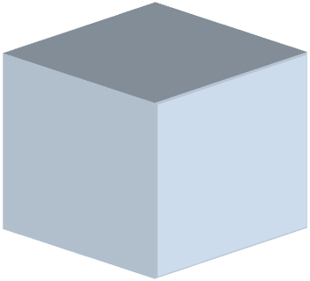
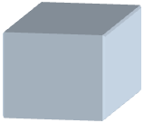
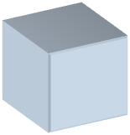
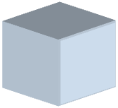
Structure from motion
aka “bundle adjustment” (texts: Zisserman; Faugeras)
p₄
p₁
p₃
minimize
p₂
g (R, T, P)
p₅
p₇
p₆
Camera 1
Camera 3
R₁,t₁
R₃,t₃
Camera 2
R₂,t₂
Notes:
Structure from motion solves the following problem:
Given a set of images of a static scene with 2D points in correspondence, shown here as color-coded points, find…
a set of 3D points P and
a rotation R and position t of the cameras that explain the observed correspondences. In other words, when we project a point into any of the cameras, the reprojection error between the projected and observed 2D points is low.
This problem can be formulated as an optimization problem where we want to find the rotations R, positions t, and 3D point locations P that minimize sum of squared reprojection errors f. This is a non-linear least squares problem and can be solved with algorithms such as Levenberg-Marquart. However, because the problem is non-linear, it can be susceptible to local minima. Therefore, it’s important to initialize the parameters of the system carefully. In addition, we need to be able to deal with erroneous correspondences.

Slide 9
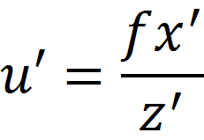
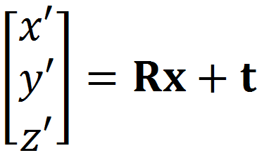
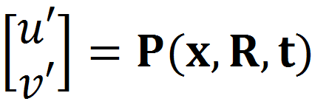
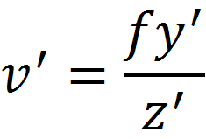
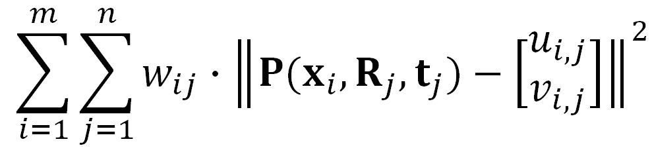

SfM objective function
Given point x and rotation and translation R, t
Minimize sum of squared reprojection errors:
predicted
image location
observed
image location

Slide 10
Solving structure from motion
Minimizing g is difficult:
  g is non-linear due to rotations, perspective division
  lots of parameters: 3 for each 3D point, 6 for each camera
  difficult to initialize
  gauge ambiguity: error is invariant to a similarity transform (translation, rotation, uniform scale)
Many techniques use non-linear least-squares optimization (bundle adjustment)
  Levenberg-Marquardt is a popular algorithm
  http://en.wikipedia.org/wiki/Levenberg-Marquardt_algorithm
Good code online
  Bundler: http://phototour.cs.washington.edu/bundler/
  Multicore: http://grail.cs.washington.edu/projects/mcba/

Slide 11
Suppose we know 3D points and affine camera parameters …
then, we can compute the observed 2d positions of each point
3D Points (3xn)
Camera Parameters (2mx3)
2D Image Points (2mxn)

Slide 12
What if we instead observe corresponding 2d image points?
Can we recover the camera parameters and 3d points?
cameras (2 m)
points (n)
What rank is the matrix of 2D points?
Notes:
The measurement matrix D = MS must have rank 3!

Slide 13
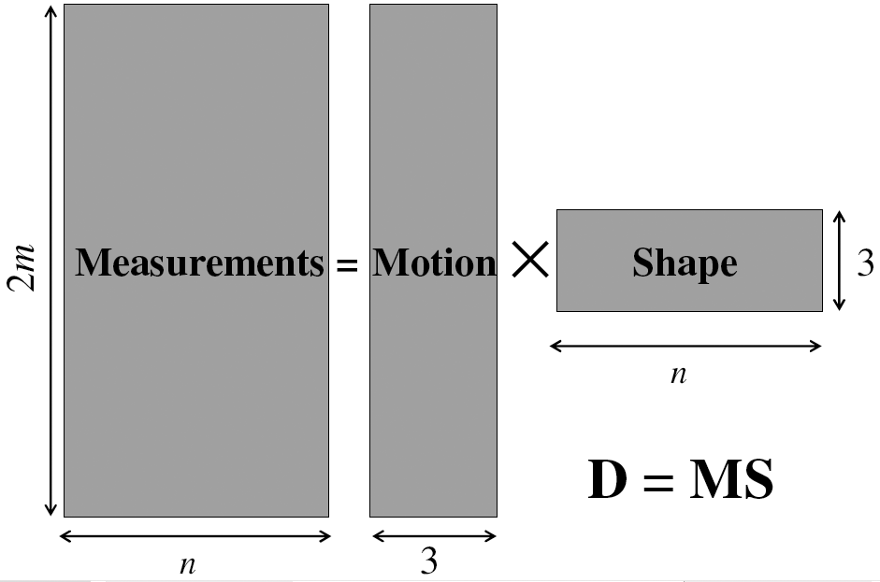
Factorizing the measurement matrix
Source: M. Hebert

Slide 14
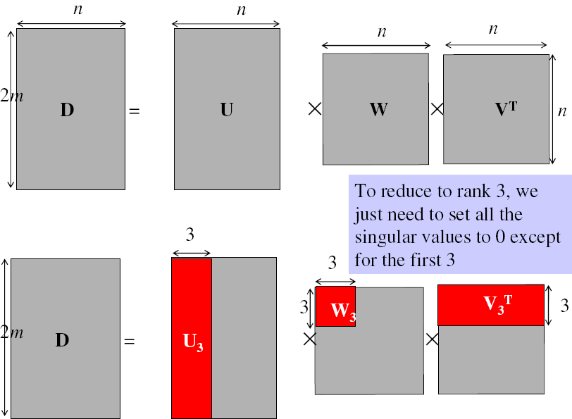
Factorizing the measurement matrix
Singular value decomposition of D:
Source: M. Hebert

Slide 15
Factorizing the measurement matrix
Singular value decomposition of D:
Source: M. Hebert

Slide 16
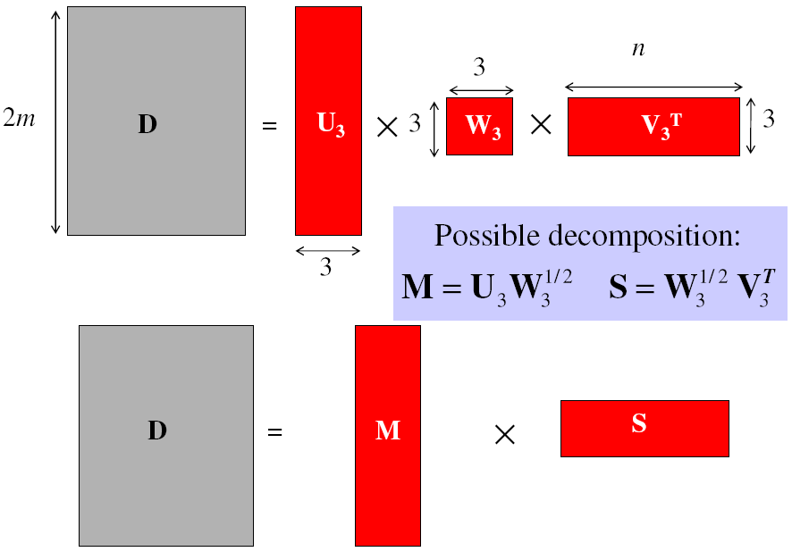
Factorizing the measurement matrix
Obtaining a factorization from SVD:
Source: M. Hebert

Slide 17
Factorizing the measurement matrix
Obtaining a factorization from SVD:
This decomposition minimizes
|D-MS|²
Source: M. Hebert

Slide 18
















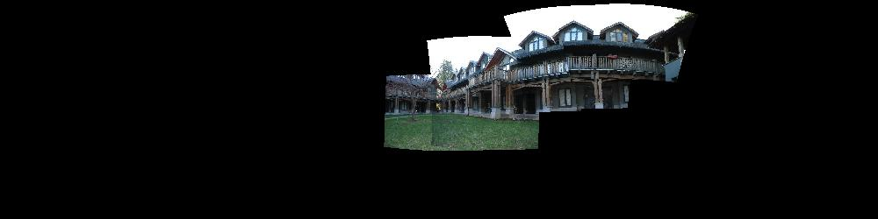
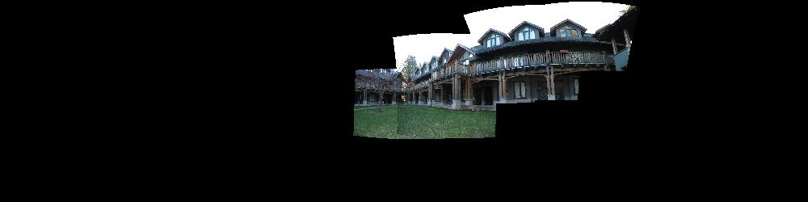
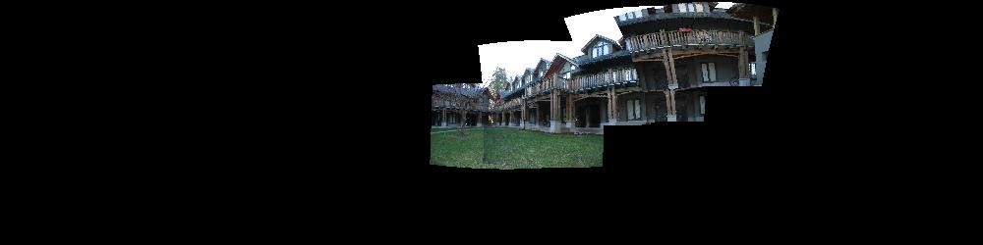
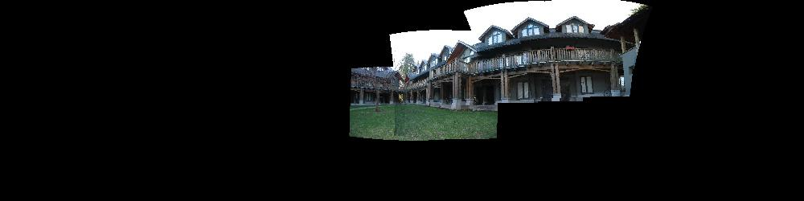
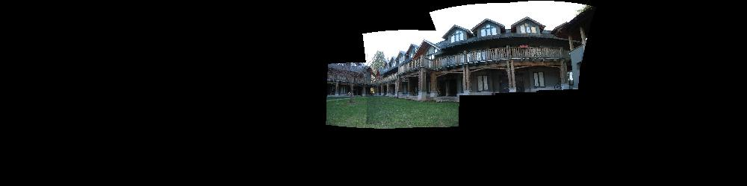
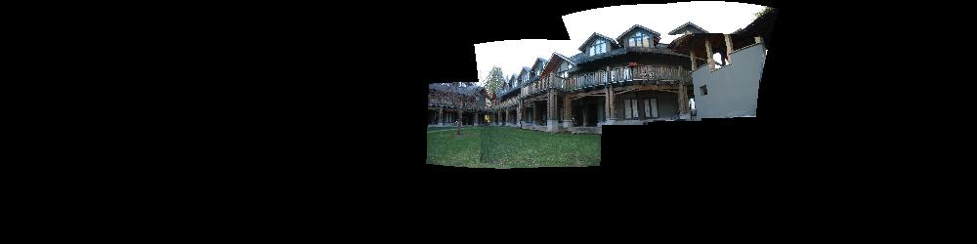
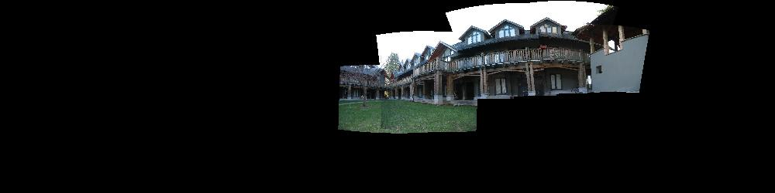

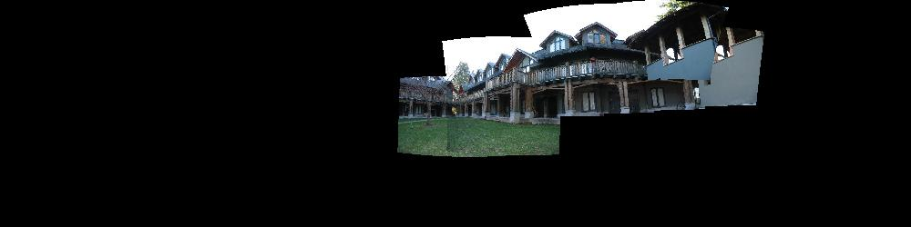
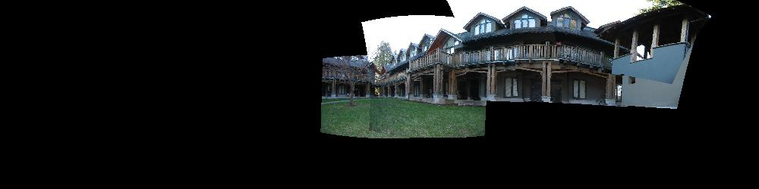
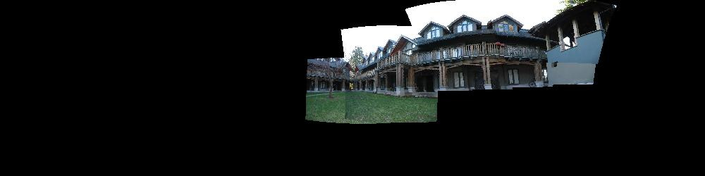
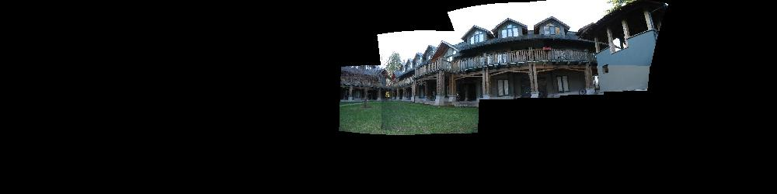
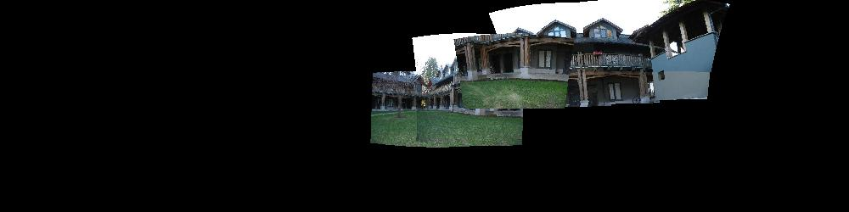
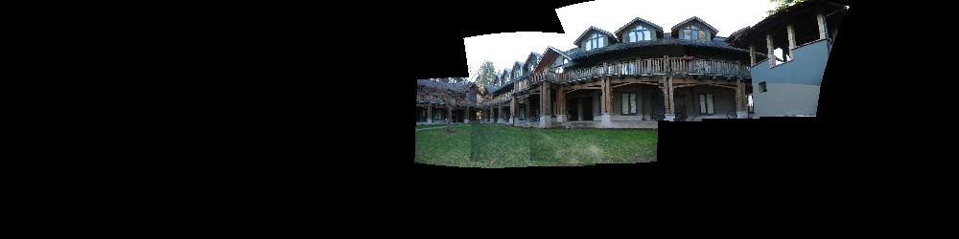
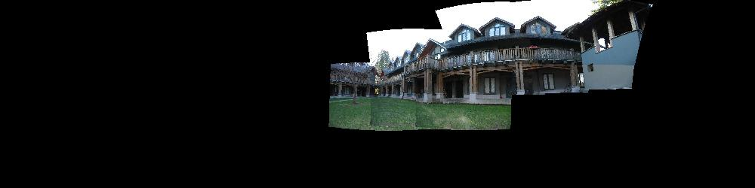
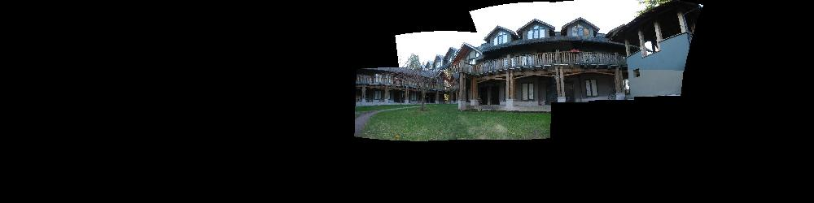
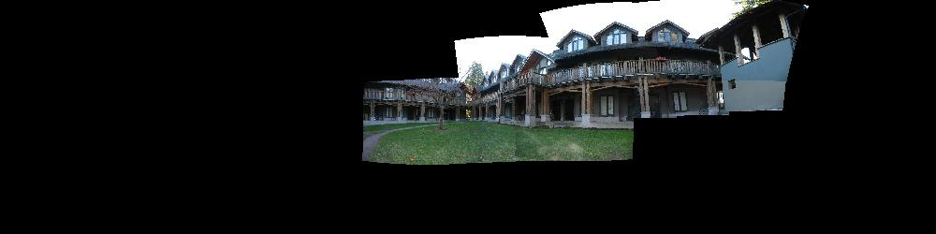
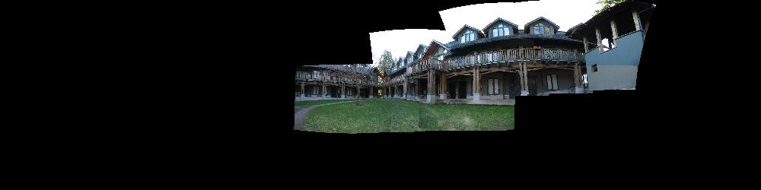
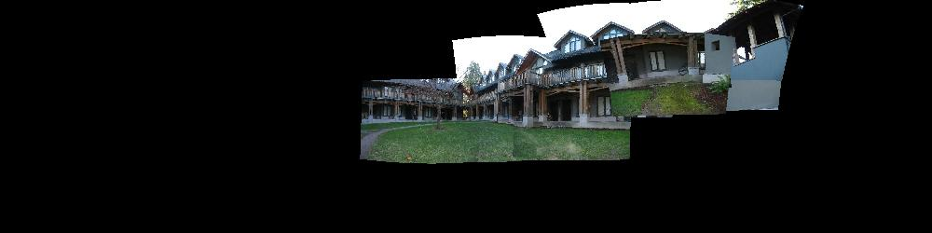
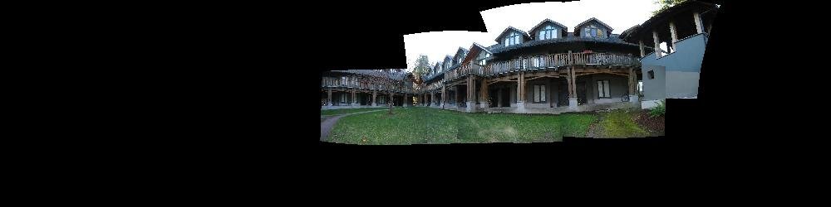

Bundle Adjustment
New images initialised with rotation, focal length of best matching image

Slide 19
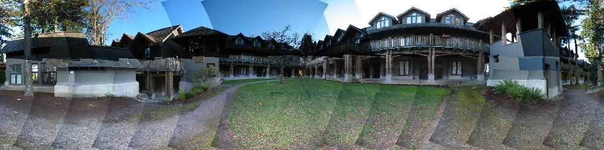
Bundle Adjustment
New images initialised with rotation, focal length of best matching image

Slide 20
Algorithm summary
Given: m images and n features x_{ij}
For each image i, center the feature coordinates
Construct a 2m × n measurement matrix D:
  Column j contains the projection of point j in all views
  Row i contains one coordinate of the projections of all the n points in image i
Factorize D:
  Compute SVD: D = U W V^{T}
  Create U₃ by taking the first 3 columns of U
  Create V₃ by taking the first 3 columns of V
  Create W₃ by taking the upper left 3 × 3 block of W
Create the motion and shape matrices:
  M = U₃W₃^{½} and S = W₃^{½} V₃^{T} (or M = U₃ and S = W₃V₃^{T})
Source: M. Hebert

Slide 21

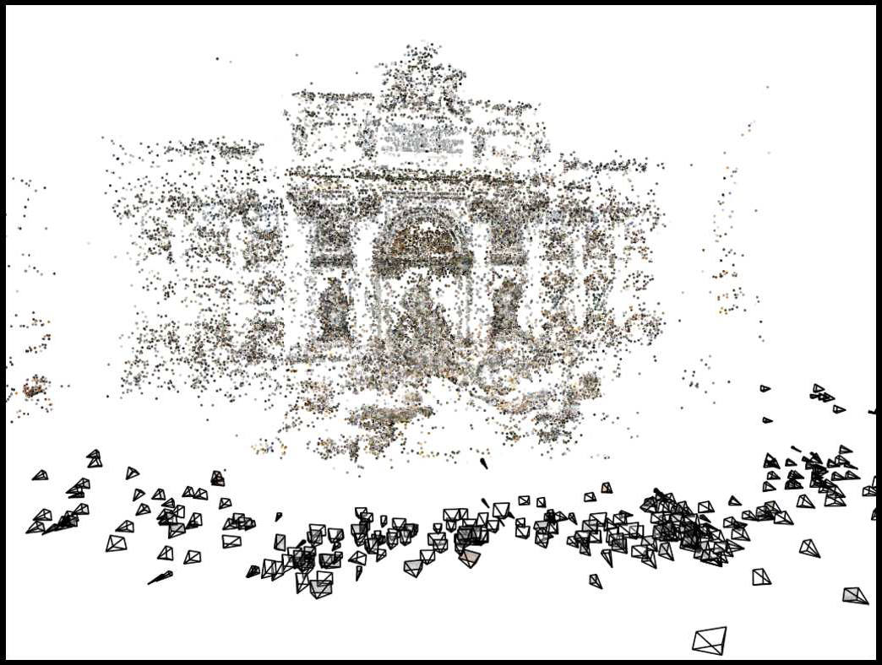
Structure from motion
Images on the Internet
Computed 3D structure

Slide 22
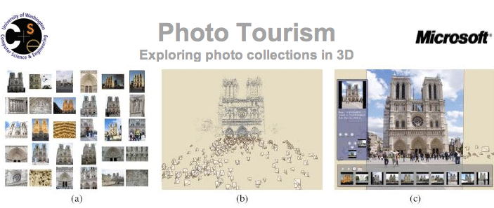
Photo tourism video: http://www.youtube.com/watch?v=5Ji84zb2r8s
Photosynth: http://photosynth.net/

Slide 23
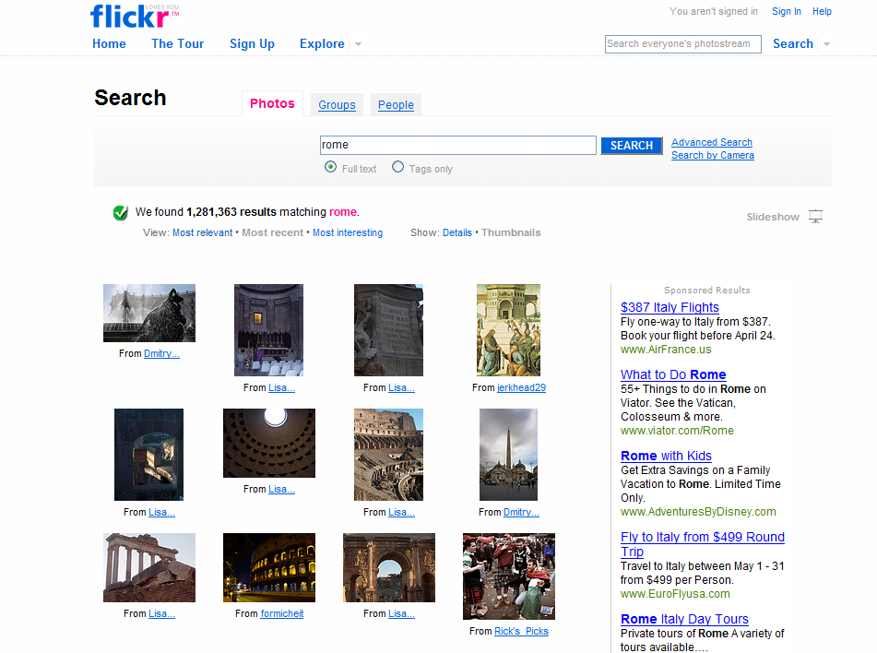

Slide 24
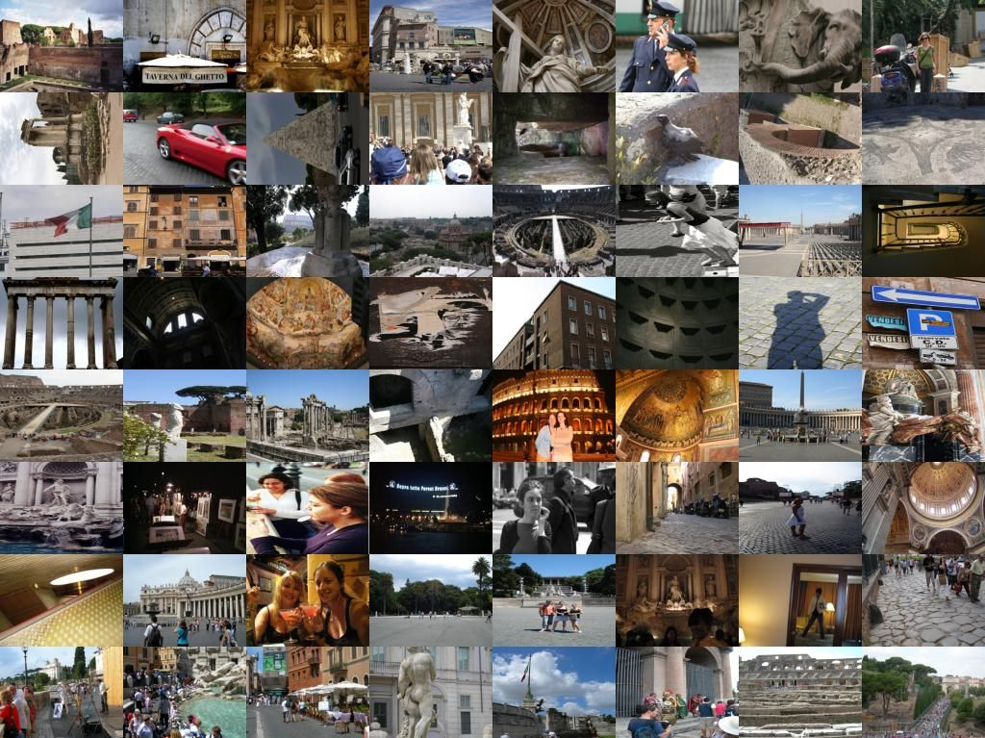


Slide 25
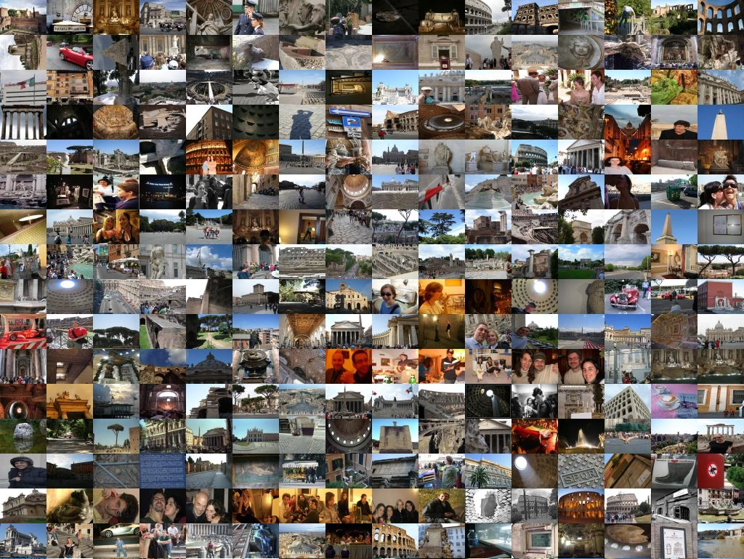


Slide 26
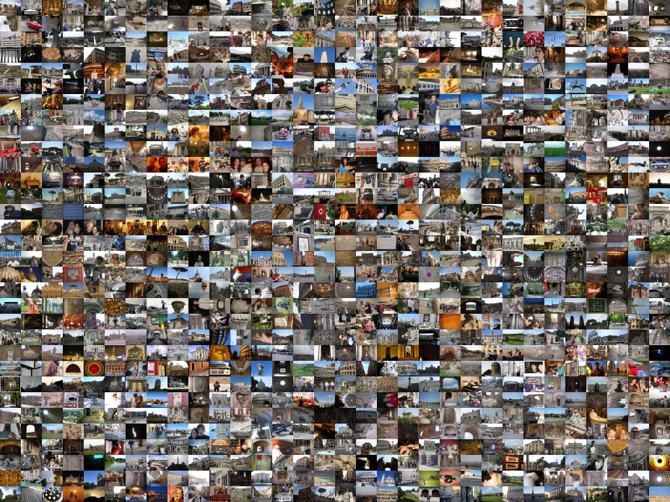


Slide 27
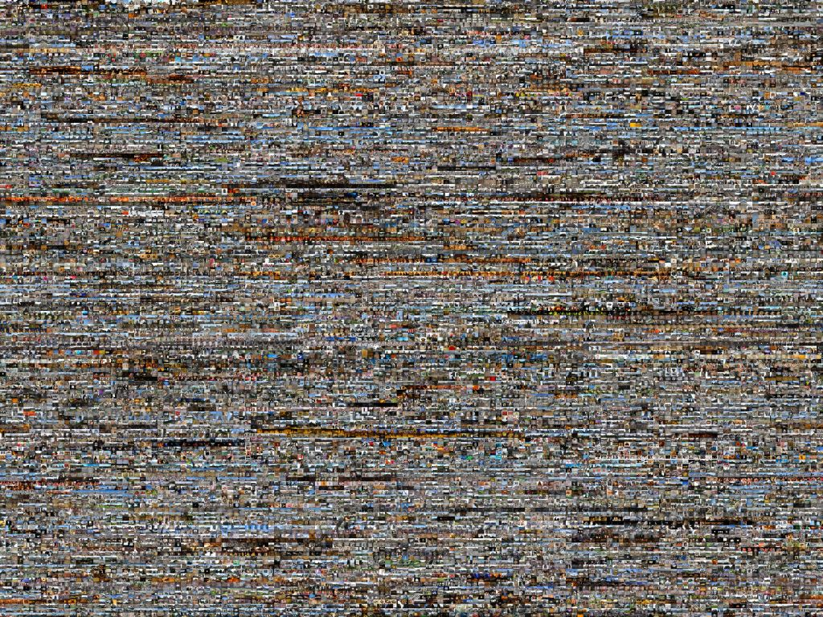


Slide 28
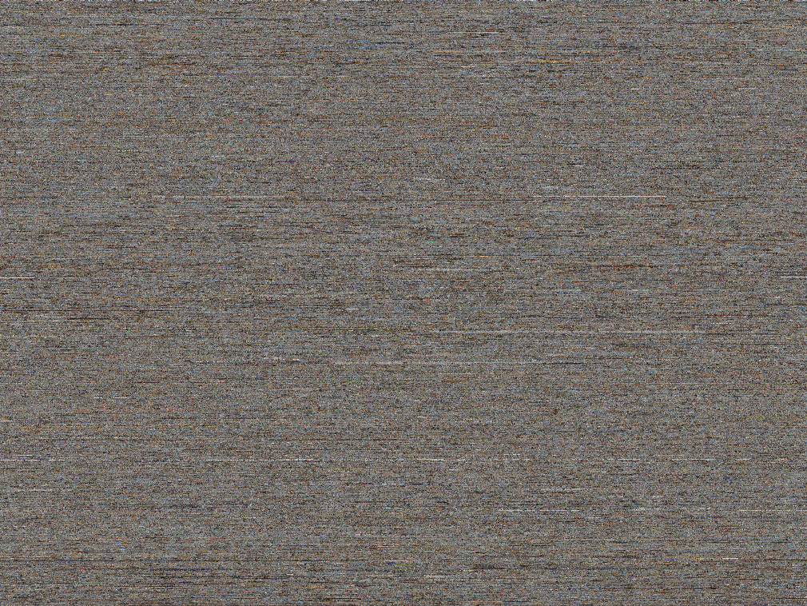

?

Slide 29
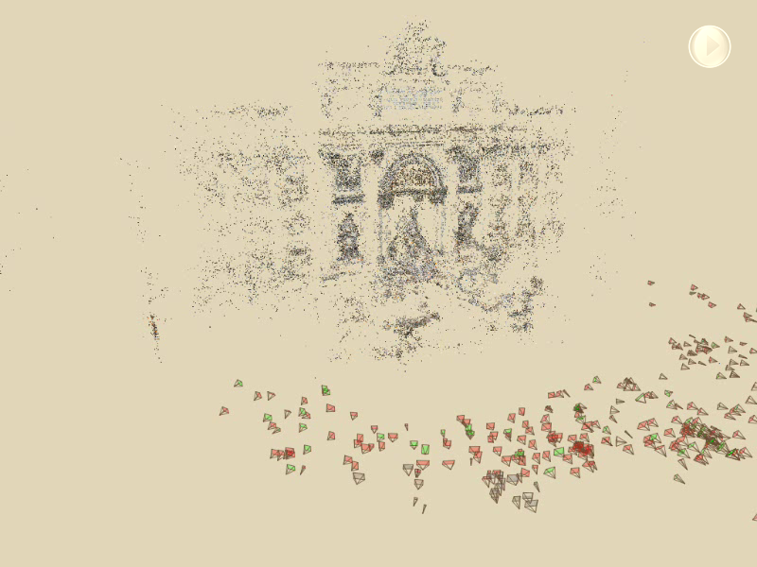

Slide 30
Scene reconstruction
Automatically estimate
  position, orientation, and focal length of cameras
  3D positions of feature points
Feature detection
Incremental structure from motion
Pairwise
feature matching
Correspondence estimation
Notes:
Again, the goal of the reconstruction procedure is to automatically estimate the relative positions and orientations, as well as the focal length or zoom, of each of the photographs in a connected component of the scene. The process consists of four steps: detecting features in each of the input photos; matching features between each pair of photos; grouping the matches into correspondences across multiple photos; and using the correspondences to estimate the geometry of the scene and the cameras in a technique known as structure from motion.
I’ll now describe each of these steps in more detail.
[Structure from motion techniques for unordered image collections have also been developed by others, such as Brown and Lowe and Schaffalitzky and Zisserman, and the basic pipeline of our system closely follows that of Brown and Lowe. To our knowledge, our system is the first to have been demonstrated on large collections of photos from the Internet.]

Slide 31
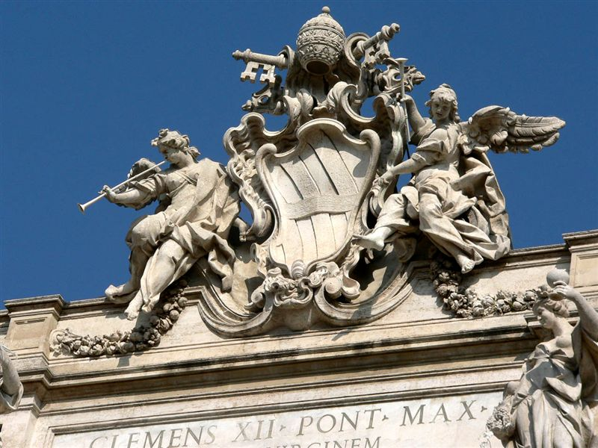
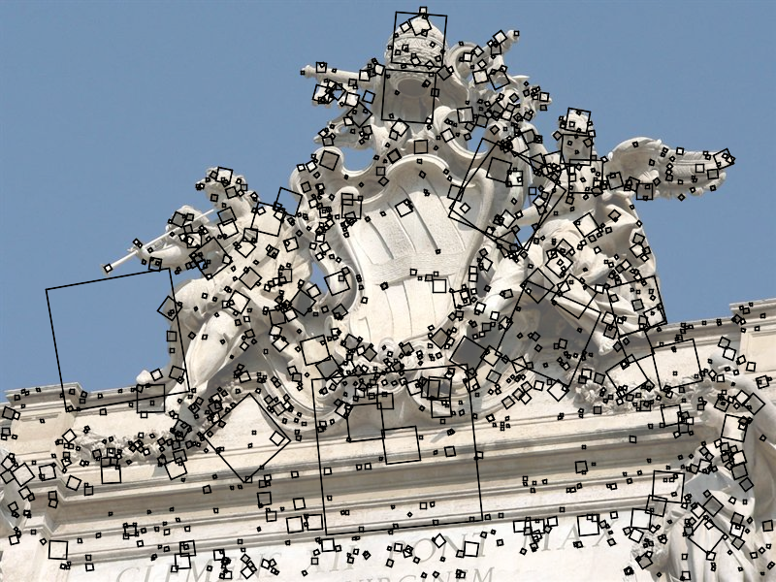
Feature detection
Detect features using SIFT [Lowe, IJCV 2004]
Notes:
The core of the reconstruction process is the ability to reliably match feature points between images. Fortunately, over the last few years feature detection and matching techniques have improved dramatically. Many different technique exist – we use SIFT, or scale-invariant feature transform, developed by David Lowe. SIFT is designed to be invariant to image scale and rotation, as well as affine changes in image intensity.
Here is an image from the Trevi Fountain, and here are the features SIFT detects in the image, shown as square patches. The squares are scaled and rotated to reflect the scale and orientation of the features.

Slide 32
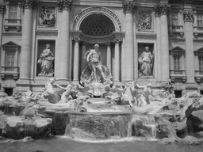
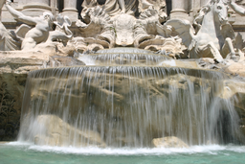
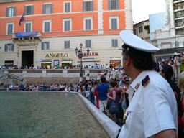
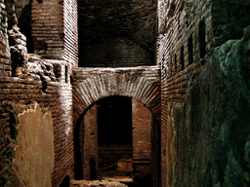












Feature detection
Detect features using SIFT [Lowe, IJCV 2004]
Notes:
So, we begin by detecting SIFT features in each photo.
[We detect SIFT features in each photo, resulting in a set of feature locations and 128-byte feature descriptors…]

Slide 33
Feature detection
Detect features using SIFT [Lowe, IJCV 2004]

Slide 34


Correspondence estimation
Link up pairwise matches to form connected components of matches across several images
Image 1
Image 2
Image 3
Image 4
Notes:
The next step of our reconstruction algorithm is to link up matches between pairs of images into correspondences between multiple images, by finding connected components of matches. Suppose among these images, these features are matched only between consecutive pairs of images, perhaps because the scales of the images are so different. During correspondence estimation we link these matches and consider them to be 2D projections of a single 3D point in the scene.

Slide 35
Feature matching
Match features between each pair of images
Notes:
Next, we match features across each pair of photos using approximate nearest neighbor matching.

Slide 36
Feature matching
Refine matching using RANSAC [Fischler & Bolles 1987]
Notes:
The matches are refined by using RANSAC, which is a robust model-fitting technique, to estimate a fundamental matrix between each pair of matching images and keeping only matches consistent with that fundamental matrix.
We then link connected components of pairwise feature matches together to form correspondences across multiple images.
Once we have correspondences, we run structure from motion to recover the camera and scene geometry. Structure from motion solves the following problem:

Slide 37
Incremental structure from motion
Notes:
To help get good initializations for all of the parameters of the system, we reconstruct the scene incrementally, starting from two photographs and the points they observe.

Slide 38

Incremental structure from motion
Notes:
We then add several photos at a time to the reconstruction, refine the model, and repeat until no more photos match any points in the scene.

Slide 39

Photo Explorer

Slide 40

Coliseum
(outside)
St. Peters (inside)
Coliseum
(inside)
St. Peters (outside)
Il Vittoriano
Trevi Fountain
Forum

Slide 41

Navigation: Prague Old Town Square
Notes:
Now we’ll move on to another dataset to demonstrate some more of the navigation features of our system.
This is a reconstruction of the Old Town Square in Prague from about 200 photos, shown inside our photo explorer. An overhead map is shown in the upper right corner.
For this dataset, we render the scene using 3D line segments and add color to the scene by projecting blurred, partially transparent versions of the photos onto detected planes.
The user can select photos from the map, and the map tracks the movement of the virtual camera. Here the user selects a building to see a better picture.
Now here’s another example of relation-based browsing – the user can click on the “move right” button to move right to the next building in the row of façades.
Now the user clicks on the zoom out button to see more of the scene.

Slide 42

Hierarchical annotations

Slide 43

Locking the camera (stabilization)

Slide 44
Skeletal set
Goal: select a smaller set of images to reconstruct, without sacrificing quality of reconstruction
Two problems:
  How do we measure quality?
  How do we find a subset of images with bounded quality loss?

Slide 45

Skeletal set
Goal: given an image graph ,
select a small set S of important images to reconstruct, bounding the loss in quality of the reconstruction
Reconstruct the skeletal set S
Estimate the remaining images with much faster pose estimation steps

Slide 46




Properties of the skeletal set
Should touch all parts of
  Dominating set
Should form a single reconstruction
  Connected dominating set
Should result in an accurate reconstruction
?

Slide 47



Example
Full graph
Skeletal graph

Slide 48



Representing information in a graph
What kind of information?
  No absolute information about camera positions
  Each edge provides information about the relative positions of two images
  … but not all edges are equally informative
We model information with the uncertainty (covariance) in pairwise camera positions

Slide 49
Estimating certainty
Usually measured with covariance matrix
SfM has thousands or millions of parameters
We only measure covariance in camera positions (3x3 matrix for every camera)

Slide 50


Pantheon
Full graph
Skeletal graph (t=16)

Slide 51



Pantheon
Skeletal reconstruction
101 images
After adding leaves
579 images
After final optimization
579 images

Slide 52


Trafalgar Square
2973 images registered (277 in skeletal set)

Slide 53


Trafalgar Square

Slide 54

Results: Dubrovnik

Slide 55


Slide 56
Applications

Slide 57



Community photo collections
“Wikipedia for photos” – visual record of world through community of photographers
  Geograph British Isles http://www.geograph.org.uk/
Users can tag and comment on photos, link to other content
  World-wide telescope
“Where should I take a photo?”
  http://photocitygame.com/

Slide 58


Community photo collections
Leveraging large databases of photos, large number of users
  Annotations / augmented reality

Slide 59







Virtual tour guide scenario
St. Peter’s Basilica
Built: 1506-1626
http://en.wikipedia.org/wiki/St._Peter's_Basilica
St. Peter’s Basilica
Built: 1506-1626

Slide 60




Rephotography
Topographic data courtesy USGS

Slide 61





Internet Computer Vision

Slide 62



Summary
Large (Internet) photo collections: the next frontier in computer vision
Efficient algorithms for large-scale 3D matching and reconstruction
New challenges for 3D recognition

