Slide 1
Recognition II
Ali Farhadi

Slide 2
We have talked about
Nearest Neighbor
Naïve Bayes
Logistic Regression
Boosting

Slide 3
Support Vector Machines

Slide 4
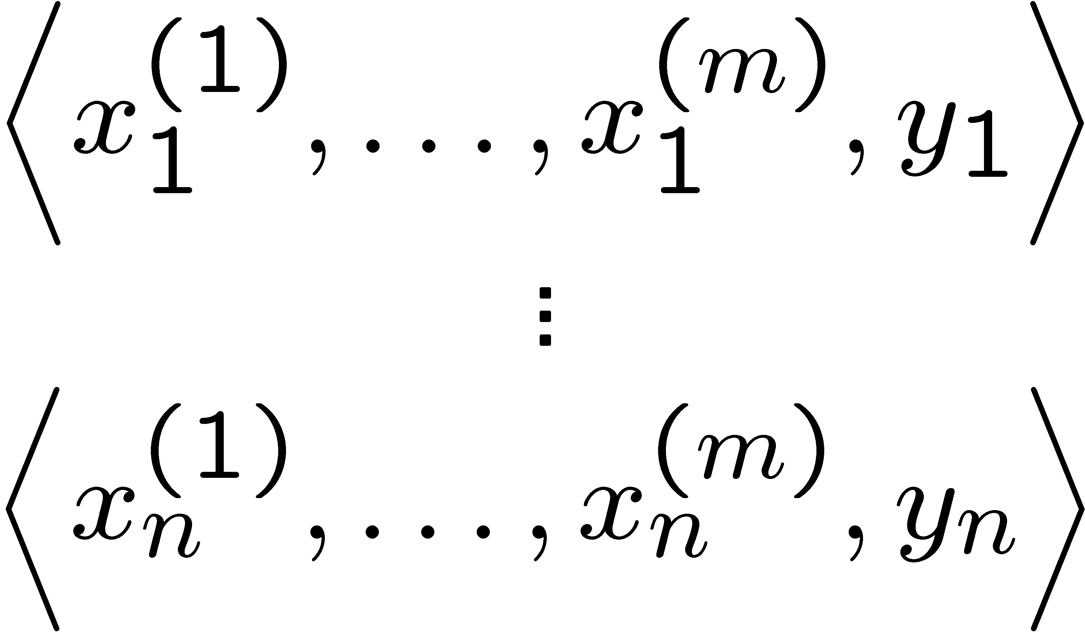
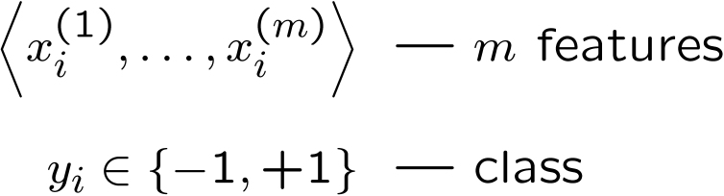
Linear classifiers – Which line is better?
w. = ∑_{j} w^{(j)} x^{(j)}
Data
Example i
Notes:
(1) perceptron, (2) minize weights, (3) max margin

Slide 5
Pick the one with the largest margin!
Margin: measures height of w.x+b plane at each point, increases with distance
w.x + b >> 0
w.x + b > 0
w.x + b = 0
w.x + b < 0
w.x + b << 0
γ
γ
γ
Max Margin: two equivalent forms
γ
(1)
(2)
w.x = ∑_{j} w^{(j)} x^{(j)}

Slide 6
How many possible solutions?
w.x + b = 0
Any other ways of writing the same dividing line?
w.x + b = 0
2w.x + 2b = 0
1000w.x + 1000b = 0
….
Any constant scaling has the same intersection with z=0 plane, so same dividing line!
Do we really want to max _{γ,w,b}?

Slide 7
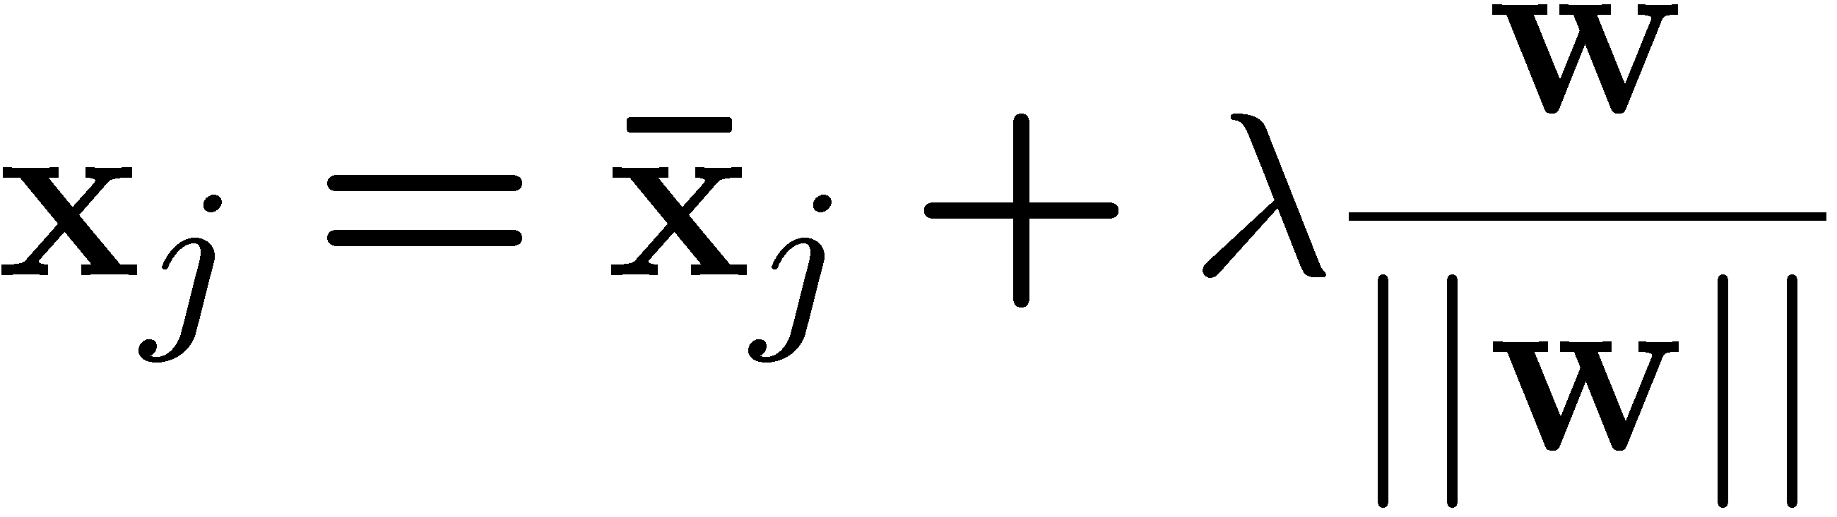
Review: Normal to a plane
w.x + b = 0
Key Terms
-- projection of x_{j} onto w
-- unit vector normal to w

Slide 8
Idea: constrained margin
Generally:
w.x + b = +1
w.x + b = 0
w.x + b = -1
Assume: x⁺ on positive line, x⁻ on negative
γ
x⁺
x⁻
Final result: can maximize constrained margin by minimizing ||w||₂!!!

Slide 9
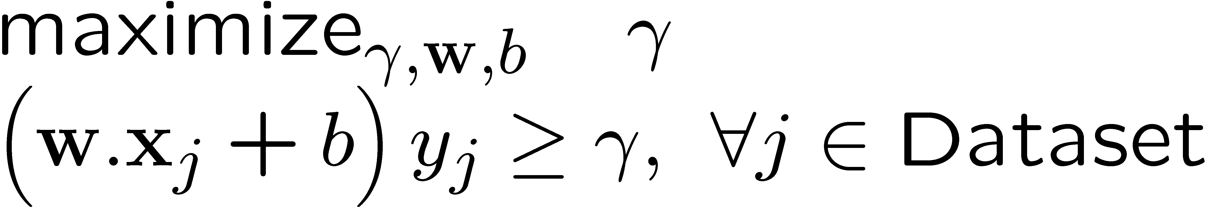
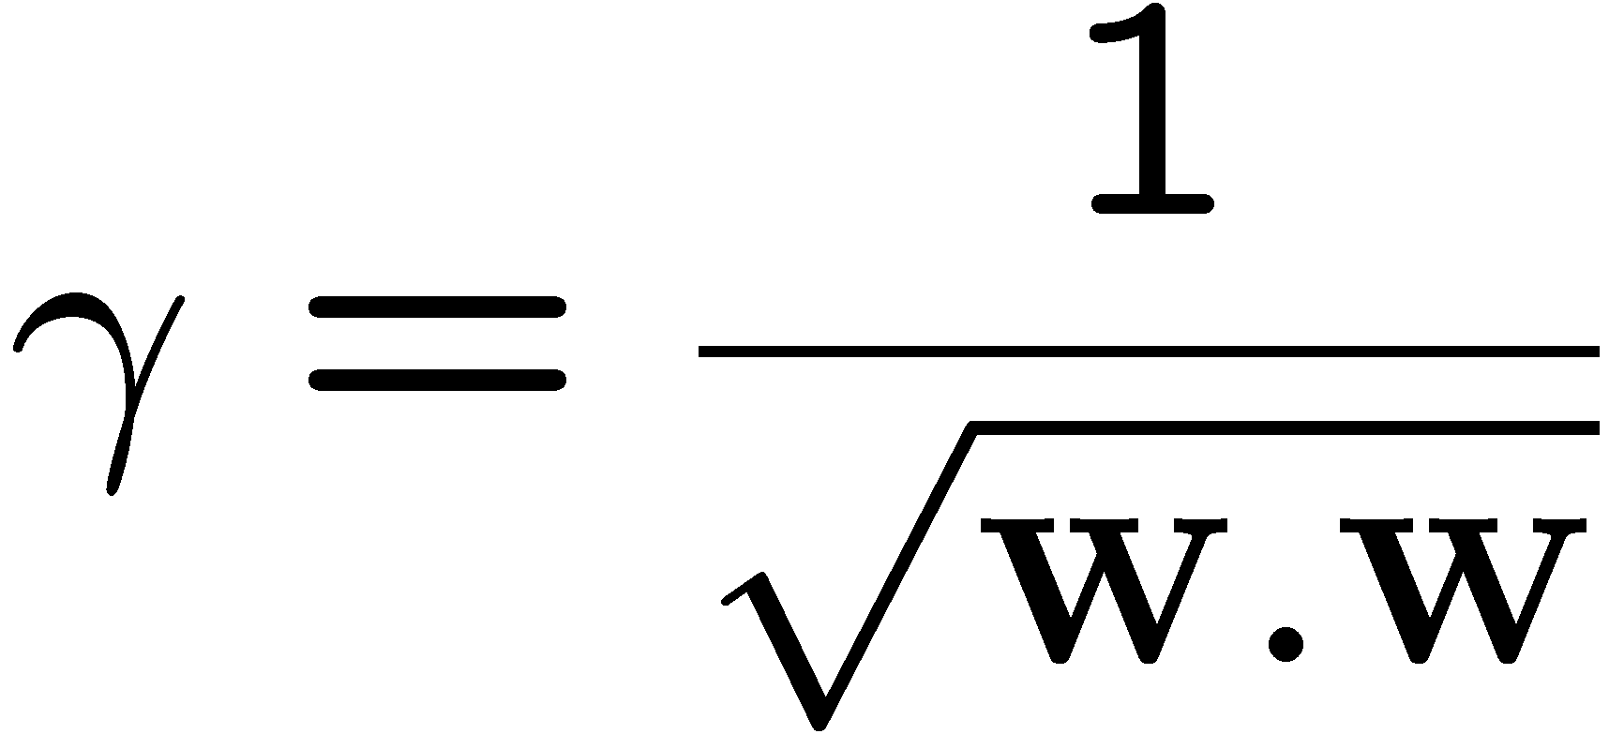
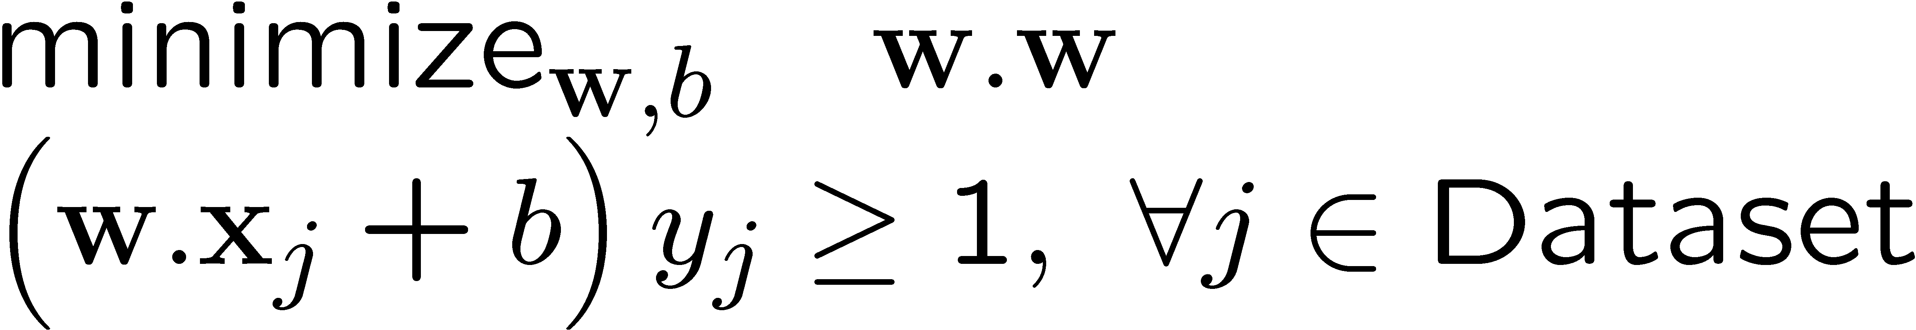
Max margin using canonical hyperplanes
w.x + b = +1
w.x + b = 0
w.x + b = -1
γ
x⁺
x⁻
The assumption of canonical hyperplanes (at +1 and -1) changes the objective and the constraints!

Slide 10
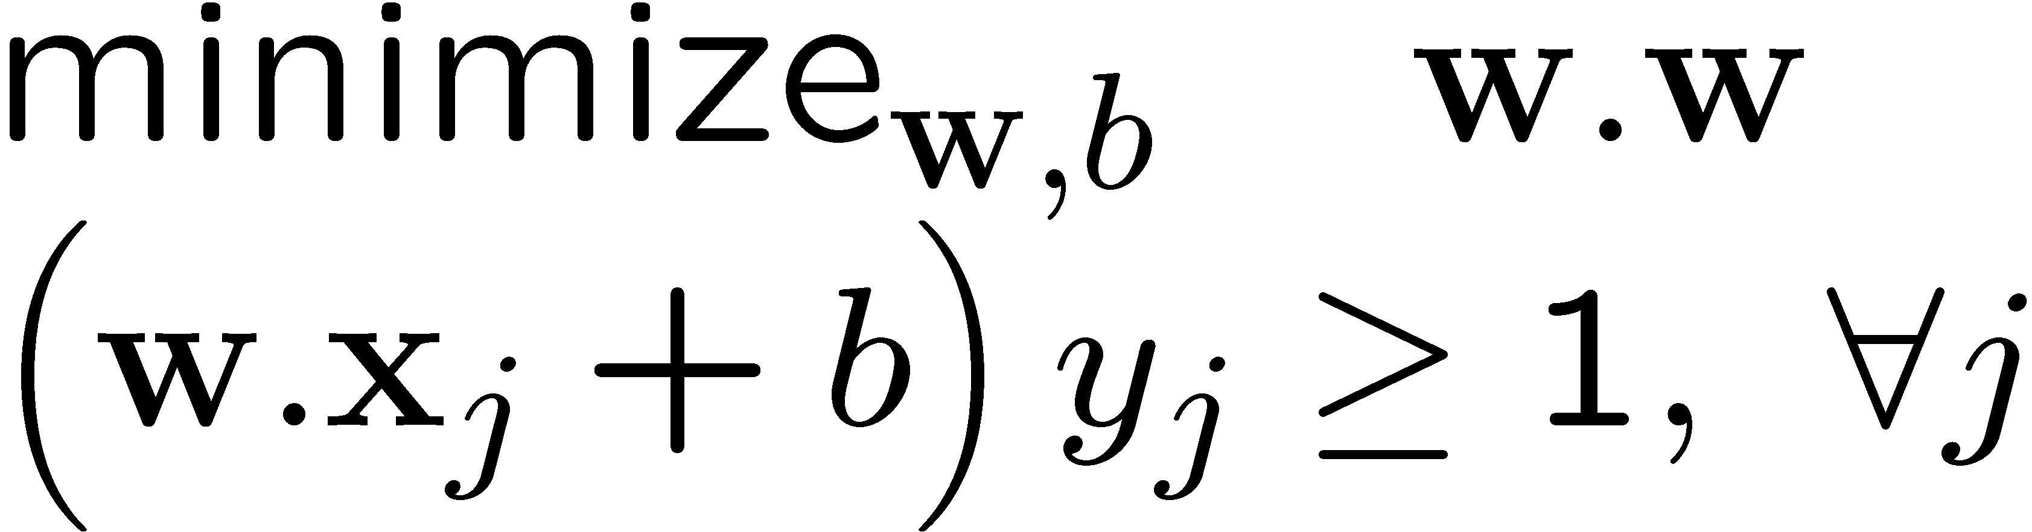
Support vector machines (SVMs)
w.x + b = +1
w.x + b = 0
w.x + b = -1
Solve efficiently by quadratic programming (QP)
  Well-studied solution algorithms
  Not simple gradient ascent, but close
Hyperplane defined by support vectors
  Could use them as a lower-dimension basis to write down line, although we haven’t seen how yet
  More on this later
margin 2γ
Non-support Vectors:
everything else
moving them will not change w
Support Vectors:
data points on the canonical lines

Slide 11
What if the data is not linearly separable?
Add More Features!!!
What about overfitting?

Slide 12
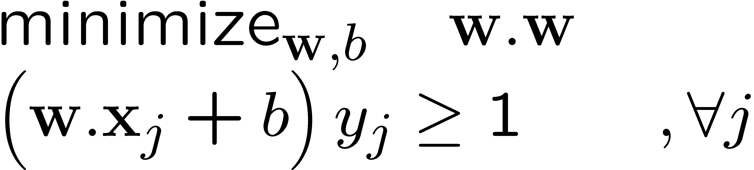
What if the data is still not linearly separable?
+ C #(mistakes)
First Idea: Jointly minimize w.w and number of training mistakes
  How to tradeoff two criteria?
  Pick C on development / cross validation
Tradeoff #(mistakes) and w.w
  0/1 loss
  Not QP anymore
  Also doesn’t distinguish near misses and really bad mistakes
  NP hard to find optimal solution!!!

Slide 13
Slack variables – Hinge loss
+ C Σ_{j} ξ_{j}
w.x + b = +1
w.x + b = 0
w.x + b = -1
- ξ_{j}
ξ_{j}≥0
ξ
ξ
Slack Penalty C > 0:
C=∞ → have to separate the data!
C=0 → ignore data entirely!
Select on dev. set, etc.
ξ
ξ
For each data point:
If margin ≥ 1, don’t care
If margin < 1, pay linear penalty

Slide 14
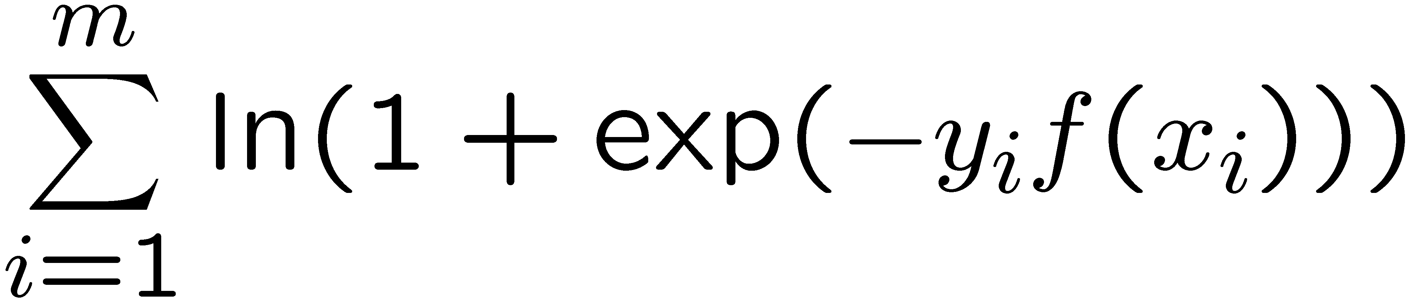
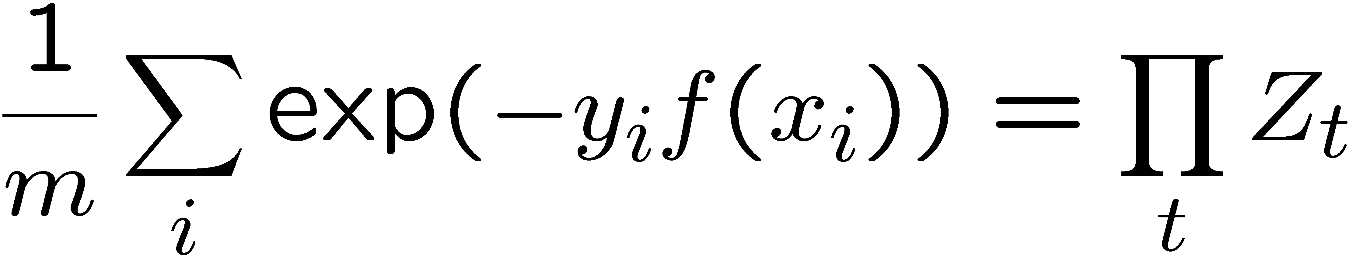
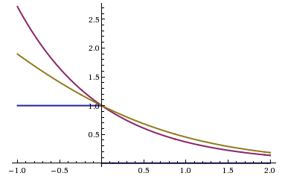
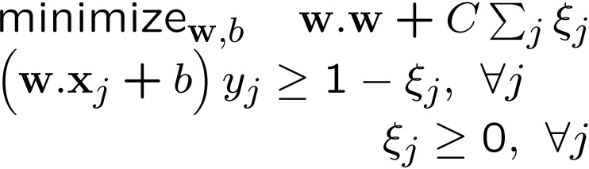
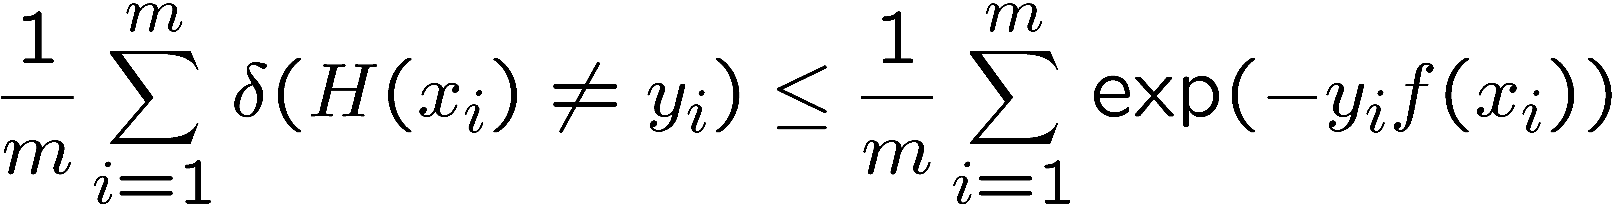
Side Note: Different Losses
Logistic regression:
Boosting :
SVM:
Hinge loss:
0-1 Loss:
All our new losses approximate 0/1 loss!
Notes:
Hinge loss can lead to sparse solutions!!!!

Slide 15
What about multiple classes?

Slide 16
One against All
w₊
Learn 3 classifiers:
+ vs {0,-}, weights w₊
- vs {0,+}, weights w₋
0 vs {+,-}, weights w₀
Output for x:
y = argmax_{i} w_{i}.x
w₋
w₀
Any other way?
Any problems?
Notes:
Could we learn lines above? Yes, but would require slack vairables?

Slide 17
Learn 1 classifier: Multiclass SVM
w₊
Simultaneously learn 3 sets of weights:
How do we guarantee the correct labels?
Need new constraints!
w₋
w₀
For j possible classes:
Notes:
Could we learn lines above? Currently, no slack variables…

Slide 18
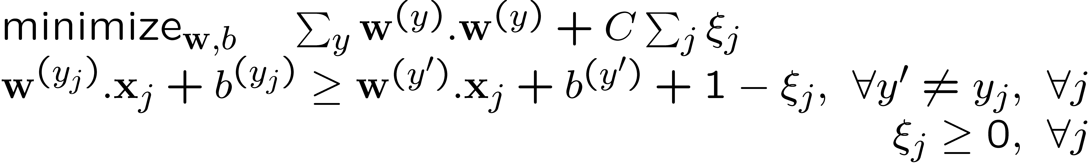
Learn 1 classifier: Multiclass SVM
Also, can introduce slack variables, as before:

Slide 19
What if the data is not linearly separable?
Add More Features!!!

Slide 20
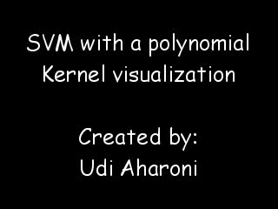

Slide 21
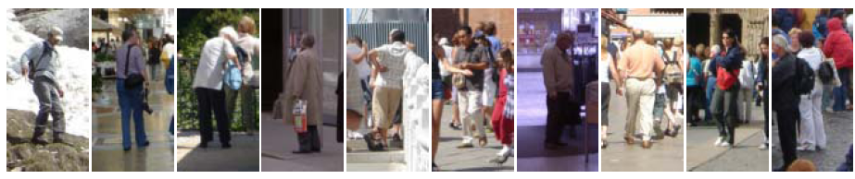
Example: Dalal-Triggs pedestrian detector
Extract fixed-sized (64x128 pixel) window at each position and scale
Compute HOG (histogram of gradient) features within each window
Score the window with a linear SVM classifier
Perform non-maxima suppression to remove overlapping detections with lower scores
Navneet Dalal and Bill Triggs, Histograms of Oriented Gradients for Human Detection, CVPR05

Slide 22
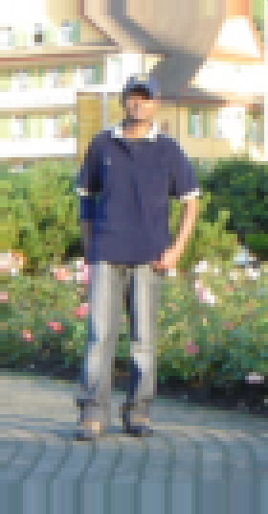
Slides by Pete Barnum
Navneet Dalal and Bill Triggs, Histograms of Oriented Gradients for Human Detection, CVPR05

Slide 23
Tested with
  RGB
  LAB
  Grayscale
Slightly better performance vs. grayscale

Slide 24
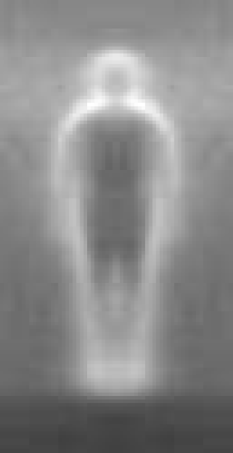

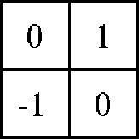

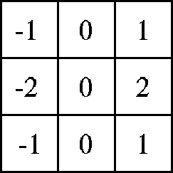

Outperforms
centered
diagonal
uncentered
cubic-corrected
Sobel
Slides by Pete Barnum
Navneet Dalal and Bill Triggs, Histograms of Oriented Gradients for Human Detection, CVPR05

Slide 25

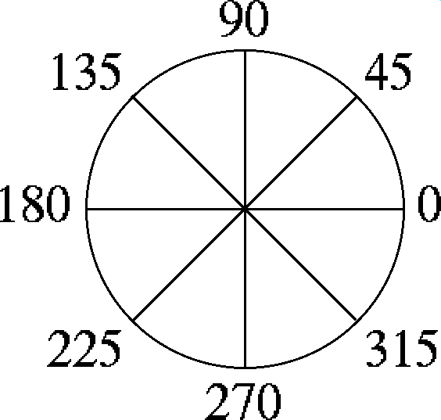
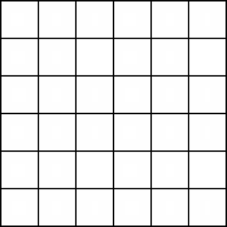
Histogram of gradient orientations
  Votes weighted by magnitude
  Bilinear interpolation between cells
Orientation: 9 bins (for unsigned angles)
Histograms in 8x8 pixel cells
Slides by Pete Barnum
Navneet Dalal and Bill Triggs, Histograms of Oriented Gradients for Human Detection, CVPR05

Slide 26
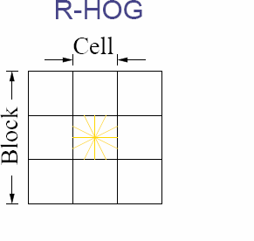
Normalize with respect to surrounding cells
Slides by Pete Barnum
Navneet Dalal and Bill Triggs, Histograms of Oriented Gradients for Human Detection, CVPR05

Slide 27
# orientations
# features = 15 x 7 x 9 x 4 = 3780
X=
# cells
# normalizations by neighboring cells
Slides by Pete Barnum
Navneet Dalal and Bill Triggs, Histograms of Oriented Gradients for Human Detection, CVPR05

Slide 28
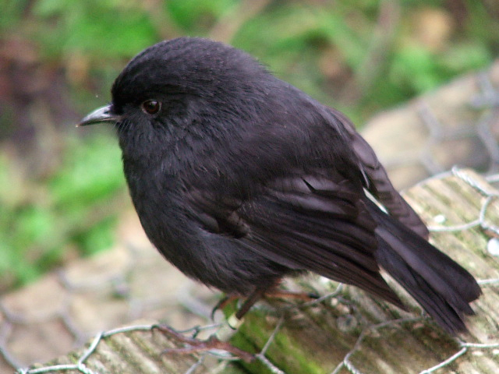
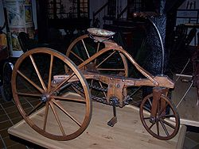
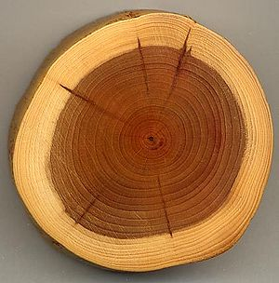
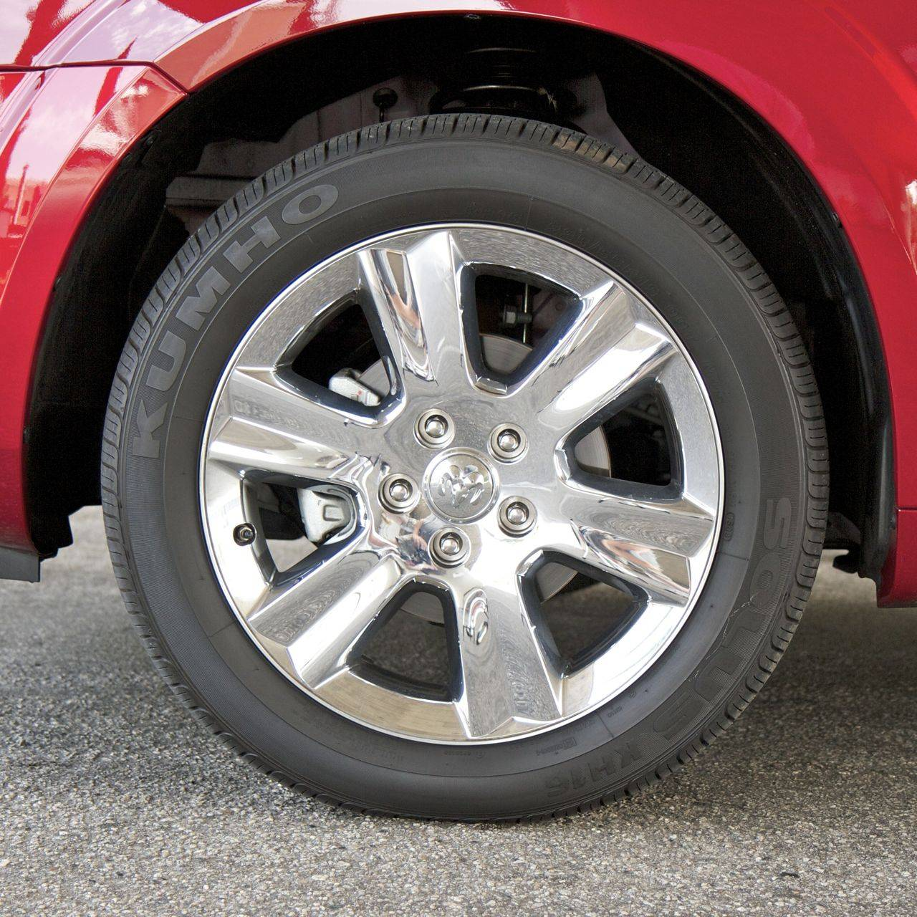
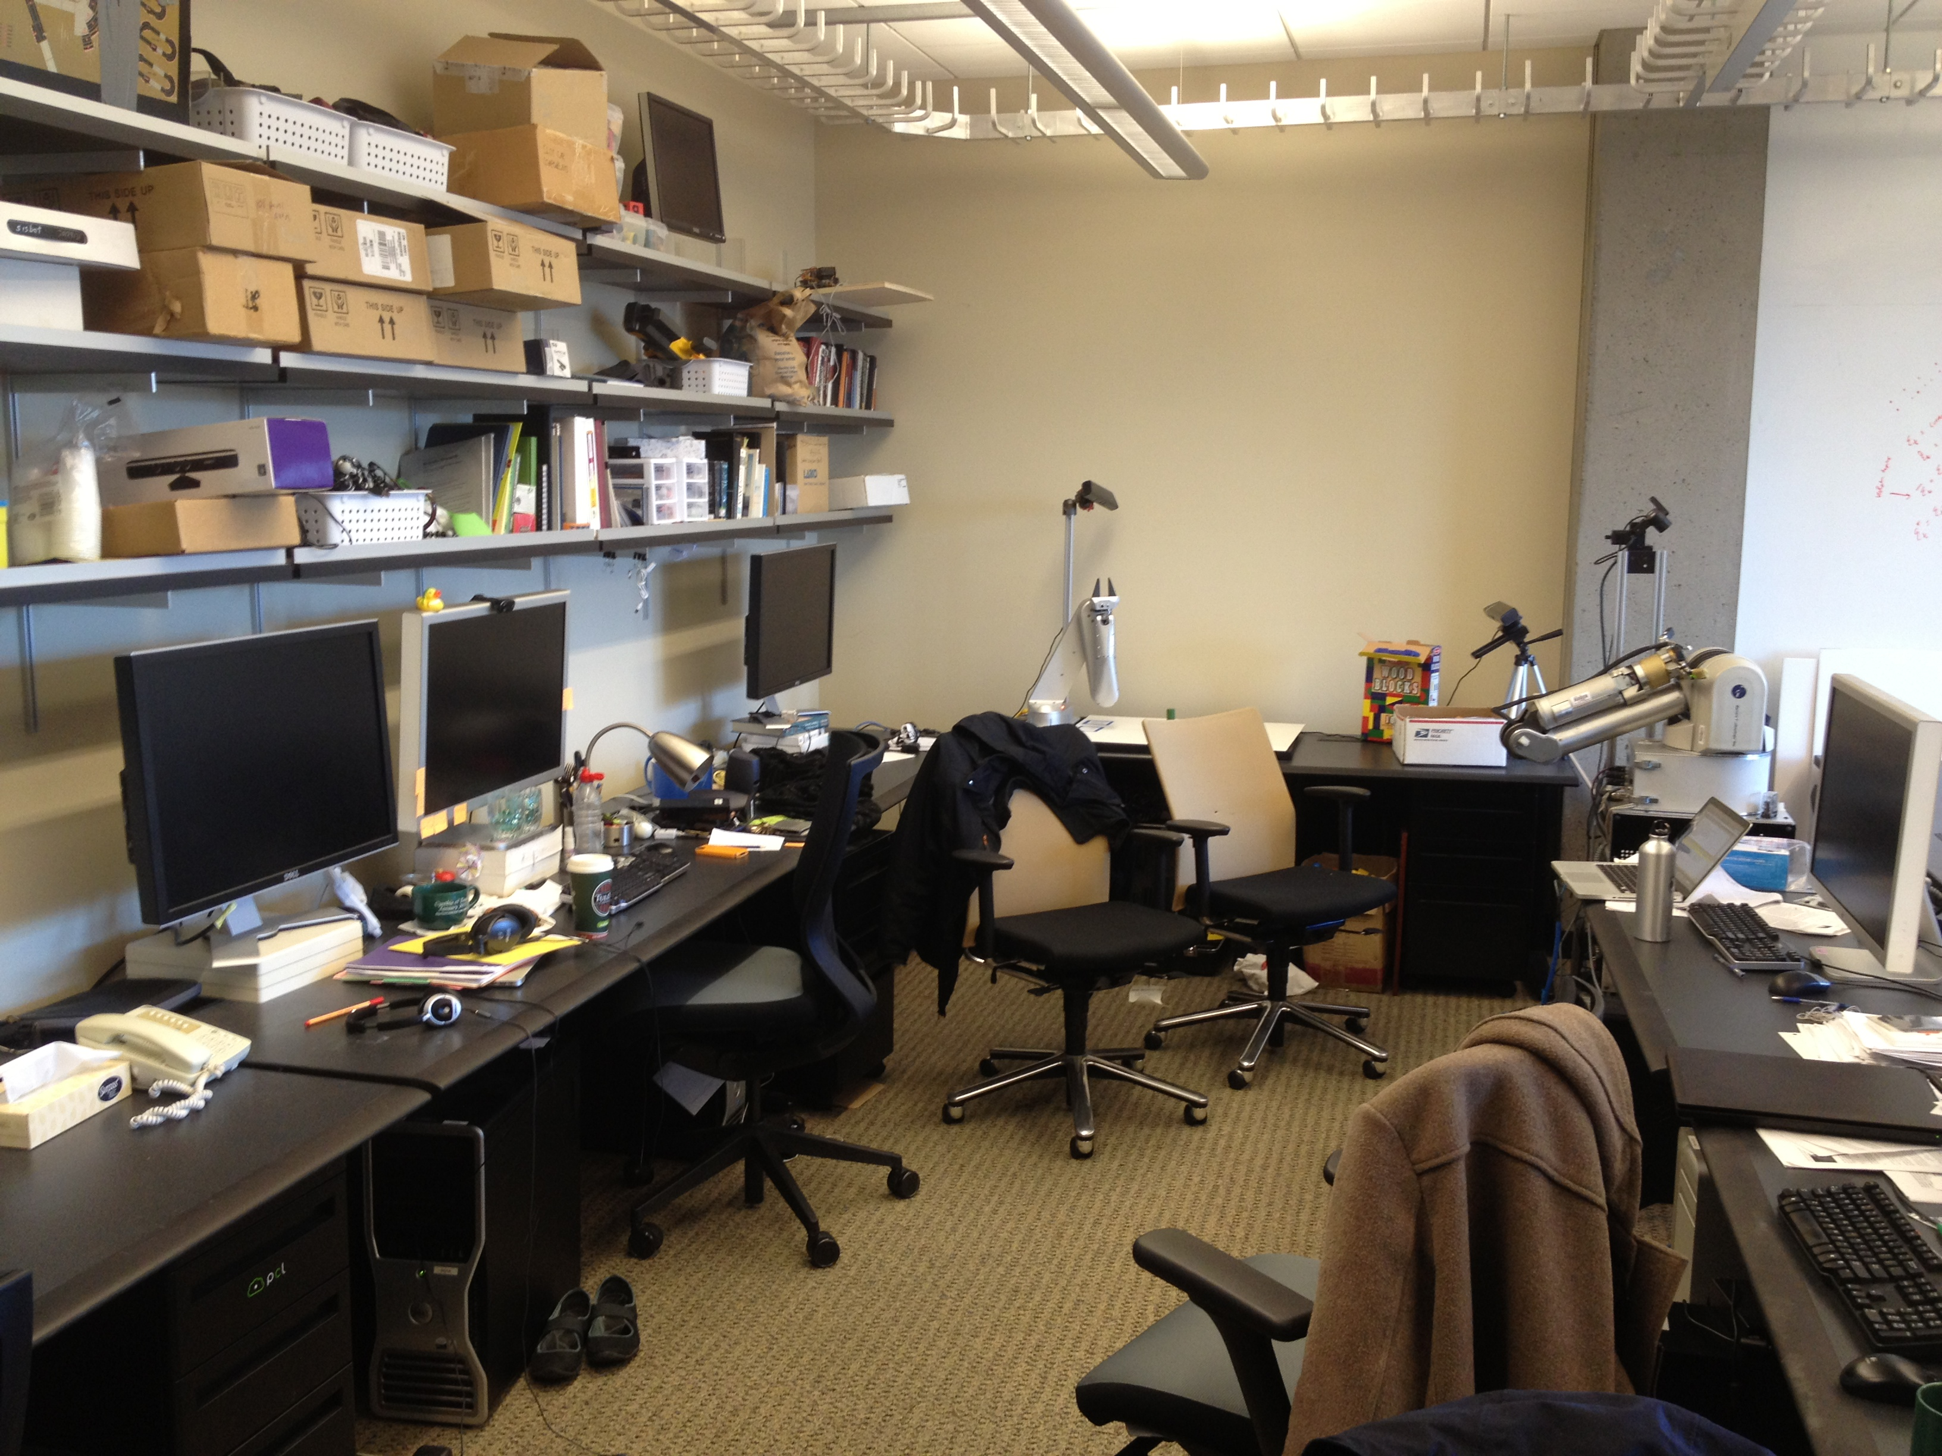
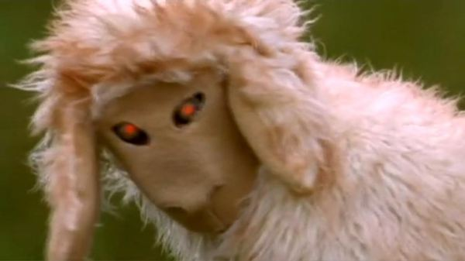
Training set

Slide 29
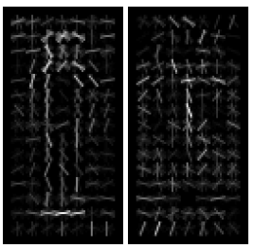
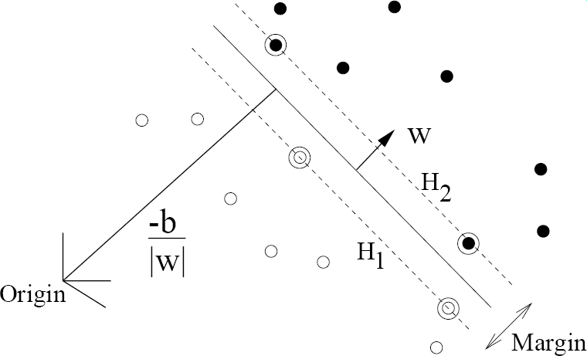
pos w
neg w
Slides by Pete Barnum
Navneet Dalal and Bill Triggs, Histograms of Oriented Gradients for Human Detection, CVPR05

Slide 30
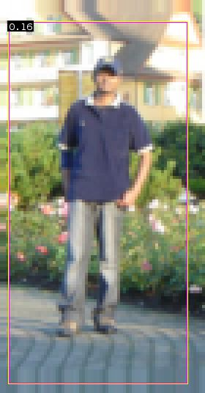


pedestrian
Slides by Pete Barnum
Navneet Dalal and Bill Triggs, Histograms of Oriented Gradients for Human Detection, CVPR05

Slide 31
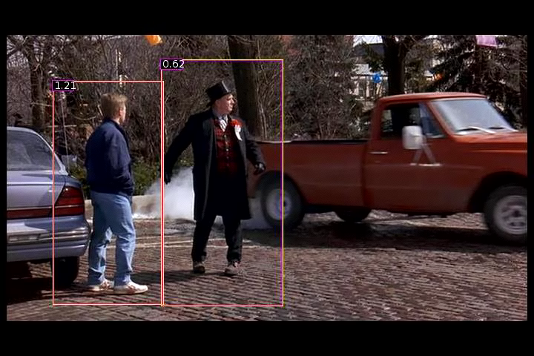
Detection examples

Slide 32


Slide 33

Each window is separately classified

Slide 35
Statistical Template
Object model = sum of scores of features at fixed positions
?
+3
+2
-2
-1
-2.5
= -0.5
> 7.5
Non-object
?
+4
+1
+0.5
+3
+0.5
= 10.5
> 7.5
Object

Slide 36
Part Based Models
Before that:
  Clustering

