Slide 1
Edge Detection
CSE P 576
Larry Zitnick (larryz@microsoft.com)

Slide 2
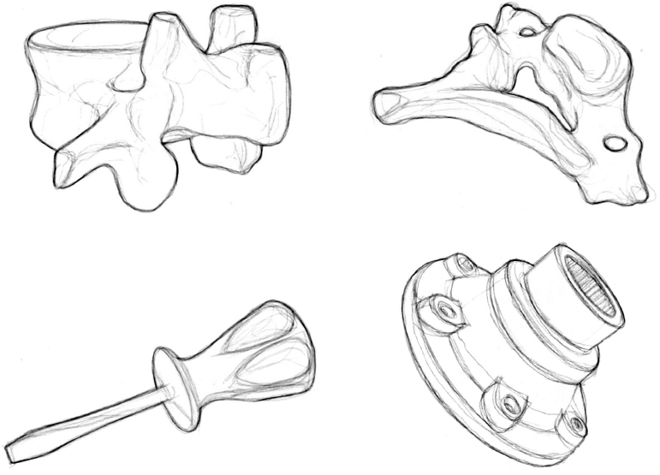
What is an edge?
Cole et al. Siggraph 2008, results of 107 humans.

Slide 3

Origin of edges
surface normal discontinuity
depth discontinuity
surface color discontinuity
illumination discontinuity
Edges are caused by a variety of factors

Slide 4
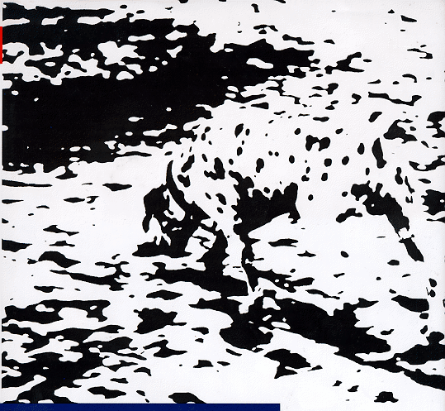

Illusory contours

Slide 5

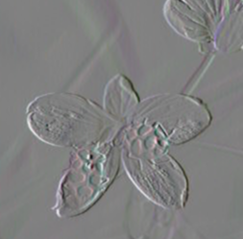
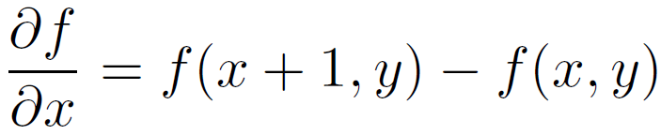

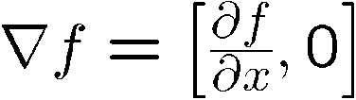
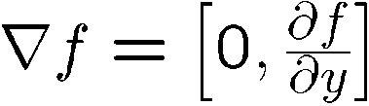
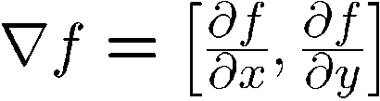
Image gradient
The gradient of an image:
The gradient points in the direction of most rapid change in intensity

Slide 6

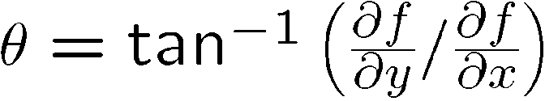
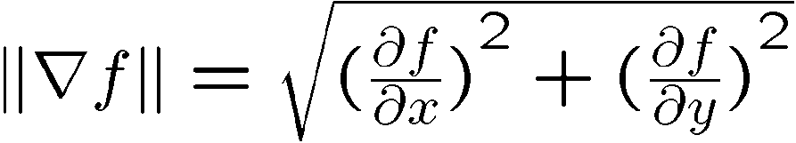
Image gradient
How would you implement this as a filter?
The gradient direction is given by:
  How does this relate to the direction of the edge?
The edge strength is given by the gradient magnitude

Slide 7


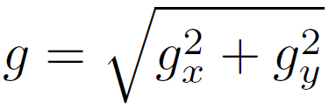
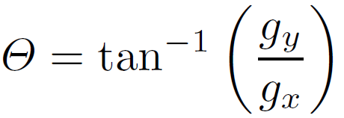
Sobel operator
In practice, it is common to use:
-1 | 0 | 1
-2 | 0 | 2
-1 | 0 | 1
-1 | -2 | -1
0 | 0 | 0
1 | 2 | 1
Magnitude:
Orientation:

Slide 8
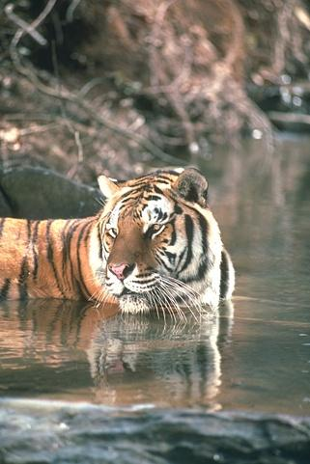
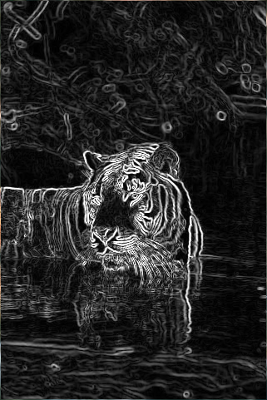
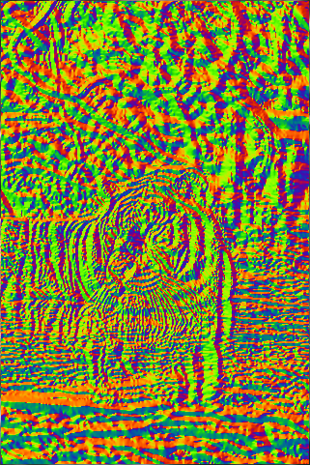
Sobel operator
Original
Magnitude
Orientation

Slide 9



Effects of noise
Consider a single row or column of the image
  Plotting intensity as a function of position gives a signal
Where is the edge?

Slide 10
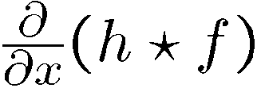

Solution: smooth first
Where is the edge?
Look for peaks in

Slide 11

Non-maximum suppression
Check if pixel is local maximum along gradient direction
  requires checking interpolated pixels p and r

Slide 12




Effect of σ (Gaussian kernel spread/size)
original
Canny with
Canny with
The choice of depends on desired behavior
  large detects large scale edges
  small detects fine features

Slide 13
An edge is not a line...
How can we detect lines ?

Slide 14
Finding lines in an image
Option 1:
  Search for the line at every possible position/orientation
  What is the cost of this operation?
Option 2:
  Use a voting scheme: Hough transform

Slide 15

Finding lines in an image
y
b
b₀
x
m₀
m
image space
Hough space
Connection between image (x,y) and Hough (m,b) spaces
  A line in the image corresponds to a point in Hough space
  To go from image space to Hough space:
    given a set of points (x,y), find all (m,b) such that y = mx + b

Slide 16

Finding lines in an image
y
b
y₀
x₀
x
m
image space
Hough space
Connection between image (x,y) and Hough (m,b) spaces
  A line in the image corresponds to a point in Hough space
  To go from image space to Hough space:
    given a set of points (x,y), find all (m,b) such that y = mx + b
  What does a point (x₀, y₀) in the image space map to?
    A: the solutions of b = -x₀m + y₀
    this is a line in Hough space

Slide 17

Hough transform algorithm
Typically use a different parameterization
  d is the perpendicular distance from the line to the origin
  θ is the angle
  Why?

Slide 18
Hough transform algorithm
Basic Hough transform algorithm
  Initialize H[d, θ]=0
  for each edge point I[x,y] in the image
    for θ = 0 to 180
      H[d, θ] += 1
  Find the value(s) of (d, θ) where H[d, θ] is maximum
  The detected line in the image is given by
What’s the running time (measured in # votes)?

Slide 19

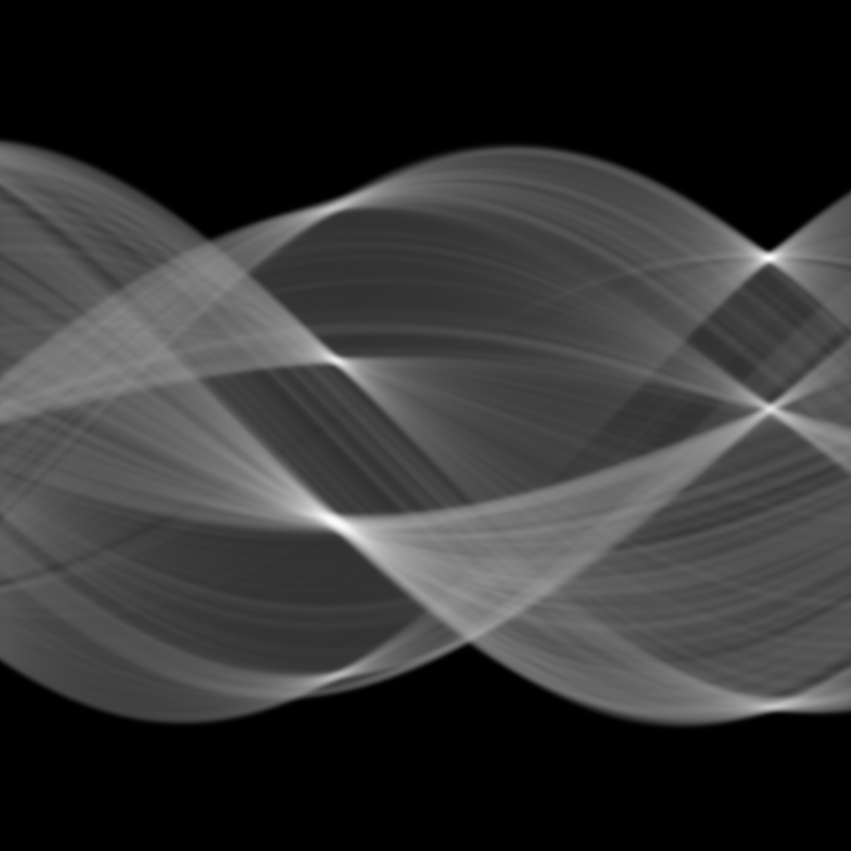

Hough transform algorithm
http://www.cs.utah.edu/~vpegorar/courses/cs7966/
Notes:
Sketch this parameterization on the board

Slide 20
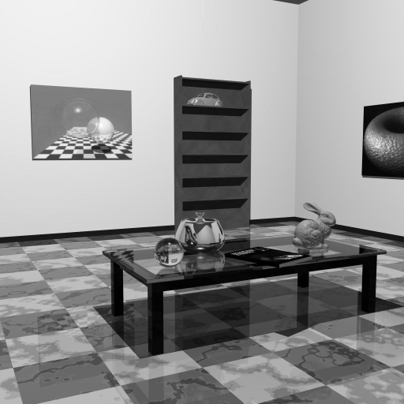
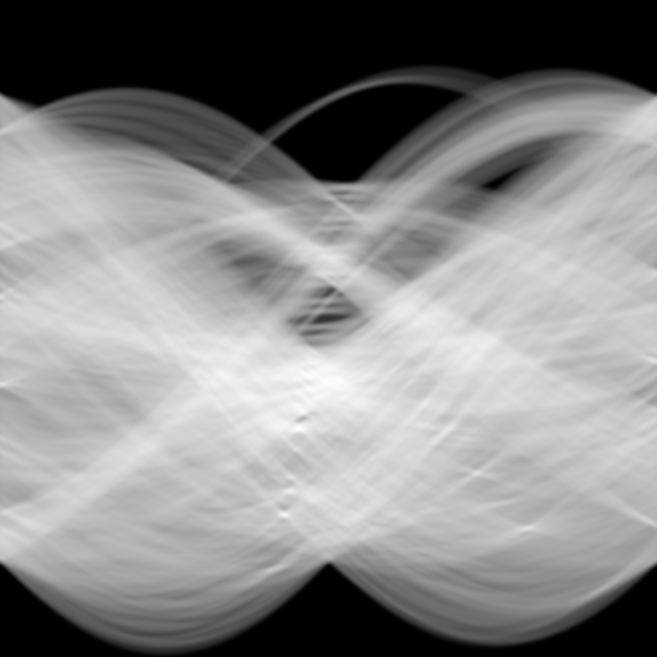
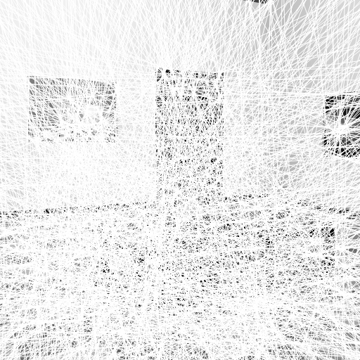
Hough transform algorithm
http://www.cs.utah.edu/~vpegorar/courses/cs7966/
Notes:
Sketch this parameterization on the board

Slide 21
Extensions
Extension 1: Use the image gradient
  same
  for each edge point I[x,y] in the image
    compute unique (d, θ) based on image gradient at (x,y)
      H[d, θ] += 1
  same
  same
What’s the running time measured in votes?
Extension 2
  give more votes for stronger edges
Extension 3
  change the sampling of (d, θ) to give more/less resolution
Extension 4
  The same procedure can be used with circles, squares, or any other shape
Notes:
Ask: what are the axes for a circle Hough space? What does a point in the image map to in the Hough space?

