Slide 1
3d shape reconstruction from photographs: a Multi-View Stereo approach
Carlos Hernández George Vogiatzis Yasutaka Furukawa
Google Aston University Google
http://carlos-hernandez.org/cvpr2010/index.html

Slide 2
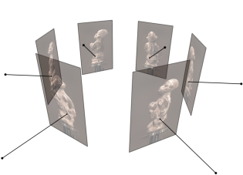
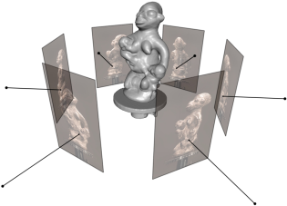
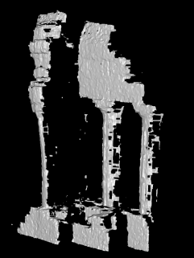
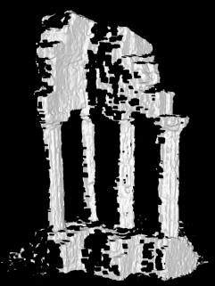
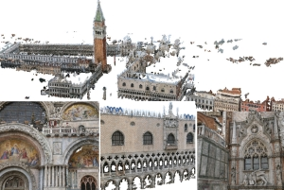
Talk plan
Introduction
Multi-View Stereo pipeline
Fusion of occlusion-robust depth-maps
Region growing

Slide 3
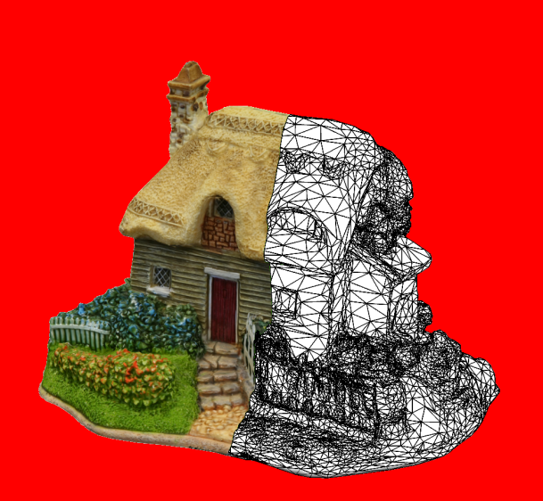
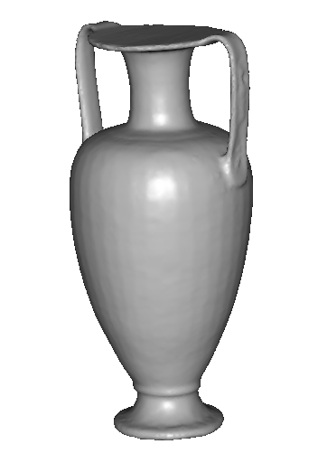
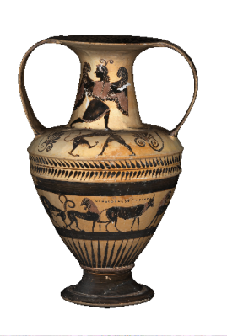
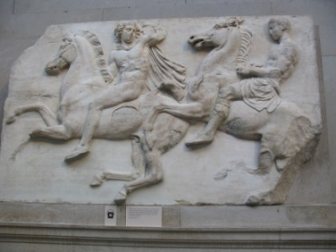
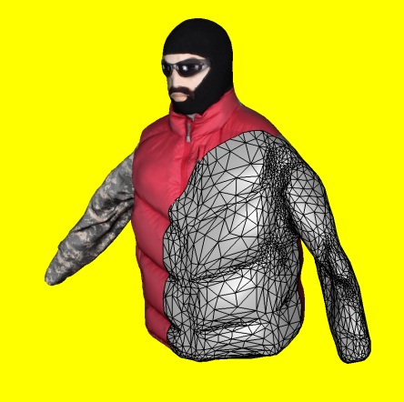
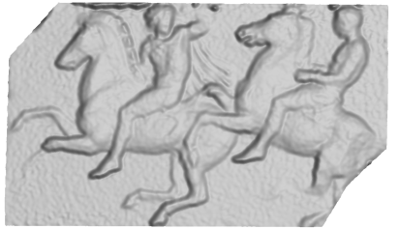
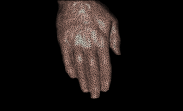
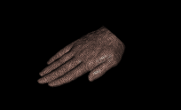
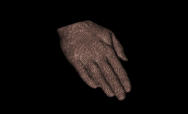
3d model
“Digital copy” of real object
Allows us to
Inspect details of object
Measure properties
Reproduce in different material
Many applications
Cultural heritage preservation
Computer games and movies
City modelling
E-commerce
3d object recognition/scene analysis

Slide 4
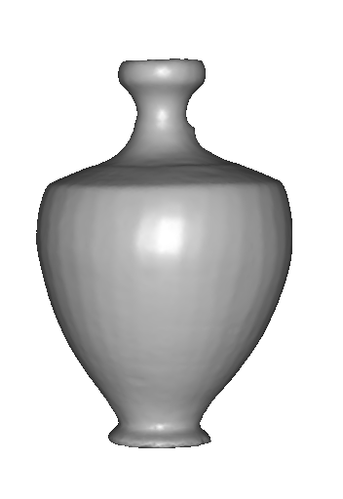
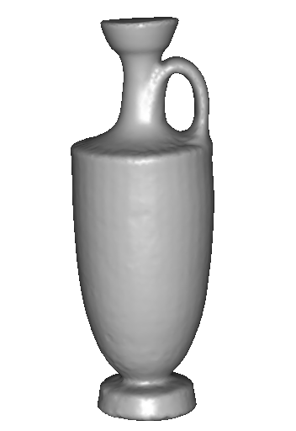
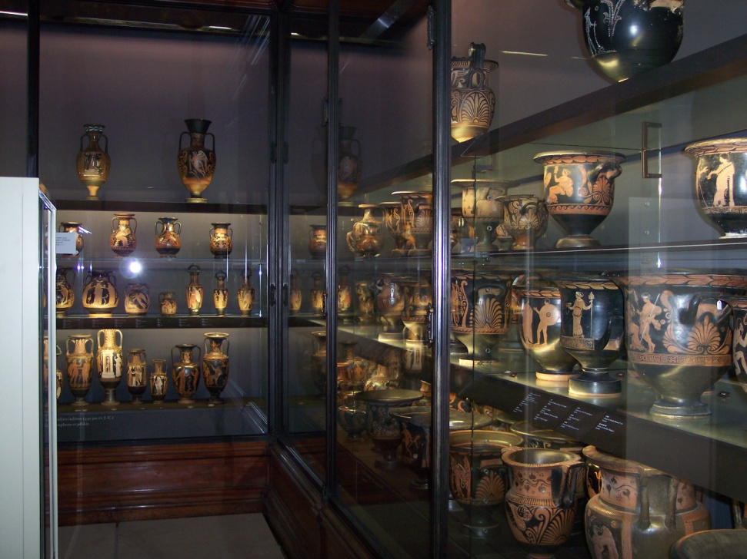
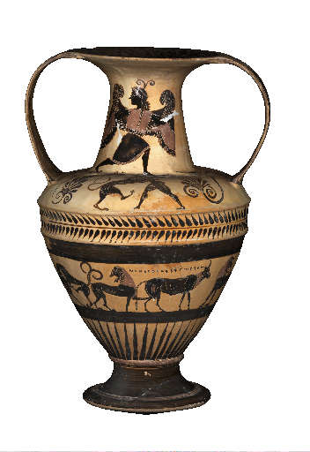
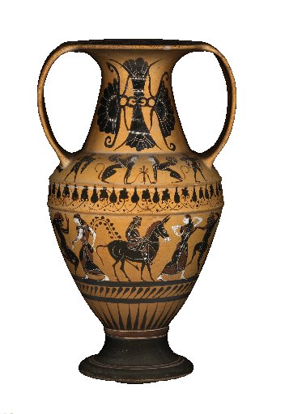
Applications: cultural heritage
SCULPTEUR European project
Notes:
To sum up,

Slide 5
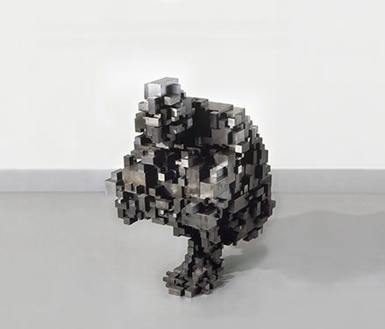
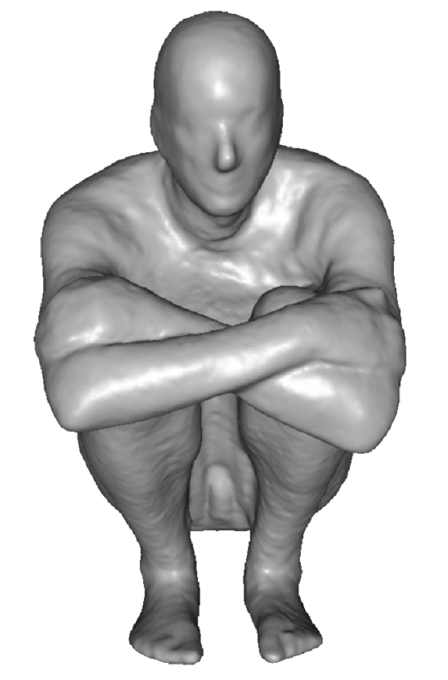
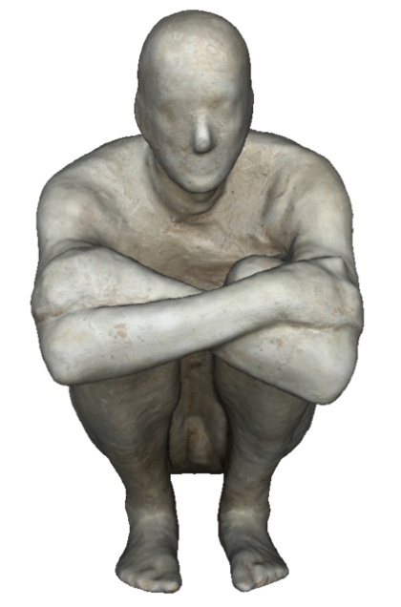
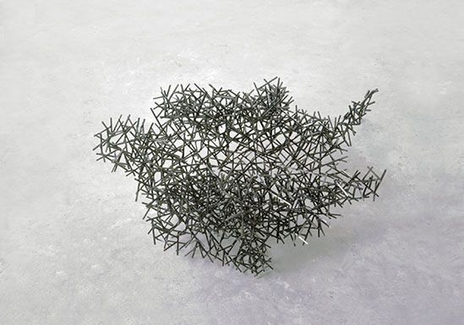
Applications: art
Block Works Precipitate III 2004 Mild steel blocks 80 x 46 x 66 cm
Domain Series Domain VIII Crouching 1999 Mild steel bar 81 x 59 x 63 cm
Notes:
To sum up,

Slide 6
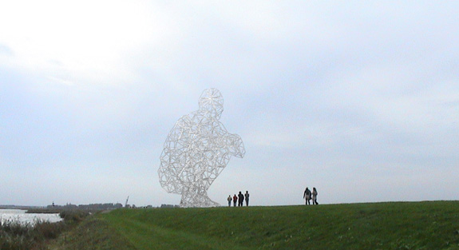
Applications: structure engineering
BODY / SPACE / FRAME, Antony Gormley, Lelystad, Holland
Notes:
To sum up,

Slide 7
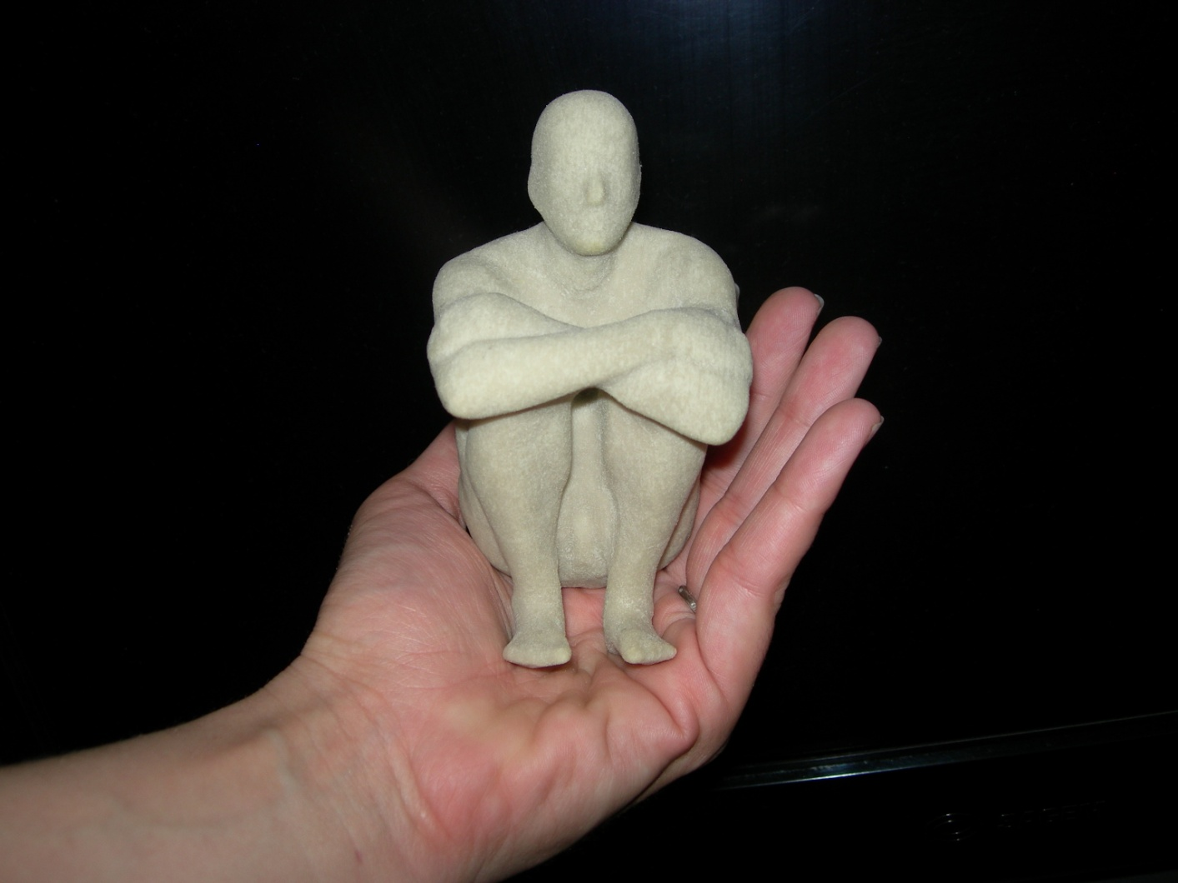
Applications: art
Notes:
To sum up,

Slide 8
Applications: computer games
Notes:
To sum up,

Slide 9
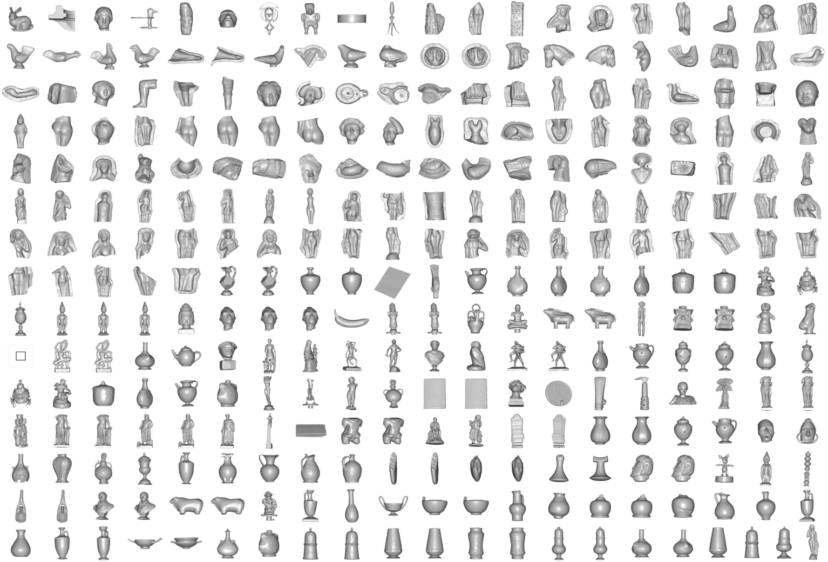
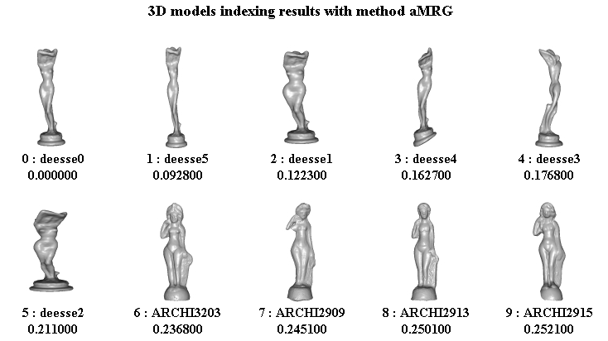
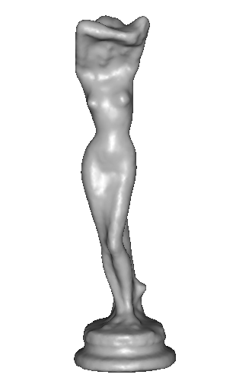
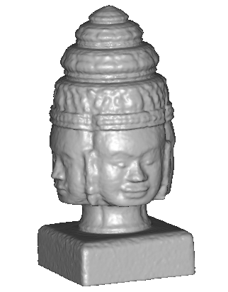
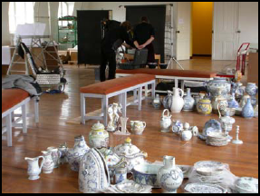
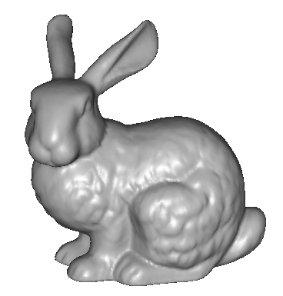
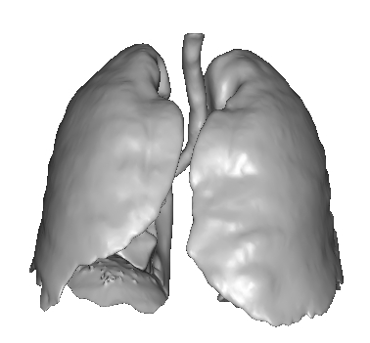
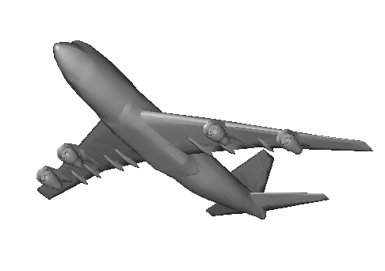
Applications: 3D indexation
? ?
? ? ?
?
? ?
?
SCULPTEUR European project
medical, industrial and cultural heritage indexation
Notes:
Les modèles 3D sont donc de plus en plus utilisés, et dans de nombreux domaines d’applications
Ex: héritage culturel, le médical, l’industrie, etc.
il y de plus en plus de bases de données de modèles 3D
Le problème, lorsqu’elles deviennent + grandes et c’est ce qui se passe actuellement,
Et qu’il devient difficile de naviguer à travers ces données.
L’indexation 3D va donc pouvoir nous aider à caractériser les formes des différents objets
Et en particulier elle va permettre de reconnaître ces formes pour pouvoir faire des comparaisons,
Classifications,
Et c’est ce qui a été développé dans le cadre du projet sculpteur

Slide 10
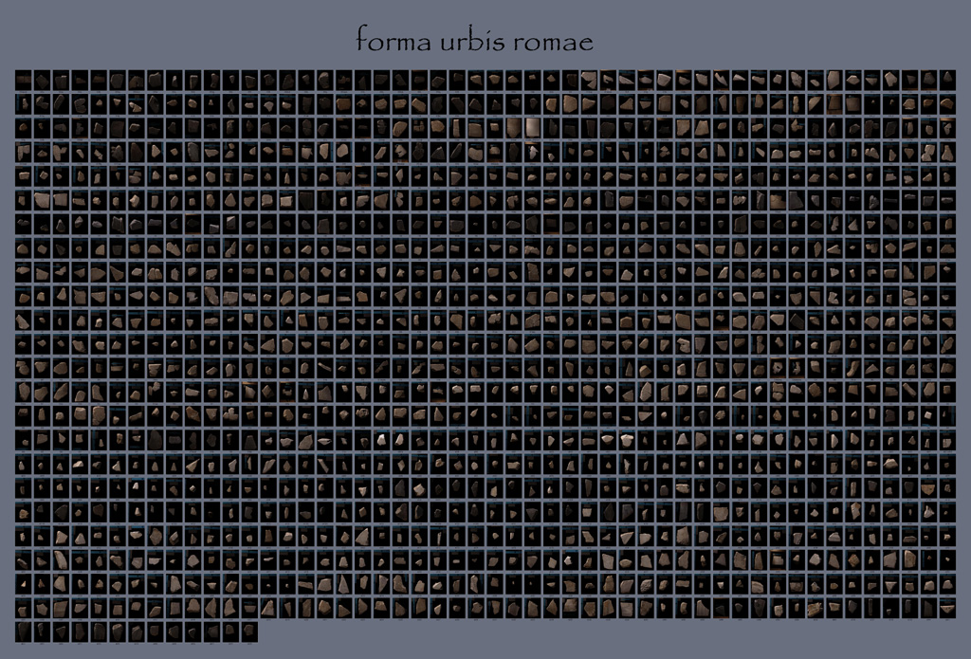
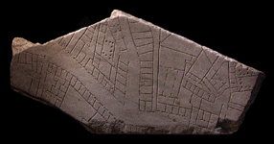
Applications: archaeology
“forma urbis romae” project
Fragments of the City: Stanford's Digital Forma Urbis Romae Project David Koller, Jennifer Trimble, Tina Najbjerg, Natasha Gelfand, Marc Levoy Proc. Third Williams Symposium on Classical Architecture, Journal of Roman Archaeology supplement, 2006.
1186 fragments

Slide 11
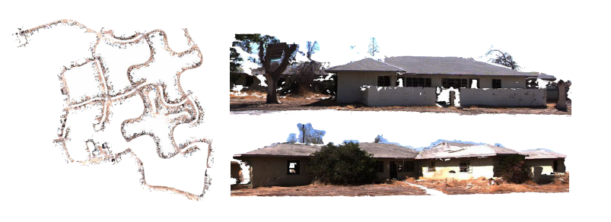
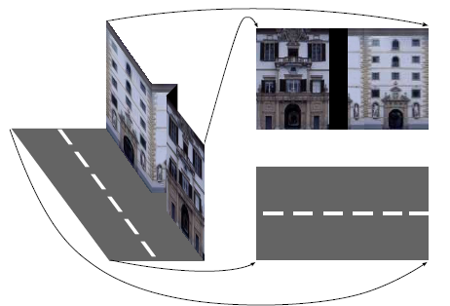
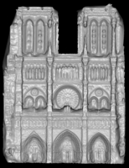
Applications: large scale modelling
[Furukawa10]
[Pollefeys08]
[Cornelis08]
[Goesele07]

Slide 12
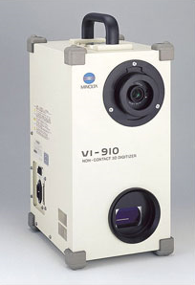
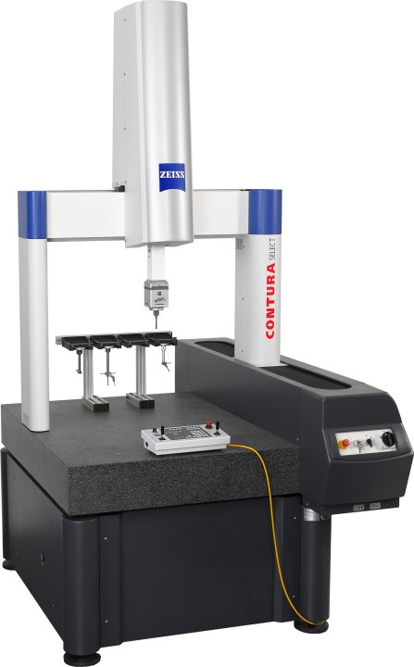
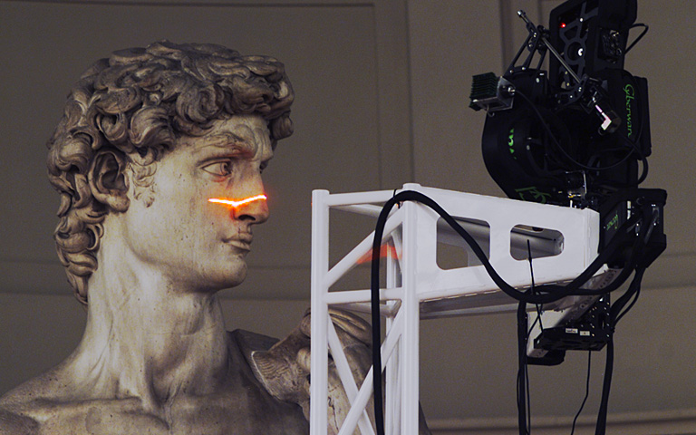
Scanning technologies
Laser scanner, coordinate measuring machine
Very accurate
Very Expensive
Complicated to use
Minolta
“Michelangelo” project
Contura CMM

Slide 13
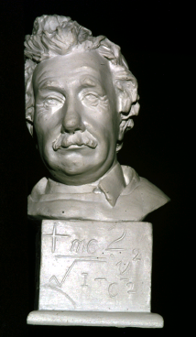
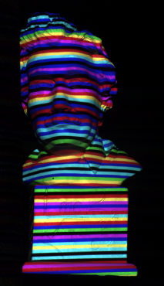
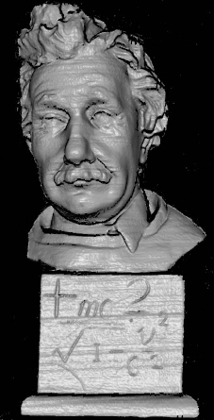
Scanning technologies
Structured light
[Zhang02]

Slide 14
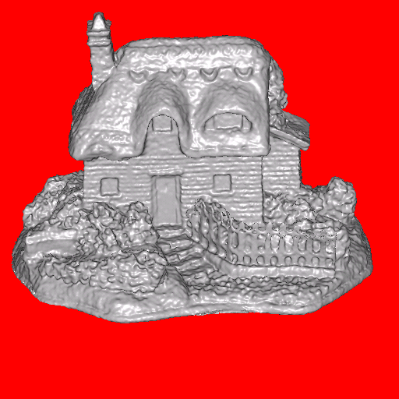
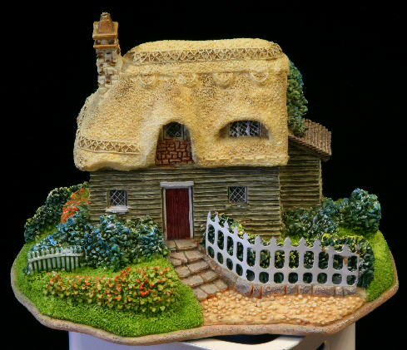
3d shape from photographs
“Estimate a 3d shape that would generate the input photographs given the same material, viewpoints and illumination”
viewpoint
?
geometry
material
illumination
image

Slide 15
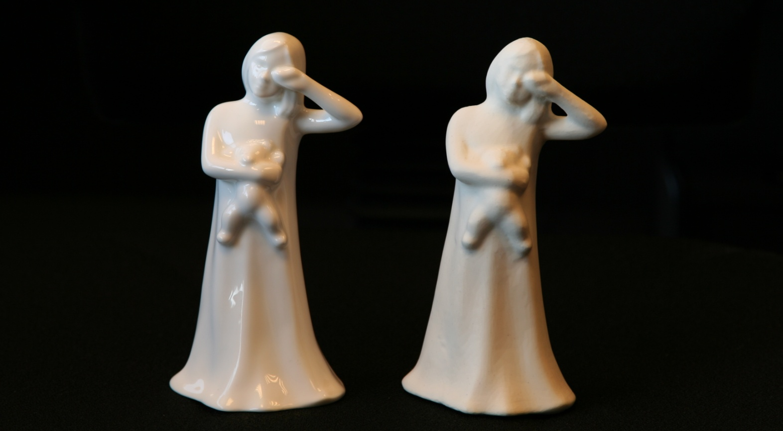
3d shape from photographs
“Estimate a 3d shape that would generate the input photographs given the same material, viewpoints and illumination”
Real
Replica

Slide 16
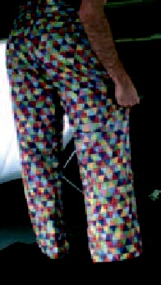
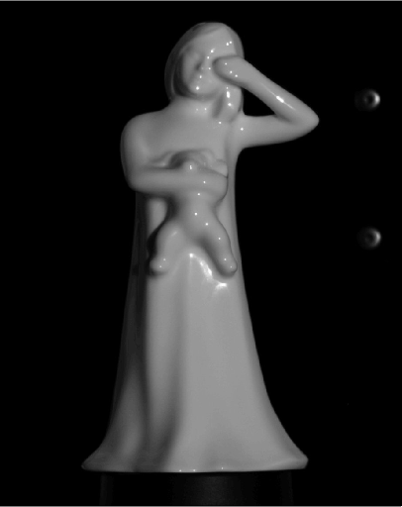
3d shape from photographs
Appearance strongly depends on the material and lighting
textured
rigid
deforming
textureless

Slide 17
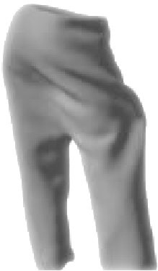
3d shape from photographs
Appearance strongly depends on the material and lighting
⇓
⇓
No single algorithm exists dealing with any type of scene
textured
rigid
deforming
textureless

Slide 18
3d shape from photographs
Photograph based 3d reconstruction is:
practical
fast
non-intrusive
low cost
Easily deployable outdoors
“low” accuracy
Results depend on material properties

Slide 19
Talk plan
Introduction
Multi-View Stereo pipeline
Fusion of occlusion-robust depth-maps
Region growing

Slide 20
Multi-view stereo pipeline
Image acquisition
Camera pose
3d reconstruction

Slide 21
Image acquisition
Studio conditions
controlled environment
Uncontrolled environment
hand-held
unknown illumination
Internet
Unknown content
Video
small motion between frames
huge amount of data

Slide 22
Studio image acquisition

Slide 23
Outdoor image acquisition

Slide 24
Internet image acquisition
...

Slide 25
Video image acquisition

Slide 26
Multi-view stereo pipeline
Image acquisition
Camera pose
3d reconstruction

Slide 27
Camera pose
Small Scenes
Robotic arm
Fiduciary markers
Structure-from-Motion
SfM from unorganized photographs
Large scenes

Slide 28
Robotic arm

Slide 29
Fiduciary markers
ARToolkit
Bouguet´s MATLAB Toolbox
Robust planar patterns
www.vision.caltech.edu/bouguetj/calib_doc/

Slide 30
Structure from motion
Input sequence
2d features
2d track
3d points

Slide 31
Motion estimation result

Slide 32
Structure-from-Motion from unordered image collections
[Brown05, Snavely06, Agarwal09]
Image clustering
Pose initialization
Bundle-adjustment
phototour.cs.washington.edu/bundler

Slide 33
Camera pose
Robotic arm
Fiduciary markers
Structure-from-Motion
SfM from unorganized photographs

Slide 34
Multi-view stereo pipeline
Image acquisition, camera pose
3d photo-consistency from images
3d surface from 3d photo-consistency
Image acquisition
Camera pose
3d reconstruction
3d reconstruction = 3d segmentation

Slide 35
Photo-consistency of a 3d point
Photo-consistent point
≈

Slide 36
Photo-consistency of a 3d point
Non photo-consistent point
≠

Slide 37
Photo-consistency of a 3d patch

Slide 38
Challenges of photo-consistency
Camera visibility
Failure of comparison metric
repeated texture
lack of texture
specularities

Slide 39
Multi-view stereo algorithms
Comparison and evaluation:
A Comparison and Evaluation of Multi-View Stereo Reconstruction Algorithms, S. Seitz et al., CVPR 2006, vol. 1, pages 519-526.
Quick history of algorithms:
Representing stereo data with the Delaunay triangulation, O. Faugeras et al., Artificial Intelligence, 44(1-2):41-87, 1990.
A multiple-baseline stereo, M. Okutomi and T. Kanade, TPAMI, 15(4):353-363, 1993.
Object-centered surface reconstruction: Combining multi-image stereo and shading, P. Fua, Y. Leclerc, International Journal of Computer Vision, vol. 16:35-56, 1995.
A portable three-dimensional digitizer, Y. Matsumoto et al., Int. Conf. on Recent Advances in 3D Imaging and Modeling, 197-205, 1997.
Photorealistic Scene Reconstruction by Voxel Coloring, S. M. Seitz and C. R. Dyer, CVPR., 1067-1073, 1997.
Variational principles, surface evolution, PDE's, level set methods and the stereo problem, O. Faugeras and R. Keriven, IEEE Trans. on Image Processing, 7(3):336-344, 1998.

Slide 40
Multi-view stereo algorithms
Comparison and evaluation:
A Comparison and Evaluation of Multi-View Stereo Reconstruction Algorithms, S. Seitz et al., CVPR 2006, vol. 1, pages 519-526.
http://vision.middlebury.edu/mview/
Recently many new algorithms
Very good accuracy & completeness
Almost all deal with small number of images (~100) main exception [Pollefeys08]
Offline algorithms, no feedback

Slide 41
Best flexible algorithms
 | Region growing | Depth-map fusion
 | Starts from a cloud of 3d points, and grows small flat patches maximizing photo-consistency | Fuses a set of depth-maps computed using occlusion-robust photo-consistency
 | Provides best overall results due to a plane-based photo-consistency | Elegant pipeline Plug-n-play blocks Easily parallelizable
 | Many tunable parameters, i.e., difficult to tune to get the optimal results | Photo-consistency metric is simple and not optimal. The metric suffers when images are not well textured or low resolution
summary
pros
cons

Slide 42
Bird’s-eye view: depth-map fusion
Compute depth hypotheses
Volumetrically fuse depth-maps
Extract 3d surface

Slide 51
Bird’s-eye view: region growing
Fitting step A local surface patch is fitted, iterating visibility
Filter step Visibility is explicitly enforced
Expand step Successful patches are used to initialise active boundary

Slide 52
Patch-based MVS and its Applications
Why patches (oriented points)? [10 mins]
Algorithmic details [30 mins]
Applications [20 mins]

Slide 53
What is a patch?
Patch consists of
Position (x, y, z)
Normal (nx, ny, nz)
Extent (radius)
Tangent plane approximation
Normal
Position
Extent

Slide 54
What is a patch?
Patch consists of
Position (x, y, z)
Normal (nx, ny, nz)
Extent (radius)
Tangent plane approximation
Mesh
Normal
Position
Extent
Patch

Slide 55
Why patches?
Flexible

Slide 56
Why patches?
Flexible

Slide 57
Why patches?
Flexible Hard to enforce regularization

Slide 58
Why patches?
Flexible Hard to enforce regularization
Regularization not really necessary
because
Local image patch is descriptive enough
[Goesele et al., CVPR06], [Furukawa et al., CVPR07]
9x9 pixels

Slide 59
Why patches?
Extracts pure 3d data w/o interpolation
Meshing w/
standard interpolation
Image
Scene analysis from
pure 3d data
Meshing w/
smart interpolation
Patches (pure 3d data)
[Sinha ICCV09, Furukawa ICCV09]

Slide 60
Patches vs. multiple depthmaps (could be my biased-view…)
Patches → Single global 3D model Depthmaps → Multiple redundant 3D models
Patches → Clean 3D points Depthmaps → Noisy without merging
Patches → Hard to make it fast (complex algo) Depthmaps → Easy to make it fast

Slide 61
Patch-based MVS and its Applications
Why patches (oriented points)? [10 mins]
Algorithmic details [30 mins]
Applications [20 mins]

Slide 62
Patch-based MVS
[Lhuillier and Quan,
PAMI 05]
[Furukawa and Ponce,
CVPR 07]
[Habbecke and Kobbelt,
CVPR 07]

Slide 63
Patch-based MVS
Shown to work very well
Multi-view stereo evaluation
http://vision.middlebury.edu/mview
D. Scharstein et al.

Slide 64
Patch-based MVS [Furukawa and Ponce 07]
Preliminaries
Algorithm
Input image
#1
#2
#3

Slide 65
Patch definition
Position, normal, and extent
Normal
Position
Extent

Slide 66
Patch definition
Patch p is defined by
Position c(p)
Normal n(p)
Visible images V(p)
Extent is set so that p is roughly 9x9 pixels in V(p)
Normal n(p)
Position c(p)
Extent
9x9 pixels
Visible images V(p)

Slide 67
Photo-consistency
Photo-consistency N(I, J, p) of p between two images I and J
Ixy: pixel color in image I
I12
I11
I
J

Slide 68
Photo-consistency
Photo-consistency N(I, J, p) of p between two images I and J
Ixy: pixel color in image I
Jxy: pixel color in image J
I
J11
J
J12

Slide 69
Photo-consistency
Photo-consistency N(I, J, p) of p between two images I and J
Ixy: pixel color in image I
Jxy: pixel color in image J
Photo-consistency N(p) of p with visible images V(p) = {I1, I2, …, In}
I
J11
J
J12

Slide 70
Reconstruct patch p
Given initial estimates of
Position c(p)
Normal n(p)
Visible images V(p)
Refine c(p) and n(p)
c(p)
n(p)

Slide 71
Reconstruct patch p
Given initial estimates of
Position c(p)
Normal n(p)
Visible images V(p)
Refine c(p) and n(p)
1 DOF

Slide 72
Reconstruct patch p
Given initial estimates of
Position c(p)
Normal n(p)
Visible images V(p)
Refine c(p) and n(p)
2 DOF

Slide 73
Verify a patch
Textures may match by accident

Slide 74
Verify a patch
Textures may match by accident
Photo-consistency must be reasonably high

Slide 75
Verify a patch
Textures may match by accident
Photo-consistency must be reasonably high
Verification process
Keep only high photo-consistency images in V(p)

Slide 76
Verify a patch
Textures may match by accident
Photo-consistency must be reasonably high
Verification process
Keep only high photo-consistency images in V(p)
Accept if |V(p)|≥3

Slide 77
Patch-based MVS [Furukawa and Ponce 07]
Preliminaries
Algorithm
Input image
#1
#2
#3

Slide 78
Patch-based MVS [Furukawa and Ponce 07]
#1. Feature detection
#2. Initial feature matching
#3. Patch expansion and filtering
Input image
#1
#2
#3

Slide 79
Algorithm overview
#1. Feature detection
#2. Initial feature matching
#3. Patch expansion and filtering
Input image
#1
#2
#3

Slide 80
Feature detection
Extract local maxima of
Harris corner detector (corners)
Difference of Gaussian (blobs)

Slide 81
Algorithm overview
#1. Feature detection
#2. Initial feature matching
#3. Patch expansion and filtering
Input image
#1
#2
#3

Slide 82
Initial feature matching
c(p):
n(p):
V(p):
c(p): triangulation
n(p):
V(p):
p
Epipolar line
Image 3
Image 1
Image 2

Slide 83
Initial feature matching
c(p):
n(p):
V(p):
c(p): triangulation
n(p): parallel to Image1
V(p): {Image1, Image2}
p
Epipolar line
Image 3
Image 1
Image 2

Slide 84
Initial feature matching
c(p):
n(p):
V(p):
c(p): triangulation
n(p): parallel to Image1
V(p): {Image1, Image2}
c(p): triangulation
n(p): parallel to Image1
V(p): {Image1, Image2, Image3}
p
Add visible images
If
Epipolar line
Image 3
Image 1
Image 2

Slide 85
Initial feature matching
c(p): triangulation
n(p): parallel to Image1
V(p): {Image1, Image2, Image3}
p
Epipolar line
Image 3
Image 1
Image 2

Slide 86
Initial feature matching
c(p): refine
n(p): refine
V(p): {Image1, Image2, Image3}
p
Epipolar line
Image 3
Image 1
Image 2

Slide 87
Initial feature matching
c(p): refine
n(p): refine
V(p): {Image1, Image2, Image3}
p
Epipolar line
Image 3
Image 1
Image 2

Slide 88
Initial feature matching
Verification
(update V(p) and check |V(p)|≥3)
p
Image 3
Image 1
Image 2

Slide 89
Initial feature matching
p
Occupied
Image 3
Image 1
Image 2

Slide 90
Initial feature matching
Occupied
Epipolar line
Image 3
Image 1
Image 2

Slide 91
Initial feature matching
Occupied
Epipolar line
Image 3
Image 1
Image 2

Slide 92
Initial feature matching
Occupied
Epipolar line
Image 3
Image 1
Image 2

Slide 93
Initial feature matching
Repeat for all the image features
Occupied
Image 3
Image 1
Image 2

Slide 94
Algorithm overview
#1. Feature detection
#2. Initial feature matching
#3. Patch expansion and filtering
Input image
#1
#2
#3

Slide 95
Patch expansion
Occupied pixel
Image 1
Image 2
Image 3

Slide 96
Patch expansion
Pick a patch
Image 1
Image 2
Image 3

Slide 97
Patch expansion
Pick a patch
Look for neighboring
empty pixels
All occupied
Do nothing
Image 1
Image 2
Image 3

Slide 98
Patch expansion
p
Pick a patch
Image 1
Image 2
Image 3

Slide 99
Patch expansion
p
Pick a patch
Identify neighboring
empty pixels
Image 1
Image 2
Image 3

Slide 100
Patch expansion
p
c(q):
n(q):
V(q):
q
c(q): {tangent plane of p
intersects w/ ray}
n(q):
V(q):
Reconstruct a patch
visible in an empty pixel
Image 1
Image 2
Image 3

Slide 101
Patch expansion
p
c(q):
n(q):
V(q):
q
c(q): {tangent plane of p
intersects w/ ray}
n(q): n(p)
V(q): V(p)
Reconstruct a patch
visible in an empty pixel
Image 1
Image 2
Image 3

Slide 102
Patch expansion
p
q
c(q): refine
n(q): refine
V(q): V(p)
q
Reconstruct a patch
visible in an empty pixel
Image 1
Image 2
Image 3

Slide 103
Patch expansion
p
c(q): refine
n(q): refine
V(q): V(p)
q
Reconstruct a patch
visible in an empty pixel
Patch verification!
Image 1
Image 2
Image 3

Slide 104
Patch expansion
p
c(q): refine
n(q): refine
V(q): V(p)
q
Reconstruct a patch
visible in an empty pixel
Patch verification!
Image 1
Image 2
Image 3

Slide 105
Patch expansion
p
q
Repeat
for every patch
for every neighboring empty pixel
Image 1
Image 2
Image 3

Slide 106
Patch filtering
Visibility consistency
p3
p4
p5
p2
p6
Filter out p1 if
p1
Image1
Image5
Image2
Image3
Image4

Slide 107
Patch-based MVS [Furukawa and Ponce 07]
#1. Feature detection
#2. Initial feature matching
#3. Patch expansion and filtering
Input image
#1
#2
#3

Slide 108
Skull - 24 images
2000x2000 [pixels]
Face - 4 images
1400x2200 [pixels]
(Courtesy of Industrial Light & Magic)

