Slide 1
Chapel: Status/Community
Brad Chamberlain
Cray Inc.
CSEP 524
May 20, 2010

Slide 2
Outline
Chapel Context
Global-view Programming Models
Language Overview
Status, Collaborations, Future Work

Slide 3
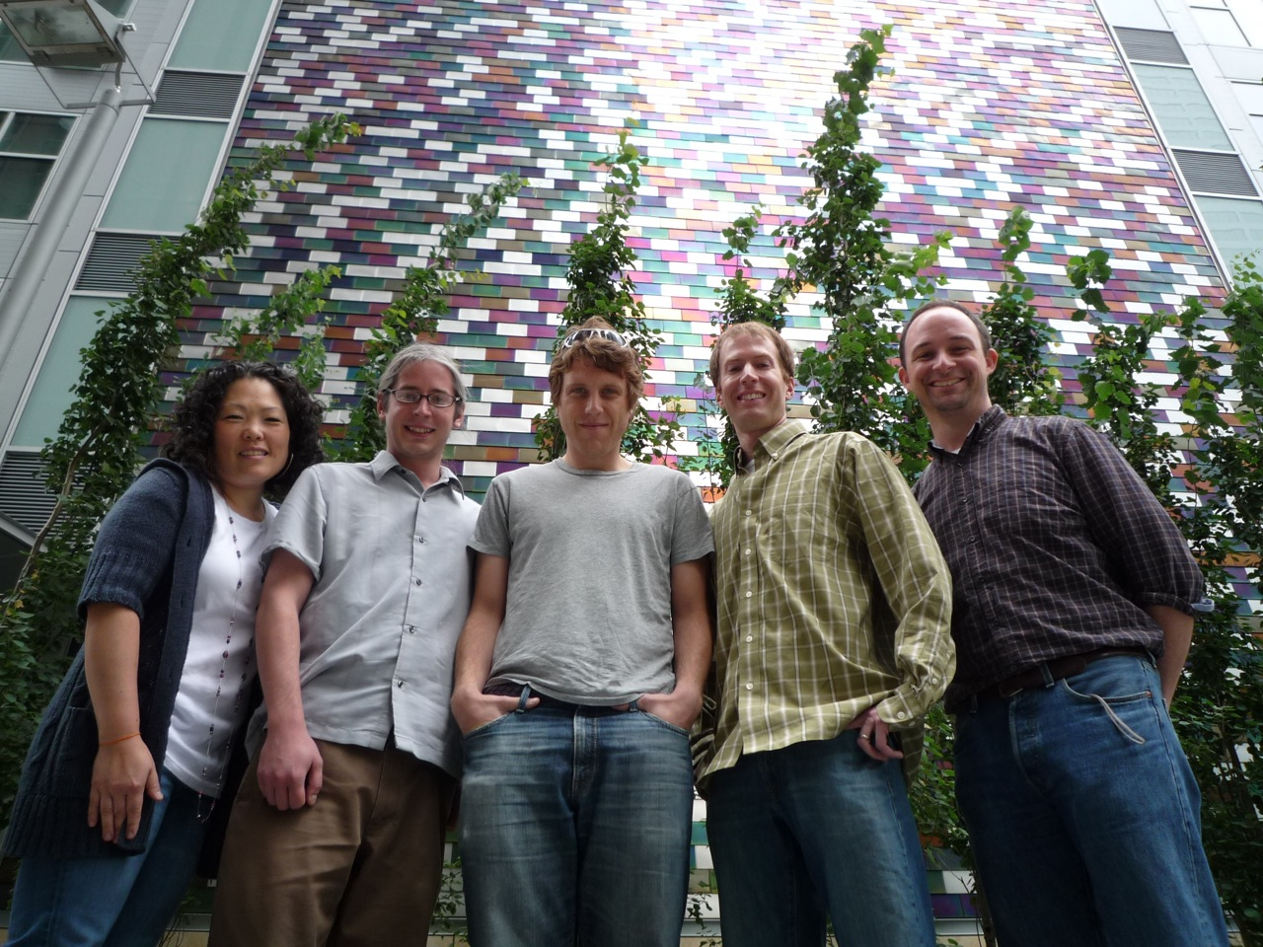
The Chapel Team
Interns
Hannah Hemmaplardh (`10–UW)
Jonathan Turner (`10 – Boulder)
Jacob Nelson (`09 – UW)
Albert Sidelnik (`09 – UIUC)
Andy Stone (`08 – Colorado St)
James Dinan (`07 – Ohio State)
Robert Bocchino (`06 – UIUC)
Mackale Joyner (`05 – Rice)
Alumni
David Callahan
Roxana Diaconescu
Samuel Figueroa
Shannon Hoffswell
Mary Beth Hribar
Mark James
John Plevyak
Wayne Wong
Hans Zima
Sung-Eun Choi, David Iten, Lee Prokowich,
Steve Deitz, Brad Chamberlain,
and half of Greg Titus

Slide 4
Chapel Work
Chapel Team’s Focus:
specify Chapel syntax and semantics
implement open-source prototype compiler for Chapel
perform code studies of benchmarks, apps, and libraries in Chapel
do community outreach to inform and learn from users/researchers
support users of code releases
refine language based on all these activities
implement
code
studies
specify
Chapel
outreach
support
release

Slide 5
Compiling Chapel
Chapel
Source
Code
Chapel
Compiler
Chapel
Executable
Chapel
Standard
Modules

Slide 6
Chapel Compiler Architecture
Chapel
Compiler
Chapel
Source
Code
Generated
C Code
Chapel-to-C
Compiler
Standard
C Compiler
& Linker
Chapel
Executable
Chapel
Standard
Modules
Internal Modules
(written in Chapel)
Runtime Support
Libraries (in C)
1-sided Messaging,
Threading Libraries

Slide 7
Chapel and the Community
Our philosophy:
help the parallel community understand what we are doing
develop Chapel as an open-source project
encourage external collaborations
over time, turn language over to the community
Goals:
to get feedback that will help make the language more useful
to support collaborative research efforts
to accelerate the implementation
to aid with adoption

Slide 8
Chapel Release
Current release: version 1.1 (April 15th, 2010)
Supported environments: UNIX/Linux, Mac OS X, Cygwin
How to get started:
Download from: http://sourceforge.net/projects/chapel
Unpack tar.gz file
See top-level README
for quick-start instructions
for pointers to next steps with the release
Your feedback desired!
Remember: a work-in-progress
⇒ it’s likely that you will find problems with the implementation
⇒ this is still a good time to influence the language’s design

Slide 9
Implementation Status (v1.1)
Base language: stable (some gaps and bugs remain)
Task parallel:
stable multi-threaded implementation of tasks, sync variables
atomic sections are an area of ongoing research with U. Notre Dame
Data parallel:
stable multi-threaded data parallelism for dense domains/arrays
other domain types have a single-threaded reference implementation
Locality:
stable locale types and arrays
stable task parallelism across multiple locales
initial support for some distributions: Block, Cyclic, Block-Cyclic
Performance:
has received much attention in designing the language
yet minimal implementation effort to date

Slide 10
Selected Collaborations (see chapel.cray.com for complete list)
Notre Dame/ORNL (Peter Kogge, Srinivas Sridharan, Jeff Vetter):
Asynchronous Software Transactional Memory over distributed memory
UIUC (David Padua, Albert Sidelnik):
Chapel for hybrid CPU-GPU computing
BSC/UPC (Alex Duran):
Chapel over Nanos++ user-level tasking
U/Malaga (Rafa Asenjo, Maria Gonzales, Rafael Larossa):
Parallel file I/O for whole-array reads/writes
University of Colorado, Boulder (Jeremy Siek, Jonathan Turner):
Concepts/interfaces for improved support for generic programming
PNNL/CASS-MT (John Feo, Daniel Chavarria):
Hybrid computing in Chapel; performance tuning for the Cray XMT; ARMCI port
ORNL (David Bernholdt et al.; Steve Poole et al.):
Chapel code studies – Fock matrices, MADNESS, Sweep3D, coupled models, …
U Oregon, Paratools Inc.:
Chapel performance analysis using Tau
(Your name here?)

Slide 11
Collaboration Opportunities (see chapel.cray.com for more details)
memory management policies/mechanisms
dynamic load balancing: task throttling and stealing
parallel I/O and checkpointing
exceptions; resiliency
language interoperability
application studies and performance optimizations
index/subdomain semantics and optimizations
targeting different back-ends (LLVM, MS CLR, …)
runtime compilation
library support
tools
debuggers, performance analysis, IDEs, interpreters, visualizers
database-style programming
(your ideas here…)

Slide 12
Chapel and Education
If I were to offer a parallel programming class, I’d want to teach about:
data parallelism
task parallelism
concurrency
synchronization
locality/affinity
deadlock, livelock, and other pitfalls
performance tuning
…
I don’t think there’s a good language out there…
…for teaching all of these things
…for teaching some of these things at all
…until now: I think Chapel has the potential to play a crucial role here

Slide 13
Our Next Steps
Expand our set of supported distributions
Continue to improve performance
Continue to add missing features
Expand the set of codes that we are studying
Expand the set of architectures that we are targeting
Support the public release
Continue to support collaborations and seek out new ones
Continue to expand our team

Slide 14
Summary
Chapel strives to greatly improve Parallel Productivity
via its support for…
…general parallel programming
…global-view abstractions
…control over locality
…multiresolution features
…modern language concepts and themes

