Slide 1
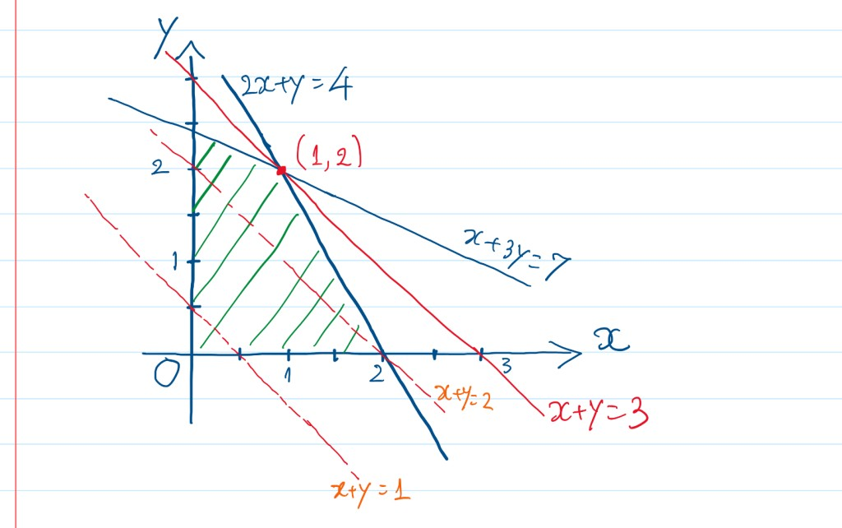
CSEP 521: Linear Programming
Richard Anderson, March 11, 2021

Slide 2
Announcements
Readings
Skim textbook chapters on Linear Programming
DasGupta, Papadimitriou, and Vazarani
Course evaluations
You should have received a link on your UW account
Last homework is due tonight
Notify instructor if any homework is going to be turned in after March 14

Slide 3
Linear Programming
A linear program is a problem with n variables x₁,…,x_{n}, that has:
A linear objective function, which must be maximized (or minimized). max c₁x₁+c₂x₂+… +c_{n}x_{n}
A set of m linear constraints.
a_{i1}x₁ + a_{i2}x₂ + … + a_{in}x_{n} ≤ b_{i} (or ≥ or =)
Note: the values of the coefficients c_{i}, a_{i,j} are given in the problem input.

Slide 4
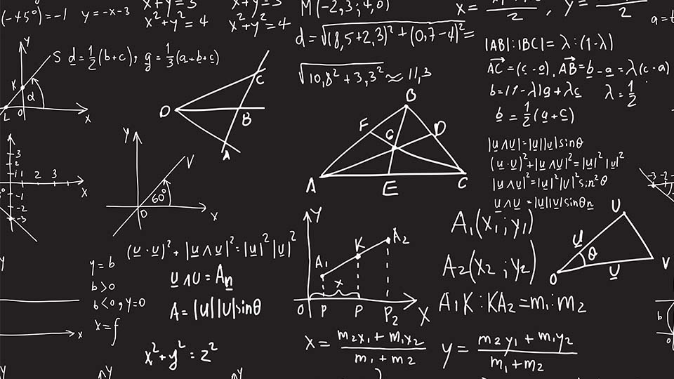
Geometry
Convexity
Intersection of convex sets is convex
Max / Min always at the corner

Slide 5
Convexity
A set of points is convex if for all pairs x, y in the set, every point on the line segment { t x+(1-t) y | 0 < t < 1 } connecting them is also in the set
y
y
x
x
convex non-convex

Slide 6
Convexity and half-spaces
An inequality a_{i1}x₁ + a_{i2}x₂ + … + a_{in}x_{n} ≤ b defines a half-space.
Half-spaces are convex
Intersections of convex sets are convex
So, the feasible region for a linear program is always a convex polyhedron

Slide 7
Max/Min is always at a “corner”
Linear extrema are not in the interior of a convex set
E.g.: maximize c₁x₁+c₂x₂+… +c_{n}x_{n}
If max were in the interior, there’s always a better interior point just off the hyperplane c^{T}x = d
On a polyhedron, max may = line, face, …, but includes vertices thereof, so always a “corner,” (though maybe not uniquely a corner)
Σc_{i}x_{i} > d
Σc_{i}x_{i} < d
(but non-convexity is a problem for “hill-climbing”)

Slide 8
Convex combinations
Defn: a convex combination of points/vectors p₁,p₂, …, p_{n} is a point α₁p₁ + α₂p₂ + … + α₂p_{n} where α_{i} > 0 and ∑_{i} α_{i} =1
Fact: the set of all convex combinations of p₁,p₂, …, p_{n} sweep out their convex hull

Slide 9
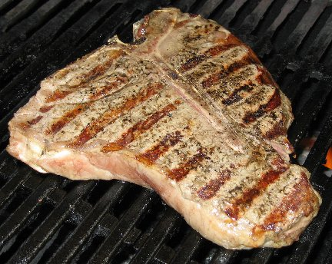
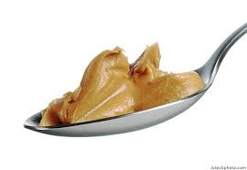
The diet problem
Maximize protein consumption subject to
≤ 5 units of fat per day
≤ 6 dollars per day
 | Protein / lb | Fat / lb | $ / lb
Steak | 2 | 1 | 4
Peanut Butter | 1 | 2 | 1

Slide 10
The diet problem
4x + y ≤ 6
Maximize:
2x + y
Subject to:
4 x + y ≤ 6
x + 2y ≤ 5
x ≥ 0
y ≥ 0
x + 2y ≤ 5
2x + y = 4
2x + y = 0
2x + y = 2

Slide 11
Duality - upper bounds
Maximize:
2x + y
Subject to:
4 x + y ≤ 6 (1)
x + 2y ≤ 5 (2)
x ≥ 0
y ≥ 0
(1): 2x + y ≤ 4x + y ≤ 6
2(2): 2x + y ≤ 2(x + 2y) ≤ 10
.5(1) + .25(2) 2x + y ≤ .5(4x + y) + .25(x + 2y) ≤ 3 + 1.25
What is the best upper bound we can get?

Slide 12
Upper bounds
min 6a + 5b
Subject to
4a + b ≥ 2
a + 2b ≥ 1
a ≥ 0
b ≥ 0
a(4x + y) ≤ 6a
b(x + 2y) ≤ 5b
If a(4x + y) + b(x + 2y) ≥ 2x + y
then 6a + 5b ≥ opt

Slide 13
A Central Result of LP Theory: Duality Theorem
Every linear program has a dual
If the original is a maximization, the dual is a minimization and vice versa
Solution of one leads to solution of other
Primal: Maximize c^{T}x subject to Ax ≤ b, x ≥ 0
Dual: Minimize b^{T}y subject to A^{T}y ≥ c, y ≥ 0
If one has optimal solution so does the other, and their values are the same.

Slide 14
Duality Theorem
Practical Use of Duality:
Sometimes LP algorithms will run faster on the dual than on the primal.
Can be used to bound how far you are from optimal solution.
Important implications for economists.

Slide 15
Standard Form of a Linear Program.
Minimize b₁y₁ + b₂y₂ + … + b_{m}y_{m}
subject to Σ _{1 ≤ i ≤ m} a_{ij}y_{i} ≥ c_{j} j = 1..n
y_{i} ≥ 0 i = 1..m
or
Maximize c₁x₁ + c₂x₂ + … + c_{n}x_{n}
subject to Σ _{1 ≤ j ≤ n} a_{ij}x_{j} ≤ b_{j} i = 1..m
x_{j} ≥ 0 j = 1..n

Slide 16
The Feasible Set
Intersection of a set of half-spaces is called a polyhedron.
A bounded, nonempty polyhedron is a polytope.
There are 3 cases:
feasible set is empty.
cost function is unbounded on feasible set.
cost has a minimum (or max) on feasible set.
(First two cases uncommon for real problems in economics and engineering.)

Slide 17
Optimal vector occurs at some corner of the feasible set
y
An example with 6 constraints.
feasible set
x

Slide 18
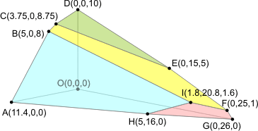
Linear Programming in n dimensions
Feasible region is an n-dimensional polytope
Solving the linear program is finding the vertex that maximizes the objective function
Each vertex is determined by a set of n-constraints (hyperplanes)
General form n variables, m ≥ n constraints
Vertices determined by making n constraints tight

Slide 19
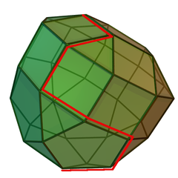
Simplex Algorithm
Traverse the polytope from vertex to vertex in a direction that increases the objective function
When a maximum is reached the problem is solved
Traversing the edges means changing the constraints that are tight

Slide 20
The Simplex Method – more details
Phase 1 (start-up): Find initial feasible vertex.
Phase 2 (iterate):
Can the current objective value be improved by swapping a basic variable? If not - stop.
Select entering variable, e.g. via greedy heuristic: choose the variable that gives the fastest rate of increase in the objective function value.
Select the leaving basic variable by applying the minimum ratio (tightest constraint) test
Update equations to reflect new basic feasible solution.

Slide 21
Degeneracy, Cycling, Pivot Rules
Some (of many) pivot rules:
Largest coefficient (Danzig)
Largest increase
Bland’s rule (entering/exiting vars w/ min index)
Random edge
Steepest edge – seems to be best in practice
In n dimensions, n hyperplanes can define a point. If more intersect at a vertex, the LP is degenerate, and most of the above rules may stall there, i.e., “move” to same vertex (with different basis); some may cycle there: infinite loop
Pathological cases for simplex algorithm can take an exponential number of steps
Not a problem in practice, but this bugged the theorists for years
Notes:
stalling rare; cycling rarer, but obviously to be avoided.
Bland is important because it avoids it
I guess largest increase is stall- and cycle-proof, but slow to compute

Slide 22
Simplex Algorithm Runtime
Algorithm implemented by (m+1) X (m + n + 1) array with row and column operations
Performs well in practice
Worst case performance is exponential on the Klee-Minty cube
Randomized versions are polynomial time
Average case is polynomial time

Slide 23
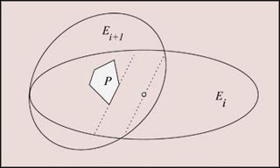
Other algorithms for Linear Programming
Exterior methods
Bound the polytope to find the maximum
Khachiyan [1979]
First polynomial time algorithm
But not really practical
And has numerical stability issues

Slide 24
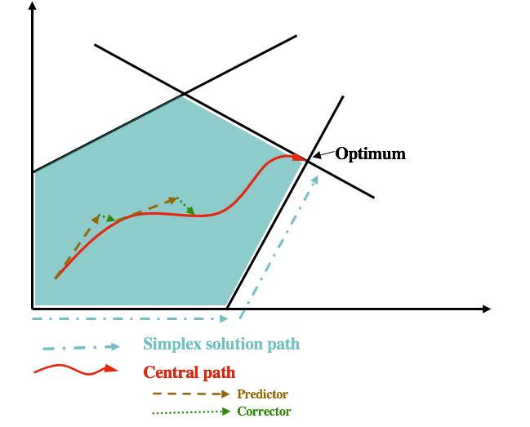
Interior Point Methods
Instead of working on the surface of the polytope (as the simplex algorithm) go through the interior of the polytope
Karmarkar [1987] developed a poly time (and practical) method
Key idea is to have a path in the inside of the polytope that does not break through
Interior point methods have runtimes of O(n³) (or less)

Slide 25
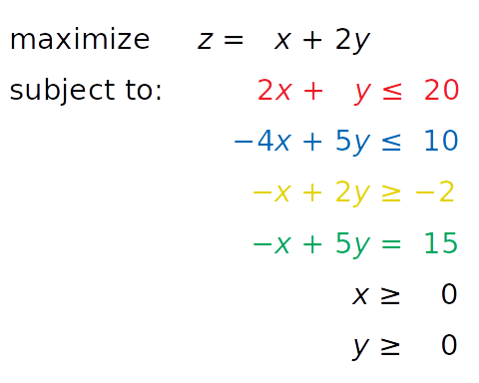
Linear programming algorithms
LP Solver

Slide 26
Linear Program for the Assignment Problem
.32 | .41 | .95 | .83 | .11
.81 | .22 | .54 | .91 | .61
.02 | .41 | .24 | .76 | .86
.16 | .85 | .52 | .85 | .02
.76 | .82 | .82 | .59 | .65
Weighted bipartite matching
Choose assignments to maximize profit
0 ≤ x_{ij} ≤ 1
Σ_{i} x_{ij} = 1
Σ_{j} x_{ij} = 1
max Σ_{ij} a_{ij} x_{ij}
x_{ij} = 1, edge (i,j) is matched
x_{ij} = 0, edge (i,j) is unmatched

Slide 27
Fractional solutions
Optimal solution may be fractional: x₁₂ = 0.5 and x₁₃ = 0.5
For the assignment problem (and network flow), there is a theorem which guarantees the existence of an integer solution
``Total Unimodularity’’
Specific algorithms (e.g., Hungarian Algorithm) will generate the integral solution
LP Algorithm may support the integral solution
Post processing of LP solution may also find integer solution
Round the values while preserving the optimal value

Slide 28
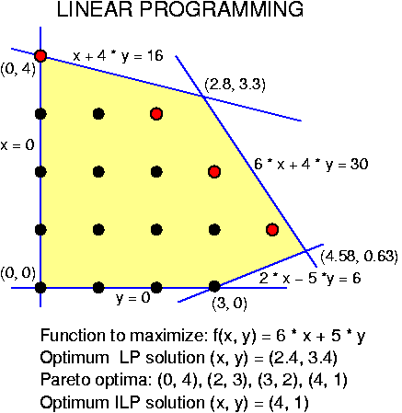
Integer Linear Programming
What if we have a linear program where we require (some) variables to have integer solutions
Rounding does NOT always work
Fractional solutions can be a long way from integer solutions
NP Complete problems can be reduced to ILPs with 0-1 variables
Reduction from satisfiability

Slide 29
Linear Programming Summary
High dimensional algorithms with practical solutions
Relies on geometry
Bridge between Applied Math and Computer Science

Slide 30
Course summary
What was this course about?
Algorithmic ideas
Randomness and average case
Hashing – the use of random functions
Stream based algorithms – small space computation
Working in high dimensions

