Slide 1
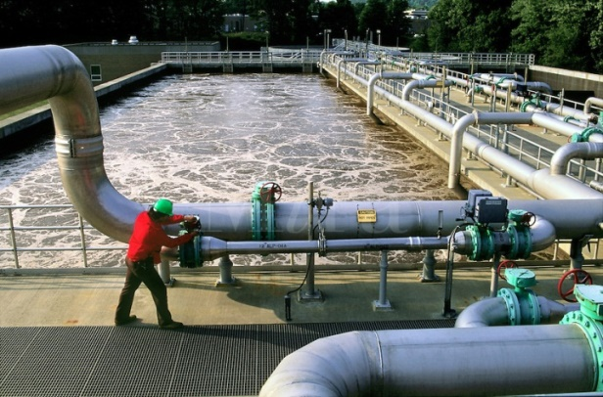
CSEP 521: Network Flow and Linear Programming
Richard Anderson, March 9, 2021

Slide 2
Announcements
Remaining lectures on Optimization
Combinatorial Optimization
Linear Programming
Course Evaluation
You will have received a link
Readings
Skim textbook chapters on Matching/Network Flow (CLRS or KT)
Skim textbook chapters on Linear Programming
DasGupta, Papadimitriou, and Vazarani
Last homework is due Thursday, March 11
Notify instructor if any homework is going to be turned in after March 14

Slide 3
Optimization
Solve a problem by expressing it as minimizing or maximizing a real valued function
Examples:
Page layout
Allocation of industrial materials for a five year plan
Placement of on-line ads
Pricing of airline seats

Slide 4
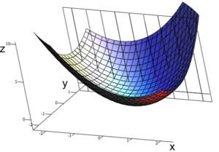
Optimization
Local improvement algorithms
Iteratively improve solution until a local maximum (or minimum) is reached
Prove that the maximum is a global maximum
Duality
Pairs of problems that bound solutions
Finding the maximum for one problem finds the minimum for another problem
Bipartite Matching
Vertex Cover

Slide 5
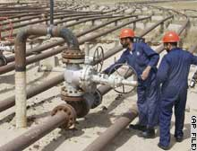
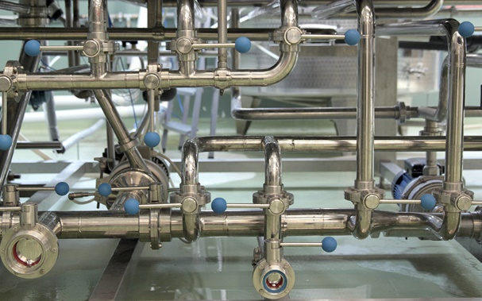
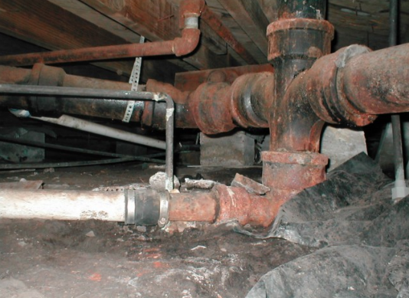
Network Flow
u
20
10
s
30
t
10
20
v

Slide 6
Network Flow Definitions
Flowgraph: Directed graph with distinguished vertices s (source) and t (sink)
Capacities on the edges, c(e) >= 0
Problem, assign flows f(e) to the edges such that:
0 <= f(e) <= c(e)
Flow is conserved at vertices other than s and t
Flow conservation: flow going into a vertex equals the flow going out
The flow leaving the source is a large as possible
u
20
10
s
30
t
10
20
v

Slide 7
20/20
20/20
a
d
g
0/5
0/5
20/20
20/20
5/5
0/5
0/5
5/5
0/20
s
25/30
b
20/20
e
h
30/30
t
20/20
0/5
5/5
20/20
0/5
0/5
15/20
15/25
c
f
i
20/20
10/10

Slide 8
Residual Graph
u
15/20
0/10
s
15/30
t
Flow graph G, Residual Graph G_{R}
G: edge e from u to v with capacity c and flow f
G_{R}: edge e’ from u to v with capacity c – f
G_{R}: edge e’’ from v to u with capacity f
Find a path from s to t in G_{R} with minimum edge capacity (in G_{R}) of b > 0
Add flow b to the path from s to t in G
5/10
20/20
v
u
5
10
15
s
15
15
t
5
5
20
v

Slide 9
Ford-Fulkerson Algorithm (1956)
while not done
Construct residual graph G_{R}
Find an s-t path P in G_{R} with capacity b > 0
Add b units along P in G
If the sum of the capacities of edges leaving S is at most C, then the algorithm takes at most C iterations

Slide 10
Flow Example
20
15
a
d
g
5
20
5
5
10
5
10
5
20
s
20
b
15
e
h
30
t
10
10
5
5
20
5
20
20
c
f
i
15
20

Slide 11
a
20 /10
d
15/10
g
20/10
5
5
5
10/10
5
10
5
20
s
20/10
b
15/10
e
h
30/10
t
10/10
a
20 /15
d
15/15
g
20/15
5
10
5
5
20/15
5
20
20/15
5
5
5
10/10
10/5
5/0
20
c
15/15
f
20/15
i
20/10
30/10
s
b
15/10
e
h
t
10/10
a
20 /15
d
15/15
g
20/15
5
10
5
5/5
20/20
20/15
5
5
5
10/10
20
5
10/5
5/0
20
c
15/15
f
20/15
i
s
20/15
b
15/15
e
h
30/15
t
10/10
20/15
5
10
5/5
5/0
20/20
20
c
15/15
f
20/20
i

Slide 12
a
20 /15
d
15/15
g
20/20
5
5
5
10/10
5
10/5
5/5
20
s
20/15
b
15/15
e
h
30/20
t
20 /20
15/15
10/10
a
d
g
20/15
5
10
5/5
5/0
20/20
20/20
5
5
5/5
10/10
20/5
5/5
10/10
5/5
20/5
c
15/15
f
20/20
i
s
20/20
b
15/15
e
h
30/25
t
10/10
20/15
5
10
5/0
5/0
20/20
20/5
c
15/15
f
20/15
i

Slide 13
Cuts in a graph
Cut: Partition of V into disjoint sets S, T with s in S and t in T.
Cap(S,T): sum of the capacities of edges from S to T
Flow(S,T): net flow out of S
Sum of flows out of S minus sum of flows into S
Flow(S,T) <= Cap(S,T)

Slide 14
Cap(S,T) and Flow(S,T)
S={s, a, b, e, h}, T = {c, f, i, d, g, t}
20/20
20/20
a
d
g
0/5
0/5
20/20
20/20
5/5
0/5
0/5
5/5
0/20
s
25/30
b
20/20
e
h
30/30
t
20/20
0/5
5/5
20/20
0/5
0/10
15/20
15/25
c
f
i
20/20
10/10
Cap(S,T) = 95, Flow(S,T) = 80 – 15 = 65

Slide 15
Minimum value cut
u
40
10
s
10
t
10
40
v

Slide 16
MaxFlow – MinCut Theorem
There exists a flow which has the same value as the minimum cut
This shows that both the flow is maximum and the cut is minimum since the flow is always less than or equal to the cut
The proof is to run the Ford-Fulkerson algorithm until it completes and look at the residual graph
This is a ``duality theorem’’ as the MaxFlow and MinCut problems are duals

Slide 17
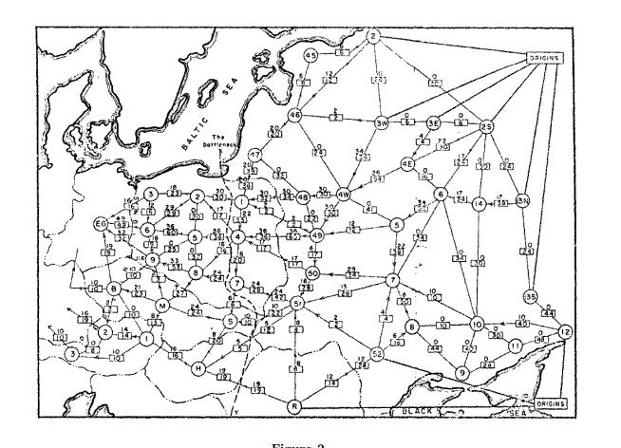
History
Ford / Fulkerson studied network flow in the context of the Soviet Rail Network

Slide 18
Ford Fulkerson Runtime
Cost per phase times number of phases
Phases
Capacity leaving source: C
Add at least one unit per phase
Cost per phase
Build residual graph: O(m)
Find s-t path in residual: O(m)
u
1000
1000
s
1
t
1000
1000
v

Slide 19
Better methods of finding augmenting paths
Find the maximum capacity augmenting path
O(m²log(C)) time algorithm for network flow
Find the shortest augmenting path
O(m²n) time algorithm for network flow
Find a blocking flow in the residual graph
O(mnlog n) time algorithm for network flow

Slide 20
Network Flow Applications

Slide 21
Converting Matching to Network Flow
s
t

Slide 22
Resource Allocation: Assignment of reviewers
A set of papers P₁, . . ., P_{n}
A set of reviewers R₁, . . ., R_{m}
Paper P_{i} requires A_{i} reviewers
Reviewer R_{j} can review B_{j} papers
For each reviewer R_{j}, there is a list of paper L_{j1}, . . ., L_{jk} that R_{j} is qualified to review
s
B₁
B₂
B₃
B₄
B₅
R₁
R₂
R₃
R₄
R₅
P₁
P₂
P₃
P₄
P₅
A₂
A₃
A₄
A₁
A₅
t

Slide 23
Image Segmentation
Separate foreground from background
s
a_{v}
p_{vu}
u
v
p_{uv}
b_{v}
t

Slide 24
MinCost Network Flow Problem
Directed graph with source and sink
Each edge has a capacity c(e) and a cost d(e)
A total flow value K is specified
Find a flow function f(e) on the edges such that
0 ≤ f(e) ≤ c(e)
Sum of the flows leaving the source is K
Flow is conserved at the vertices
The cost of the flow, Σ_{e} f(e)d(e), is minimized

Slide 25
Applications of min cost flow
Transportation problems – taking cost into account
An oil company is charged for using pipeline
Allocation problems
Account for costs and profits
Showing internet ads
Certain number of ads of different types are available to show
Ads are required to reach certain demographics
Different profits associated with different users

Slide 26
Mincost Flow
K = 7
2:1
3:3
3:1
3:1
2:1
4:2
4:4
3:2
1:1
2:3
2:2
3:1
3:4

Slide 27
Solving MinCost Flow
25:0
u
Circulation – a flow problem with no source or sink
Add an edge from t to s with capacity K
Find a flow of size K (K units leaving s)
Build residual graph G_{R} (except for (t,s) )
G: edge e from u to v with capacity c, cost d, and flow f
G_{R}: edge e’ from u to v with capacity c – f, cost d
G_{R}: edge e’’ from v to u with capacity f, cost -d
40:3
10:3
s
10:1
t
10:2
40: 1
v

Slide 28
Mincost flow algorithm
while not done
Construct residual graph G_{R}
Find negative cost cycle C in G_{R} with capacity b > 0
Add b units along C in G
Adding flow along a cycle preserves the conservation of flow
With negative cost cycles the cost keeps decreasing
We could prove that when this stops, it has an optimal solution
Basic algorithm needs serious engineering to make it practical

