Slide 1
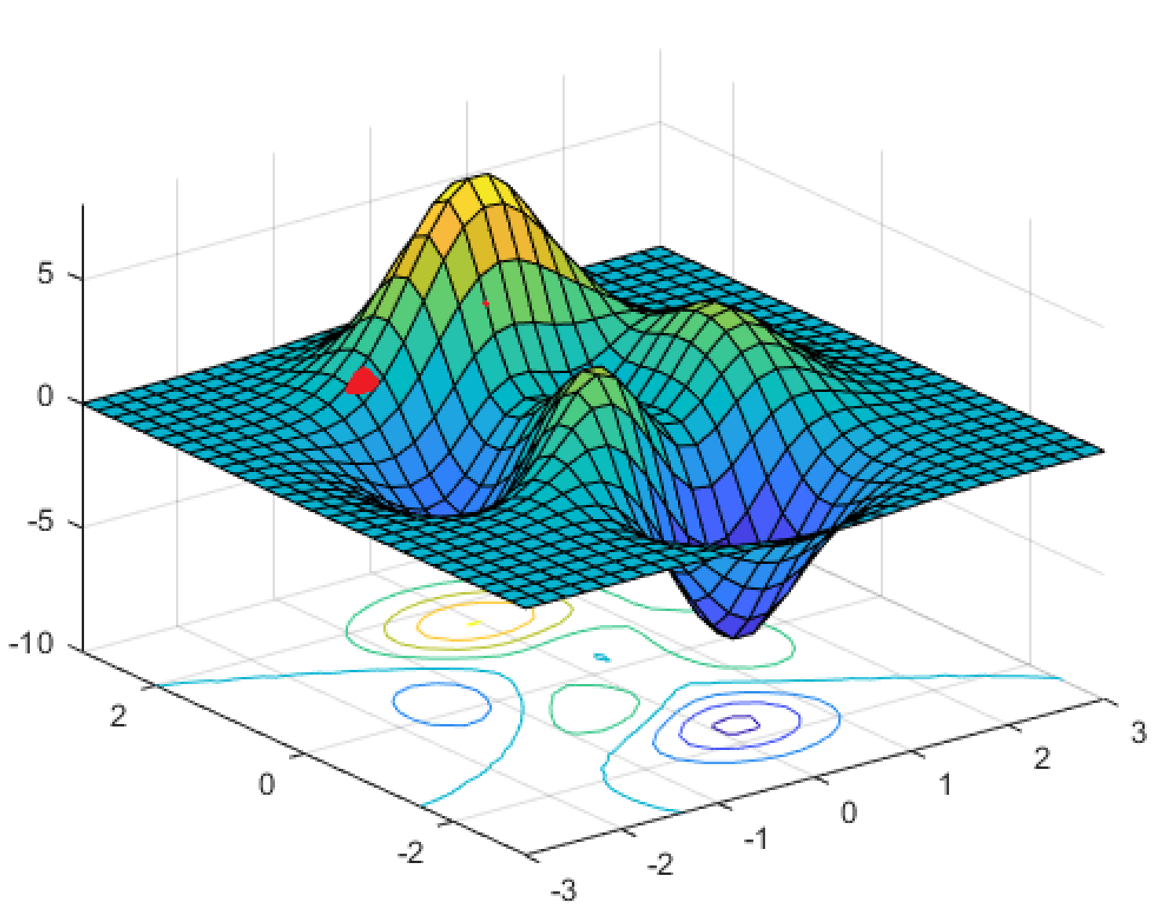
CSEP 521: Optimization
Richard Anderson, March 4, 2021

Slide 2
Announcements
Remaining lectures on Optimization
Combinatorial Optimization
Linear Programming
Readings
Skim textbook chapters on Matching/Network Flow (CLRS or KT)
Linear programming readings should be available Friday
Last homework is due Thursday, March 11
Notify instructor if any homework is going to be turned in after March 14

Slide 3
Algorithmic Ideas
Randomized algorithms and expected case analysis
Hashing techniques
Sketches and ultra low-space algorithms
Geometry and high dimensional data

Slide 4
Optimization
Express a problem as a mathematical function, and then find a solution that minimizes or maximizes the objective function
Domain
Instance
Solution
Optimization Function
Vaccine allocation – determine what order people get vaccines
Output: Partial order on the set of all people in Washington
Objective function: Minimize the DALYs (Disability-adjusted life years) due to Covid

Slide 5
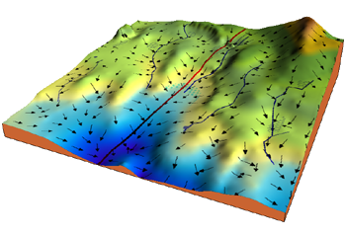
One big, obvious idea
Local improvement algorithms
Start with a valid solution
Keep modifying the solution as long as it improves
When done, hope you have a maximum
Geometry of solution space
When is a local solution guaranteed to be a global solution?

Slide 6
Another big, less obvious idea
Duality – pairing a maximization problem with a corresponding minimization problem
Pairs of problems over a domain D
P₁: Solution S₁, Optimization F₁
P₂: Solution S₂, Optimization F₂
I ∈ D, s ∈ S₁(I), t ∈ S₂(I), F₁(s) ≤ F₂(t)
I ∈ D, Max { x ∈ S₁(I) | F₁(x) } = Min { y ∈ S₂(I) | F₂(y) }

Slide 7
Bipartite Matching
Given a bipartite graph G=(U,V,E), find a subset of the edges M of maximum size with no common endpoints.
Application:
U: Professors
V: Courses
(u,v) in E if Prof. u can teach course v

Slide 8
Find a maximum matching

Slide 9
Augmenting Path Algorithm
s
t
Trace path from s to t to
show augmenting path

Slide 10
Bipartite Matching
M = ∅;
while ((P = AugmentingPath(G, M)) != null)
M = M ⊕ P
AugmentingPath(G=(U,V,E), M){
Orient edges in M from U to V
Orient edges not in M from V to U
Find a path P from an unmatched vertex in U to
an unmatched vertex in V
return P
Is the symmetric difference (XOR) operator on sets
Path can be found with a standard path finding algorithm
Each time a path is found the number of edges in the matching increases
Simple runtime is O(nm), can be improved to O(n^{1/2}m)

Slide 11
Vertex Cover (for bipartite graphs)
A vertex cover for a graph G=(V,E) is a set of vertices C, such that every edge has at least on endpoint in C
If C is a vertex cover and M is a matching |C| ≥ |M|

Slide 12
Weighted Matching
Let G=(U,V,E) be a bipartite graph with weights assigned to the edges
For simplicity, we are going to assume
|U|=|V|=n
This is a complete graph
w(u,v) ≥ 0 for u ∈ U and v ∈ V
We want to find a complete matching (|M| = n) of minimum weight

Slide 13
Weighted Matching Algorithm
Given a graph with a complete matching M, find a matching M’ with w(M’) < w(M)
Iterate until you can no longer improve the solution
Show that when this process stops you are at a global minimum
To establish runtime, derive a bound on the number of iterations

Slide 14
Augmenting cycles for matching M
1
3
2
2
4
Construct a directed graph:
If (u,v) ∈ M
(u,v) ∈ E with w’(u,v) = - w(u,v)
If (u,v) ∉ M
(v,u) ∈ E with w’(v,u) = w(u,v)
Find a negative cost cycle C with the Bellman-Ford Algorithm
Update the matching to M’ = M⊕C
3
2
1
3
-2
-2
-4
3
2
1
3
-2
-2
-4
3
2
1
3
2
2
4
3
2

Slide 15
Weighted Matching
Also called the Assignment Problem
Standard Algorithm is the Hungarian Algorithm
Runtime is O(n³) or O(nm + n² log n)
Implementation as an n×n matrix
Same ideas work for finding maximum weight matching

Slide 16
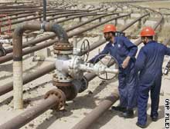
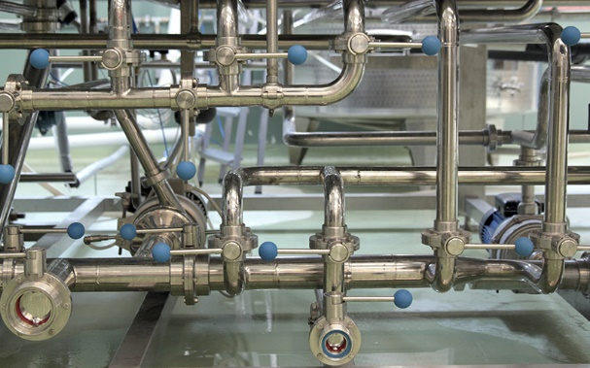
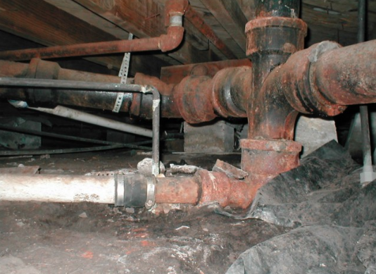
Network Flow
u
20
10
s
30
t
10
20
v

Slide 17
Network Flow Definitions
Flowgraph: Directed graph with distinguished vertices s (source) and t (sink)
Capacities on the edges, c(e) >= 0
Problem, assign flows f(e) to the edges such that:
0 <= f(e) <= c(e)
Flow is conserved at vertices other than s and t
Flow conservation: flow going into a vertex equals the flow going out
The flow leaving the source is a large as possible

Slide 18
Maximum flow example
20/20
20/20
a
d
g
0/5
0/5
20/20
20/20
5/5
0/5
0/5
5/5
0/20
s
25/30
b
20/20
e
h
30/30
t
20/20
0/5
5/5
20/20
0/5
0/5
15/20
15/25
c
f
i
20/20
10/10

Slide 19
Residual Graph
Flow graph showing the remaining capacity
Flow graph G, Residual Graph G_{R}
G: edge e from u to v with capacity c and flow f
G_{R}: edge e’ from u to v with capacity c – f
G_{R}: edge e’’ from v to u with capacity f
Find a path from s to t in G_{R} with minimum edge capacity (in G_{R}) of b > 0
Add flow b to the path from s to t in G

Slide 20
Flow assignment and the residual graph
u
u
15/20
0/10
5
10
15
s
15/30
t
15
15
s
t
5
5/10
20/20
5
20
v
v

Slide 21
Ford-Fulkerson Algorithm (1956)
while not done
Construct residual graph G_{R}
Find an s-t path P in G_{R} with capacity b > 0
Add b units along in G
If the sum of the capacities of edges leaving S is at most C, then the algorithm takes at most C iterations

Slide 22
Flow Example
20
15
a
d
g
5
20
5
5
10
5
10
5
20
s
20
b
15
e
h
30
t
10
10
5
5
20
5
20
20
c
f
i
15
20

Slide 23
Cuts in a graph
Cut: Partition of V into disjoint sets S, T with s in S and t in T.
Cap(S,T): sum of the capacities of edges from S to T
Flow(S,T): net flow out of S
Sum of flows out of S minus sum of flows into S
Flow(S,T) <= Cap(S,T)

Slide 24
Cap(S,T) and Flow(S,T)
S={s, a, b, e, h}, T = {c, f, i, d, g, t}
20/20
20/20
a
d
g
0/5
0/5
20/20
20/20
5/5
0/5
0/5
5/5
0/20
s
25/30
b
20/20
e
h
30/30
t
20/20
0/5
5/5
20/20
0/5
0/10
15/20
15/25
c
f
i
20/20
10/10
Cap(S,T) = 95, Flow(S,T) = 80 – 15 = 65

Slide 25
Minimum value cut
u
40
10
s
10
t
10
40
v

Slide 26
MaxFlow – MinCut Theorem
There exists a flow which has the same value as the minimum cut
This shows that both the flow is maximum and the cut is minimum since the flow is always less than or equal to the cut
The proof is to run the Ford-Fulkerson algorithm until it completes and look at the residual graph
This is a ``duality theorem’’ as the MaxFlow and MinCut problems are duals

Slide 27
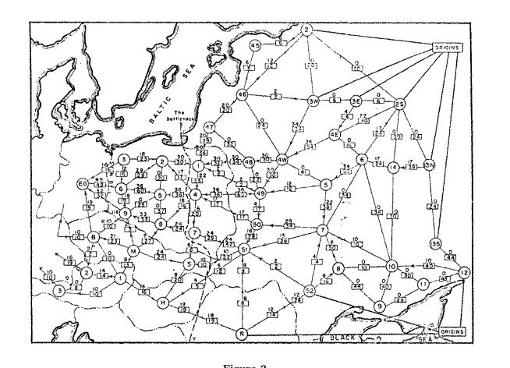
History
Ford / Fulkerson studied network flow in the context of the Soviet Rail Network

Slide 28
Ford Fulkerson Runtime
Cost per phase times number of phases
Phases
Capacity leaving source: C
Add at least one unit per phase
Cost per phase
Build residual graph: O(m)
Find s-t path in residual: O(m)
u
1000
1000
s
1
t
1000
1000
v

Slide 29
Better methods of finding augmenting paths
Find the maximum capacity augmenting path
O(m²log(C)) time algorithm for network flow
Find the shortest augmenting path
O(m²n) time algorithm for network flow
Find a blocking flow in the residual graph
O(mnlog n) time algorithm for network flow

