Slide 1
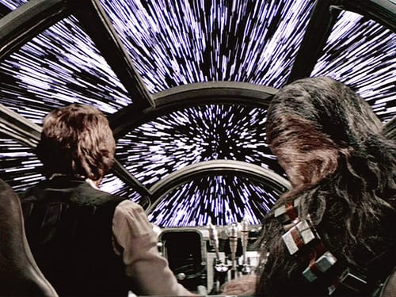
CSEP 521: Dimension Reduction
Richard Anderson, March 2, 2021

Slide 2
Announcements
Homework 9 is available, Due March 11.
Course grade based on top 8 of 9 homeworks. All weighted equally.
Remaining lectures
Optimization to linear programming and beyond

Slide 3
Dimension Reduction
A key problem in working with large scale data sets
Can we reduce representation size at the expense of a small error

Slide 4
Warmup for dimension reduction for R^{n}
Consider the distance function D(x,y) = 0 if x = y, D(x,y) = 1 if x ≠ y
Suppose we have a domain U and want to answer distance queries between a set of n elements
Natural solution is to use log₂ U bits to describe the elements
Can we use less space if we want to approximately answer distance queries
Scenario: We have a database of objects (e.g. people), and a field with domain U (e.g. favorite movie) – we are interested in reducing the space required to store the field info and to answer the query of whether or not X and Y have the same favorite movie.

Slide 5
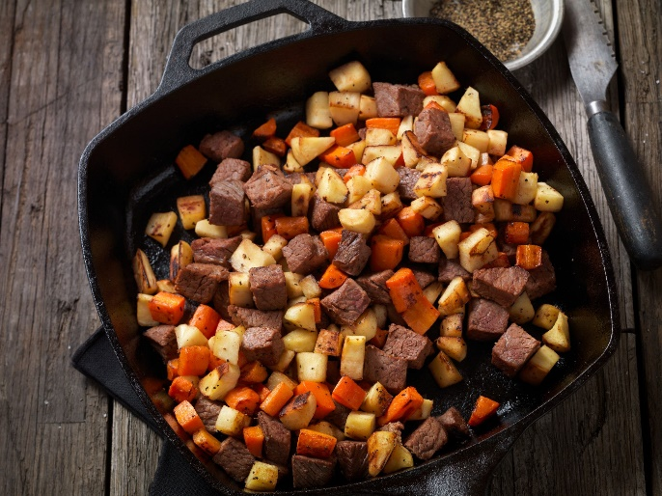
Of course this is going to be hashing
Choose a good hash function h: U → 2³²
Let f₁(x) = h(x) mod 2
1 bit representation
If x = y, then f₁(x) = f₁(y)
If x ≠ y, then Pr[f₁(x) = f₁(y)] ≤ ½
Property preserved with probability at least 50%
Repeat with k independent has functions h₁, . . . , h_{k}
If x = y, then f_{i}(x) = f_{i}(y) for all i = 1, . . ., k
If x ≠ y, then Pr[f_{i}(x) = f_{i}(y) for all i = 1, . . ., k] ≤ 2^{-k}
To achieve error of δ, we need to use k = ⎡log₂ 1/δ⎤

Slide 6
Random Projections for L₂ Distance in R^{N}
Johnson-Lindenstrauss Transform
Extensions of Lipschitz mappings into a Hilbert space, William Johnson and Joram Lindenstrauss, 1984
Pure mathematics result that crossed over to Computer Science
Project from R^{N} to a random R^{K} dimensional subspace where K is O(ε⁻² log N) and distances are preserved to a factor of 1+ε
In practice, K≈100

Slide 7
Projections
Projection onto a line
Inner Product
If b is a unit vector than a . b gives the position of a when projected onto b
Project [4, -1, 3 ] onto [2, 1, 1]

Slide 8
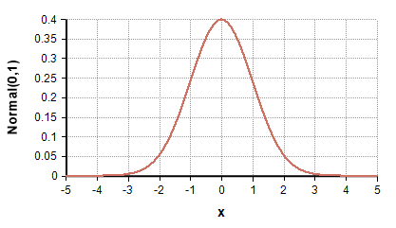
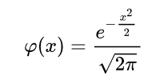
Gaussian Distribution
N(μ,σ²) – Normal distribution with mean μ and variance σ²
X₁ and X₂ are independent random variables with distribution N(μ₁,σ₁²) and N(μ₂,σ₂²) then X₁ + X₂ has distribution N(μ₁+ μ₂,σ₁²+ σ₂²)

Slide 9
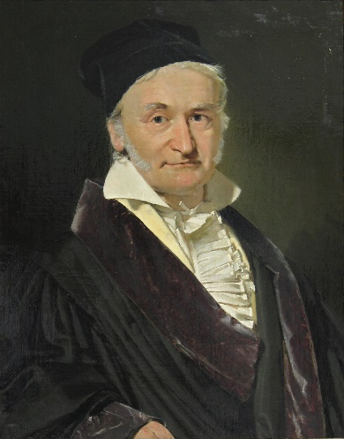
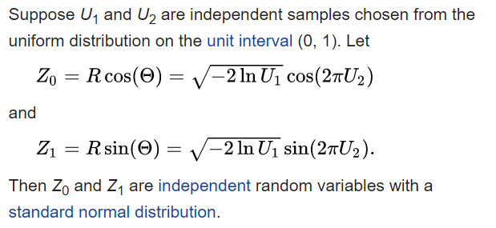
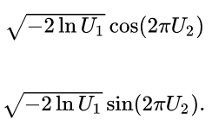
Aside: Generating Gaussians
Box-Muller methods generates a pair of independent Gaussian RVs from two random points from [0,1)
Mapping of unit square to independent Gaussians
Many languages have a Gaussian generator (Matlab, Python, Java)
Web sites will generate them for you

Slide 10
Random Projection
Objects are points in n dimensional Euclidean space R^{n}
Choose random vector r = (r₁, . . ., r_{n}) ∈ R^{n}
Real valued function f_{r} : R^{n} → R
Random linear combination of components of x

Slide 11
Unbiased Estimator of Squared L₂ Distance
For x, y in R^{n}, (f_{r}(x) – f_{r}(y))² is an unbiased estimator of |x - y|²
Fix x, y in R^{n}
r_{j} is a Gaussian with mean zero and variance 1, (x_{j}-y_{j})r_{j} is a Gaussian with mean zero and variance (x_{j} – y_{j})²
Right-hand side is a Gaussian with mean zero and variance

Slide 12
Cont.
By definition Var(X) = E((X – E(X])²), so Var(X) = E(X²) when E(X) = 0
Taking X as the random variable f_{r}(x) – f_{r}(y)
Estimator of the squared L₂ distance between x and y

Slide 13
Independent Trials
Pick d vectors r₁, . . ., r_{d}
Each vector is drawn i.i.d. from a standard Gaussian
Given points x, y, we get d independent estimates of |x-y|²
“One can figure out exactly how large d needs to be to achieve a target approximation’’
For a set of k points in n dimensions, to preserve all k(k-1)/2 interpoint Euclidean distances up to a 1 ± ε factor, set d = Θ(ε⁻² log k)

Slide 14
Johnson-Lindenstrauss Transform
JL transform maps from R^{n} to R^{d}, where d is selected based on desired accuracy
The JL transform is represented as a d×n matrix A where each of the dn entries is chosen i.i.d. from a standard Gaussian distribution
Mapping from n vectors to d vectors is defined x → Ax / sqrt(d)
1/sqrt(d) factor scales to be an average over d estimates

Slide 15
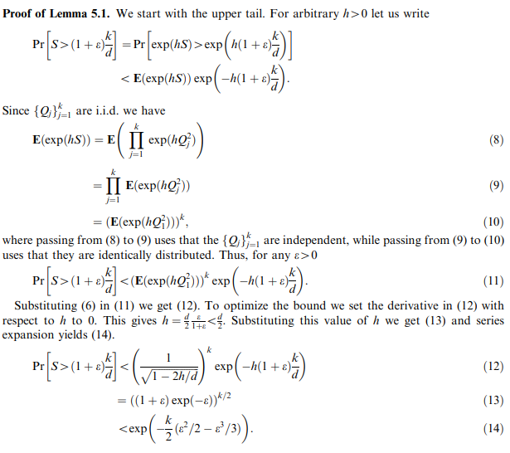
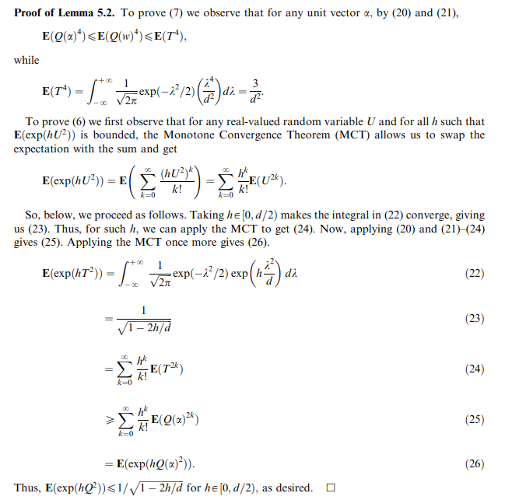
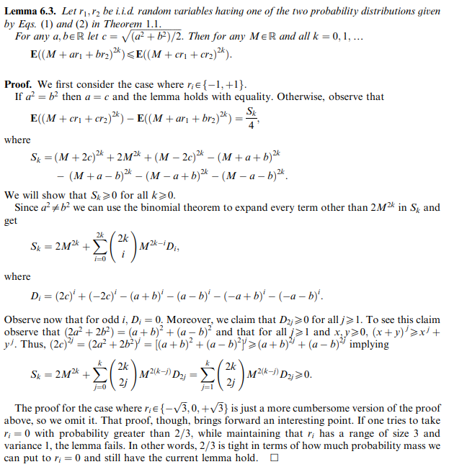
Simplification
D. Achlioptas (2003). Similar results hold if matrix entries are chosen uniformly from {-1, 1} or from {-sqrt(3), 0, sqrt(3)} with probability 1/6, 2/3, 1/6 respectively
Proof:

Slide 16
Applications
High dimensional data sets
Facebook
Friend neighborhood
Stories followed
Biochemistry
Candidate compounds for pharmaceuticals
Youtube
Videos watched
Phone metadata
Numbers called

Slide 17
Range queries
Queries such as “k-Nearest Neighbors”, all points within distance B, count points within distance B
Standard approach – reduce dimension and search using k-D trees*
Results subject to errors by factors of 1±ε
k-Nearest Neighbors
Given query point y, return k points within (1+ε)B of y, where B is the k-NN distance from y
Points with distance B
Given query point y, return a set of points which contains all points within distance (1- ε)B of y and no point of distance greater than (1+ ε)B of y
* Different k

Slide 18
k-means clustering
Given S, a set of n points in R^{m}, find k representative points in R^{m} that that best partition the data into clusters
Application – use these points for classification – a new point finds it nearest neighbor among the k points. Rocchio Algorithm.
Partition the space into Voronoi cells
k-clustering of S is a partition into k subsets
The cluster-variance is the sum of the squares of the distances of each point to the respective center of its cluster
The k-means clustering of a set S is the k-clustering that minimizes the cluster-variance
Finding the optimal k-means cluster is NP-Hard, but we will ignore that

Slide 19
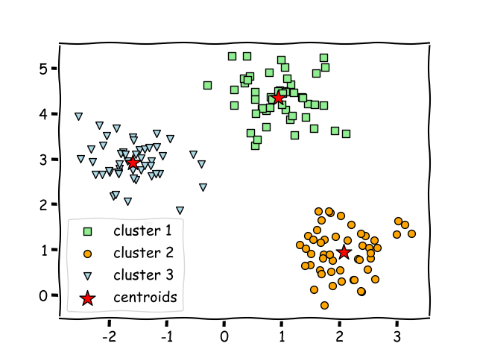
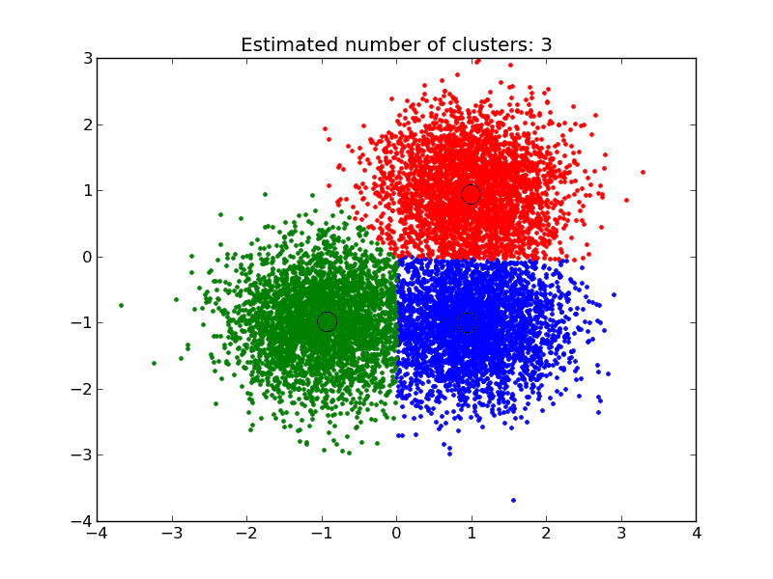
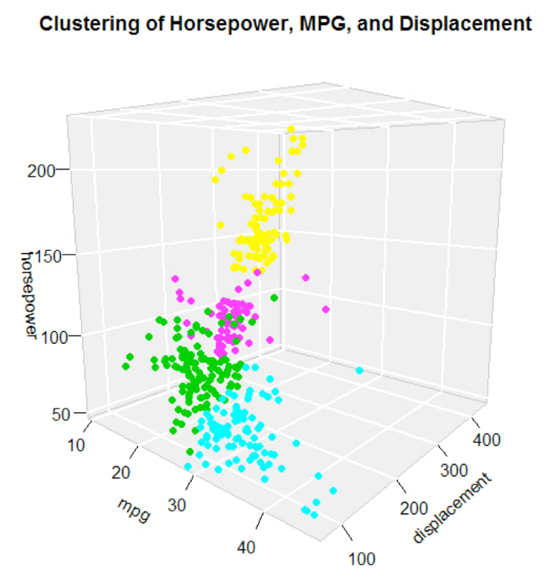
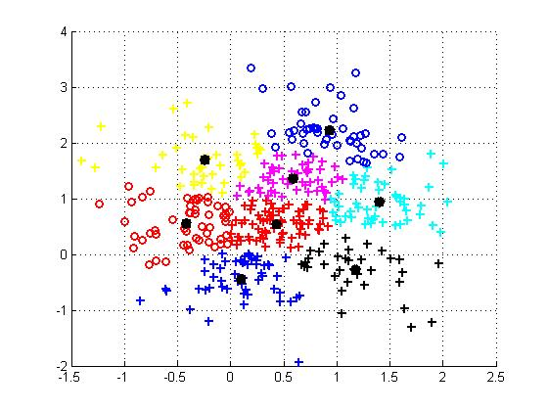

Slide 20
Higher dimensional clustering
It gets harder to draw!
Same idea works in high dimensions
Results show that k-means clustering can be done after dimension reduction, greatly improving performance of constructing and using clustering (at the expense of 1+ε error)
Heuristic algorithms are used to construct a k-means clustering (with common confusion between the algorithm and the definition of clustering)

Slide 21
Lloyd’s Algorithm (Stuart Lloyd, Bell Labs, 1957)
Iterative algorithm that (usually) converges to a good approximation.
Pick an initial clustering
Repeat until tired
Compute centers of clusters
Reassign points to closest center

Slide 22
Lloyd’s Algorithm
for (int i = 0; i < N; i++){
CS.AddPoint(i, i % K);
}
int count = 0;
while (count < TOO_LONG){
CS.SetCenters();
bool moved = false;
for (int i = 0; i < N; i++){
int g = CS.Group(i);
double d_min = dist(P[i], CS.Center(g));
for (j = 0; j < K; j++){
if (j == CS.Group(i))
continue;
double d = dist(P[i], CS.Center(g));
if (d < d_min){
g = j; d_min = d;
}
}
if (g != CS.Group(i)){
CS.MovePoint(i, g);
moved = true;
}
}
count++;
if (! moved)
break;
}
CS is a ClusterSet which associates points with clusters and maintains the centers of the clusters.
Methods
AddPoint(int i, int g);
MovePoint(int i, int g);
SetCenters();
Group(int i);
Center(int g);

