Slide 1
CSEP 521: Applied Algorithms Lecture 16 – Document Similarity
Richard Anderson, February 25, 2021

Slide 2
Announcements

Slide 3
Topics
Document similarity
MinHash
String similarity
Edit Distance / Longest Common Subsequence
Sharding strings
Dimension reduction

Slide 4
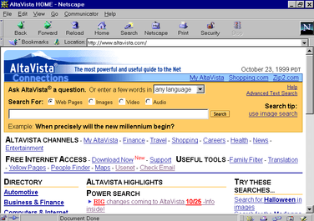
Document Similarity
Want to be able to identify documents that are “very close” to each other
Very large number of documents
Individually pre-process documents
Save a small amount of data per document (sketch)
Perform similarity tests based on sketch

Slide 5
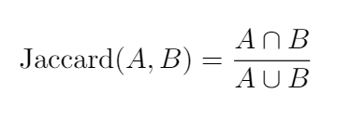
Jaccard Similarity
A
B
Let X be the characteristic vector for A where x_{j} is the multiplicity of item j
and Y be the characteristic vector for B where y_{j} is the multiplicity of item j.

Slide 6
Representation scheme
far out in the uncharted backwaters of the
unfashionable end of the western spiral arm of the
galaxy lies a small unregarded yellow sun
far out in the uncharted
out in the uncharted backwaters
in the uncharted backwaters of
the uncharted backwaters of the
uncharted backwaters of the unfashionable
backwaters of the unfashionable end
of the unfashionable end of
the unfashionable end of the
unfashionable end of the western
end of the western spiral
of the western spiral arm
the western spiral arm of
Tokenize document
Break document into shards
Hash each shard into a domain of size 2⁶⁴ (unsigned long)
Treat as a bag of words*
Use Jaccard similarity measure
* In this application, we use bag of words without multiplicity

Slide 7
Similarity testing
Identify document pairs that have high similarity by doing pairwise comparison
Precompute hashes of shards – n shards for document of n tokens
Cost of comparison is O(n)
How to improve this: reduce the amount of information stored per document

Slide 8
MinHash
U is the domain (in this case, the hash of the shards, [0 . . . 2⁶⁴))
Choose a random permutation π on U
Let A ⊆ U
MinHash(A) = argmin_{x∈A} π(x)
MinHash is the smallest element of A under the random permutation
U = {a, b, c, d, e, f, g, h, i, j }
A = { b, c, e, g }
B = { c, e, f }
π₁ = [ a, c, d, i, j, h, b, e, f, g ]
π₂ = [ j, i, g, c, b, h, e, a, d, f ]

Slide 9
An amazing result
A
B
U

Slide 10
Using the MinHash
Identify document pairs where Jaccard(A,B) ≥ 0.95
Run MinHash with k independent random permutations
Number of times MinHash(A)=MinHash(B) is a good estimate of Jaccard Similarity
Compute the k MinHashes for each documents as a sketch
Comparison of documents requires k comparisons

Slide 11
Similarity of Strings
String edit distance – how many edits to convert S₁ into S₂
Edit operations: Add character, Remove character, (Change character)

Slide 12
BARTHOLEMEWSIMPSON → KRUSTYTHECLOWN
B | A | R | T | H | O | L | E | M | E | W | S | I | M | P | S | O | N |  |  |  | B-
A | R | T | H | O | L | E | M | E | W | S | I | M | P | S | O | N |  |  |  |  | A-
R | T | H | O | L | E | M | E | W | S | I | M | P | S | O | N |  |  |  |  |  | K+
K | R | T | H | O | L | E | M | E | W | S | I | M | P | S | O | N |  |  |  |  | U+
K | R | U | T | H | O | L | E | M | E | W | S | I | M | P | S | O | N |  |  |  | S+
K | R | U | S | T | H | O | L | E | M | E | W | S | I | M | P | S | O | N |  |  | Y+
K | R | U | S | T | Y | H | O | L | E | M | E | W | S | I | M | P | S | O | N |  | T+
K | R | U | S | T | Y | T | H | O | L | E | M | E | W | S | I | M | P | S | O | N | O-
K | R | U | S | T | Y | T | H | L | E | M | E | W | S | I | M | P | S | O | N |  | L-
K | R | U | S | T | Y | T | H | E | M | E | W | S | I | M | P | S | O | N |  |  | M-
K | R | U | S | T | Y | T | H | E | E | W | S | I | M | P | S | O | N |  |  |  | E-
K | R | U | S | T | Y | T | H | E | W | S | I | M | P | S | O | N |  |  |  |  | C+
K | R | U | S | T | Y | T | H | E | C | W | S | I | M | P | S | O | N |  |  |  | L+

Slide 13
BARTHOLEMEWSIMPSON → KRUSTYTHECLOWN
K | R | U | S | T | Y | T | H | E | C | L | W | S | I | M | P | S | O | N |  |  | O+
K | R | U | S | T | Y | T | H | E | C | L | O | W | S | I | M | P | S | O | N |  | S-
K | R | U | S | T | Y | T | H | E | C | L | O | W | I | M | P | S | O | N |  |  | I-
K | R | U | S | T | Y | T | H | E | C | L | O | W | M | P | S | O | N |  |  |  | M-
K | R | U | S | T | Y | T | H | E | C | L | O | W | P | S | O | N |  |  |  |  | P-
K | R | U | S | T | Y | T | H | E | C | L | O | W | S | O | N |  |  |  |  |  | S-
K | R | U | S | T | Y | T | H | E | C | L | O | W | O | N |  |  |  |  |  |  | O-
K | R | U | S | T | Y | T | H | E | C | L | O | W | N

Slide 14
Longest Common Subsequence
C=c₁…c_{g} is a subsequence of A=a₁…a_{m} if C can be obtained by removing elements from A (but retaining order)
LCS(A, B): A maximum length sequence that is a subsequence of both A and B
ocurranec
occurrence
attacggct
tacgacca
bartholemewsimpson
krustytheclown

Slide 15
Edit Distance and LCS
String A has length n and B has length m
Suppose that A is converted to B by removing k characters and adding j characters
Number of unchanged characters is c = n – k = m – j
Edit distance d is k + j
n + m = 2c + k + j = 2c + d
d = n + m – 2c
Minimizing the edit distance is maximizing the length of the common sequence

Slide 16
LCS Optimization
A = a₁a₂…a_{m}
B = b₁b₂…b_{n}
Opt[ j, k] is the length of LCS(a₁a₂…a_{j}, b₁b₂…b_{k})
Optimization recurrence
If a_{j} = b_{k}, Opt[ j,k ] = 1 + Opt[ j-1, k-1 ]
If a_{j} ≠ b_{k}, Opt[ j,k] = max(Opt[ j-1,k], Opt[ j,k-1])
Opt[j,0] = Opt[0,k] = 0

Slide 17
Dynamic Programming Computation

Slide 18
Code to compute Opt[ n, m]
for (int i = 0; i < n; i++)
for (int j = 0; j < m; j++)
if (A[ i ] == B[ j ] )
Opt[ i,j ] = Opt[ i-1, j-1 ] + 1;
else if (Opt[ i-1, j ] >= Opt[ i, j-1 ])
Opt[ i, j ] := Opt[ i-1, j ];
else
Opt[ i, j ] := Opt[ i, j-1];

Slide 19
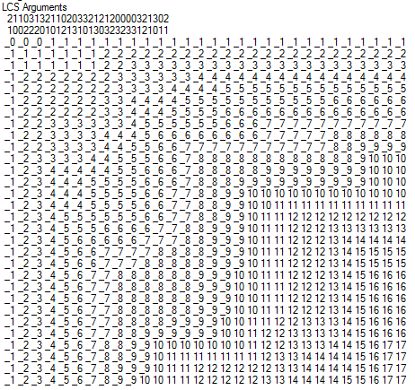
Computing the Longest Common Subsequence

Slide 20
LCS Performance
Runtime is O(n²) for a pair of strings of length n
Space requirement is O(n²)
Which can be reduced to O(n) be reusing rows
Recovering the actual LCS is more work, but can also be done in O(n) space
Experiment: compute the length of two random bit strings (alphabet size 2)
N: 10000 Base 2 Length: 8096 Gamma: 0.8096 Runtime:00:00:01.86
N: 20000 Base 2 Length: 16231 Gamma: 0.81155 Runtime:00:00:07.45
N: 30000 Base 2 Length: 24317 Gamma: 0.8105667 Runtime:00:00:16.82
N: 40000 Base 2 Length: 32510 Gamma: 0.81275 Runtime:00:00:29.84
N: 50000 Base 2 Length: 40563 Gamma: 0.81126 Runtime:00:00:46.78
N: 60000 Base 2 Length: 48700 Gamma: 0.8116667 Runtime:00:01:08.06
. . . . .
N: 300000 Base 2 Length: 243605 Gamma: 0.8120167 Runtime:00:28:07.32

Slide 21
Space efficient implementation
public int SpaceEfficientLCS() {
int n = str1.Length;
int m = str2.Length;
int[] prevRow = new int[m + 1];
int[] currRow = new int[m + 1];
for (int j = 0; j <= m; j++)
prevRow[j] = 0;
for (int i = 1; i <= n; i++) {
currRow[0] = 0;
for (int j = 1; j <= m; j++) {
if (str1[i - 1] == str2[j - 1])
currRow[j] = prevRow[j - 1] + 1;
else if (prevRow[j] >= currRow[j - 1])
currRow[j] = prevRow[j];
else
currRow[j] = currRow[j - 1];
}
for (int j = 1; j <= m; j++)
prevRow[j] = currRow[j];
}
return currRow[m];
}

Slide 22
String similarity
Edit distance
Advantages – measure of distance between strings
Flexibility in edit operation and weighting
Disadvantages
Relatively inefficient: O(n²), heuristics may help for large strings or looking for similarity
Requires looking at the entire string

Slide 23
String similarity with shards
Same basic idea as with documents
Consider alphabets with a small number of characters, e.g., {a, c, t, g}
Take shards as being strings of length k
k a multiple of 32 would make sense for packing into long ints
Hashing and minhash sketches apply as for documents
Domain characteristics may be important
Mutation rate / distribution in sequences

Slide 24
Coming next: Dimension reduction for R^{n}
Consider the distance function D(x,y) = 0 if x = y, D(x,y) = 1 if x ≠ y
Suppose we have a domain U and want to answer distance queries between a set of n elements
Natural solution is to use log₂ U bits to describe the elements
Can we use less space if we want to approximately answer distance queries

Slide 25
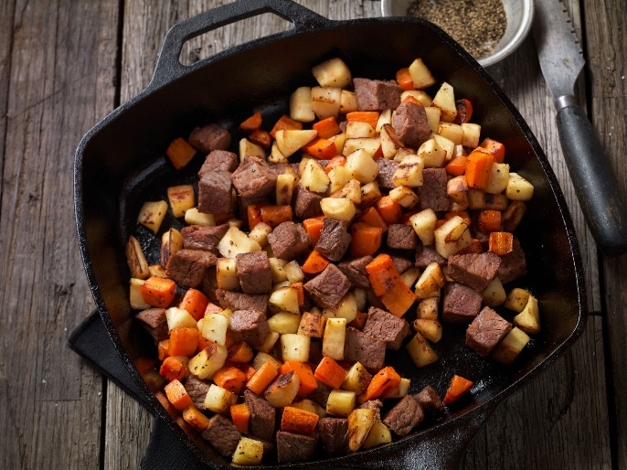
Of course this is going to be hashing
Choose a good hash function h: U → 2³²
Let f₁(x) = h(x) mod 2
1 bit representation
If x = y, then f₁(x) = f₁(y)
If x ≠ y, then Pr[f₁(x) = f₁(y)] ≤ ½
Property preserved with probability at least 50%
Repeat with k independent has functions h₁, . . . , h_{k}
If x = y, then f_{i}(x) = f_{i}(y) for all i = 1, . . ., k
If x ≠ y, then Pr[f_{i}(x) = f_{i}(y) for all i = 1, . . ., k] ≤ 2^{-k}
To achieve error of δ, we need to use k = ⎡log₂ 1/δ⎤

