Slide 1
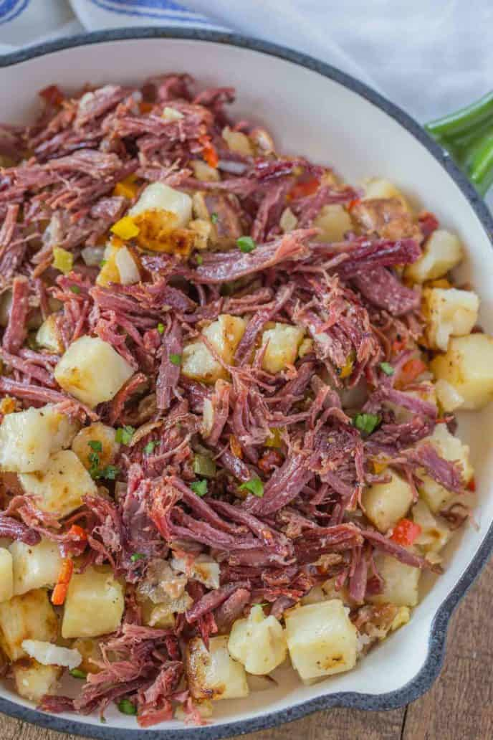
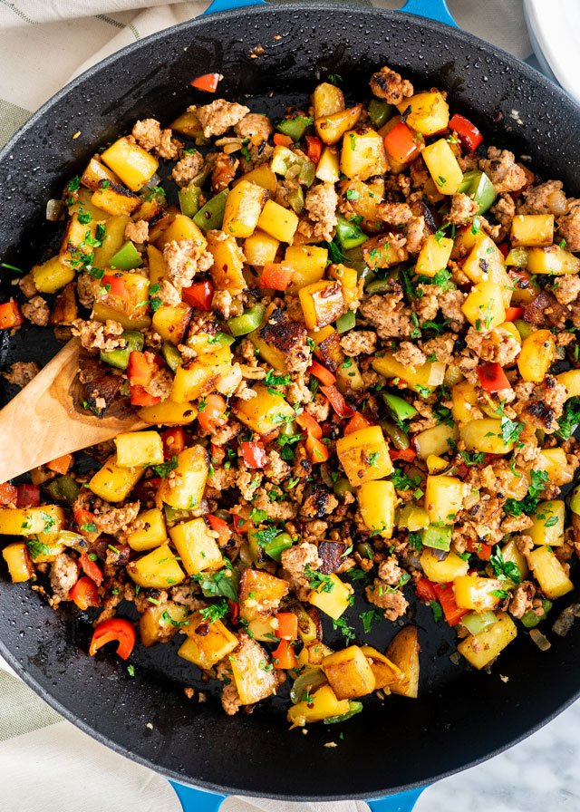
CSEP 521: Applied Algorithms Lecture 15 – Nearest neighbors
Richard Anderson, February 23, 2021

Slide 2
Announcements
HW 8 available
HW 9 will be due March 11
All work should be turned in by March 18
Grading based on top 8 of 9 assignments
Late days will be computed at end of term

Slide 3
Topics
Bad cases for quad trees
Hashing for nearest neighbors
High dimensional data sets
Documents data sets
Jaccard Similarity
MinHash
Dimension Reduction

Slide 4
Bad case for Nearest Neighbor Query

Slide 5
Quad tree
Search algorithm will lead us to expand every cell containing a point
Approximate search gives a much better results

Slide 6
Voronoi diagram
In theory, Voronoi diagram should work fine
Vertices of degree greater than three are not expected
Numerical issues can be very challenging
Nightmare to debug

Slide 7
Hashing Based nearest neighbors
Hashing to test if a query point y is with distance δ of a point in S
Center boxes on coordinates of the form c2^{-k}
Hash the boxes so that O(n) boxes are used
Query point hashed to same boxes
]
[ ]
[
[
[ ]
[ ]
]

Slide 8
Hashing based nearest neighbors
Is y within δ of any point x in y in S?
Construct three grids with 3δ × 3δ squares, offset by (δ, δ) and (2δ, 2δ)
Use hashing to record the squares containing points of S
Lookup the squares containing y by the hash function and test if there are neighbors in S
Use a hierarchy of values powers of two of δ for an approximate nearest neighbor

Slide 9
More on distance metrics
Implement across structures with multiple types
Record: (int Age, string Name, enum HairColor, int Weight)
Weighting of coordinates and monotonic functions of coordinates generally preserve being a distance function
Can be tuning parameters for an application
Example data set – Health Facility Lists, Entity resolution problem
Problem seems like it should be easy: merge lists of health facilities from different sources
Fields: name, admin region, health facility type, geographic coordinates

Slide 10
High dimensional searching
Many data sets are high dimensional
High dimension can mean a mathematical space, such as R^{d}, or a structure, such as bag-of-words representation of documents
Large scale data sets – Billions of photographs, web documents, sequences
Tree based algorithms break down for high dimensions
Number of points in a ball of radius B increases exponentially with dimension
Processing dimensions is expensive
Idea – dimension reduction techniques
Is it possible to reduced N-dimensional data to K-dimensional data, K << N, that approximately preserves distances

Slide 11
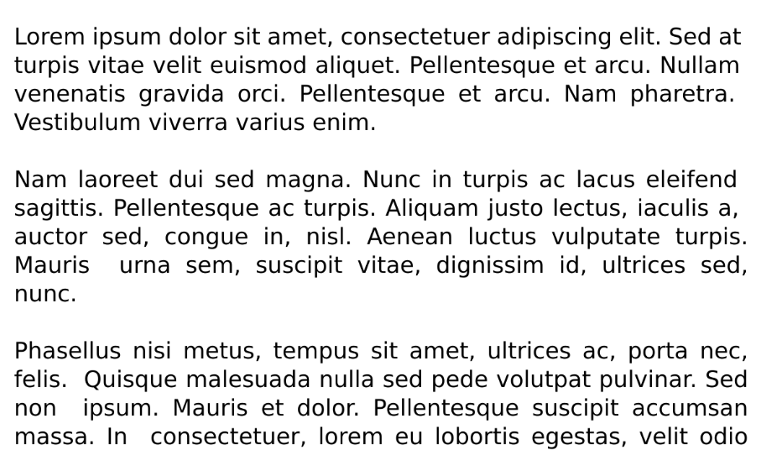
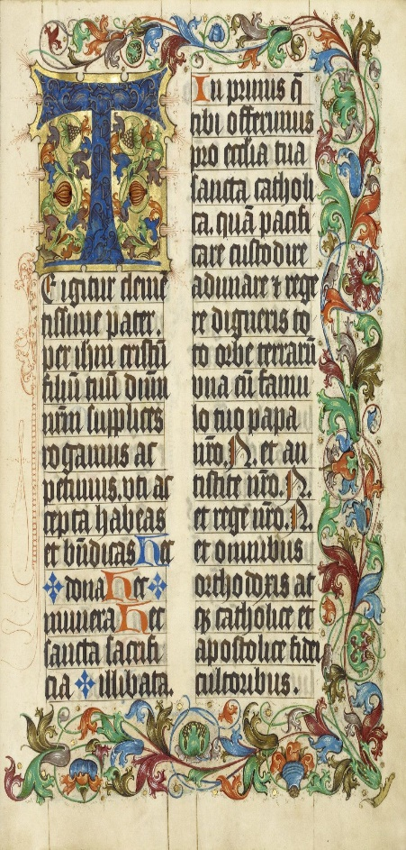
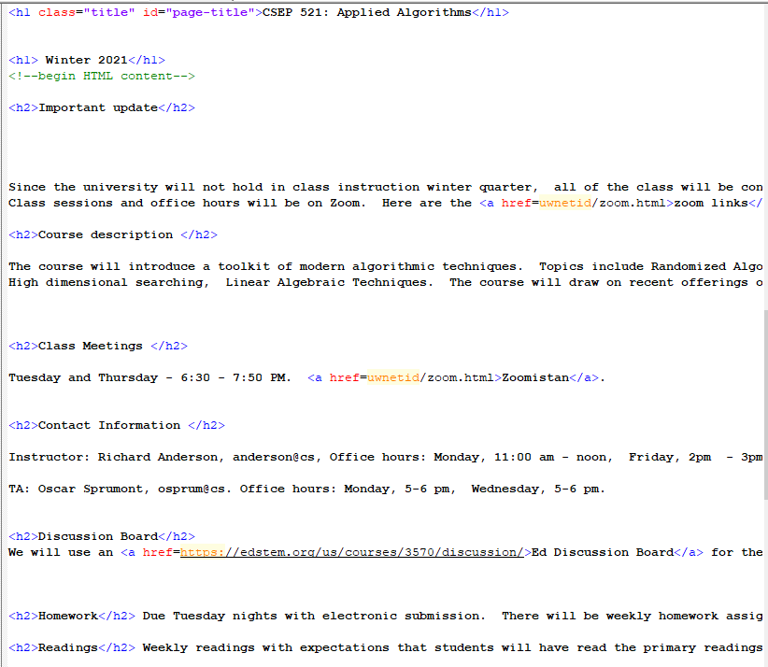
Document databases
Large collections of text documents
Applications such as similarity search, plagiarism detection, classification
Distance metrics vs. similarity measures
Similarity measure a function where a high value is a more similar documents
Representation – strings, token streams, bags of words

Slide 12
Document representation
Text strings
Edit distance as a similarity measure
Token streams
Simplify words and remove punctuation or markup
Bag of words
Represent the words as a set or a multiset
Sparse representation
Homework
Similarity of articles from news groups
Sample of 50 articles each from 20 groups
data50.csv Bag of bag of words
labels.csv Association of articles to groups
groups.csv Names of groups
data50.csv
article id, word id, multiplicity
Words have been replaced by integers into another (missing) table, so the data is not readable

Slide 13
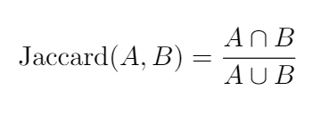
Jaccard Similarity
A
B
Let X be the characteristic vector for A where x_{j} is the multiplicity of item j
and Y be the characteristic vector for B where y_{j} is the multiplicity of item j.

Slide 14
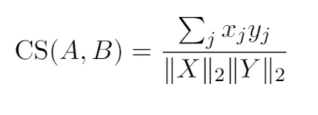
Cosine Similarity
X is the characteristic vector for A where x_{j} is the multiplicity of item j
Y is the characteristic vector for B where y_{j} is the multiplicity of item j.
Used in programming assignment – but not a focus of the lecture

Slide 15
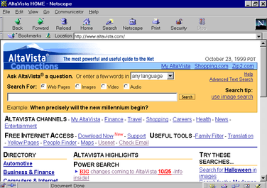
AltaVista search engine problem
Avoid returning (near) duplicate items in search results
Can fingerprinting techniques apply?
Fingerprinting is usually applied to detect or amplify small changes

Slide 16
Representation scheme
far out in the uncharted backwaters of the
unfashionable end of the western spiral arm of the
galaxy lies a small unregarded yellow sun
far out in the uncharted
out in the uncharted backwaters
in the uncharted backwaters of
the uncharted backwaters of the
uncharted backwaters of the unfashionable
backwaters of the unfashionable end
of the unfashionable end of
the unfashionable end of the
unfashionable end of the western
end of the western spiral
of the western spiral arm
the western spiral arm of
Tokenize document
Break document into shards
Hash each shard into a domain of size 2⁶⁴ (unsigned long)
Treat as a bag of words
Use Jaccard Similarity measure

Slide 17
Aside – Rabin Fingerprinting
n-bit message m₀ , . . . ,m_{n-1} viewed as polynomial over Z₂
f(x) = m₀ + m₁x + m₂x² + . . . + m_{n-1} x^{n-1}
Pick a random irreducible polynomial p(x) of degree k (k = 64) and the fingerprint is f(x) mod p(x)
Suitable for domain of size 2^{k}
Efficient implementation with bit operations including shifts
Rolling hash that can reuse computation from shard
Cool algebra for math majors

Slide 18
Similarity testing
Identify document pairs that have high similarity by doing pairwise comparison
Precompute hashes of shards – n shards for document of n tokens
Cost of comparison is O(n)
How to improve this: reduce the amount of information stored per document

Slide 19
MinHash
U is the domain. In this case, the hash of the shards, [0 . . . 2⁶⁴)
Choose a random permutation π on U
Let A ⊆ U
MinHash(A) = argmin_{x∈A} π(x)
MinHash is the smallest element of A under the random permutation

Slide 20
An amazing result
A
B
U

Slide 21
Using the MinHash
Identify document pairs where Jaccard(A,B) ≥ 0.95
Run MinHash with k independent permutations
Number of times MinHash(A) = MinHash(B) is a good estimate of Jaccard Similarity
Compute the k MinHashes for each documents as a sketch
Comparison of documents requires k comparisons

