Slide 1
CSEP 521: Applied Algorithms Lecture 14 – Nearest neighbors
Richard Anderson
February 18, 2021

Slide 2
Announcements
Homework schedule
Homework 7, Due Thursday, February 25, 11:59 pm.
Homework 8, Due Thursday, March 4, 11:59 pm.
Homework 9, Due Thursday, March 11, 11:59 pm.
Homework 10, Due Thursday, March 18, 11:59 pm.

Slide 3
High dimensional searching
Many data sets are high dimensional
High dimension can mean a mathematical space, such as R^{d}, or a structure, such as bag-of-words representation of documents
Canonical problem:
Given a new datum x, find the closest element y in the dataset
Lots of things need to be defined, like “closest”
Think of the data set as being very large, so we would like a mechanism that avoids having to do comparisons with all elements

Slide 4
Nearest neighbor motivation
Find closest match to a query in a large data set

Slide 5
Outline
Metric (distance measures)
Coding theory
Searching in 2-d
Quad trees
Voronoi diagrams
Higher (but not too high) dimensions
K-d trees

Slide 6
Concepts
Metric
Distance measure, d(x,y), d: A × A → [0, ∞)
Properties
d(x,y) = 0 iff x = y
d(x,y) = d(y,x)
d(x,y) ≤ d(x,z) + d(z,y)
d(x,y) ≥ 0
Standard Euclidean distance – L² Norm
L^{p} Norm
L¹ Norm
L∞ Norm

Slide 7
Nearest neighbor problem
Set of points S
Given query point y, find a point in S closest to y

Slide 8
Nearest neighbor problem: L₁ and L∞ metrics

Slide 9
And now for R²

Slide 10
Quad Tree
Start with a bounding square
Each level divides a square into four quadrants
Search explores cells which may contain nearest neighbor
Track best-so-far distance to prune sub trees in recursive tree traversal
Depth is determined by closest pair distance

Slide 11
Nearest Neighbor Search
Search(tree T, point P, int bound, point closest){
if leaf node
if non-empty
if (dist(P, X) < bound) update bound and closest
else
foreach subtree T1
if (dist(P, T.Region) < bound)
Search(T1, P, bound, closest)
}

Slide 12
Voronoi diagram
For each point x, Voronoi region is the set of points (in R²) where x is the nearest neighbor in S
Between each pair of points we can look at the separating half spaces
A point’s Voronoi region is the intersection of half spaces (and convex)
The number of segments is O(N)

Slide 13
Voronoi Regions Compute Intersection of Half Spaces

Slide 14
Building the Voronoi diagram
Lots of algorithms exist
It can be done in O(n log n) time
Programming is a challenge
Lots of special cases
Careful numerical programming
Hard to debug
Most practical algorithm is probably to insert points in random order into an existing diagram

Slide 15
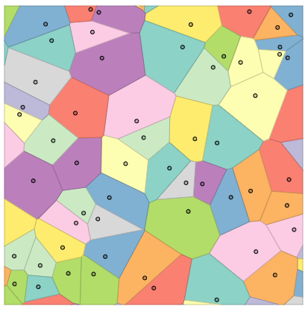
Search in a Voronoi diagram
Need to overlay a search structure on top of the diagram
Can use a sequence of separating segments
Binary space partition trees can be used
In theory, this can be done in O(log n) query time

Slide 16
What about 3 dimensions?
Quad trees generalize to oct-trees in 3d, with 8 children instead of 4
Unfortunately, the 3-d Voronoi tessellation (honeycomb) can have size n²
Proof: divide the points into to sets A and B, and put A and B on separate arcs. This can be done so that each point a_{i} in A shares a face with each b_{j} in B

Slide 17
K-D trees
Another spatial decomposition tree
Bentley, 1975
Separate across dimensions in order d₁, d₂, d₃, . . .
Split point sets evenly, not space evenly

Slide 18
KD-Tree construction
Find median point in dimension d_{j}
Split points into left/right
Recursively decompose regions
Maintain bounding boxes and/or splitting axis
Tree depth is O(log n)
Tree construction is O(n log n)

Slide 19
Tree operations
Locate point
Traverse tree
Range query: return points inside a bounding box
Traverse tree
Nearest neighbor search
Traverse tree

Slide 20
Comparison between KD Trees and generalized Quad Trees
KD trees have degree 2 and height log n
Gen-Quad Trees have degree 2^{d} and height dependent on point distribution
KD bounding boxes can be narrow
Gen-Quad Trees are cubes
KD trees generally preferred for d ≥ 4

Slide 21
Approximate closest points
Approximate closest point
Suppose the closest point distance from y to a point in S is r
Find a point in S that has distance (1+ε)r from y
r

Slide 22
Approximate closest points
Nearest neighbor search
Approximation algorithm
if (dist(P, T.Region) < bound)
Search(T1, P, bound, closest)
bound
dist
if ((1+ε)*dist(P, T.Region) < bound)
Search(T1, P, bound, closest)

