Slide 1
CSEP 521: Applied Algorithms Lecture 13 – Geometry and Searching
Richard Anderson
February 16, 2021

Slide 2
Announcements

Slide 3
Course outline
Probabilistic algorithms and average case analysis
Sublinear space algorithms for streaming
Geometry and searching
Nearest neighbor problems
Low dimensional searching
Higher dimensions
Locally sensitive hashing
Document similarity
Linear programming

Slide 4
High dimensional searching
Many data sets are high dimensional
High dimension can mean a mathematical space, such as R^{d}, or a structure, such as bag-of-words representation of documents
Canonical problem:
Given a new datum x, find the closest element y in the dataset
Lots of things need to be defined, like “closest”
Think of the data set as being very large, so we would like a mechanism that avoids having to do comparisons with all elements

Slide 5
Outline for this week
Concepts
Coding theory
Searching in 2-d
Quad trees
Voronoi diagrams
Higher (but not too high) dimensions
K-d trees

Slide 6
Concepts
Product space
Mathematically – Cartesian Product
Euclidean space, R^{d}
Other spaces, Z_{p}^{d}
Metric
Distance measure, d(x,y), d: A × A → [0, ∞)
Properties
d(x,y) = 0 iff x = y
d(x,y) = d(y,x)
d(x,y) ≤ d(x,z) + d(z,y)
d(x,y) ≥ 0

Slide 7
Closest points and approximate closest points
Set of points S
Given query point y, find a point in S closest to y
ε - Approximate closest point
Suppose the closest point distance from y to a point in S is r
Find a point in S that has distance (1+ε)r from y

Slide 8
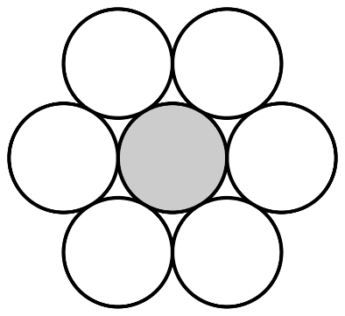
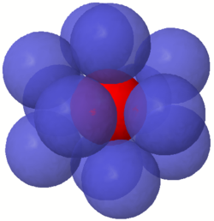
Intuition and where it breaks down
My pictures are in R²
I can imagine what happens in R³
Higher dimensions are much, much harder
Imagine an N dimensional sphere
Low dimensional intuition is not necessarily good for higher dimensions
Many quantities grow exponentially with dimension
Kissing number – number n dimensional sphere that can be arranged to touch a single sphere
Dim | Lower | Upper
2 | 6 | 6
3 | 12 | 12
4 | 24 | 24
8 | 240 | 240
12 | 840 | 1357
16 | 4320 | 3183
20 | 17400 | 36764
24 | 196560 | 196560
28 | 204368
32 | 276032
36 | 484568

Slide 9
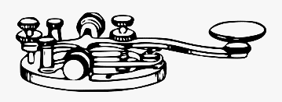
Warm up – Coding theory
Problem – sending data across a noisy channel
Model
Words encoded as a block of digits
Digits are transmitted
Some digits may be changed
The block is decoded to get the message
ALICE
BOB

Slide 10
Idea one – parity bit
Add a parity bit or check sum
Message x₁, x₂, . . ., x_{k}
Let y = x₁ ⊕ x₂ ⊕ . . . ⊕ x_{k} (exclusive OR)
Send message x₁, x₂, . . ., x_{k}, y
Resulting message has even parity
If a block is received with odd parity, at least one bit was flipped
Single error detection

Slide 11
Idea two - redundancy
Make three copies of each code word
One error correcting
Every pair of code words is at distance at least three
But this is a very dumb code
Text | Codeword
000 | 000000000
001 | 001001001
010 | 010010010
011 | 011011011
100 | 100100100
101 | 101101101
110 | 110110110
111 | 111111111

Slide 12
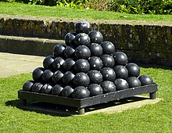
Block codes
Coding theory / Information theory started in 1940s at Bell Labs
Clause Shannon, Richard Hamming
(n,k,d)_{q} : Alphabet size q (omit for 2), block length n, message length k, distance d
k/n gives the rate
(n,k,d)_{q} code can detect d-1 errors and correct ⎣(d-1)/2⎦ errors

Slide 13
Hamming(7,4) code
Linear code with 3 parity bits
Basis vectors
[1,1,1,0,0,0,0]
[1,0,0,1,1,0,0]
[0,1,0,1,0,1,0]
[1,1,0,1,0,0,1]
Encoding / Decoding / Error correction are linear algebra operations over Z₂

Slide 14
Golay Code: G₂₄ [24,12,8]₂ and G₂₃ [23,12,7]₂
Closely related codes, 12 dimensional subspaces of Z₂²⁴ and Z₂²³ respectively
G₂₄ is used because it is 3 bytes
G₂₃ is a perfect code. Spheres of radius 3 around the code words partition the vector space
Imagine a 23 dimensional sphere of radius three centered at z, find the codeword in the sphere

Slide 15
Hamming distance
A and B are binary vectors of length k
Hamming Distance, HD(A,B) is the number of positions where they differ
A = 10110010
B = 00100110
HD(A,B) = 3
Ball of radius r centered at A is the set of all B with HD(A,B)≤r
A = 10011, r = 2, ball of radius 2: {10011, 00011, 11011, 10111, 10001, 10010, 01011, 00111, 00001, 00010, 11111, 11001, 11010, 10101, 10110, 10000}

Slide 16
Low dimensional problems
S = {x₁, x₂, . . . , x_{n}}
Given an value y, find the closest point in S to y.
Min_{i} d(y, x_{i})
y

Slide 17
How do we solve this in R¹

Slide 18
Issues
Static versus dynamic data structures
Average case versus worst case
Numerical precision of coordinates

Slide 19
And now for R²

Slide 20
What is the distance function?
Standard Euclidean distance – L² Norm
L^{p} Norm
L¹ Norm
L∞ Norm

Slide 21
Data structures for 2-d nearest neighbor
Unlike 1-d we do not have a linear order on the points
Multiple options are available (and variants exist)
Quad trees
K-d trees
Voronoi diagram

Slide 22
Quad Tree
Start with a bounding square
Each level divides a square into four quadrants
Search explores cells which may contain a nearest neighbor
Track best-so-far distance to prune sub trees in recursive tree traversal
Depth is determined by closest pair distance

Slide 23
Voronoi diagram
For each point x in S, the Voronoi region is the set of points (in R²) where x is the nearest neighbor in S
Between each pair of points we can look at the separating half spaces
A point’s Voronoi region is the intersection of half spaces (and is convex)
The number of segments is O(N)

Slide 24
Building the Voronoi diagram
Lots of algorithms exist
It can be done in O(n log n) time
Programming is a challenge
Lots of special cases
Careful numerical programming
Hard to debug
Most practical algorithm is probably to insert points in random order into a Voronoi diagram

Slide 25
Search in a Voronoi diagram
Need to overlay a search structure on top of the diagram
Can use a sequence of separating segments
Binary space partition trees can be used
In theory, this can be done in O(log n) query time

Slide 26
What about 3 dimensions?
Quad trees generalize to oct-trees in 3-d, with 8 children instead of 4
Unfortunately, the 3-d voronoi tessellation (honeycomb) can have size n²
Proof: divide the points into to sets A and B, and put A and B on separate arcs. This can be done so that each point a_{i} in A shares a face with each b_{j} in B

