Slide 1
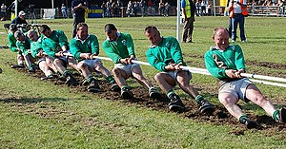
CSEP 521: Applied Algorithms Lecture 12 - Stream Algorithms: Frequency Estimates
Richard Anderson
February 11, 2021

Slide 2
Announcements

Slide 3
Frequency Moments
Compute the sum of powers of frequency of elements
Higher moments put more emphasis on most frequent items

Slide 4
F₀, F₁
F₀ = Σf_{i}⁰
We will define 0⁰ = 0 here
f_{i}⁰ = 1 if f_{i} > 0
Hence, F₀ is just the number of items. See lecture 11
F₁ = Σf_{i}¹ = N

Slide 5
F₂ = Σ f_{i}²
A, B, B, A, C, D, A, D, B, A, A, D
f_{A} = 5
f_{B} = 3
f_{C} = 1
f_{D} = 3
F₂ = 5² + 3² + 1² + 3² = 25 + 9 + 1 + 9 = 44

Slide 6
Variance
Var(X) = E[(X-μ)²] = E[X²] – E[X]²
Measure of the skew of the distribution

Slide 7
Join estimation
F₂ gives the number of pairs in the self join of R and R
Also applies to the number of pairs in a join of R and S

Slide 8
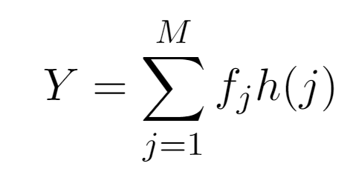
Basic Algorithm – Tug-of-war algorithm
Choose a random hash function h: U → {-1, 1}
Y = 0;
foreach x in stream s
Y += h(x);
return Y²;

Slide 9
Hash function assumption Pairwise independence
Assumptions on the hash function
Prob[h(x) = -1] = 0.5
Prob[h(x) = 1] = 0.5
Hash values are pairwise independent
Prob[h(x) = h(y)] = 1/m
Knowing the value of h(x) tells you nothing about the value of h(y)
Independent random variables

Slide 10
Tug-of-war algorithm is a good estimator of F₂
Result – Expected value of Y² is F₂

Slide 11
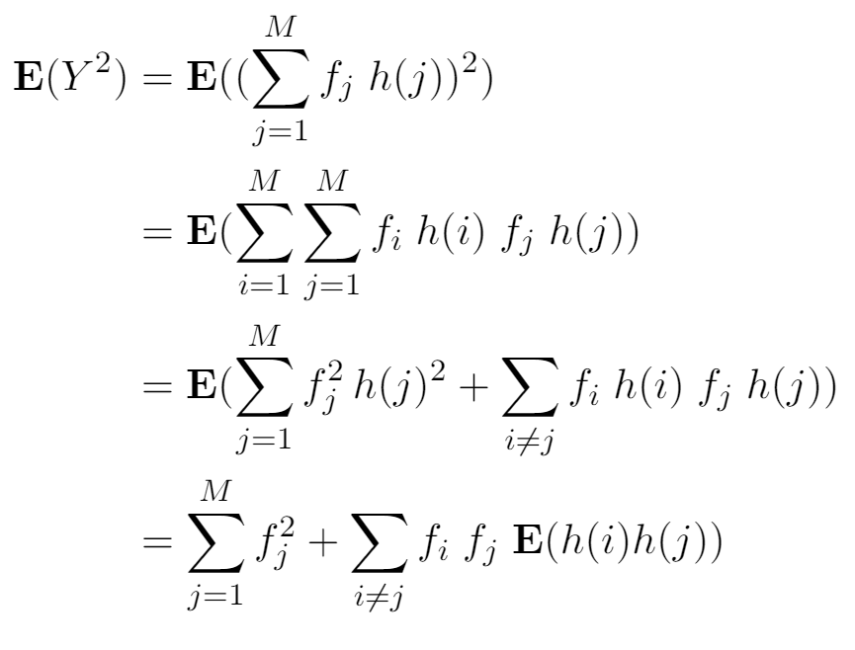
Analysis

Slide 12
If X and Y are independent random variables, E(XY) = E(X)E(Y)

Slide 13
Improving the algorithm
Space requirement is just one register
Improve performance by using more space
Compute multiple estimates using independent hash functions
This is where generating multiple hash functions is important
Two different ways of combining estimates
E = (1/k)(E₁ + E₂ + . . . E_{k})
E’ = Median(E₁, E₂, . . . ,E_{k})
These two methods are combined to get the AKS algorithm

Slide 14
Overall result
Efficient approximation for F₂
(1 + ε) approximation with probability at least (1-δ)
Space requirement O((1/ ε²) log (1/ δ)(log M + log N))
Extend to higher moments

Slide 15
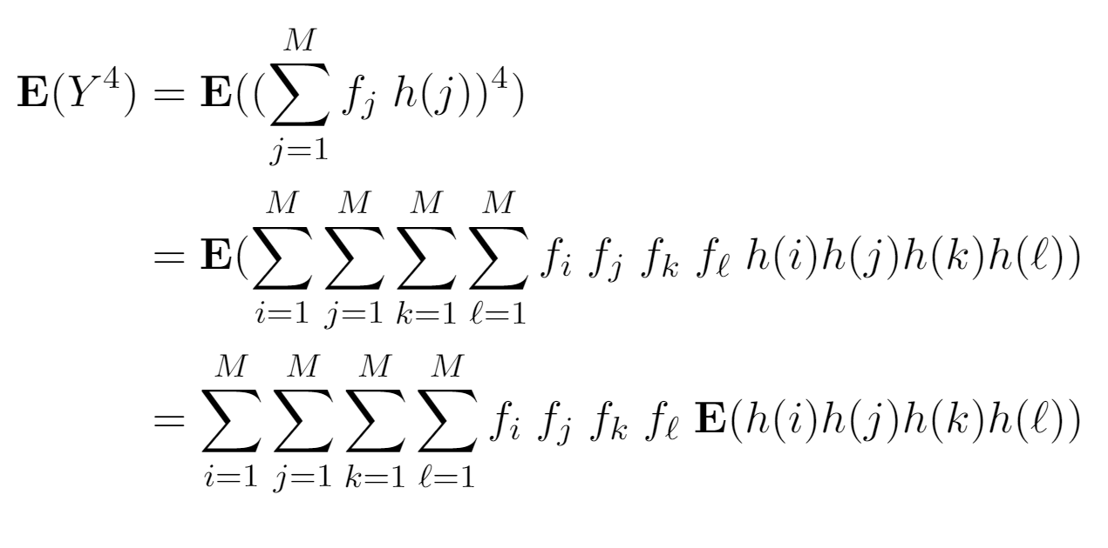
Deeper analysis, compute Var(Y²)
Need four-wise independence to simplify expectation expression

Slide 16
Universal Family of Hash Functions
Really good practical hash functions exist
Fast and good distribution of keys
Cryptographic hash functions are difficult to invert and more work
Choose a random hash function
Set of hash functions H: U→[1..m]
Universal property
For all x, y in U, with x ≠ y, if h is chosen at random from H
This is a minimal property for good hash functions
Practical university families exist, so mathematically sound algorithms could be implemented

Slide 17
Carter-Wegman hash functions
Hashing from [0..p-1] to [0..p-1]
p is a moderate sized prime (p ≅ 2³²)
h_{ab}(x) = (ax + b) mod p where 0 ≤ a < p and 0 ≤ b < p
If a and b are chosen at random, x ≠ y, then Prob[h (x) = h (y)] = $\frac{1}{p}$
h (x) and h (y) are independent

Slide 18
Pairwise independence
Suppose x ≠ y, and 0 ≤ x, y ≤ p – 1 and 0 ≤ u, v ≤ p – 1
The equations (with unknowns a and b) have a unique solution
(ax + b) mod p = u
(ay + b) mod p = v
Hence Prob[h(x) = u and h(y) = v] = 1/p² proving independence

Slide 19
k-wise independence
Hash functions such that h(x₁), h(x₂), . . ., h(x_{k}) are probabilistically independent
Important mathematical tool to prove rigorous bounds
Parameterized hash functions to allow random generation
In practice, other hash functions may be used which have a seed that can be set

Slide 20
Generalized Carter-Wegman hash functions 4-wise independence
Hashing from [0..p-1] to [0..p-1]
p is a moderate sized prime (p ≅ 2³²)
h_{abcd}(x) = (ax³ + bx² + cx + d) mod p where 0 ≤ a, b, c, d ≤ p-1
Proof of independence is similar to the 2-wise case.
Show h_{abcd}(w) = q, h_{abcd}(x) = r, h_{abcd}(y) = s, h_{abcd}(z) = t has a unique solution for a, b, c, d over [0..p-1]

