Slide 1
CSEP 521: Applied Algorithms Lecture 11 Stream Algorithms: Hyperloglog
Richard Anderson
February 9, 2021

Slide 2
Announcements
HW6
Implement count min and test on provided dataset
Course material – streaming algorithms
Today: Count number of distinct elements: Hyperloglog
Thursday: Determine the second moment
Σ f_{x}²
Alon, Matias, Szegedy

Slide 3
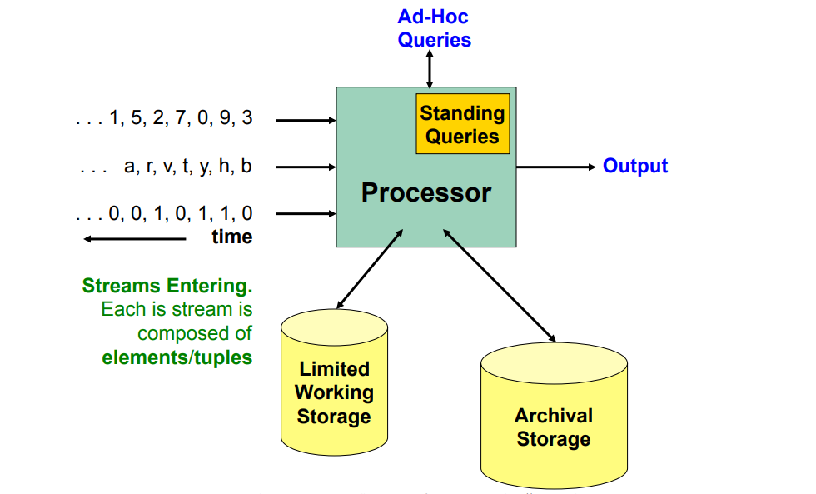
Algorithms for data streams
Data items received one at a time, N is number of items received
Computation performed on each data item
Memory is limited to being much less than N
Memory in thousands
Data in millions
Motivation
Large scale computation
Estimates are often good enough

Slide 4
Results so far
Easy things that require little memory
Computing the maximum, sample a random element
Impossible things (provably require Ω(n) memory)
Is there an element with frequency ≥ n/3, find the median
Identification and approximate estimates of high frequency items

Slide 5
Warmup
Suppose we want to track j smallest items in a stream
Space complexity
Time complexity

Slide 6
Count distinct problem
FB Distinct visitors per week
How many distinct IP addresses accesses a website

Slide 7
Solutions
public int CountUnique(List<string> strings){
Dictionary<string, int> dict
= new Dictionary<string, int>();
foreach (string str in strings)
dict.TryAdd(str, 1);
return dict.Count;
}
Sort, remove duplicates
sort –u foo.txt | wc
Hashing
Bloom Filter

Slide 8
Estimator
Assign each distinct element a random value, in [0, 1)
By hashing, of course
Each copy of the same item has the same hash value
Compute the minimum value: min_val
Only remember a single data item
If the number of distinct items is K, the expected value of min_val is 1/K
Report the estimate 1/min_val

Slide 9
Improve the estimator
Track the J smallest values
J values need to be maintained
Compute min_val_{J}
Expected value of min_val_{J} is J/K
Report estimate of J/min_val_{j}
Probabilistically, this is a far more robust estimator

Slide 10
Hyperloglog
Estimate number of distinct elements
Estimate cardinalities of > 10⁹ with accuracy 2% using 1.5 kB of memory
Derived from a 1984 theoretical result
Suggested practical applications in early 2000s
Derivatives are now used as a practical tool by large internet companies
APPROX_COUNT_DISTINCT in BigQuery
Reddit, to count unique views of posts
From this discussion
Key ideas
Basic algorithm
But the analysis still contains some magic

Slide 11
Log Log idea
What is the probability that a random number has exactly k consecutive one’s (in binary) in low order bits
1010001010010100100100100111
Define ρ(x) as consecutive ones at end of hash(x)
Estimate the cardinality of {x₁, x₂, . . ., x_{M}} as 2^{Q} where Q = max{ρ(x₁) , ρ(x₂) ,…, ρ(x_{M}) }
ρ(x) = k with probability 2^{-(k+1)}
Q is an estimate of log M, so Q can be stored in log log M bits

Slide 12
Intuition
If you have one million distinct items, one of them is going to have a hash that ends in: 01111111111111111111

Slide 13
Strengthening the estimate
Risk of over estimating with a very unlikely hash
If we have 2^{k} distinct items, we expect to have items of that have hashes that end with j consecutive 1’s for j ≤ k
We will need to track all the ρ values, which we will do by keep a bitwise-or

Slide 14
Some bit hacking
r(x) is the number of trailing 1’s in the binary representation of x
R(x) = 2^{r(x)}
R(x) = ~x & (x+1)

Slide 15
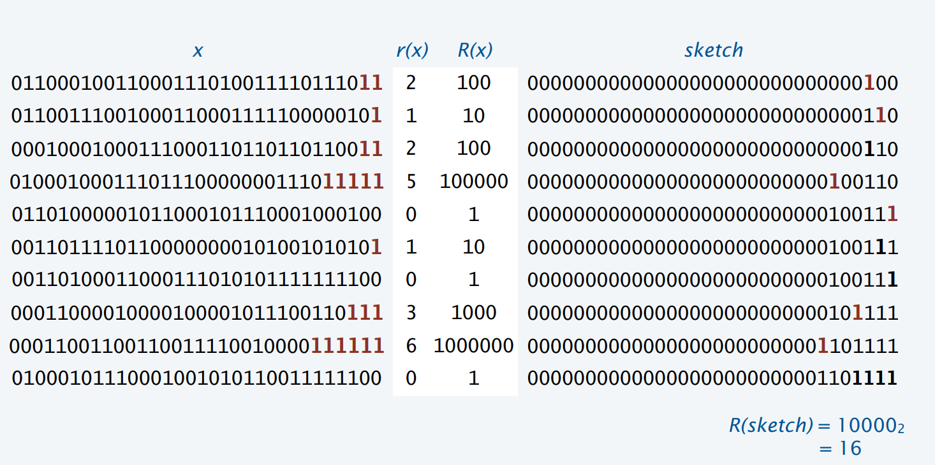
Probabilistic Counting Trace

Slide 16
Probabilistic Counting
Returns the smallest value not seen
It can be shown that this off by a factor of 0.77351
Established mathematically, and verified experimentally
Typically off by a binary order of magnitude
public long R(long x) {
return ~x & (x+1);
}
public long estimate (iterable<string> stream){
long sketch;
for (s : stream)
sketch |= R(Hash(s));
return R(sketch);
}

Slide 17
Next idea – M independent experiments
M independent hash functions and average: work, but expensive
Stochastic averaging
Divide stream into 2^{m} independent streams
Use probabilistic counting on each stream, yielding 2^{m} sketches
Compute mean = average number of trailing bits in each sketch
Return 2^{mean} / .77531

Slide 18
Constructing the independent experiments
Assume we have a j bit has function (so hashing to [0..2^{j}-1])
Use the first m bits to divide into substreams
Use the remaining j-m bits as a hash function (into [0..2^{j-m}-1])
1010100010101010001010
0100010101010101001111
0101010101011101110011
1001010100110010010001
0010010101000100100010
1101000101000101001011
1001001011101101110101
1010110111011000100111

Slide 19
Probabilistic Counting Algorithms
Flajolet-Martin, 1983
Use of M words to achieve relative accuracy of 0.78/sqrt(M)
Validated through experimentation
Theory doesn’t answer questions such as performance with real hash functions or what are the implementational constants
Many versions now available with modified techniques
E.g., different mechanisms for averaging estimates across substreams, harmonic means vs. geometric means

