Slide 1
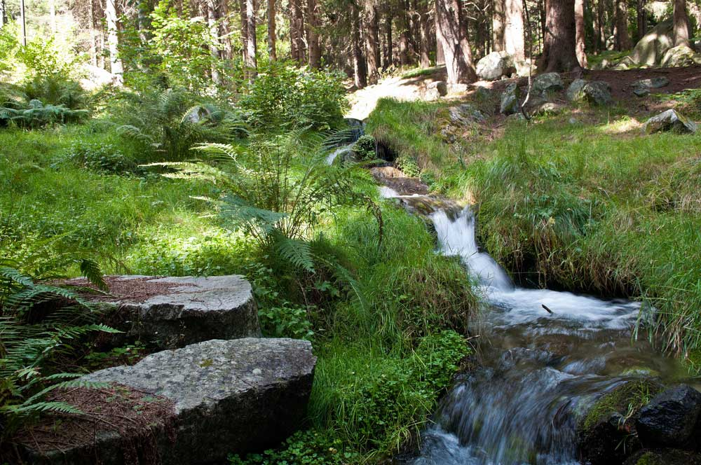
CSEP 521: Applied Algorithms Lecture 10 Stream Algorithms: Heavy Hitters
Richard Anderson
February 4, 2021

Slide 2
Announcements

Slide 3
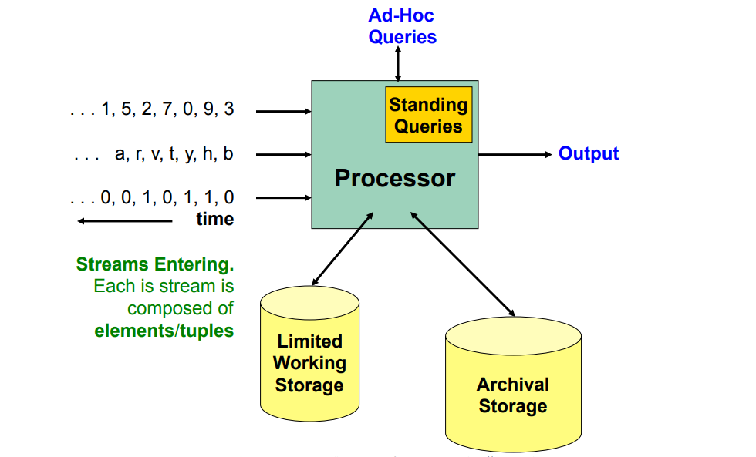
Algorithms for data streams
Data items received one at a time, N is number of items received
Computation performed on each data item
Memory is limited to being much less than N
Memory in thousands
Data in millions

Slide 4
Formal stream model
Data items received one at a time, N is number of items received
Computation performed on each data item
Memory is limited to being much less than N
It may be a constant b, or log N
Think of b in thousands (or millions), N in billions (or gazillions)
Low runtime per item and stay within memory bounds

Slide 5
Heavy Hitters Problem
n/k – εn
n/k
No
Maybe
Yes
Find elements which occur at least n/k times
Cannot be solved exactly for k ≥ 3
ε-Heavy Hitters: Approximation algorithm for Heavy Hitters
Parameters k, ε and δ:
Every value that occurs at least n/k times in A is in the list
Every value on the list occurs at least n/k – εn times in A.
Probability of not achieving this is at most δ

Slide 6
Count Min Sketch
Simple data structure for estimating the number of occurrence of items
Looks like a counting Bloom filter
Counts provide an UPPER BOUND for number of occurrences
Only accurate for counting the most frequent values
Term “sketch” is used in streaming to refer to saving just a small amount of info as the data goes by

Slide 7
Multiple hash functions
k hash tables with independent hash functions h₁(x) . . . h_{k}(x)
We can think of k=5
Each table has b buckets, where b << n
We can think of b = 1000
Int HT[k][b]
Inc(x), add one to each counter for x, HT[j][h_{j}(x)]++
Count(x), min(HT[1][h₁(x)], HT[2][h₂(x)], . . . HT[k][h_{k}(x)])
Upperbound on the count (but can easily be wrong)

Slide 8
Example
 | h₁(x) | h₂(x) | h₃(x) | h₄(x) | h₅(x)
A | 9 | 2 | 10 | 2 | 5
B | 1 | 7 | 4 | 7 | 3
C | 3 | 10 | 7 | 10 | 9
D | 7 | 3 | 10 | 7 | 3
E | 1 | 10 | 7 | 4 | 2
F | 6 | 9 | 8 | 4 | 1
G | 10 | 6 | 9 | 5 | 2
H | 7 | 4 | 7 | 6 | 1
1 |  | 1 |  |  |  | 2 |  | 3
 | 3 |  | 2 |  |  | 1 |  |  | 1
 |  |  | 1 |  |  | 1 |  |  | 3+2
 | 3 |  |  |  |  | 1+2 |  |  | 1
 |  | 1+2 |  | 3 |  |  |  | 1
Sequence: A, B, C, D, A, D, A

Slide 9
Example
 | h₁(x) | h₂(x) | h₃(x) | h₄(x) | h₅(x)
A (16) | 9 | 2 | 10 | 2 | 5
B (10) | 1 | 7 | 4 | 7 | 3
C (6) | 6 | 10 | 7 | 10 | 9
D (17) | 7 | 3 | 10 | 7 | 3
E (2) | 1 | 10 | 7 | 4 | 2
F (16) | 6 | 9 | 8 | 4 | 1
G (6) | 10 | 6 | 9 | 5 | 2
H (6) | 7 | 4 | 7 | 6 | 1
I (4) | 9 | 2 | 1 | 2 | 7
J (3) | 4 | 9 | 3 | 9 | 8
K (5) | 2 | 8 | 8 | 6 | 5
12 | 5 |  | 3 |  | 22 | 24 |  | 20 | 6
 | 22 | 17 | 6 |  | 6 | 10 | 5 | 19 | 8
4 |  | 3 | 10 |  |  | 14 | 21 | 6 | 33
 | 25 |  | 18 | 6 | 6 | 27 |  | 3 | 6
22 | 8 | 27 |  | 21 |  | 4 | 3 | 6
A: 20, 22, 33, 25, 21
D: 24, 17, 33, 27, 27
F: 22, 19, 21, 18, 22
Sequence: A, B, C, D, A, D, A, J, A, I, D, B, F, G, G, H, E, B, A, K, A, B, A, A, D, D, D, C, I, A, B, C, D, E, F, G, K, H, G, H, B, D, D, K, H, A, B, I, D, A, D, A, B, C, C, D, A, F, F, F, I, F, F, F, G, H, A, B, D, K, D, D, D, A, K, B, C, F, G, H, F, F, J, J, F, D, F, A, F, F, F

Slide 10
Heuristic Error Analysis
f_{x} is the true frequency count for x
Single row analysis
If we’re lucky, HT[h(x)] will be the true count, f_{x}
If we’re unlucky, y collides with x, then f_{y} contributes to HT[h(x)]
In general, HT[h(x)] = f_{x} + Σ_{s}f_{y} where s = {y≠x : h(x) = h(y)}
With a good hash function h, x collides with an expected 1/b elements
Therefore, we expect

Slide 11
Lemma
Let X be a positive random variable with expectation E[X] = C
The probability that X is greater than 2C is at most one half

Slide 12
Error analysis
Applying the lemma
Now consider k hash tables
If we want error δ, we need k ≥ log (1/δ)
For δ = .01 this is k = 7
For ε-Heavy Hitters, we want error at most εn, we take b = 1/ε

Slide 13
Rigorous analysis (see 2.5 in the notes)
What we’ve covered up: choosing random hash functions
Universal family of hash functions
Markov’s Inequality

Slide 14
Universal Family of Hash Functions
Really good practical hash functions exist
Fast and good distribution of keys
Cryptographic hash functions are difficult to invert and more work
Choose a random hash function
Set of hash functions H: U→[1..m]
Universal property
For all x, y in U, with x ≠ y, if h is chosen at random from H
This is a minimal property for good hash functions
Practical university families exist, so mathematically sound algorithms could be implemented

Slide 15
Carter-Wegman hash functions
Hashing from [0..m-1] to [0..m-1]
Choose prime p, p >> m
h_{ab}(x) = ((ax + b) mod p) mod m) where 1 ≤ a < p and 0 ≤ b < p
If a and b are chosen at random, x ≠ y, then Prob[h_{ab}(x) = h_{ab}(y)] = 1/m

Slide 16
Markov’s Inequality
If X is a non-negative random variable and c ≥ 1 is a constant
Crude method from converting from expectation to probability

Slide 17
ε-Heavy Hitters
Find elements which occur at least n/k times with error range εn
Parameters k and ε:
Every value that occurs at least n/k times in A is in the list
Every value on the list occurs at least n/k – εn times in A.
Choose ε = 1/2k
For CountMin, we take b = 1/ε and with j hash functions, where j = log (1/δ)
Reasonable practical values are k=100 and δ=.01, so this is a table of size 1000 for an n as large as you want!

Slide 18
Tracking the heavy hitters
Note that we don’t even need to know what n is.
We track the values of the potential heavy hitters as the algorithm runs
The easiest way is to just keep the values on the ε-heavy hitters list in a heap as there are at most 2k of these values (independent of n)

Slide 19
Big numbers
2¹⁰ ≅ 10³
What is the biggest value of N we need to worry about as an input size
What is an appropriate domain, [0..m-1] for a hash function
Big numbers:
Number of US social security numbers 10⁹
Populations of India, China: 1.4 Billion
World Population: 7.8 Billion
Stars in Galaxy 10¹²
Galaxies in Universe 10¹²
log log 2⁶⁴ = log 64 = 6
Answer: 2⁶⁴

Slide 20
More on hash functions
Hashing from [1..m] to [1..t]
Considerations
Uniformity, “randomness”
Sensitive to small changes
Speed
Cryptographic security
Hashing from U to [1..m]
Avoid losing information
Avoid regular collisions
Combine words with operations such as SHIFT and XOR
You shouldn’t have to invent or code your hash functions
Multiplicative approaches to hash functions are common
But have some risks on poor choices of multipliers
Saving middle part of multiplication is common
Bitwise operations such as XOR, <<, >>
Common to have algorithms based on particular key numbers
a=11400714819323198485 for Fibonacci hashing
Power of two close to 2⁶⁴

Slide 21
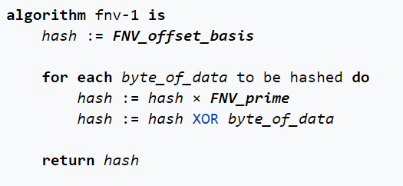
Sample hash function: Fowler-Noll-Vo
The FNV_offset_basis is the 64-bit FNV offset basis value: 14695981039346656037.
The FNV_prime is the 64-bit FNV prime value: 1099511628211.
64-bit unsigned arithmetic, so multiplication is mod 2⁶⁴

Slide 22
Coming attractions . . .
Hyperloglog

