Slide 1
CSEP 521: Applied Algorithms Lecture 9 Algorithms for Streams
Richard Anderson
February 2, 2021

Slide 2
Announcements
Homework 5 is out
Its raining, there’s homework . . .
All students should be on the Ed discussion board now
Apologies for this Snafu – the problem was with CSEM registrations

Slide 3
Algorithms
Designing computational processes
Abstract expression of instructions for a task built on a set of computational primitives
A key part of this class is thinking about algorithms across different computational settings
Some problems become interesting (and important) in novel settings

Slide 4
Models of Computation
Ground rules for defining computation
Expression of key operations and resources
Link with mathematics
Abstract away grim reality of real devices
Capture setting and constraints

Slide 5
Standard Model
RAM (Random Access Machine)
Idealized computer
Natural instructions
Unit cost models
Compute functions of inputs
Develop runtime functions

Slide 6
Memory Based Models
Real systems are based on a memory hierarchy, and optimization for storage may be a central concern
External Storage models
Consider costs for external access, as well as paged access
Data Base Systems
View computations as interacting with internal state through DBMS

Slide 7
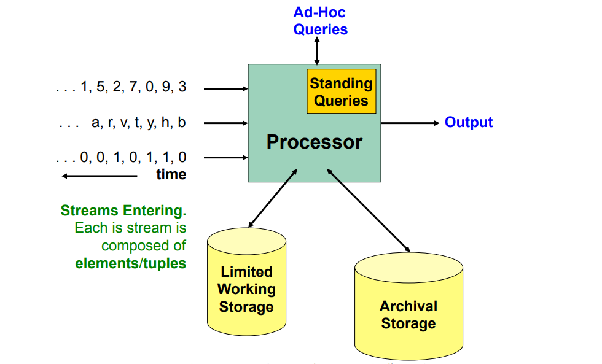
Stream Models
Reacting to ongoing data sources
Viewing data a single time
Large quantities of data
Limited local resources

Slide 8
Formal stream model
Data items received one at a time, N is number of items received
Computation performed on each data item
Memory is limited to being much less than N
It may be a constant b, or log N
Think of b in thousands (or millions), N in billions (or gazillions)
Low runtime per item and stay within memory bounds

Slide 9
Some trivial examples of Stream Algorithms
Count the elements
Find a specific element
Count by property
Average value
Maximum
Pick a random element
Not trivial, so its homework

Slide 10
Element Distinctness
Determine if there are any duplicate elements
Yes/No question: Are all of the elements distinct
…,4,19,11,21,93,0,1,15,46,18,31,41,51,96,42,19,33

Slide 11
Theorem: Element distinctness requires Ω(N) space
Make the assumption you are drawing elements from a large domain
Assume elements are from 1..N² for N elements in the stream
Heuristic argument:
You need to save all of the items, since the last one could match any one you have seen
Rigorous argument:
This is much more work, as you need to define the model of computation to prevent cheating in storage – you need a model that counts the bits of storage
To make this work requires tools such as information theory (which is very cool!)

Slide 12
Majority Element
In a sequence of n elements, a Majority Element is an element that occurs at least n/2 + 1 times. Given a sequence with a Majority Element, find the Majority Element.
GME, MSFT, GME, GME, GME, AMZN, AMZN, GME, GME, GME, FB
This is a standard exercise in Divide and Conquer algorithms
Or if you are allowed to compare elements, you can sort, or compute the median and verify
But there is a better way . . .

Slide 13
Counter based algorithm*
Find a majority element in array A of length n
Counter = 0
Current = null
for j = 1 to n
if Counter == 0
Current = A[j]
Counter = Counter + 1
else if A[j] == Current
Counter = Counter + 1
else
Counter = Counter -1
return Current
*I hate specifying algorithms as just code

Slide 14
Correctness Proof*
If X is a majority element, it will be found by the counter based algorithm
When A[j] = X, either the counter for X increases or a non-X counter decreases
At least n/2 + 1 times
When A[j] ≠ X, either a non-X counter increases, a non-X counter decreases, or the X-counter decreases
At most n/2 – 1 times
*I’m assuming n is even so I don’t get confused on rounding

Slide 15
How about this one? Breakout groups
Determine if a stream algorithm can find an element that occurs more than n/3 times

Slide 16
Impossibility results

Slide 17
Heavy Hitters Problem
Find elements which occur at least n/k times
ε-Heavy Hitters: Approximation algorithm for Heavy Hitters
Parameters k and ε:
Every value that occurs at least n/k times in A is in the list
Every value on the list occurs at least n/k – εn times in A.
In other words
At least n/k times. One the list
Between n/k – εn and n/k times. Maybe on the list
Fewer than n/k – εn times. Not on the list

Slide 18
Applications
Most common items in a stream
Detecting common searches
Frequent stock trades
TCP flows – identifying DOS attacks

Slide 19
Count Min Sketch
Simple data structure for estimating the number of occurrence of items
Looks like a counting Bloom filter
Counts provide an UPPER BOUND for number of occurrences
Only accurate for counting the most frequent values
Term “sketch” is used in streaming to refer to saving just a small amount of info as the data goes by

Slide 20
Count values in a hash table
for each X in the stream
Count[Hash[X]] = Count[Hash[X]] + 1
First idea, store the counts in a cell indexed by the hash of a value
What could go wrong? Do we worry about Hash[x] = Hash[y]

Slide 21
Multiple hash functions (think Bloom filter)
k hash tables with independent hash functions h₁(x) . . . h_{k}(x)
We can think of k=5
Each table has b buckets, where b << n
We can think of b = 1000
Int HT[k][b]
Inc(x), add one to each counter for x, HT[j][h_{j}(x)]++
Count(x), min(HT[1][h₁(x)], HT[2][h₂(x)], . . . HT[k][h_{k}(x)])
Upperbound on the count (but can easily be wrong)

Slide 22
Setting expectations
This is an approximation
We are interested in estimating counts of most common items
Counts for rare items will be garbage
Epsilon approximation for Heavy Hitters

Slide 23
Example
 | h₁(x) | h₂(x) | h₃(x) | h₄(x) | h₅(x)
A | 9 | 2 | 10 | 2 | 5
B | 1 | 7 | 4 | 7 | 3
C | 3 | 10 | 7 | 10 | 9
D | 7 | 3 | 10 | 7 | 3
E | 1 | 10 | 7 | 4 | 2
F | 6 | 9 | 8 | 4 | 1
G | 10 | 6 | 9 | 5 | 2
H | 7 | 4 | 7 | 6 | 1
1 |  | 1 |  |  |  | 2 |  | 3
 | 3 |  | 2 |  |  | 1 |  |  | 1
 |  |  | 1 |  |  | 1 |  |  | 3+2
 | 3 |  |  |  |  | 1+2 |  |  | 1
 |  | 1+2 |  | 3 |  |  |  | 1
Sequence: A, B, C, D, A, D, A

Slide 24
Example
 | h₁(x) | h₂(x) | h₃(x) | h₄(x) | h₅(x)
A (16) | 9 | 2 | 10 | 2 | 5
B (10) | 1 | 7 | 4 | 7 | 3
C (6) | 3 | 10 | 7 | 10 | 9
D (17) | 7 | 3 | 10 | 7 | 3
E (2) | 1 | 10 | 7 | 4 | 2
F (16) | 6 | 9 | 8 | 4 | 1
G (6) | 10 | 6 | 9 | 5 | 2
H (6) | 7 | 4 | 7 | 6 | 1
12 |  | 6 |  |  | 26 | 24 |  | 16
 | 16 | 17 | 6 |  | 6 | 10 |  | 16 | 8
 |  |  | 10 |  |  | 14 | 16 | 6 | 33
 | 16 |  | 18 | 6 | 6 | 27 |  |  | 6
24 | 8 | 27 |  | 16 |  |  |  | 6
Sequence: A, B, C, D, A, D, A, A, D, B, F, G, G, H, E, B, A, A, B, A, A, D, D, D, C, A, B, C, D, E, F, G, H, G, H, B, D, D, H, A, B, D, A, D, A, B, C, C, D, A, F, F, F, F, F, F, G, H, A, B, D, D, D, D, A, B, C, F, G, H, F, F, F, D, F, A, F, F, F

Slide 25
Heuristic Error Analysis
A short, incorrect proof is often more convincing than a longer correct one – J.D.Ullman
f_{x} is the true frequency count for x
Single row analysis
If we’re lucky, HT[h(x)] will be the true count, f_{x}
If we’re unlucky, y collides with x, then f_{y} contributes to HT[h(x)]
In general, HT[h(x)] = f_{x} + Σ_{s}f_{y} where s = {y≠x : h(x) = h(y)}
With a good hash function h, x collides with an expected 1/b elements
Therefore, we expect

Slide 26
Lemma
Let X be a positive random variable with expectation E[X] = C
The probability that X is greater than 2C is at most one half

Slide 27
Error analysis
Applying the lemma
Now consider k hash tables
If we want error δ, we need k ≥ log (1/δ)
For δ = .01 this is k = 7
For ε-Heavy Hitters, we want error at most εn, we take b = 1/ε

Slide 28
Rigorous analysis (see 2.5 in the notes)
What we’ve covered up: choosing random hash functions
Universal family of hash functions
Markov’s Inequality

Slide 29
Universal Family of Hash Functions
Really good practical hash functions exist
Fast and good distribution of keys
Cryptographic hash functions are difficult to invert and more work
Choose a random hash function
Set of hash functions H: U→[1..m]
Universal property
For all x, y in U, with x ≠ y, if h is chosen at random from H
This is a minimal property for good hash functions
Practical university families exist, so mathematically sound algorithms could be implemented

Slide 30
Markov’s Inequality
If X is a non-negative random variable and c ≥ 1 is a constant
Crude method from converting from expectation to probability

Slide 31
ε-Heavy Hitters
Find elements which occur at least n/k times with error range εn
Parameters k and ε:
Every value that occurs at least n/k times in A is in the list
Every value on the list occurs at least n/k – εn times in A.
Choose ε = 1/2k
For CountMin, we take b = 1/ε and with j hash functions, where j = log (1/δ)
Reasonable practical values are k=100 and δ=.01, so this is a table of size 1000 for an n as large as you want!

Slide 32
Tracking the heavy hitters
Note that we don’t even need to know what n is.
We track the values of the potential heavy hitters as the algorithm runs
The easiest way is to just keep the values on the ε-heavy hitters list in a heap as there are at most 2k of these values (independent of n)

Slide 33
Coming attractions . . .
Hyperloglog

