Slide 1
CSEP 521: Applied Algorithms Lecture 8 Cuckoo Hashing
Richard Anderson
January 28, 2021

Slide 2
Announcements

Slide 3
Finishing up Bloom Filters
Basic idea – k-hash functions
Bits are set at h₁(x), h₂(x), . . ., h_{k}(x)
Lookup is done by reading h₁(x), h₂(x), . . ., h_{k}(x)
False positives are possible, false negatives are not
Goal is to have a small number of bits per value
Example: set of malicious URLs

Slide 4
Bloom Filter Example (k = 3)
0 | 0 | 0 | 0 | 0 | 0 | 0 | 0 | 0 | 0 | 0 | 0 | 0
X₁
X₂
0 | 1 | 0 | 0 | 1 | 0 | 1 | 0 | 0 | 0 | 1 | 0 | 0
0 | 1 | 0 | 0 | 1 | 0 | 1 | 0 | 0 | 0 | 1 | 0 | 0
Z

Slide 5
Some Bloom Filter Math
0 | 0 | 0 | 0 | 0 | 0 | 0 | 0 | 0 | 0 | 0 | 0 | 0
Table size m, data items n
After n members of S have been hashed, compute the probability of specific element being zero
False probability rate

Slide 6
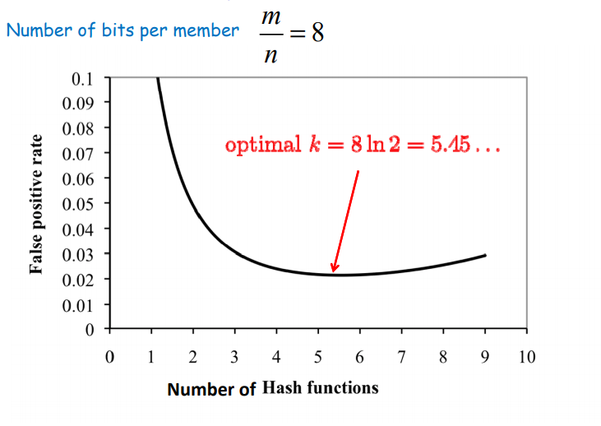
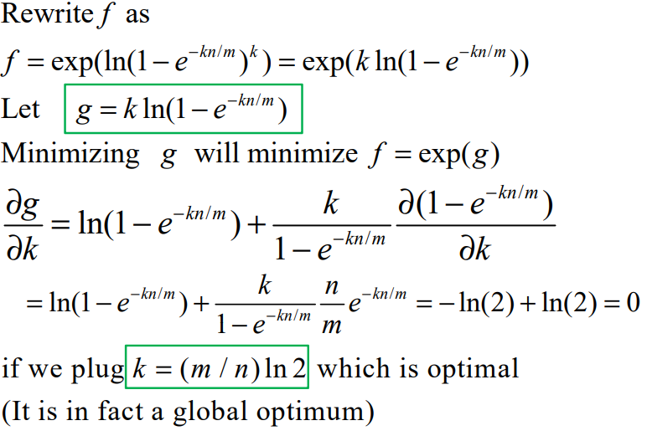
False positive rate vs. k Find optimal with calculus

Slide 7
Bloom filter deletes
Why do Bloom filters fail for deletes?
Counting Bloom Filters
Each cell is a counter (4 bits considered sufficient)
Insert, add one to each target cell
Delete, subtract one from each target cell
Find, test if target cells non-zero
On overflow, leave counter at maximum value

Slide 8
Bloom Filter Deletes (k = 3)
0 | 0 | 0 | 0 | 0 | 0 | 0 | 0 | 0 | 0 | 0 | 0 | 0
X₁
X₂
Insert X₁
Insert X₂
Insert Y₁
Delete Y₂
Find Z
0 | 0 | 0 | 0 | 0 | 0 | 0 | 0 | 0 | 0 | 0 | 0 | 0
Y₁
Y₂
0 | 0 | 0 | 0 | 0 | 0 | 0 | 0 | 0 | 0 | 0 | 0 | 0
Z

Slide 9
Cuckoo hashing
A table based hashing scheme that is competitive with other table based hashing schemes and has guaranteed constant find and delete runtimes

Slide 10
Cuckoo Hashing claims
Simple hashing without errors
Lookups are worst case O(1) time
Deletions are worst case O(1) time
Insertions are expected O(1) time
Insertion time is O(1) with good probability
Plausibly suitable for real world application
Storage requirements and implementation complexity in line with conventional hash tables
How do these compare with conventional hashing?

Slide 11
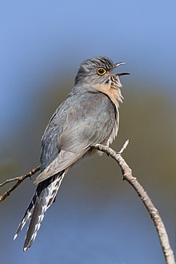
Cuckoos
Brood parasitism
Laying eggs in other birds nests
Cuckoo hashing
On collision, move to another cell
Generate a series of moves of data items

Slide 12
Data structure
A₁
 | A |  |  |  | B
Two tables A₁ and A₂ of size m
Two hash functions h₁, h₂ : U → [1..m]
When an element x is inserted, if either A₁[h₁(x)] or A₂[h₂(x)] is empty, store x there.
A₂
 |  |  | C |  |  |  | D | E

Slide 13
Bumping
A₁
 | A |  |  |  | B
When an element x is inserted, if either A₁[h₁(x)] or A₂[h₂(x)] is empty, store x there.
If both locations are occupied, then place x in A₁[h₁(x)] and bump the current occupant.
When an element z is bumped
from A₁[h₁(z)] store it in A₂[h₂(z)]
from A₂[h₂(z)] store it in A₁[h₁(z)]
A₂
 |  |  | C |  |  |  | D | E
h₁(F) = 6, h₂(F) = 4

Slide 14
Time outs
A₁
I | H | C |  |  | F
After 6 log N consecutive bumps, stop the process and build a fresh hash table using new random hash functions h’₁ and h’₂
Might be a good time to grow the table as well
A₂
J | A | G | B |  |  |  | D | E
h₁(K) = 6, h₂(K) = 2

Slide 15
Cycles
A₁
 | A | C |  |  | F
Creating a cycle is okay
Adding an edge to a cycle is not okay
The problem with a cycle of length k with a cross edge is that we are trying to put k+1 items in k cells
Detecting cycles can be done by the timeout
A₂
 |  | G | B |  |  |  | D | E
h₁(H) = 6, h₂(H) = 2
h₁(I) = 2, h₂(I) = 4

Slide 16
Theorem Expected time for insert is O(1) if m ≥ 2n
Okay, 25% memory utilization, but can actually get about 50%
Engineering optimizations
3 hash functions instead of two
Multiple items stored in a bucket
These get 90% utilization in simulation, but tight analysis is open

Slide 17
To show O(1) expected time
We need to show
Expected traversal time is O(1) when we don’t time out
Probability of timing out is O(1/n)
This is done with the theory for random graphs and is really, really hairy
In practice, failing items can be set aside in a ``stash’’ instead of rehashing
Experiments show that the number of elements stashed is tiny

Slide 18
Bad Case
Show this is really rare

Slide 19
Undirected Graphs
a
c
b
Vertices V, |V| = n, V = {a, b, c}}
Edges E, |E| = m, E ={{a,b}, {b,c}}
m ≤ n(n-1) / 2
Key concepts
Vertex degree
Isolated vertex
Path
Tree
Cycle
Connectivity
Connected components

Slide 20
Random Graphs
G^{n,m}: Set of all undirected graphs with n vertices and m edges
Select a graph uniformly from G^{n,m}
Average degree is 2m/n

Slide 21
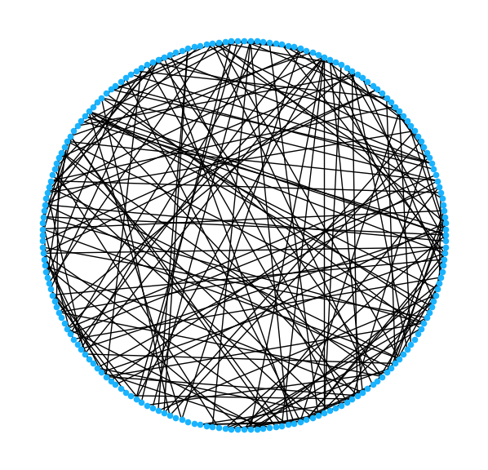
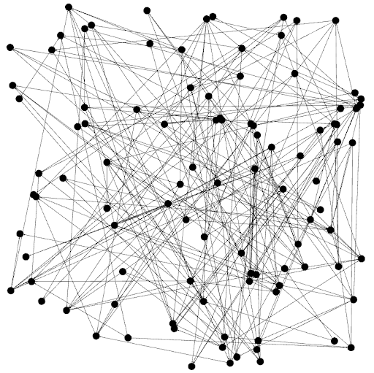
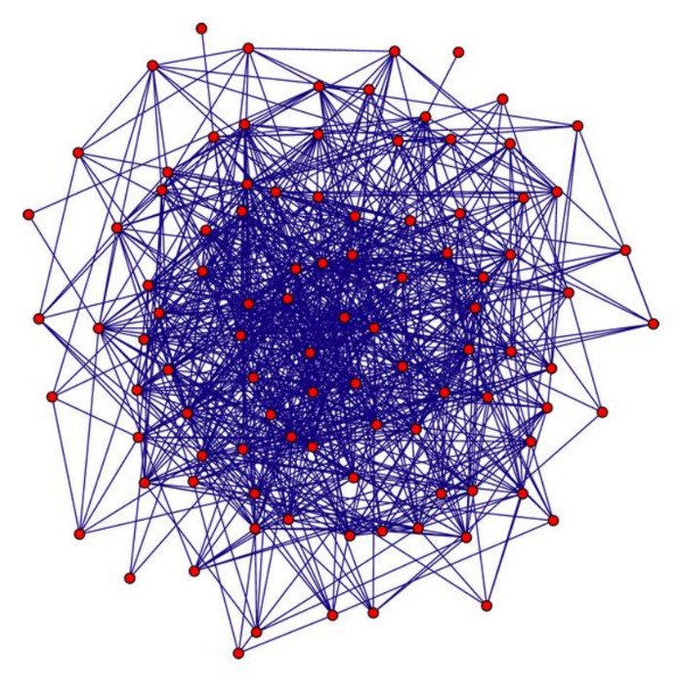
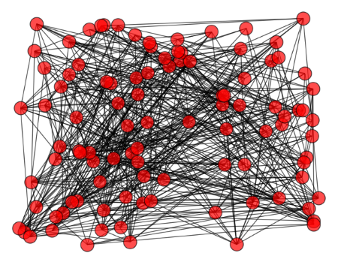

Slide 22
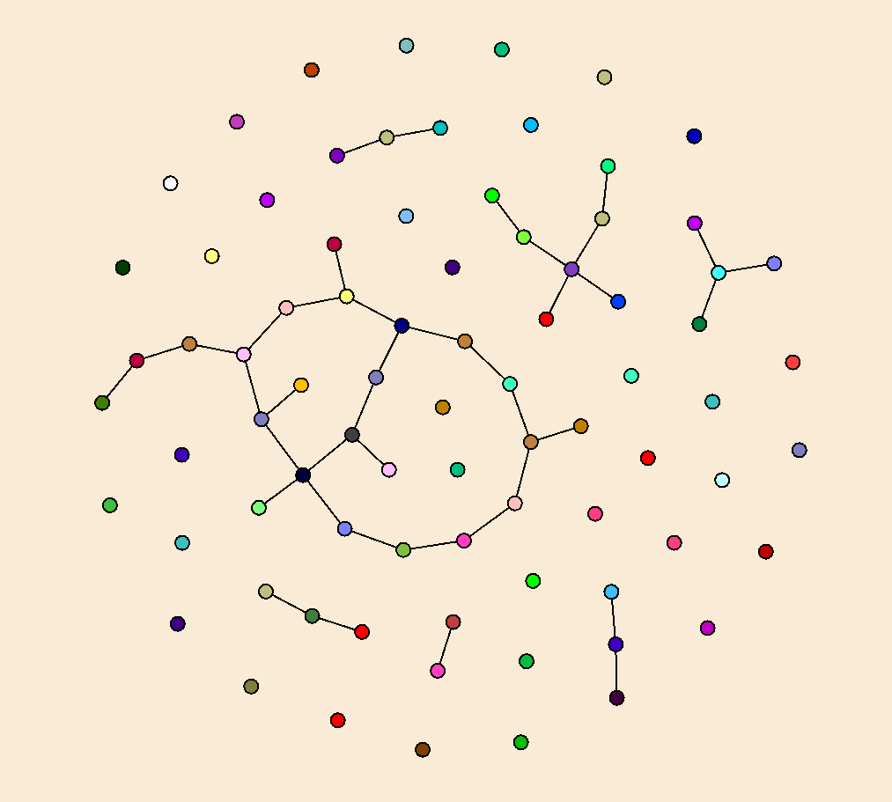
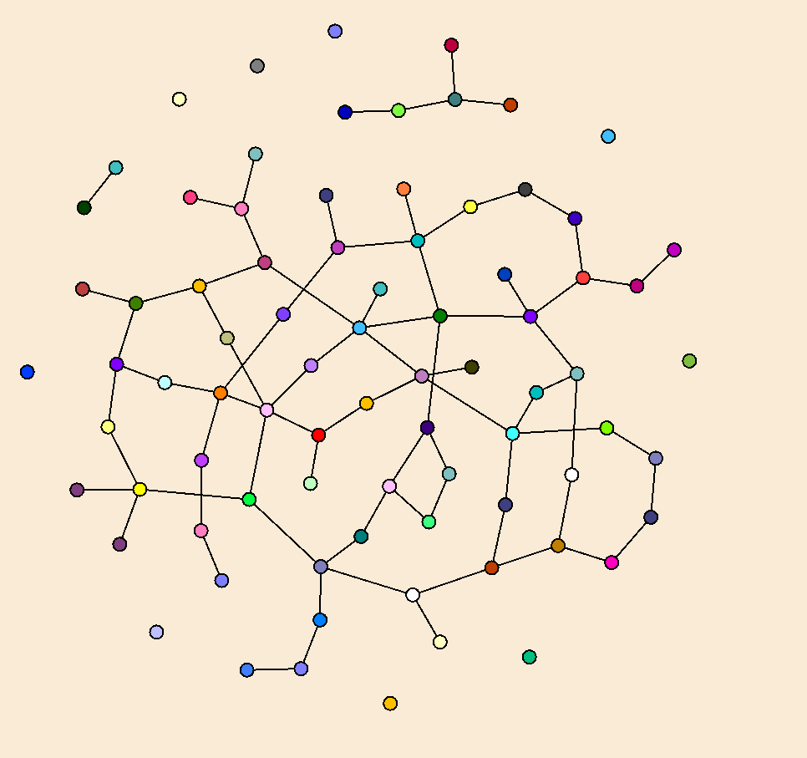
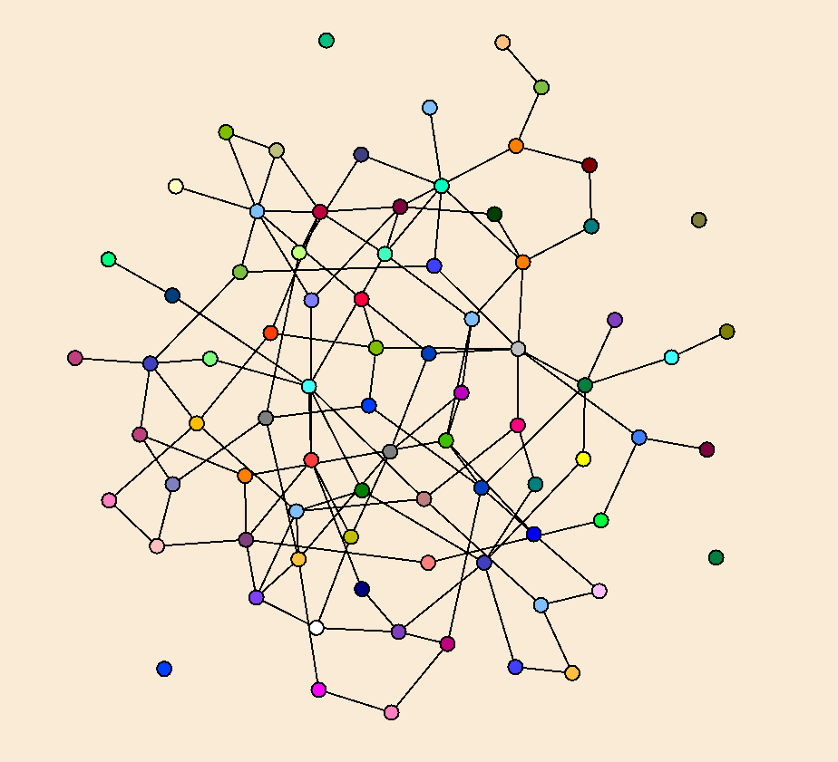
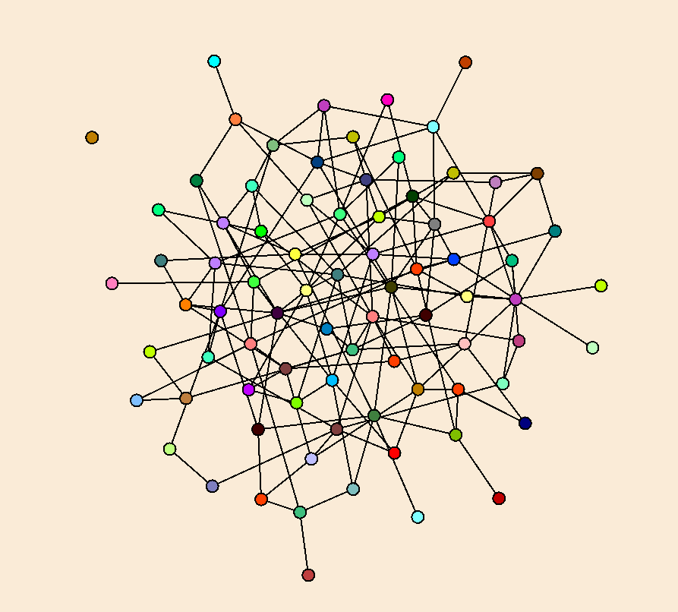

Slide 23
Edge Density
Consider the number of edges as a function of the number of vertices
Low density graphs, m = O(n), degree O(1)
Medium density, m = O(n log n), degree O(log n)
High density, m = O(n^{1+ε}), degree O(n^{ε})

Slide 24
Properties of Random Graphs
Random graphs are surprisingly regular
Edge degree is close to the average degree
Dense graphs will be connected and have a Hamiltonian circuit (WHP)
Low diameter

Slide 25
Evolution of Random Graphs
Consider the process of building a random graph one edge at a time
Look at how structures of the graph evolve
Vertices start being connected, then start to form small components
At a certain point, the components start to coalesce into a ``giant’’ component with most of the vertices
Finally, all of the vertices become connected

Slide 26
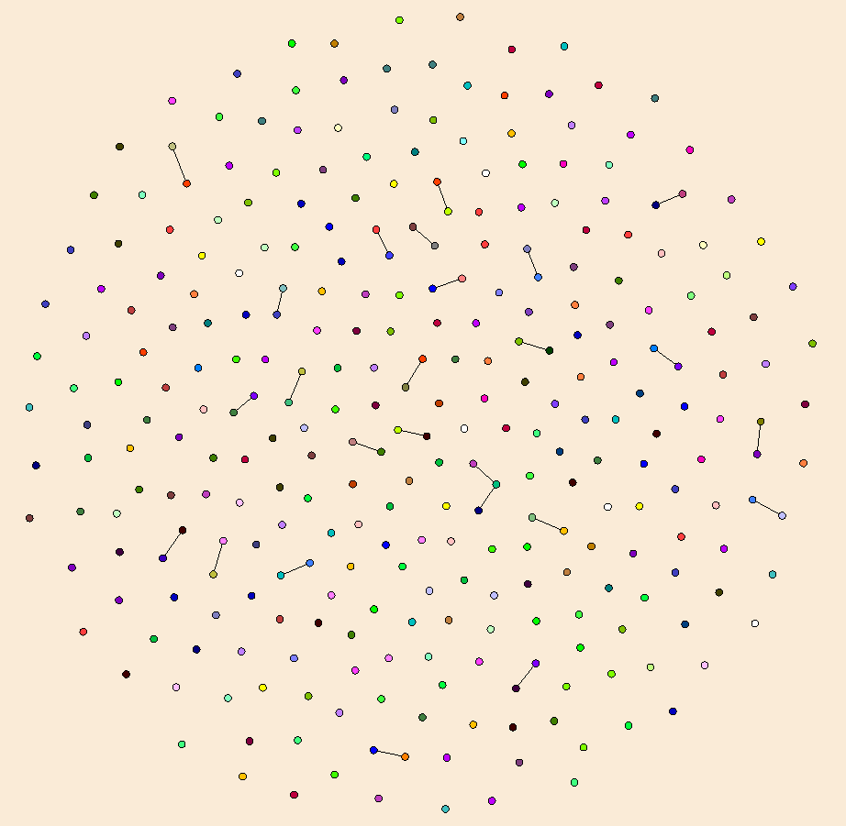
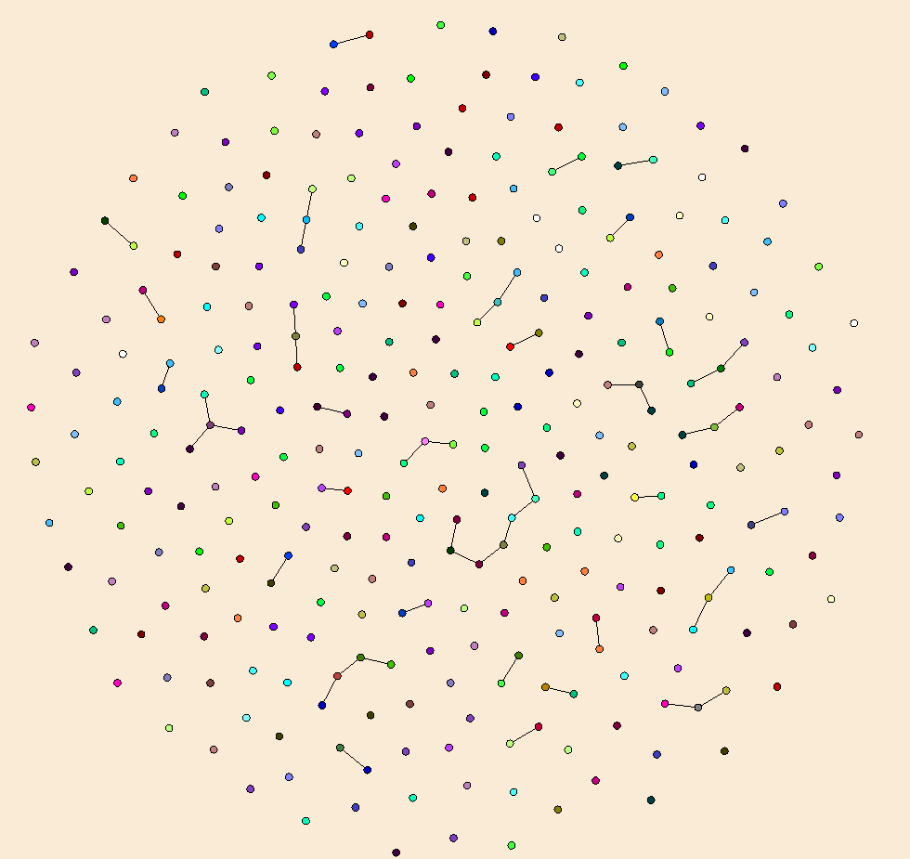
N = 300, M = 25
N = 300, M = 50
Random bipartite graphs with N=300

Slide 27
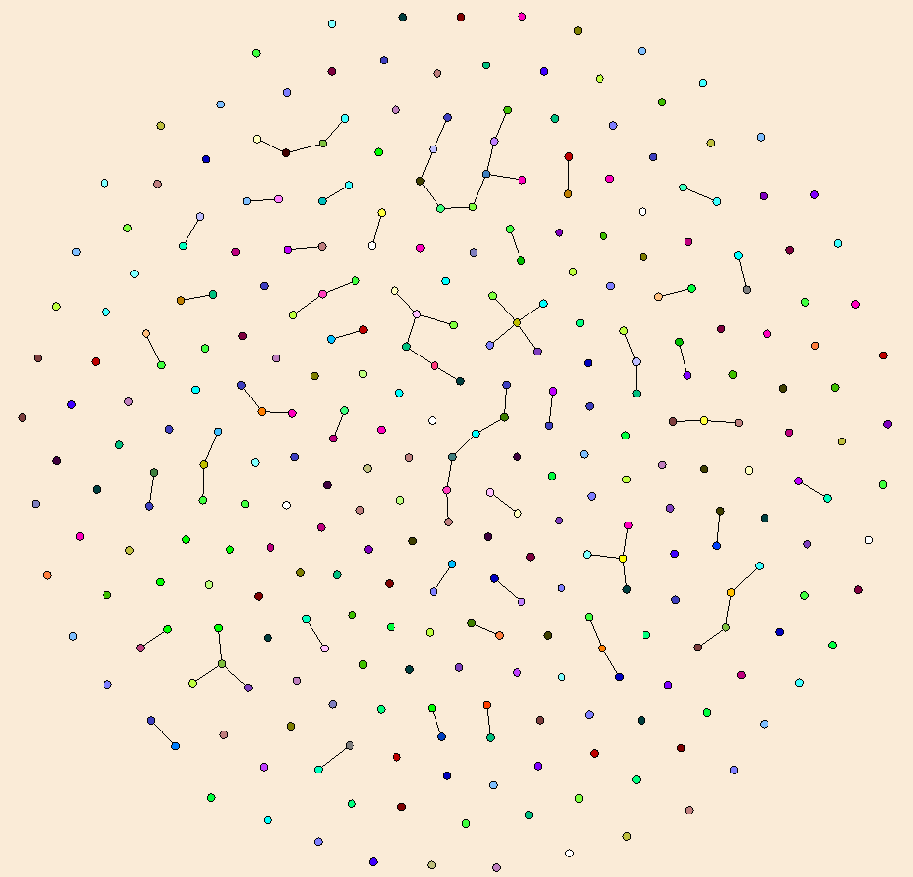
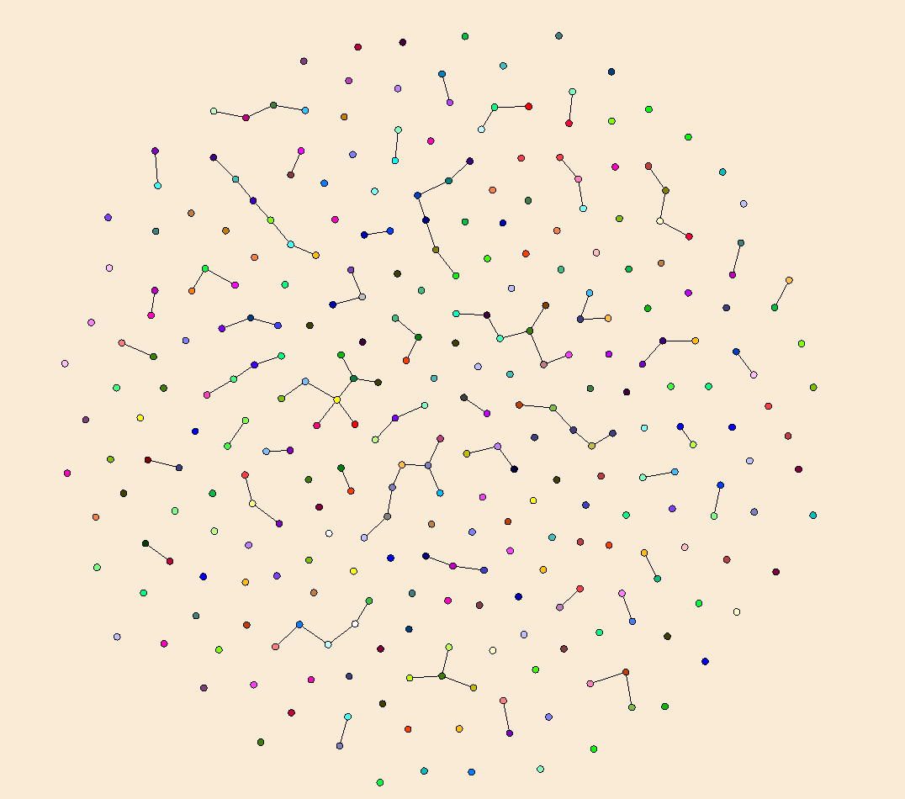
N = 300, M = 75
N = 300, M = 100

Slide 28
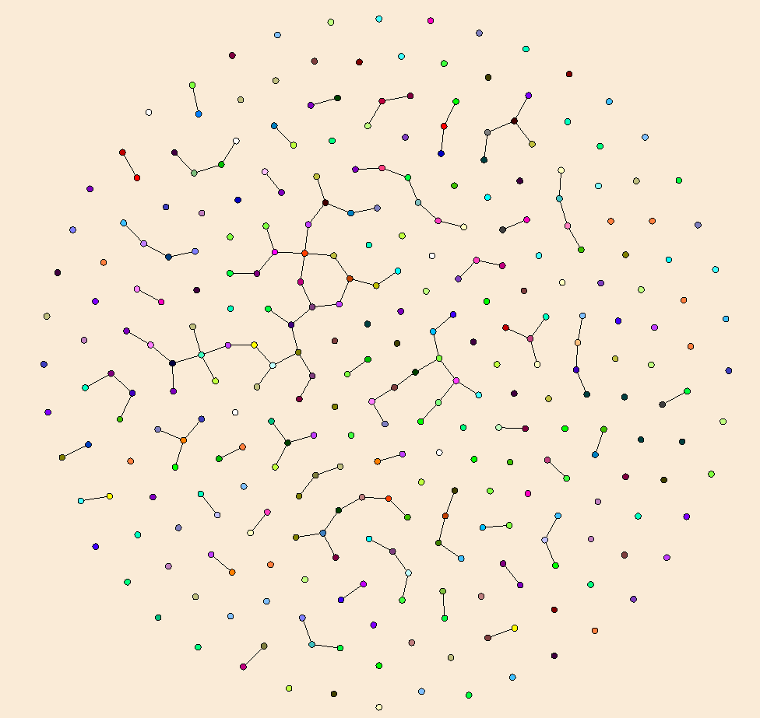
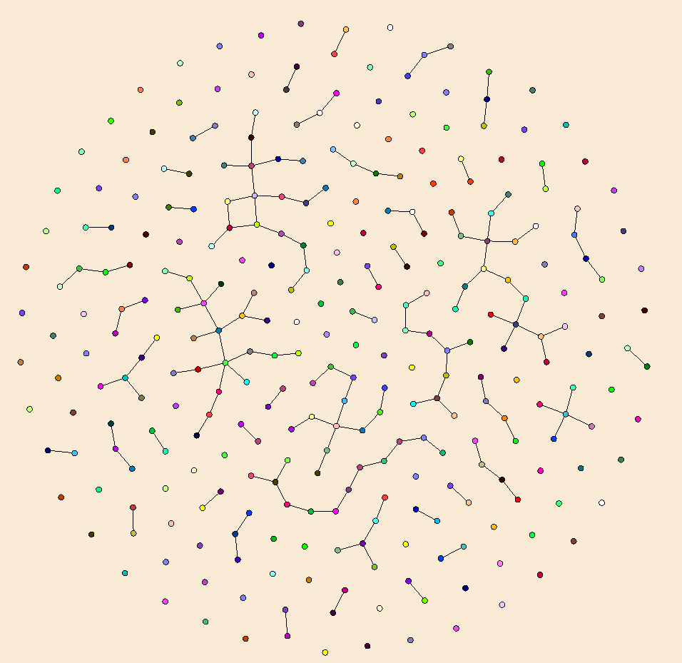
N = 300, M = 125
N = 300, M = 150

Slide 29
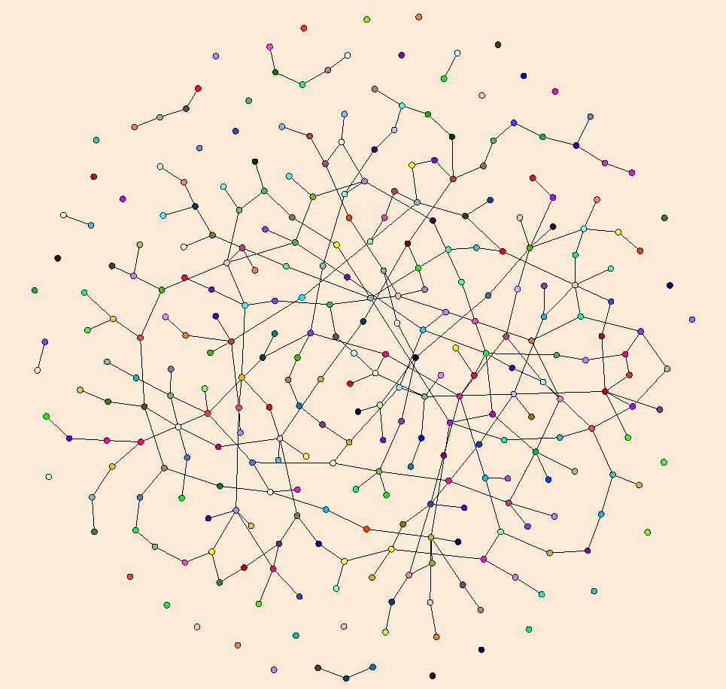
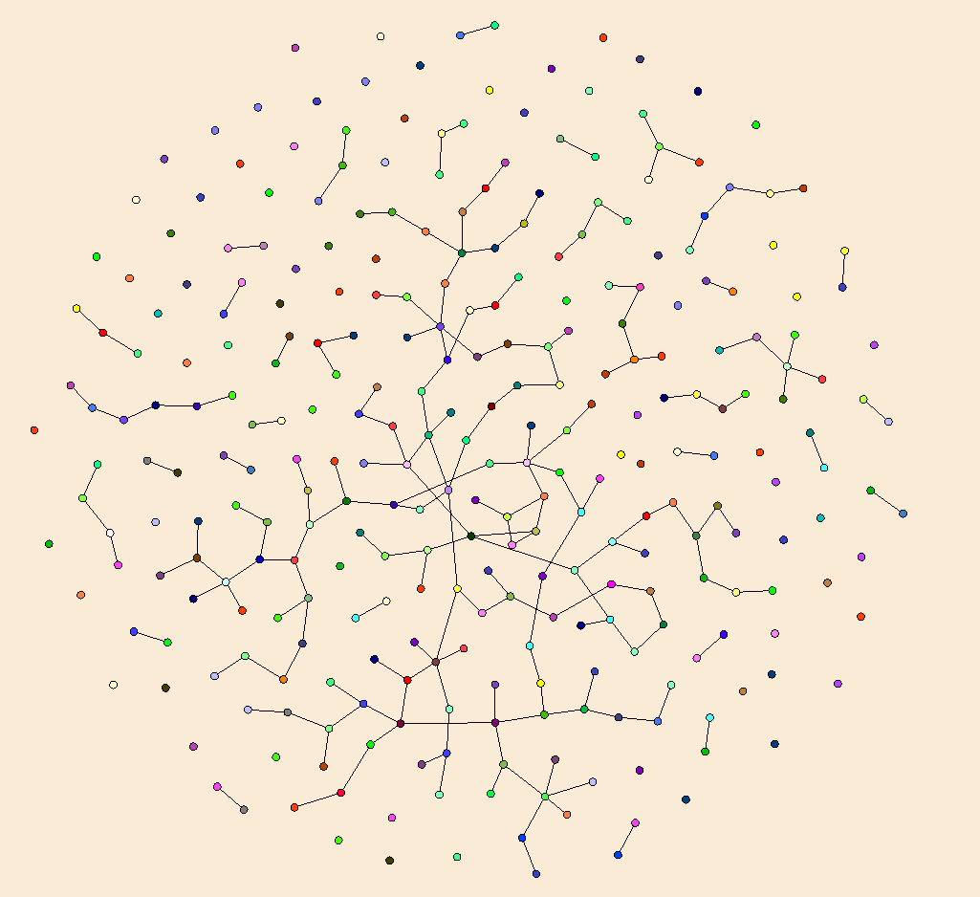
N = 300, M = 200
N = 300, M = 300

Slide 30
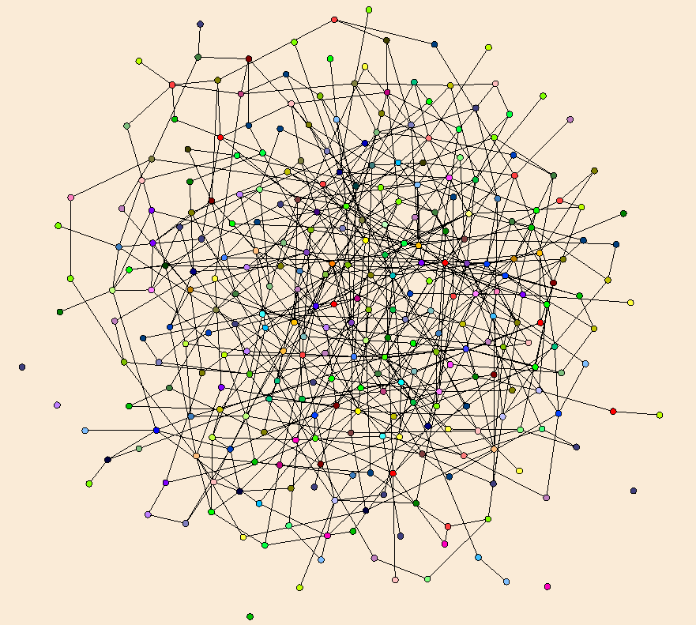
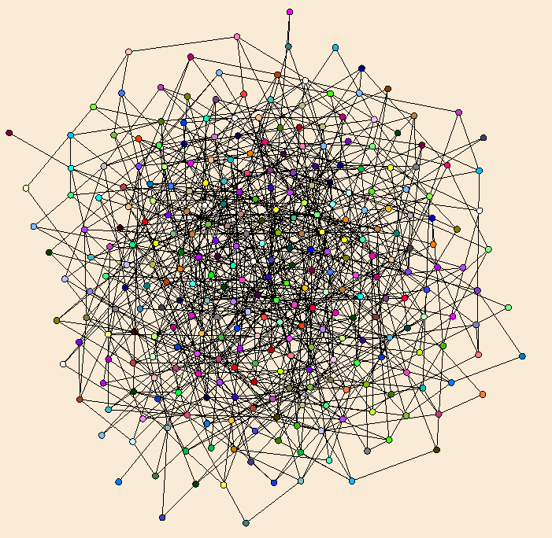
N = 300, M = 600
N = 300, M = 900

Slide 31
Threshold properties
Point at which properties are very likely to hold
Giant component
All vertices have degree at least one
Graph connected
Graph has a Hamiltonian path
Giant component forms at m = n/2
Connectivity occurs at m = (1/2)nlog n

Slide 32
Results for Cuckoo Hashing Low edge density m ≤ n/2
Let |S| = K, use two tables of size 2K each
Construct a graph where the edges are (h₁(x_{i}), h₂(x_{i})) for i = 1..K
This is a random graph on 4K vertices with K edges

Slide 33
If m ≤ cn, for c < ½ the components are trees of size O(log n)
Mathematical proof based on probabilities of groups of vertices being connected
If graph density is sparse, the probability of having enough edges in a set of vertices of size αlog n for it to be connected is small
Cycles are unlikely to form
Intuition is that in early stage of growth, most vertices are isolated, so random edges are unlikely to connect components

Slide 34
If components are small, then there is little chance of creating a bad cycle for hashing
Bad structure is a cycle with an additional edge coming into the cycle
Random pairs of vertices (from hash pairs) are unlikely to form this structure until at least ¼ cells are used

Slide 35
Cuckoo Hashing summary
Table based hashing using two hash functions
Collision resolution done at insert time with cascades of swaps
Timeout at O(log n) steps
Expected O(1) time insert
Finds are O(1) worst case
Delete are O(1) worst case and easy to do
Relatively low hash table utilization
Practical improvements of utilization based on three has functions
Theoretical analysis based on theory of random graphs

