Slide 1
CSEP 521: Applied Algorithms Lecture 7 Hashing
Richard Anderson
January 26, 2021

Slide 2
Announcements
Homework 4 is available
Three problems
Program – evaluate “two choice” hashing
Thursday, Cuckoo Hashing
Reading + Video link

Slide 3
Randomness so far
Average case QuickSelect
MinCut Analysis
Binary Space Partition
Average Case for Stable Marriage
Primality Testing
A random world is more predictable than a deterministic one
Law of large numbers

Slide 4
Data structures
Keeping track of stuff
Supporting algorithms
Sometimes they matter and sometimes they don’t
Heapsort( A, n)
H = new Heap()
for j = 1 to n-1
Heap.Insert(A[j])
for j = 1 to n-1
A[i] = Heap.DeleteMin()

Slide 5
Data structure trade offs
Operation Time
Space
Accuracy
Implementation complexity

Slide 6
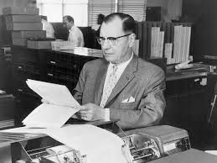
Hashing
Tracking information associated with keys
Set
Search tree
Arrays if the keys can be an index
Key idea – map from key space S to table T, |S| = n, |T| = m
Hash function h, store data at location h(x)
Collision if h(x) = h(y) for x ≠ y
In practice, O(1) access
Hans Peter Luhn

Slide 7
Hash functions
Start by assuming h is completely random
Universe U, |U| = d, table size m
Ω : set of all mappings from 1..d to 1..m
Lots of work in
Creating practical hash functions
Identifying weaker assumptions than “completely random”
For some applications, “random” hash functions are important
Useful class of hash functions, H = { H^{p}_{a,b} | p prime, a, b in [1 .. p-1]}
H^{p}_{a,b}(x) = (a x + b) mod p

Slide 8
Collision resolution (review)
Method 1 – Chaining (Closed addressing, open hashing)
Method 2 – Table based (Open addressing, closed hashing)
Load factor α, ratio of stored elements to table size
For Chaining, want 0.5 <= α <= 1
For Table based, need α < 1, α <= 0.75 recommended
Common approach is to increase table size (e.g., by a factor of 2) and rehash when load factor exceeds a bound

Slide 9
Balls and boxes
N boxes, repeatedly assign balls to random boxes
Coupon collecting – expected number of balls until every box is occupied
How about if we assign K balls at random to N boxes
How many cells are occupied?
What is the expected number of balls in the first box?
What is the expected maximum for the number of balls assigned to any cell?
Balls and boxes basis for the theory of hashing

Slide 10
N balls in N boxes What is the maximum number of balls in any box?
Definition w.h.p.
For any j, with appropriate choice of constants, probability of failure is O(n^{-j})
Maximum number of balls in a box is O(log n / log log n)
log n / log log n analysis
Compute the probability that a given bin has more k items
Show that this is less than 1 / k!
Choose k = c log n / log log n, so that 1/k! < 1/n²
Probability that any bin has more than k items is less than 1/n

Slide 11
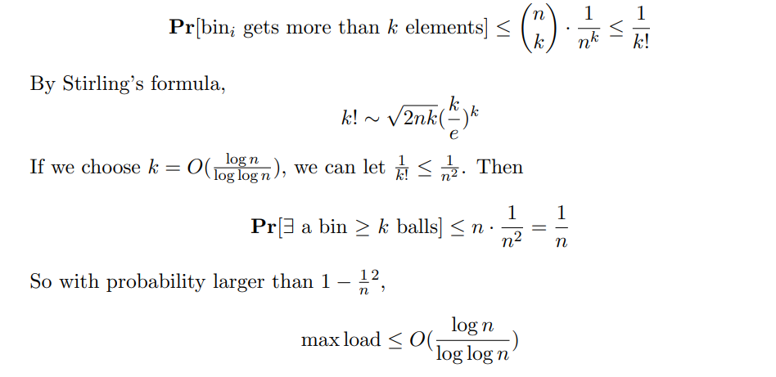
The Math

Slide 12
Power of hashing twice Load balancing
Let h₁ and h₂ by random hash functions
When element x is inserted, it goes to the cell h₁(x) or h₂(x) with least number of elements elements
Find must check cells h₁(x) and h₂(x)
The maximum number of elements assigned to any cell is O(loglog n) with high probability

Slide 13
Proof (Intuition)
Ball has height k when it is placed in a bin with k-1 balls
Expect <= n/2 bins with 2 balls
Expect <= n/2² bins with 3 balls
Expect <= n/2⁴ bins with 4 balls
Expect <= n/2⁸ bins with 5 balls
Expect <= n/2¹⁶ bins with 6 balls
Expect <= n/2³² bins with 7 balls

Slide 14
Tracking keys without data
If the key domain is [1..n] a bit vector is ideal
What if you hash into a bit vector?
What type of errors occur

Slide 15
Bloom Filter
Basic idea – k-hash functions
Bits are set at h₁(x), h₂(x), . . ., h_{k}(x)
Lookup is done by reading h₁(x), h₂(x), . . ., h_{k}(x)
Can we get a false negative
Can we get a false positive

Slide 16
Bloom Filter
Alternative data structures: List, Hash Table
Critical reason for using Bloom Filter – limited storage
Lots of data
Devices with limited memory (e.g., network routers)
Need for main memory versus going to disk
Don’t need to remember the actual data (in the data structure)
Measure of interest – number of bits per data element
Bloom filters have been left out of computer science curriculum

Slide 17
Bloom Filter Example (k = 3)
0 | 0 | 0 | 0 | 0 | 0 | 0 | 0 | 0 | 0 | 0 | 0 | 0
X₁
X₂
0 | 1 | 0 | 0 | 1 | 0 | 1 | 0 | 0 | 0 | 1 | 0 | 0
Y₁
Y₂
0 | 1 | 0 | 0 | 1 | 0 | 1 | 0 | 0 | 0 | 1 | 0 | 0
Z

Slide 18
Some Bloom Filter Math
Table size m, data items n
After all members of S have been hashed probability of specific element being zero is
False probability rate
Express rate as a function of probability

Slide 19
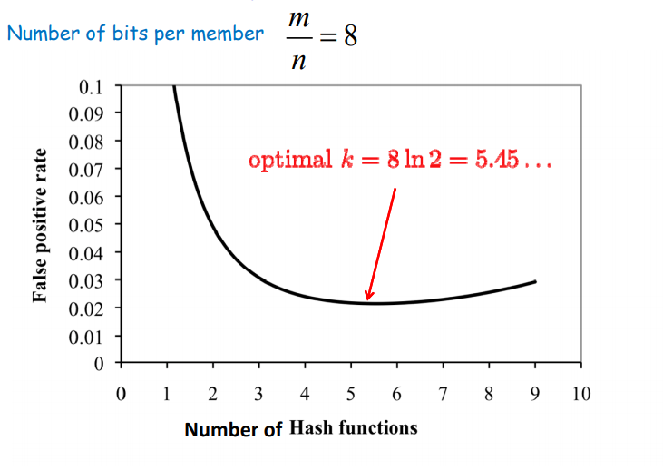
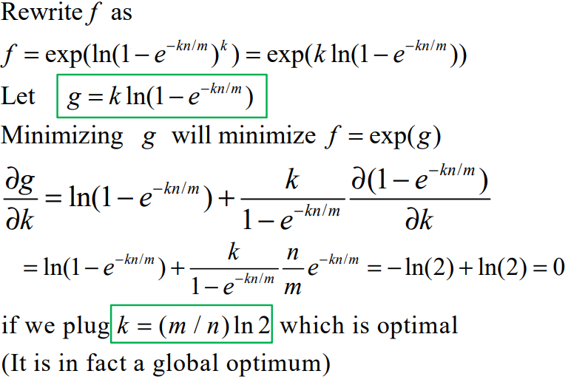
False positive rate vs. k Find optimal with calculus

Slide 20
Bloom Filter Applications
Dictionary to detect speling mistakes
All good words let through, some mistakes will happen
List of malicious URLs in browser
List of keys needed for a database join
Akamai web caching, avoid caching data only requested once
List of requests put into a Bloom filter, store data on the second request

Slide 21
Bloom filter deletes
Why do Bloom filters fail for deletes?
Counting Bloom Filters
Each cell is a counter (4 bits considered sufficient)
Insert, add one to each target cell
Delete, delete one from each target cell
Find, test if target cells non-zero
On overflow, leave counter at maximum value

Slide 22
Bloom Filter Deletes (k = 3)
0 | 0 | 0 | 0 | 0 | 0 | 0 | 0 | 0 | 0 | 0 | 0 | 0
X₁
X₂
Insert X₁
Insert X₂
Insert Y₁
Delete Y₂
Find Z
0 | 0 | 0 | 0 | 0 | 0 | 0 | 0 | 0 | 0 | 0 | 0 | 0
Y₁
Y₂
0 | 0 | 0 | 0 | 0 | 0 | 0 | 0 | 0 | 0 | 0 | 0 | 0
Z

