Slide 1
CSEP 521: Applied Algorithms Lecture 6 Randomized Primality Testing
Richard Anderson
January 21, 2021

Slide 2
Announcements
Today is the 21st day of the 21st year of the 21st century

Slide 3
Primality Testing
Miller-Rabin test demonstrated importance of randomized algorithm
Break through result in 1980
Depends on number theory (maybe a senior ugrad class)
But much of the algorithm can be appreciated without the theory
The key concept is that of a witness
If something is true, a witness always says TRUE
If something is false, a witness says TRUE with probability less than ½

Slide 4
Primality testing
Is the number:
38,448,590,786,041,766,459,732,220,363,801,744,241,896,763,259,493,887,920,989,231,800,007,262,253,532,084,767,190,284,597,690,724,762,898,279,841,570,128,623,506,757,165,008,658,334,072,162,989,430,299,242,002,399,263,948,157,607,441,618,354,889,045,484,455,604,450,713,181,265,743,757,650,808,578,235,094,058,535,442,090,523,274,067,570,229,406,671,451,796,017,542,179,880,527,768,546,296,447,905,493,082,191
prime?
A number p is prime if its only proper divisors are 1 and p, and is composite otherwise
Small primes {2, 3, 5, 7, 11, 13, 17, 19, 23, 29, 31, 37, 41, 43, 47, . . .}
Simple primality testing algorithms
Trial division
Sieve of Eratosthenes

Slide 5
Why prime testing is important: cryptography
RSA public key encryption
Relies on factoring “being hard”, N = pq where p and q are prime
Recommendation is that N is 2048 bits with p and q roughly 1024 bits
1024 bits is roughly 300 digits
Need a way to generate “random primes”
Guess and check

Slide 6
Complexity of number problems
Run time based on size of input
Input N has size Log₂ N
Polynomial time corresponds to polynomial in the size of the number
Runtime polynomial in N is exponential in the number of bits

Slide 7
Bignum computation
Arithmetic computation on large numbers – hundreds or thousands or millions of digits
Run time expressed as a function of the number of digits
Addition of two n-bit numbers: O(n)
Multiplication of two n-bit numbers: O(n²) or O(n^{3/2}) or O(n log n loglog n)
Bignum arithmetic implemented by storing numbers in an array of ints
1024 bit number would require an array of 32 ints

Slide 8
Exponentiation: Compute A^{N}
Do the computation mod M
129038105814095380935⁸⁴³⁰⁹⁸¹⁴²³⁰⁹¹²⁴³⁸⁰⁹ MOD 10000000000000000000000
Compute by repeated squaring
A raised to 2^{K} can be computed in K multiplications

Slide 9
Greatest Common Divisor
GCD(A, B) = D, where D is the largest number that divides both A and B
Runs in O(n²) time for n bit numbers
A: 33707, B: 15207
A: 15207, B: 3293
A: 3293, B: 2035
A: 2035, B: 1258
A: 1258, B: 777
A: 777, B: 481
A: 481, B: 296
A: 296, B: 185
A: 185, B: 111
A: 111, B: 74
A: 74, B: 37
A: 37, B: 0
function gcd(a, b)
while b ≠ 0
t := b
b := a mod b
a := t
return a

Slide 10
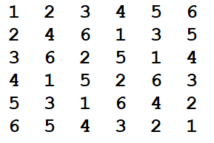
Prime testing – Idea: Modular arithmetic
Let P be prime
Consider the set of integers {1, 2, 3, . . ., P-1} with the operation *, where multiplication is done mod P
Can the structure of modular multiplication be used to show P is prime?
Set with multiplication mod P referred to as Z*_{P}

Slide 11
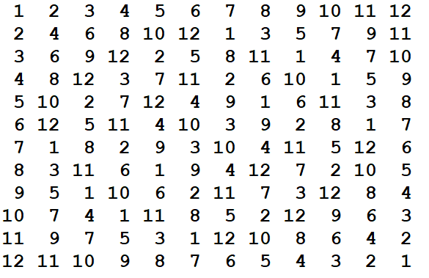
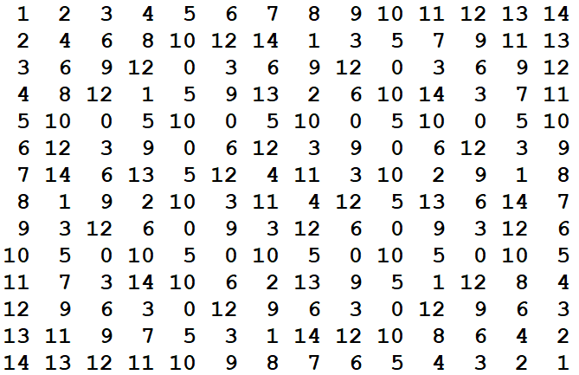
Modular multiplication

Slide 12
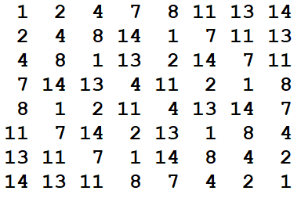
Zero divisors for integers mod N
X is a zero divisor if AX = 0 mod N for some A != 0
Fact: X is a zero divisor if and only if GCD(X, N) > 1
Z*_{N} = { y in [1 .. N-1] | GCD(y, N) = 1 }
|Z*_{N}| = Φ(N)

Slide 13
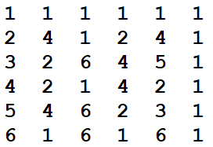
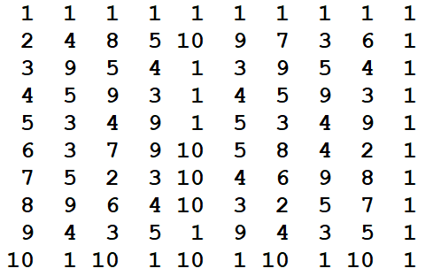
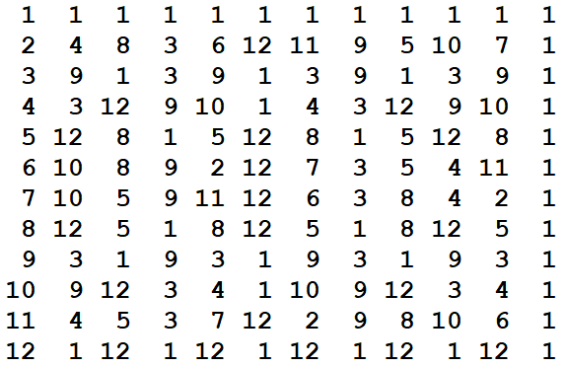
Powers of elements
P = 7, 11, 13
Compute A¹, A², A³, . . ., A^{P-1}

Slide 14
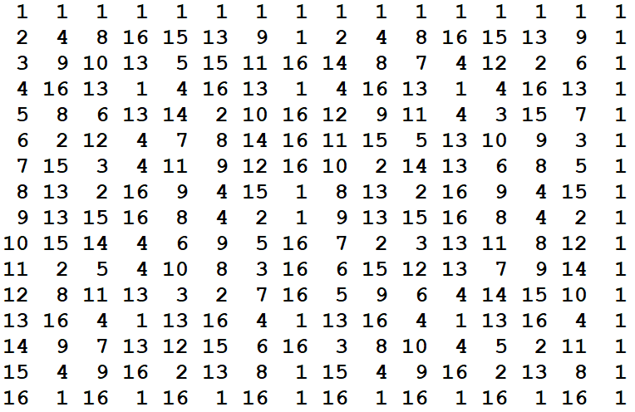
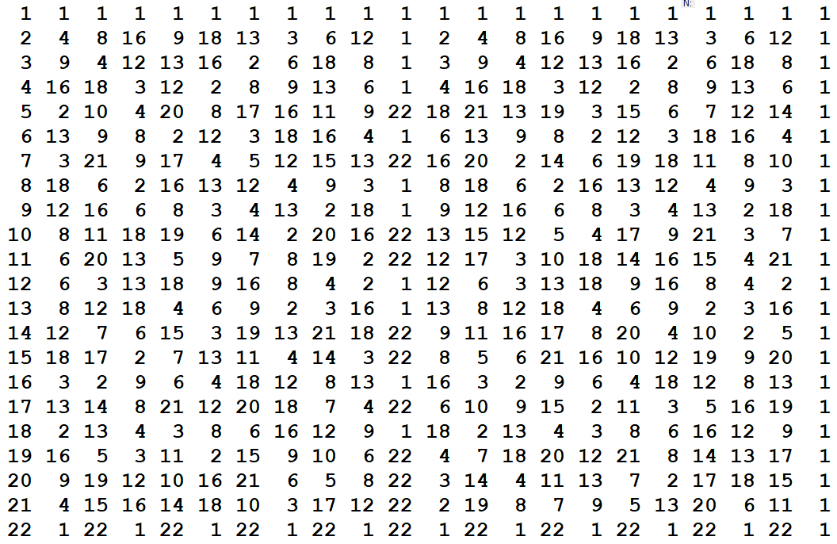
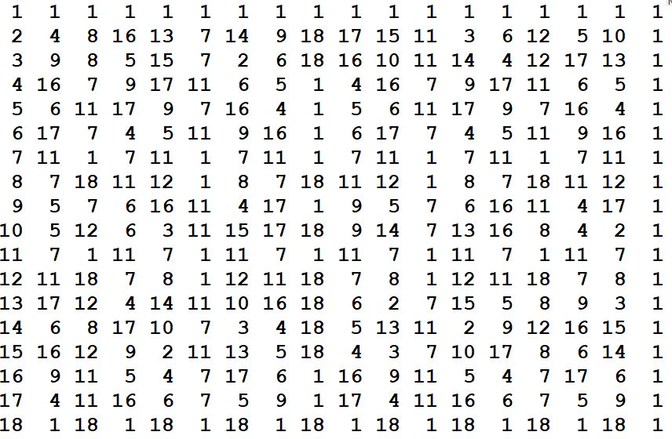
P = 17, 19, 23

Slide 15
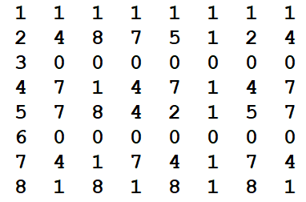
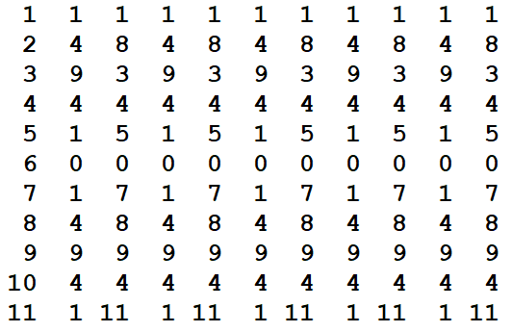
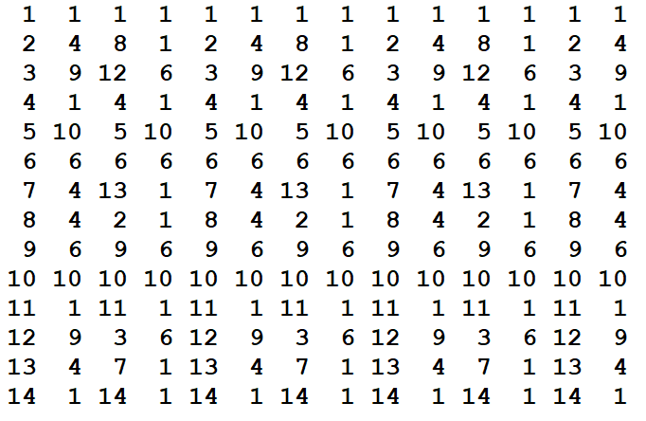
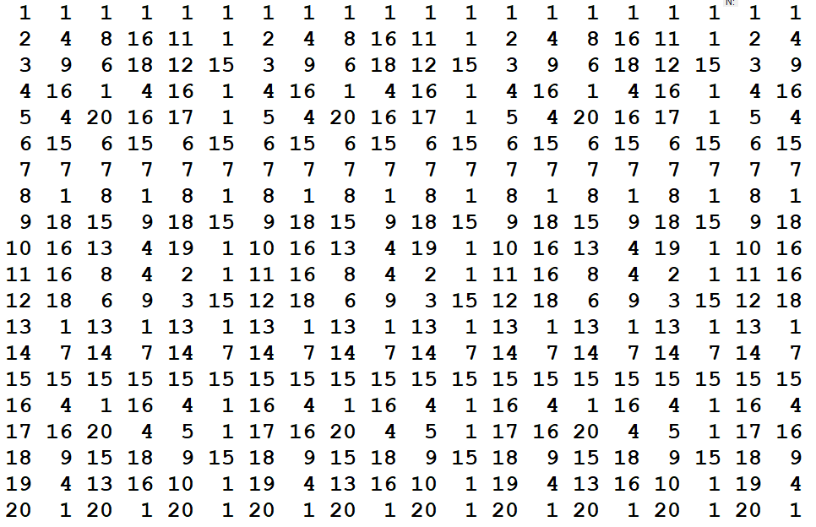
P = 9, 12, 15, 21

Slide 16
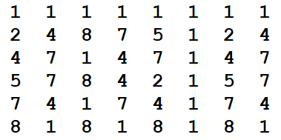
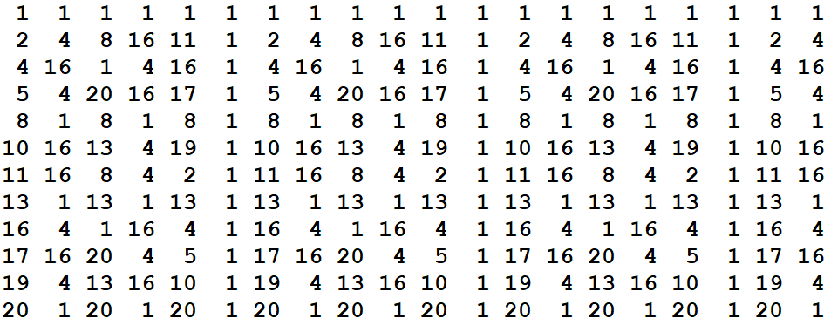
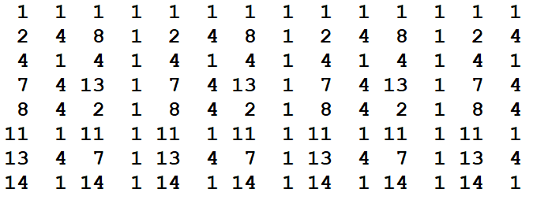
P = 9, 12, 15, 21 for Z*_{N}

Slide 17
Idea (that doesn’t quite work)
Theorem: if P is prime, A^{P-1} = 1 (mod P)
Pick a bunch of numbers at random from [1 .. P-1]
Compute X^{P-1} mod P for each one
If all results are 1, then say Prime
If at least one of them is not 1, then say Composite

Slide 18
Carmichael Numbers What about 561 = 3*11*17
2⁵⁶⁰ = 1 mod 561
4⁵⁶⁰ = 1 mod 561
5⁵⁶⁰ = 1 mod 561
7⁵⁶⁰ = 1 mod 561
8⁵⁶⁰ = 1 mod 561
10⁵⁶⁰ = 1 mod 561
14⁵⁶⁰ = 1 mod 561
. . . . .
Carmichael numbers are rare (but there are an infinite number)
Either all numbers in Z*_{N} satisfy X^{N-1} = 1 mod N or at most half the numbers in Z*_{N} satisfy X^{N-1} = 1 mod N

Slide 19
Witnesses and Certificates
Certificate C that can be used to prove a property
To show N is composite, find a number A such that 1 < GCD(A, N) < N
178 is a Certificate that 11481 is composite
Is there a certificate for primality?
Prime Witness
A property that always holds for primes
A property that only sometimes holds for composites

Slide 20
Euler Test
N – 1 mod N = -1 mod N, so we can think of N-1 as -1 in Z*_{N}
For P prime, a^{(p-1)/2} = 1 or a^{(p-1)/2} = -1
Half of the values of a have a^{(p-1)/2} = 1 and half have a^{(p-1)/2} = -1
But there are composite numbers that fool the Euler Test
1729 = 7 * 13 * 19
2⁸⁶⁴ = 1 mod 1729, 3⁸⁶⁴ = 1 mod 1729, 4⁸⁶⁴ = 1 mod 1729, . . .

Slide 21
Lemma 14.32 (Motwani-Raghavan)
Let N an odd composite that is not a power of a prime and suppose that for some a in Z*_{N}, a^{(N-1)/2} = -1 mod N
Let S be the set of numbers a in Z*_{N} where a^{(N-1)/2} = -1 mod N or a^{(N-1)/2} = 1 mod N
Then |S| <= ½ |Z*_{N}|
Or in English: if the Euler Test passes with a -1, then at most half the values fool the test

Slide 22
Prime Testing Algorithm
If N is perfect power return Composite
Choose a bunch of random values b₁, b₂,…,b_{t} from [1..n-1]
If GCD(b_{j},N) return Composite
r_{j}= b_{j}^{(N-1)/2}
If r_{j} != 1 and r_{j} != -1 return Composite
If r_{j} = 1 for all j return Composite
Return prime

Slide 23
What could go wrong
Composite number could fail line 5 and fail line 6 and be called prime
Prime could be reported as composite on line 6
Double sided error with failure probability 2^{-t}

Slide 24
Miller-Rabin test
Determine if n is prime
Given an integer a, 1 < a < n,
Miller(n, a) returns either “maybe prime” or “definitely composite”
For n prime, Miller(n, a) always says “maybe prime”
For n composite, Miller(n, a) says “maybe prime” with probability at most ¼ for a random a
By running the Miller test repeatedly, we can make it arbitrary high probability

Slide 25
Fermat Test
Fermat’s little theorem
For prime n, a^{(n-1)} = 1 (mod n) for all a
For most composite numbers, this fails most of the time
Unfortunately, there are set of composite numbers (Carmichael numbers) that satisfy this
{561, 1105, 1729, 2465, 2821, 6601, 8911, 10585, 15841, 29341, 41041, 46657, 52633, 62745, 63973, 75361, 101101, 115921, 126217, 162401, 172081, 188461, 252601, 278545, 294409, 314821, 334153, ...}

Slide 26
Miller-Rabin test
For a prime number n, the only square roots of 1 modulo n, are 1 and -1
For n = 2^{s}d +1, a^{d}= 1(mod n) or a^{(2^r)d} = -1 (mod n) for some 0<=r<s
For a composite number at most ¼ of values a satisfy these conditions

Slide 27
Pseudo-code
Input #1: n > 3, an odd integer to be tested for primality
Input #2: k, the number of rounds of testing to perform
Output: “composite” if n is found to be composite, “probably prime” otherwise
write n as 2^{r}·d + 1 with d odd (by factoring out powers of 2 from n − 1)
WitnessLoop: repeat k times:
pick a random integer a in the range [2, n − 2]
x ← a^{d} mod n
if x = 1 or x = n − 1 then
continue WitnessLoop
repeat r − 1 times:
x ← x² mod n
if x = n − 1 then
continue WitnessLoop
return “composite”
return “probably prime”

Slide 28
Other facts on Prime Testing
Miller-Rabin test is deterministic if Extended Riemann Hypothesis is true
2002 a deterministic polynomial time test based on Cyclotomic Polynomials was discovered
Agrawal-Kayal-Saxena, IIT Kanpur
Not practical (termed galactic algorithm – see Wikipedia)
Factoring is thought to be harder then primality testing
In practice, numbers of about 100 decimal digits are factorable in a few hours on a PC
250 decimal digit (829 bit) RSA keys have been factored (2700 CPU Years)
Recommendation for RSA is 2048 bit keys

Slide 29
RSA
RSA key is a number n=pq, where p and q are prime
How do you generate random primes of 300 digits?
Generate random number of 300 digits and test if they are prime
Of course, there are simple tricks to avoid small divisors
Prime number theorem: Probability of a random number less than N is prime is about 1/log N (Natural logarithm)
For 300 digits, this is about 1 in 690

