Slide 1
CSEP 521: Applied Algorithms Lecture 3 Randomized Algorithms
Richard Anderson
January 12, 2021

Slide 2
Announcements
Homework deadline shifted to Thursday (including HW 1)
But distribution will remain Tuesdays (HW 2 has been posted)
Sign up for Gradescope (?)

Slide 3
Randomized Algorithms
Randomization comes up in many different ways in computation
Illustrate different ways randomization is used by example algorithms
Algorithmic Techniques + Analysis Techniques
Demonstrate some incredibly cool idea that are foundational for computing
K-th largest problem (median problem)
Randomization to avoid bad case
Random sampling
Random sampling to look for solutions
Reordering to avoid bad case solutions

Slide 4
Probability theory
Basic ideas:
Sample space and events
Random variables
Expectation: E(X) – average value of X
Linearity of expectation: E(X + Y) = E(X) + E(Y)
Conditional Probability: P(A | B)
Independence: P(A | B) = P(A)
Great review videos
Tim Roughgarden (ex-Stanford), Videos 7.1 and 7.2
Many other references

Slide 5
Randomized Algorithms
How can random choices be used to make algorithms efficient?
Suppose you have a minimization problem, where given a solution you can easily compute the value of the solution
Now suppose you have an algorithm, which returns a specific optimal solutions with probability p.
Can you find an optimal solution? What can go wrong?
S

Slide 6
Mincut problem: Karger’s Algorithm
Graph problem
Random result – might be correct
Given an undirected graph, partition the vertices into two non-empty pieces to minimize the edges between the pieces
Undirected graph with parallel edges
Notes:
Different from the standard mincut problem presented along with Network Flow
The algorithm presented is not very efficient, but can be improved to be faster than any known deterministic algorithm for the problem

Slide 7
Minimum Cut Problem
Given an undirected graph with parallel edges, find non-empty sets S and S’ that minimized the number of edges between S and S’

Slide 8
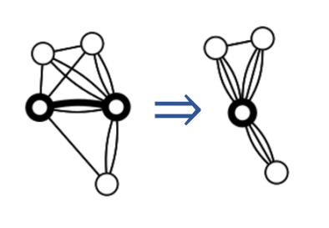
Edge contraction operation
Observation: The number of edges in the mincut of G/E is at least as great as the number of edges in a mincut of G

Slide 9
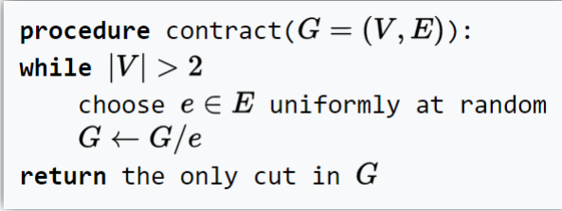
Randomized Algorithm

Slide 10
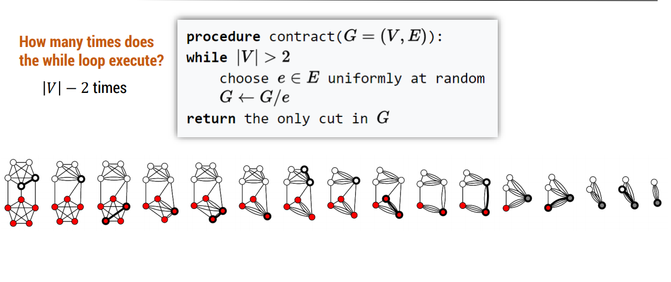

Slide 11
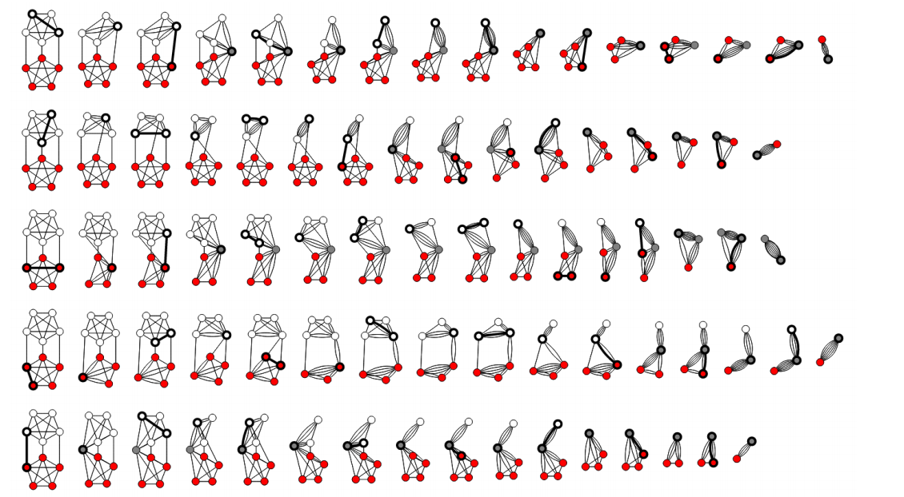

Slide 12
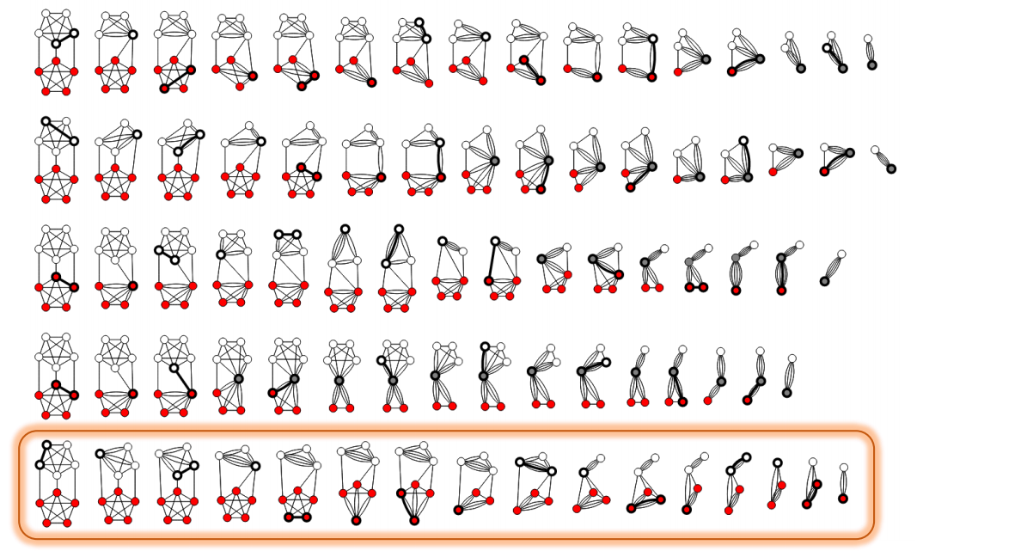

Slide 13
Analysis
Let C be a min cut (where C is the set of edges between sets of vertices S and S’ and |C| = k). What is the probability that C survives the contraction process?
G has at least kn/2 edges, otherwise G would have a vertex of degree less than k (and consequently a cut of size less than k).
Probability that the first edge picked is in C is at most k / (nk/2) = 2/n

Slide 14
Conditional Probabilities
E_{i}: Event of not picking an edge from C on the i-th step
Probability that no edges from C are picked:
p = Prob[E₁] Prob[E₂ | E₁] Prob[E₃ |E₁ E₂] … Prob [E_{n-2} |E₁ E₂… E_{n-3}]
Prob[E_{i} | E₁ E₂ . . . E_{i-1} ] >= 1 – 2 / (n- i + 1) = (n – i – 1) / (n – i + 1)
p >= (n-2)/ n * (n-3) / (n-1) * (n-4) / (n-2)* . . . * 2/4 * 1/3 = 2 / n(n-1)

Slide 15
Min Cut Result
Probability that C survives is at least 2 / n(n-1) on one iteration
If we repeat the algorithm n(n-1) / 2 times we have probability at least 1 - 1/e that C has survived at least once
Mathematical fact: (1 – 1/k)^{k} < 1/e
If we run O(n² log n) iterations, we have the probability of at least 1 – 1/n of finding a mincut

Slide 16
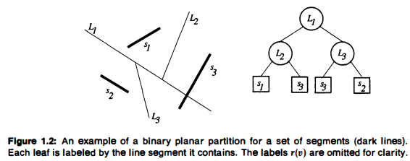
Binary planar partition
S = {s₁, s₂, . . . s_{n}}: non-intersecting line segments in the plane
Binary tree, each node v of the tree is a region r(v) of the plane and has a line l(v) which separates r(v) into regions r₁(v) and r₂(v) which are associated with it children
The line segments are then cut up and assigned to the associated leaf regions

Slide 17
Motivation: hidden surface elimination
2-D Version, draw the line segments visible from any point in space
Painters algorithm: draw the lines from back to front in viewing direction
Tree traversal algorithm. Determine which side of the line you are on for each node. Traverse the subtree on the other side of the line, then the subtree on your side of the line
Run time is proportional to the size of the tree
Tree size O(n)? O(n log n)? O(n²)?

Slide 18
Greedy Algorithm
Permutation of line segments
While a region has more than one segment
Choose the next segment, and use its line to split segments

Slide 19
Warmup exercises (breakout)
Show that there exists a set of line segments for which no binary planar partition can avoid breaking up some of the segments into pieces, if each segment I to lie in a different region of the partition
What is a bad case of partitioning
Layout + choice of tree

Slide 20
Random algorithm
Choose the segments in a random order
Result: Expected number of partitions is O(n log n)

Slide 21
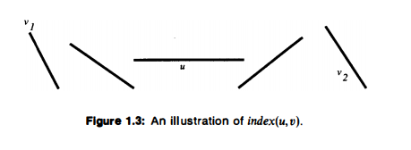
Argument
index (u, v) is 1 + number of segments intersected by l(u) before hitting v, and is infinity if l(u) does not intersect v
index(u,v₁) = index(u,v₂) = 2

Slide 22
Mathy stuff
Cut(u,v) the event that l(u) cuts v
Suppose index(u,v) = i
Cut(u,v) happens only if u occurs before any of u₁, u₂, …, u_{i-1}, v in the random permutation
C_{uv} indicator variable for Cut(u,v)
E[C_{uv}] = Pr(Cut(u,v)) = 1/(i + 1)

Slide 23
Completing the proof
Size of the partition is n + number of cuts
Expected size n + E(Sum_{uv} C_{uv})
Line segment u has at most 2 segments v and w with index(u,v)= i and index(u,w) = i
Bound n + 2nH_{n}

Slide 24
Summary of result
Binary Space Partition trees are small with random ordering
This result generalizes to higher dimensions where it is useful for hidden surface elimination
Leads to simple algorithms that perform well
Use of randomization to defeat the bad case

