Slide 1
CSEP 521: Applied Algorithms Lecture 2 Randomized Algorithms
Richard Anderson
January 7, 2021

Slide 2
Announcements
Contact info:
Richard Anderson, anderson@cs.washington.edu
Oscar Sprumont, osprum@cs.washington.edu
Office hours (Zoom)
Richard Anderson, Monday 11 am – noon, Friday 2 pm – 3 pm
Oscar Sprumont, Wednesday 11 am – noon, Friday 11 am – noon
Edstem Discussion board set up
https://edstem.org/us/courses/3570/discussion/
Course readings
Starting to put of references and links on website (under readings)

Slide 3
Randomized Algorithms
Randomization comes up in many different ways in computation
Illustrate different ways randomization is used by example algorithms
Algorithmic Techniques + Analysis Techniques
Demonstrate some incredibly cool ideas that are foundational for computing
K-th largest problem (median problem)
Randomization to avoid bad case
Relation between average case and randomized analysis
Random sampling algorithms (again for the median)
Solutions by guessing (Undirected MinCut problem)

Slide 4
Probability theory
Basic ideas:
Sample space and events
Random variables
Expectation: E(X) – average value of X
Linearity of expectation: E(X + Y) = E(X) + E(Y)
Conditional Probability: P(A | B)
Independence: P(A | B) = P(A)
Great review videos on probability
Tim Roughgarden (ex-Stanford), Videos 7.1 and 7.2
Many other references

Slide 5
Finding the k-th largest
Given n numbers and an integer k, find the k-th largest
If k = n/2 this is computing the median
Obviously, we can solve this problem by sorting (in time O(n log n)) but can we do better
Quicksort idea, but only one recursive call
This will still have the same pathological case

Slide 6
QSelect(A, k)
QSelect(A, k){
Choose element x from A
S₁ = {y in A | y < x}
S₂ = {y in A | y > x}
S₃ = {y in A | y = x}
if (|S₂| >= k)
return QSelect(S₂, k)
else if (|S₂| + |S₃| >= k)
return x
else
return QSelect(S₁, k - |S₂| - |S₃|)
}
S₁
S₃
S₂

Slide 7
Quick Select
Same worst case as Quick Sort
Random pivot will give an O(n) solution (Expected time)
Deterministic solution (due to BFPRT) not practical
Exact evaluation of Quick Select recurrence is very difficult

Slide 8
Evaluating Quick Select
Important divide and conquer recurrence:
T(1) = 1; T(N) = T(aN) + bN for a < 1
What is the chance that for a random pivot, the subproblem is of size at most aN (for an appropriate a < 1)

Slide 9
Analysis
A random pivot reduces the problem to less than ¾ the size with probability at least ½
Recurrence T(n) <= ½ T(3n/4) + ½ T(n) + cn
Recurrence for expected number of steps
This recurrence gives an upper bound on the number of steps for randomized selection

Slide 10
Selection results
O(n) expected time median algorithm
Practical algorithm
How many comparison to find the median?

Slide 11
Sampling algorithm for finding median
Two pivot algorithm
Choose pivot p₁, such that p₁ is less than the median
Choose pivot p₂, such that p₂ is greater than the median
Identify the elements between p₁ and p₂
Find the k-th largest element of S₃ where k = n/2 - |S₃|
p₁
p₂
S₁
S₃
S₂

Slide 12
Finding the pivots
Select a set A of m random values from the input
Let p₁ be the element of rank m/2 + r in A
Let p₂ be the element of rank m/2 – r in A
Claim: if m << n and |S₃| << n then the comparisons are (3/2)n + o(n)
Choose m = n^{2/3} and r = n^{1/3}

Slide 13
Breakout session
Suppose P is a random permutation (on 1..n), what is the expected number of elements k such that P[k] = k
This could be given with a story line, such as saying that when everyone in an office goes back to work, they are assigned a random desk, what is the expected number of people that are assigned to their old desk
Discuss as a group, and if you come up with a solution, make sure all group members understand the solution

Slide 14
Randomized Algorithms
How can random choices be used to make algorithms efficient?
Suppose you have a minimization problem, where given a solution you can easily compute the value of the solution
Now suppose you have an algorithm, which returns a specific optimal solutions with probability p.
Can you find an optimal solution? What can go wrong?
S

Slide 15
Mincut problem: Karger’s Algorithm
Graph problem
Random result – might be correct
Given an undirected graph, partition the vertices into two non-empty pieces to minimize the edges between the pieces
Undirected graph with parallel edges
Notes:
Different from the standard mincut problem presented along with Network Flow
The algorithm presented is not very efficient, but can be improved to be faster than any known deterministic algorithm for the problem

Slide 16
Minimum Cut Problem
Given an undirected graph with parallel edges, find non-empty sets S and S’ that minimize the number of edges between S and S’

Slide 17
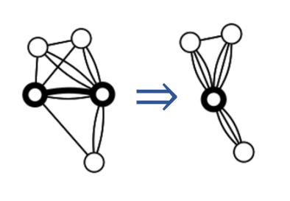
Edge contraction operation
Observation: The number of edges in the mincut of G/E is at least as great as the number of edges in a mincut of G

Slide 18
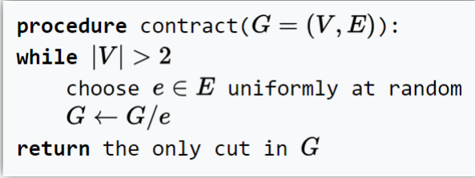
Randomized Algorithm

Slide 19
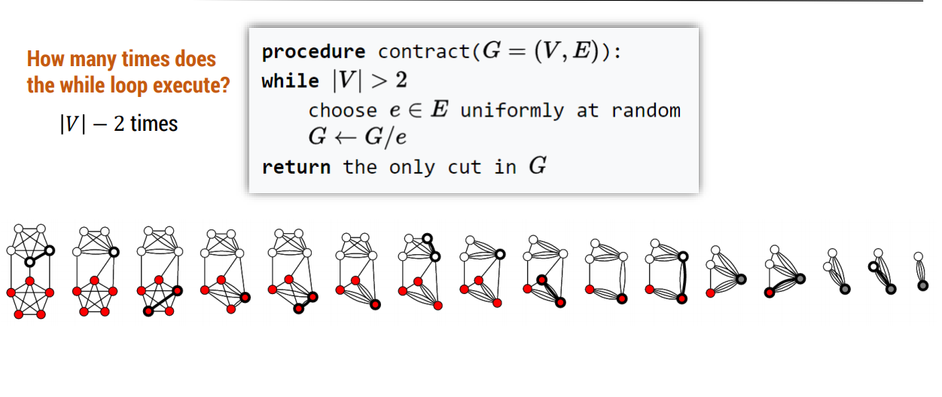

Slide 20
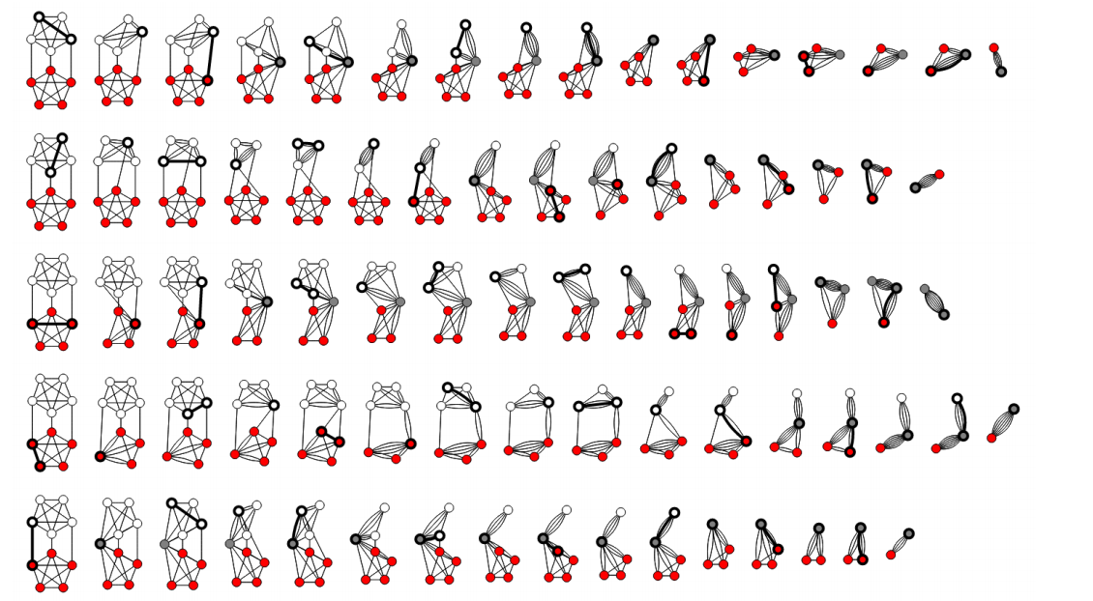

Slide 21
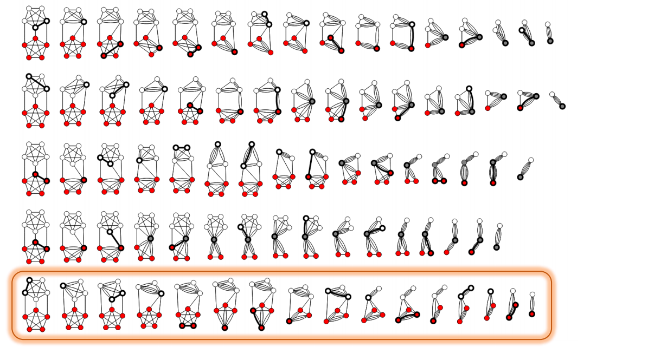

Slide 22
Analysis
Let C be a min cut (where C is the set of edges between sets of vertices S and S’ and |C| = k). What is the probability that C survives the contraction process?
G has at least kn/2 edges, otherwise G would have a vertex of degree less than k (and consequently a cut of size less than k).
Probability that the first edge picked is in C is at most k / (nk/2) = 2/n

Slide 23
Conditional Probabilities
E_{i}: Event of not picking an edge from C on the i-th step
Probability that no edges from C are picked:
p = Prob[E₁] Prob[E₂ | E₁] Prob[E₃ |E₁ E₂] … Prob [E_{n-2} |E₁ E₂… E_{n-3}]
Prob[E_{i} | E₁ E₂ . . . E_{i-1} ] >= 1 – 2 / (n- i + 1) = (n – i – 1) / (n – i + 1)
p >= (n-2)/ n * (n-3) / (n-1) * (n-4) / (n-2)* . . . * 2/4 * 1/3 = 2 / n(n-1)

Slide 24
Min Cut Result
Probability that C survives is at least 2 / n(n-1) on one iteration
If we repeat the algorithm n(n-1) / 2 times we have probability at least 1 - 1/e that C has survived at least once
Mathematical fact: (1 – 1/k)^{k} < 1/e
If we run O(n² log n) iterations, we have the probability of at least 1 – 1/n of finding a mincut

