Slide 1
One World
Your Translation Companion
Kenny Risk
Alex Cheng
Angapparaj Kalimuthu
Daniel Mejia

Slide 2
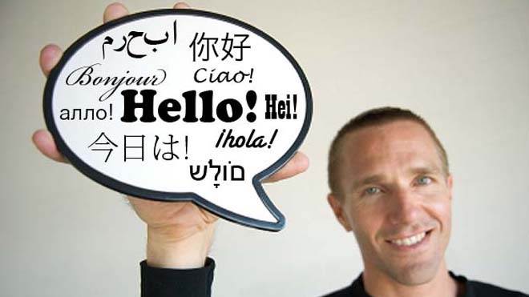
Problem and Solution
Globalized culture
Human translators
Technology available
  Speech Recognition
  Machine Translation
Notes:
Frequent interactions between people who are from different cultures and speak different language
In business settings we often have professional translators, but this incurs additional cost to business. In travel scenarios we sometimes have friends who speak the other language, but this could not always be the case..

Slide 3
どのように私は今日あなたを助けることができるか？
How can I help you today?
東京でホテルを予約したいです。
I want to book a hotel in Tokyo

Slide 4
Overview
Problem description
Context Inquiry
Brainstorming & Task Analysis
Early Sketches
Selected Interface
Scenario Design
Notes:
Kenny Nintendo
We have always situation where we are the translator
Danny’s friend with travel

Slide 5

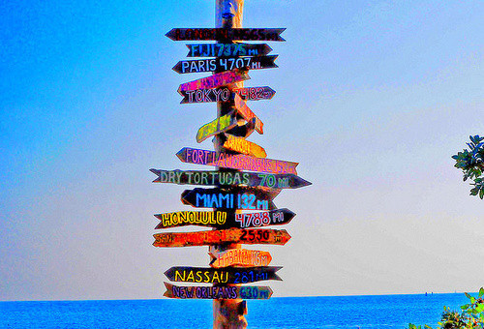
Contextual Inquiry
Business Meetings
  Video Conferencing
Foreign Travelers
  Travel Reservation
Notes:
Talk about the setting, who we observed

Slide 6
Global Partner Weekly Sync
Interpreter as an active participant
Latency
Summary vs. word-for-word
Lengthy pauses
Interpreter feedback
Terminology

Slide 7
Travel Reservation
Preparation
Online Automated Translation
Numbers
Quality of audio
Lack of Transcript
Image search
Feedback through clarification & re-phrasing

Slide 8
Tasks
Business Meeting in a specific domain
Casual conversation in a travel setting
Online dating with language barrier
Notes:
Need to explain why easy->hard
Domain specific

Slide 9
Task analysis and how one world help solve these issues
Add table now and then

Slide 10
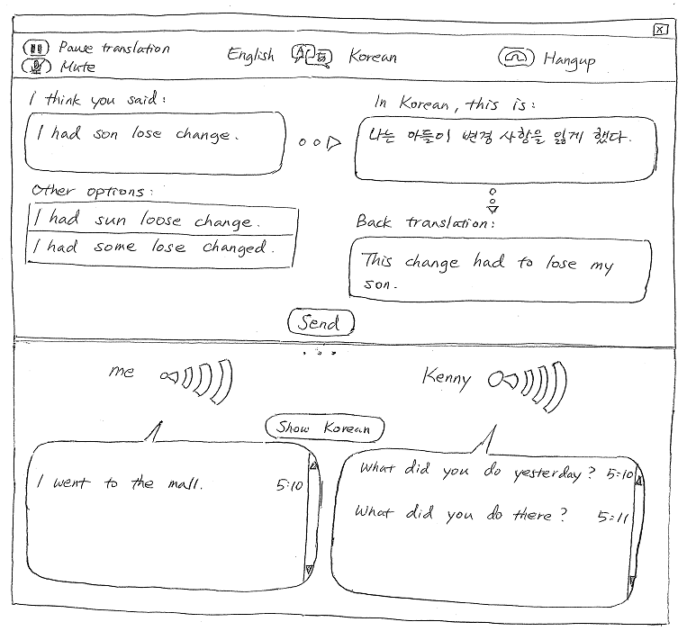
Early designs – speech to speech

Slide 11
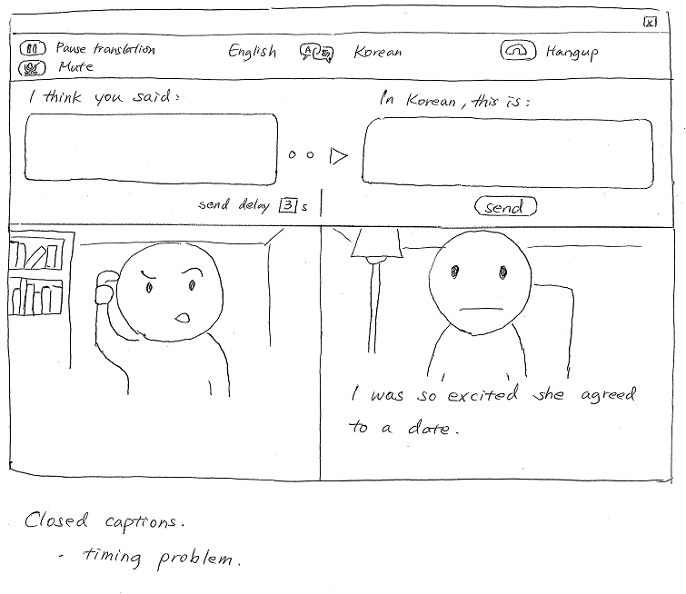
Early design (Close captions)

Slide 12
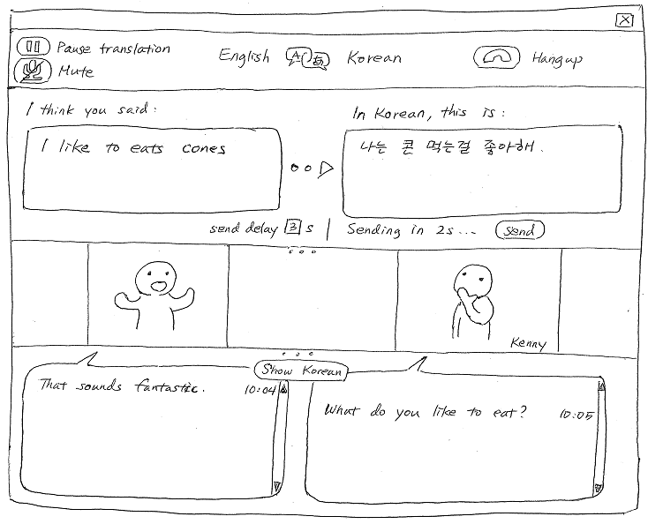
Selected design

Slide 13
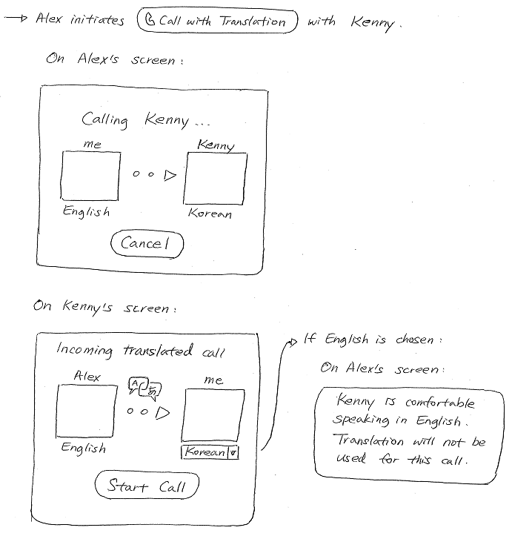

Slide 14
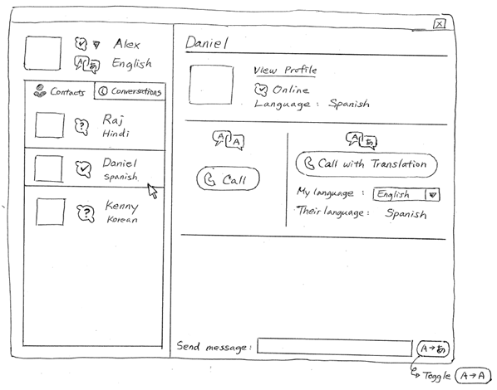
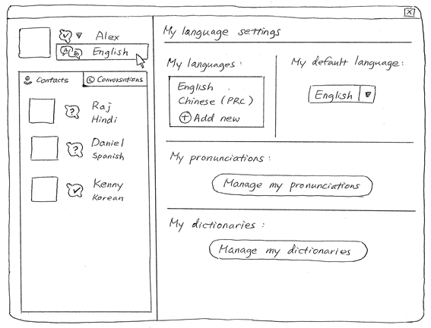
Selected Design- Profile/settings

Slide 15
Scenarios
Call acceptance, simple sentence detection, automatic and forced submissions
Call initiation, speech recognition error handling, incorrect translation signaling
Custom language settings, long speech handling, incorrect translation resolution
Notes:
Need to explain why easy->hard
Domain specific

Slide 16
Summary
Overcoming quality challenges of the automated system
Notes:
The goal of our system is to overcome the quality challenges
From context inquiry, we observe how ppl interact with human translator / machine translator
We find that the visual part of communication is very important
Having a transcript of the translated text vs speech output b/c (less destruptive) & ppl are faster readers
We built in feedback / correction mechanism, ability to customize the system

