Slide 1
Cooking Companion
Aaron Roney (aroney) Ananda Sarkar (anandsar) Jason Cho (darken1) Ryan Olmstead (rolm)

Slide 2
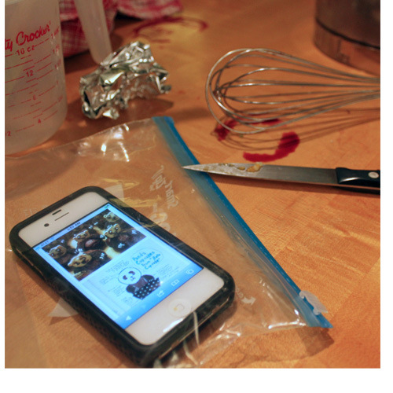
Background
Abundant online recipes
Existing recipe apps inconvenient when cooking
Features limited, usually require touching device

Slide 3
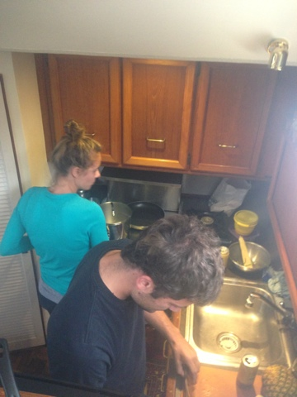
Contextual Inquiry Participants
Layla – Biologist, uses “The Recipe Box” application for recipes
Tessa – Bioengineer, enjoys baking
Lisa – Nurse, regularly cooks for large groups
Naresh – Software Engineer, Uses Windows Phone app for recipes

Slide 4
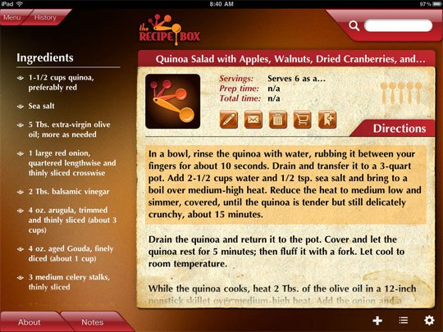
Contextual Inquiry Description
Participants asked to prepare a recipe of their choice
Three of four used recipe found online
Participants observed while cooking

Slide 5
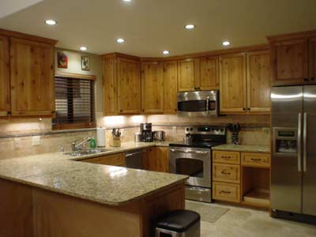
Contextual Inquiry Results
Recipes chosen by reviews and difficulty
Participants continually checked recipe
Recipes followed out of order
Recipes customized from experience

Slide 6
Problems & Opportunities
Support for different interaction models critical
Personalizing (for family, preferences, kitchen) is important
Ability to plan ahead and integration with camera & services

Slide 7
Vision
Design an application for working adults who are enthusiastic but not expert cooks, that elevate to a true cooking companion – offering personalization (for family, choice, kitchen), novel interaction model and planning capabilities, saving time, money & energy.

Slide 8
Tasks
EASY: Search for a recipe and cook for family.
MODERATE: Find and use a recipe. Cook the recipe out of order and use substitution on ingredients.
DIFFICULT: Find a few recipes, upload camera piocture for few others. Plan ahead and purchase ingredients for the week. Customize recipe for family and friends.

Slide 9
Design
4 designs – 1 idea:
Clutter-free homepage
Personalized experience
Planning ability
Search
Gesture / voice control
Notes:
Integration with Services – facebook, coupon apps, grocery finder, social contact preferences, yelp reviews, out of scope?

Slide 10
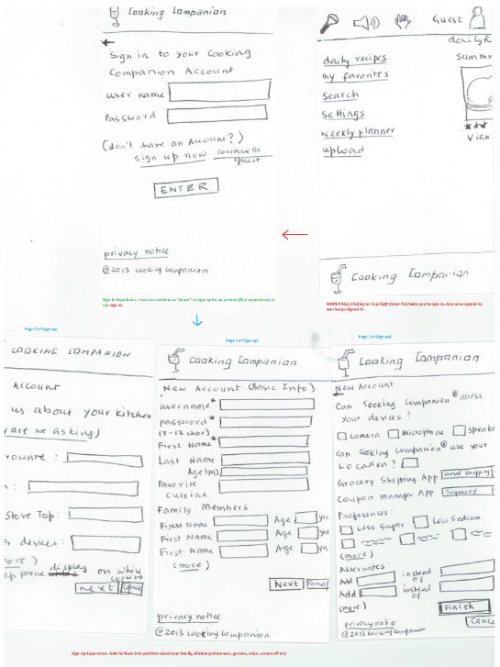
Sketch #1

Slide 11
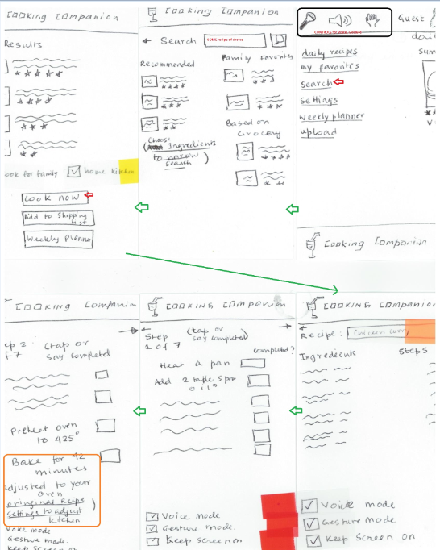
Sketch #1

Slide 12
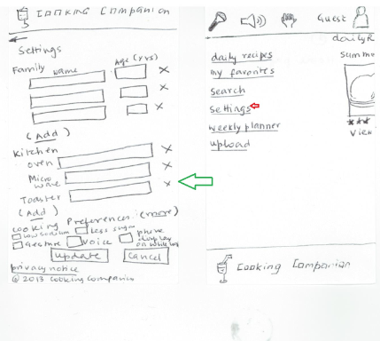
Sketch #1

Slide 13
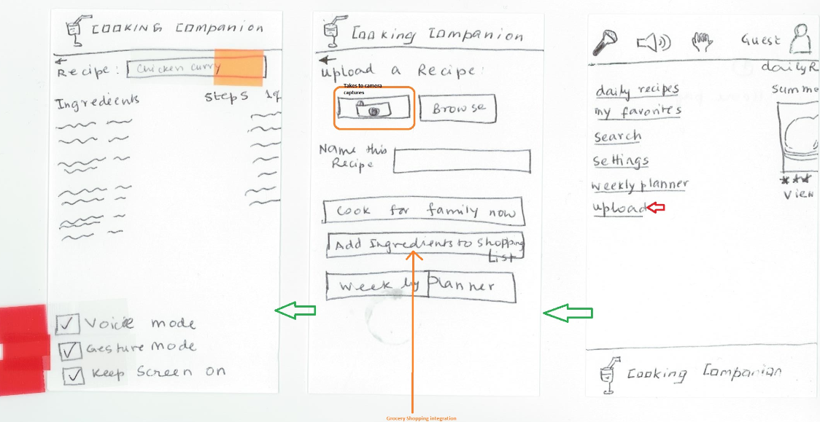
Sketch #1

Slide 14
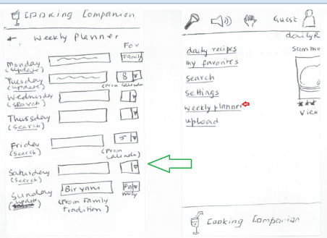
Sketch #1

Slide 15
1
Sketch #2

Slide 16
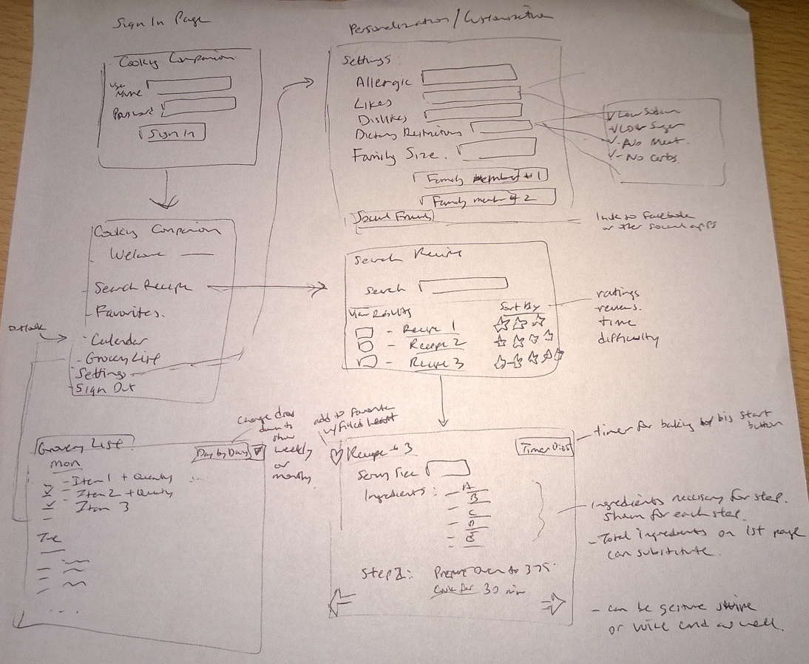
Sketch #3

Slide 17
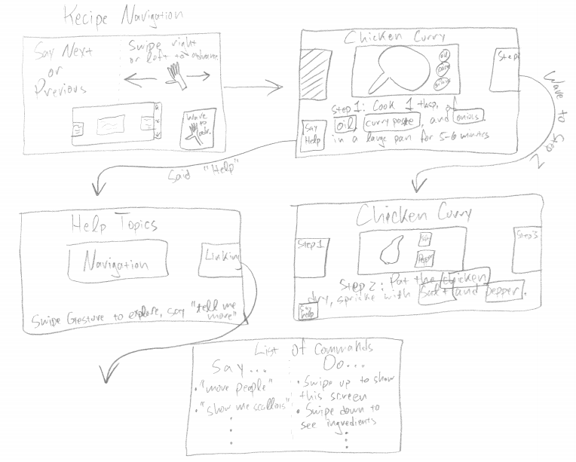
Sketch #4

Slide 18
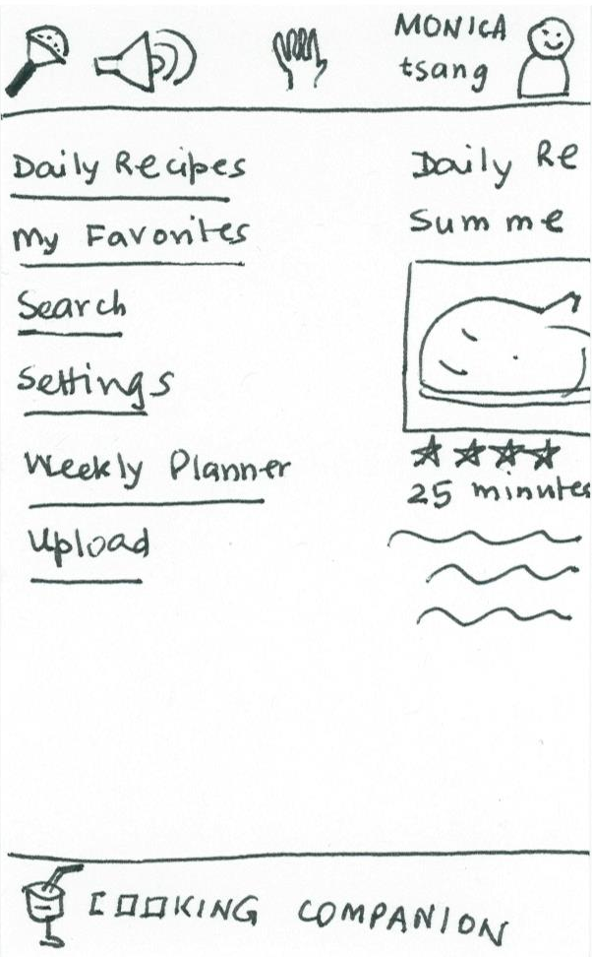
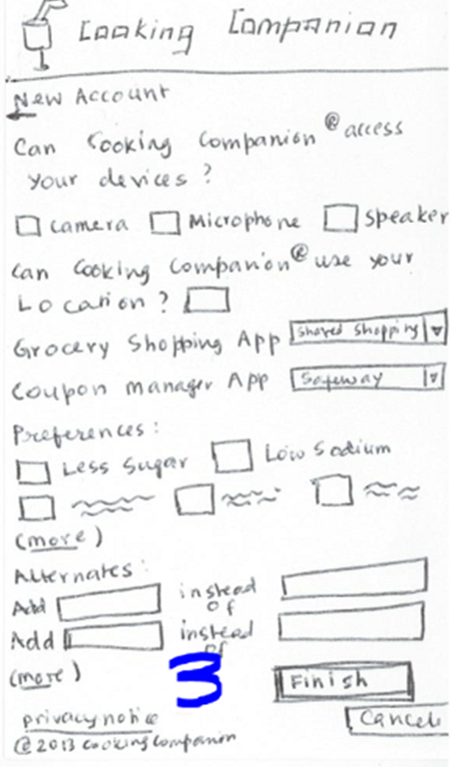
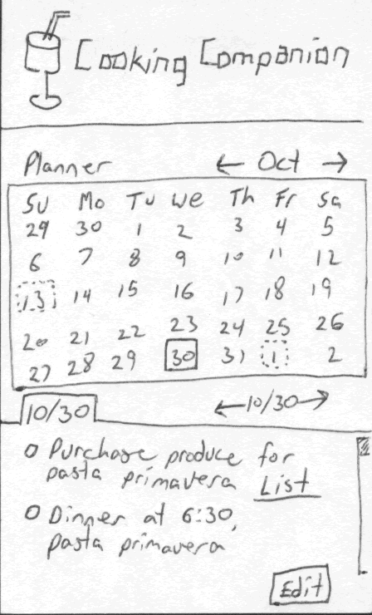
Final Design
Landing page
Personalization
Planning

Slide 19
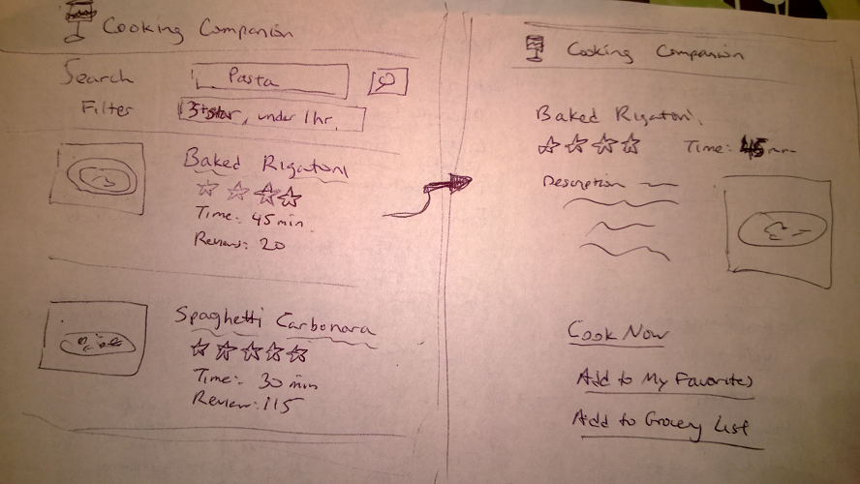
Final Design
Search

Slide 20
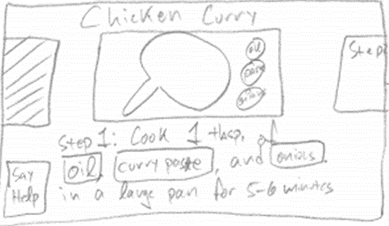
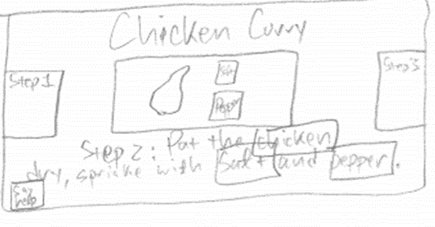
Final Design
Hands-Free Navigation

Slide 21
Easy Scenario
SEARCH for a RECIPE and COOK FOR FAMILY.
Sign up for an account
Choose family size and food preferences
Searches for baked rigatoni recipe
Verify ingredient list
Recipe Adjusts serving size down from 8 to 4
Follows recipe with gestures without touching device

Slide 22
Moderate Scenario
Find and use a recipe. Cook the recipe out of order and use substitution on ingredients.
Logs in to his account
Search for simple cake recipe (under 1 hour, high ratings + reviews, use bananas)
Performs steps out of order – use voice for next step navigation
Substitution – find alternative ingredient (baking powder → baking soda w/ lemon juice)
Use voice to start oven timer

Slide 23
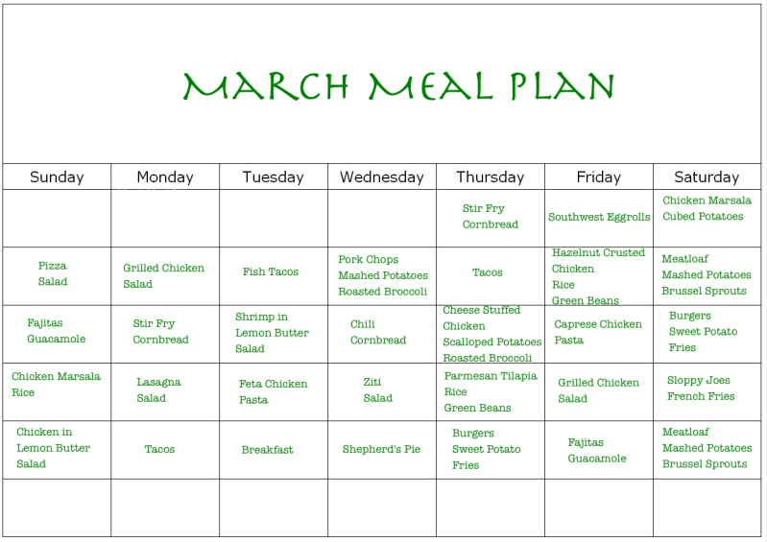
Difficult Scenario
Find a few recipes, UPLOAD CAMERA PICTURE FOR FEW OTHERS. Plan ahead and purchase ingredients for the week. Customize recipe for family and friends.
Logs in to her account
Select online recipe and add to favorites (seafood dishes)
Takes camera picture from magazine using smartphone and imports picture to app
Adds to dinner calendar for next Friday
Calendar reminder (friends gathering on Thursday)
read up on friend’s profile
Discover friend allergy to shrimp.
Replace shrimp cocktail with crab cakes recipe
Grocery list– day / week / month view
Store (coupons& discounts)

Slide 24
Summary – Lessons Learned
Privacy issues with services (social apps)
Many scenario walkthrough and features to cover – scope down
Variety of contextual inquiry participants and feedback
Individual & Collective design – helps see big picture
Decide upon collaboration method early on
Notes:
Email vs skydrive vs github vs google drive, etc.
Email, skype, communicator, conference room sync

Slide 25
Questions?

