Slide 1
Cooking Companion
Aaron Roney (aroney) Ananda Sarkar (anandsar) Jason Cho (darken1) Ryan Olmstead (rolm)

Slide 2
Topics
Problem & Solution
Tasks & Scenarios
Design Evolution
Current Interface, Demo
Summary
Notes:
Topics to Cover:
Title (1 slide)
Overall Problem & Solution (1 slide)
Overview of Talk (1 slide)
Three Representative Tasks & why we chose them (1 – 3 slides)
Design evolution and why changes were made (w/ images) (3 slides)
(i.e. contextual inquiry, low fidelity testing, evidence for changes)
Current Interface Design (w / images)
What does it do or show
How does it work
What is not implemented
Demo
Summary of Talk

Slide 3
Overview
Lots of recipe apps but none elevate to kitchen companion
Personalized experience
Innovative interaction model need of the hour
Gesture, voice, camera
Planning support and help with grocery welcome
Weekly planner, upload recipe, shopping list
Notes:
Talking Points:
Hundreds of recipe search and navigation applications exist on all platforms. But all they do is mere recipe search & cook.
Lack of personalization means not much help in kitchen. We need an application that is completely personalized for users’ needs.
Interaction model with applications should be innovative. Gesture, voice, camera support very much needed.
Helping users plan for their week, or with their grocery list avoiding multiple trips would provide delightful experience to working, busy professional.

Slide 4
Target Audience Profile
Busy working professional
Access to connected device in kitchen
Amateur but enthusiastic in kitchen
Spends minimum time grocery shopping
Likes to plan ahead
Notes:
Target Audience Profile:
Working professional with super-busy life.
Has access to smart phone or a tablet in kitchen.
Amateur but very enthusiastic in kitchen – enjoys cooking for friends and family
Grocery shopping is an unavoidable chore. Wishes multiple trips could be avoided and precise items could be picked to avoid wastage.
Planning for the week is a great idea – reduces daily stress.

Slide 5
Vision
Design an application for working adults who are enthusiastic but not expert cooks, that elevate to a true cooking companion – offering personalization (for family, choice, kitchen), novel interaction model and planning capabilities, saving time, money & energy.

Slide 6
Easy Task
Sign in, search for a recipe and cook for family in home kitchen. Use gestures to follow recipe.
Why?
Basic search & cook experience
Personalization experience
Innovative interaction model
Notes:
EASY: Monica lives with her husband and 2 kids (ages 3 and 7). She is cooking dinner for her husband’s birthday. Her husband likes pasta dishes. Monica does a quick search of her recipe library in Cooking Companion and selects a baked rigatoni recipe. She goes to the recipe ingredients list and veriﬁes that she has all of the ingredients in her kitchen. Though the original recipe was meant for 8 people, Monica easily adjusts the recipe down to 4 with the help of Cooking Companion and sees that the ingredients are also scaled down as well. Using her phone, she follows the recipe step by step. She uses gestures to move from one step to the next without having to touch the screen.
DATA TO USE: Sign up data: Monica Tsang, Family includes: Rob Tsang (husband), Kids: Chloe (7 years) and Stanley (4 years). Use GE Advanced for Microwave and GE 1245 Oven for Oven appliance.

Slide 7
Moderate Task
Find a recipe using filters. Use voice commands and cook the recipe out of order. Use substitution on ingredients.
Why?
Filter-based search
Innovative interaction model
Problem solving in kitchen
Notes:
MEDIUM: Joe is a grad student and does not have the budget for a well-stocked pantry. He is taking a dessert to a potluck at a friend’s house, and he uses Cooking Companion to ﬁnd a banana cake recipe that everyone will appreciate. He begins cooking it immediately. Joe is an eﬃcient cook, and does not like to keep walking back to his phone to check the ingredient list. Instead, he tells Cooking Companion to read the recipe step to him. Joe performs some recipe steps in a diﬀerent order than the recipe lists them, and Cooking Companion is able to accommodate this based upon Joe’s voice command by telling the phone to move on to the next step. When Joe gets to a point in the recipe that calls for baking powder, and he realizes that he only has baking soda, Joe asks for an alternate and Cooking Companion suggests baking soda with lemon juice instead. Joe is pleased to see that he is able to continue on with his recipe steps even with the substitution mishap during cooking.
DATA TO USE: Start with sign-in page of Joe Johnson. Search for Banana cake under an hour recipe.

Slide 8
Hard Task
Find a few recipes, upload camera picture for few others. Plan ahead and purchase ingredients for the week.
Why?
Magazine to your plate
Plan early for the whole week
Shop what you need
Notes:
HARD: Robin works as a Software Engineer and lives with her ﬁanc´e. Given that she typically has a busy schedule throughout the week, she prefers to plan her dinner plans for the week well ahead of time. She picks up a few recipes suggested by Cooking Companion, and she also takes a picture of a Chinese dish from a magazine that she is reading using her smartphone. The picture is imported into Cooking Companion and this new information is now updated in her recipe library. Cooking Companion sends an alert through its calendar reminding her that Josh and his wife would be over for dinner Thursday. Robin has recently resolved to cook healthier meals, and decides to adjust her recipes to reduce sodium. She updates her proﬁle, and her recipes are automatically adjusted. Based on her choices for the dinner all week, Cooking Companion is able to plan her grocery list. As Robin heads out grocery shopping Sunday evening, she checks Cooking Companion grocery list for the week, and checks them oﬀ as she purchases them. She is conﬁdent that she got all ingredients covered for the week.
DATA TO USE: Sign-up data: Robin Alphin, husband Sam Alphin. Use photo for Chicken in Hot Garlic Sauce for (take picture) for Monday, use Macaroni & Cheese for Tuesday, Chicken Teriyaki Pizza for Wednesday, use Baked Rigatoni for Thursday, use Chicken Thai Curry & rice for Saturday and Baked Salmon for Sunday. Thursday dinner should be for 4 people (including Josh & Katie).

Slide 9
Findings from Usability Study
What seems obvious is not really obvious
Participants focus on task completion
Participants take different route and often take the less desired path
Navigation experience needs to be brain-dead simple
Notes:
Talking Points:
Obvious is not really obvious to participants:
Most participants did not sign-up to the app and continued as guest, though they typically sign-up to most of their modern apps.
Reasoning: Get to task as quickly as possible, Option to avoid sign-up (continue as guest) drove them to take that path.
We put an upload button on home screen, but participants went search and looked for “upload” there.
We added a “cook for family” button in search page hoping users have all signed up getting there. But users continued as guest and are confused with that button.
Participants focus on Task Completion:
They get to search-n-cook before signing up
Navigation Experience:
Way to get back to home screen
How do I ask for replacement ingredient
…
Different Route:
We hoped upload -> my favorites, then planner -> look from my favorites.
Participants mostly started from weekly planner and now need to upload
We thought user signs up, defines family and then “cook for family” seems obvious.
They signed up as guest and then added 4 people as friends.

Slide 10
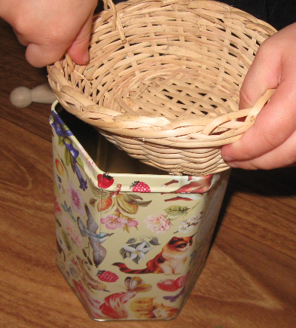
Heuristic Evaluation
Issue | Category * | Sev * | Mitigation
Requiring users to sign-up. No easy way to exit during cooking. | User Control & Freedom | 4 | Allow Guest sign-in. Easy access to go back to “home screen”
Guest users did not know what they missed | Error Prevention | 4 | A soft block on “guest sign in”
User name, family info, appliance info were buried and not visible in context | Visibility of System Status, Recognition rather than recall | 4 | Home shows user name, search page reminds family info, easy access to settings, recipe reminds appliance info
Help not always available at fingertip | Help & Documentation | 4 | Make Help first class citizen (home page, recipe navigation page)
* Following Jakob Nielsen scale, only a few Sev 4 ranked issues shown here.
Notes:
Talking Points:
Usability Study + Heuristic Evaluation = strong foundation for design
We show here only some very high severity (rank = 4) issues from our Heuristic Evaluation.
Users should not be forced to sign-up, they could continue as guest. Also, there should be easily accessible “emergency exit” (get to home screen) from all pages.
Not forcing users to sign-up meant many users would just continue as guest and then subsequently miss various features. A soft block should help users realize what they are missing.
User name and the information they provided that CC uses (like family info, appliance info) need to be accessible in context so that users don’t have to remember everything.
Help should be made first-class-citizen in the design, available on home page, shown during recipe navigation as reminder etc.

Slide 11
Design Evolution
Contextual Inquiry
Support Personalization
Innovative interaction
Usability Study
Sign-up flow but support for guest account
Upload and search are disjoint
Final Design
Clear ambiguity
Guided sign-up
Search, upload and calendar are related
Notes:
Contextual Inquiry:
Support Personalization
Innovative interaction
Usability Study
Sign-up flow but support for guest account
Upload and search are disjoint
Final Design
Guided sign-up
Clear ambiguity
Search, upload and calendar are related

Slide 12
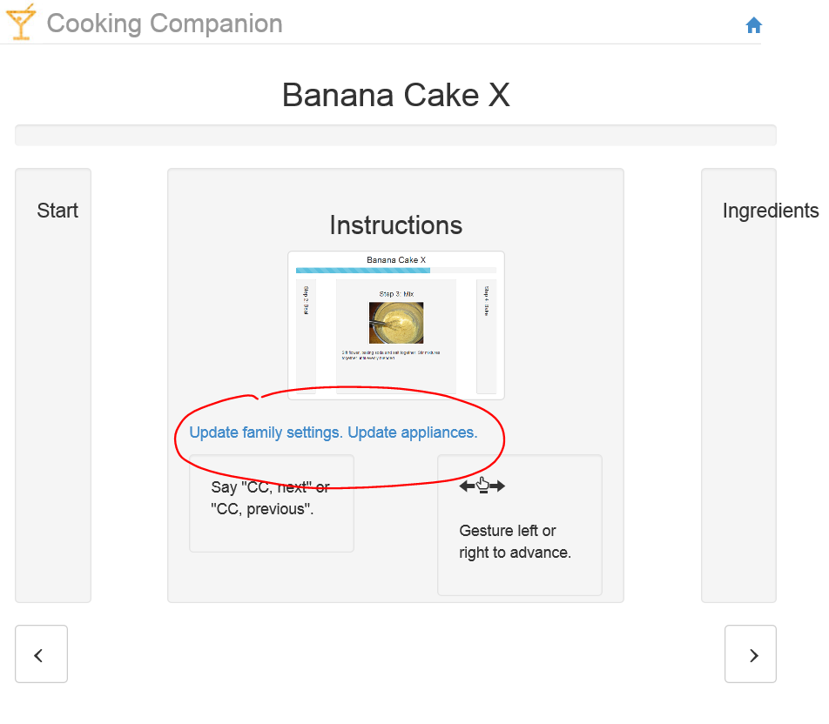
Evolution - Personalization Experience
Put a soft-block on “continue as guest” during sign-up.
Educate users along the way while making smart choices
“Family” has a link to view / edit family
Adjusted “bake time” has a link to view / edit appliance.

Slide 13
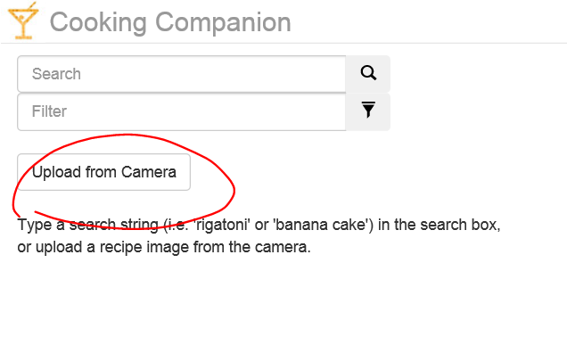
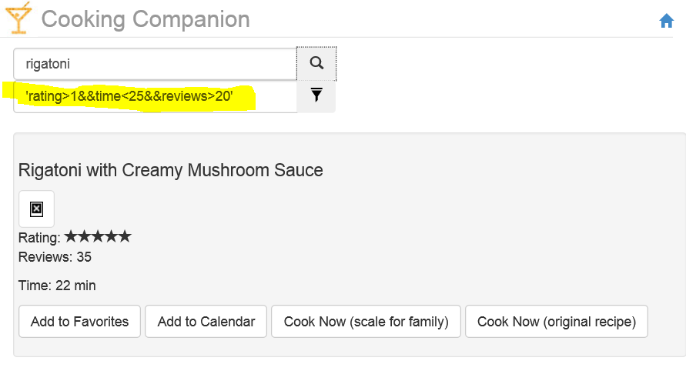
Evolution - Search Experience
Add “upload” option in Search page
“Cook for Family” and “Follow original recipe” are two different options.
More filters during searching

Slide 14
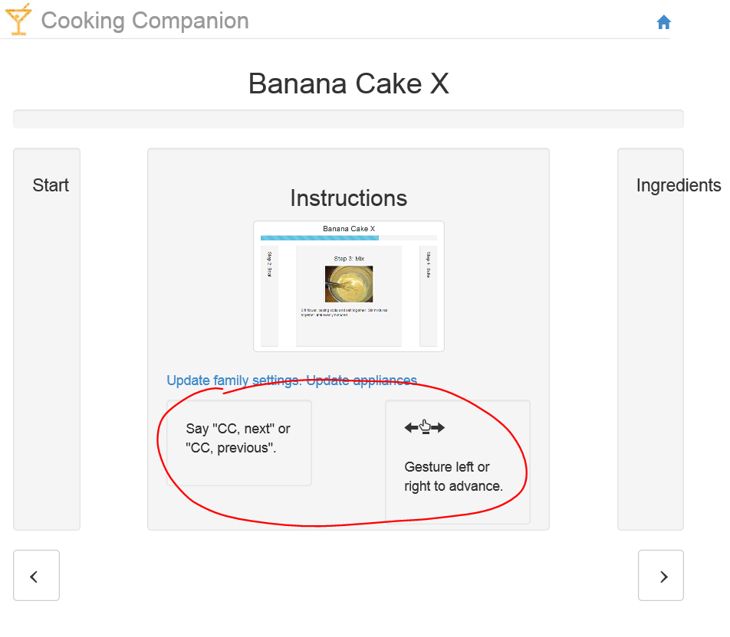
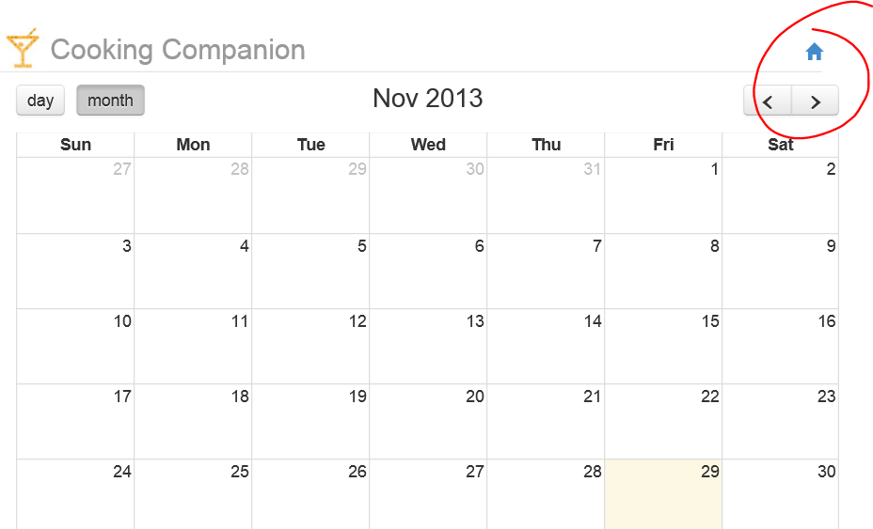
Evolution – Cooking & Navigation Experience
Link on each page to get back to home screen
Updated Help / instruction first page with navigation help.
Make Voice command recognition module more vocab-powerful.

Slide 15
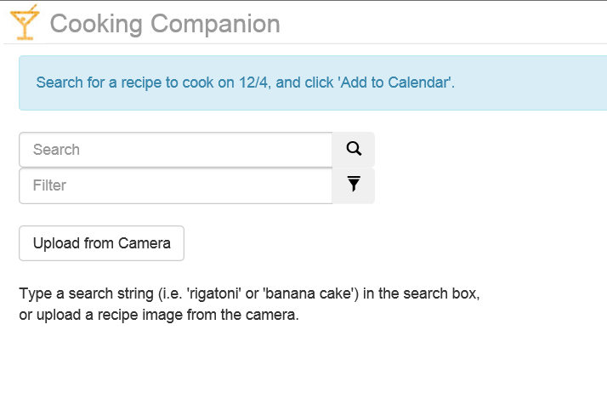
Evolution - Planning Experience
Elevate “planning” to be a home screen activity
Planning, upload and search very related

Slide 16
Value Sensitive Design
Issue * | Mitigation
Direct: User consent should be obtained before collecting information. | Privacy Notice shown contextually, Users in control and not forced to provide personal data
Direct: Camera, Microphone data is sensitive. | Never store device data. Also devices turned off except only during recipe follow (cooking).
Indirect: Users should not be guided towards a particular brand / product | Grocery list does not contain any brand information
Direct: Integration with services, social scenarios cause privacy concerns. | Cut social & service integration scenarios.
* Only some most important issues shown.
Notes:
Value Sensitive Design:
Direct stakeholders: Users of the app, users who sign-up to the application, provide personal information ( family, appliances etc.)
Indirect stakeholders: Companies producing appliances, Food brands etc.
Users should be in control of what info to provide and what not. They should have contextual access to privacy notice and should be consented before collecting and using their personal information.
Camera, Microphone data is sensitive and hence should never be stored and only collected after user consent and that too during recipe process.
Grocery list should not contain any brand information and users should be guided towards a particular brand.
Integration with services and social scenarios cause privacy concerns, so those were CUT in our design.

Slide 17
Final Design

Slide 18
Demo
High-resolution prototype

Slide 19
Summary – Lessons Learned
Scoping exercise extremely useful.
Contextual inquiry provides a great foundation for paper prototype.
User study tells us that users are all different and they think differently from one another and designers.
Final Design has more than one way of doing almost everything.
Heuristic evaluation very helpful learning to rectify issues with design early on.
Value Sensitive design was used to scope out social scenarios
Glad we had 4 people in the team ☺
Notes:
Talking Point:
Scoping:
Social scenarios
Interaction with services
Contextual Inquiry:
Taught us real problems like poor personalization and navigation experience.
User Study:
Users used Guest to continue.
Searched and then looked to upload
How to go to home screen.
Final Design has more than one ways to:
Sign-up
Search
Add to favorites
Adjust preferences
Interact while following recipe
Heuristic evaluation helped resolve:
Navigation improvements
How much help users should need to navigate recipe and interact.
VST used:
Privacy worry surface reduced using VST

Slide 20
Questions?

Slide 22
Backup Slides

Slide 23
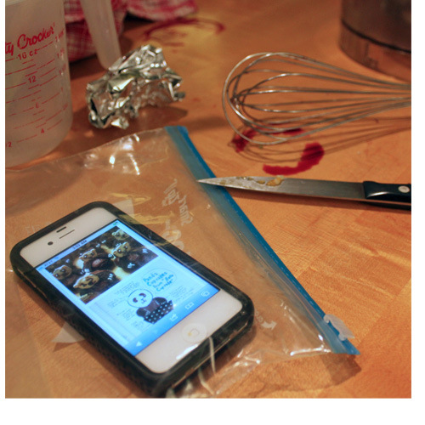
Background
Abundant online recipes
Existing recipe apps inconvenient when cooking
Features limited, usually require touching device

Slide 24
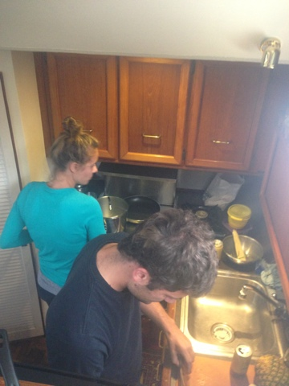
Contextual Inquiry Participants
Layla – Biologist, uses “The Recipe Box” application for recipes
Tessa – Bioengineer, enjoys baking
Lisa – Nurse, regularly cooks for large groups
Naresh – Software Engineer, Uses windows phone app for recipes

Slide 25
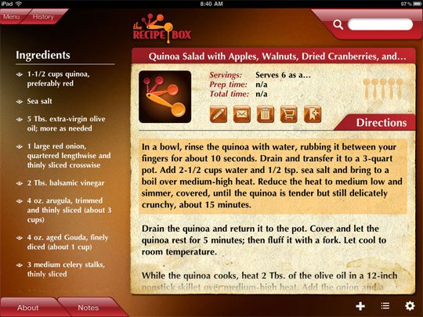
Contextual Inquiry Description
Participants asked to prepare a recipe of their choice
Three of four used recipe found online
Participants observed while cooking

Slide 26
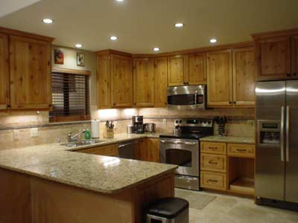
Contextual Inquiry Results
Recipes chosen by reviews and difficulty
Participants continually checked recipe
Recipes followed out of order
Recipes customized from experience

Slide 27
Problems & Opportunities
Support for different interaction models critical
Personalizing (for family, preferences, kitchen) is important
Ability to plan ahead and integration with camera & services

Slide 28
Tasks
EASY: Search for a recipe and cook for family. Use gestures to follow recipe.
MODERATE: Find and use a recipe. Cook the recipe out of order and use substitution on ingredients.
DIFFICULT: Find a few recipes, upload camera picture for few others. Plan ahead and purchase ingredients for the week.
Notes:
EASY: Monica lives with her husband and 2 kids (ages 3 and 7). She is cooking dinner for her husband’s birthday. Her husband likes pasta dishes. Monica does a quick search of her recipe library in Cooking Companion and selects a baked rigatoni recipe. She goes to the recipe ingredients list and veriﬁes that she has all of the ingredients in her kitchen. Though the original recipe was meant for 8 people, Monica easily adjusts the recipe down to 4 with the help of Cooking Companion and sees that the ingredients are also scaled down as well. Using her phone, she follows the recipe step by step. She uses gestures to move from one step to the next without having to touch the screen.
DATA TO USE: Sign up data: Monica Tsang, Family includes: Rob Tsang (husband), Kids: Chloe (7 years) and Stanley (4 years). Use GE Advanced for Microwave and GE 1245 Oven for Oven appliance.
MEDIUM: Joe is a grad student and does not have the budget for a well-stocked pantry. He is taking a dessert to a potluck at a friend’s house, and he uses Cooking Companion to ﬁnd a banana cake recipe that everyone will appreciate. He begins cooking it immediately. Joe is an eﬃcient cook, and does not like to keep walking back to his phone to check the ingredient list. Instead, he tells Cooking Companion to read the recipe step to him. Joe performs some recipe steps in a diﬀerent order than the recipe lists them, and Cooking Companion is able to accommodate this based upon Joe’s voice command by telling the phone to move on to the next step. When Joe gets to a point in the recipe that calls for baking powder, and he realizes that he only has baking soda, Joe asks for an alternate and Cooking Companion suggests baking soda with lemon juice instead. Joe is pleased to see that he is able to continue on with his recipe steps even with the substitution mishap during cooking.
DATA TO USE: Start with sign-in page of Joe Johnson. Search for Banana cake under an hour recipe.
HARD: Robin works as a Software Engineer and lives with her ﬁanc´e. Given that she typically has a busy schedule throughout the week, she prefers to plan her dinner plans for the week well ahead of time. She picks up a few recipes suggested by Cooking Companion, and she also takes a picture of a Chinese dish from a magazine that she is reading using her smartphone. The picture is imported into Cooking Companion and this new information is now updated in her recipe library. Cooking Companion sends an alert through its calendar reminding her that Josh and his wife would be over for dinner Thursday. Robin has recently resolved to cook healthier meals, and decides to adjust her recipes to reduce sodium. She updates her proﬁle, and her recipes are automatically adjusted. Based on her choices for the dinner all week, Cooking Companion is able to plan her grocery list. As Robin heads out grocery shopping Sunday evening, she checks Cooking Companion grocery list for the week, and checks them oﬀ as she purchases them. She is conﬁdent that she got all ingredients covered for the week.
DATA TO USE: Sign-up data: Robin Alphin, husband Sam Alphin. Use photo for Chicken in Hot Garlic Sauce for (take picture) for Monday, use Macaroni & Cheese for Tuesday, Chicken Teriyaki Pizza for Wednesday, use Baked Rigatoni for Thursday, use Chicken Thai Curry & rice for Saturday and Baked Salmon for Sunday. Thursday dinner should be for 4 people (including Josh & Katie).

Slide 29
Design of Paper Prototype

Slide 30
Design
4 designs – 1 idea:
Clutter-free homepage
Personalized experience
Planning ability
Gesture / voice control
Plan ahead
Integration with services
Notes:
Integration with Services – facebook, coupon apps, grocery finder, social contact preferences, yelp reviews, out of scope?

Slide 31
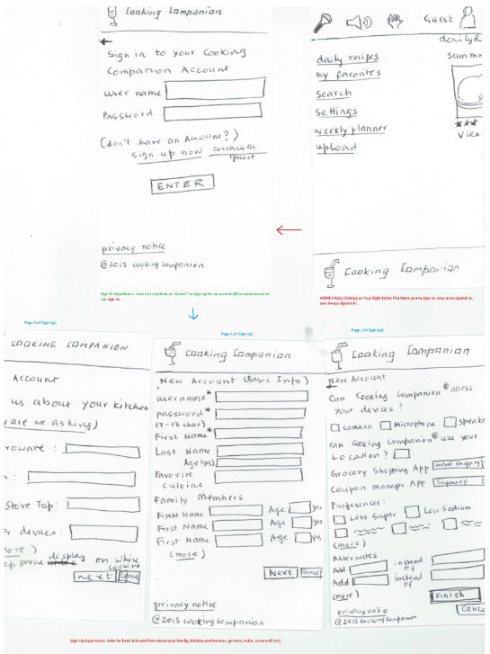
Sketch #1

Slide 32
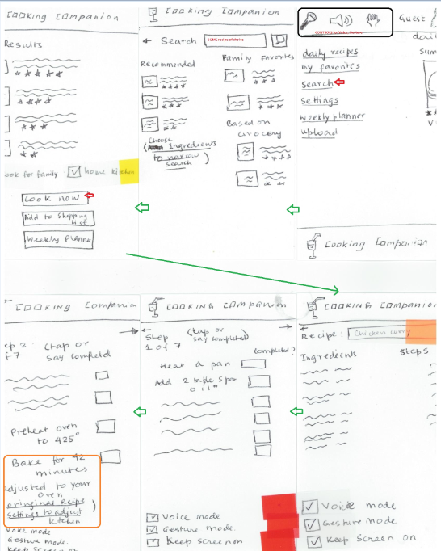
Sketch #1

Slide 33
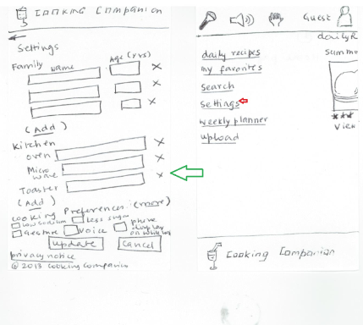
Sketch #1

Slide 34
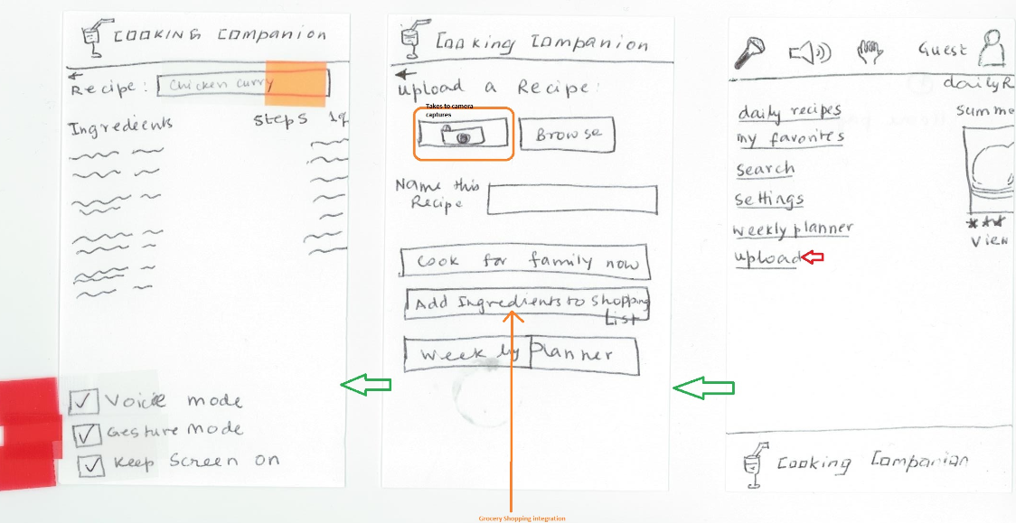
Sketch #1

Slide 35
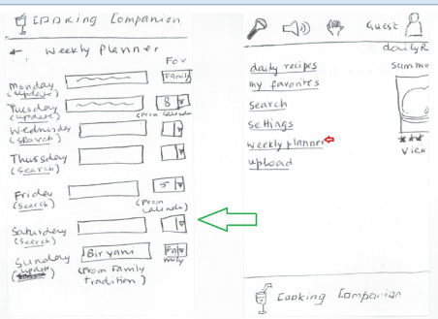
Sketch #1

Slide 36
1
Sketch #2

Slide 37
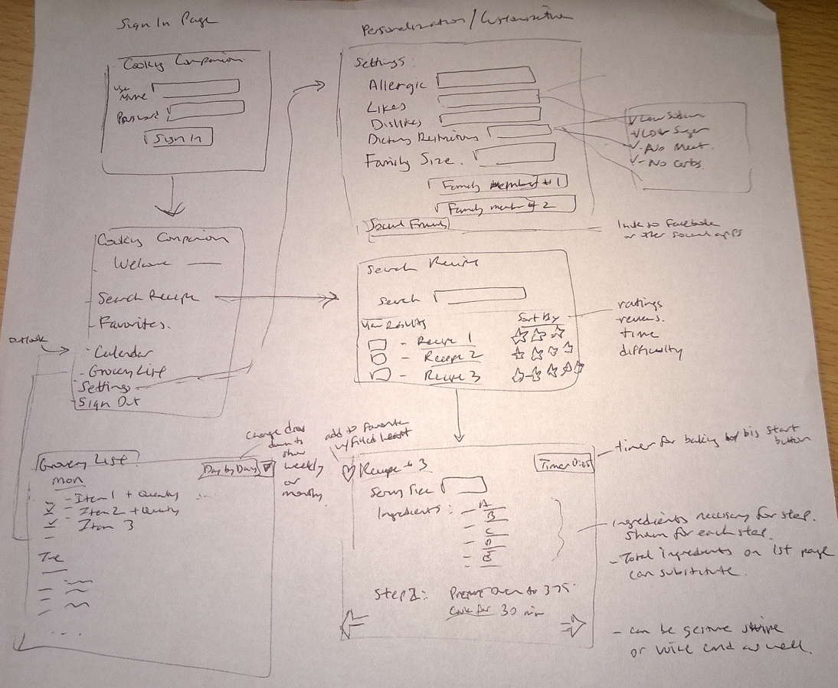
Sketch #3

Slide 38
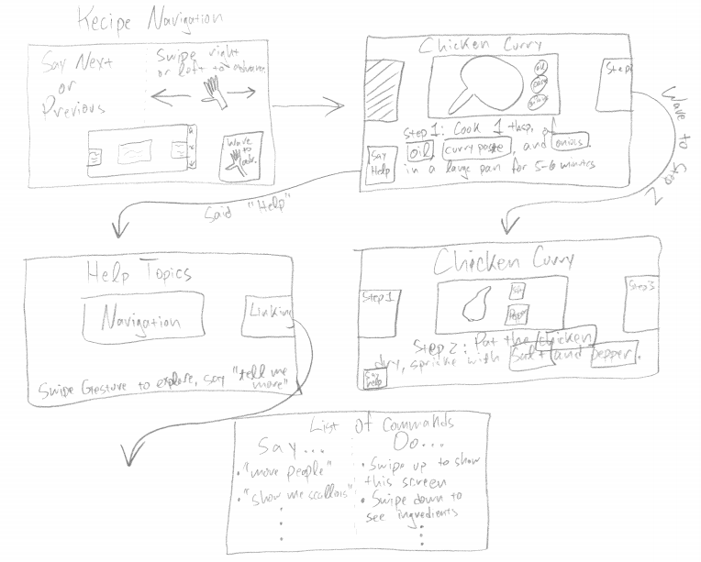
Sketch #4

Slide 39
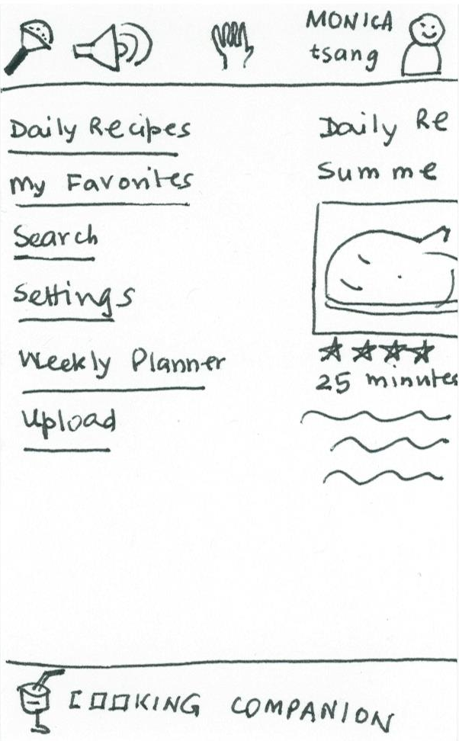
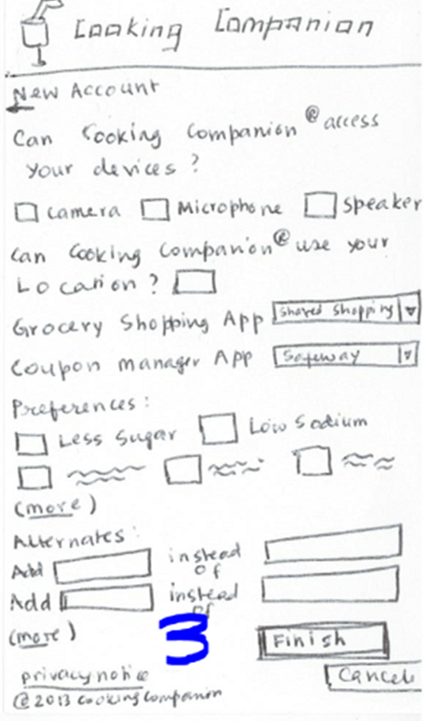
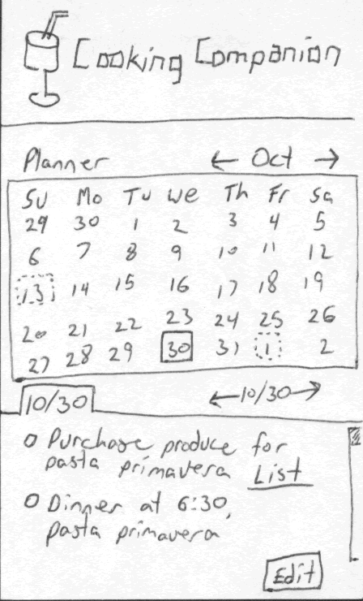
Final Design
Landing page
Personalization
Planning

Slide 40
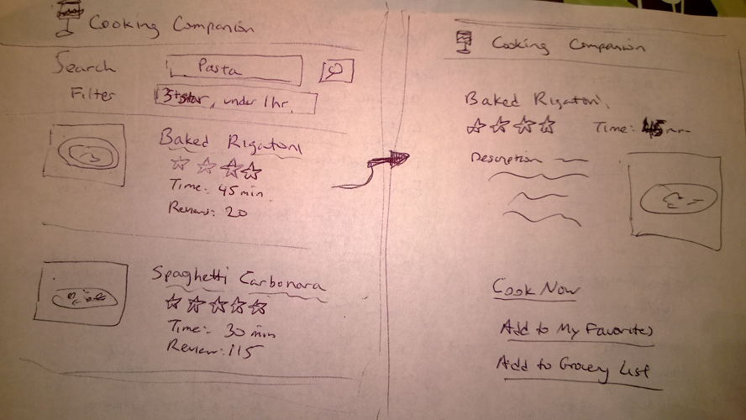
Final Design
Search

Slide 41
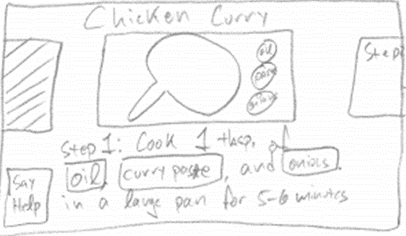
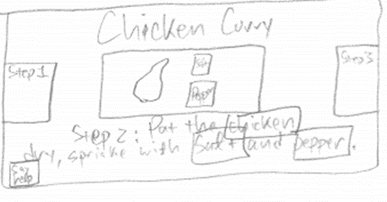
Final Design
Hands-Free Navigation

Slide 42
Scenarios for Usability Study

Slide 43
Easy Scenario
SEARCH for a RECIPE and COOK FOR FAMILY.
Sign up for an account
Choose family size and food preferences
Searches for baked rigatoni recipe
Verify ingredient list
Recipe Adjusts serving size down from 8 to 4
Follows recipe with gestures without touching device

Slide 44
Moderate Scenario
Find and use a recipe. Cook the recipe out of order and use substitution on ingredients.
Logs in to his account
Search for simple cake recipe (under 1 hour, high ratings + reviews, use bananas)
Performs steps out of order – use voice for next step navigation
Substitution – find alternative ingredient (baking powder → baking soda w/ lemon juice)
Use voice to start oven timer

Slide 45
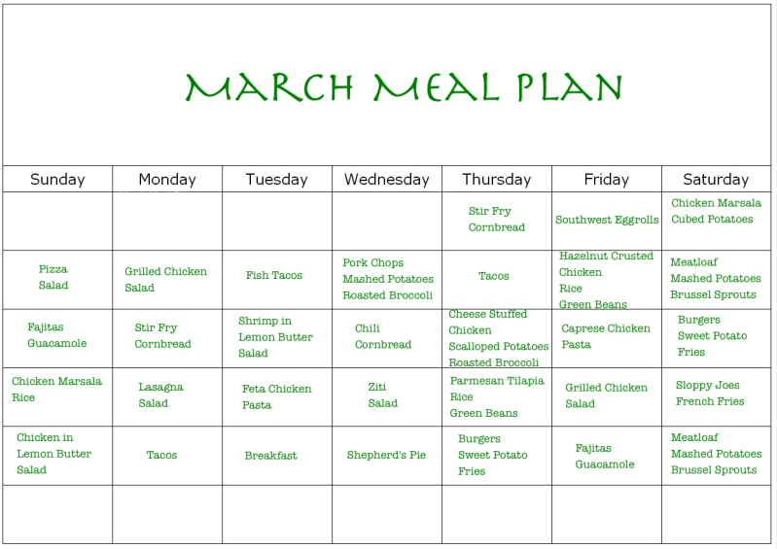
Difficult Scenario
Find a few recipes, UPLOAD CAMERA PICTURE FOR FEW OTHERS. Plan ahead and purchase ingredients for the week. Customize recipe for family and friends.
Logs in to her account
Select online recipe and add to favorites (seafood dishes)
Takes camera picture from magazine using smartphone and imports picture to app
Adds to dinner calendar for next Friday
Calendar reminder (friends gathering on Thursday)
read up on friend’s profile
Discover friend allergy to shrimp.
Replace shrimp cocktail with crab cakes recipe
Grocery list– day / week / month view
Store (coupons& discounts)

