Slide 1
Catch A Ride
Ashwini, Keith, and Jarret

Slide 2
Overall problem and solution
Ad-hoc Ridesharing Problems
Craigslist: unreliable, unsafe, difficult to find rideshares, minimal driver profile info
Catch-A-Ride Solution
Smartphone application including strong user profiles and advanced search and filter functionality

Slide 3
Talk overview
Core Tasks
Design Evolutions
interviews
main feature changes
Demo Video
Current Interface
Wrap-up

Slide 4
Representative Task - Offer a Ride
Allow drivers to post ride offers through the system
Motivation: enable Catch-A-Ride to collect structured data better than craigslist

Slide 5
Representative Task - Find a Ride
Primary need of passengers
Motivation: Offer rating information of the driver to address safety concerns of users

Slide 6
Representative Task - Add Reviews
Allow a user to leave publicly-visible feedback about others, especially drivers, in the application.
Motivation: adds trust in our system based on feedback about safety concerns in other applications

Slide 7
Design Evolution - User Inquiry
Interviewed 3 participants:
Max - Drives regularly from Eugene to Seattle. Has offered rides in the past. Main motivation is splitting fuel cost
Traci - Doesn’t own a car; would be interested in finding rideshares
Joe - Primarily a driver & would offer rides. Also interested in finding rideshares.

Slide 8
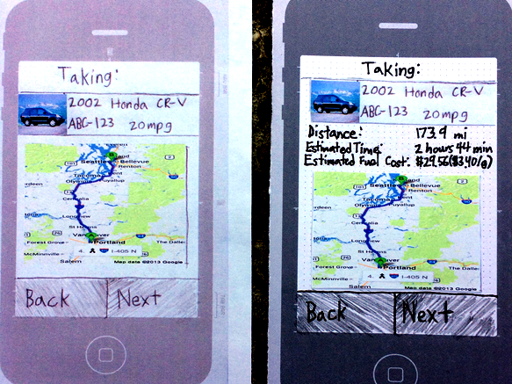
Design Evolution (1 of 3)
Driver feedback: include MPG and distance

Slide 9
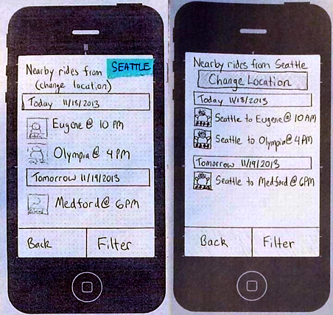
Design Evolution (2 of 3)
Available rides: display origin and destination

Slide 10
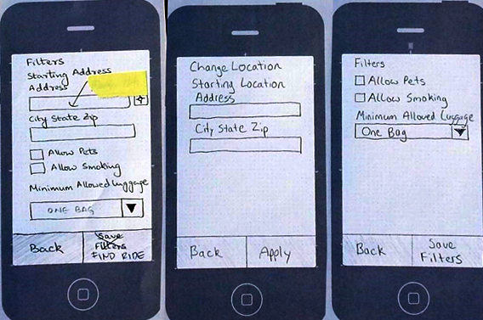
Design Evolution (3 of 3)
Available rides: Make location setting more discoverable

Slide 11
Video
http://courses.cs.washington.edu
/courses/csep510/13au/projects/Catch-A-Ride/

Slide 12
Current Interface Description
Wizard for the lengthy posting task
Hub and Spoke to find rideshares
Single form supports reviews

Slide 13
Current Interface - What was Missing
Profile Manager
Login/Sign Up
User preferences or settings
Communication mechanism
Back & forth messaging to coordinate the trip
Mechanism for driver to accept/reject a rider request

Slide 14
Summary and Wrap-up
Main learnings
Productive feedback from each paper prototype revision
Prototype application may be easier to use, although social aspects remain uncovered
Timing of when to use a software prototype vs paper prototype

