Slide 1
Nexmail
Lei Guang,
Haroon Barri

Slide 2
Problem and Solution
Email - Widely used digital message communication channel
Sizable portion of a working Professional day spent over Email
Aim to make the interaction faster, especially for long email conversations
Notes:
Email is the most widely user method for exchange digital message. People use email every day and for many different purposes. Working professional heavily rely on email for their daily tasks and communication. A portion of their time is spent on coping with the existing system; participating in long email conversation, finding precise information they are looking for, making replies, etc. We aim to improve that experience by making it faster, easy to use and intuitive, so that they spend less time on long emails and get more stuff done.

Slide 3
Overview of the Talk
Tasks
Design Evolution
Current Interface
Interactive Prototype
Summary

Slide 4
Tasks
Easy – Read and Make Quick Reply
Moderate – Navigate Long Email Thread
Difficult – Reply with In-Line Comments

Slide 5
Read and Make Quick Reply
Basic and Simple
Ensures that we are not compromising on the most basic user experiences
Lays down the foundation for more complex, upcoming tasks

Slide 6
Navigate Long Email Thread
Long Emails – One of our major focus area
Makes use of our Filter People feature
Evaluates UI when there is quite a bit of information
Evaluates user interaction more than our first task

Slide 7
Reply with In-Line Comments
In-Line Comment – One of our major focus area
Evaluates the reading experience for In-Line comments
Evaluates the writing experience for In-line comments

Slide 8
Design Evolution
Reply TextBox & Buttons
Scrolling Bar Navigation
People Filter
Inline Comments

Slide 9
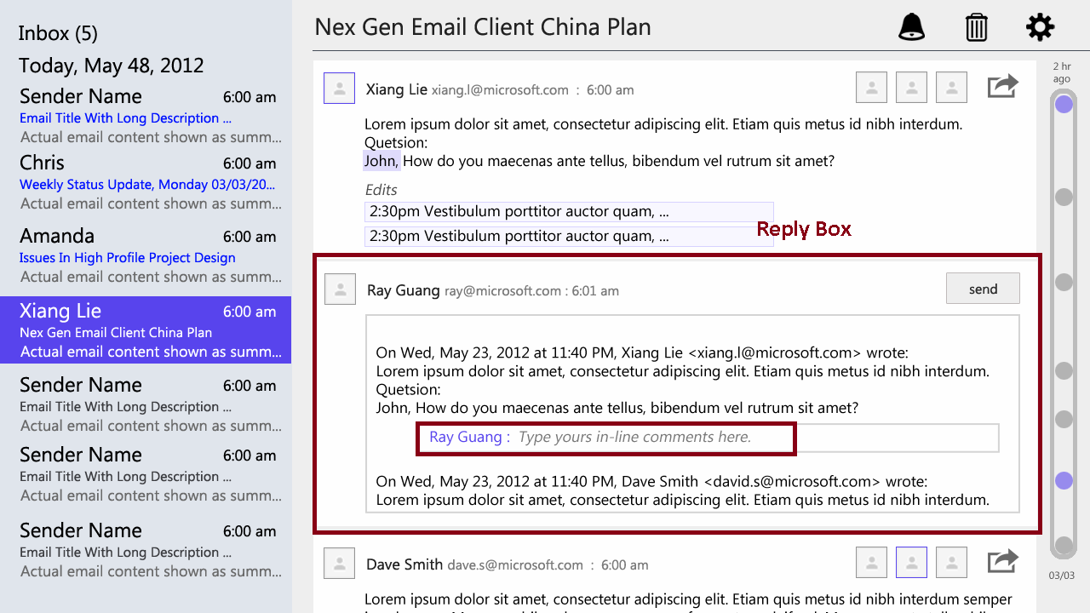
Reply TextBox
Experimented different locations of reply text box: top, bottom, right, inline.
Final choice: below the message

Slide 10
Reply Button
Try to make it easily accessible.
Provide reply for each thread.
Button for reply to the thread is always available on the top.
Icon and label.

Slide 11
Scroll Bar Navigation
Provide more than just position information.
Changing from dots to rich sender information.

Slide 12
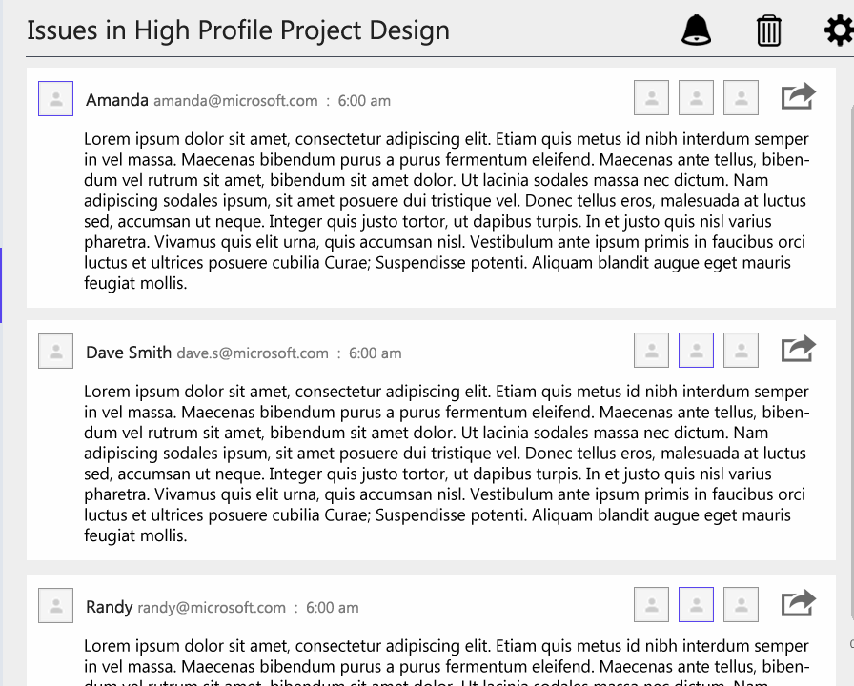
People Filter
Simple
Non-intrusive
One-tap filter

Slide 13
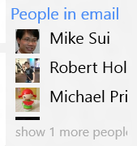
People Filter

Slide 14
Inline Comments
Consistent Style
Easy to read
Easy to write
Automatic Styling

Slide 15
Inline Comments

Slide 16
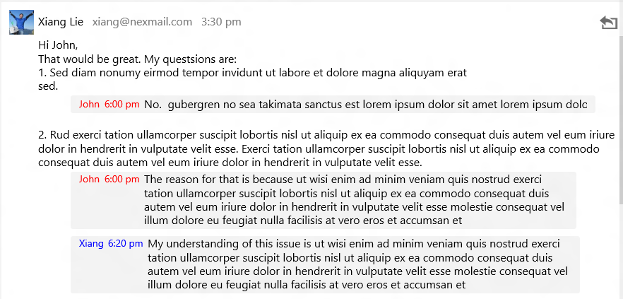
Inline Comments

Slide 17
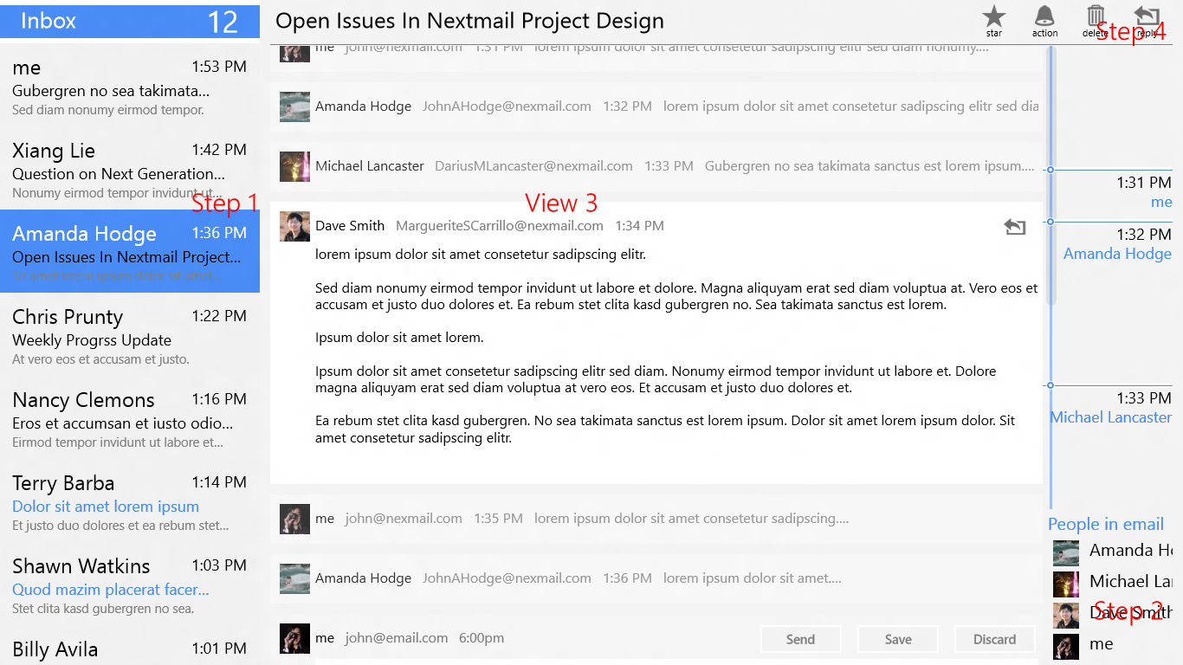
Current Interface

Slide 18
Interactive Prototype
Task 1 Video
Task 2 Video
Task 3 Video

Slide 19
Summary
Project Lifecycle
Contextual Inquiry – Lessons Learned
Be Prepared for Surprises
Default Experiences Are Important
Sometimes few extra clicks are too much
Audience Selection plays an important part
User Testing – Lessons Learned
Intuitiveness varies form Person to Person
Limitations of Paper Prototyping
Customization of Tasks and/or Paper Prototype
Not Easy to decide what is distracting and what is not
Audience Selection plays an important part
Conclusion
Notes:
To sum-up, it was quite amazing to see all the transitions our project took, right form the point of its inception, till its conclusion. The processes involved in the exercise helped us shape the project better. We got some valuate feedback and insights from all the participants, which was great. Instructor and TA gave some real good feedback. Finally, it was nice working in a team; we had a common vision and our good understanding throughout the project helped us land it well.

