Slide 1
Nexmail
Lei Guang,
Haroon Dawood

Slide 2
Nexmail
Reduce overhead in email usage.
Improve email discussion efficiency.
Focusing on working professionals with heavy email usage.

Slide 3
Interview Participants
Jane – Software Engineer at Microsoft
Jo – Senior Accountant at a Mid-size Accounting firm
Jessie – Designer at Microsoft

Slide 4
Results
In-line Replies
Navigate and Search in Email
Categorization
Less overhead in headers

Slide 5
Tasks
Easy – Read and Make Quick Reply
Moderate – Navigate Long Email Thread
Difficult – Reply with In-Line Comments

Slide 6
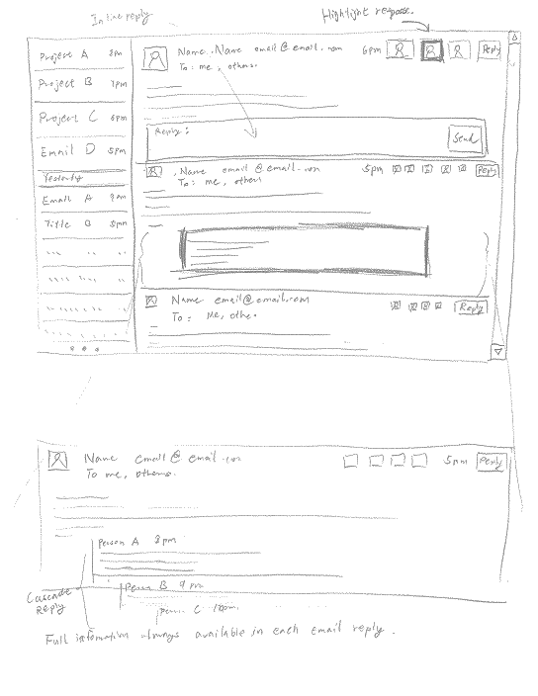
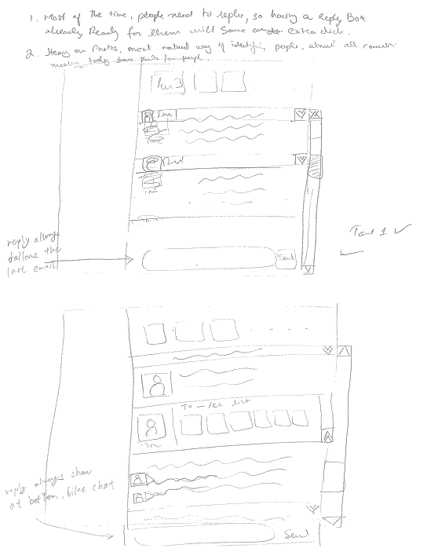

Slide 7
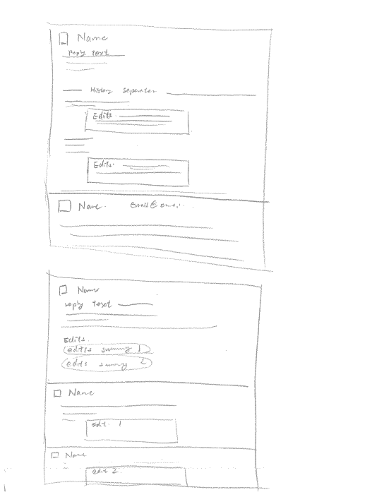
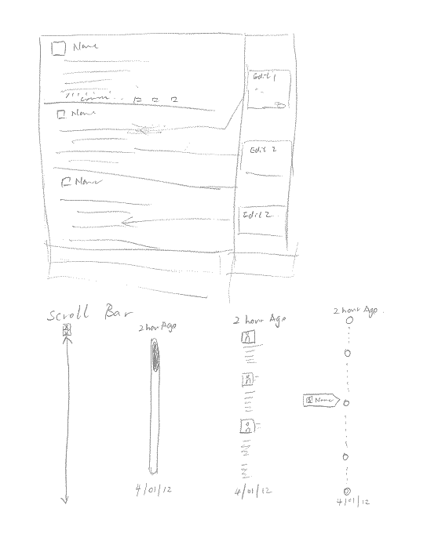

Slide 8
Selected Design

Slide 10
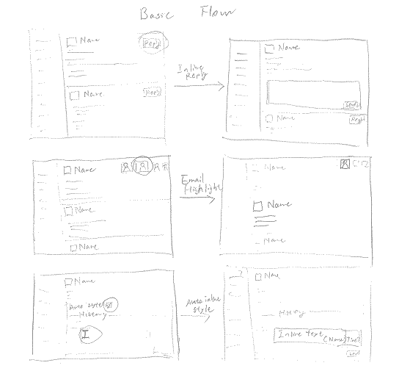

Slide 11
Summary
Results is different than we originally thought.
Audience selection
Default experiences are important

