Slide 1
CSEP504:
Advanced topics in software systems
Tonight
  India trip report
  Apologies and status
  Evaluation approaches for software engineering research
  Software engineering economics
  David Notkin  Winter 2010  CSEP504 Lecture 7
Notes:
Lecture 1: Tools & Environments (roles and historical perspectives)
- What are the main roles of tools in our development process?
- Understanding
- Building
- Modifying
- Debugging
- Testing
- Historical overview of how we got to here:
- (Wouldn't bother with pre-basic editors)
- text editors galore
- emacs & other syntax-aware editors
- semantically-aware editors (e.g. pascal)
- smalltalk
- modern environments (visual studio, eclipse, etc)
- What new development approaches will _require_ specific tools?
- Modelling
- SMT stuff from 590N seminar (incl verifying protocols)

Slide 2
India trip report
Microsoft Research India
3rd India Software Engineering Conference
SEA ⇒ CDG ⇒ BLR
  Microsoft Research India guest house
Car and driver Bangalore ⇒ Mysore
  Infosys campus
Car and driver Mysore ⇒ Mysore Palace ⇒ BLR
BLR ⇒ CDG
  Radisson Blu
CDG ⇒ SLC ⇒ SEA

Slide 3
Microsoft Research India
Recently celebrated its first 5 years
Close connections with Indian Institute of Science
Strong External Research Program
Ties with Microsoft India Development Center (Hyderabad) and soon with Yahoo
50-70 technical staff
  Double that in summer (interns)
Algorithms Research Group
Cryptography, Security, and Applied Mathematics
Mobility, Networks, and Systems
Multilingual Systems
Rigorous Software Engineering
Technology for Emerging Markets
Vision, Graphics, and Visualization
Advanced Development and Prototyping

Slide 4
Rigorous software engineering
Akash Lal
Aditya Nori
Sriram Rajamani
Kaushik Rajan
Ganesan Ramalingam
Venkatesh-Prasad Ranganath
Kapil Vaswani

Slide 5
Recent publications (selected)
Kaushik Rajan, Sriram Rajamani, and Shashank Yaduvanshi, GUESSTIMATE: A Programming Model for Collaborative Distributed Systems. PLDI 2010
Prakash Prabhu, G Ramalingam, and Kapil Vaswani, Safe Programmable Speculative Parallelism. PLDI 2010
Aditya V. Nori and Sriram K. Rajamani, An Empirical Study of Optimizations in Yogi, ICSE 2010
  Yogi: a scalable software property checker that systematically combines static analysis with testing.
Nels E. Beckman, Aditya V. Nori, Sriram K. Rajamani, Robert J. Simmons, Sai Deep Tetali, and Aditya V. Thakur, Proofs from Tests. IEEE TSE 2010

Slide 6
Recent publications (con’t)
Dawei Qu, Abhik Roychoudhury, Zengkai Lang, and Kapil Vaswani, Darwin: An Approach for Debugging Evolving Programs. ESEC/FSE 2009
B. Ashok, Joseph Joy, Hongkang Liang, Sriram Rajamani, Gopal Srinivasa, and Vipindeep Vangala, DebugAdvisor: A Recommender System for Debugging, ESEC/FSE 2009
Benjamin Livshits, Aditya V. Nori, Sriram K. Rajamani, and Anindya Banerjee, Merlin: Specification Inference for Explicit Information Flow Problems. PLDI 2009
Trishul Chilimbi, Ben Liblit, Krishna Mehra, Aditya V. Nori, and Kapil Vaswani, Holmes: Effective Statistical Debugging via Efficient Path Profiling. ICSE 2009
  Holmes: a statistical tool to find the most likely cause of test failures by collecting and analyzing fine-grained path coverage data and identified code paths that strongly correlate with failure

Slide 7
Other projects
Mining API specifications – quantified temporal rules
Debug Advisor – a search using fat multi-dimensional queries (KBs of structured and unstructured data describing the contextual information) to find similar bugs and related information– people related to it, relevant source and binary files, etc.
Shadowed upgrades
…much more!

Slide 8
3rd ISEC
Conference developed primarily by Pankaj Jalote and Sriram Rajmani – build a stronger software engineering research community in India
  Hyderabad, Pune, Mysore, Kerala, …
Three legs
  Reviewed research papers, posters, etc.
  Keynotes
  ESEC/FSE and ICSE best paper presentations
Mysore 2010: at Infosys training and education campus; about 200 attendees at ISEC

Slide 9
Infosys
Infosys founded 1981, now over 100K employees
  Business and technology consulting, application services, systems integration, product engineering, custom software development, maintenance, re-engineering, independent testing and validation services, IT infrastructure services and business process outsourcing
In 2007, received ~1.3M applications and hired ~3%
NYSE INFY ADR: market cap of ~US$34B; 2009 revenue about US$4.7B, 11.7% growth

Slide 10
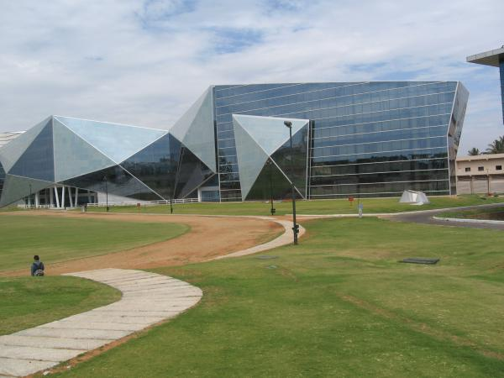

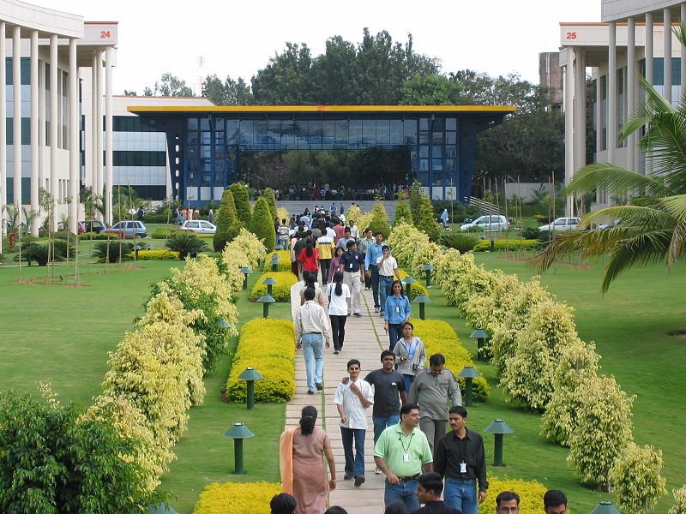

Infosys Mysore campus

Slide 11
Comments
“Too many kinds of cookies in the same box.”
“Like Disneyland without the rides.”

Slide 12
SE Research Center roundtable
Should India have a software engineering research center something like the CMU Software Engineering Institute, Fraunhofer Institute, etc.?
Most interesting point to me: why aren’t more students in India interested in software engineering research?

Slide 13
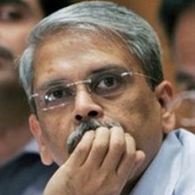

Keynotes
Me
Kris Gopalakrishnan (CEO/MD Infosys)
William Cook (UT Austin)

Slide 14
Best papers ESEC/FSE and ICSE
Does Distributed Development Affect Software Quality? An Empirical Case Study of Windows Vista
  Christian Bird, Nachiappan Nagappan, Premkumar Devanbu, Harald Gall, Brendan Murphy
Asserting and Checking Determinism for Multithreaded Programs
  Jacob Burnim, Koushik Sen
DARWIN: An Approach for Debugging Evolving Programs
  Dawei Qi, Abhik Roychoudhury, Zhenkai Liang, Kapil Vaswani

Slide 15
My perspective
India’s software engineering and software engineering research communities are vibrant
  I heard some fascinating stories of start-ups leveraging the “cloud”
There are educational and funding issues to address – real, but not insurmountable

Slide 16
Recap and status
Lectures: tonight is the last one
Grading: Sai has been on top of the structured reports; I have not been on top of the state-of-the-research papers – this week’s job
Deadlines remain the same: I have some give on the March 14th deadlines, if needed, for the state-of-the-research paper.
Unassigned 10% of class grade
Choppiest class I’ve ever taught due to travel, holidays, etc. Never again.

Slide 17
Evaluation of SE research
You are in the field in industry
You’ve read a number of SE research papers
What convinces you?
  Not necessarily to adopt a tool, but to consider an approach worthwhile enough to pursue in more detail
Why?

Slide 18
Possible answers include
Intuition
Quantitative assessments
Qualitative assessments
Case studies
… other possible answers?

Slide 19
Which papers/ideas…
…have you found most compelling?
Why those?

Slide 20
Brooks on evaluation
The first user gives you infinite utility – that is, you learn more from the first person who tries an approach than from every person thereafter
In HCI, Brooks compared
  "narrow truths proved convincingly by statistically sound experiments, and
  broad 'truths', generally applicable, but supported only by possibly unrepresentative observations.”
  Grasping Reality Through Illusion -- Interactive Graphics Serving Science. Proc 1988 ACM SIGCHI

Slide 21
More on Brooks by Mary Shaw
“Brooks proposes to relieve the tension through a certainty-shell structure – to recognize three nested classes of results,
  Findings: well-established scientific truths, judged by truthfulness and rigor;
  Observations: reports on actual phenomena, judged by interestingness;
  Rules of thumb: generalizations, signed by their author but perhaps incompletely supported by data, judged by usefulness.”
What Makes Good Research in Software Engineering? International Journal of Software Tools for Technology Transfer, 2002

Slide 22
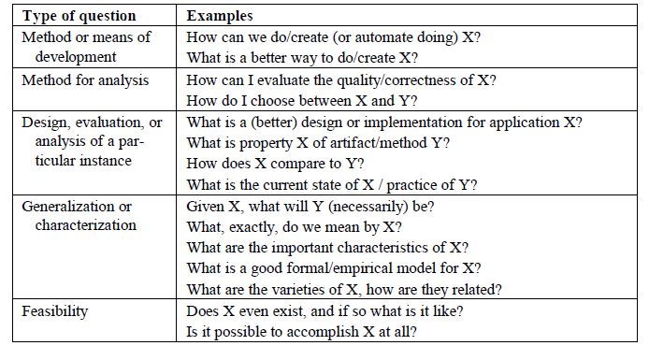
Shaw: research questions in SE

Slide 23
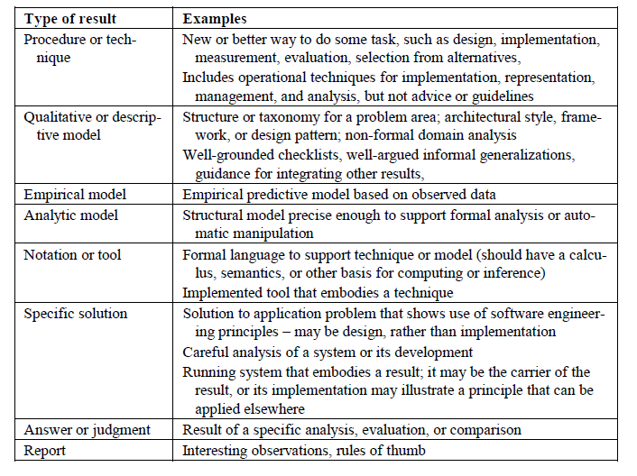
Shaw: types of SE results

Slide 24
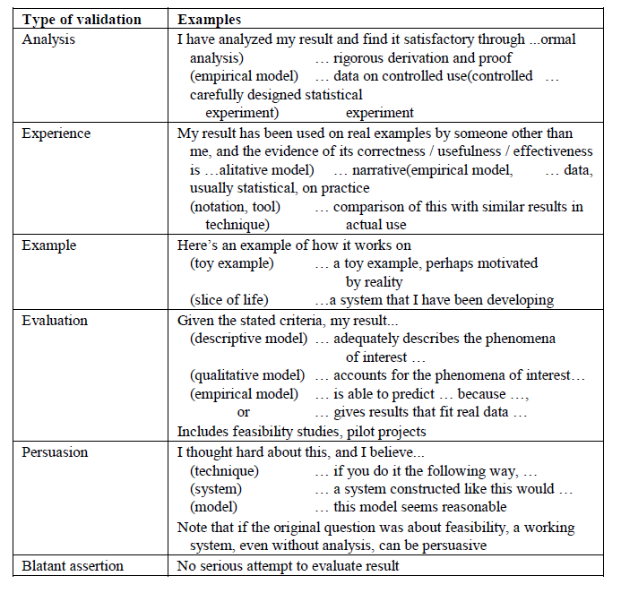
Shaw
Types
of
validation

Slide 25
Tichy et al. on quantitative evaluation
Experimental evaluation in computer science: A quantitative study. Journal of Systems and Software 1995
  Tichy, Lukowicz, Prechelt & Heinz
Abstract:
A survey of 400 recent research articles suggests that computer scientists publish relatively few papers with experimentally validated results. The survey includes complete volumes of several refereed computer science journals, a conference, and 50 titles drawn at random from all articles published by ACM in 1993. The journals of Optical Engineering (OE) and Neural Computation (NC) were used for comparison. .. (con’t)

Slide 26
Con’t
Of the papers in the random sample that would require experimental validation, 40% have none at all. In journals related to software engineering, this fraction is 50%. In comparison, the fraction of papers lacking quantitative evaluation in OE and NC is only 15% and 12%, respectively. Conversely, the fraction of papers that devote one fifth or more of their space to experimental validation is almost 70% for OE and NC, while it is a mere 30% for the computer science (CS) random sample and 20% for software engineering. The low ratio of validated results appears to be a serious weakness in computer science research. This weakness should be rectified for the long-term health of the field. The fundamental principle of science, the definition almost, is this: the sole test of the validity of any idea is experiment. —Richard P. Feynman. Beware of bugs in the above code; I have only proved it correct, not tried it. —Donald E. Knuth

Slide 27
Technology transfer: briefly
Not a consumer problem
Not a producer problem
An ecosystem issue

Slide 28
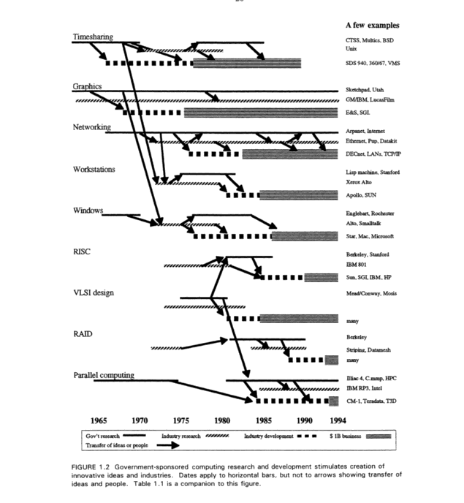
Evolving the High Performance Computing and Communications Initiative to Support the Nation's Information Infrastructure (1995)
“Brooks-Sutherland” report
Computer Science and Telecommunications Board (CSTB)

Slide 29
Comments?

Slide 30
Software engineering economics
The phrase dates to around 1981, when Barry Boehm published his tome with the same title
His 1976 IEEE Transactions on Computers article “Software Engineering” identified engineering economics as one “scientific principle” in which software engineering fell short of hardware engineering
To the first order, the focus of his book was on how to better estimate effort, cost and schedule for large software projects – COCOMO (COnstructive COst MOdel)

Slide 31
COCOMO basics
Algorithmic software cost estimation modeled with a regression formula that has parameters derived from historical project data and current project characteristics
The basic COCOMO equations take the form
  Effort Applied = a(KLOC)^{b} (person-months)
  Development Time = c(Effort Applied)^{d} (months)
  People required = Effort Applied / Development Time (count)
 | a | b | c | d
Organic | 2.4 | 1.05 | 2.5 | 0.38
Semi-detached | 3.0 | 1.12 | 2.5 | 0.35
Embedded | 3.6 | 1.20 | 2.5 | 0.32

Slide 32
Regression parameters
Basic COCOMO
Based on waterfall-based 63 projects at TRW Aerospace
Projects from 2KLOC to 100KLOC, languages from assembler to PL/I
The Basic Model designed for rough order-of-magnitude estimates, focused on small to medium-sized projects
  Three sets of parameters: organic, semideteched and embedded

Slide 33
Intermediate COCOMO
Uses more parameters (cost drivers) that account for additional differences estimates
Product attributes: required software reliability, complexity of the product, …
Hardware attributes: run-time performance constraints, memory constraints, …
Personnel attributes: software engineering capability, applications experience, programming language experience, …
Project attributes: use of software tools, application of software engineering methods, …

Slide 34
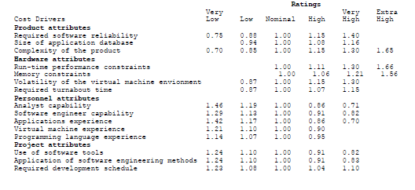
Intermediate COCOMO
The 15 sub-attributes are each rated from “very low” to “extrahigh” with six discrete choices
Effort multipliers are empirically derived and the EAF is the product of the multipliers
http://neohumanism.org/i/in/intermediate_cocomo_1.html

Slide 35
Intermediate COCOMO
E=a(KLOC)^{b} × EAF
  And similarly for development time and people counts
There is a separate table for parameters a and b across organic, semi-detached, embedded for Intermediate COCOMO

Slide 36
Detailed COCOMO & COCOMO II
Detailed COCOMO also accounts for the influence of individual project phases
COCOMO II was developed and released in 1997, aimed at (then) modern software projects
  Newly tuned parameters
  Accounted for move from mainframes to desktops, from batch to interface computation, to code reuse, etc.

Slide 37
1981 Boehm book also discusses
Multiple-goal decision analysis
  Most optimization theory assumes that there is a single objective function to maximize
  Models like this one account for multiple goals that must be balanced in a definable manner
Risk analysis
  Foundation for his later work in the spiral model
And more…

Slide 38
Boehm Sullivan “Software Economics” roadmap (ICSE 2000)
“The core competency of software engineers is in making technical software product and process design decisions. Today, however, there is a ‘disconnect’ between the decision criteria that tend to guide software engineers and the value creation criteria of organizations in which software is developed. It is not that technical criteria, such as information hiding architecture, documentation standards, software reuse, and the need for mathematical precision, are wrong. On average, they are enormously better than no sound criteria.

Slide 39
Con’t
“However, software engineers are usually not involved in or often do not understand enterprise-level value creation objectives. The connections between technical parameters and value creation are understood vaguely, if at all. There is rarely any real measurement or analysis of how software engineering investments contribute to value creation. And senior management often does not understand success criteria for software development or how investments at the technical level can contribute fundamentally to value creation. As a result, technical criteria tend to be applied in ways that in general are not connected to, and are thus usually not optimal for, value creation.”

Slide 40
Thinking about value
Decision theory (or utility theory) defines a framework for decisions under uncertainty, depending on the risk characteristics of decision makers
This is closely related to (again) multi-objective decision-making
Classical corporate finance uses net present value (NPV) as an investment decision criterion and computes it by discounted cash flow analysis (DCF) – can’t make a business case without these

Slide 41
NPV example from Wikipedia
A corporation must decide whether to introduce a new product line. The new product will have startup costs, operational costs, and incoming cash flows over six years. This project will have an immediate (t=0) cash outflow of $100,000 (which might include machinery, and employee training costs). Other cash outflows for years 1-6 are expected to be $5,000 per year. Cash inflows are expected to be $30,000 each for years 1-6. All cash flows are after-tax, and there are no cash flows expected after year 6. The required rate of return is 10%.

Slide 42
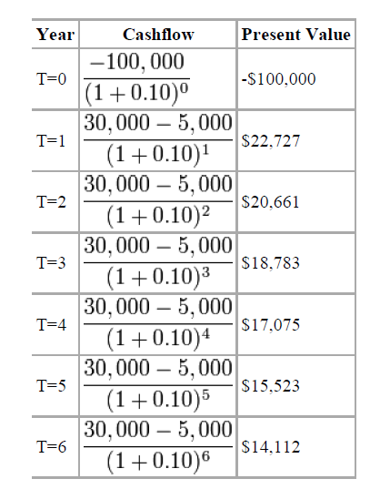
Con’t
The table shows the present value (PV) for each year
The NPV is the sum of the PVs
In this case, it’s $8,881.52
A positive NPV means it would be better to invest in the project than to do nothing – but there might be other opportunities with higher NPV

Slide 43
Real options
DCF/NPV treats assets as passively held – not actively managed
But projects are (or can be ☺) actively managed
  Management usually has the flexibility to make changes to real investments in light of new information. (e.g., to abandon a project, enter a new market, etc.)
The key idea of real options is to treat such flexibility as an option, and to (in some cases) price them using techniques related to those for financial options

Slide 44

Baldwin and Clark (2000)
Baldwin and Clark view Parnas' information hiding modules as creating options
They value these and develop a theory of how modularity in design influenced the evolution of the industry structure for computers over the last forty years
Non-modular systems must be kept or replaced as a whole whole
A system of independent modules can be kept or replaced (largely) individually based on judgments of improvement (or not)
Modularity provides a portfolio of options vs. an option on a portfolio

Slide 45
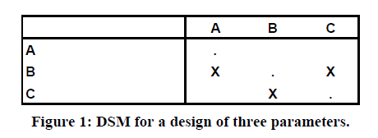
DSMs: design structure matrices
The parameters are A, B, and C
The X in row B, column A means that good choice for B depends on the choice made for A.
Parameters requiring mutual consistency are interdependent, resulting in symmetric marks: (B,C) and (C,B).
When one parameter choice must precede another the parameters are said to be hierarchically dependent: (B,A).
Independent parameters can be changed without coordination.
Material from
Sullivan, Griswold, Cai, Hallen. The structure and value of modularity in software design. ESEC/FSE 2001

Slide 46
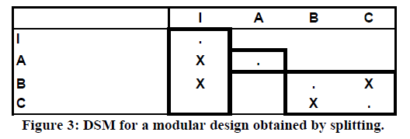
Splitting
DSMs may not show largely independent designs
In these cases, one approach is to apply splitting
Break a dependence with a new parameter that constrains the values of the original parameters – this means, in part, that they depend on it
Fix the value of the new parameter so that the original parameters to be changed independently as long as they are only changed in ways consistent with the new constraint
For example, introduce a new interface (I, in the below example)

Slide 47
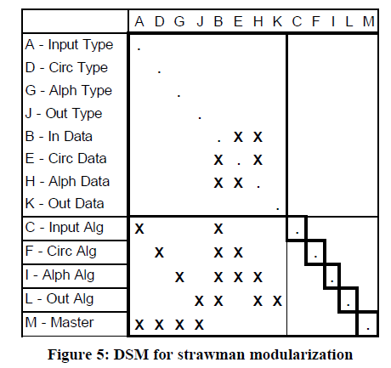
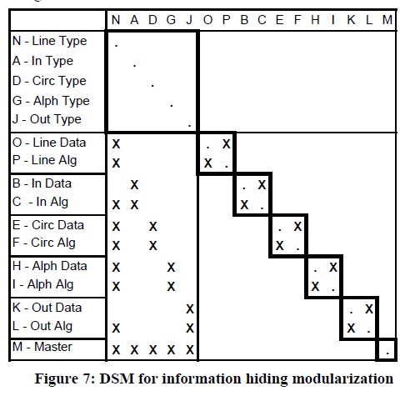
Parnas KWIC

Slide 48
NOV (net option value)
A module creates an opportunity
  to invest in k experiments to create candidate replacements,
  each at a cost related to the complexity of the module
  if any of the results are better than the existing choice, to substitute in the best of them
  at a cost that related to the visibility of the module to other modules in the system

Slide 49
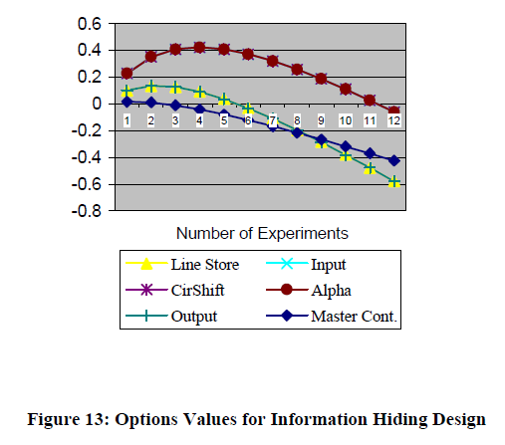
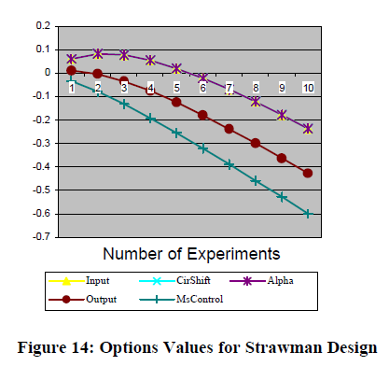
KWIC NOV
The option value of each module is the value at the peak
Sum the module NOV’s
  0.26 for the strawman design
  1.56 for the information-hiding

Slide 50
Status
The basic idea seems to make sense to many people
One of the core problems is the notion of how to tune the model parameters
  Financial markets set parameters based primarily on scads of historic data
  COCOMO set parameters based on careful studies of a reasonably large set of reasonably similar software projects
  Tuning parameters for modularity seems more complicated

Slide 51
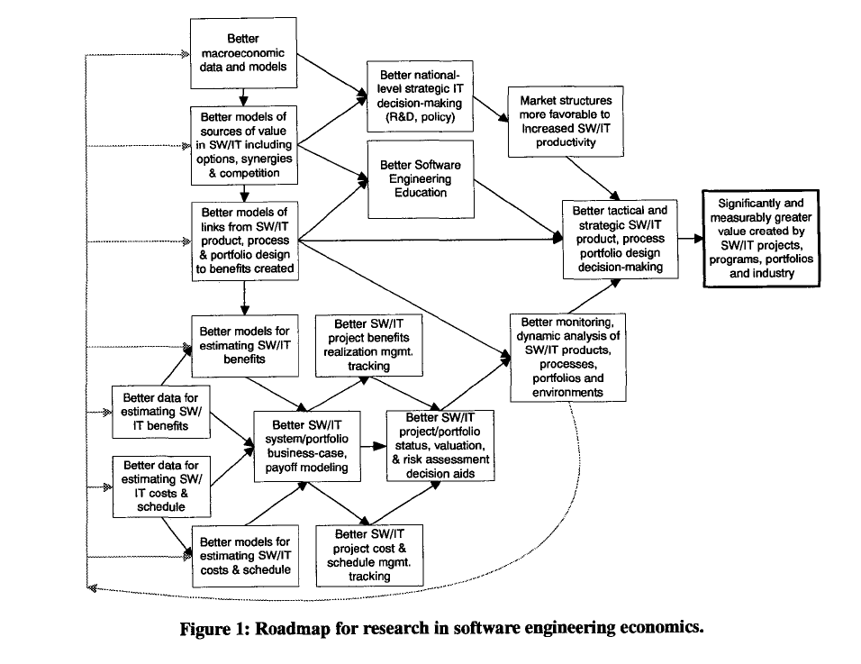
Boehm-Sullivan roadmap
Boehm-Sullivan roadmap

Slide 52
Your turn
In what ways does your organization link technical decision making with business-level decision making?
And not?

Slide 53
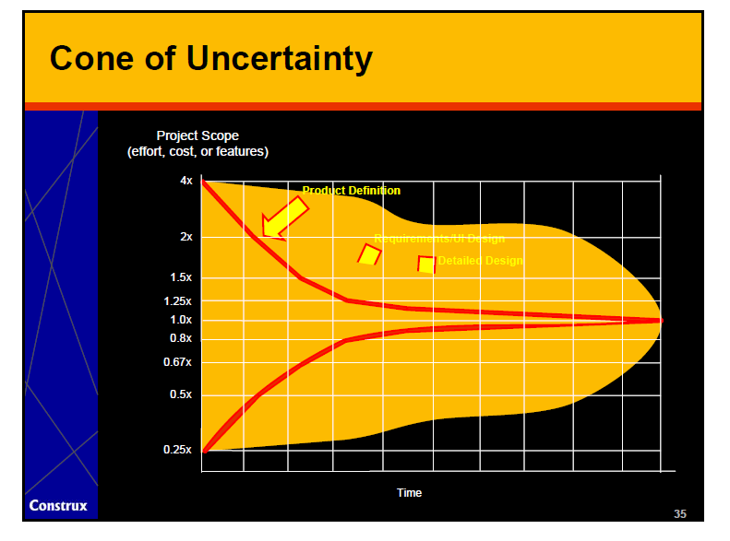
McConnell’s cone of uncertainty
ICSE 2009 keynote

Slide 54
Governance of Software Development
Clay Williams, IBM Research
Slides directly taken from an NSF workshop presentation
Governance @ IBM
Future Directions

Slide 55
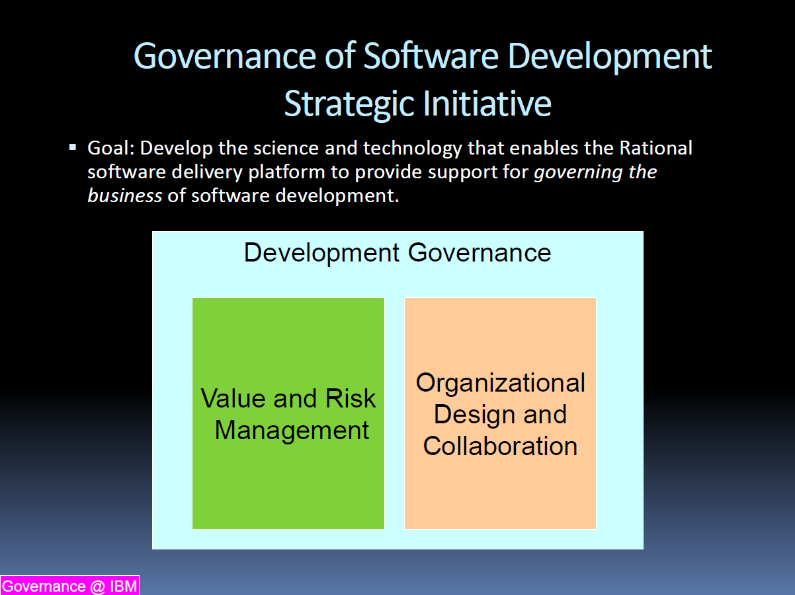

Slide 56
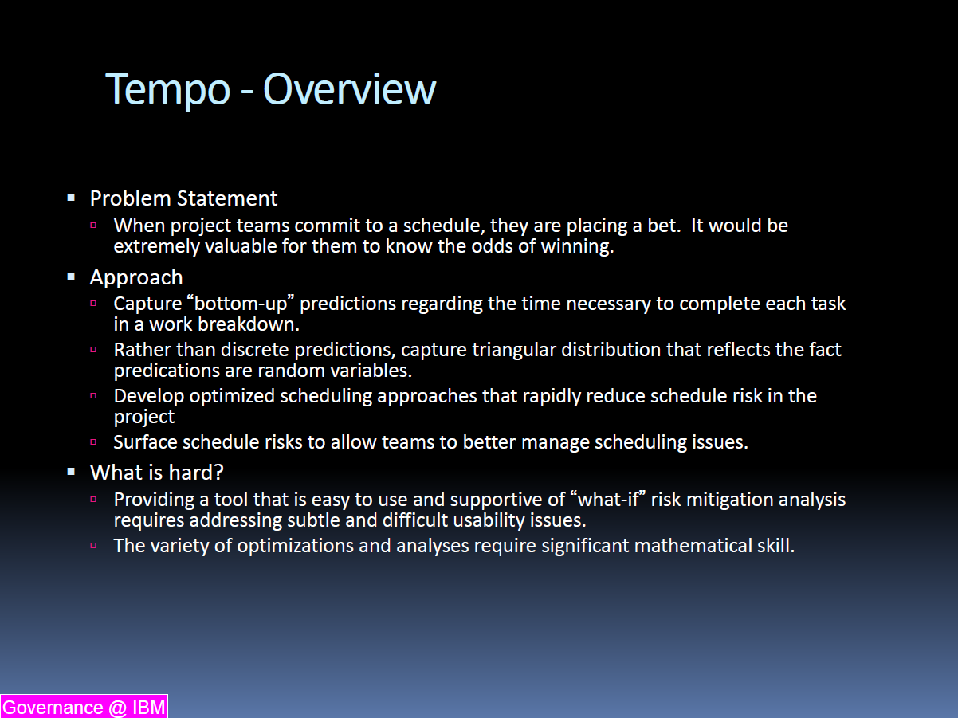

Slide 57
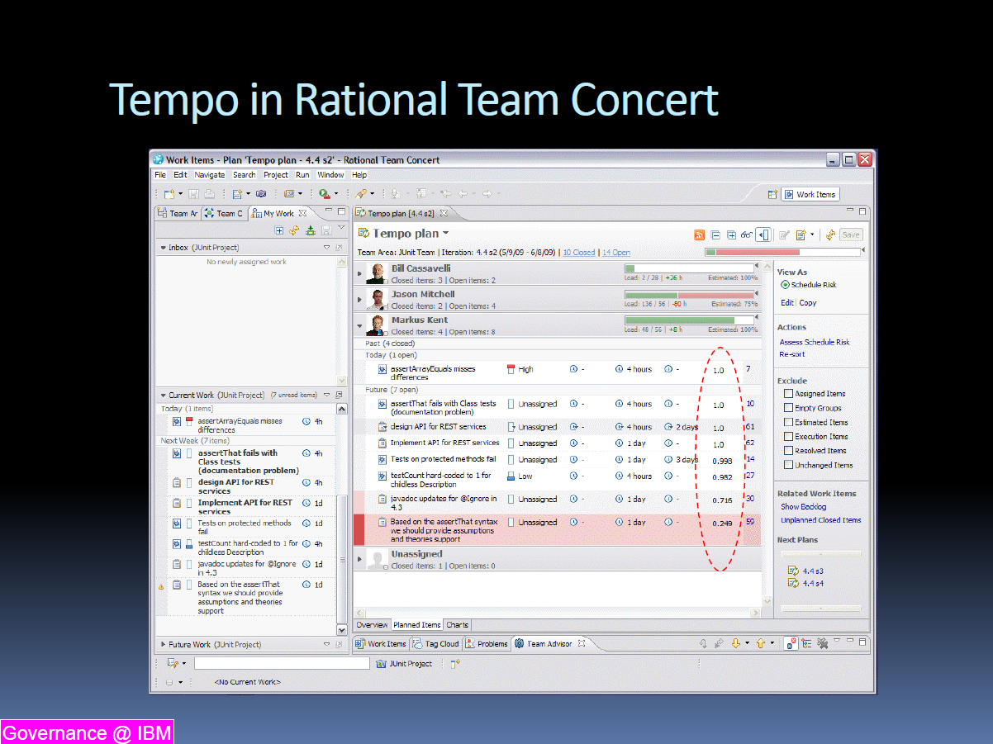

Slide 58
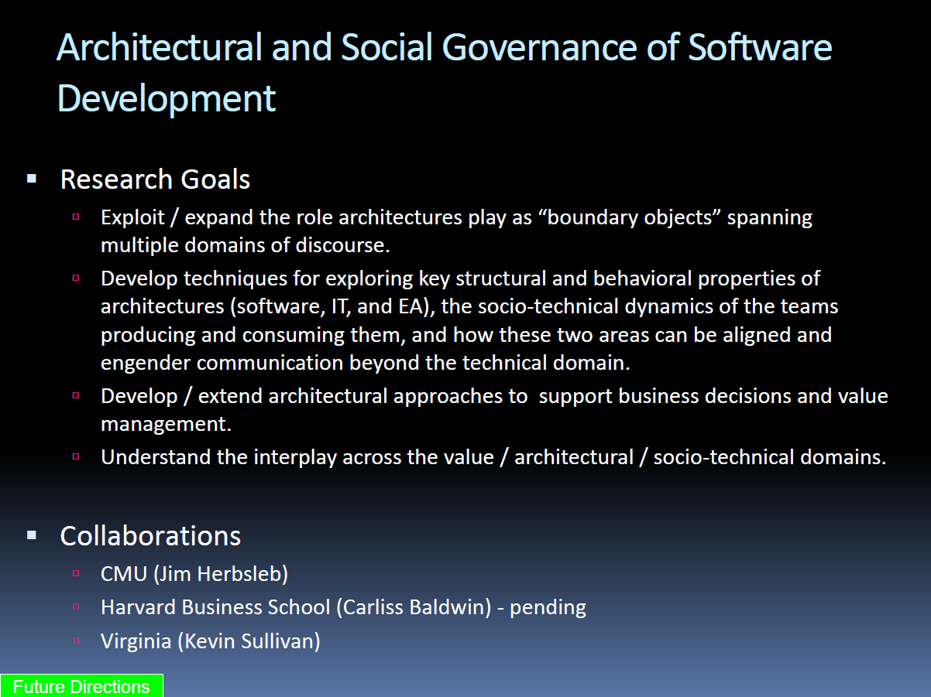

Slide 59
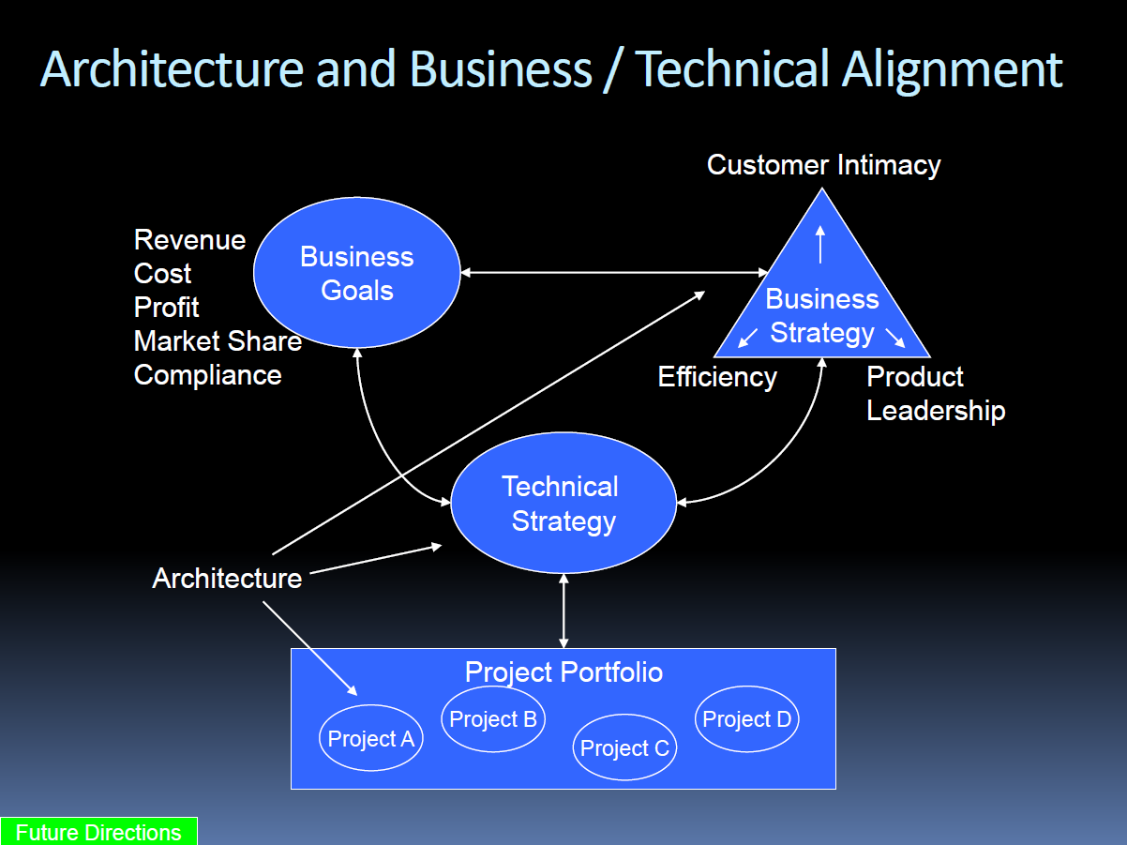

Slide 60
My bottom line
The long-term goal of software engineering economics is to help everybody make more sensible decisions
  Technical decisions
  Business decisions
  Project management decisions
Not one of these is primary with the others secondary – but that is how we each seem to treat the others
Better understanding the links among them is crucial; the models may give us opportunities to better understand these links
I am always scared that quantification tends to lead to a focus on the quantities, and there is often a disconnect between the quantities we can measure and want we want to do

Slide 61
Questions?
For tonight?
For the quarter?

Slide 62
Course evaluations…

